Slide 1
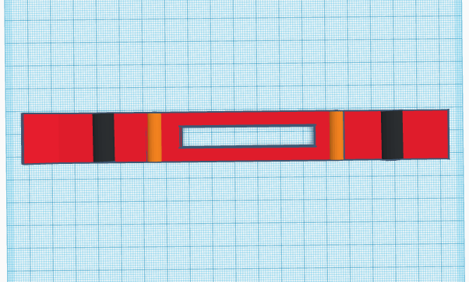
SKEES™
Skees
Group A5: Julian, Mihir, and Leo

Slide 2
Our Clients and Their Problem
Our clients are involved in the LIFE Program run by Partners in Parenting, that allows disabled people a fun learning environment
They are physically disabled and require a wheelchair for transportation, making it hard in the winter time
Physical activity is a portion of the LIFE Program, and usually the city doesn’t maintain the sidewalks properly, leaving heavy snow and ice
In sum, they are not easily able to go out for strolls in the winter time because of the snow being a barrier against their wheelchairs.
Notes:
The City of Ottawa rarely provides proper maintenance to the sidewalks in close proximity to the LIFE headquarters in the winter, which raises the complication of not being able to get around in wheelchairs. The thick snow and slippery ice simply makes it next to impossible to use a wheelchair the way it was meant to be used.
One of the LIFE programs goals is to provide time for physical activity in conjunction with the classroom learning, and that aspect of the program is dwindled when wheelchairs are not able to be transported through winter conditions.

Slide 3
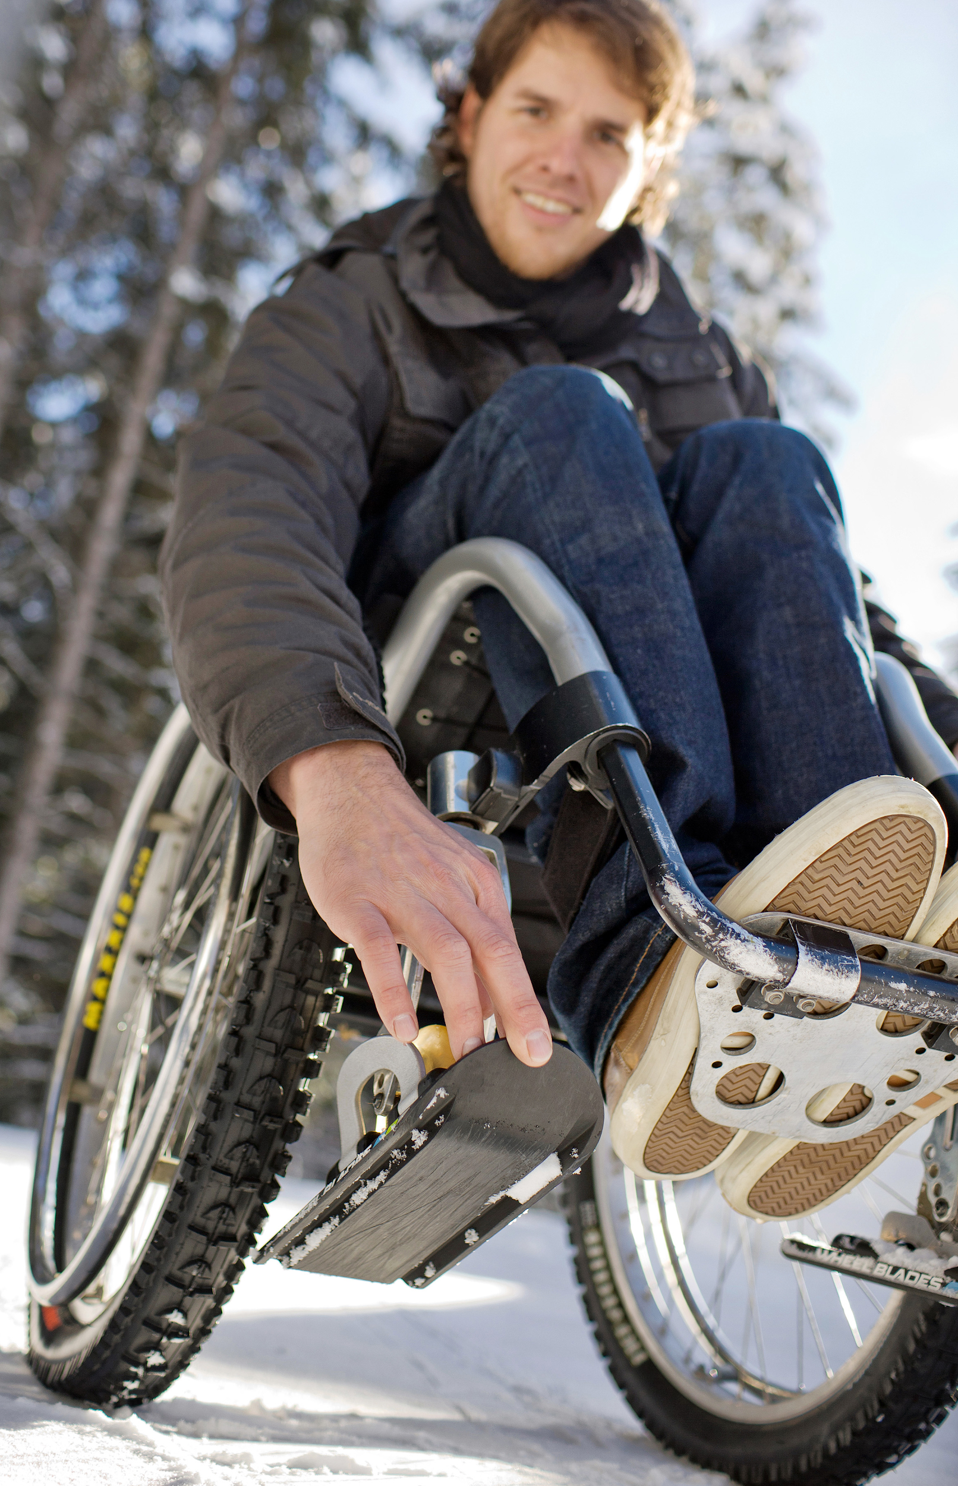
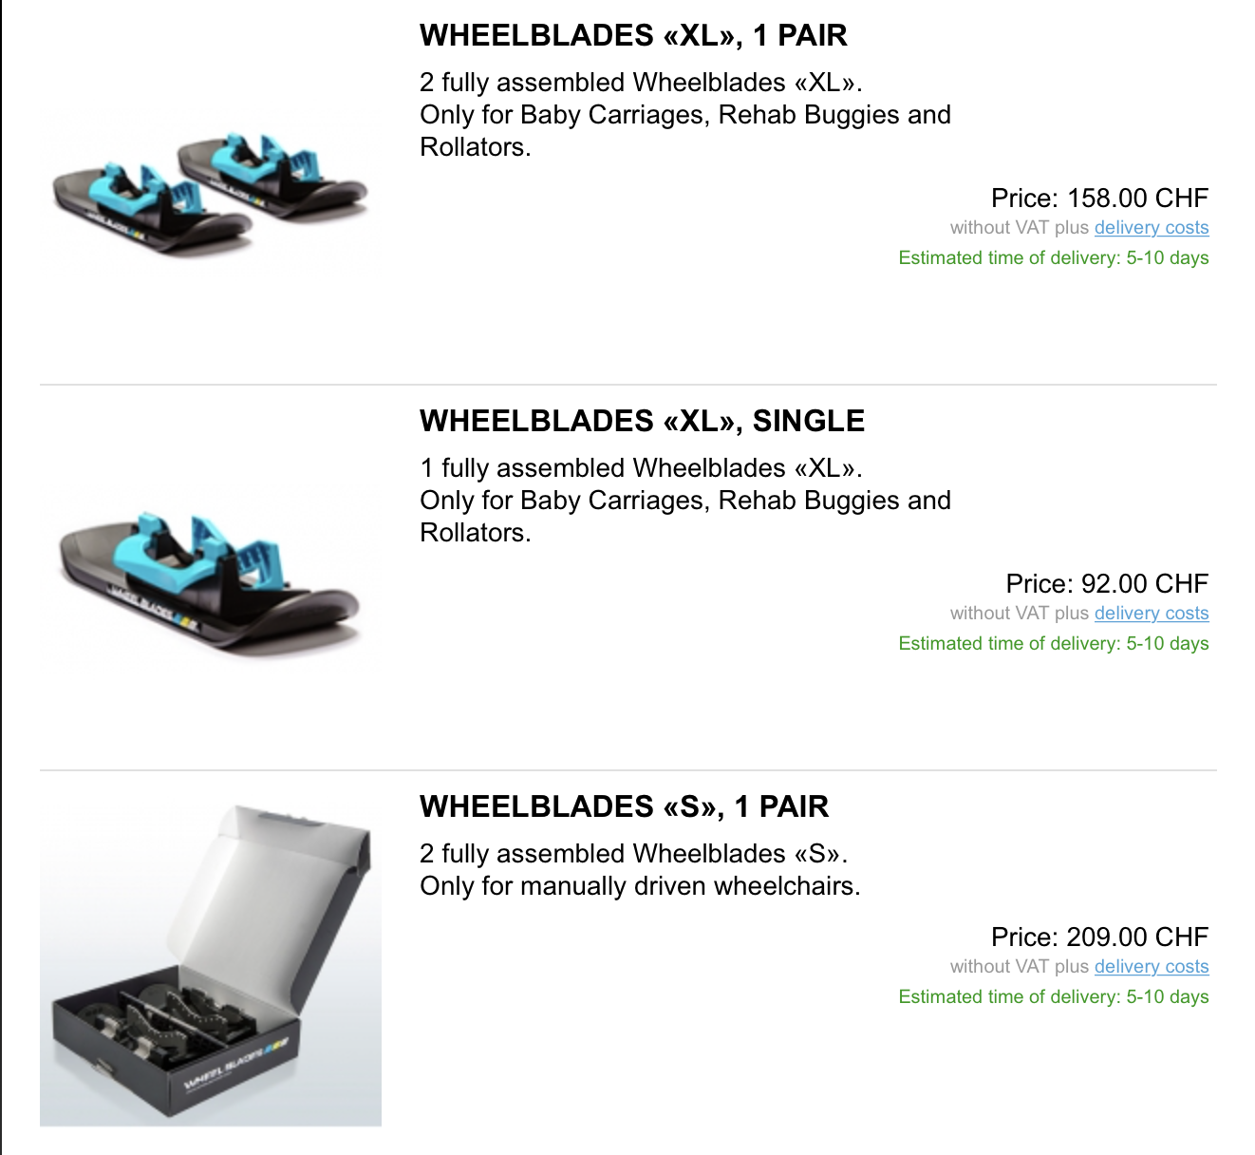
Benchmarking
WheelBlades
Notes:
Products similar to what the clients require in this solution more than often only replace certain parts of the wheelchair such as the flywheels. Other models that appear commonly add attachments onto the main wheels of the wheelchair that allow them to function as skis as well as having the aforementioned flywheel replacements.The most immediate comparable product that is similar to to what the clients require would be the Wheelblades S by Epical Solutions. These skis directly attach onto only the flywheels of the wheelchair in order to increase their mobility. The skis seems to have a rather generalized clip on system that simply slides on locks on to the flywheels of the wheelchair.

Slide 4
Skees™ to the Rescue
Notes:
Design and build of a set of skis that will allow a wheelchair to easily glide through snowy and icy terrain.
Our clients at the LIFE Program located just outside of Downtown Ottawa, sometimes have trouble getting through the snowy sidewalks in their wheelchairs, as the city usually doesn’t properly maintain them.
Our skis will allow any manual wheelchair to easily glide through heavy snow or slippery ice, all while maintaining the normal functionality of the wheelchair (brakes, steering, wheel contact with ground, etc).
Design and build of a set of skis that can be attached onto the wheelchair that help increase the maneuverability and control of the wheelchair for the client. These skis should ultimately help the client traverse through snowy and slippery terrain.

Slide 5
Gantt Chart

Slide 6
Solution Concepts 1- Wheelchair Skis (Attachable)
Attach a ski apparatus
Lightweight durable plastic
Gloss coating to reduce friction
Includes a cut-out portion for wheel to make contact with the ground
Connections to attach ski to wheelchair base to make product an optional attachment
Notes:
Wheelchair skis are designed and operate as simple as the nae makes it out to be. The concept of this design includes the client being able to easily attach a ski apparatus that will allow the wheelchair to move efficiently in thick snow or icy conditions. The material of the skis will be a lightweight durable plastic, with a smooth gloss coating (like downhill skis) to minimize the friction of the snow/ice on the skis, making it easier to push the wheelchair. Moreover, the skis design will be oriented in a way to minimize the amount of snow build up under the wheelchair which eventually causes it to get stuck. This setup will either attach to the bottom frame of the wheelchair and will have a lever mechanism that will lift the wheels from the ground and place all the weight on the ski system, and will provide a locking mechanism for safety. This design, like all of our design ideas will have reflectors installed for roadside safety of the patrons being pushed and pushing the wheelchair on the sidewalk. This system will also be equipped with a braking system which will involve a metal piece with teeth to be gradually placed into the ground to allow the wheelchair to come to a stop. Extra braking mechanisms will be put in place for emergency stops which will allow the wheelchair to come to a complete stop in a shorter distance. The only issue we face with this solution is that it will have to be configured differently for different types of chairs (manual and electric). We are expecting the cost to build this product to be low, which makes it one of our favourable ideas.

Slide 7
Solution Concept 2 - Wheelchair Main Wheel and Flywheel Skis
Both the main wheel and flywheels would get skis to glide on
Wider skis to more evenly distribute the weight of the client and wheelchair
Skis would lock onto both sets of wheels to prevent them from moving completely
Wheelchair would essentially glide over snow due to much more even weight distribution
Client would need an external force to propel them
Notes:
This product concept would improve on product concept 1 in the sense that this would be applied to both the main wheels and the flywheels. The flywheel skis would remain largely the same, however the main difference would be on the skis for the main wheels. These skis would be wider than typical skis in order to more evenly distribute the weight of the wheelchair and the client. These skis would ideally lock and latch onto the wheelchair wheel, preventing it from moving completely. This would mean that the client would have to be propelled by an external force, such as a push from someone else. This concept would also glide over snow rather than through it but would do with a greater degree of efficiency because in this case both sets of wheels have a larger surface area to distribute the weight over. In design concept 1, the main wheels would sink into the snow and decrease traversing speed as well as maneuverability.

Slide 8
Chosen Concept
Our chosen concept was the Attachable Wheelchair Ski.
Reasons:
Skis are an optional attachment
Skis help main wheel with traction as that is where the problem is focused
Two sets of skis (Main Wheel and Flywheel) would conflict with one another while moving and maneuvering
Much easier to fit within given budget

Slide 9
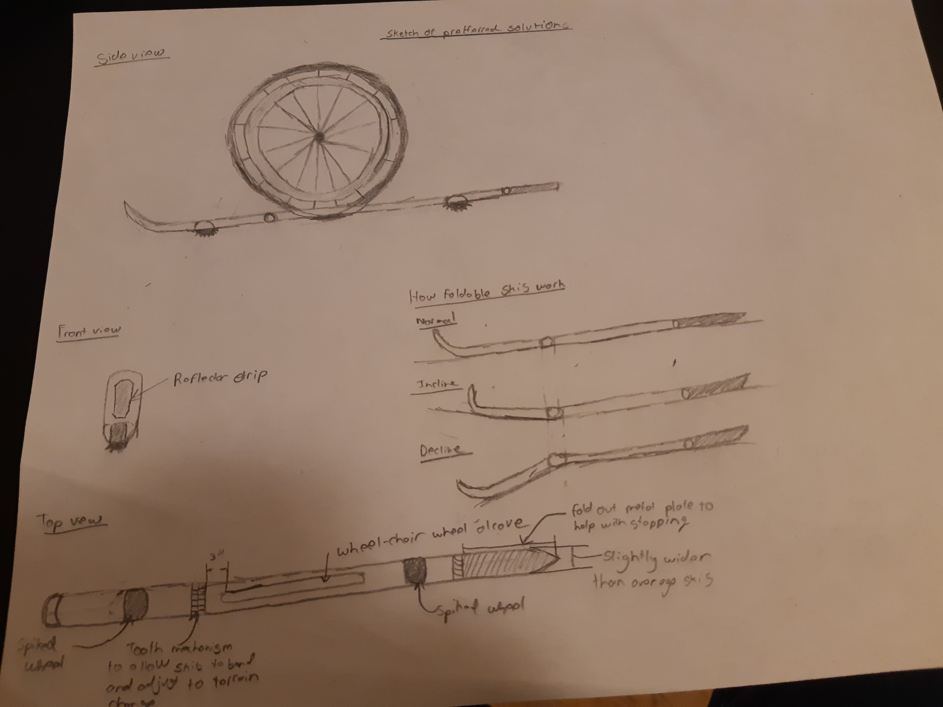
Initial Concept Design
Notes:
Wheelchair wheels resting on skis
Skis supporting weight of wheelchair and allowing it to glide across snow without becoming stuck/preventing buildup of snow
Key features:
Freely angling ski tip
Allows ski to mount slopes/bumps easily
Metal brake plate
Prevents wheelchair from sliding away on downhills, and allows person pushing chair to stop quickly
Reflector strip
Makes wheelchair visible to oncoming cars
Under-ski wheels
Supports ski over surfaces where snow isn’t present, protecting bottom of ski from damage

Slide 10
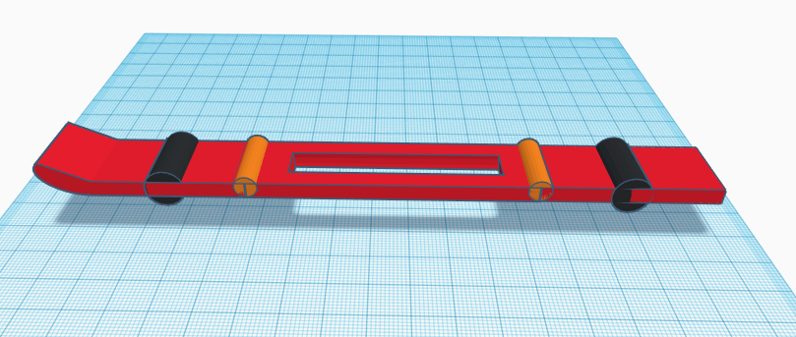
Initial Concept Design

Slide 11
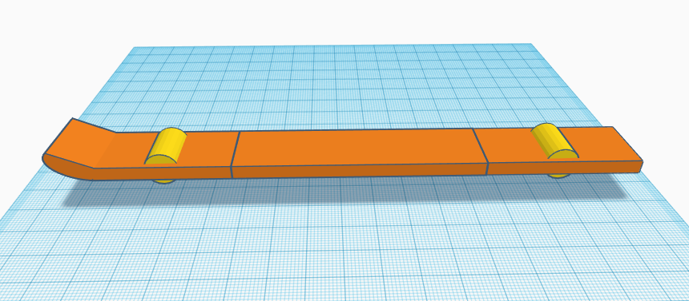
Prototype I

Slide 12
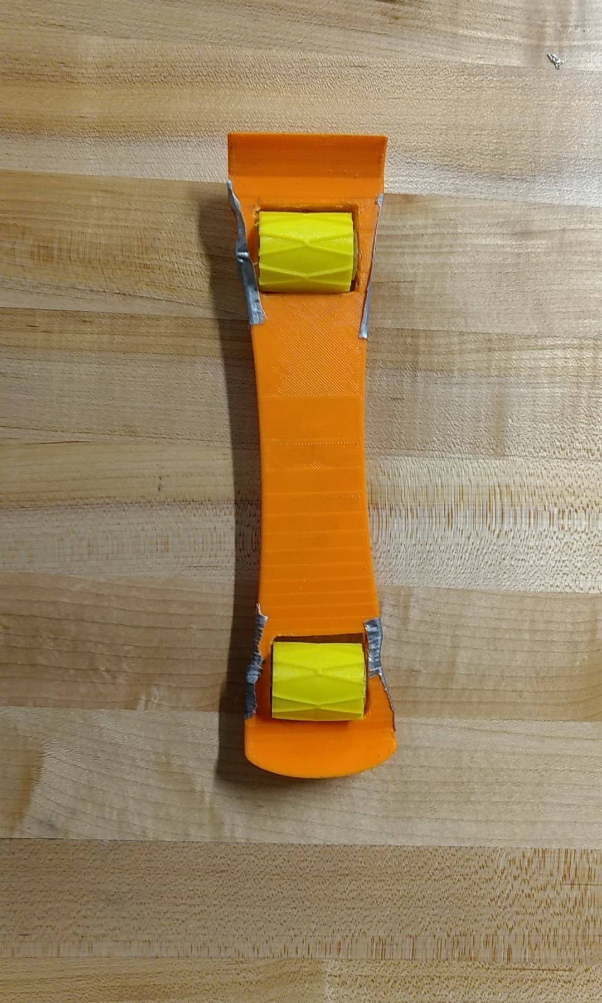
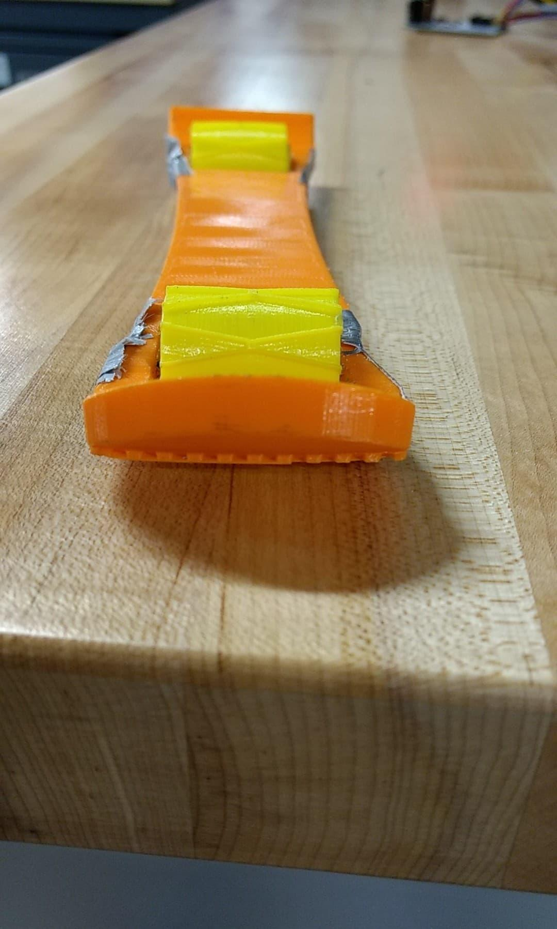
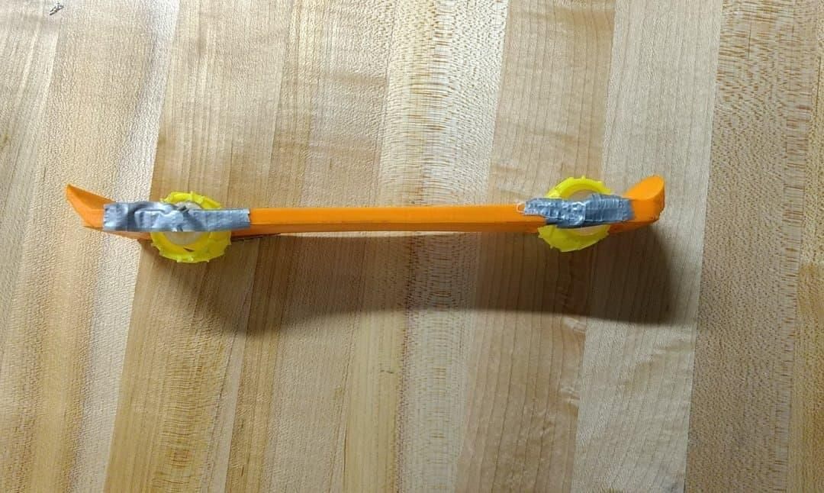
Prototype I (3D printed)
Notes:
3D printed ski
Downhill ski shape
Roller wheels (larger than final prototype)
Prototype designed for testing strength of 3D printed ski and how well the wheel/ski combination works on different terrain

Slide 13
First Client Feedback - Thoughts, Suggestions, Recommendations

Slide 14
Client Feedback Based on Initial Design
Notes:
This initial conceptual design above was presented to the client at our second client meeting.
We would create skis such that the large wheels of the wheelchair would roll onto the skis and would be fitted into the hole of the skis.
The skis would be created to adapt to any type of terrain that have either valleys or hills because the front of the skis are able to be angled at the given terrain.

Slide 15
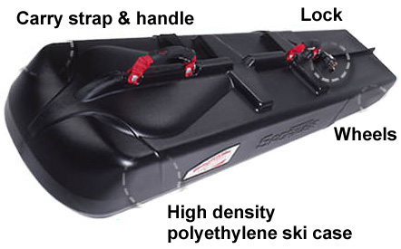
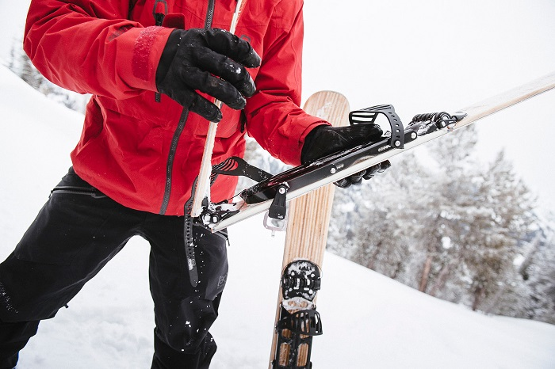
Client Feedback - Recommendations
Portability - Foldable, latchable, handle for carrying
New Material - Structural integrity, weight management, durability
Retractable bar for wheel base width setting (Easy install)
Front 360 Degree wheels narrower than main wheels, two seperate skis must be used
Locking Mechanism - Will have to be attached to structural frame directly behind main wheel
Notes:
Our previous method of 3D printing the skis won’t quite work because of the low strength and durability.
Recommends we use a set of downhill skis as a base
2.
Foldable skis that latch together and have a fixed handle for carrying
Carrying case
Mounting bracket for back of the wheelchair

Slide 16
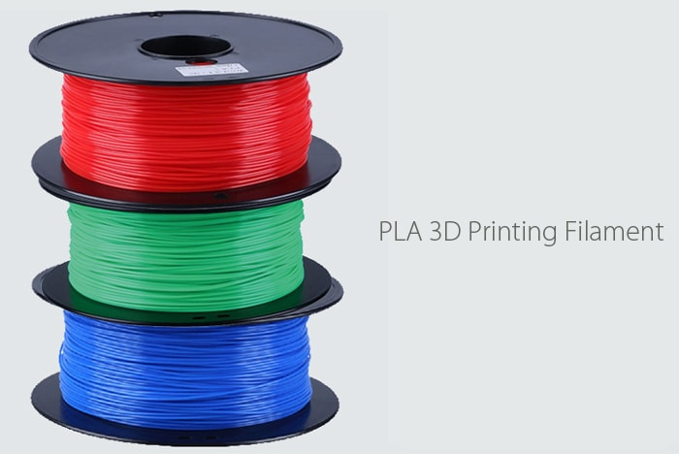
Client Feedback - Different Material
Notes:
We need to look at either a new material for the skis or just using a pair of downhill skis because the 3D printed plastic is not strong enough to support the weight of the chair.
Therefore, we can look at placing something in the middle of the 3D printed skis for support and weight balance.
If we 3D print, we have to be careful with the sanding/grinding of the plastic as it will be fragile.
Also if we 3D print, there is a larger 3D printing machine that we have to look into how to use and will be easier for printing the ski as one piece instead of seperate pieces.

Slide 17
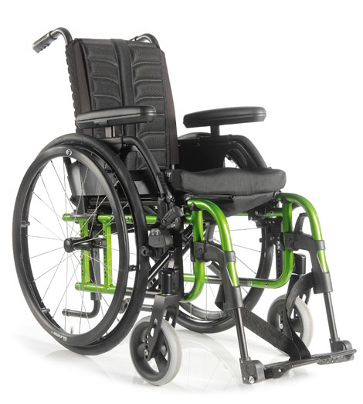
Client Feedback - 360 Degree Wheels
Notes:
Front 360 degree wheels are narrower than the main wheel so we have to look at two seperate skis. Julian recommended attaching a bowl shaped piece to the 360 wheels so that the wheel is still able to move in every direction, or using something similar to what is pictured above.

Slide 18
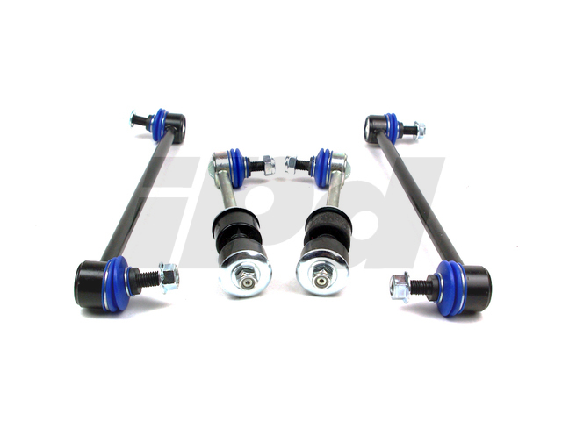
Client Feedback - Locking Bracket
Locking mechanism will attach to the frame directly behind the wheel as mentioned
Will be an arm bracket that grips and tightens to the frame, looking like a sway bar on a car pictured above
Notes:
We looked at the wheelchairs, and the locking bracket will have to attach to the bar that is directly behind the main wheel and runs along to the front which also holds the 360 degree wheel.

Slide 19
Changes or Improvements to Design & Development of Two Physical Prototypes
Thoughts: - Downhill Ski Composite > Plastic (PLA)
- No braking system
Notes:
We have been thinking that we should purchase and wood use as our replacement to 3D printing PLA material.
Wood is stronger than plastic, and wood is stronger than 3D printing PLA material.
Since wood degrades over time, we can put a layer of coating on the wood, so the wood material lasts longer.
Another change is to our design is that we will not be including a braking system, but we originally did have a braking system.
The development of our first prototype went well because we learned how the 3D printers created the object, and we realized that PLA might not be strong enough because it becomes very brittle after any sort of drilling or milling.

Slide 20
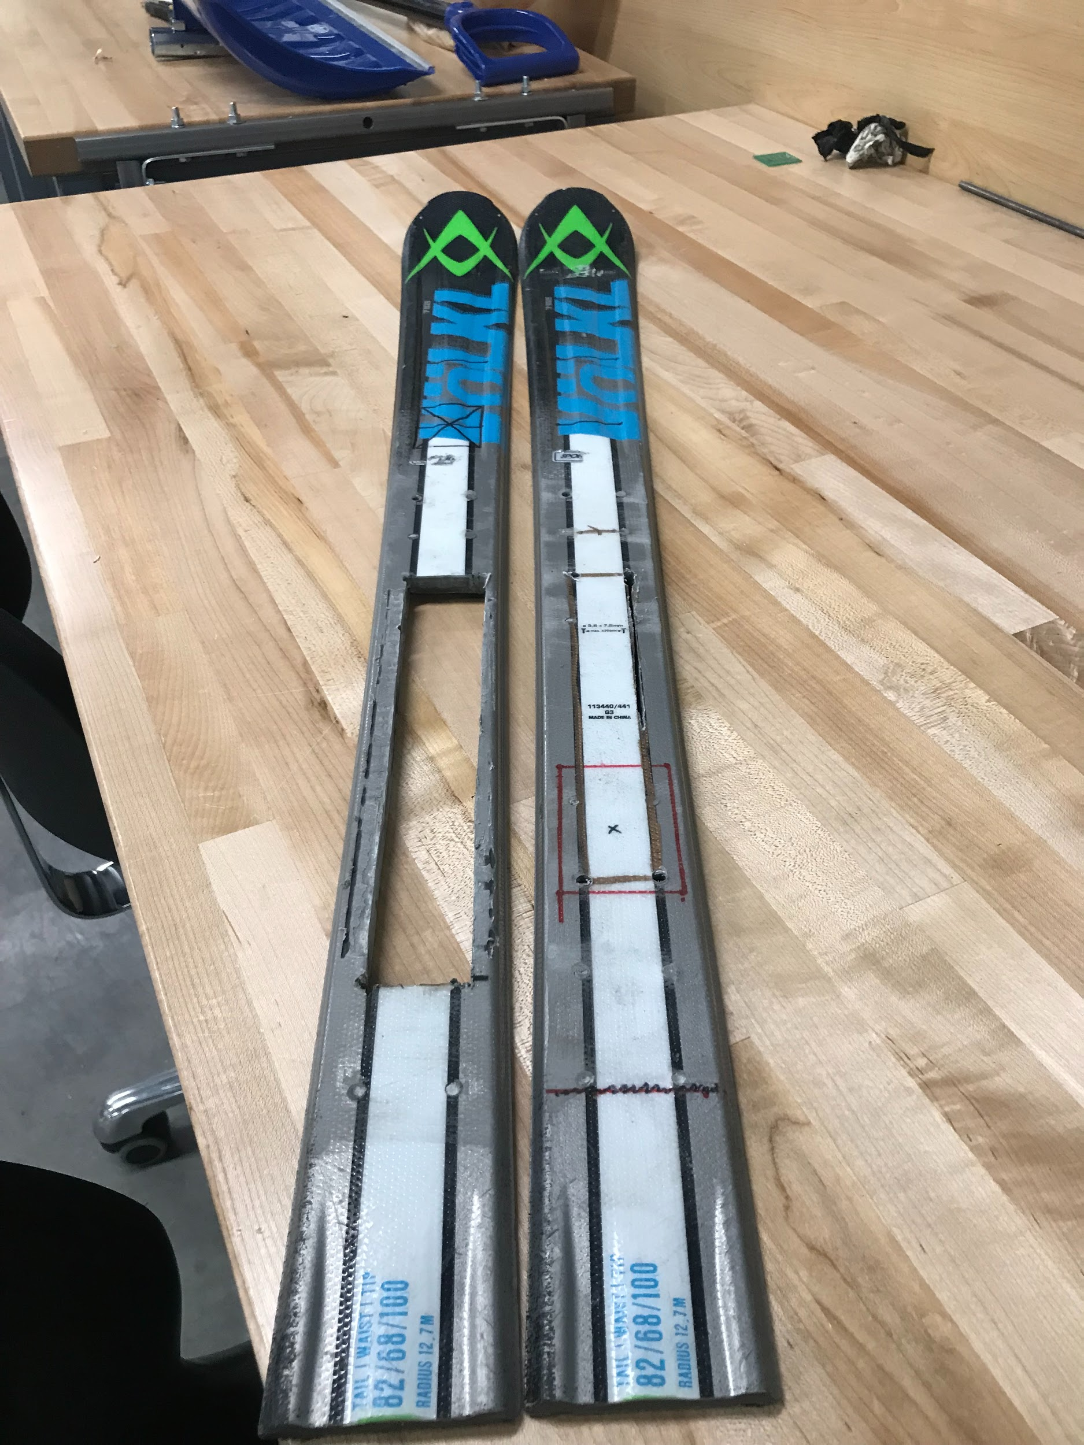
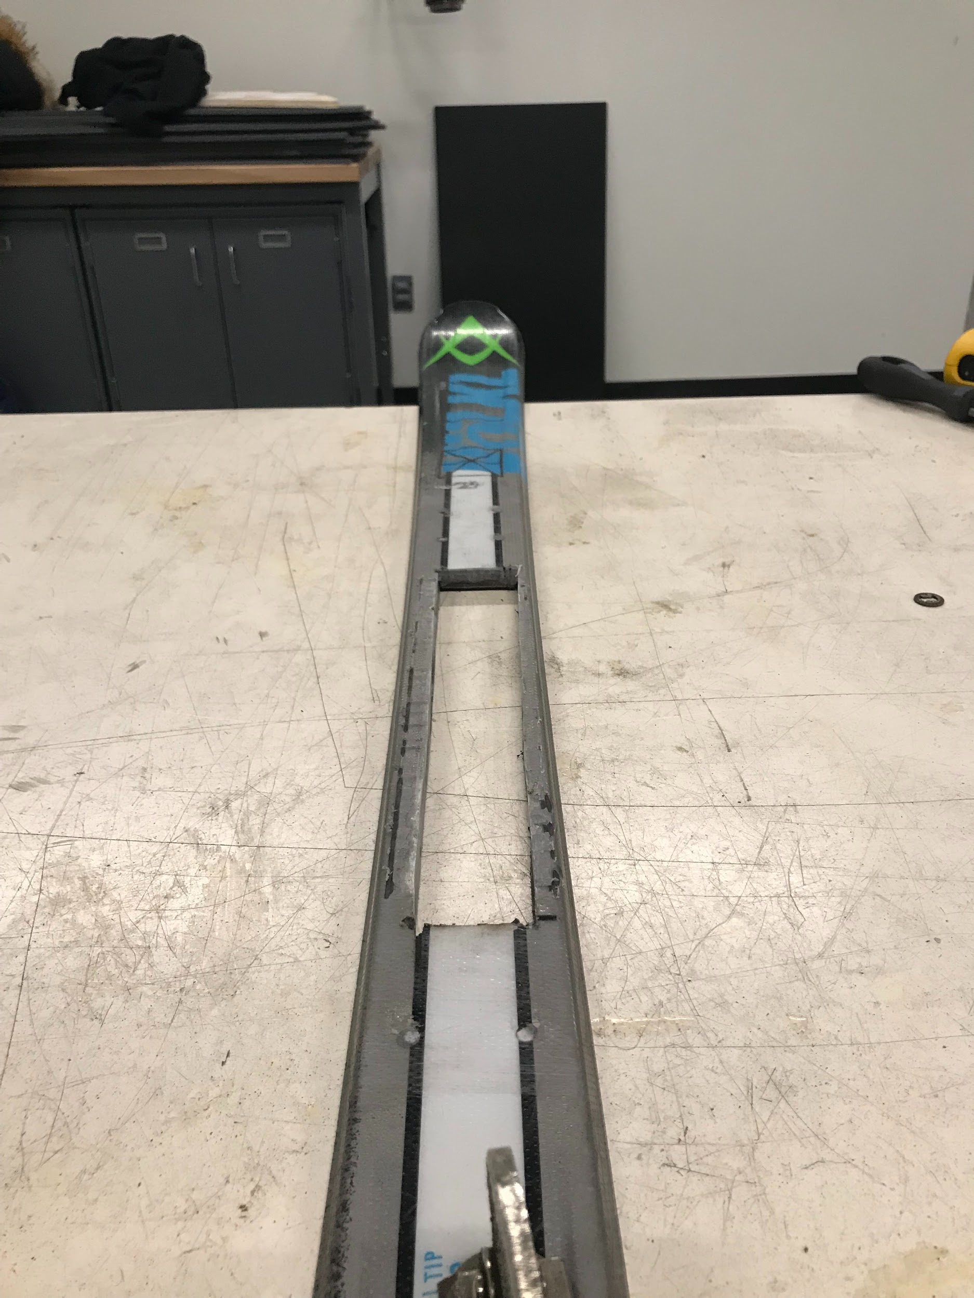
Prototype II

Slide 21
Decisions Made
Cutouts for the main wheelchair wheel
Non flexible
Notes:
No other cutouts other than the cutouts for the main wheelchair wheel
Ski should not have hinges as this could add unneeded instability and friction to the system
Skis need to be shorter so they do not impede the helper that pushes our client around
Attach skis to series of bar under the chair for better load bearing
Modify existing pair of skis so shape is ideal for mobility through snow
Hinges can be used to adjust connection to wheelchair for different sized wheelbases

Slide 22
Decisions Made
Material Decisions
Switch from PLA to Composite
Saves time and increases strength

Slide 23
Trials and Tribulations, Lessons Learned
Composite is extremely tough and strong
Time consuming to cut through and work with
The variety of wheelbases makes it extremely difficult to tailor a pair of skis for every wheelchair
Time management

Slide 24
Future Work
Future Work
Find a way to make skis adjustable for all sorts of wheelbases
Find a way to create wider and better shaped skis from raw materials as opposed to modifying existing skis
Create a more stable method of mounting the skis

