Slide 1
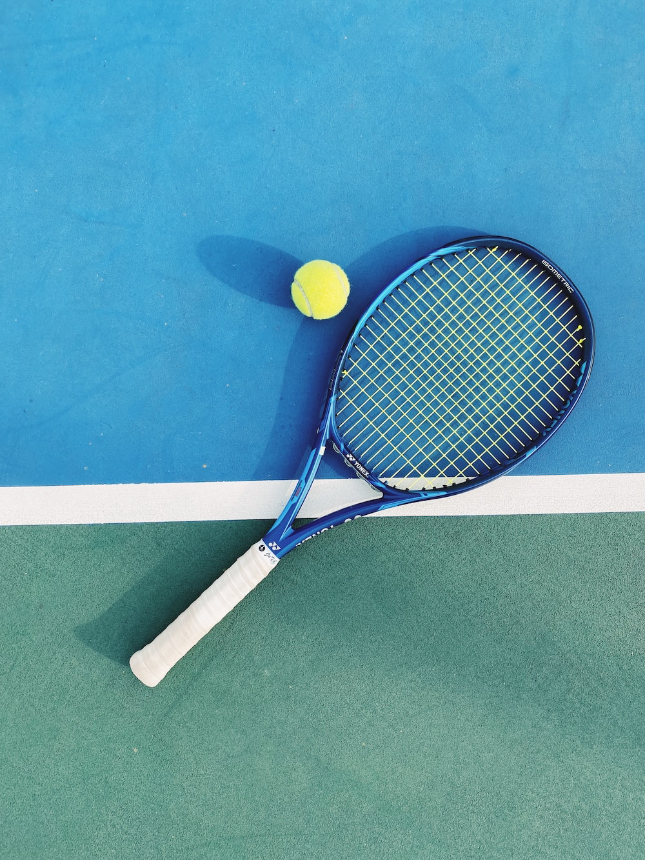
Final Presentation
PerRACKformance
Group B12

Slide 2
Agenda
Empathize
Define
Ideate
Prototype
Test
Trials & Tribulations, Lessons Learned, Future Work

Slide 3
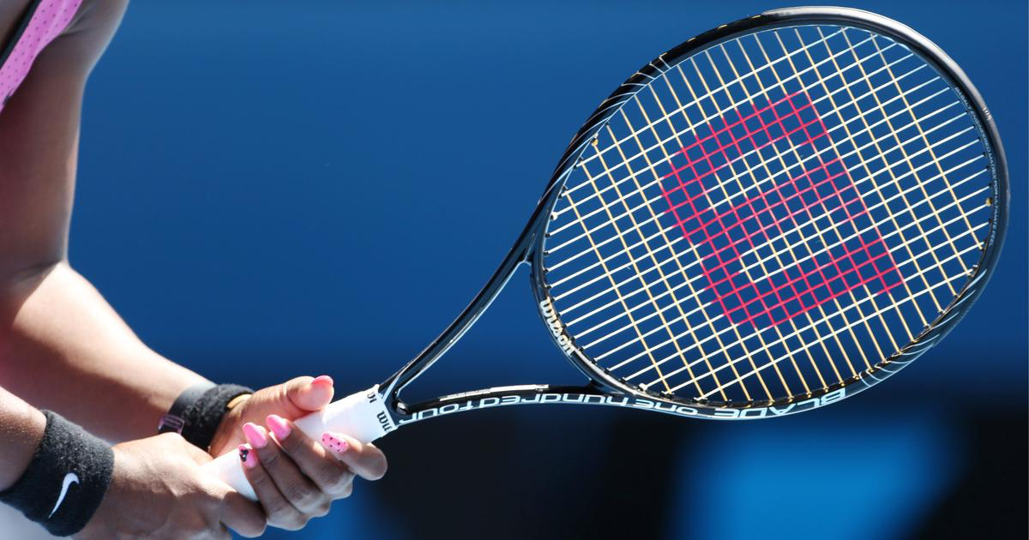
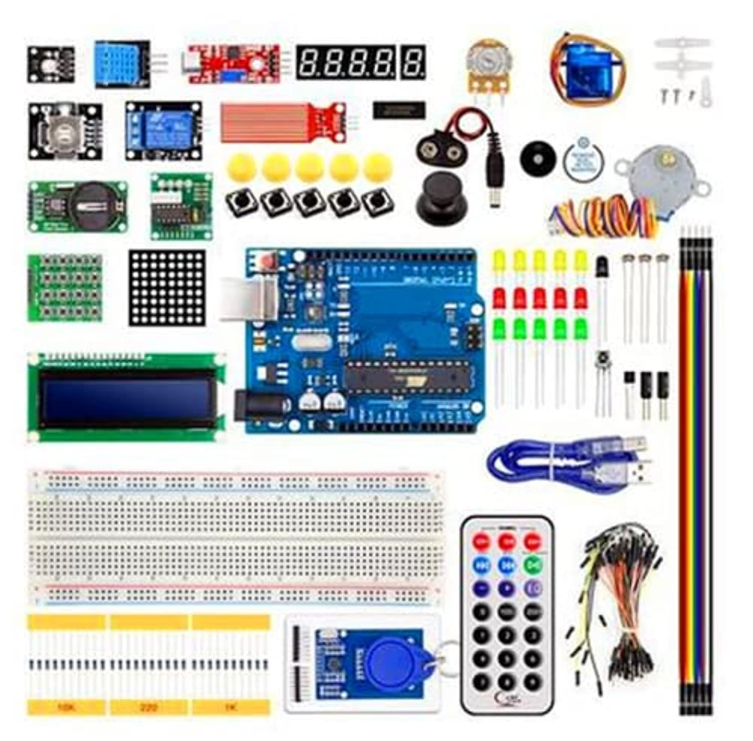
What is Our Project?
Product that measures athlete performance
Users: athletes, coaches or anyone looking to monitor or improve their performance
Includes both hardware and software components

Slide 4
Client Needs -Empathize
Key Takeaways from Client Meet 1:
The product detects and collects measurable data related to sports performance.
The product has no effect on the user’s ability to perform.
The product analyzes and categorizes data and outputs it to a user-friendly centralized platform.
The product is lightweight, portable, durable and waterproof.

Slide 5
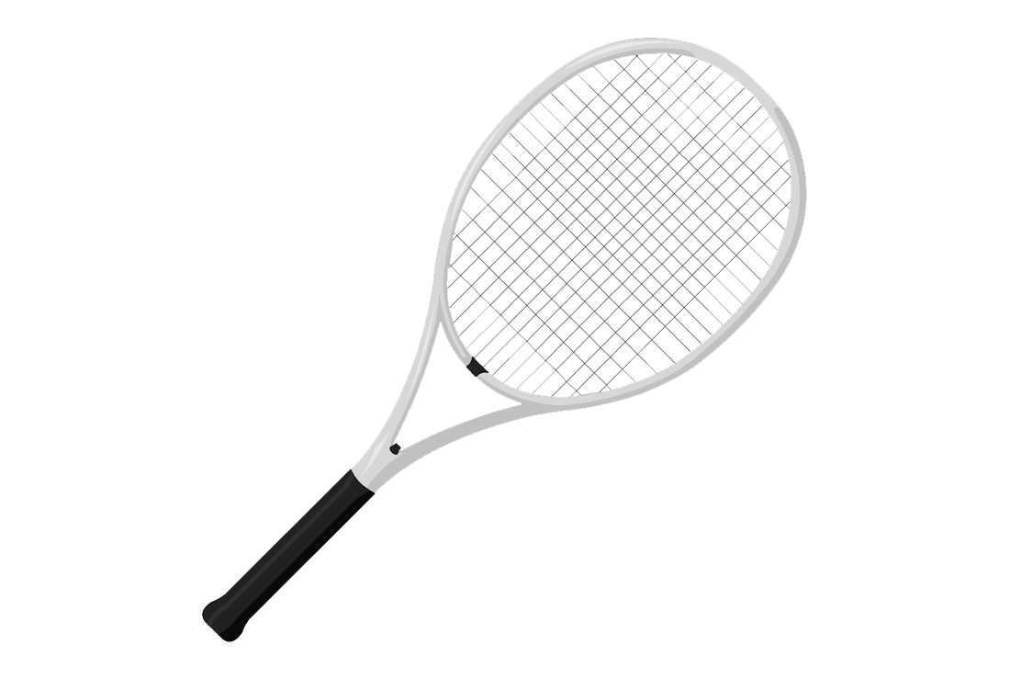
Problem Statement -Define
We are looking to solve:
Portability/durability
An accurate measurement of performance
A user-friendly website

Slide 6
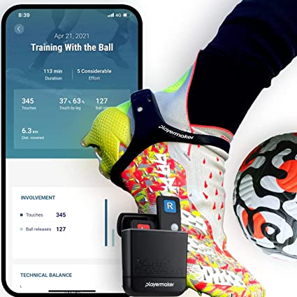
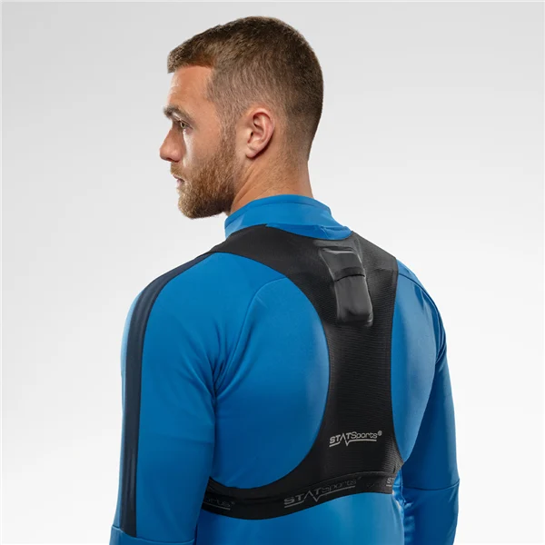
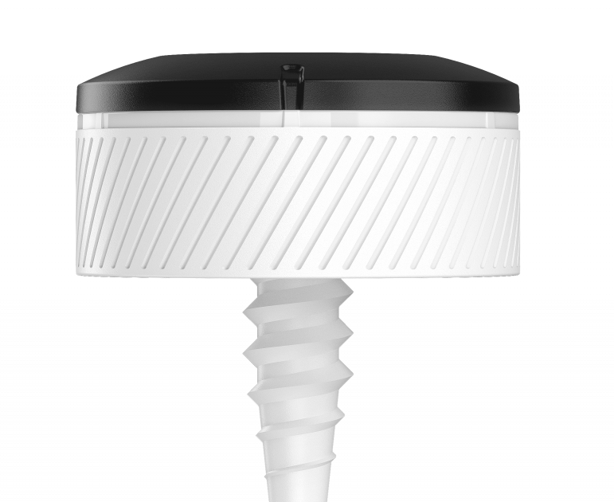
Benchmarking - Current Products in the Market
Watch Tracker
Playmaker
GPS Performance Tracker
Installed Club Sensors

Slide 7
Target Specifications
Metric | Unit | Marginal value | Ideal value | Reason for choices
Speed measurable | m/s | 0-118.33 | 0-150 | Maximum badminton hitting speed
Impact force measurable | N | >280 | >300 | Maximum and minimum speed
Weight | g | >80 | 80< | Light, Convenient, Seamless device
Size of device | cm3 | <9 | 7.5< | Small, fixable
Life expectancy | Years | >1 | >3 | Long life, replaceable

Slide 8
Decision Matrix
Selection criteria | Racket: Detachable | Racket: Built-in | Gloves
Speed measurable | 5 | 5 | 4
Impact force measurable | 5 | 5 | 4
Weight | 5 | 2 | 4
Size of device | 4 | 1 | 3
Life expectancy | 3 | 3 | 4
Total score | 22 | 16 | 19
Therefore, the Group Concept will be a detachable sensing system mounting on a tennis racket.

Slide 9
Feasibility Study
Technical
Arduino
Sensors
Website
T
Strengths:
Inexpensive and Affordable
Lightweight and Compact
Sensitive and Accurate
Data visualization
Economic
50 dollars start-up money
E
Legal
Developer-friendly Low-cost
L
Weaknesses:
Difficult installation/ disassembly process
Few target clients
Short product
development period
Operational
Rational task allocation, On-chain governance
O
Scheduling
3-month period
S

Slide 10
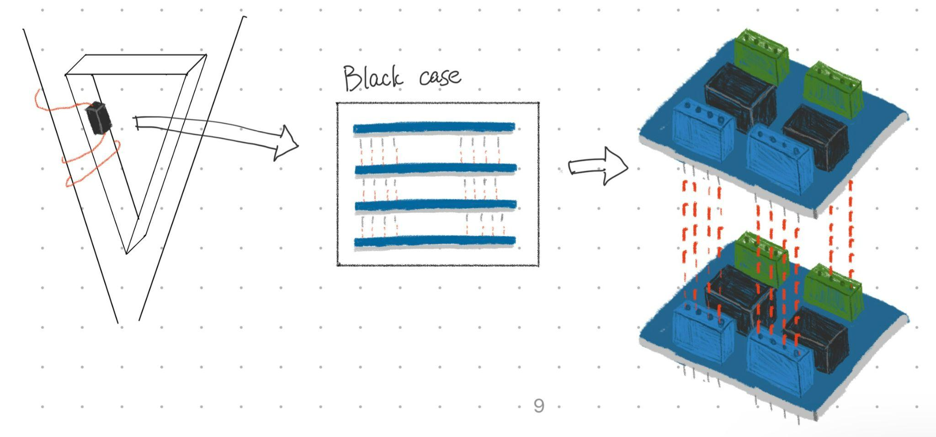

Slide 11
Ideation Phase (Initial Phase)
Bottom of Racquet Sensor
Sensors all around Racquet
Sensor in Racquet Triangle

Slide 12
Ideation Phase (Final Concept)
Final Concept (Old sketch)
Does not hinder user
Cost efficient

Slide 13
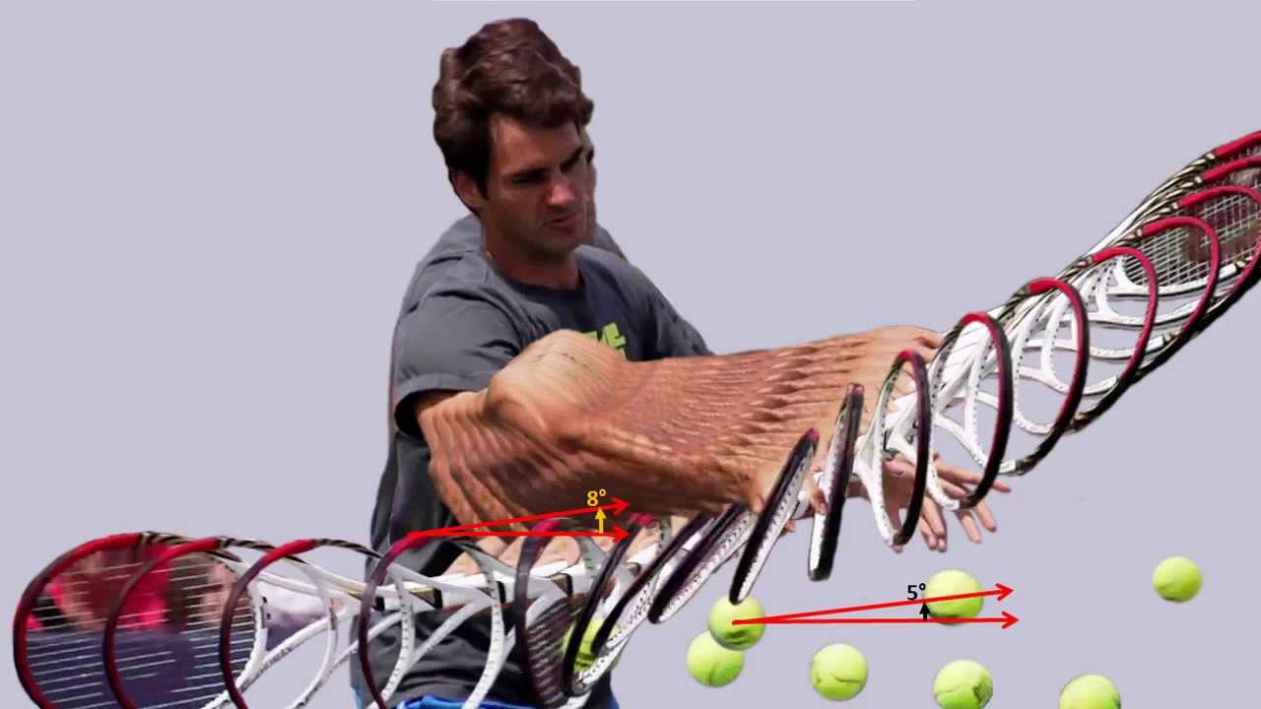
Prototype 1
Kinematic Equation: Vf = Vi + a * Δt
Calculations made to calculate
peak velocity
_____________________________________________________________
Using accelerometer on arduino
Acceleration | 0 | +2 | +3 | -1 | +1.5
Time | 0 | 1 | 2 | 4 | 5

Slide 14
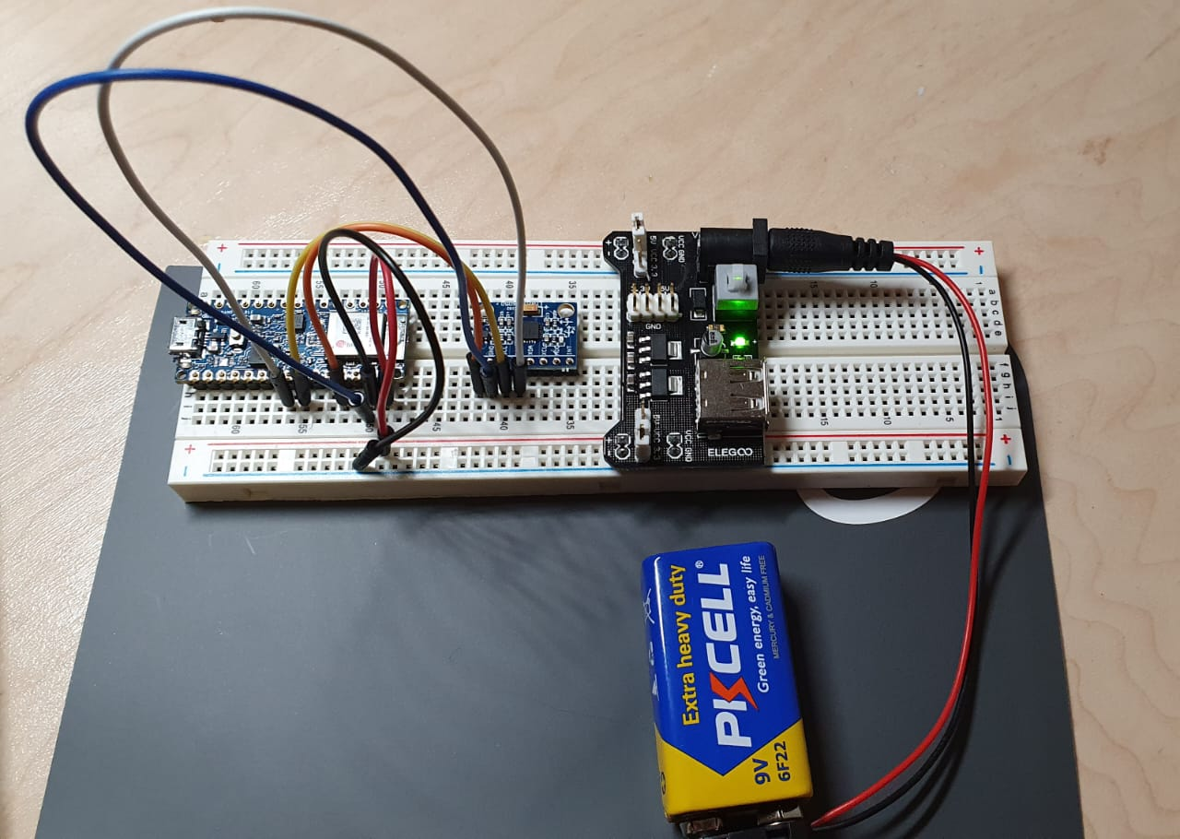
Prototype 2
Sending the average of two
Measurements to other devices with
bluetooth

Slide 15
Prototype 2
IMU-6050
Measuring regular+angular
acceleration in 3 axes

Slide 16
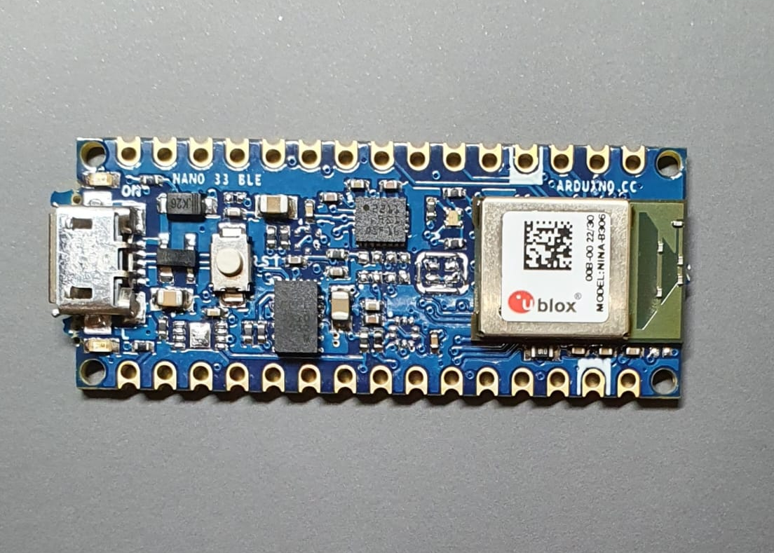
Prototype 2
Arduino Nano BLE 33
Built in IMU sensor
Built in BLE module

Slide 17
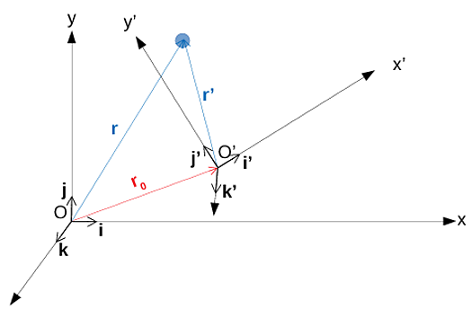
Prototype 2
Data sorting:
Using all 6 accelerations,
find x y z position over time.
Account for change of
referential at each instant
Depending on the range
of motion, approximate a
certain technique

Slide 18
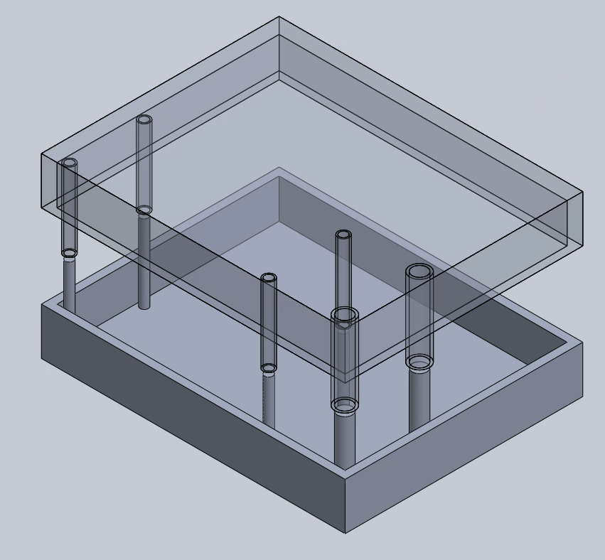
Prototype 2
Tracking device:
3D printed case
Velcro
All previous components

Slide 19
Prototype 2
Receiving device:
Arduino UNO
HM-10 module
Computer

Slide 20
Prototype 3
Website
Final Product

Slide 22
Testing
Both Bluetooth modules appear on BLE Scanner app
At rest, only constant z axis acceleration is transmitted. x y z positions remain constant

Slide 23
Demo

Slide 24
Business Model
Manufacturer Business Model
Using prefabricated components and raw materials to make product

Slide 25
Economics
Description | 1st Year | 2nd Year | 3rd Year
Revenue (Sales) | 500 units * $46.99 =$23 495 | 750 units * $46.99 =$35 243 | 2000 units *$46.99 =$93 980
Operating Expenses
Arduino Nano Components | $17 500 | $17 500 | $17 500
9 Volt Batteries | $300 | $300 | $300
3D Printable Plastic | $60 | $60 | $60
Metal Wires | $30 | $30 | $30
Rent | $12 000 | $12 000 | $12 000
Depreciation | $220 | $220 | $220
Marketing | $500 | $500 | $500
Total(OE) | $30 610 | $30 610 | $30 610

Slide 26
Operating Income | - $7 115 | $4 633 | $63 370
Taxation cost | $0 | $148 | $2 028
Net Income | - $7 115 | $4 485 | $61 342

Slide 27
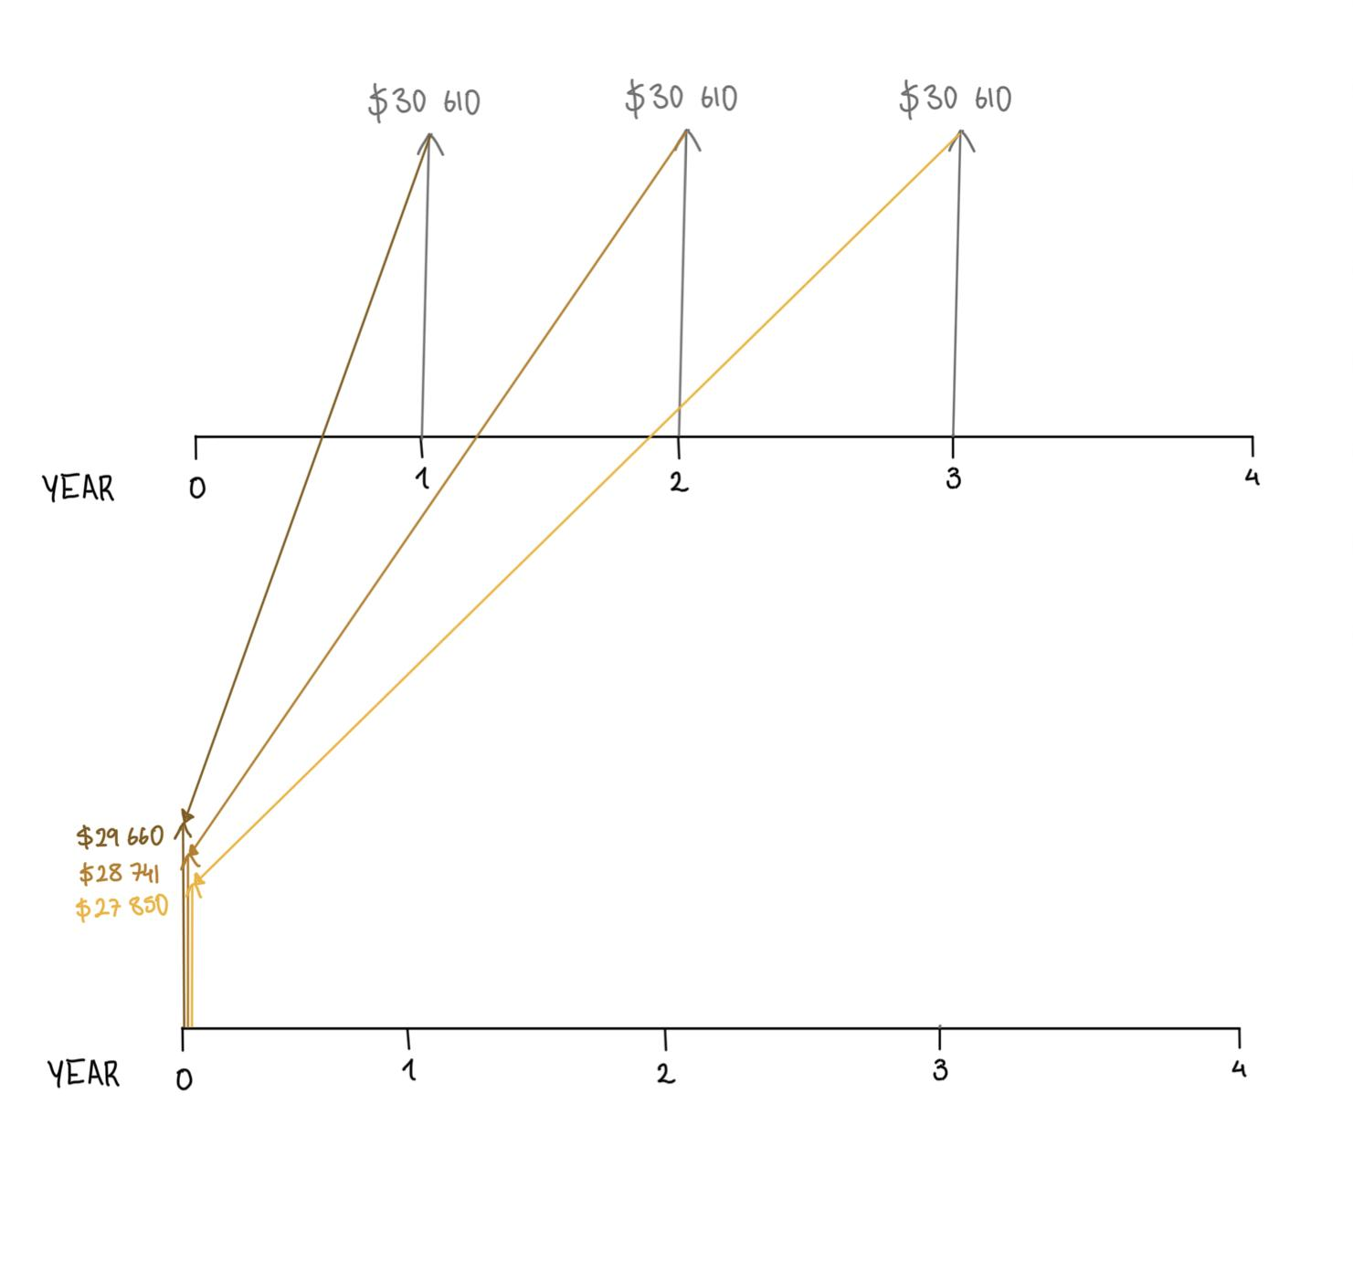
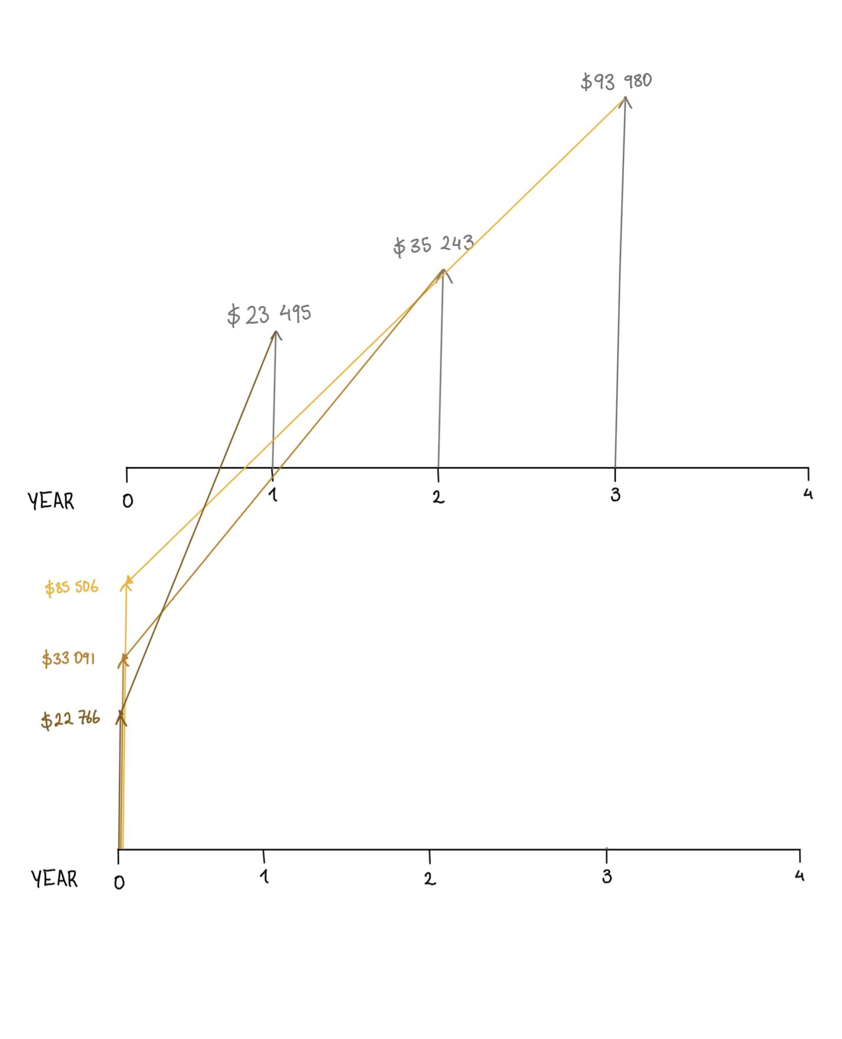
Present Value Costs
Present Value Incomes

Slide 28
Net Present Value Profit = $55 112
The break even point will be reached when 651 units are sold.

Slide 29
Project plan

Slide 30
# | Task | Time |  |  |  |  |  |  |  |  |  |  |  |  |  |  |  | Owner
 |  | September |  |  |  | October |  |  |  | November |  |  |  | December
1 | Team contract & project plan & client meeting 1 (PD-A) |  | x |  |  |  |  |  |  |  |  |  |  |  |  |  |  | All
2 | Client needs & Problem definition (PD-B) |  |  | x |  |  |  |  |  |  |  |  |  |  |  |  |  | Jemma
3 | Conceptual design & client meeting 2 (PD-C) |  |  |  | x |  |  |  |  |  |  |  |  |  |  |  |  | Vive
4 | Detailed design & Prototype 1 (PD-D) |  |  |  |  | x |  |  |  |  |  |  |  |  |  |  |  | Laura
5 | Project progress presentation (PD-E) |  |  |  |  |  | x |  |  |  |  |  |  |  |  |  |  | Yassine

Slide 31
# | Task | Time |  |  |  |  |  |  |  |  |  |  |  |  |  |  |  | Owner
 |  | September |  |  |  | October |  |  |  | November |  |  |  | December
6 | Prototype 2 (PD-F) |  |  |  |  |  |  |  | x |  |  |  |  |  |  |  |  | Chelse
7 | Business model & Economics report (PD-G) |  |  |  |  |  |  |  |  |  | x |  |  |  |  |  |  | Jemma
8 | Design day pitch & Final prototype & Client evaluation (PD-H) |  |  |  |  |  |  |  |  |  |  |  |  | x |  |  |  | Vive
9 | Video & User Manual (PD-I) |  |  |  |  |  |  |  |  |  |  |  |  |  | x |  |  | Laura
10 | Final presentation (PD-J) |  |  |  |  |  |  |  |  |  |  |  | x |  |  |  |  | Yassine

Slide 32
Trials and Tribulations
Lack of Software Knowledge
Bluetooth Module
Time Management

Slide 33
Lessons Learned
Arduino IDE/Hardware (Hard Skills)
Importance of team dynamic/trust (Soft Skills)
Engineering Design Process
Business Models

Slide 34
Future Work
Market our product (?)
Business venture
Improve the UI of our website/automate the tasks to transfer the data.

Slide 35
Thank You!
Questions?

