Slide 1
Wheelchair Skis
Group A5: Julian, Mihir, Kieran, and Leo

Slide 2
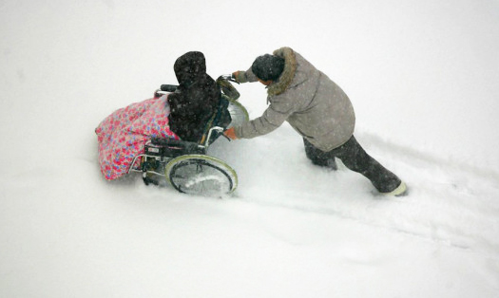
Problem Statement
Notes:
Our clients from the LIFE Program who require wheelchairs for transportation have trouble getting around in snowy or icy conditions on the sidewalks near their headquarters, even with the constant help of a staff member pushing them.
A wheelchair ski design is required to allow the clients to be able to successfully get from point A to Point B throughout Ottawa's harsh winters, while minimizing the efforts of the staff members and persons in wheelchairs and maximizing safety and effectiveness.

Slide 3
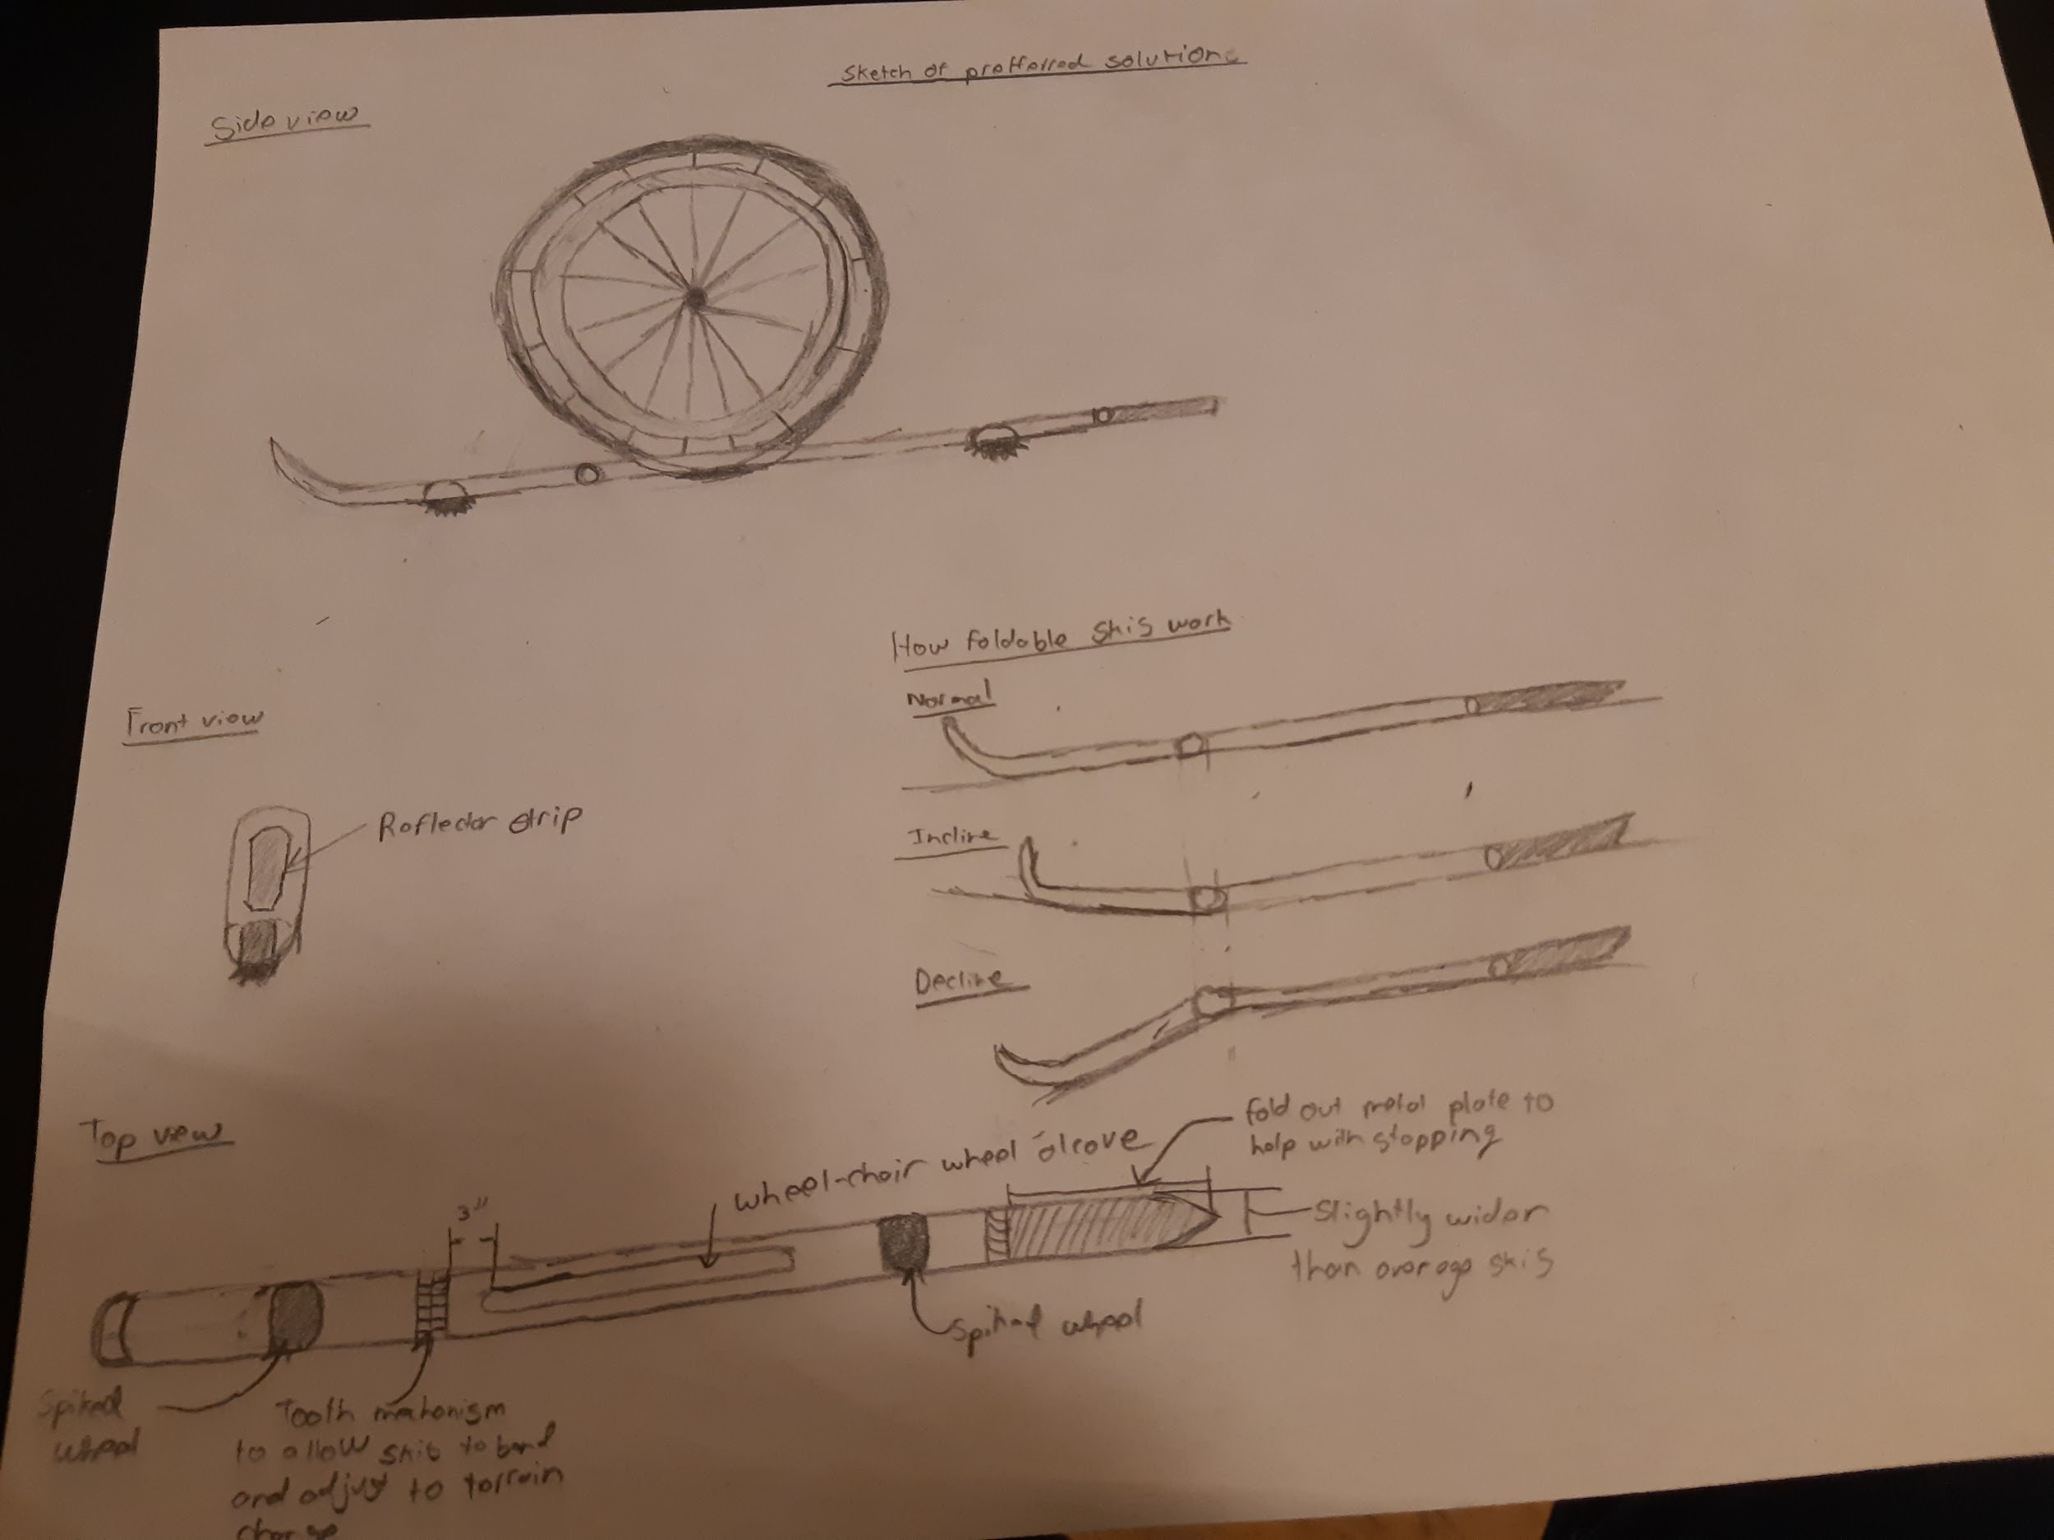
Initial Concept Design
Notes:
Wheelchair wheels resting on skis
Skis supporting weight of wheelchair and allowing it to glide across snow without becoming stuck/preventing buildup of snow
Key features:
Freely angling ski tip
Allows ski to mount slopes/bumps easily
Metal brake plate
Prevents wheelchair from sliding away on downhills, and allows person pushing chair to stop quickly
Reflector strip
Makes wheelchair visible to oncoming cars
Under-ski wheels
Supports ski over surfaces where snow isn’t present, protecting bottom of ski from damage

Slide 4
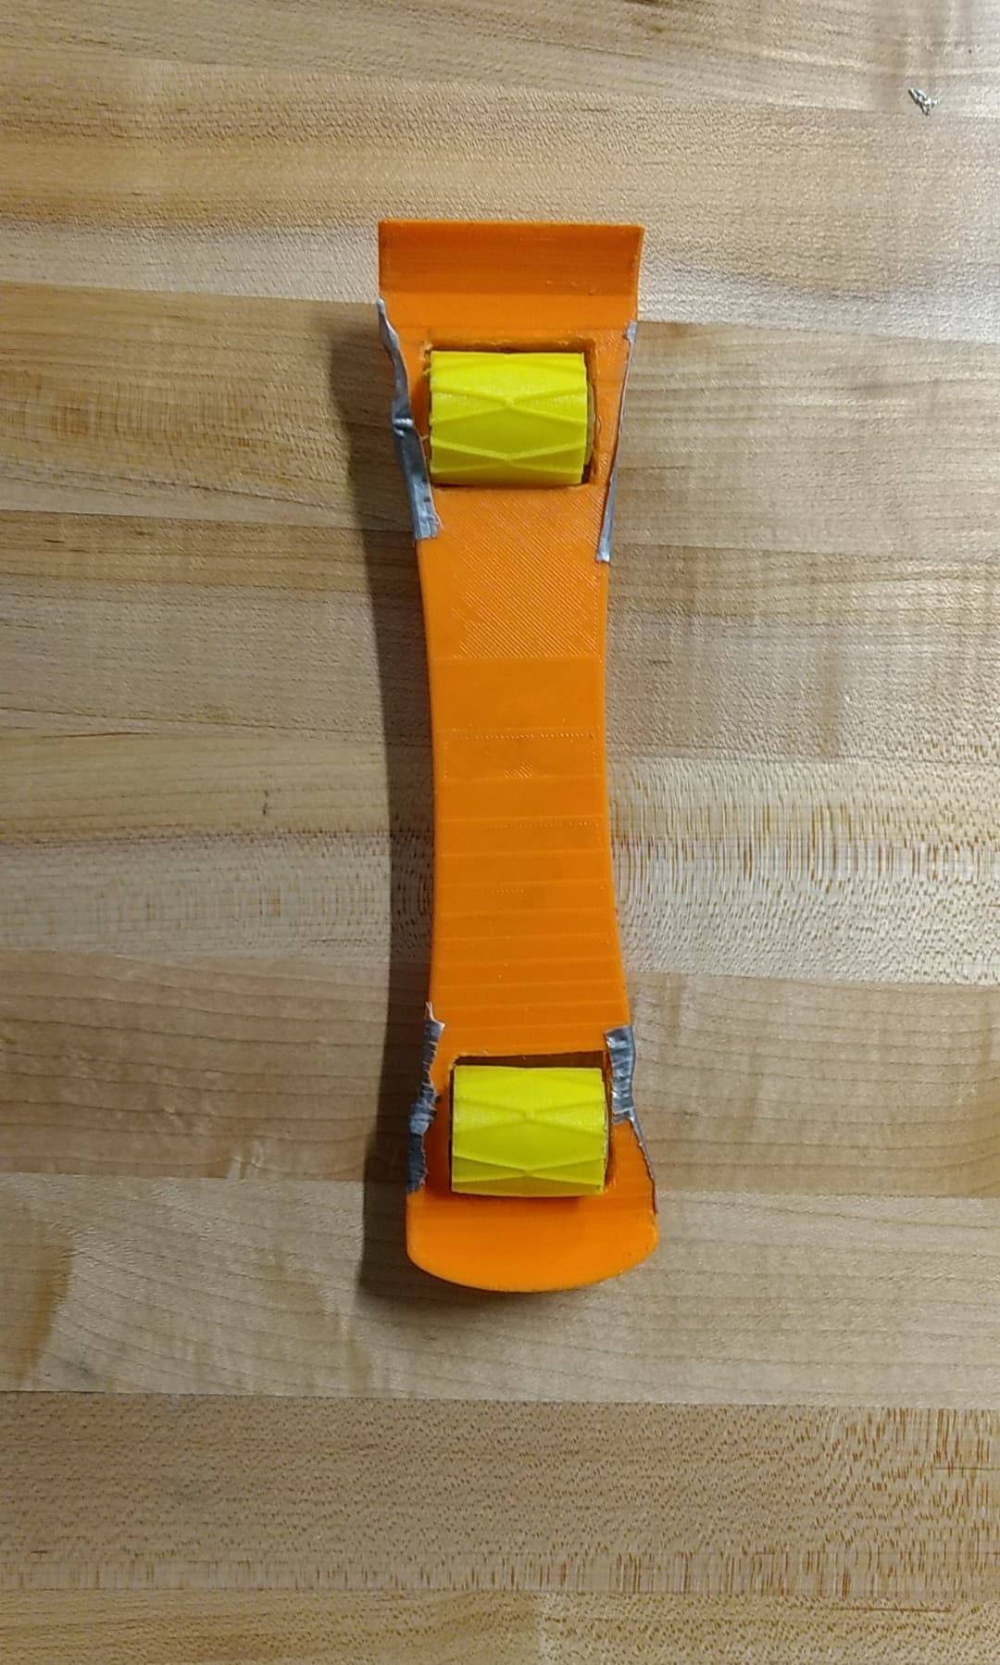
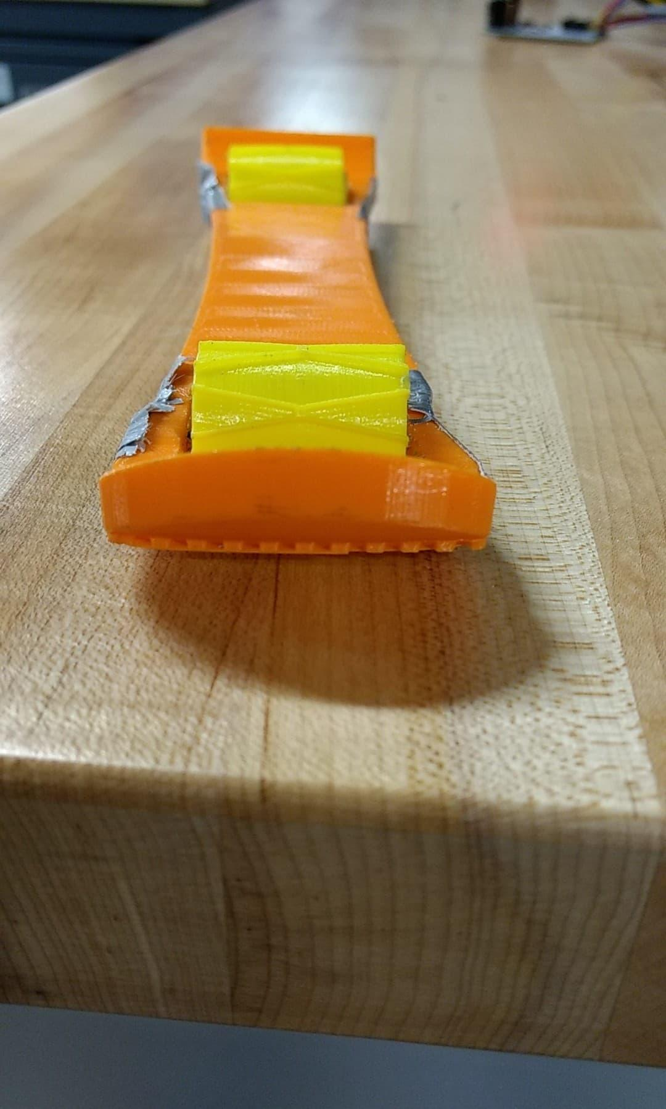
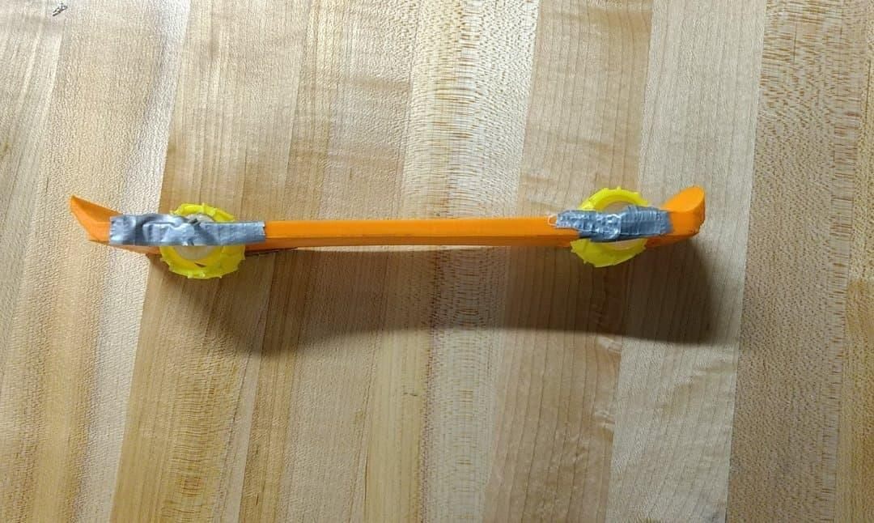
Prototype I
Notes:
3D printed ski
Downhill ski shape
Roller wheels (larger than final prototype)
Prototype designed for testing strength of 3D printed ski and how well the wheel/ski combination works on different terrain

Slide 5
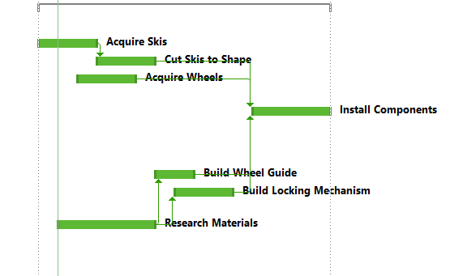
Initial Project Plan

Slide 6
Client Feedback - Thoughts, Suggestions, Recommendations

Slide 7
Client Feedback Based on Initial Design
Notes:
This initial conceptual design above was presented to the client at our second client meeting.
We would create skis such that the large wheels of the wheelchair would roll onto the skis and would be fitted into the hole of the skis.
The skis would be created to adapt to any type of terrain that have either valleys or hills because the front of the skis are able to be angled at the given terrain.

Slide 8
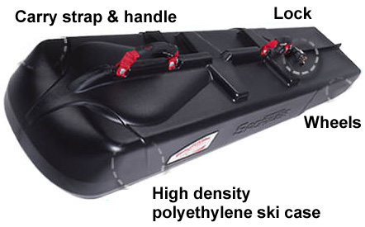
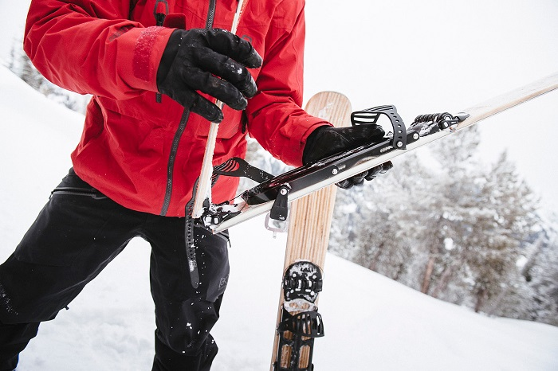
Client Feedback - Recommendations
Portability - Foldable, latchable, handle for carrying
New Material - Structural integrity, weight management, durability
Retractable bar for wheel base width setting (Easy install)
Front 360 Degree wheels narrower than main wheels, two seperate skis must be used
Locking Mechanism - Will have to be attached to structural frame directly behind main wheel
Notes:
Our previous method of 3D printing the skis won’t quite work because of the low strength and durability.
Recommends we use a set of downhill skis as a base
2.
Foldable skis that latch together and have a fixed handle for carrying
Carrying case
Mounting bracket for back of the wheelchair

Slide 9
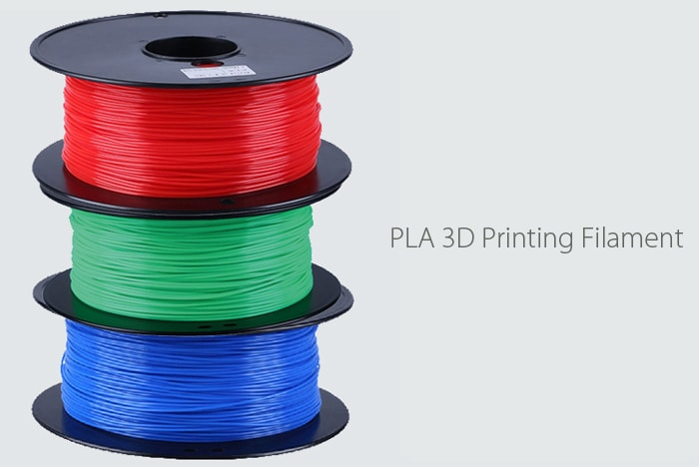
Client Feedback - Different Material
Notes:
We need to look at either a new material for the skis or just using a pair of downhill skis because the 3D printed plastic is not strong enough to support the weight of the chair.
Therefore, we can look at placing something in the middle of the 3D printed skis for support and weight balance.
If we 3D print, we have to be careful with the sanding/grinding of the plastic as it will be fragile.
Also if we 3D print, there is a larger 3D printing machine that we have to look into how to use and will be easier for printing the ski as one piece instead of seperate pieces.

Slide 10
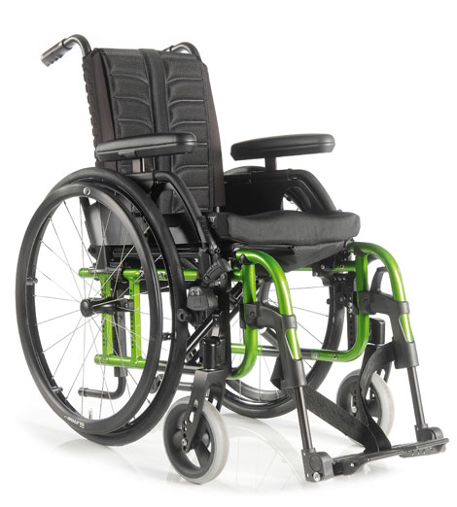
Client Feedback - 360 Degree Wheels
Notes:
Front 360 degree wheels are narrower than the main wheel so we have to look at two seperate skis. Julian recommended attaching a bowl shaped piece to the 360 wheels so that the wheel is still able to move in every direction, or using something similar to what is pictured above.

Slide 11
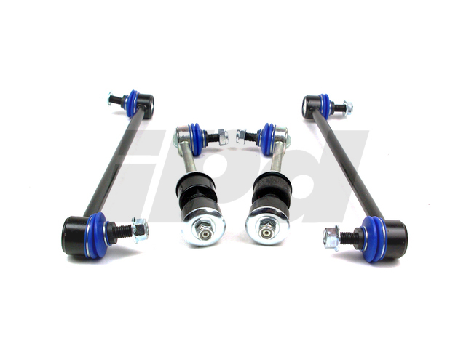
Client Feedback - Locking Bracket
Locking mechanism will attach to the frame directly behind the wheel as mentioned
Will be an arm bracket that grips and tightens to the frame, looking like a sway bar on a car pictured above
Notes:
We looked at the wheelchairs, and the locking bracket will have to attach to the bar that is directly behind the main wheel and runs along to the front which also holds the 360 degree wheel.

Slide 12
Changes or Improvements to Design & Development of Two Physical Prototypes
Thoughts: - Wood > Plastic (PLA)
- No braking system
Notes:
We have been thinking that we should purchase and wood use as our replacement to 3D printing PLA material.
Wood is stronger than plastic, and wood is stronger than 3D printing PLA material.
Since wood degrades over time, we can put a layer of coating on the wood, so the wood material lasts longer.
Another change is to our design is that we will not be including a braking system, but we originally did have a braking system.
The development of our first prototype went well because we learned how the 3D printers created the object, and we realized that PLA might not be strong enough because it becomes very brittle after any sort of drilling or milling.

