Slide 1
Design Day Presentation
PerRACKFormance
GROUP B12

Slide 2
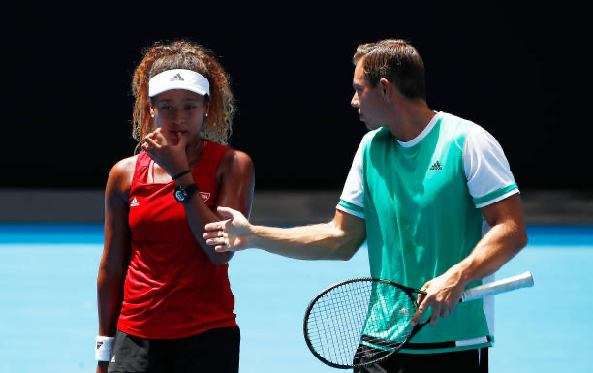
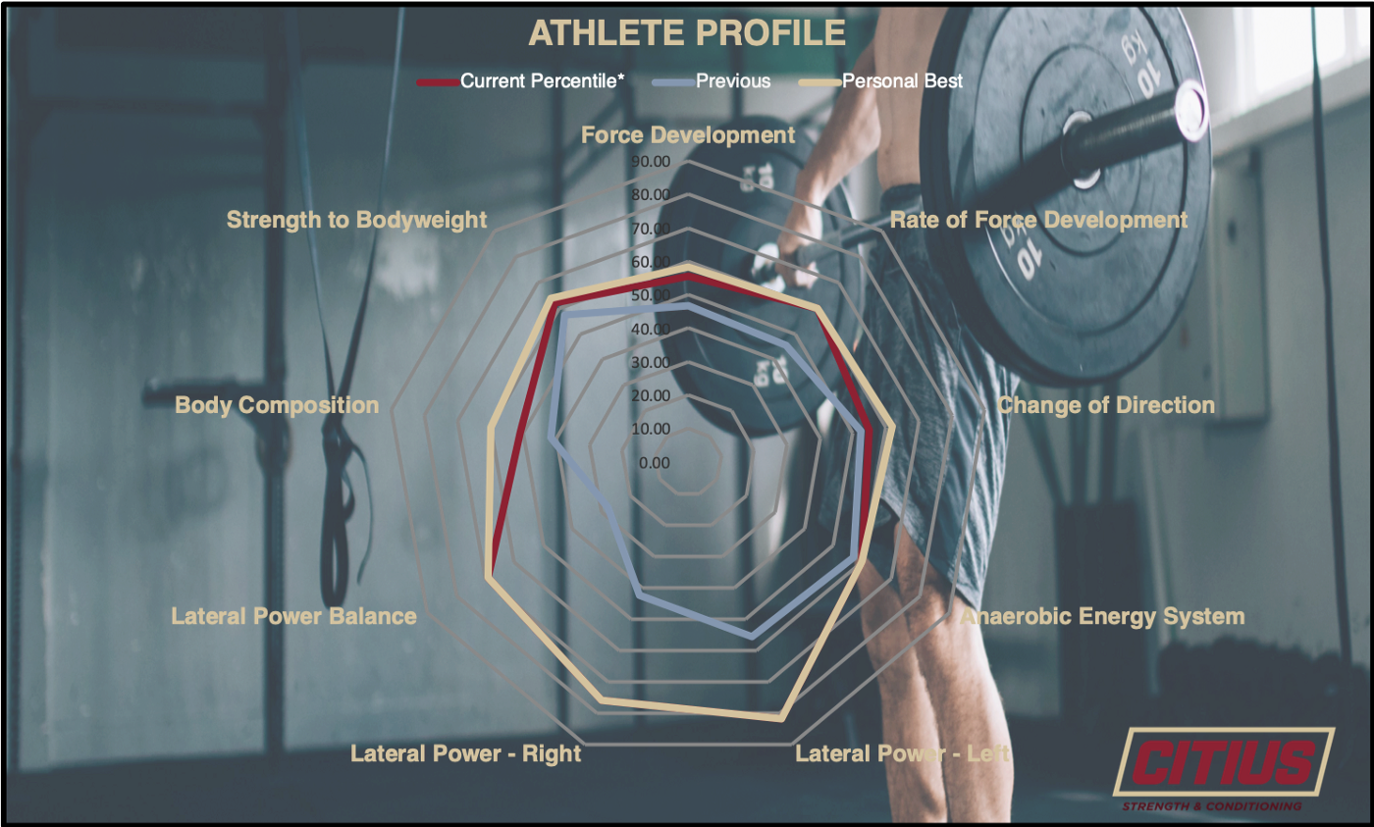
SO WHAT?
Athletes want to measure their performance using metrics
Feedback ≠ Numbers

Slide 3
WHO CARES?

Slide 4
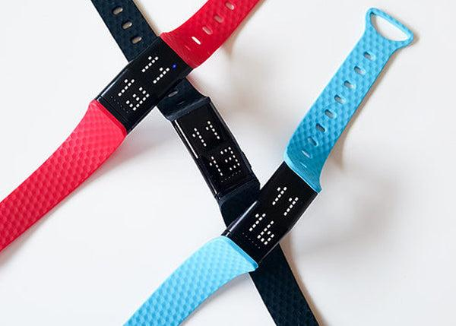
WHY US?

