Slide 1
TalkBox
Chuanzhi, Kaiyi, Michael, Victoria
GNG2101

Slide 2
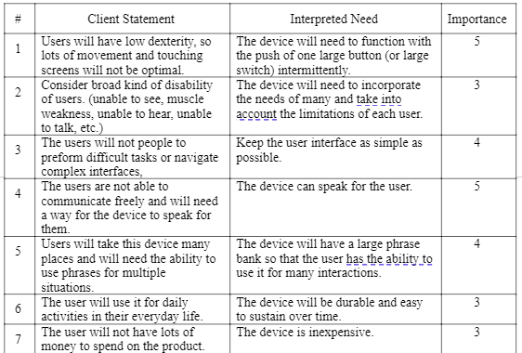
Client Needs Identification
14 Client Needs were identified
Ranking out of 1-5
5 is the most important
1 is the least important
Provides a clear picture for conceptual design

Slide 3
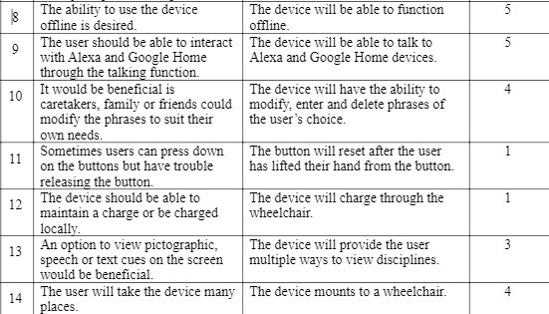
Client Needs Identification II

Slide 4
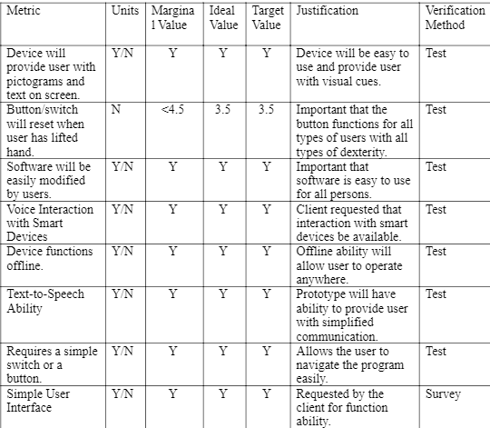
Target Specifications
Clarifies testing methods for future prototypes
Takes into account physical limitations for future prototypes
Sets a standard for conceptual design

Slide 5
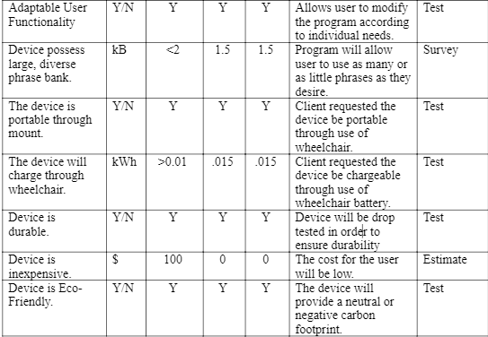
Target Specifications II

Slide 6
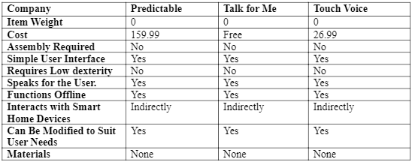
Benchmarking
Limited ability of personalization
Complicated user interface
Wide range of costs
No smart home interactions

Slide 7
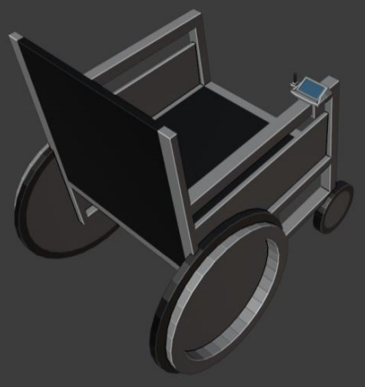
Design Solution 1
Arduino inside 3D printed case
Modular buttons
Screen for display(both pictorial and text)
Wheelchair mountable
Joystick

Slide 8
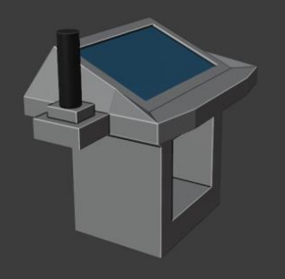
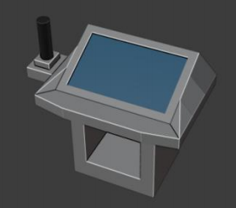
Design Solution 1

Slide 9
Design Solution 2
Arduino inside 3D printed case
No screen of display, only sound feedbacks
Wheelchair mountable
Speaks through small speaker
Controls by remembering numbers associated with phrases
Program communicates using a modular button

Slide 10
Design Solution 3
Application on user's smart devices
App includes pictorial and text information
Base on the critical assumption of user's accessibility to smart devices

Slide 11
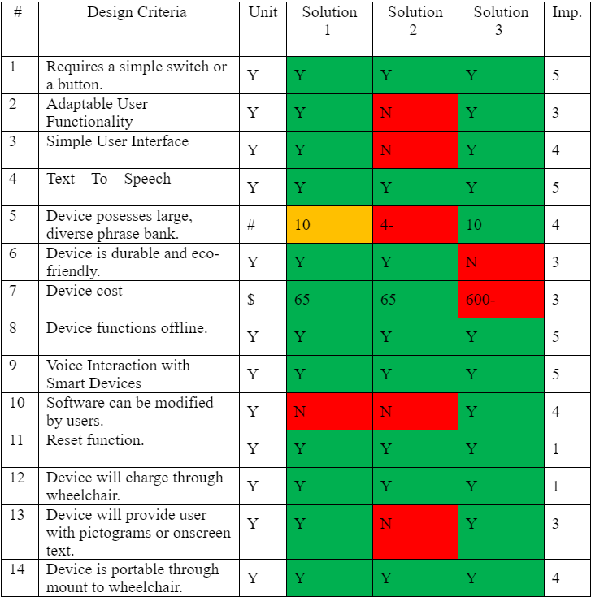
Solution Analysis(decision matrix)
Determining Factors:
User interface
Adaptable user functionality
Information feedback
Cost
Screen Capabilities

Slide 12
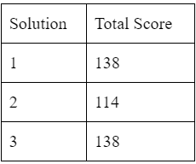
Feasibility Report and Final Decision
Solution 2: not as much programming needed not very efficient
Solution 3: not realistic due to the average user's financial conditions, and limited dexterity
Solution 1 became the final solution due to dexterity considerations, as well as financial considerations.

Slide 13
Client Feedback
Use a gooseneck mount instead of directly mount the TalkBox to wheelchair:
Can get out of wheelchair easier
No damage if bumped
Adjustable location of input device:
Joystick, or other modular buttons
Simplified methods to edit the phrases
Excel vs txt
Safety concerns on corner edges of box:
Filed or rounded corners

Slide 14
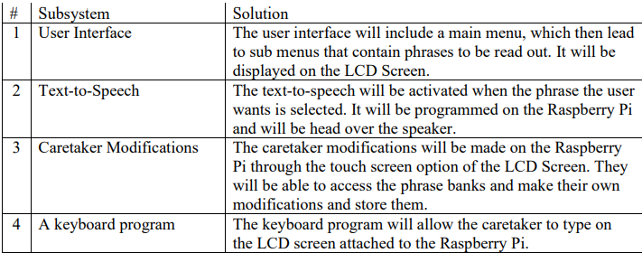
Detailed Design Concept - Software
A new definition of subsystems and solutions from the Client meet II.
Modifications to UML Diagrams
Different approach to programming with python vs C or C#
XLS vs TXT files
Keyboard is already available on Pi software
Simple User Interface.

Slide 15
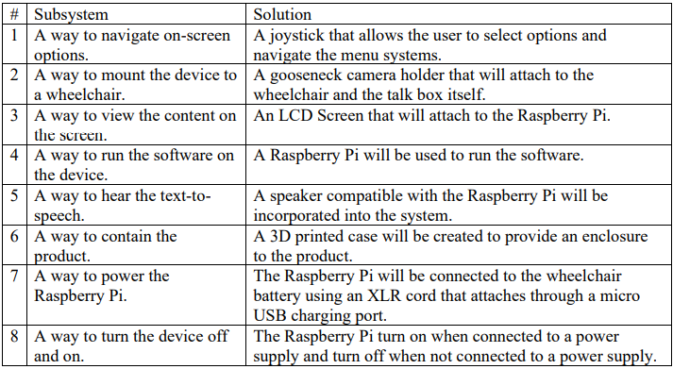
Detailed Design Concept – Physical Design
Joystick for primary operation, if time other modular buttons
Gooseneck Mount
Screen
Raspberry Pi
Speaker
3D Printed Case
XML – Micro USB Cable at 5V
Power Button

Slide 16
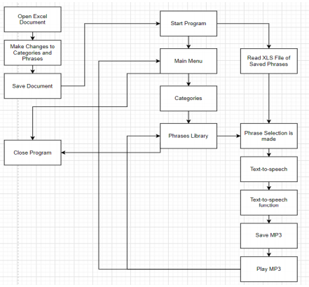
Redeveloped Subsystems
Complete UML Diagram
Easier to see what new areas to exploit
Easier to see new sub functions
Easier layout for program design
Solidified Software Design
Apparent Physical Design
3D Models

Slide 17
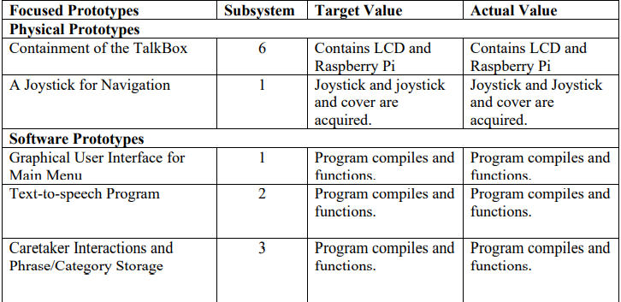
Prototype I – Focused Prototypes

Slide 18
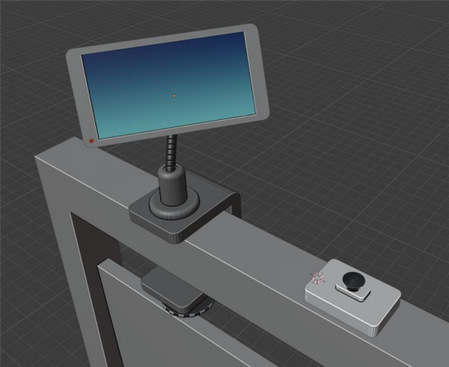
Prototype I – Physical Design
LCD Screen
Joystick with 3D Printed Case
Gooseneck Mount
Raspberry Pi
Speaker
On/Off Button
Power Connection

Slide 19
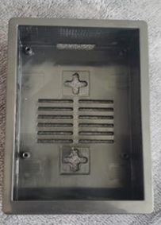
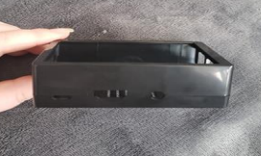
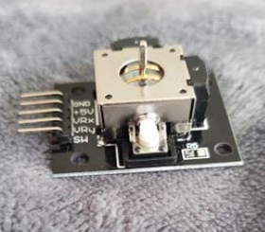
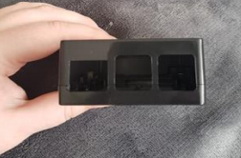
Prototype I – Physical Design

Slide 20
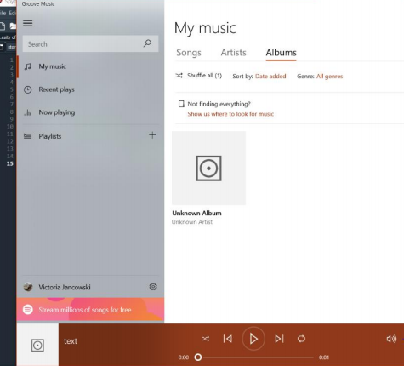
Prototype I – Software Design
Text-to-speech
Caretaker Modifications
Graphical User Interface
On-screen Keyboard with stylus
Easy to see
Adaptable
Combination of physical and programmable components
Python

Slide 21
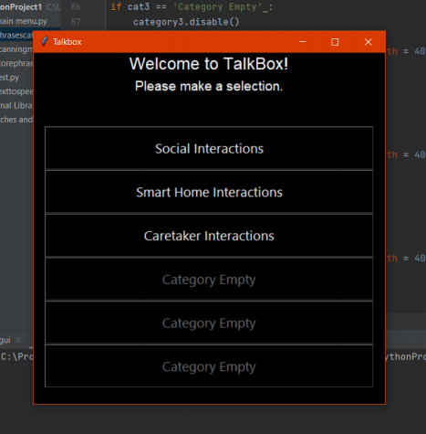
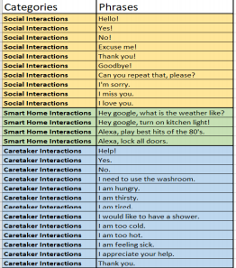
Prototype I – Software Design

Slide 22
Future Prototypes
Connection of LCD screen, speaker, joystick, mounting device.
3D Printing of new cases for joystick and case
Programming:
GUI for phrases
Implementing text-to-speech
Connecting joystick to program
Scanning Menu
Options Menu
Altering text size and fonts for better visibility

Slide 23
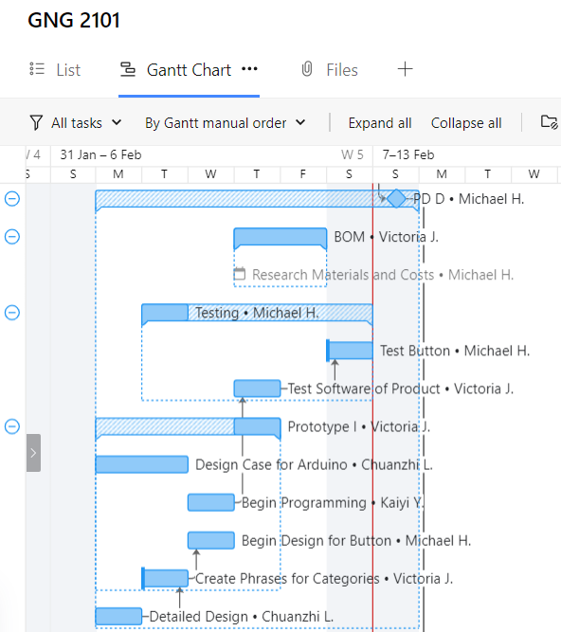
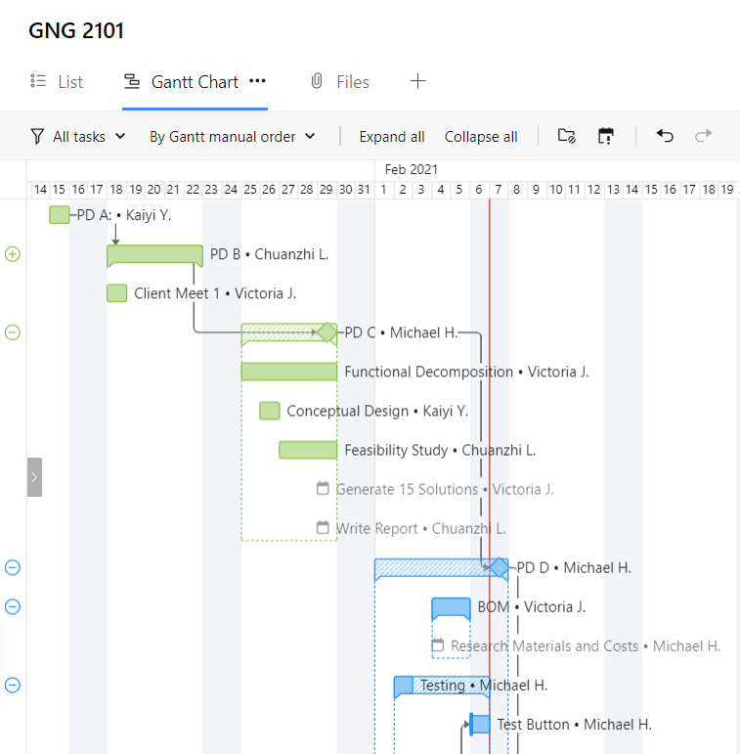
Project Plan and Management

Slide 24
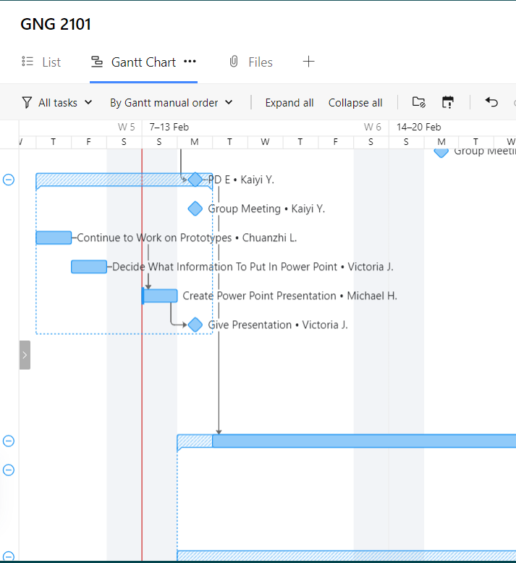
Project Plan
Continuing to use Wrike
Updating tasks multiple times per week
Keeping on top of tasks
Dependencies have been helpful with team organization
Outlines a path
Next Steps
Continual Evolvement

Slide 25
Thank you!
Questions?
Comments?

