Slide 1
Robot Arm Presentation
Group 2 – Adrianna Chouliotis, Toby Thai, Minjung Gong, Hunter Fleming

Slide 2
Table of Contents
Project Summary (Adrianna Chouliotis)
Description; Original Idea; Prototype 1, 2 and 3
3-6
Solution (Toby Thai)
Solution Options and Chosen Design
7-11
Decisions Made (Minjung Gong)
Design, End-Effector and Python
12-15
Conclusion (Hunter Fleming)
Trials and Tribulations; Lessons Learned; Future Plans
16-19

Slide 3
Problem At Hand
Used to Scan, Paint, and Sand the Halifax Class
Used by Someone with Little Experience
Use of Inverse Kinematics
Versatile End Effector
Cheap + 3D Printed
Create a robot with a 3D printed end effector, which runs on open source, user-friendly, inverse kinematics code.

Slide 4
Original Idea
Define Target Location from Origin
Choose End Effector Setting
Verify End Effector Setting and Location
Run

Slide 5
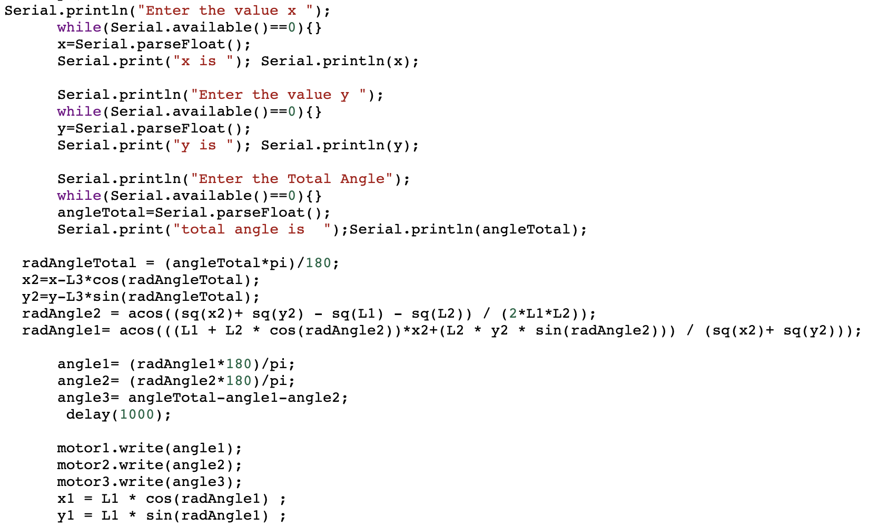
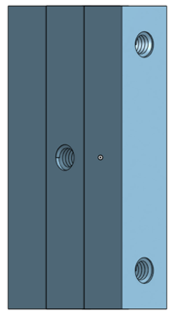
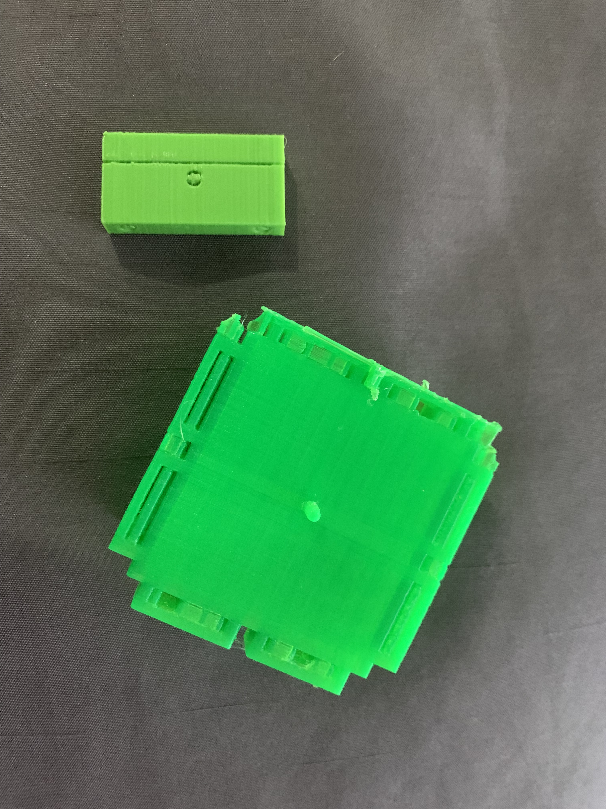
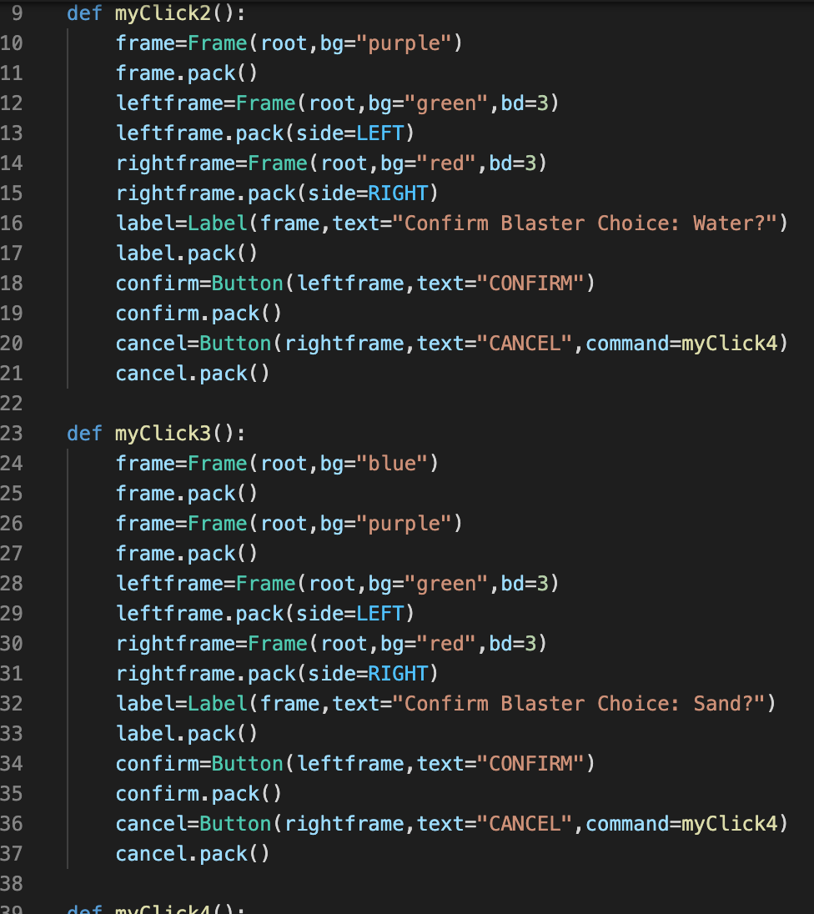
Prototype 1/2
Snippet from Original Arduino Code
Snippet from Original GUI Code
Reference: https://github.com/AymenNacer/Forward-and-Inverse-Kinematics-for-3-DOF-Robotic-arm

Slide 6
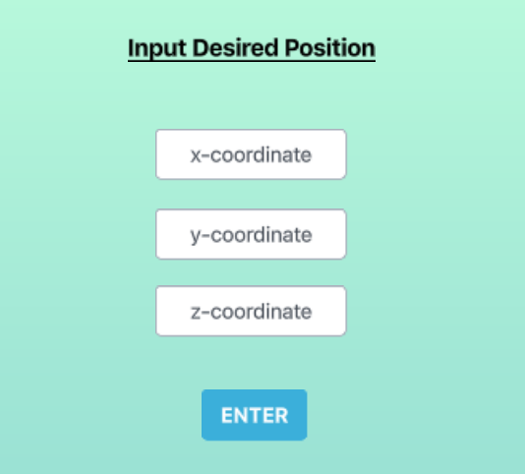
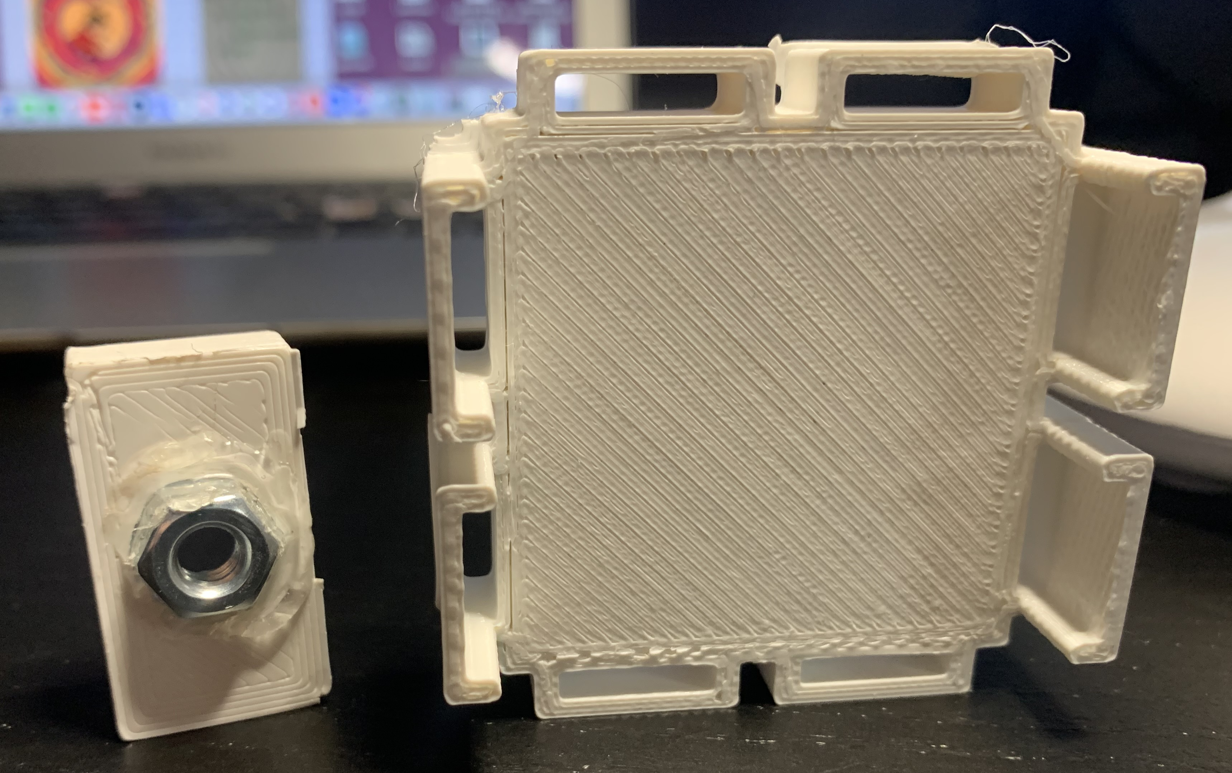
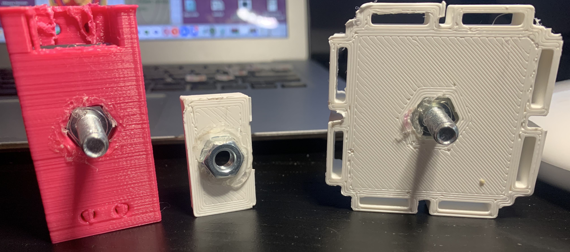
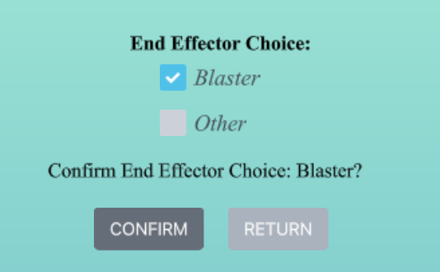
Prototype 3

Slide 7
Solution Choices

Slide 8
Design Option I
Rack and Pinion system
Can be used with a motor
360 degrees rotation
Screw-in mechanism
Coded with Python

Slide 9
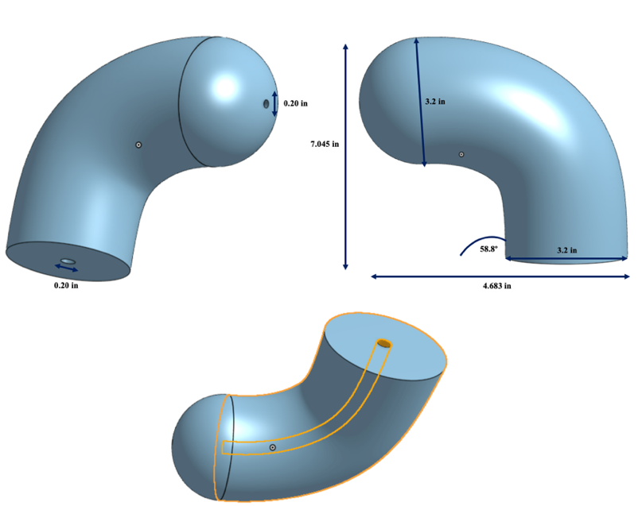
Design Option II
Rounded head connected by a ball mechanism
Tube inside, can be contracted or expanded for desired nozzle width
58-degree head curve, 180-degree rotation
Screw-in mechanism
Coded with Python

Slide 10
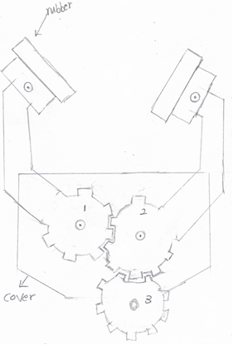
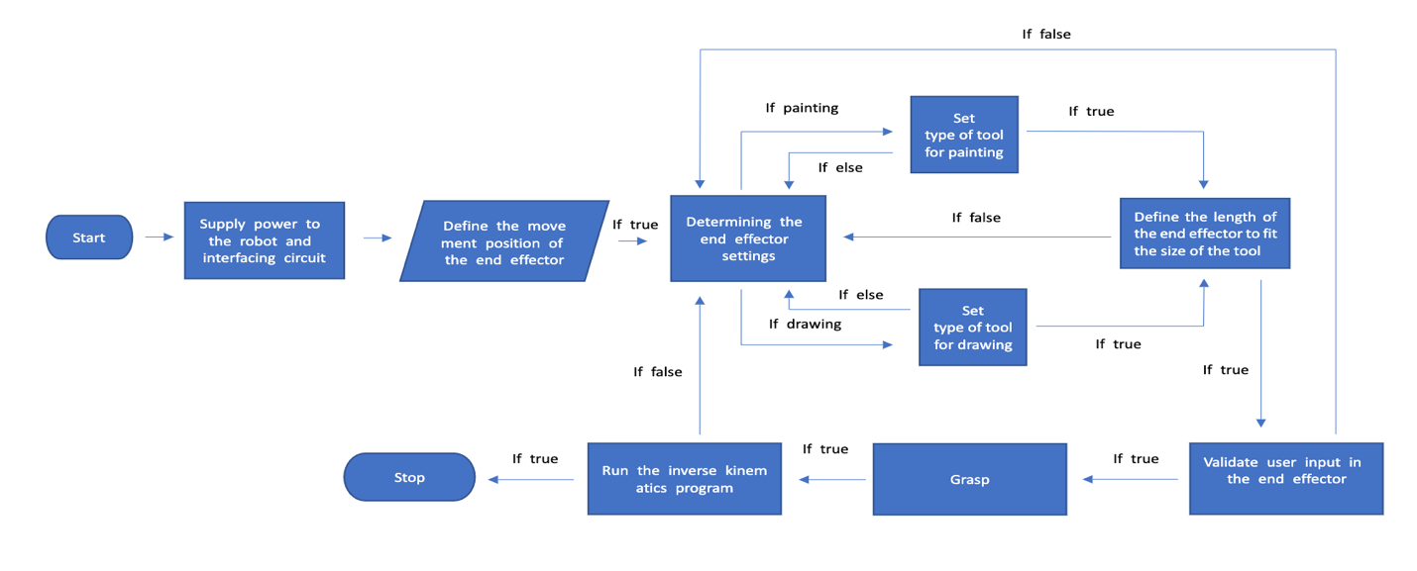
Design Option III
Made with gears connected together
Non-slip rubber pad at the tip of each claw
Three gears used
Screw-in mechanism
Coded with Python

Slide 11
Chosen Design
Better capabilities
More precise
Can hold the object tighter
Feedback from client's meeting :
Can only hold some certain objects
Cannot hold firmly enough

Slide 12
Decisions made

Slide 13
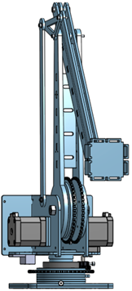
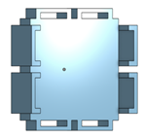
Design

Slide 14
End-Effector
3D printing
All ships have one printer for immediate product replacement.
Grasp
Use the Velcro band to hold the water blaster or pen.
3D
S
End-effector mobility is made more freely by using screw-in-out mechanism.
Mobility
Velcro bands can hold things more securely than the shape of a claw.
Safety
M
G

Slide 15
Python
Open source
Be able to be distributable and open to editing
Easy
Easiest language to learn rather than other programing languages.
O
E
Easy to adapt to even those who are learning programming for the first time
User-Friendly
Inverse kinematics programming to adjust the position of the end effector is possible.
Operation
U
O

Slide 16
Conclusion

Slide 17
Trials and Tribulations
Beginner coders
Beginner 3D designers
Initial design needed to be changed
Difficulty with communication
Initial project cost went from $100 to $50

Slide 18
Lessons Learned
Prepare for the worst-case scenario
Be honest
Team meetings early in the week
Communication is key
Constant progress updates are needed
Complete work as soon as possible
Always backup hard drive

Slide 19
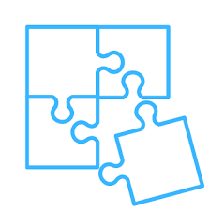
Future Plans
Test Connectivity of Arm & Code
Manual Stop Button
Further Work on GUI
Testing End Effector

Slide 20
Thank you!
Any questions?

