Slide 1
Deliverable E: Project Progress Presentation
Group 3: Accessible Digital Drawing
Eleanor Rumsey [8274066]
Callum French [300128814]
Austin Wu [300129117]
Matthew Yakubu [300123797]
Benjamin Saulnier [300121338]

Slide 2
Key components of project deliverables to date

Slide 3
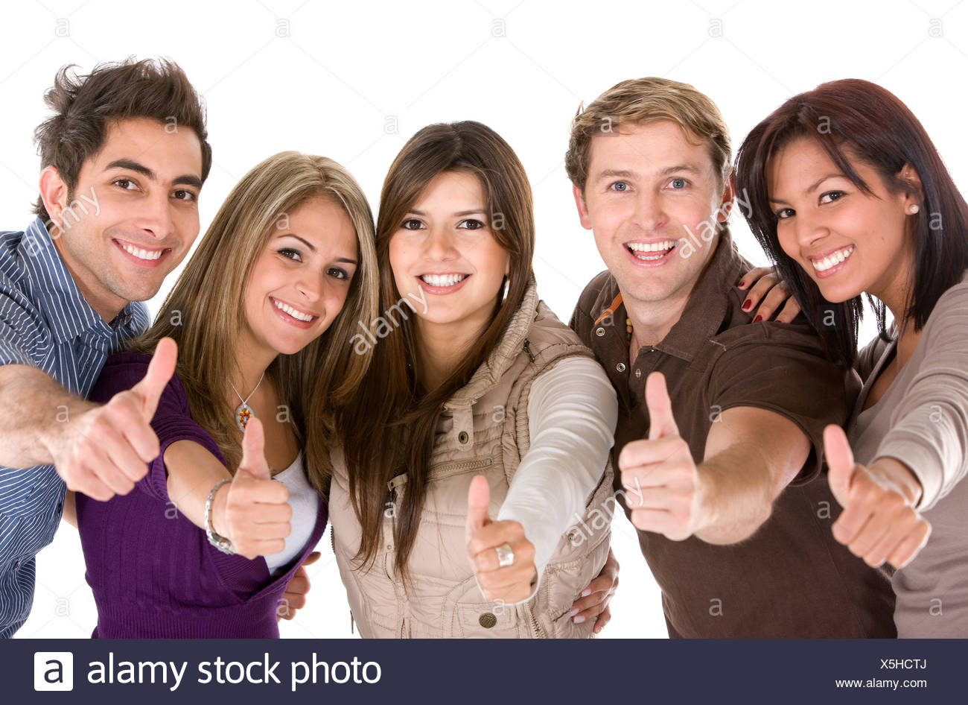
Team Contract
Deliverable A
Team Leadership: Informal
As a group of 5, we can realistically come to any solution democratically and remain on schedule.
Communication: Through Discord
Voice, Video, text chat, file sharing, and notification all in one software.
Meetings: Weekly
Notes taken
Member progress tracked in MS Project
Meeting agenda focused by Eleanor
Submissions: Weekly
Callum responsible for weekly submissions on Thursday evenings
Contract Success
Still Together
Still Kicking
Still Going Strong
Still Supporting Each Other Through any Difficulties
Notes:
MATT

Slide 4
Deliverable A
Client Summary: Madison Ward
Madii is an artist and student. They are non-binary and study Fine Arts at the University of Ottawa with the hopes of becoming a registered Art Therapist.
Their art is surrealist, and they use a variety of media. They describe their art as an “escape” and want to “invoke a reaction” from viewers. Much of their works has themes of struggling with mental health.
www.madiiwardcollective.ca
Notes:
MATT
Explain who our client is

Slide 5
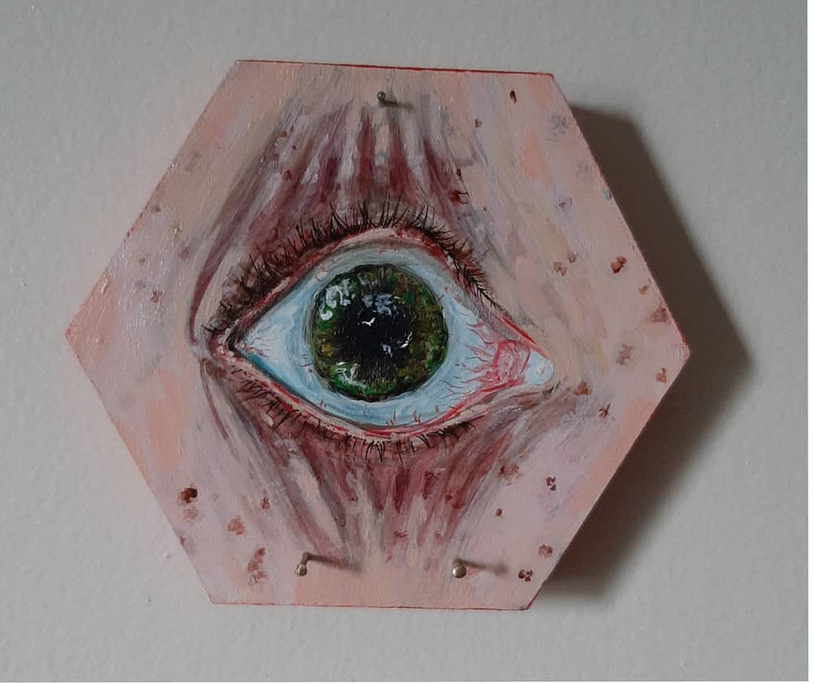
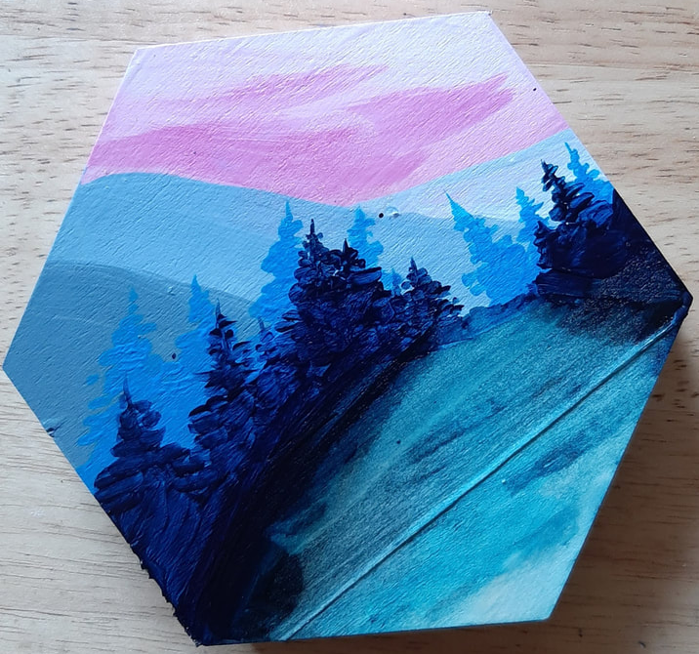
Deliverable A
Client Summary: Madison Ward
Madison has a fluctuating disability called Conversion Disorder or Functional Neurological Disorder.
The effects are vast and ever-changing. One day, Madii could be completely fine and the next, unable to move or talk. Anything can trigger these changes, from stress to the colour red.
www.madiiwardcollective.ca
Notes:
MATT
Explain who our client is

Slide 6
Deliverable A
What is our Project?
Project Name: Accessible Digital Drawings
Madii has struggled with bringing their art to the digital medium. Photoshop is too confusing, contains too many triggering features, and cannot be used every day.
Madii wants to have access to a digital art platform that is simple, accessible, and inspiring. They never want to feel like their disability is a block in their creative process, no matter the medium.
The project is designed to help Madii complete and sell their art in a digital landscape.
Notes:
MATT
Just explains a very brief overview of the clients project idea. What they proposed and what they want, not solutions.

Slide 7
Deliverable B
Client Needs
# | Need Statement | Priority 1 (low) to 5 (high)
1 | The software interface has a more comprehensible tool ribbon | 4
2 | The software has a method for easily repeatable functions | 3
3 | The software interface has large icons that are easy to find and distinguish from others | 4
4 | The software interface has minimal options shown | 3
5 | The system is able to recall and display previously and commonly used commands | 2
6 | The system is able to quickly copy and paste | 2
7 | The system can smoothen lines that are drawn shakily | 4
8 | The software interface allows selection between different line weights and patterns | 5
Notes:
BEN
These two slides show the main part of Deliverable B, the Customer Needs. Theres not much information, but reading off makes for bad presentation.
Pick a couple statements to go into detail about

Slide 8
Deliverable B
Client Needs
9 | The system can be operated using voice commands | 4
10 | The system can be operated using a keyboard or buttons | 5
11 | The software interface does not have any red colors | 5
12 | The system allows the user to choose different colors without using the typical color-picker | 4
13 | The system inspires the user to create art despite any daily struggles with their disability | 5
14 | The software interface does not have any flickering or fast popup animations | 4
15 | The software is compatible with the client’s drawing tablet and a normal mouse and keyboard | 3
Notes:
BEN
See previous slide

Slide 9
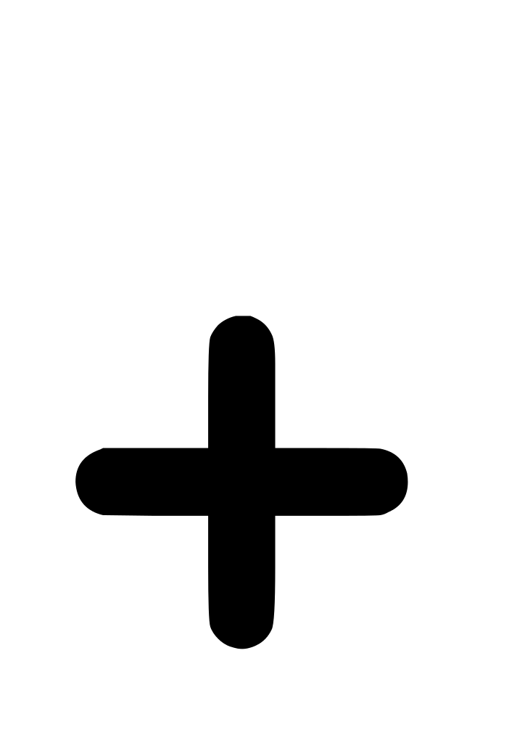
Deliverable B
Problem Statement
Photoshop has a cluttered and unfriendly interface that is especially challenging for our client, Madison, who has a fluctuating disability that occasionally affects their physical and neurological ability. An ideal solution would allow the Madison to continue to use Photoshop or other digital drawing tools, but provide additional functionality that would simplify the interface and allow multiple options for input, including voice, drawing tablet, and/or keyboard input.
Notes:
Contains just the problem statement. Explain how other concepts were looked at, but it was decided to keep the user on the most powerful software instead of having to relearn an entirely new platform just for its increased accessibility.

Slide 10
Deliverable B
Target Specifications
Metric | Units | Ideal | Acceptable
UX as empathetic with client | Personal ranking | 5 | 4-5
Number of repeatable functions | Positive integer (count) | 100 | 20-100
Icon size | px or cm (on-screen) | 50px/ 2.5cm | 35-100px/ 1.4-3.0cm
Customizability | Personal ranking | 5 | 3-5
Number of commands recorded | Positive integer (count) | 100 | 50-100
Assistive features | Personal ranking | 5 | 5
Prevalence of red | % on startup | 0% | <10%
Presence of fast pop-ups | Yes/No | No | No
Hardware Integrability | Personal Ranking | 5 | 4-5
Notes:
BEN
Be brief in this section. Just shows that we have done the deliverable requirements

Slide 11
Deliverable B
Benchmarking
Metric | Photoshop | Yanko keyboard | Procreate | GAVPI | Windows voice control
UX as empathetic with client | 2 | 1 | 5 | 2 | 2
Number of repeatable functions | >1000 | 29 | >100 | N/A | N/A
Icon size | 25px | 1.4cm | >1cm | N/A | N/A
Customizability | 2 | 1 | 1 | 5 | 2
Number of commands recorded | 0 | 0 | 1 | Infinite | 20
Assistive features | 2 | N/A | 1-2 | 5 | 4
Prevalence of red | >10% | 0% | 0% | >10% | 0%
Presence of fast pop-ups | No | No | Yes | No | No
Hardware Integrability | 5 | 5 | 3 | 4 | 4
Notes:
BEN
More focus here. Take one concept (say Procreate) and run through how the metric was decided and what we would want to integrate.

Slide 12
Deliverable C
Concept Generation
 | 1 | 2 | 3
Austin | An external custom keyboard that allows for rebinding of keys and hotkey functions for photoshop | Tool integrated into wacom tablet that allows for easy switching between tools, rapid copy pasting capabilities | New UI that allows for simplifying down the menus in photoshop
Ben | A more accessible UI over Procreate to allow user to work under many circumstances | An ergonomic pen for the wacom tablet, allowing user to hold pen more comfortably | A plug-and-play accessible keyboard that comes with accessible design software
Callum | A voice input program that will select small icons and help navigate challenging menus | A new UI to place over Photoshop, simplifying the UI | A series of easy-to-access quick “help” videos to walk clients through the complexity of photoshop, built in.
Ellie | A toolbar UI that can be used with Photoshop (or other tools) with basic commands that can be activated by mouse, keyboard, or voice | A UI that focuses specifically on aspects of the Photoshop UI that the client felt overwhelmed by - e.g. color picker, brush size | A tool integrated into the Wacom tablet that uses gesture commands for tools such as fast copy/paste, line smoothing
Matt | A voice command system that makes it sufficient to complete simple drawing processes for any possible art concepts. | A simplistic UI that will be designed to make navigation easier while using Photoshop | A modification to the Wacom tablet that stores the most common drawing patterns read by the tablet.
Notes:
AUSTIN
Shows that each team member put in significant work. Do not read each one, just pick a good one (Ellie 2) and a bad one (Callum 3).

Slide 13
Deliverable C
Decision Matrix
 | Concept | Metric
 |  | 1 | 2 | 3 | 4 | 5 | 6 | 7 | 8 | 9
Austin | 1 | 3 | 100 | 1.4cm | 5 | 100 | 3 | 0% | No | 5
 | 2 | 4 | >10 | N/A | 4 | N/A | 2 | 0% | No | 5
 | 3 | 5 | N/A | 50px | 3 | N/A | 4 | 0% | No | N/A
Ben | 1 | 4 | 100 | 50px | 2 | 1 | 4 | 0% | No | N/A
 | 2 | 3 | N/A | N/A | 5 | >10 | 3 | 0% | No | 4
 | 3 | 5 | 100 | 50px | 4 | 100 | 5 | 0% | No | 5
Callum | 1 | 3 | N/A | N/A | 3 | 100 | 4 | 0% | No | 3
 | 2 | 5 | N/A | 50px | 4 | N/A | 4 | 0% | No | 5
 | 3 | 2 | N/A | N/A | 1 | N/A | 3 | <10% | No | N/A
Ellie | 1 | 5 | 100 | 50px | 5 | 100 | 5 | 0% | No | 5
 | 2 | 5 | 50 | 50px | 4 | 100 | 4 | 0% | No | N/A
 | 3 | 4 | 20 | N/A | 2 | 10 | 4 | 0% | No | 5
Matt | 1 | 5 | 20 | N/A | 3 | 20 | 4 | 0% | No | 4
 | 2 | 4 | N/A | 50px | 4 | N/A | 4 | 0% | No | 5
 | 3 | 5 | 10 | N/A | 5 | 10 | 4 | 0% | No | 5
Each idea was evaluated against each of the Target Specification metrics.
Ideas that meet the ideal metric value are shown in yellow.
Notes:
AUSTIN
Explain the two rows of pure yellow, and run over one idea? Explain how the yellow is an easy way to see visually good ideas (Austin 1, Ben 3, Ellie 1).

Slide 14
Deliverable C
Selected concept features
Simplification of Photoshop UI
Larger icons, hiding unnecessary tools
Improvements to the brush selection tool and color picker.
Voice activation
Integration with Wacom tablet
Allows the client to maintain their current work environment
Use as a mouse
Explore functions with buttons and pen
Command and gesture history and repetition
Functionality to recreate frequently used processes
Voice activation
Notes:
AUSTIN
This section explains some of the concepts we will try to integrate into the final product. Be brief!
Simplification of Photoshop UI: Making the menus, icons, and tools in Photoshop easier for the client to navigate and use.
Integration with Wacom tablet: This is the tool the client already uses

Slide 15
Deliverable C
Selected concept features
Help system
Help build the client’s confidence with Photoshop’s tools alongside the solution
Tactile buttons
Easier to manipulate than a cursor on the screen
Large and easy to see
Line smoothing
Assists client when hands are shaky
Notes:
AUSTIN
Continue with a brief look at some of these features
Help system: The client feels overwhelmed by the options available in Photoshop. The proposed solution will make their interaction with the program simpler but also more limited. A friendly help system would help build the client’s confidence with Photoshop’s tools alongside the solution.
Tactile buttons: The client may not always be able to manipulate a cursor on a screen, in which case large, tactile buttons would be a useful feature.
Line smoothing: The client has complained about their drawn lines being shaky if their hands are unstable. Adding line smoothing functionality to the solution would add value in these situations.

Slide 16
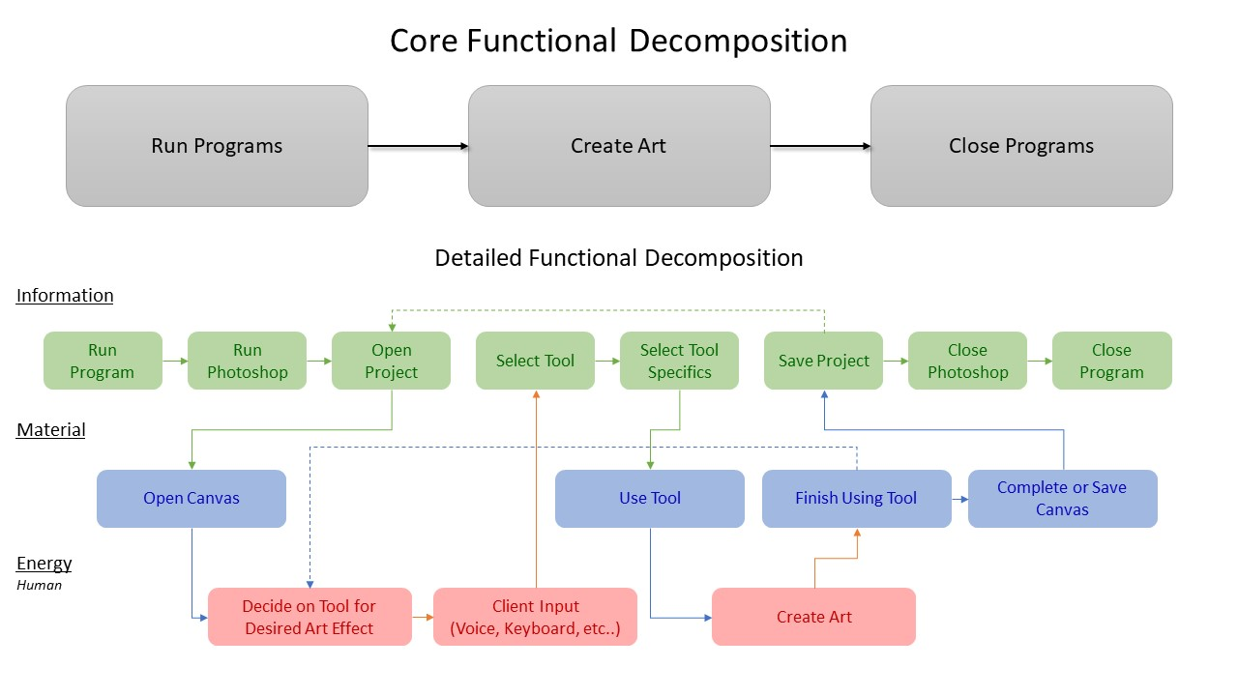
Deliverable C
Functional Decomposition
Notes:
CALLUM
This is confusing, but be brief with it. Maybe explain why energy is a human input.

Slide 17
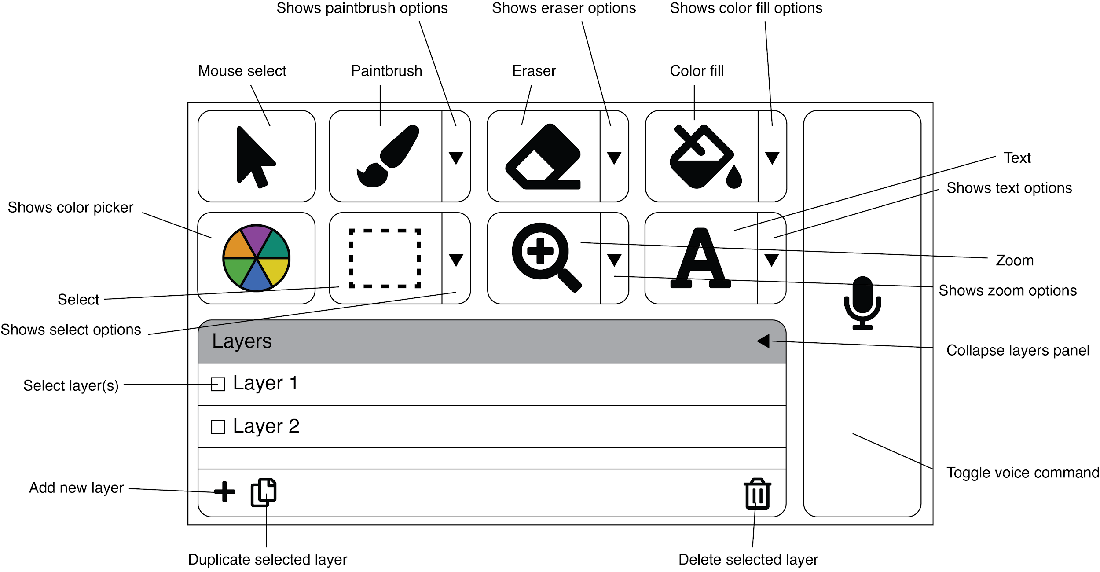
Deliverable C
Final concept
Solution: auxiliary interface that runs as a desktop application concurrently to Photoshop.
Controlled by voice, mouse, Wacom tablet (as mouse), or keyboard
Large icons, simple menu navigation, color picking, and brush selection
Record of command history that can be repeated.
Notes:
CALLUM
Talk final decided on general solution

Slide 18
Deliverable C
Feasibility: Uncertainties and risks
Experience coding desktop applications
Only Eleanor has any experience building applications from scratch.
Eleanor uses MacOS, while the client and teammates use Windows.
Voice commands
Notoriously difficult to implement and unreliable
Have to use an open-source library
Keyboard mapping
Keyboard shortcut mapping is limited by the features that have that already built into Photoshop
Only Austin has direct experience with custom key-mapping and keyboard design from scratch.
Notes:
CALLUM
Read from below or just elaborate on the fly. Really don’t spend too long, this is already minute 6.
Experience With Coding:Of the five members of the project team, only one (Eleanor) has experience with building applications from scratch. Eleanor also does not have much experience building desktop applications. However, all members of the team have experience with coding in some capacity and feel confident that the code necessary to create the product will not be beyond the team’s collective skill level.
Voice Commands:A main feature of the product is its ability to be controlled by voice. However, voice command systems are notoriously unreliable and difficult to implement. The team has performed some research and intends to make use of voice command libraries and open-source tools that are available online. Decision of the best voice command tool will be done during the prototyping phase of the project, once other system specifications have been established.
It will be important to communicate with the client that the product’s voice command system, like any other, will not be one hundred percent reliable. As the client specifically mentioned the need for voice input during our initial interview, the value added by a voice command feature outweighs the risk that it is not perfect.
Keyboard Mapping:The concept at the moment involves simulating the keyboard shortcuts that are used to access tools in Photoshop. Austin has some experience with custom key-mapping with hardware and the team is confident that this can be achieved through JavaScript. As none of the team has experience simulating these key presses using software, there is a risk that this solution will be time consuming. However, it is the simplest solution that has been discussed, that involves the fewest changes to the client’s current work environment.

Slide 19
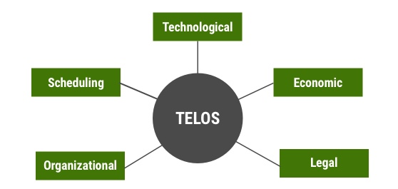
Deliverable C
Feasibility: TELOS factors
Technical: Experience and Resources
Eleanor has experience coding software applications and user interfaces.
Austin has experience building custom keyboards
Open-source resources available online (e.g. GitHub repositories)
Economic: Cost Analysis
All software used in this project is free and open source, decreasing total cost
A possible economic strategy would be to market towards other disabled artists
Only cost incurred is the keyboard construction
Notes:
CALLUM
Don’t spend too long. Elaborate a little bit on operational constraints, like the inability for in person meetings, difficulty with hardware, etc..

Slide 20
Deliverable C
Feasibility: TELOS factors
Legal: Applicable Laws
Section 17 of the Adobe Legal code prohibits reverse engineering or modifying original source code
Does not prohibit the use of a new UI on top of Photoshop
Open-source is free to use on any product created on a personal scale.
Operational: Organizable Constraints and Other Factors
Other coursework and commitments
Limited to remote collaboration within group and with client due to COVID-19
Schedule: Deadlines and Reasonability
Keeping a detailed Gantt chart created in MS project available for group members keeps everyone on track and ensures reasonability.
Notes:
CALLUM
Operational: We are not the client, and we do not know exactly what they need.
Will need consistent open communication between parties.

Slide 21
Deliverable D
Low-Fidelity Prototype Overview
Custom Keyboard
Unsure if the client would be responsive to hardware due to clutter-space
Need a yes or no on keyboard and keyboard layout design so that we can order parts right away!
User Interface
Will use keyboard shortcuts to control photoshop underneath
Simpler, cleaner, but just as powerful
Contains a new colour picker that avoids the “colour cloud” for colour picking and avoids red
Voice Control
Uses GAVPI to link voice to keyboard shortcuts.
A workable prototype has been built already!
Notes:
ELLIE
Just a brief overview of what was done in our first prototype

Slide 22
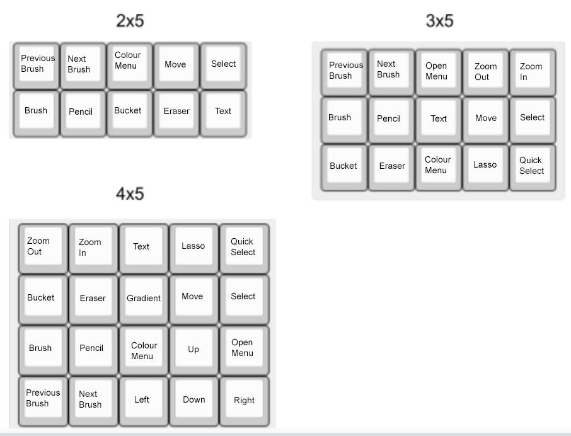
Deliverable D
Prototype Keyboard Layouts
20 common tools were picked based on Callum’s use of Photoshop
What needs to be decided early is keyboard size so an accurate bill of materials can be made
Notes:
ELLIE
Options presented to client
Describes the Keyboard Design created in deliverable D. Not the most detailed yet

Slide 23
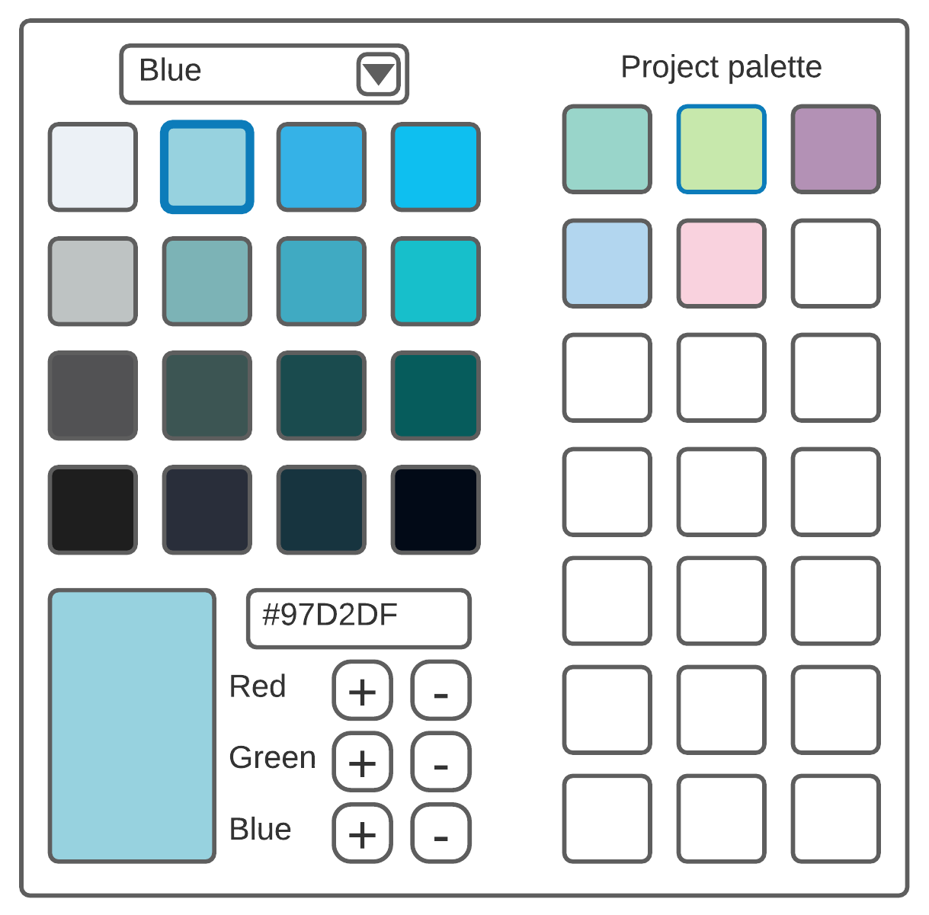
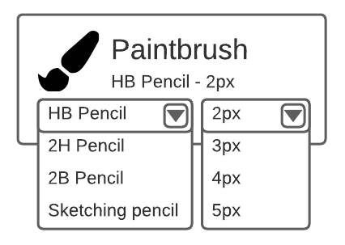
Deliverable D
Prototype:
User Interface
Avoid a “colour cloud”
Client has difficulty differentiating color
Avoid the colour red
Make the tool selections larger
Simplify as much as possible
Notes:
ELLIE
User interface description.

Slide 24
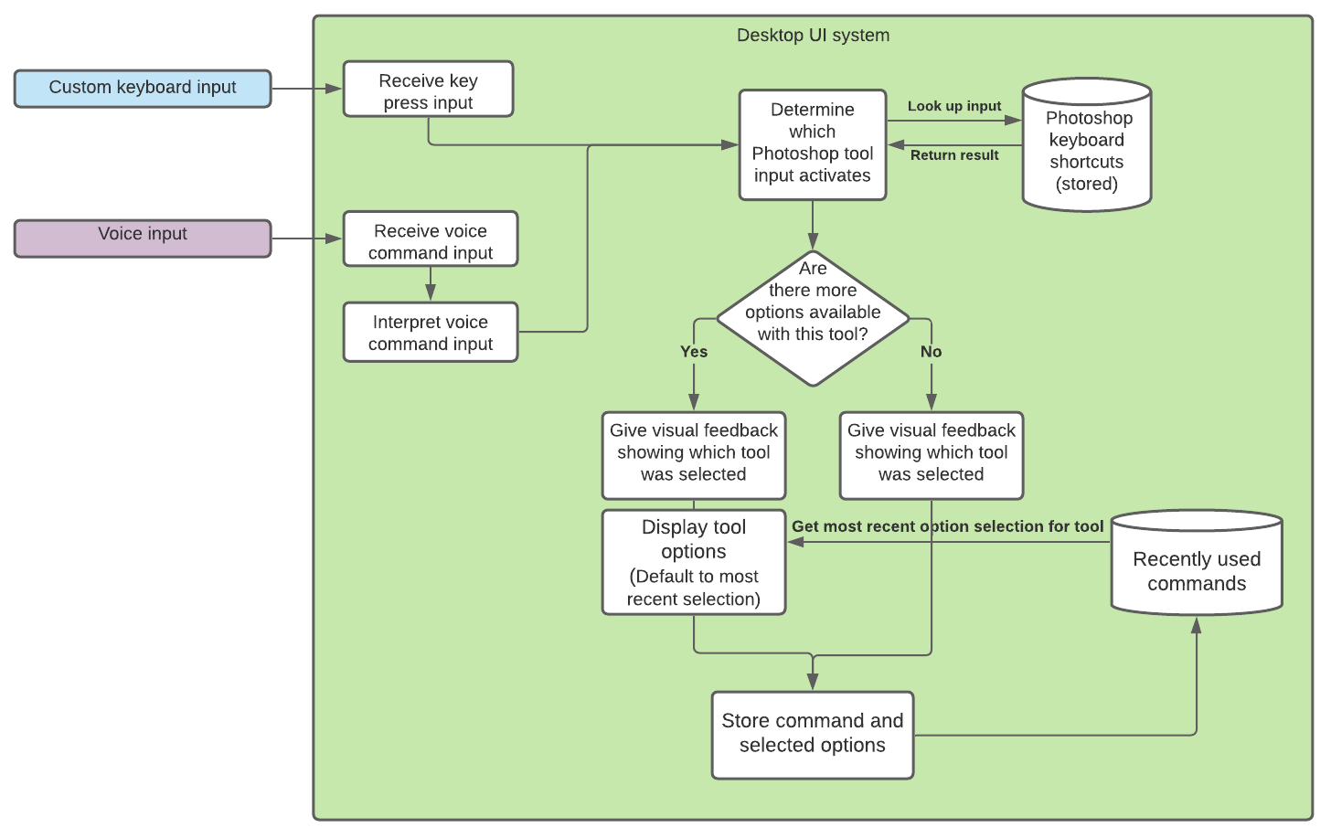
Deliverable D
Prototype:
User Interface
Integration with keyboard and voice input
Notes:
ELLIE
User interface description.

Slide 25
Deliverable D
Prototype:
Voice Control
Examples of common Photoshop pathways
Photoshop Feature | Voice Commands | Keyboard Shortcut Pathway
Open New File | “New File” | CTRL+n
Increase Paint Brush Size | “Brush”, “Increase Size” | b, ]
Duplicate Layer | “Access Layer”, “Go Down”, “Enter” | Alt, right x4, down, down, enter
Write a common word (like “Cat”) | “Text”, “Left Click”, “Type Capital C”, “Type a”, “Type t”, “Enter” | t, left click, Shift down, c, Shift up, a, t, enter
Zoom to full screen canvas | “Toggle toolbars”, “fit to screen” | Alt, CTRL+0
A series of coded keyboard combinations that are linked to voice through an open-source free program called GAVPI.
Notes:
ELLIE
Voice Control description. Elaborate showing how the keyboard keys work

Slide 26
Client feedback (Meeting #2)

Slide 27
Client Meeting 2
Voice Control and User Interface
Voice control option that can help call upon shortcuts
Voice control needs a toggle option to prevent it from always listening
Simplification of photoshop’s interface with a new UI (toolbar)
Client feedback
Interested in the voice activation software
Would like a smoother interface, better colour picker, and a better brush selector
Notes:
MATT
Talk simple about this

Slide 28
Client Meeting 2
Custom keyboard
Tactile keyboard with shortcuts
Client Feedback
Make sure keyboard isn’t heavy (>10 lbs)
Normal keyboard key size is okay
Larger icons on keyboard, but not so large that they can’t be distinguished from each other
Notes:
MATT
Talk just overall

Slide 29
Client Meeting 2
Ergonomic pen
An improved pen for the Wacom tablet to reduce hand discomfort
Client feedback
Would not necessarily be helpful
Would not be doing art if hand is in pain
Notes:
BEN
Why the pen was bad!

Slide 30
Client Meeting 2
Client feedback: Other notes
Would like a smoother interface, better colour picker, and a better brush selector
Fast pop-ups are usually not too much of an issue
The color red is a much worse trigger
Preferable to have smooth graphics and animations.
It would be best if the color picker had a border between each color to tell them apart.
It would be useful to have some feedback when a key is pressed.
The best colors would be off-white or a soft blue/green.
Notes:
BEN
Overlook a few of these points

Slide 31
Project plan

Slide 32
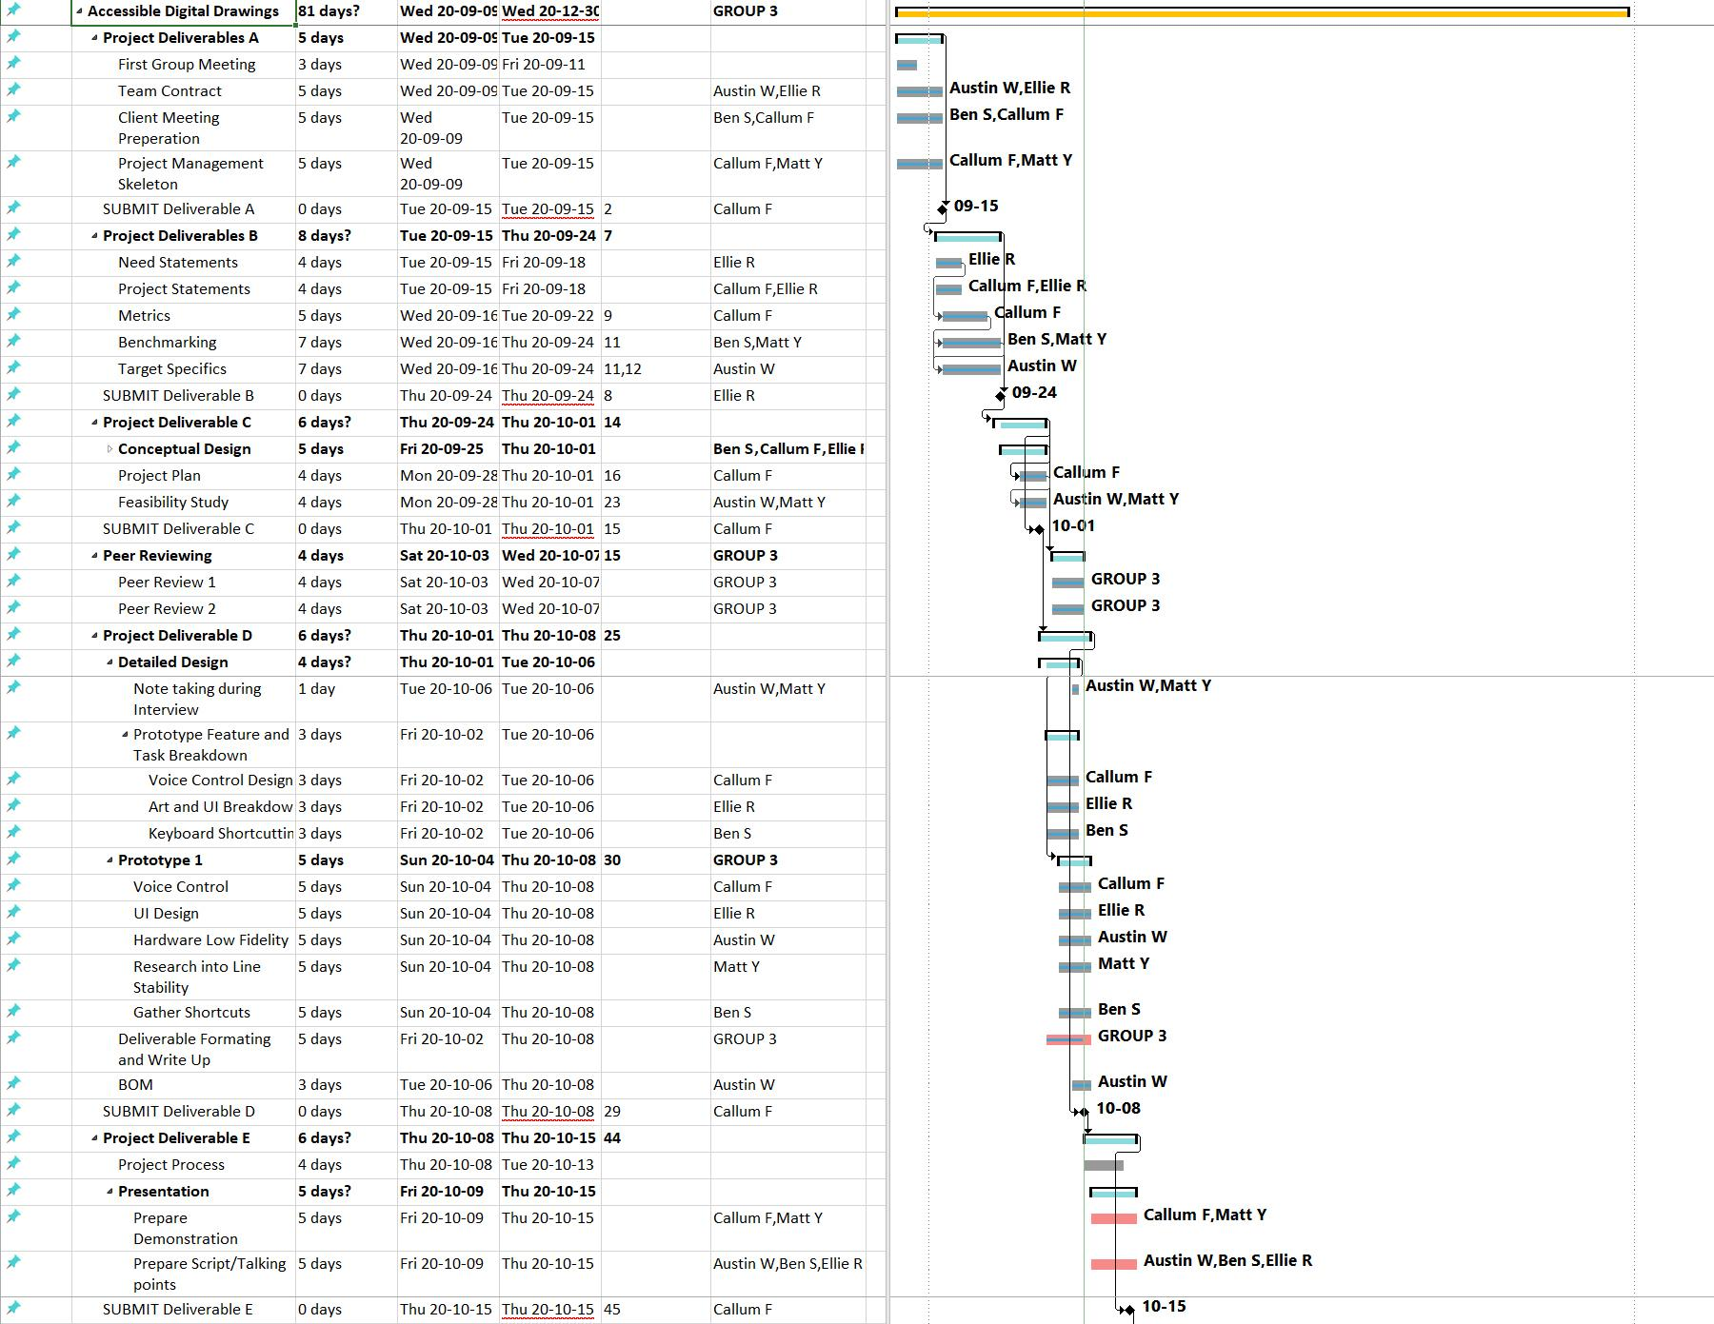
Project plan
Project plan (initial)
Weekly updates to the MS Project
Breakdown by deliverables, tasks assigned to team members
Notes:
CALLUM: Be brief, no one is going to want to analyze this chart.

Slide 33
Project plan
Project plan tracking
Team has stayed on track!
After client interview number 2, we have to keep in mind:
The keyboard construction time and cost
UI design and software construction time
Continued consistent communication with the client
Finalize a team logo and product name
Notes:
CALLUM
The new goals based on client meeting 2 mean that our project plan has changed slightly from what we originally expected -- we adapted well to these changes and are still on track

Slide 34
Plan for future prototypes

Slide 35
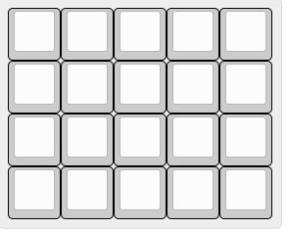
Custom keyboard
After discussing with the client, they have requested for a 4*5 matrix size
Keyboard PCB to be designed from scratch, allowing inexpensive, fully custom keyboard
Custom open source firmware allows for integration with VIA, allowing on demand remapping
Low cost and affordable, target cost is sub $30
Design will be open source
Keyboard components will all be through hole, allowing for DIY
Notes:
AUSTIN
Austin specifics? Dont go to wacky, just some hot lil details. Maybe the BOM?

Slide 36
Future Prototypes
User Interface
Use Electron to build desktop application with JavaScript
Add notification feedback when input received from voice or keyboard
Ideally integrate GAVPI code (may research other voice APIs if necessary)
Add tool options when necessary
Color picker redesign
Brush selector
Ability to toggle voice command
Notes:
ELLIE
Electron is an awesome tool for building desktop applications with JavaScript. I have built a few small applications already to get acquainted with it, and I am confident that we will be able to use it for our project’s UI. The main challenge I see us facing at the moment is integrating the GAVPI voice command system. I will be doing some basic testing in the coming weeks to see whether this is possible or whether we will need to explore other options. There are plenty of other open source voice command tools and libraries, such as Google’s Voice API, that we can try if it becomes necessary

Slide 37
Future Prototypes
Voice command
GAVPI working prototype
Can call upon variety of keyboard shortcuts
Toggle option to begin or stop listening
Seamless integration with Photoshop and UI
Minimise amount of setup and configuration needed by user
Create a detailed instruction manual that contains
An overview of the technicalities of the voice command system
A list form of all possible commands
A detailed instruction manual if the client wants to add their own commands
Notes:
CALLUM
If there is time, Callum Share screen and give a working demonstration of GAVPI

