Slide 1
GNG 1103 C -13
Omar Mortaja ♻ Tahmeed Khan ♻ Noah Jewett ♻ Panagiota Sarsaroudi

Slide 2
31,526,124
Tonnes of waste
Canadians produce more garbage per capita than any other country on earth

Slide 3
31,526,124 TONS
9,457,837 TONS
30%
Of waste across Canada
Is how much is recycled
Is only recycled

Slide 4
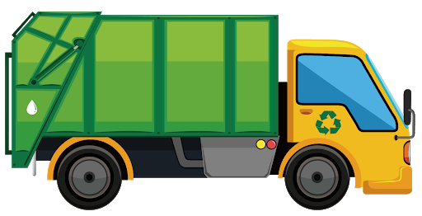
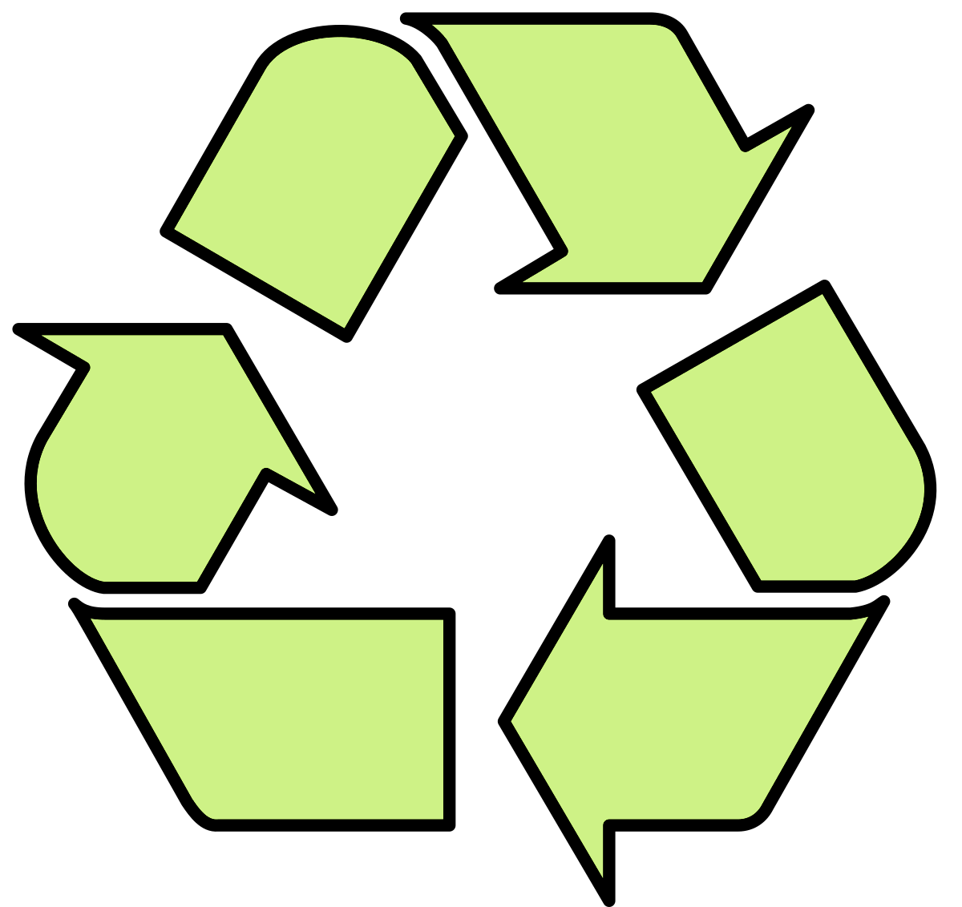
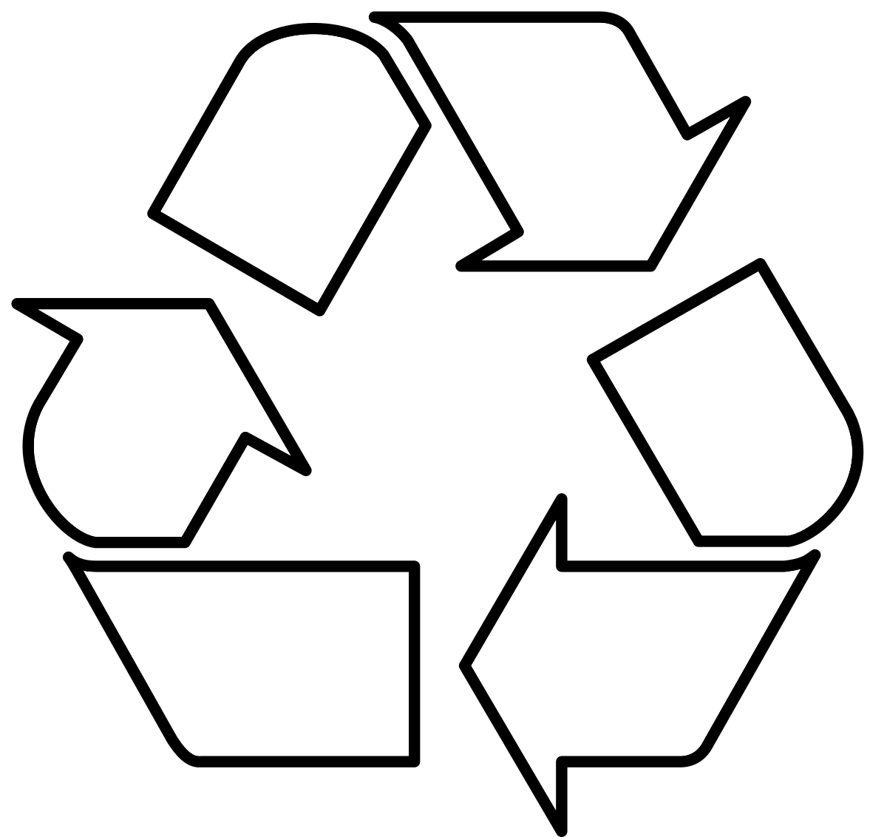
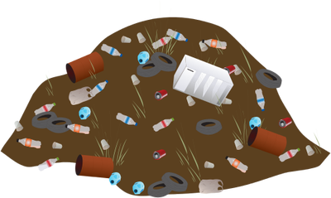
WE ARE HERE
Bin Sorting/Collection
Consumption
Landfill
Processing
Manufacturing

Slide 5
“Our client, Mitch Bouchard, seeks a user-friendly and widely-accessible product that helps people recycle more conveniently and reliably. The product should reliably identify recyclable items and inform the user of the proper measures needed to dispose of them”

Slide 6
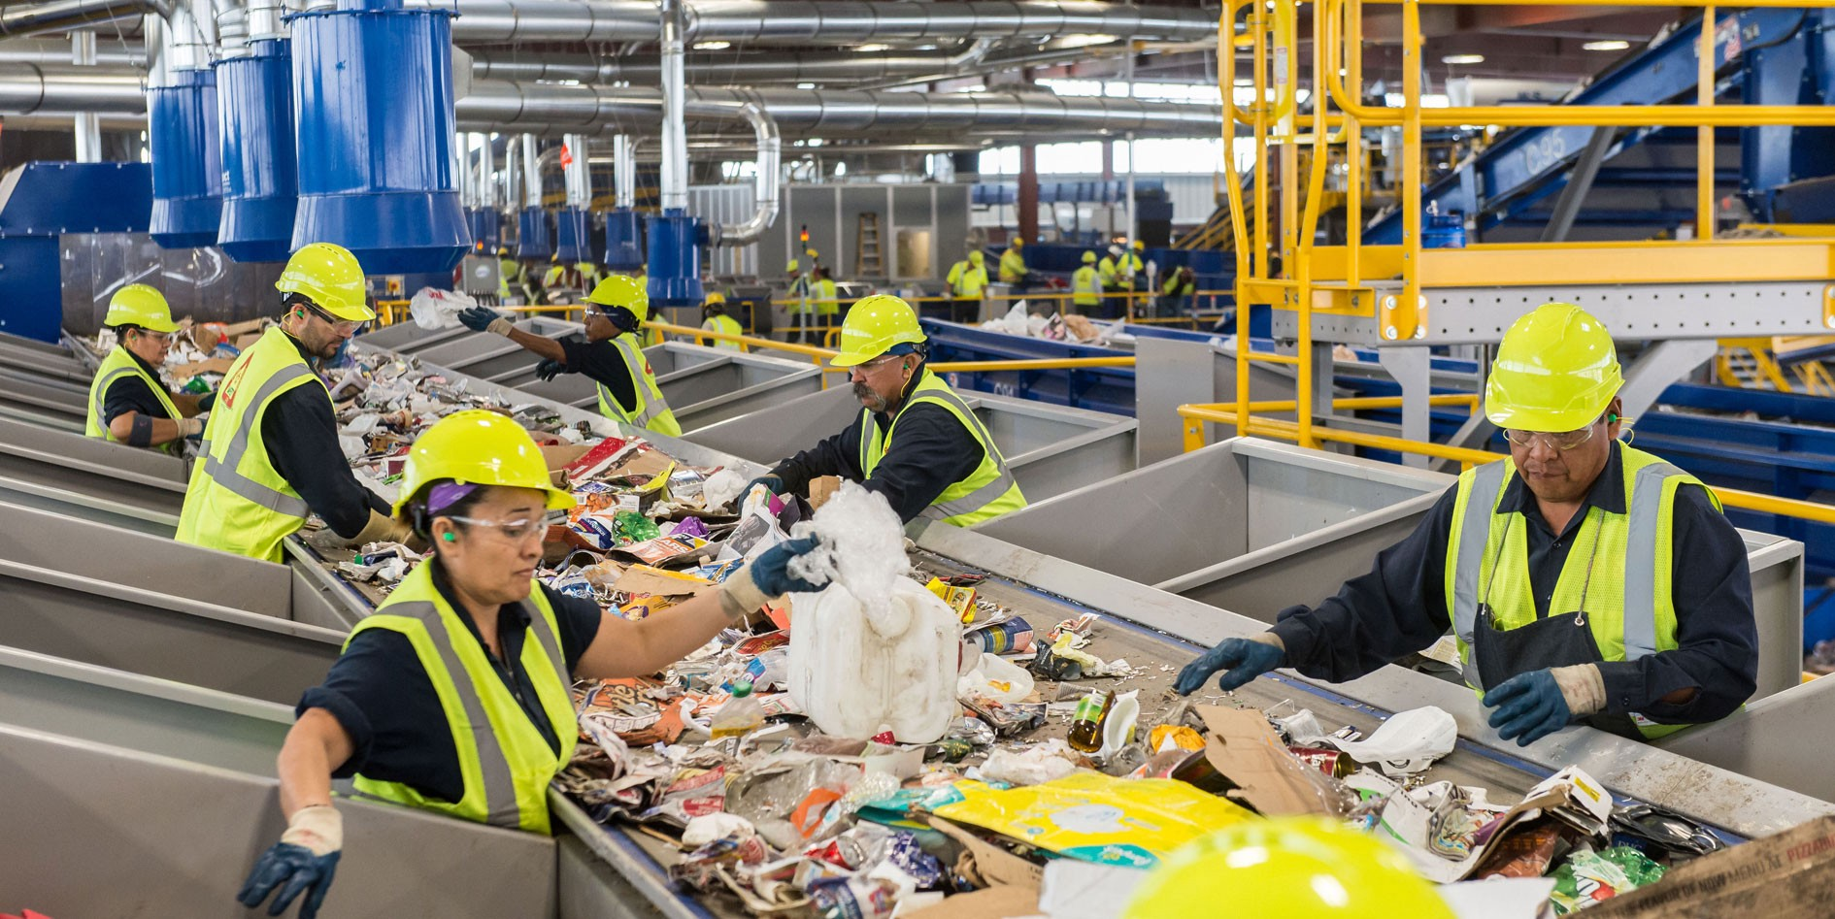
The Importance of Recycling
Goal Improve Citizen Recycling
Recycling Can
Reduce Landfill Size
Reduce Greenhouse Gas Emissions
Create Jobs

Slide 7
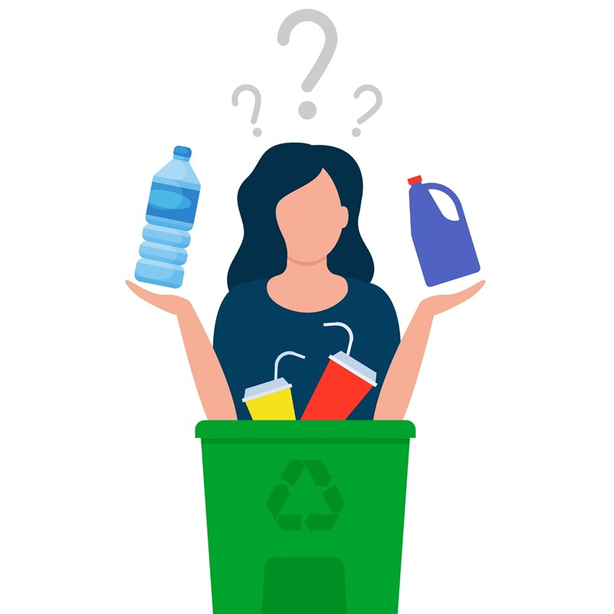
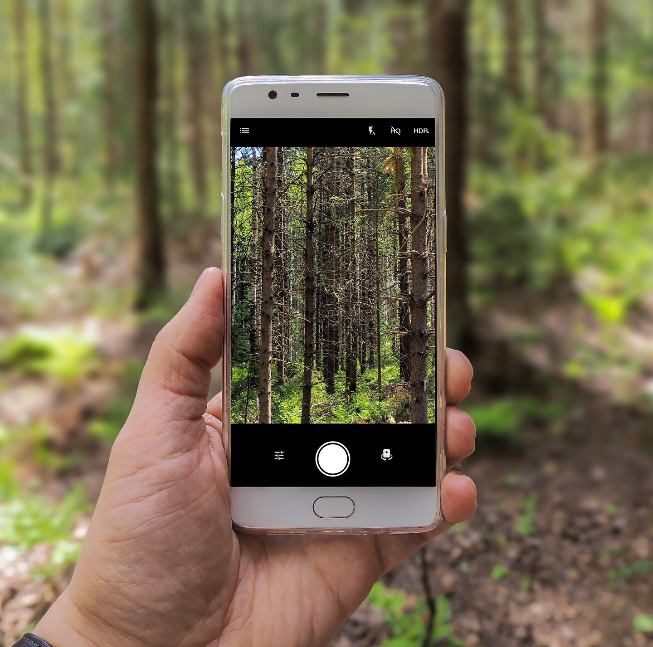
Target Audience & Requirements
Audience
Mobile Device Users
People Confused About Recycling
Hardware Requirements
Mobile Device with Functioning Camera
IOS 11.0+ & Android 7.0+

Slide 8
WHY BINZ?

Slide 9
The Rivals
Junker
Barcode Scanning Feature
Manual Item Search
~50% Scanning Accuracy
Only works in Italy
Eugene
Costly (€ 79)
Barcode Scanning feature (could not test accuracy)
TOwaste Toronto
No scanning feature
Recycling Database and Manual Item Search
Shows locations of where items could be recycled

Slide 10
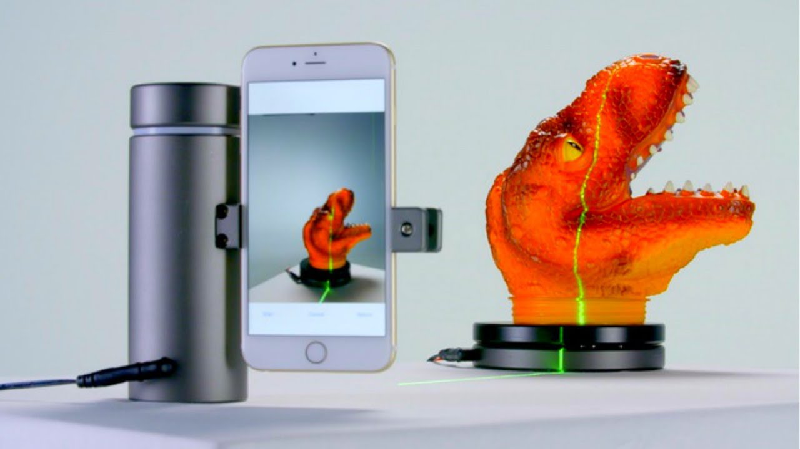
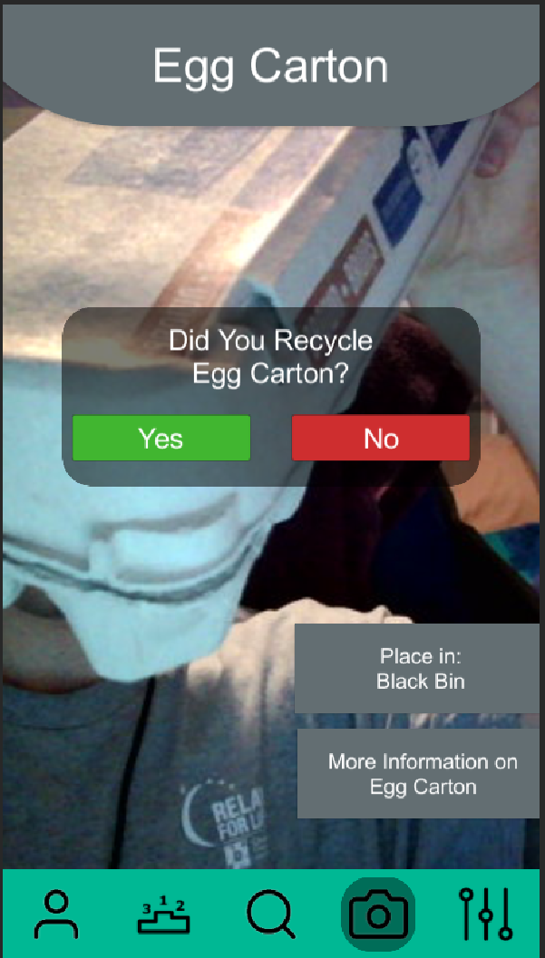
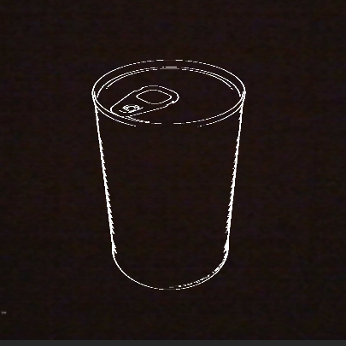
The Most Advanced Scanner

Slide 12
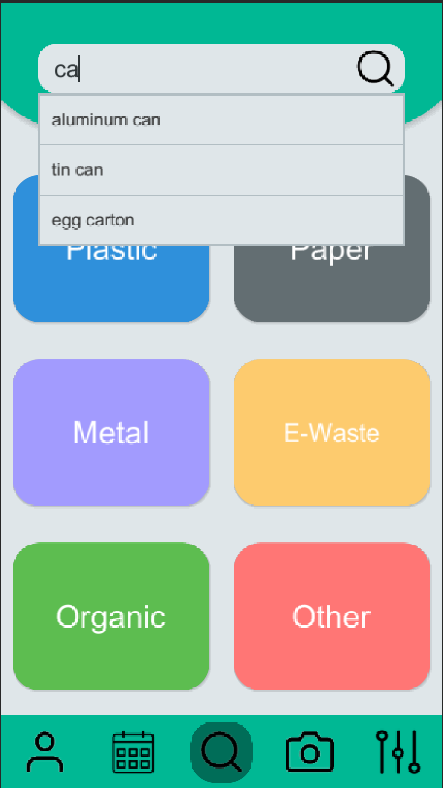
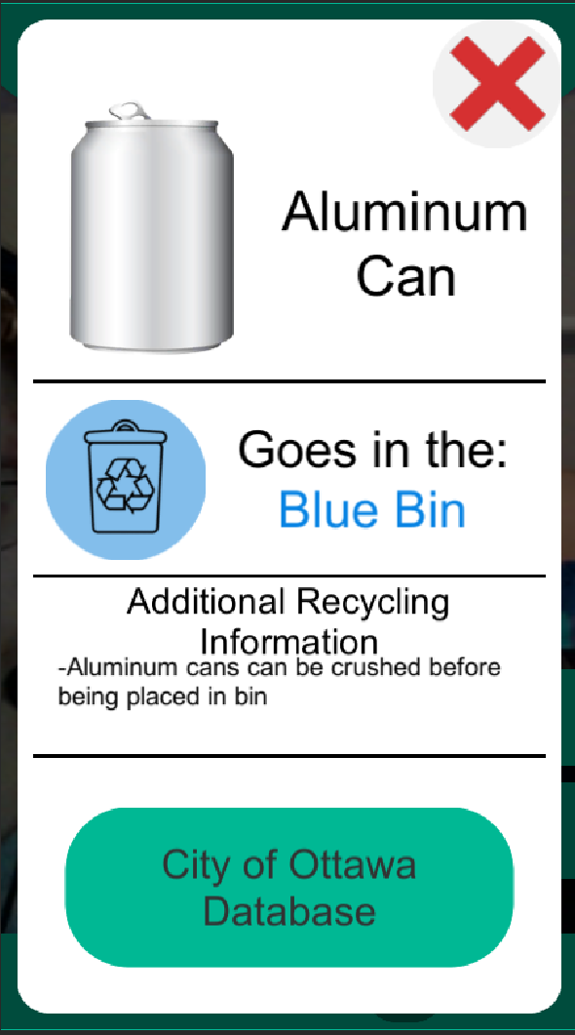
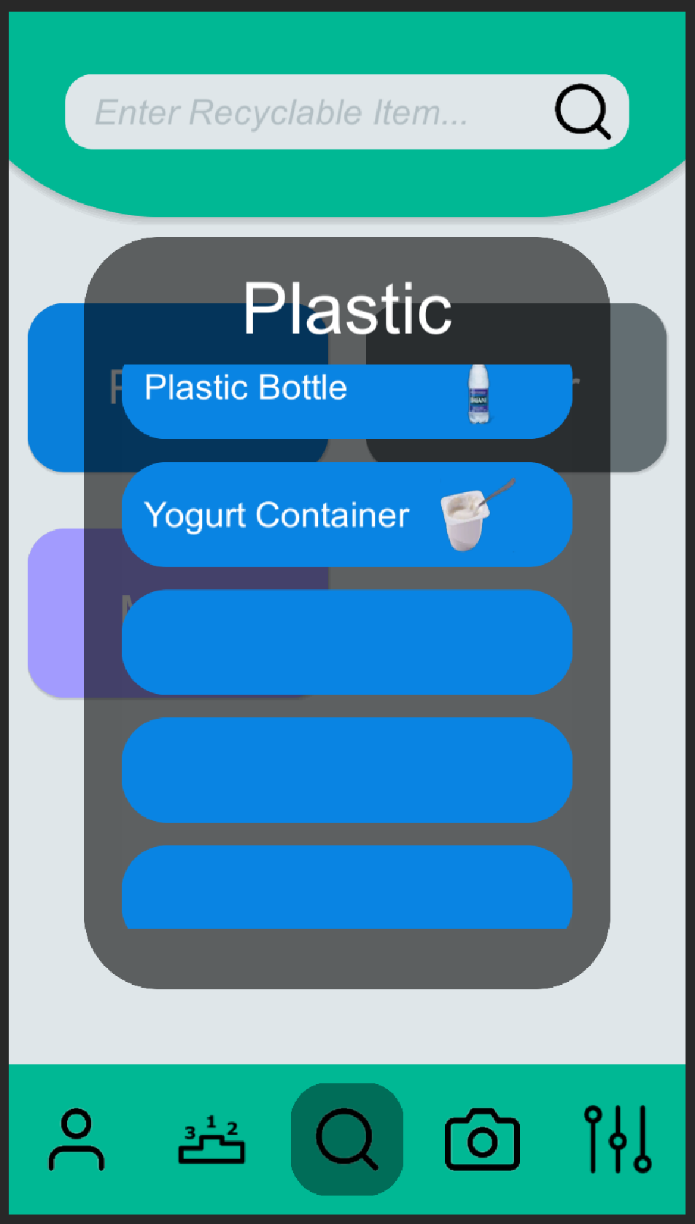
The Brains of The App

Slide 13
City Of Ottawa DataBase

Slide 14
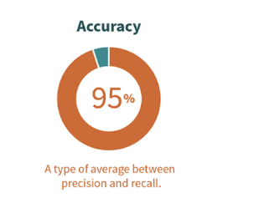
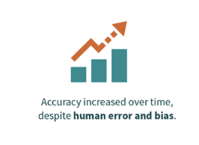
Search Page Accuracy

Slide 15
Demo

Slide 16
Thank You
Any Further Questions?

Slide 17
Thank You
Any Further Questions?

Slide 18
User Feedback
Prototype 1 - Ebin (TA):
“I like the scanning area, but it is a bit useless if it stays in one location. Once the scanner identifies an object, you could have the user click a button that says ‘scan this item’”.
Prototype 2 - Juan (Unity Developer):
“The footer for the app seems a little large”.
“Familiarize yourself with anchoring features to appropriately scale UI elements, especially on mobile platforms.”
Prototype 3 - Juilo (Neighbour)
“Really impressed, never though an app could do something like that”.

Slide 19
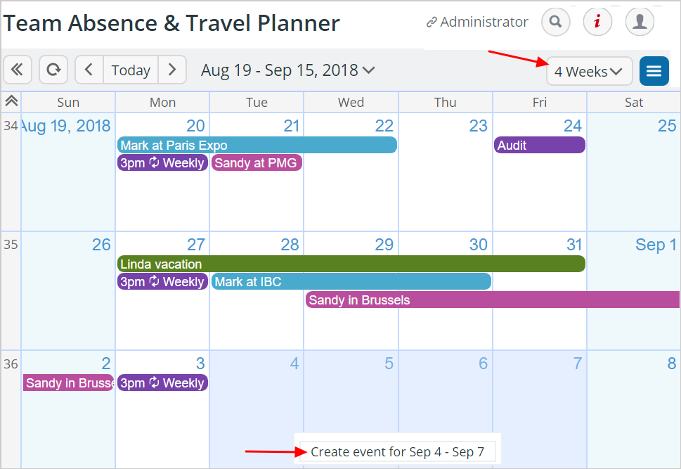
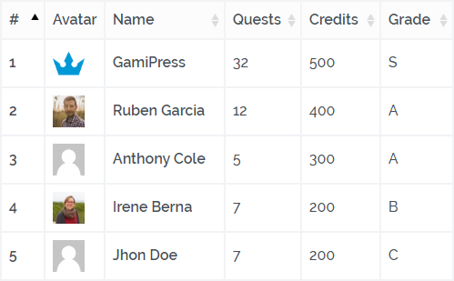
Future Developments
Leaderboard + Achievements
Calendar
More databases for different locations
Accessibility Features

