Slide 1
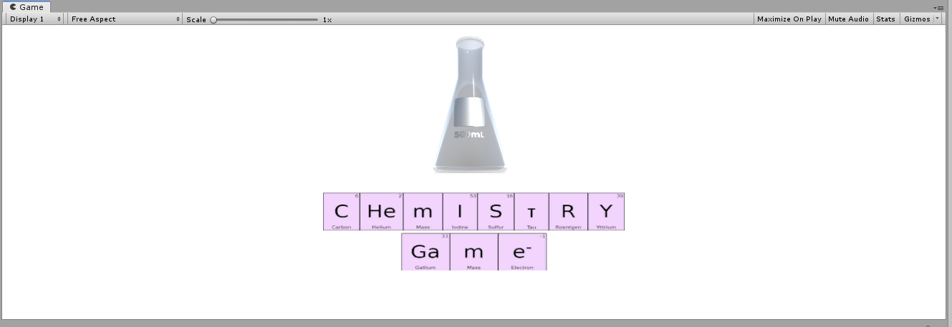
Deliverable J- Group F08

Slide 2
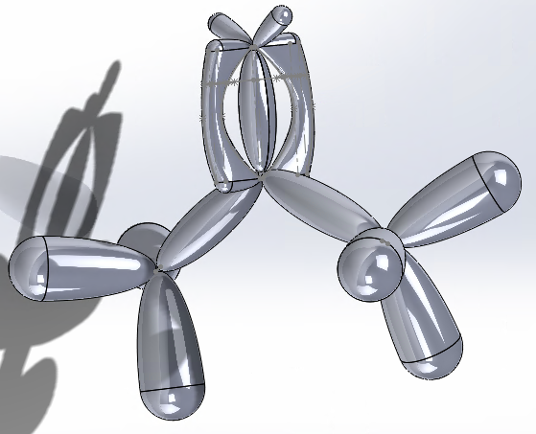
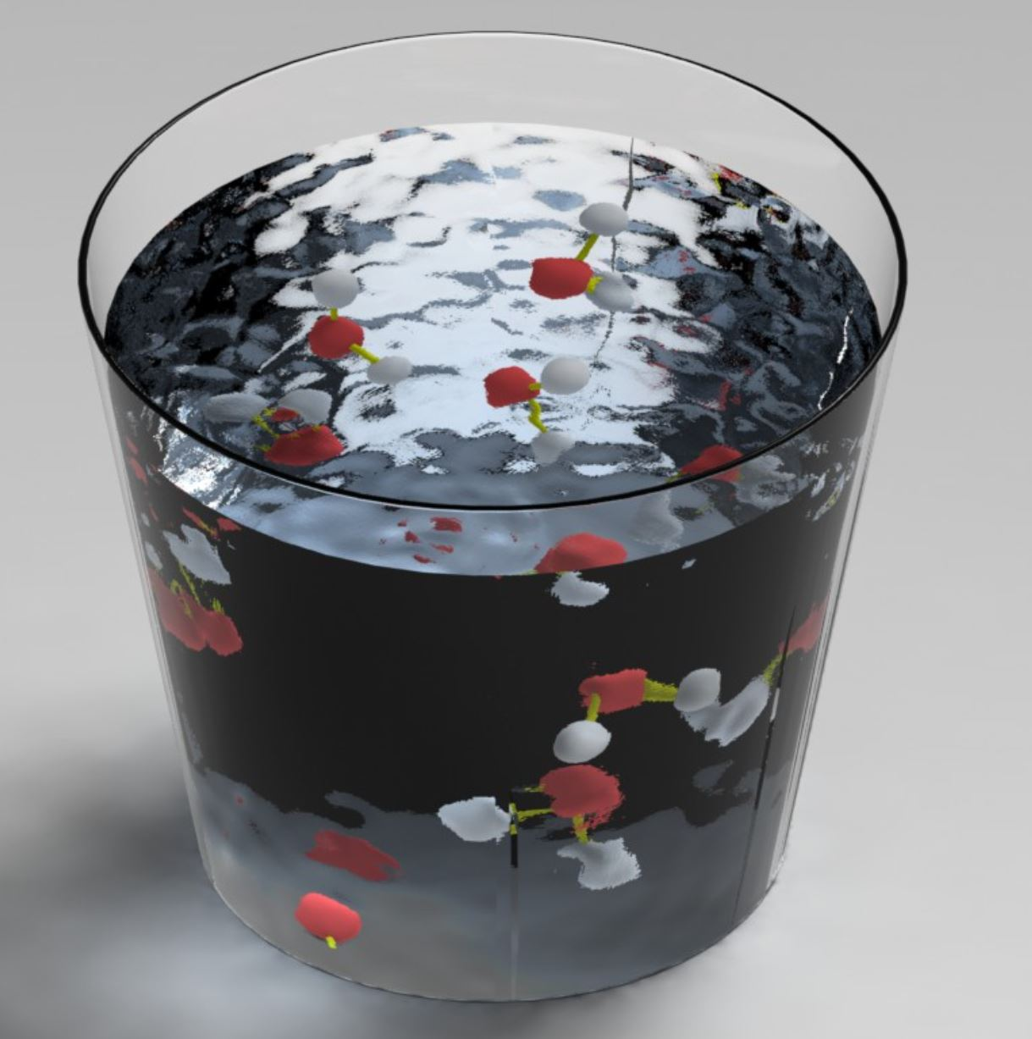
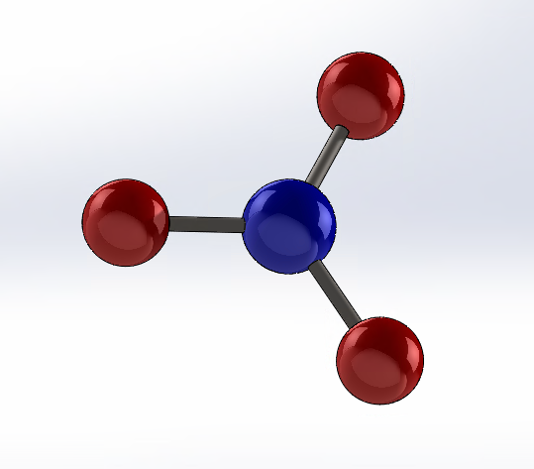
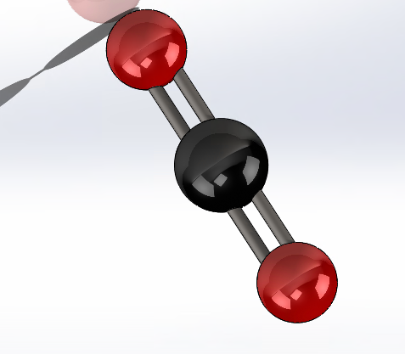
Problem Definition
Create an interactive, innovative, user-friendly, and cost effective VR learning experience that helps students currently enrolled in Organic Chemistry visually understand molecules in 3D.

Slide 3
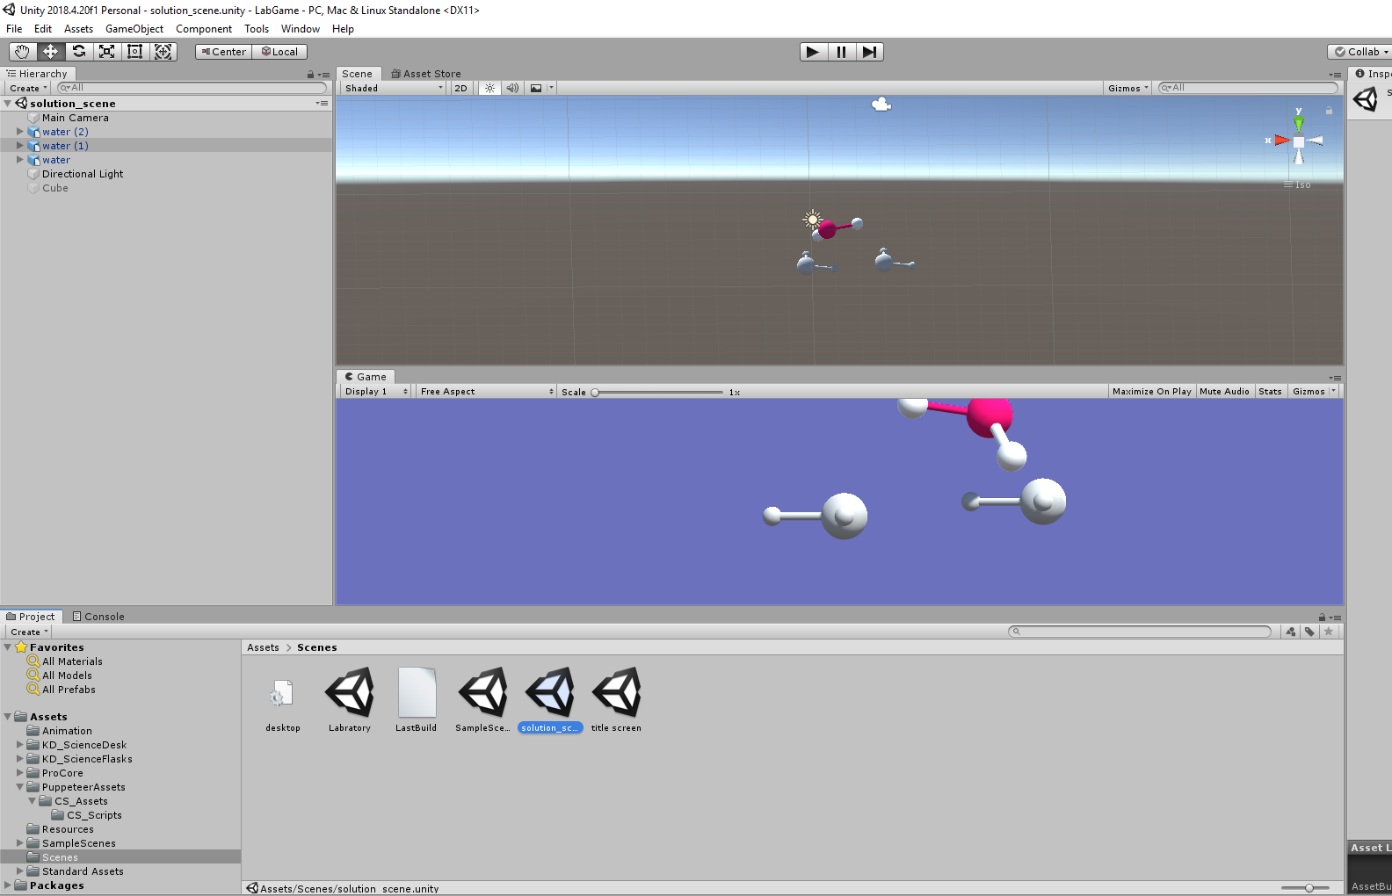
Agenda
The Design Approach
What the product is and how it’s used
Difficulties and challenges faced
Lessons Learned

Slide 4
Design Approach
Design began with extensive notes from client meetings
First element to be completed was the molecular models because visualisation of molecules was deeming the most important part
Subsequently the game environment was constructed along with primary mechanics
Trivia game to assess learning was incorporated
Movement was to be last element but had to be left incomplete

Slide 5
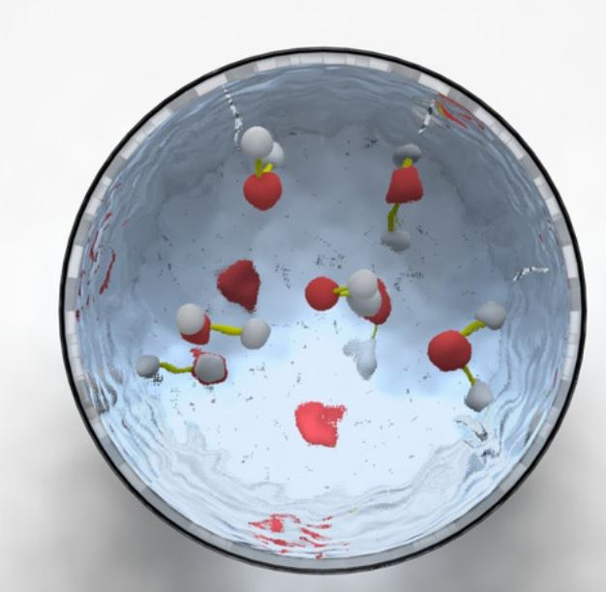
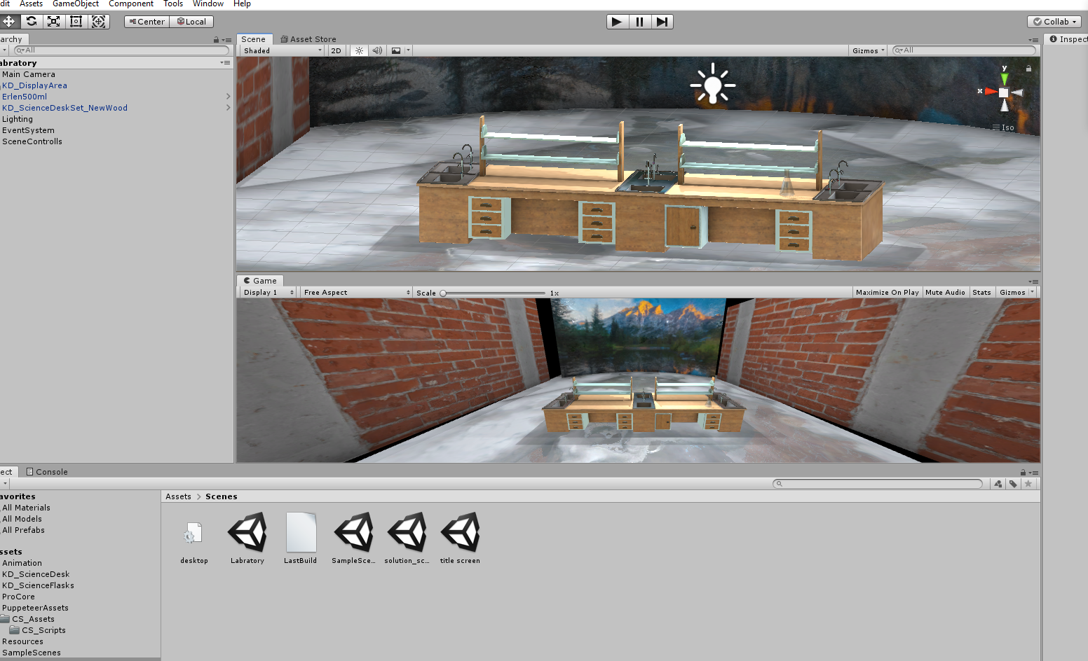
Environment
Main Scene
Styled after a laboratory
Acts as a game ‘lobby’ to select options in immersive way.

Slide 6
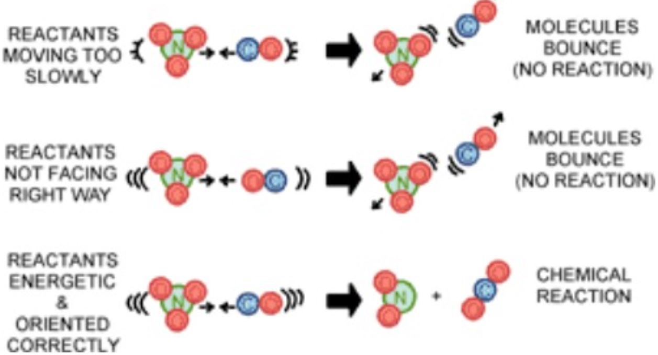
Molecular Collisions
Separate scene within solution
Allows user to experiment with various attitudes and velocities to create collisions.

Slide 7
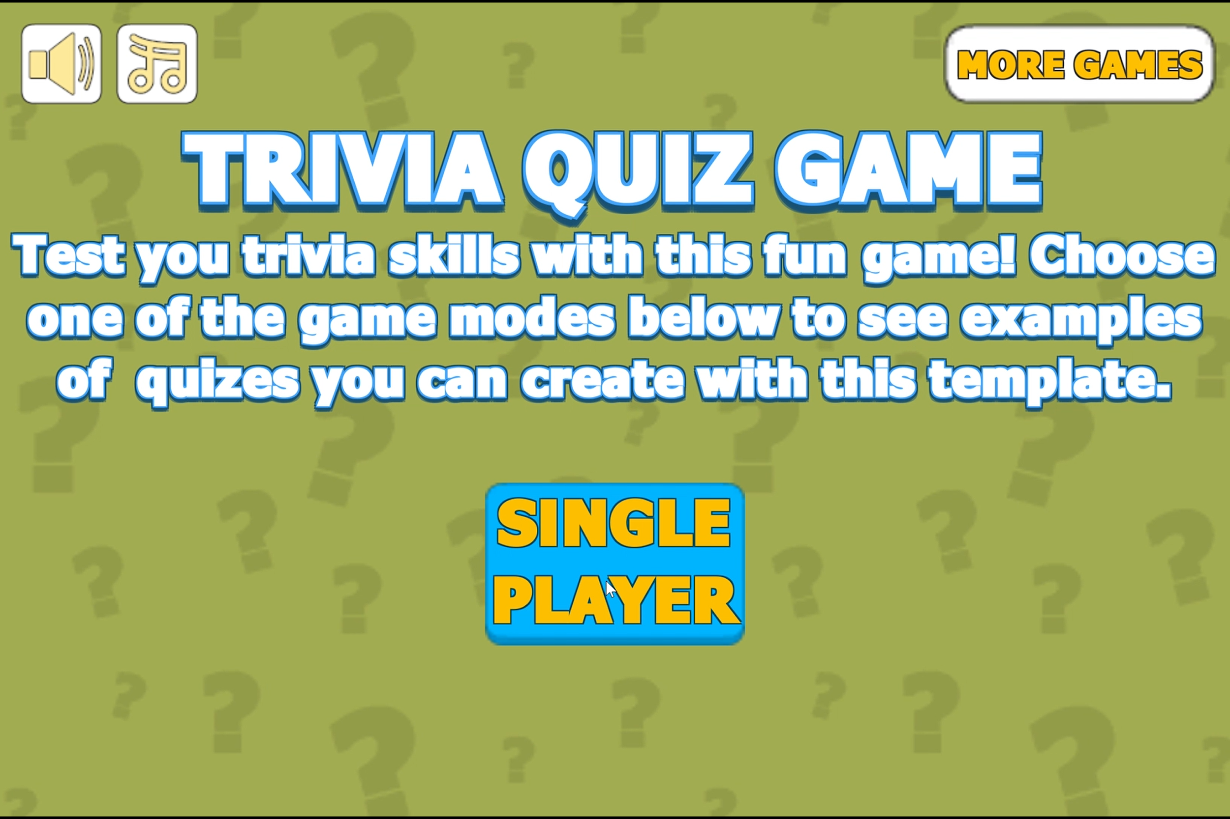
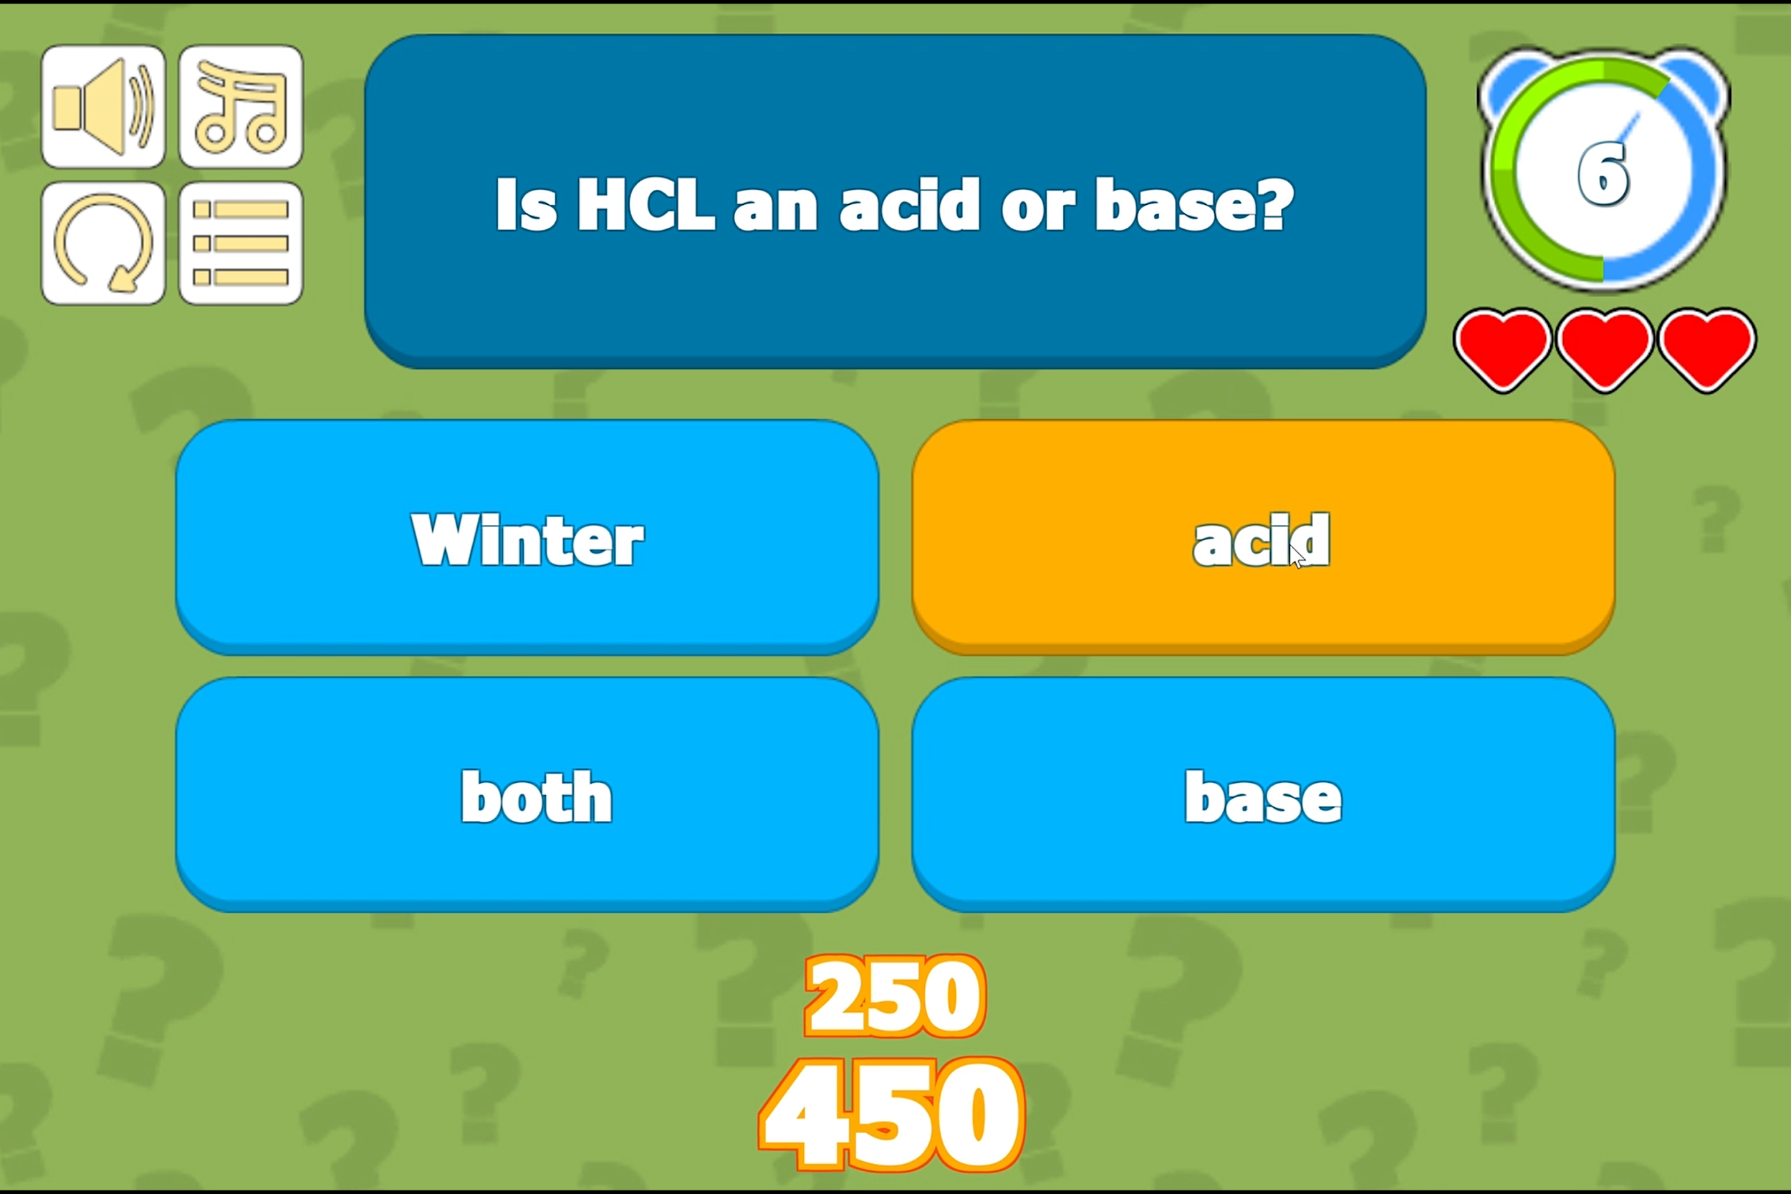
Trivia Game
Tests what users’ have learned based off stations in the game.

Slide 8
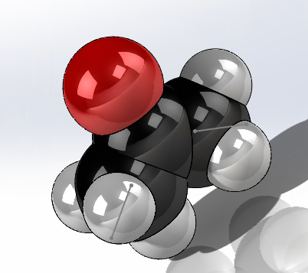
Difficulty of creating models
built-in modelling capabilities of unity found inadequate for many purposes, models created in solidworks
file conversion necessitated additional software (Blender)
some models proved to difficult or time-consuming to produce
a few models and scenes had to be purchased

Slide 9
Difficulty of depicting reactions
client desired realistic depiction of bond breaking/formation etc.
this proved far too complex, if not impossible, to program
reaction mechanism instead shown with 2-D animation played immediately after collision.
only products and reactants needed to be animated in 3-D.

Slide 10
Absence of testing as a challenge
primary testing of game was to begin soon when closure of facilities was announced
testing with headset could not be carried out
means not only is the viability of the software unknown but feedback from beta testing is not available
product is far less fine-tuned as a result

Slide 11
Challenges in player navigation
No access to VR equipment made it challenging to incorporate player navigation scripts
As a result the movement element of the game remains incomplete

Slide 12
Lessons on the Importance of Testing
Inability to properly test game elucidated the value of testing
trying to complete a project without this option proved extremely challenging

Slide 13
Tradeoffs Between Function and Complexity
Try to model reactions in 3-D showed the tradeoff between functionality and complexity
Creating an entirely realistic model proved to be infeasible so compromises had to be made

