Slide 1
Assistive Feeding
Team members:
Pthahnil Guo
Jichen Zhang

Slide 2
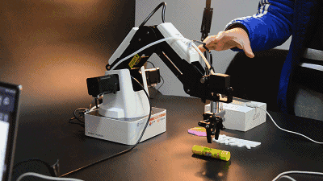
INTRODUCTION
Assist elder people
Robotic arm
Notes:
our project ‘s targeted audience are elder people who are incapable to look after and feed themselves, and our final goal is to design a robotic arm which is similar to this one, to help them to look after themselves individually and minimize the helps from others.

Slide 3
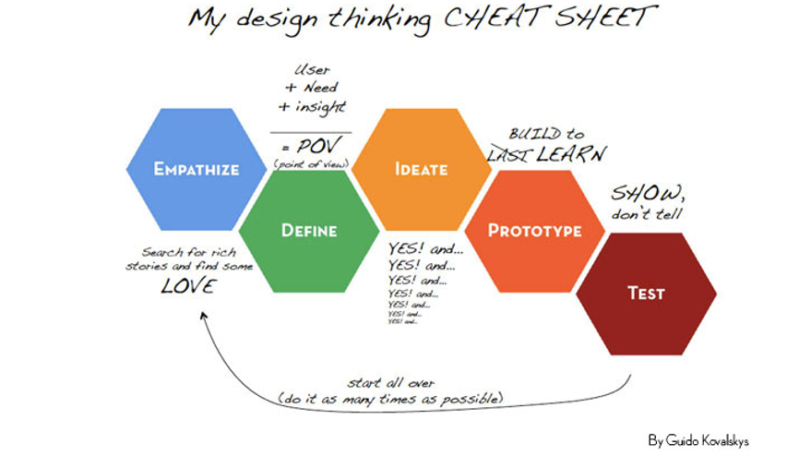
DESIGN PROCESS
Design thinking
EMPATHY
Ideation
Define
Prototype
Test
Iteration
Notes:
The design process that we choose to follow is design thinking, and the reason that we choose it is because out project needs to empathy with the clients to get their needs and feedbacks, every time when we create some news or want to eliminate some functions we need to discuses and prioritize with clients, and each modification we need generate new ideas and add to the prototype, and then iterate this process. So design thinking is one of the most suitable processes for us.

Slide 4
EMPATHY
Customer Needs：
Assist feeding
Strength
Position
Additional requirements
Notes:
After two clients meeting, we summarize clients’ need into four points.
First The fundamental and essential need for clients is to assist them to feed themselves,
and second one is the strength, our target clients cannot use their hands properly or the heaviest thing they can hold is nothing more than a book. It means that our product will be easily operate with less strength requirement.
Third, is the positions. most of the time of our clients either is either on the electric wheel chair or lying on the bed, so our product has to have the ability that can be fixed on certain places and is removeable to change to other places.
Finally, our clients also want our project to help them to do the daily things, such as push the elevator bottom, pick up something, or turning pages.

Slide 5
Define
Design an assistive feeding product with simple operations, less strength requirement, and fixed position to assist elder people who are incapable of looking after themselves.
Notes:
Here is our problem statement

Slide 6
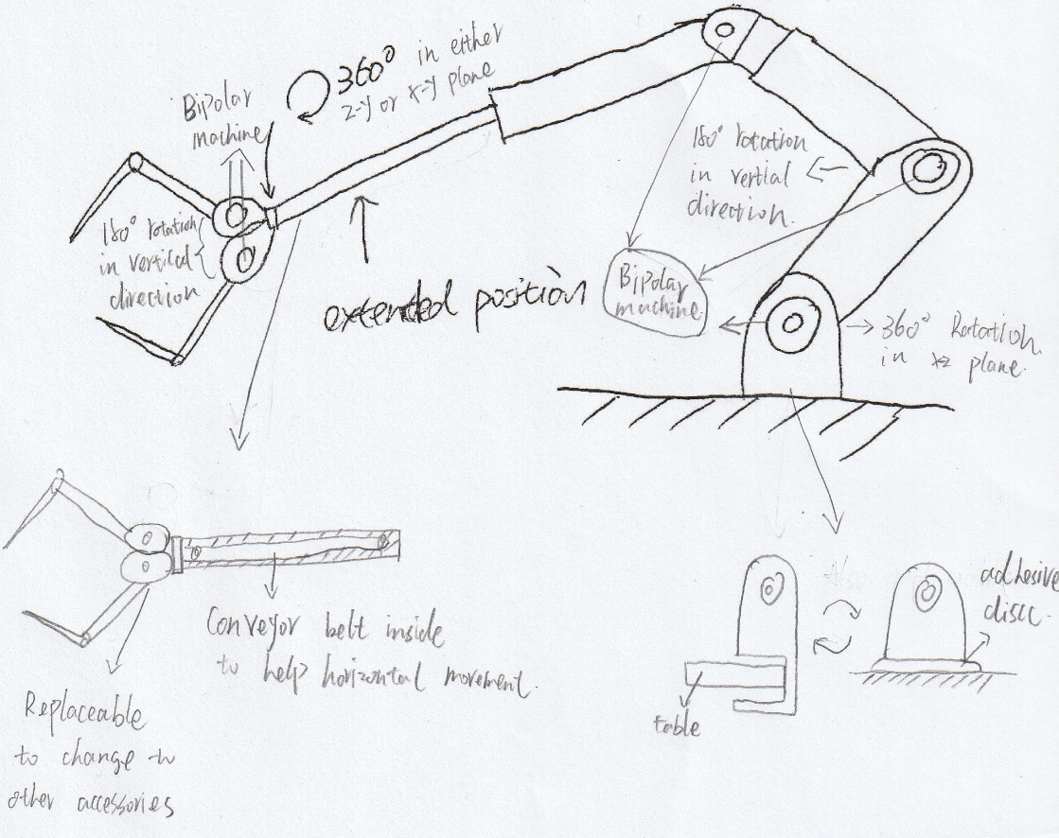
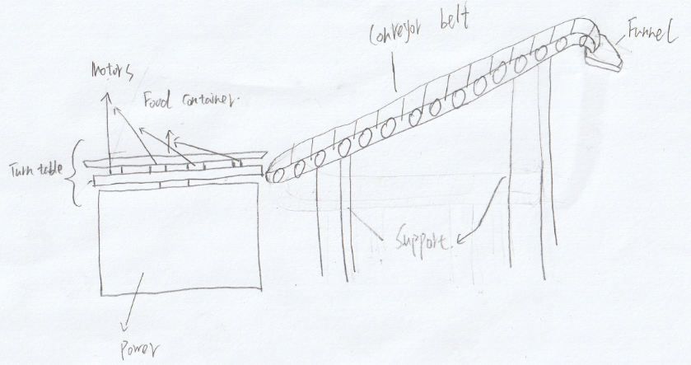
Ideation
Robotic arm
Turntable with conveyor belts
Notes:
Here is our groups’ two initial ideas of the solution.
Fist is to design a robotic arm which is fixed on the table, and this part is extendable, the main body is composed by alumni and joint together with the servo motors. The top part is a gripper used to hold a scoop or anything needed. It will work via the rotation of each servo motor at different angles.
Second one is the turntable with conveyor belts, here is the turntable, and the thing above it is a plate that dump the food into the conveyor belts and convey the food to the funnel which connect with client’s mouth. However, this design will fail some needs of the clients but is more effective on feeding them.

Slide 7
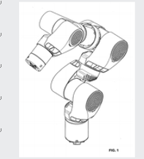
PROBLEM IDENTIFICATION
Robotic arm
Time
Imprecise & Smoothness
Programming
IP
Turntable with conveyor belt
Resources
Programming
Notes:
In order to make the decision, we list all the problems and constraints that we may counter.
For the robotic arm, the time definitely is the most important constraint that inhabit our design process. Because robotic arm involve many things and most of them are not easy to achieve.
Second, the action of the arm may be imprecise and not smooth, which will affect feeding.
Third one is the programming, to design a functional robotic arm defiantly involve a huge amount of coding, and most of our members are not familiar with it.
Last one is we need to consider many intellectual properties, because robotic arm is a hot topic and involve many techniques, such as this industrial design is pretty similar with our design.
For turntable, at that stage of process, we do think it may be easier to finish compare with the robotic arm, and we only list two which are resource and programming.
Thus, our group decide to start on the turntable.

Slide 8
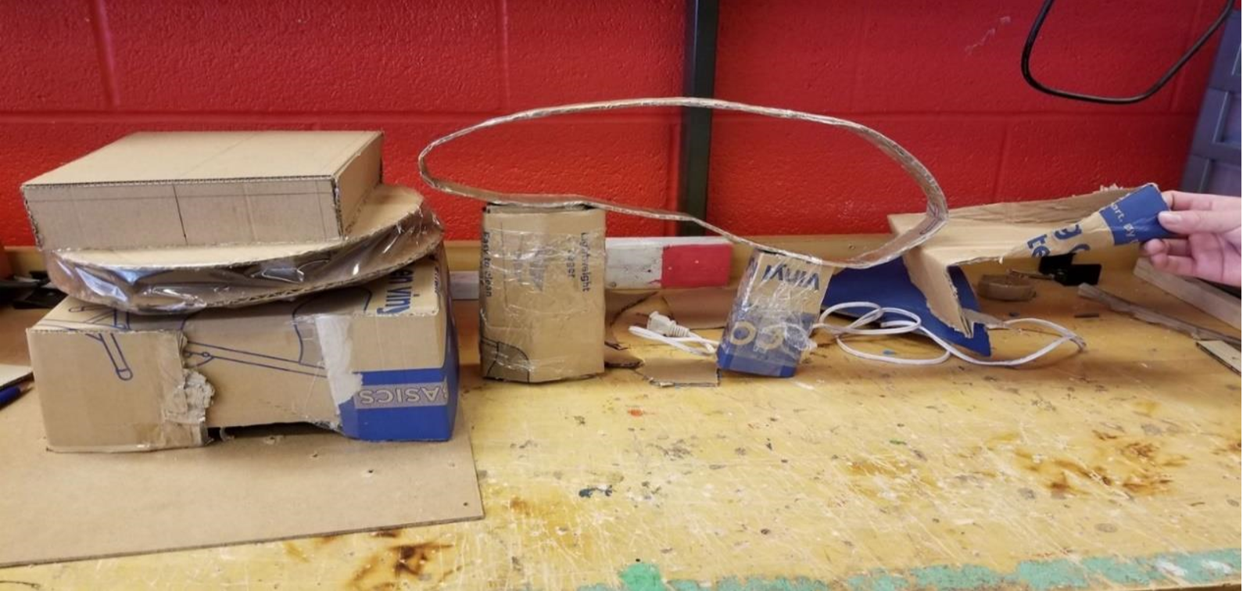
Initial Prototype
Inadequate resources
Health and safety
Benchmarking
Programming
Lost of Team members
Notes:
However, The ideal is always good, the reality is always cruel. This is our initial prototype for turntable, you can see the turntable the conveyor belt, and the funnel.
But when we want to move to the next prototype, we find there isn’t appropriate materials for conveyor belt, and if we want to make it by ourselves we need to take the consideration of health and safety compliance which are extremely sophisticated. Also there isn’t much things we can refer to, and the codes for rotating conveyor belt are much more complex than we think.
And also at this point, three teammates of our groups had dropped the course.
So, me and jichen decide to use online customer design to get the components of the robotic arm and assemble it by ourselves.

Slide 9
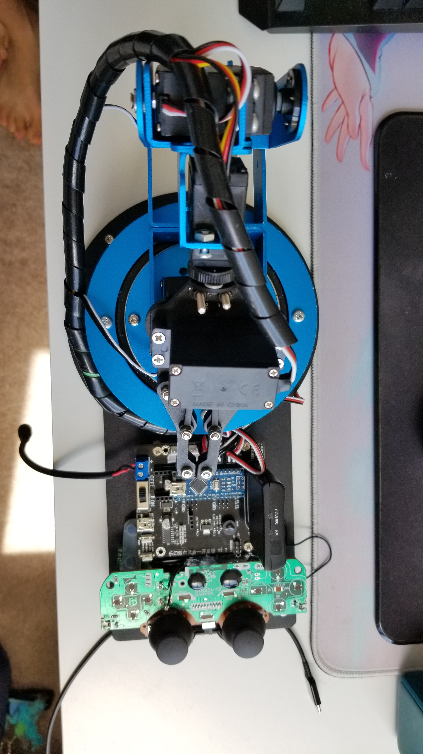
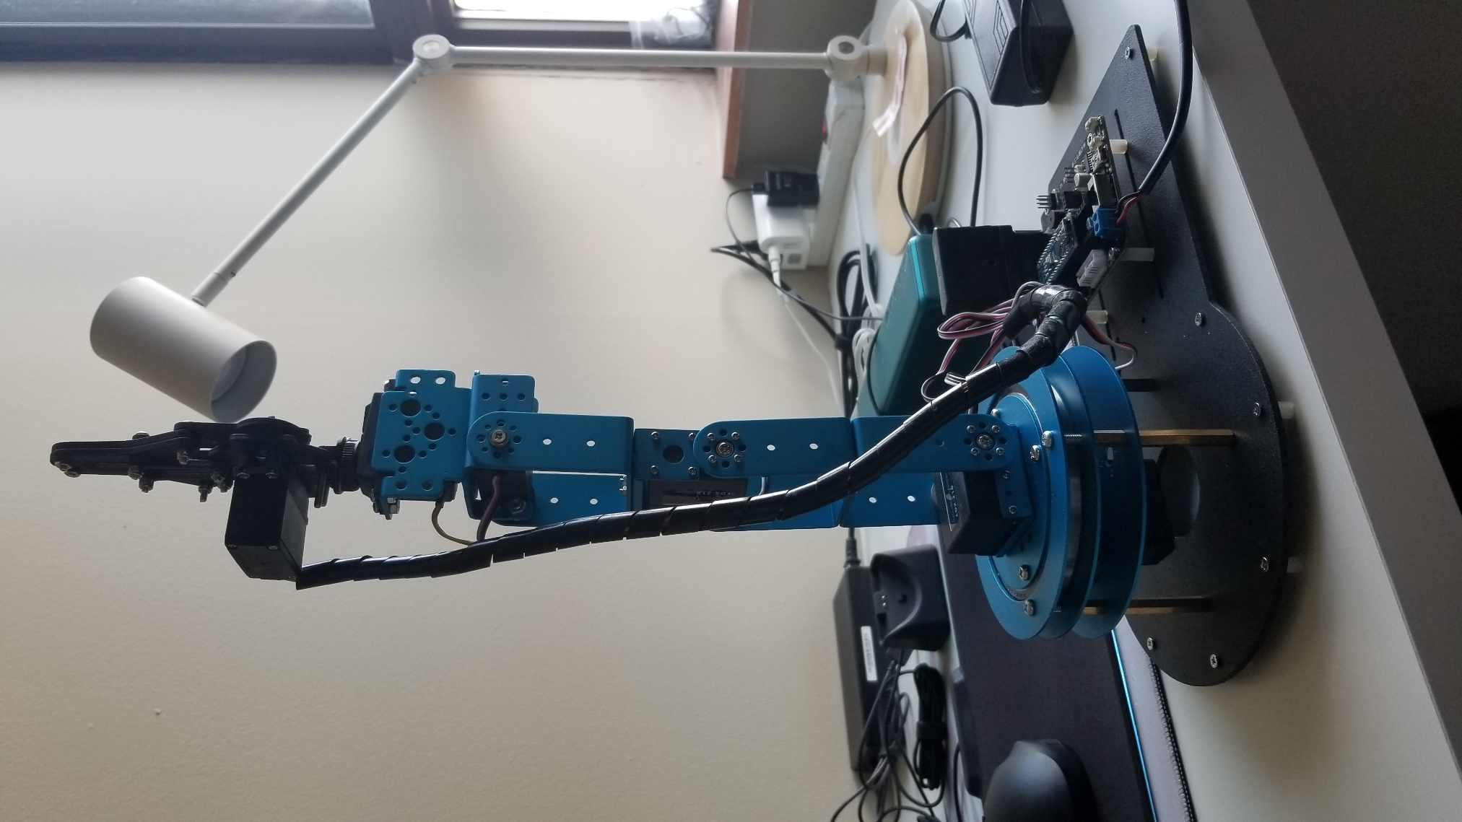
Final Prototype
Main body
Arduino
Bluetooth
Handle
1
2
3
4
5
6
Notes:
And here is our final prototype, and before it, we do have counter many problems such as assemble issues, and changing motors. But due to the time reason I will skip that.
Here is the top view of the robotic arm. This is the main body, arduino, Bluetooth, and the handle.
The main body of robotic arm will take actions by the rotations of servo motors from ID 2-5 in certain degrees. The ID 6 motor will cause main body to rotate in y-axis in the range of 180 degree. The ID 1 motor will control the gripper to hold or release staff. The basic plan to achieve assistive feeding is letting plier to hold a scoop and program a list of actions that enable the arm to finish scope and deliver foods in certain fixed areas and the action will stimulated by pressing the button on the handle via Bluetooth.
Which will working like this.

Slide 10
Test-Trials and tribulations
Defuncting of one motor
Debugging
Coding error
Mechanical failure
Arduino Board
Notes:
1. the biggest problem we have is that we have a servo motor in the robot arm keeps rotating
2. In order to solve the problem we reached out to our project manger , here are the possible causes:
- The first thing we could think of is coding error ( in order to find out if this is caused by the coding error, we and PMS checked coding but everything seems fine)
- The second possibility is the mechanical failure of the motor, (in order to confirm if there’s mechanical problem, we exchange this motor with different motors)
- The third thing could be something happened to the mother board ( to test this, we connected this motor to the other outputs on the motor board, and it works perfectly. So we came to conclusion there is nothing wrong with the board)
So far the problem is still unsolved but this doesn’t affect much about the entire project because we don’t need the utensil to turn from left to right

Slide 11
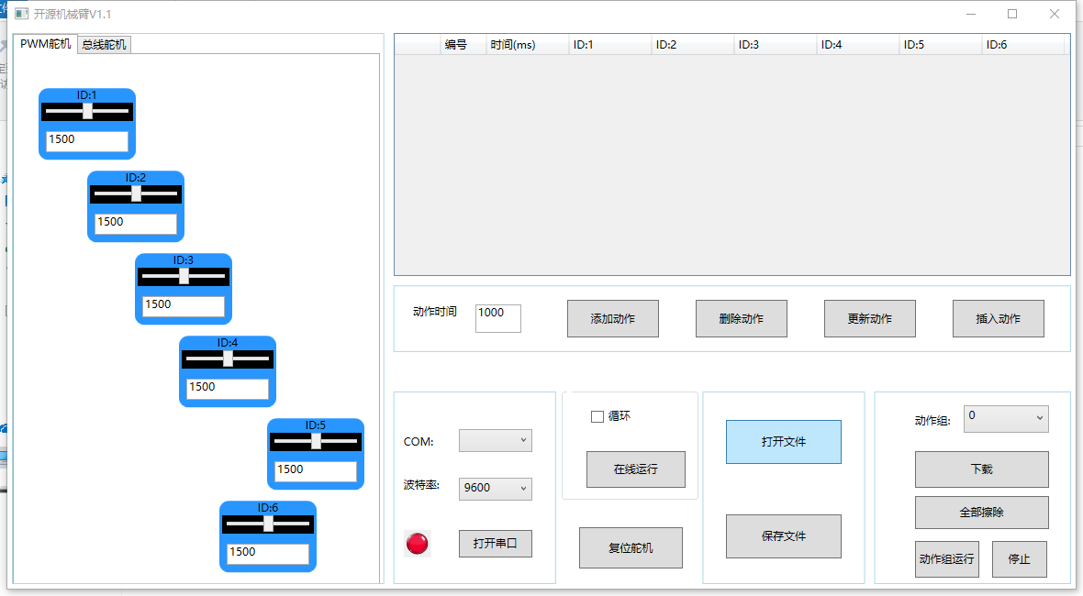
Trials and tribulations
Test-Trials and tribulations
The Rotating speed of motors
Notes:
The rotating speeding is a key part of this project because we don’t want the food to fall off the utensil.
Conventionally the speed is adjusted by the coding , the bad thing about is we don’t have much knowledge and experience in coding. So it can be challenging.
We introduce a software that we can adjust the speed by dragging the control bar, this makes our life much easier and save lots of times.

Slide 12
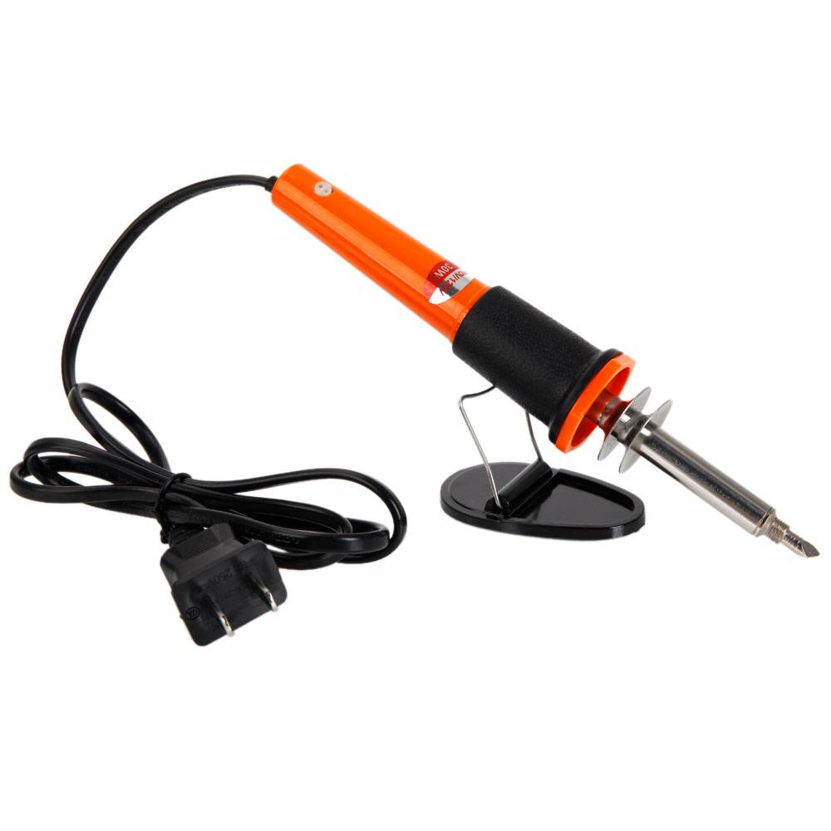
Lessons learned
Lesson Learned
The importance of communication.
How to Cooperate mechanical parts with electronic parts
Useful Skills:
Soldering
Programming
Deal with emergency
Notes:
1. First lesson is the importance of communication with other group members. Group meeting , online discussion group but three group members dropped out the course. So we have to sperate the work between two. As neither of us understands coding, it is very hard for us to work on this project.
For example how to control the movement of the robot arm with the controller. Again the key part is coding.

Slide 13
Future works
Future Works
Develop for all types of food-Scoop
Hide all the wire and circuit
Bluetooth connection
More Functionalities
Fixing the motor
Notes:
Right now the equipment is only suitable for big pieces solid food , make some change so that the equipment is good for liquids food as well

Slide 14
QUESTIONS?

Slide 15
THANKS FOR LISTENING

