Slide 1
Halifax Class Destroyer Robot
By: Akem, Ayham, Matthew, Shahrayar, & Wacira; Group C4

Slide 2
Problem Statement
Create a robot that can refurbish and paint areas of the Halifax class destroyer ship without increasing the cost of staff by using robotics. An inverse kinematics solver that is easy to use, light-weight, cost-effective, and portable with three degrees of freedom with an end effector which is able to hold a pen, water gun, camera holder with scan, and light.
Notes:
Wacira: After our first initial client meeting, our team decided to create this problem statement. Our goal is to (say problem statement). With all this in mind, we have designed this global concept.

Slide 3
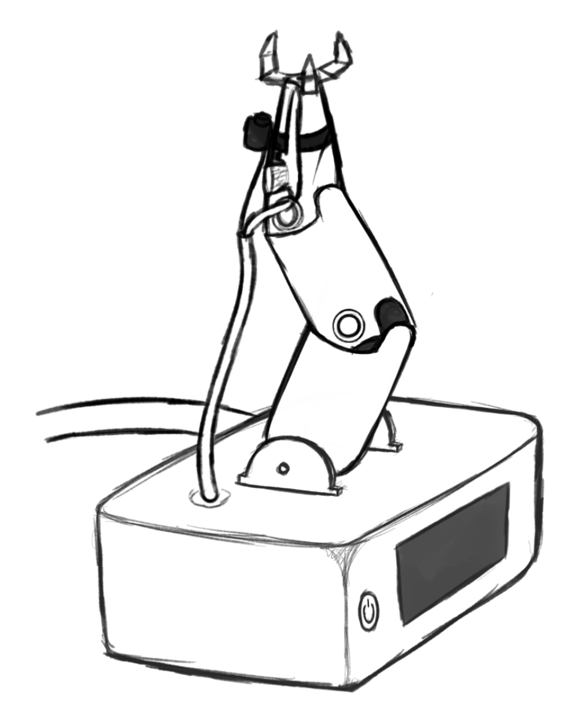
Global Concept
Notes:
Shahrayar: This is the global concept we have decided upon. The body is mainly composed of hard plastic that will be from 3D printing components, alongside other metals and gears required for the overall shape. Keep in mind, this is concept drawing so we shall make changes when necessary.

Slide 4
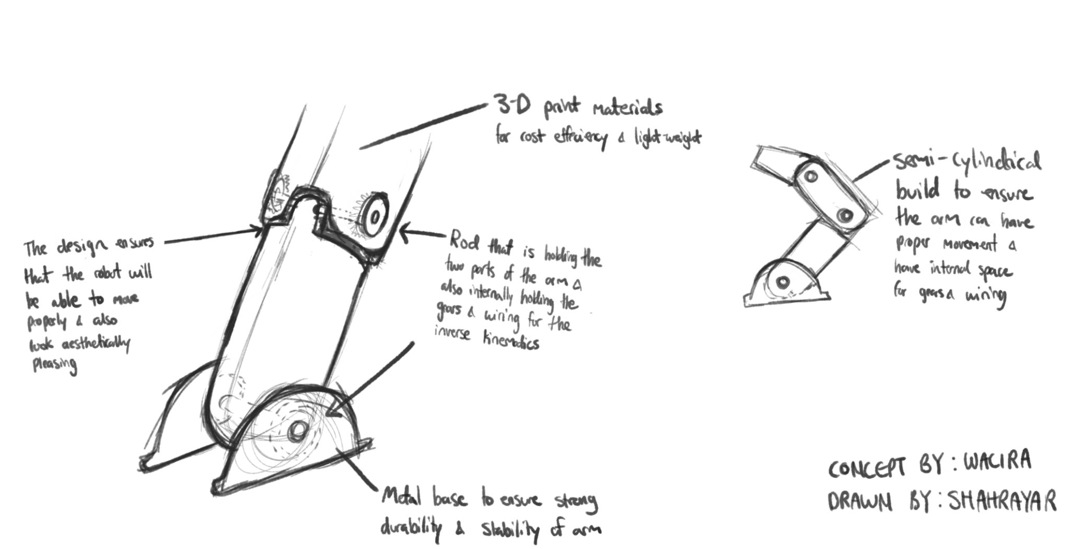
Sub system #1 Articulation
Arm consist of mostly 3D printed materials
Simple hinge joints
Firm metal base
Notes:
Wacira: The Articulation subsystem is focused on the arm of the robot, this includes the joints, base of the arm and the non-joint areas. The base of the arm is firmly planted on the base subsystem to make sure that the robotic arm wiring is unaffected by any movement. The joints are simple hinges allowing for smooth joint movement and is very easy to disassemble and reassemble. The simple design allows for maxim space for gears/wires and piping thus, reducing the chances of clamping at the joints. The arm itself has a hard outer shell protect the delicate interior, and the cylinder shape allows for more ease on the joints as well as more spacious interior for the internal hardware.

Slide 5
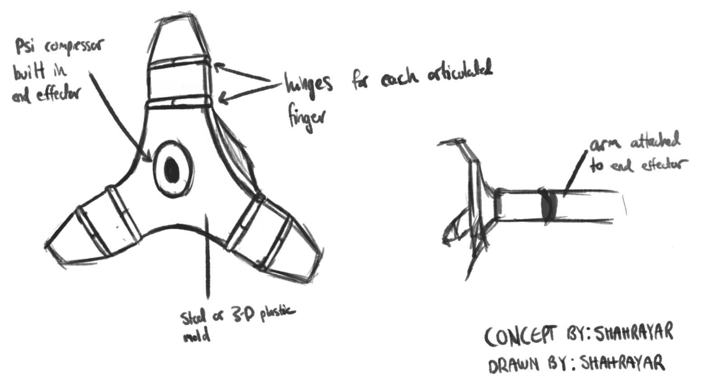
Subsystem #2 End Effector
Built in psi compressor
Unique shape for easy handling
Will be attached to arm
Notes:
Akem- The second subsystem we decided to tackle is the end effector. The end effector will have a unique design composed of either 3D plastic mold as labelled in the design or potentially a metal such as aluminum or steel. At the center of the claw, the psi compressor will be located so that when spraying the corroded area, it will be as precise as possible. We’re thinking of either having the end effector either directly connected to the arm or attached in some sort of way with the use of glue or other materials.

Slide 6
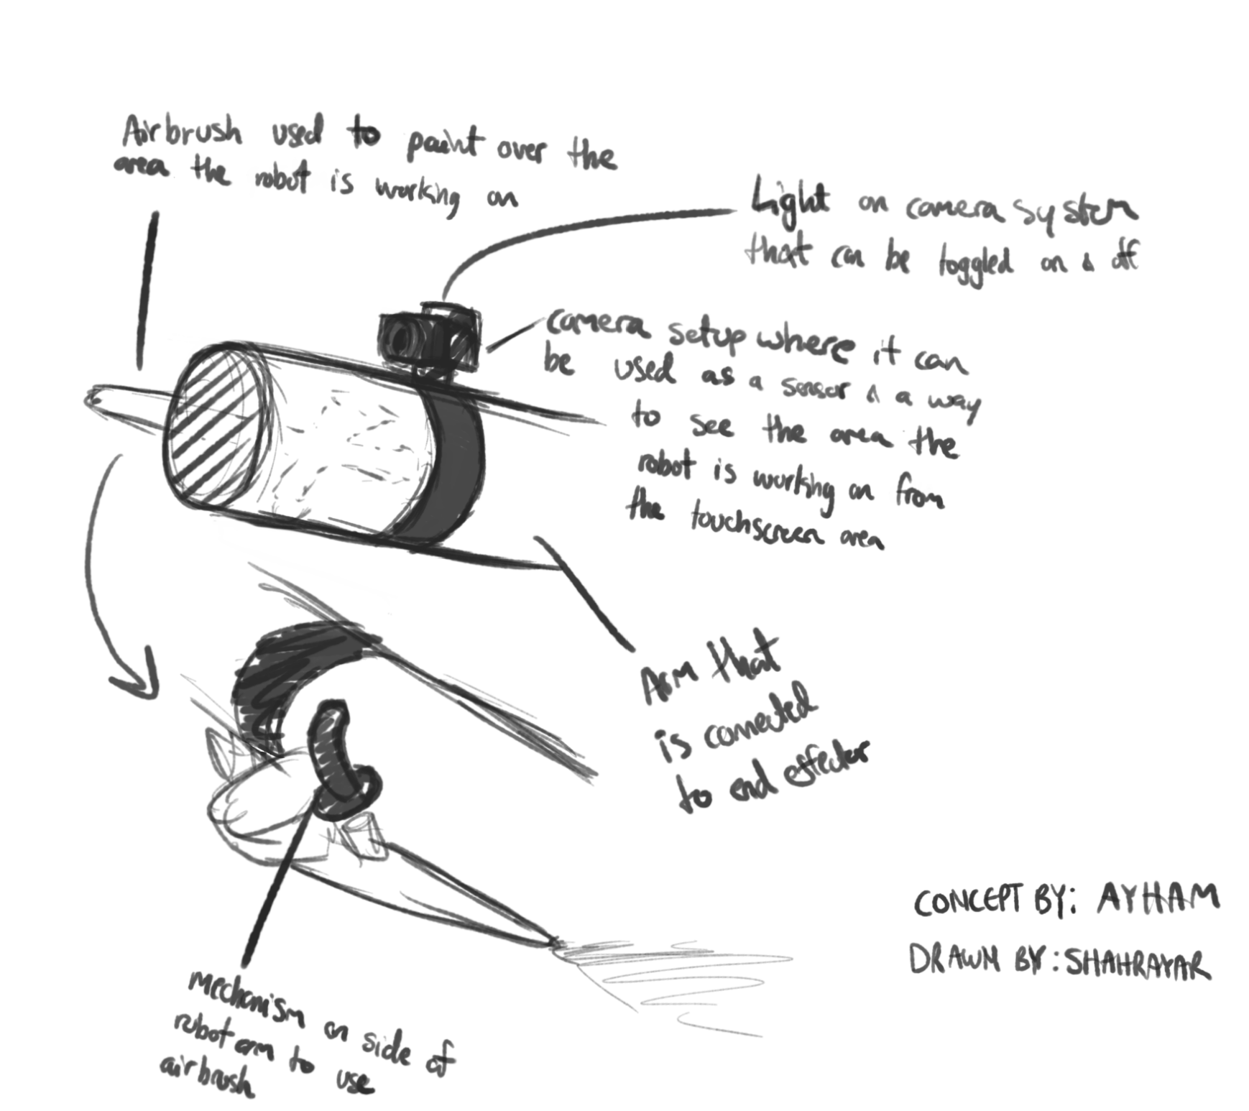
Subsystem #3 Accessories
Camera attached to top arm
Light on camera system
Airbrush attached to top arm
Mechanism to use Airbrush
Exterior wiring connected to base
Notes:
Matthew: The third subsystem is the Accessories. We decided to attach the camera on the top arm system with a strap of some sort to keep it tight and secure. Alongside the camera, we also included an airbrush tool to paint over an area on the side. In order to use the airbrush, you have to press a button in order to use it. To detour this problem, we created a mechanism that will push down the button on the airbrush to use it when the input is given by the user. Since there’s a lot of wiring, we made a large wire that connects to the base to keep the design clean by having all the wiring in one place.

Slide 7
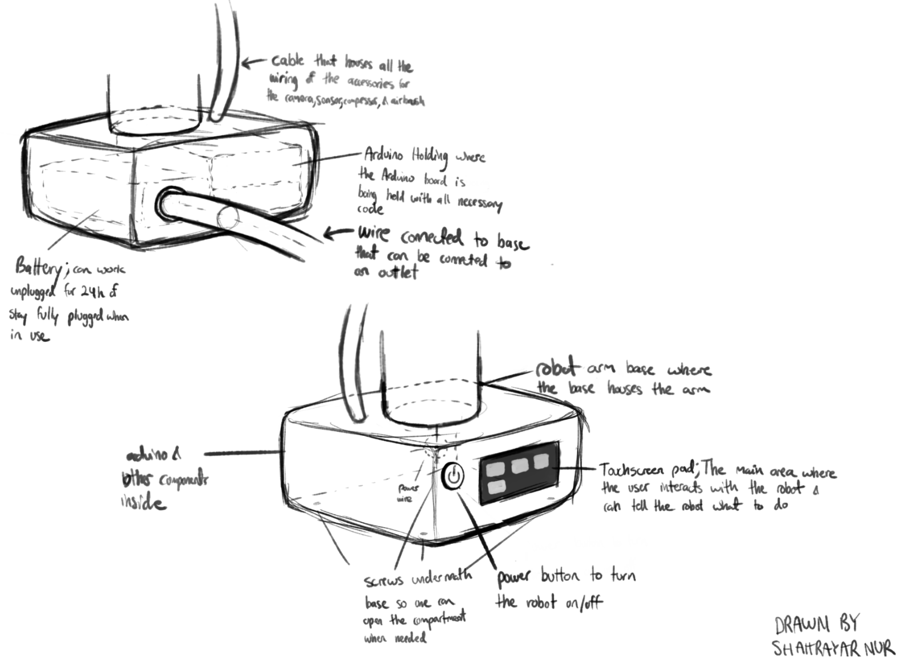
Subsystem #4 Base
Firm sturdy outer shell
Will house important components
Spacious interior for internal hardware/software
Touch screen display and toggle buttons
Notes:
Shahrayar: The base of the robot houses many important components that are essential for the robotic arm to work thus, a tough, sturdy outer shell is mandatory for the base. The rectangular shape of the base creates a firm foundation for the entire robot as well as a large interior for the internal components. The base also houses the control panel which is the touch screen display. The touch screen display allows for friendly user interaction featuring a few buttons that are easy to comprehend and use.

Slide 8
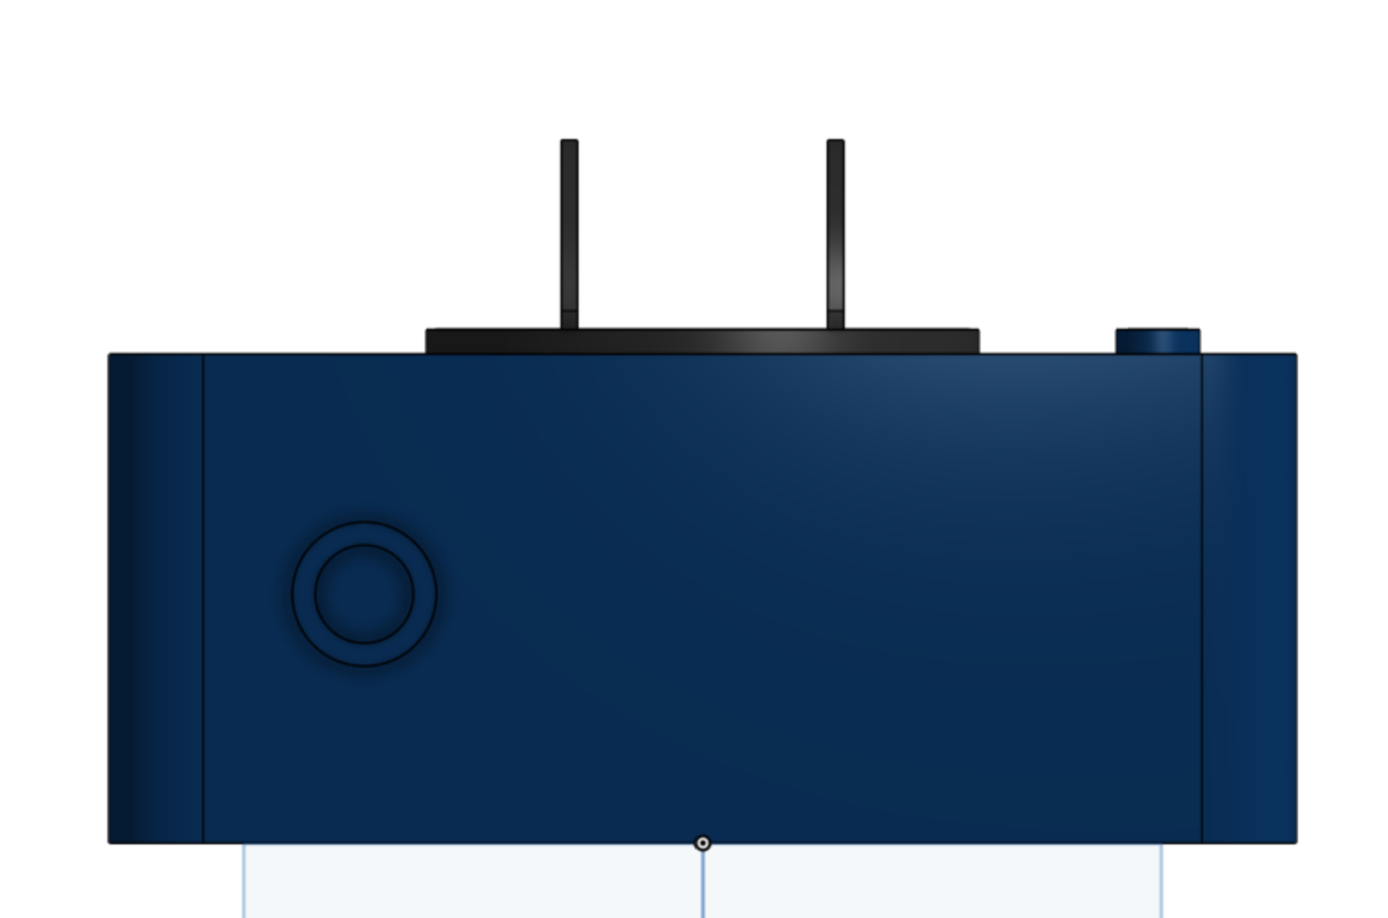
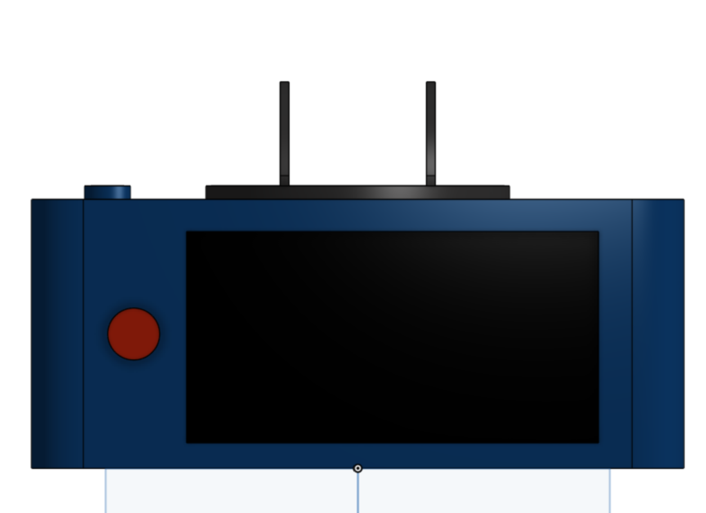
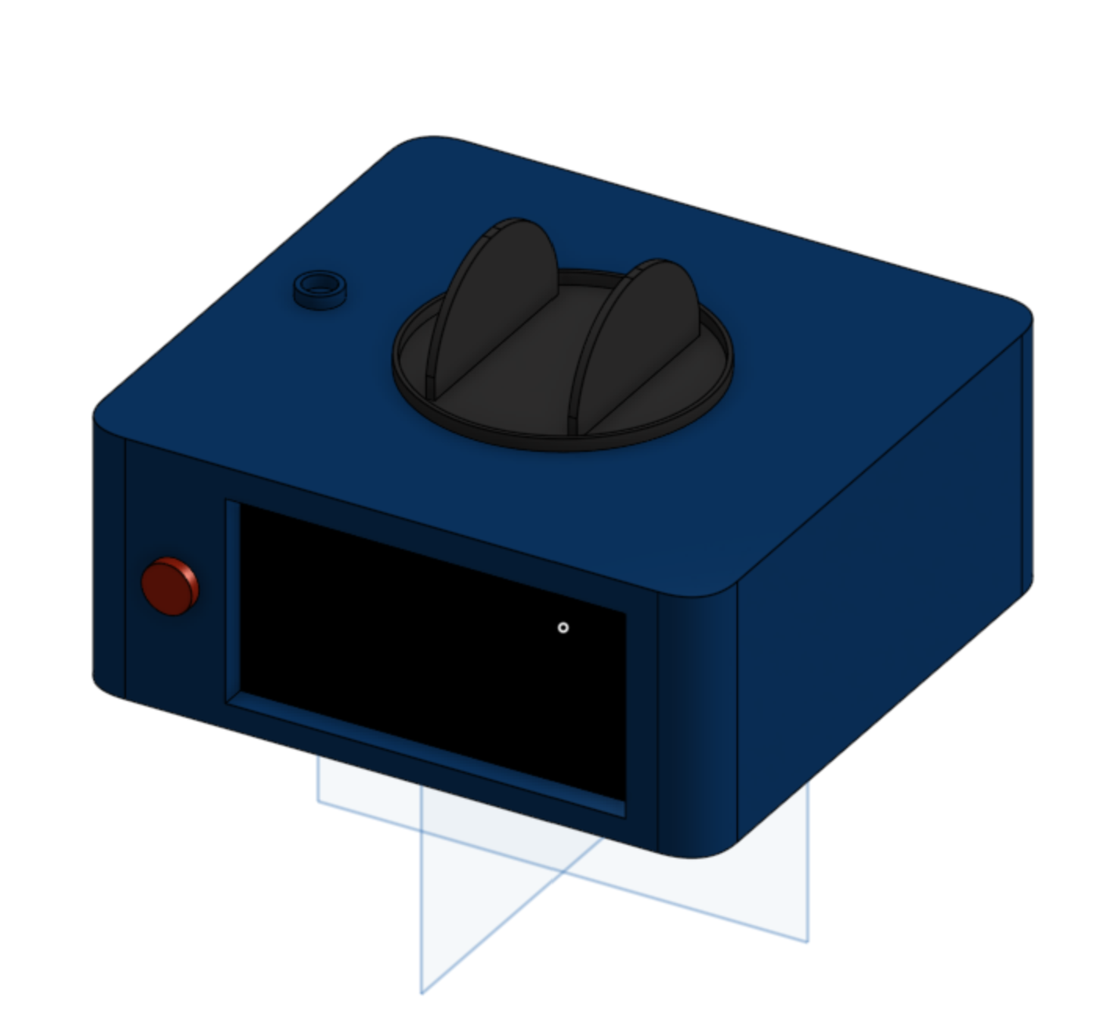
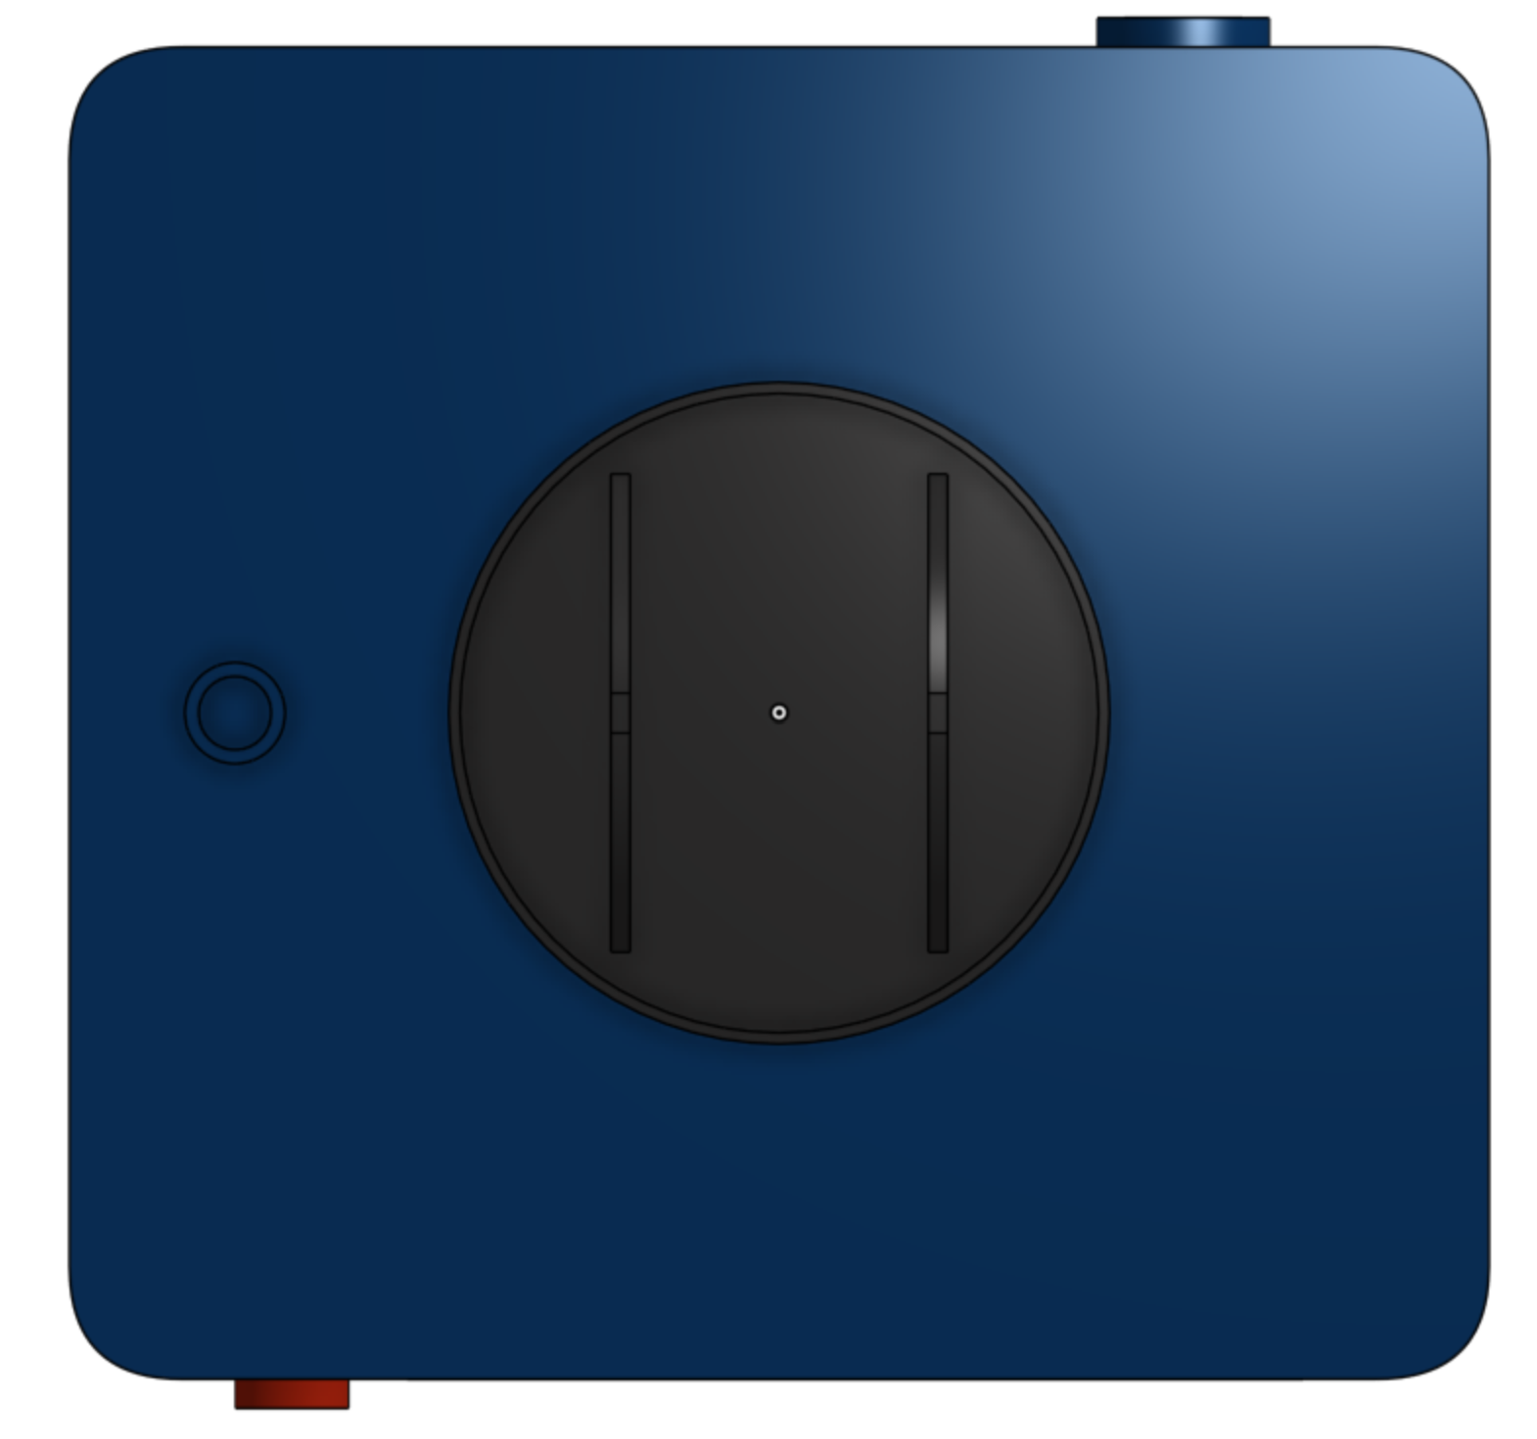
Prototype
Notes:
Ayham - This is our prototype 1 base that we made using onshape. The base is made in a rectangular like shape for stability as well as maximizing the space inside for more delicate components. The touch screen display and the on/off button is at the front, thus, making user interaction more easy and straightforward. To make sure that the front of the base is not clutter, the power cable is at the back of the base. The base also has a rotating area where the robotic arm is going to be mounted and the hole beside the rotating platform is where the important piping for the paint and water will come from. This external piping will allow for more space within the robotic arm so that the intricate gears, pulleys, rotors and other internal components can fit with ease.

Slide 9
Bill of Expense
Materials | Description | Units of Measure | Quantity | Unit Cost | Extended Cost
Filament | 3D printing material | 1.75mm | 2 | $0 | $0
LCD Touch Screen | UI Control | 7.0" (177.80mm) | 1 | $27.69 | $27.69
Onshape CAD software | Virtual 3D model maker | N/A | N/A | $0 | $0
Arduino starter kit | Coding/electronics kit | 68.6 mm by 53.4 mm | 1 | $0 | $0
Battery | Energy source for robot | DC9V-2A | 1 | $13.99 | $13.99
Power converter | Allowing the battery to charge with the power outlet | Unknown | 1 | Unknown | Unknown
Camera | Take photos/scan area | Unknown | 1 | Unknown | Unknown
Notes:
Ayham -This spreadsheet here is our bill of materials, this bill includes all our materials as well as cost, relative size, purpose and quantity. This bill can be edited in the future for any purpose. The Bill of expenses is broken into three different slides for a clearer view of the table. Thank you for listening and I hope you have a good understanding of the designs and if you have any questions, please feel free to ask, and we will try our best to answer.

Slide 10
Bill of Expense Part 2
Materials | Description | Units of Measure | Quantity | Unit Cost | Extended Cost
Cables/Wires | Transportation of energy throughout robot | Unknown | Unknown | Unknown | Unknown
Piping | Transport water/paint to nozzle | Unknown | Unknown | Unknown | Unknown
On/off button | Turn robot on/off | Unknown | 1 | Unknown | Unknown
Fan | Cooling the internal components | Unknown | 1 | Unknown | Unknown
Metal rods | key component to keep joints together | Unknown | 3 | Unknown | Unknown
adhesive | Hold arm to base/camera to arm | N/A | N/A | Unknown | Unknown
Screws(flat head sheet metal screw) | Easy access to internal hardware in base | Unknown | Unknown | Unknown | Unknown

Slide 11
Bill of Expense Part 3
Materials | Description | Units of Measure | Quantity | Unit Cost | Extended Cost
Metal sheets | External hard outer shell for base | Unknown | Unknown | Unknown | Unknown
Metal Washers | Evenly distribute the load of screws, bolts, etc. | Unknown | Unknown | Unknown | Unknown
Metal bearing | Protect the moving parts from frictional degradation | Unknown | Unknown | Unknown | Unknown
Arm3 robot | Articulation subsystem of the robot | Unknown | 1 | $0 | $0

