Slide 1
Halifax Class Destroyer Robotic Arm
By: Shahrayar, Akem, Ayham, Matthew and Wacira
Group C4

Slide 2
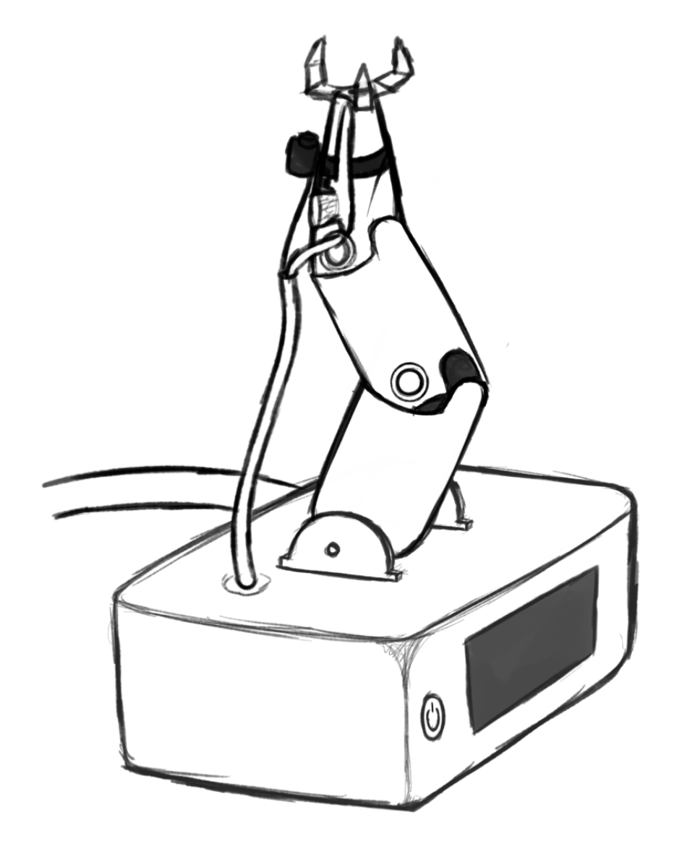
First Conceptual Design
Notes:
Following the helpful comments from our previous client meet as well as touching up on certain aspects with our PM, we’ve updated the design to better fit the feedback given to us. You will see a before and after of our brainstorming from what we showed in the second client meeting, to what we’ve been able to come up with now. The following slides have been divided to accurately represent certain details of the updated design.

Slide 3
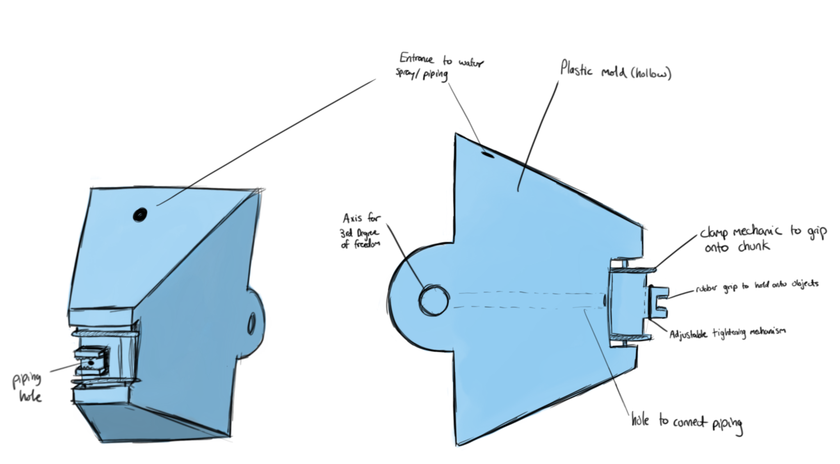
Updated Conceptual Design

Slide 4
Base
Removed touch screen user interface
Implemented simple button and light system
Notes:
Wacira- Due to the feedback that we received about the base subsystem from our second client meeting, we decided to remove the touch screen display and replace it with a button and light system. This system will allow for easy use for all users as well as enable the ability to preset the robotc arm so that robot can work in any area where people cannot enter.

Slide 5
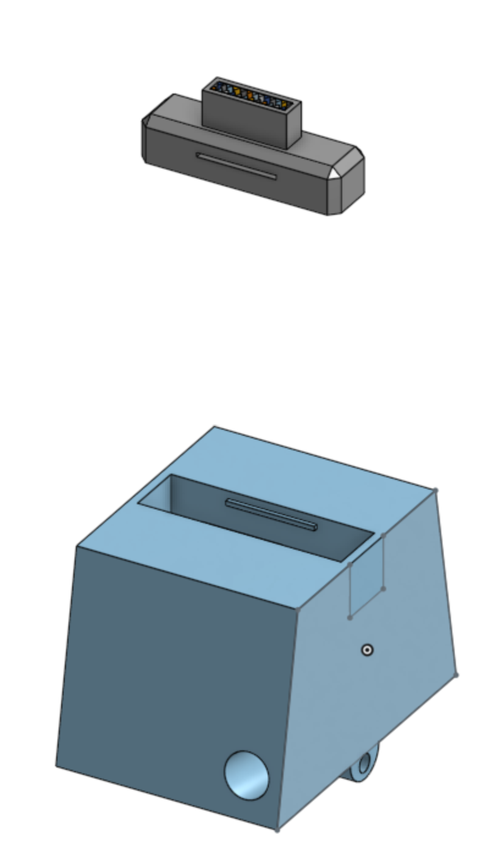
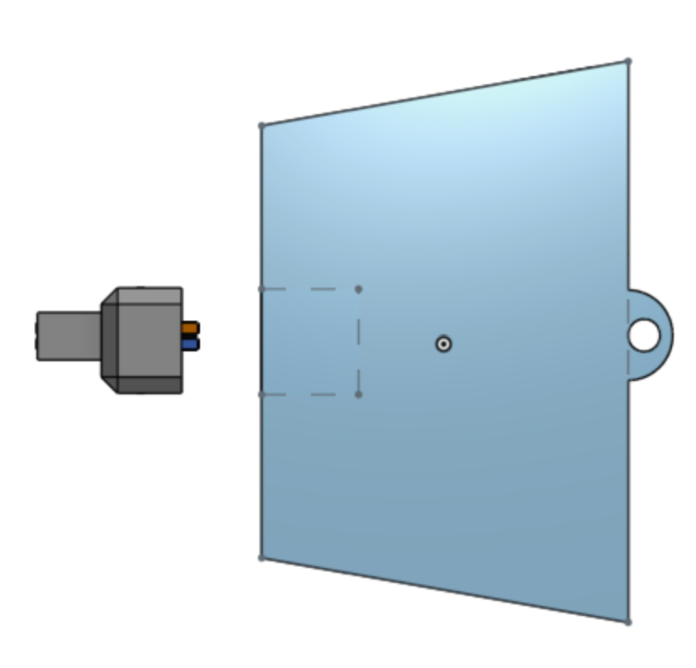
End Effector
design more reminiscent to the chuck of a drill
More compact and durable
Fits into small spaces easier
Notes:
Wacira- After speaking with our PM, we decided to redesign our end effector. This new design uses a drill-like clamping system. This allows the end effector to be more compact and durable, enabling easier movement in small spaces. The chuck and the click-in-joint give a extra secure hold on any piping going through the end effector and the connection between the pipe and accessories.

Slide 6
Source Code
Coding for the 3 DOF planar
This deals with the inverse kinematics of the robotic arm
Notes:
Based off our notes from the first client meeting, we understood the importance of specific coding for the robot arm. The main things we focused on when it came to the code was the fact that a) it has to be open source, easily accessible, and b) fits the concept of inverse kinematics for the robot arm in 3 DOF. Thanks to our use of the NumPy library, we are able to simplify the use of the inverse kinematics equations. Each part of the code seen on screen now is outlined by comments, followed by the math outlined for the use of inverse kinematics. Variables are set beforehand, allowing the implementation into these equations to be much easier.

Slide 7
Future Plans
Safety features
Testing
Notes:
Wacira- In the future we are preparing to add a variety of safety features within the source code and the actual hardware of the robotic arm. These features as well as other major components such as the source code and 3-D printed pieces will go through virgous testing to ensure all aspects of the robotic arm are in good condition.

