Slide 1
Project Progress
June 9, 2022 <Group Z24>
Sylvain Quach
Evan Tomietto
Yunsu Lee
Hans Rao Ladkoo

Slide 2
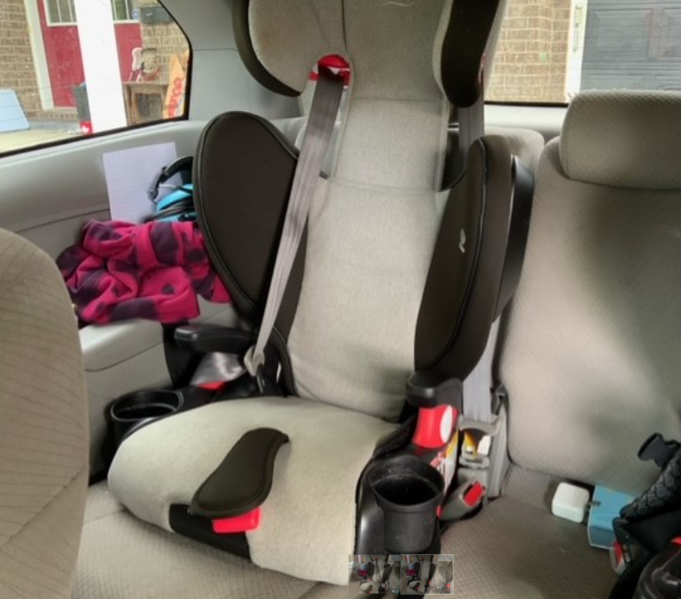
Who is our Client?
Our client, Clinton, is a father to his 6 year old daughter who suffers from arthrofibrosis. This condition causes her to experience limited mobility, strength, and flexion of her joints, especially those in her limbs. Clinton is looking for a product that will allow his daughter to secure herself in her boosted 3-point car seat belt on her own.

Slide 3
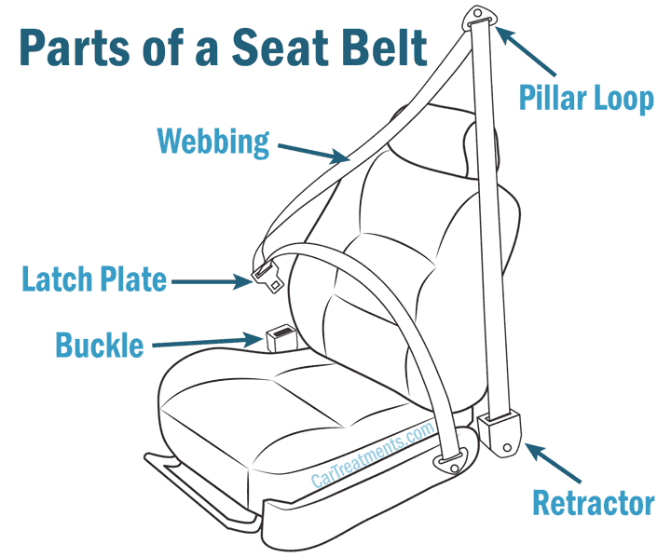
What is our Project?
The mechanism will allow her to reach for the male part of the seat belt and guide it to its female counterpart, and then finally providing the additional necessary force to clasp the two together. The product should not hinder the seat belt’s original safety, comfortability, and functional features.

Slide 4
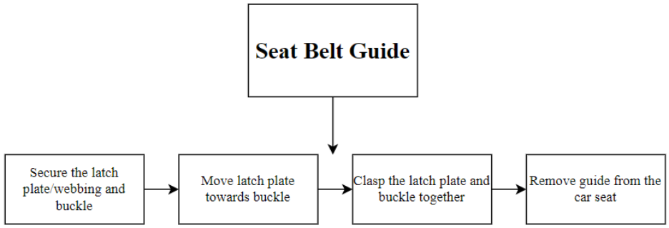
Functional Decomposition

Slide 5
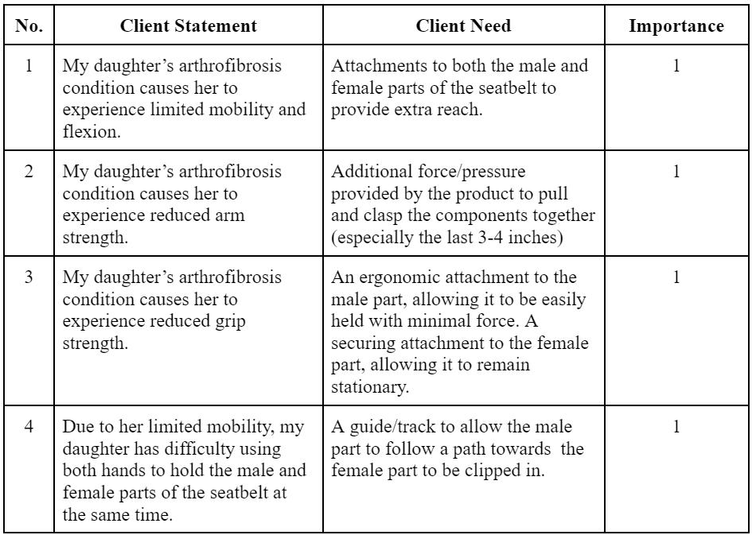
Client Statements to Client Needs

Slide 6
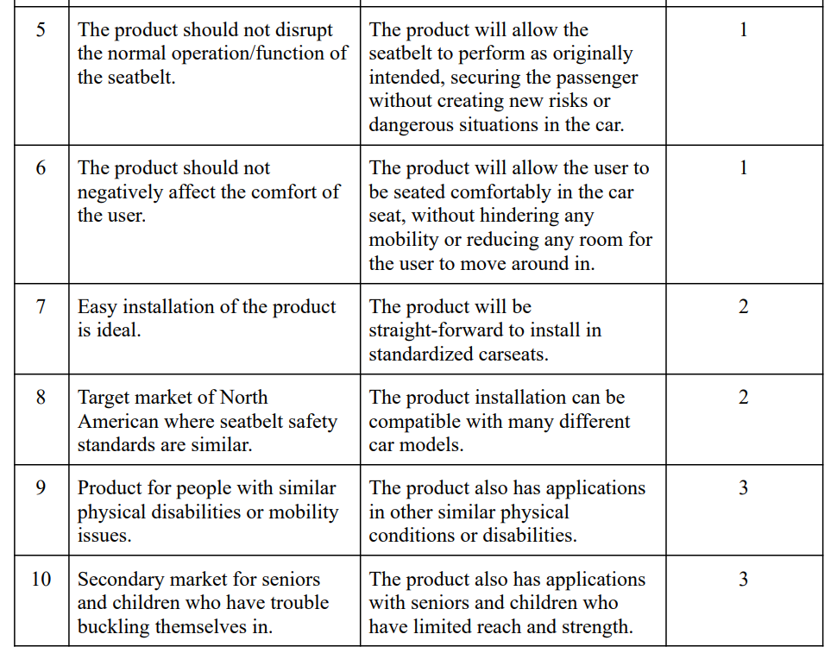

Slide 7
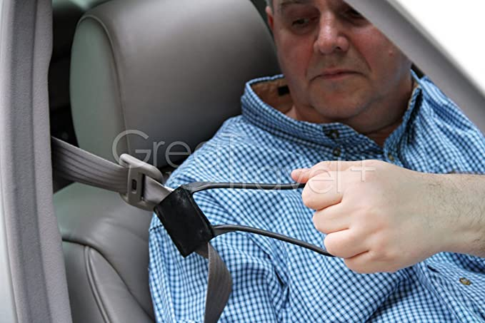
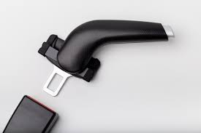
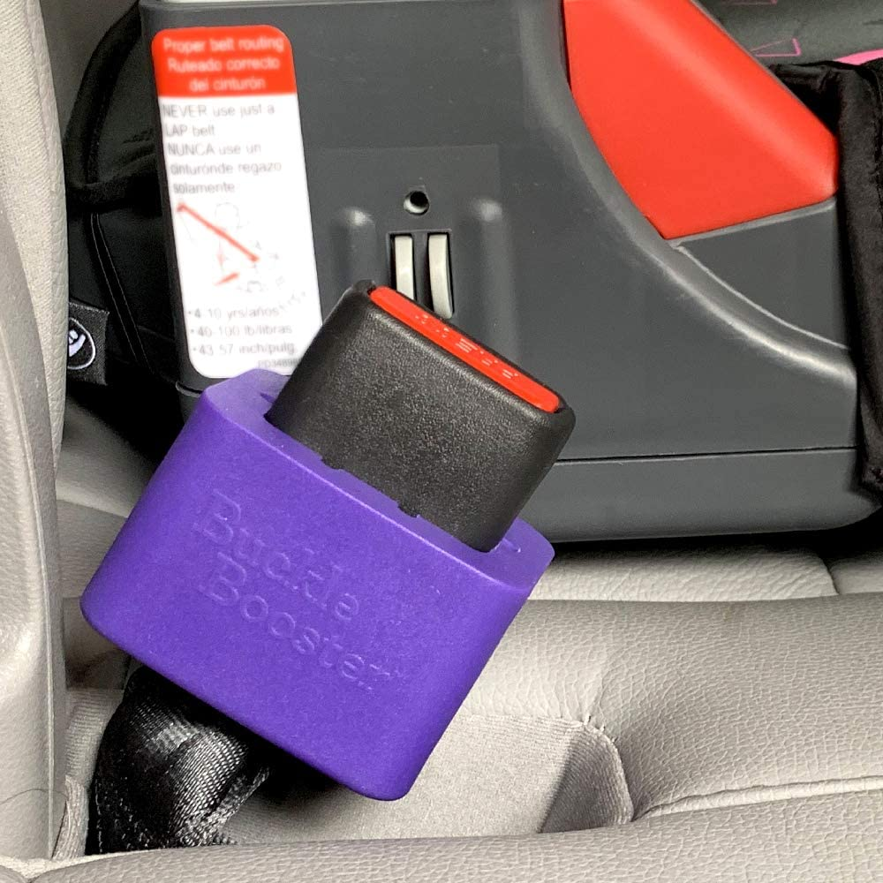
Products that Currently Exist

Slide 8
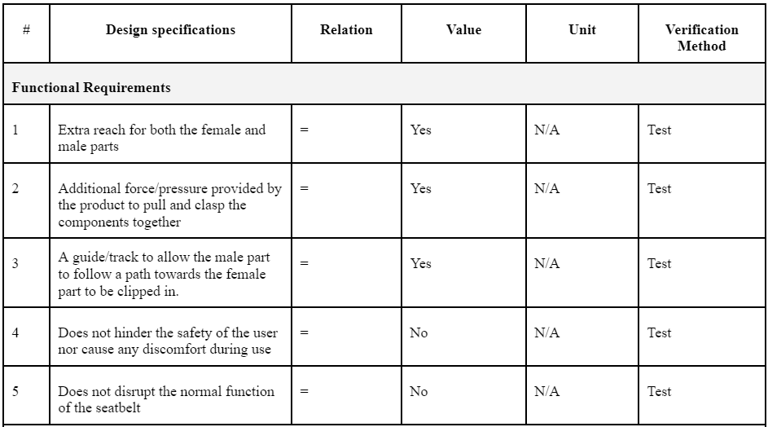
Product Target Specifications

Slide 9
Product Target Specifications

Slide 10
Product Target Specifications

Slide 11
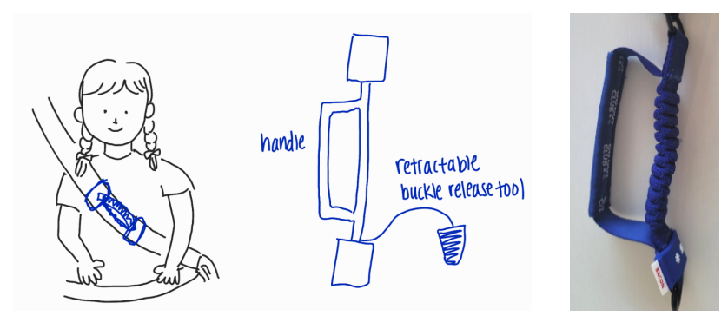
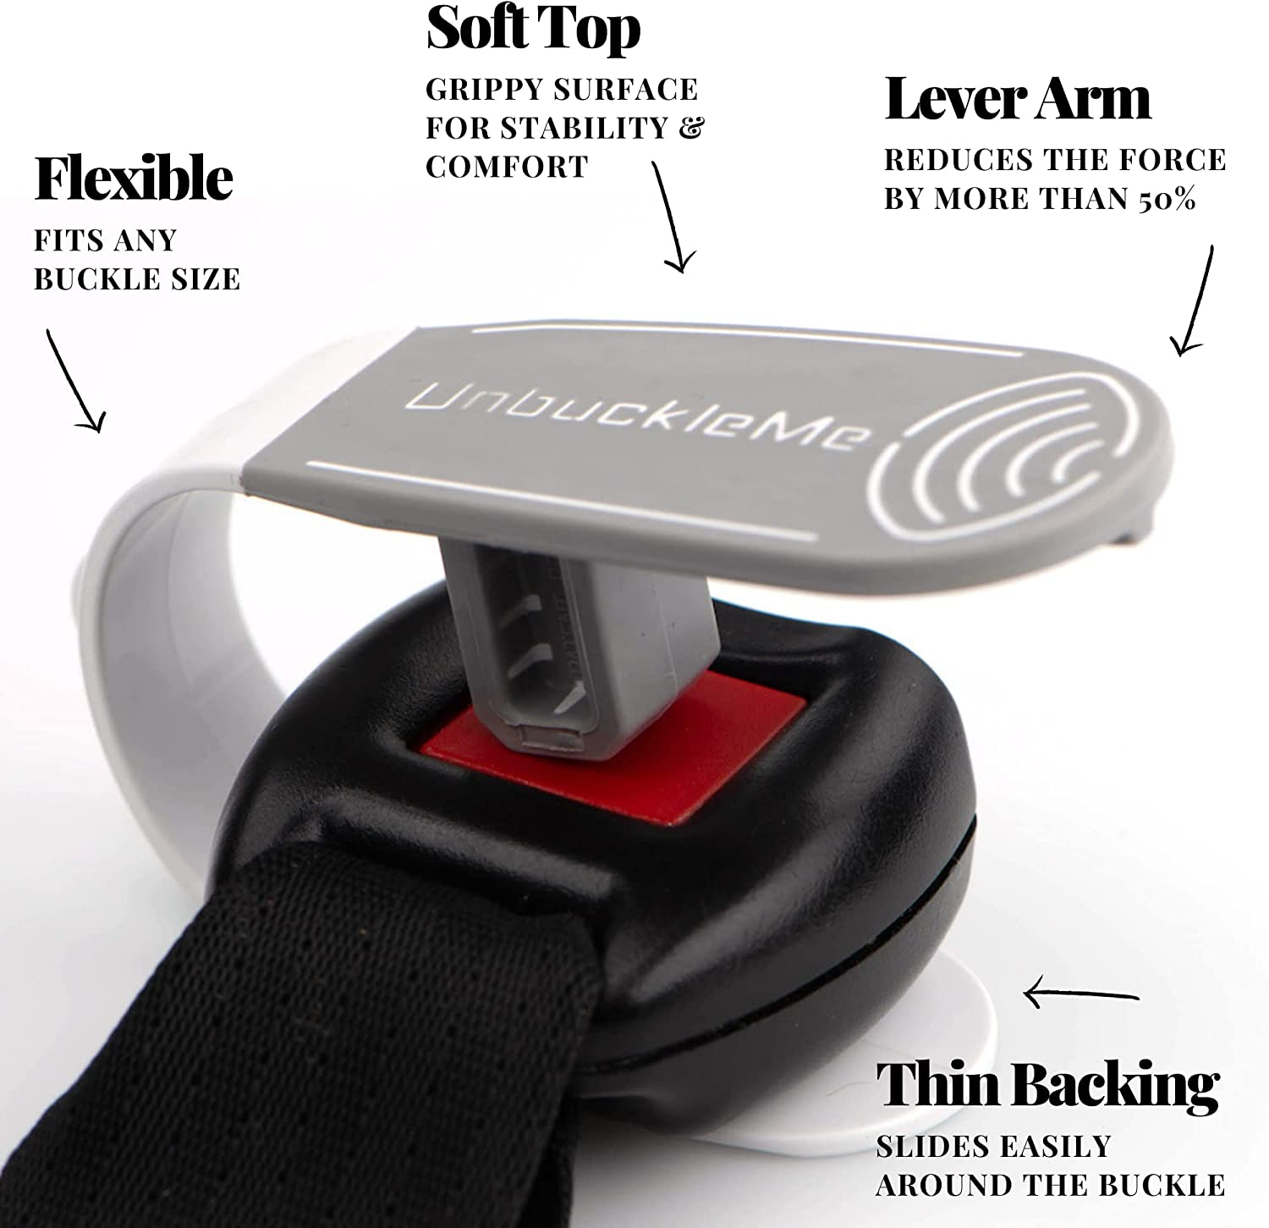
Our Concept

Slide 12
Client Feedback
✅
Clinton expressed that the problem statement, client needs, and target specifications fully met his expectations
Preferred the size and reach the first benchmarked product (webbing strap), but confirmed the solid handle of the second benchmarked product (hard plastic handle) was more of what he envisioned
Favoured our unique concept presented on the previous slide
Would like to see a more solid/rigid handle for his daughter to grab and maneuver
Product should focus on allowing the user to reach, grab, and lead the male part to the female counterpart

Slide 13
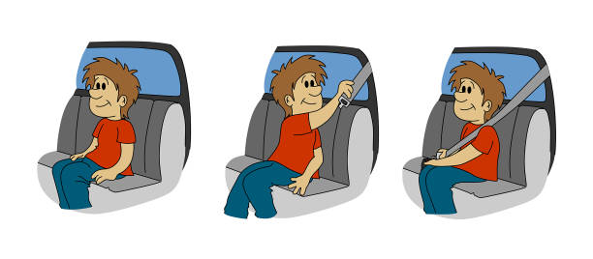
Is it Feasible?
Similar products on the market that received positive feedback from client
Our concept will be a synthesis of the previously mentioned existing products
Sourced materials within budget (3D printing at the MakerSpace)

Slide 14
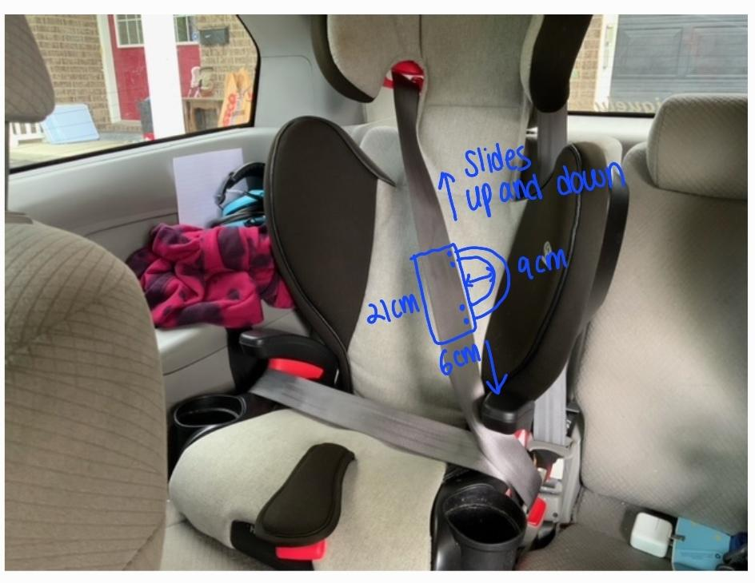
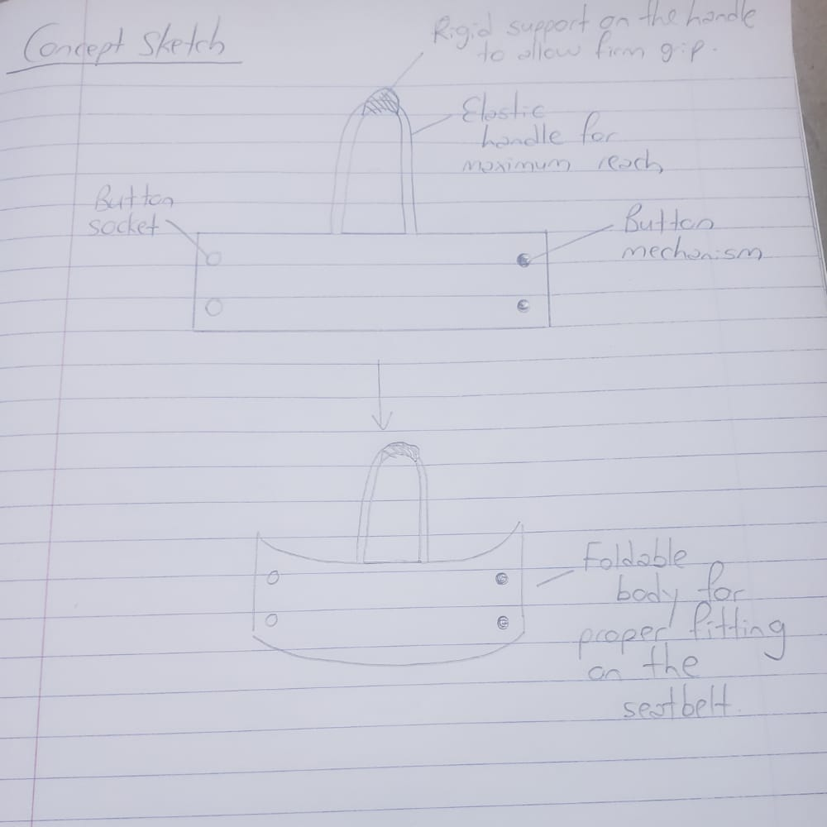
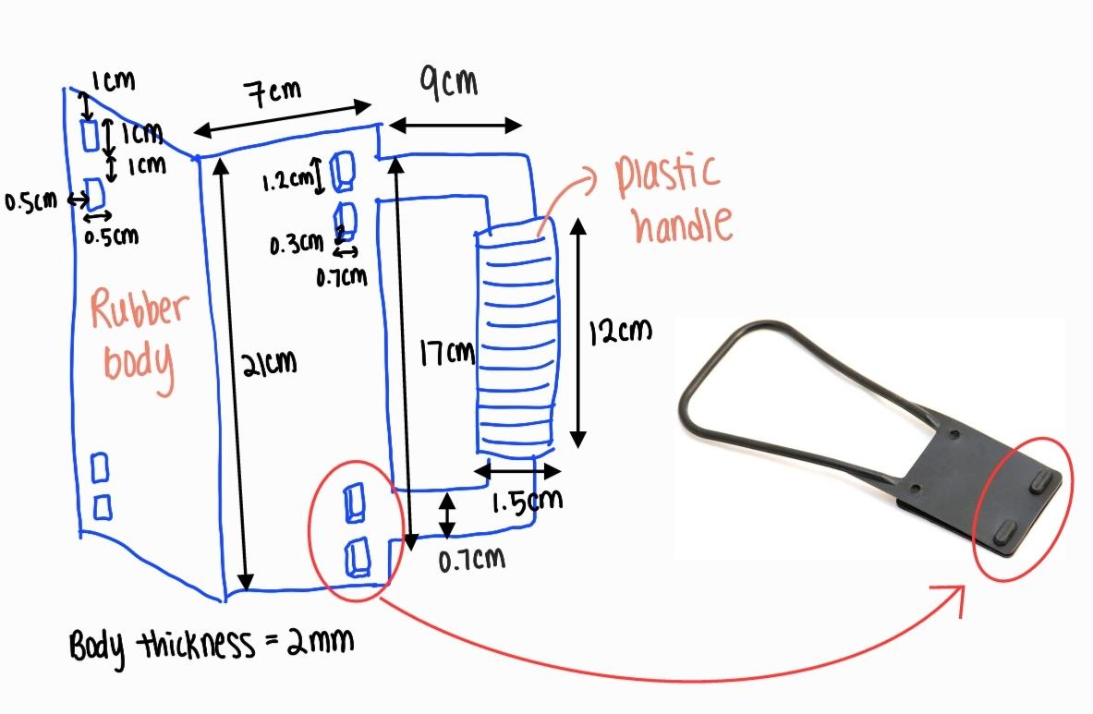
Concept Sketches before Prototype Development

Slide 15
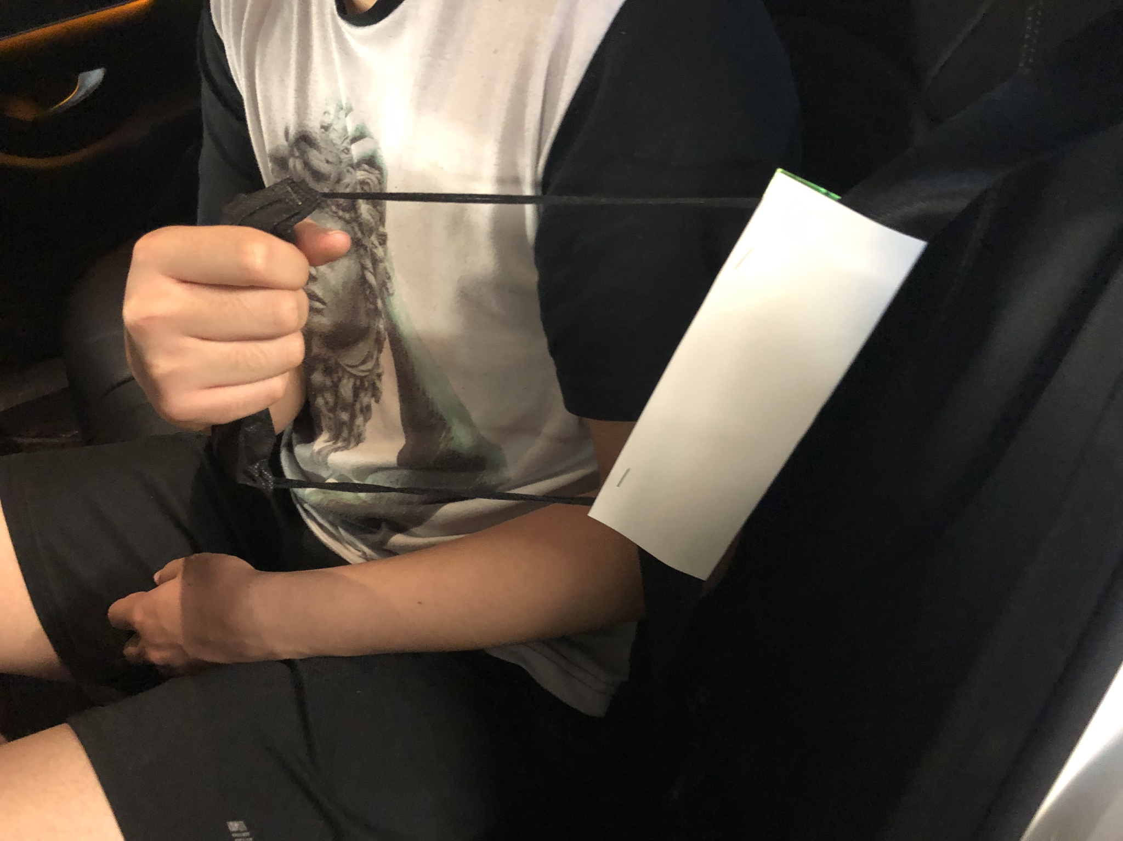
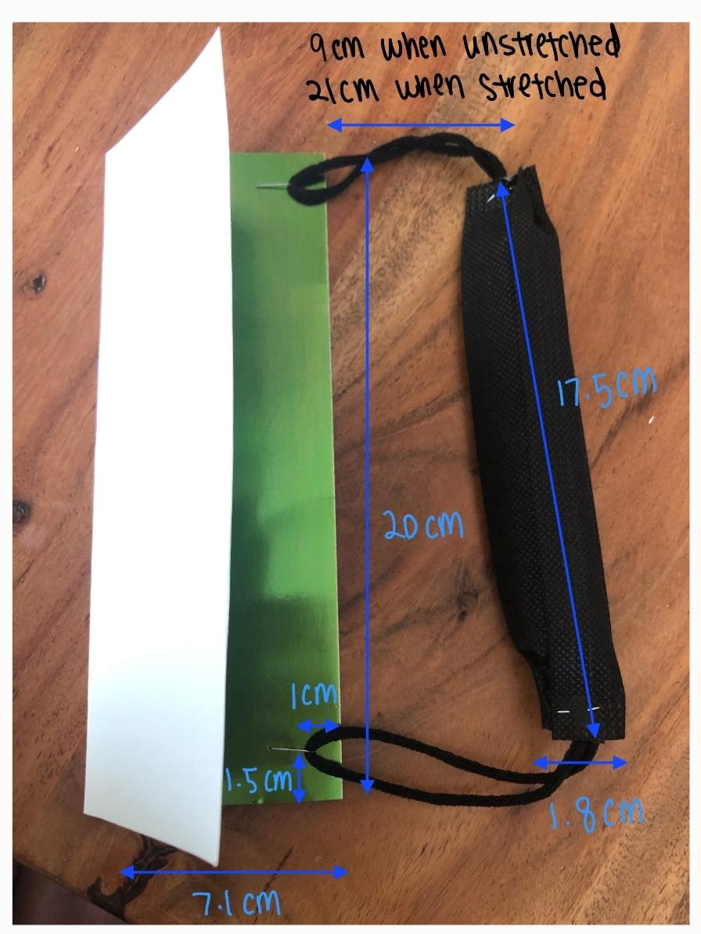
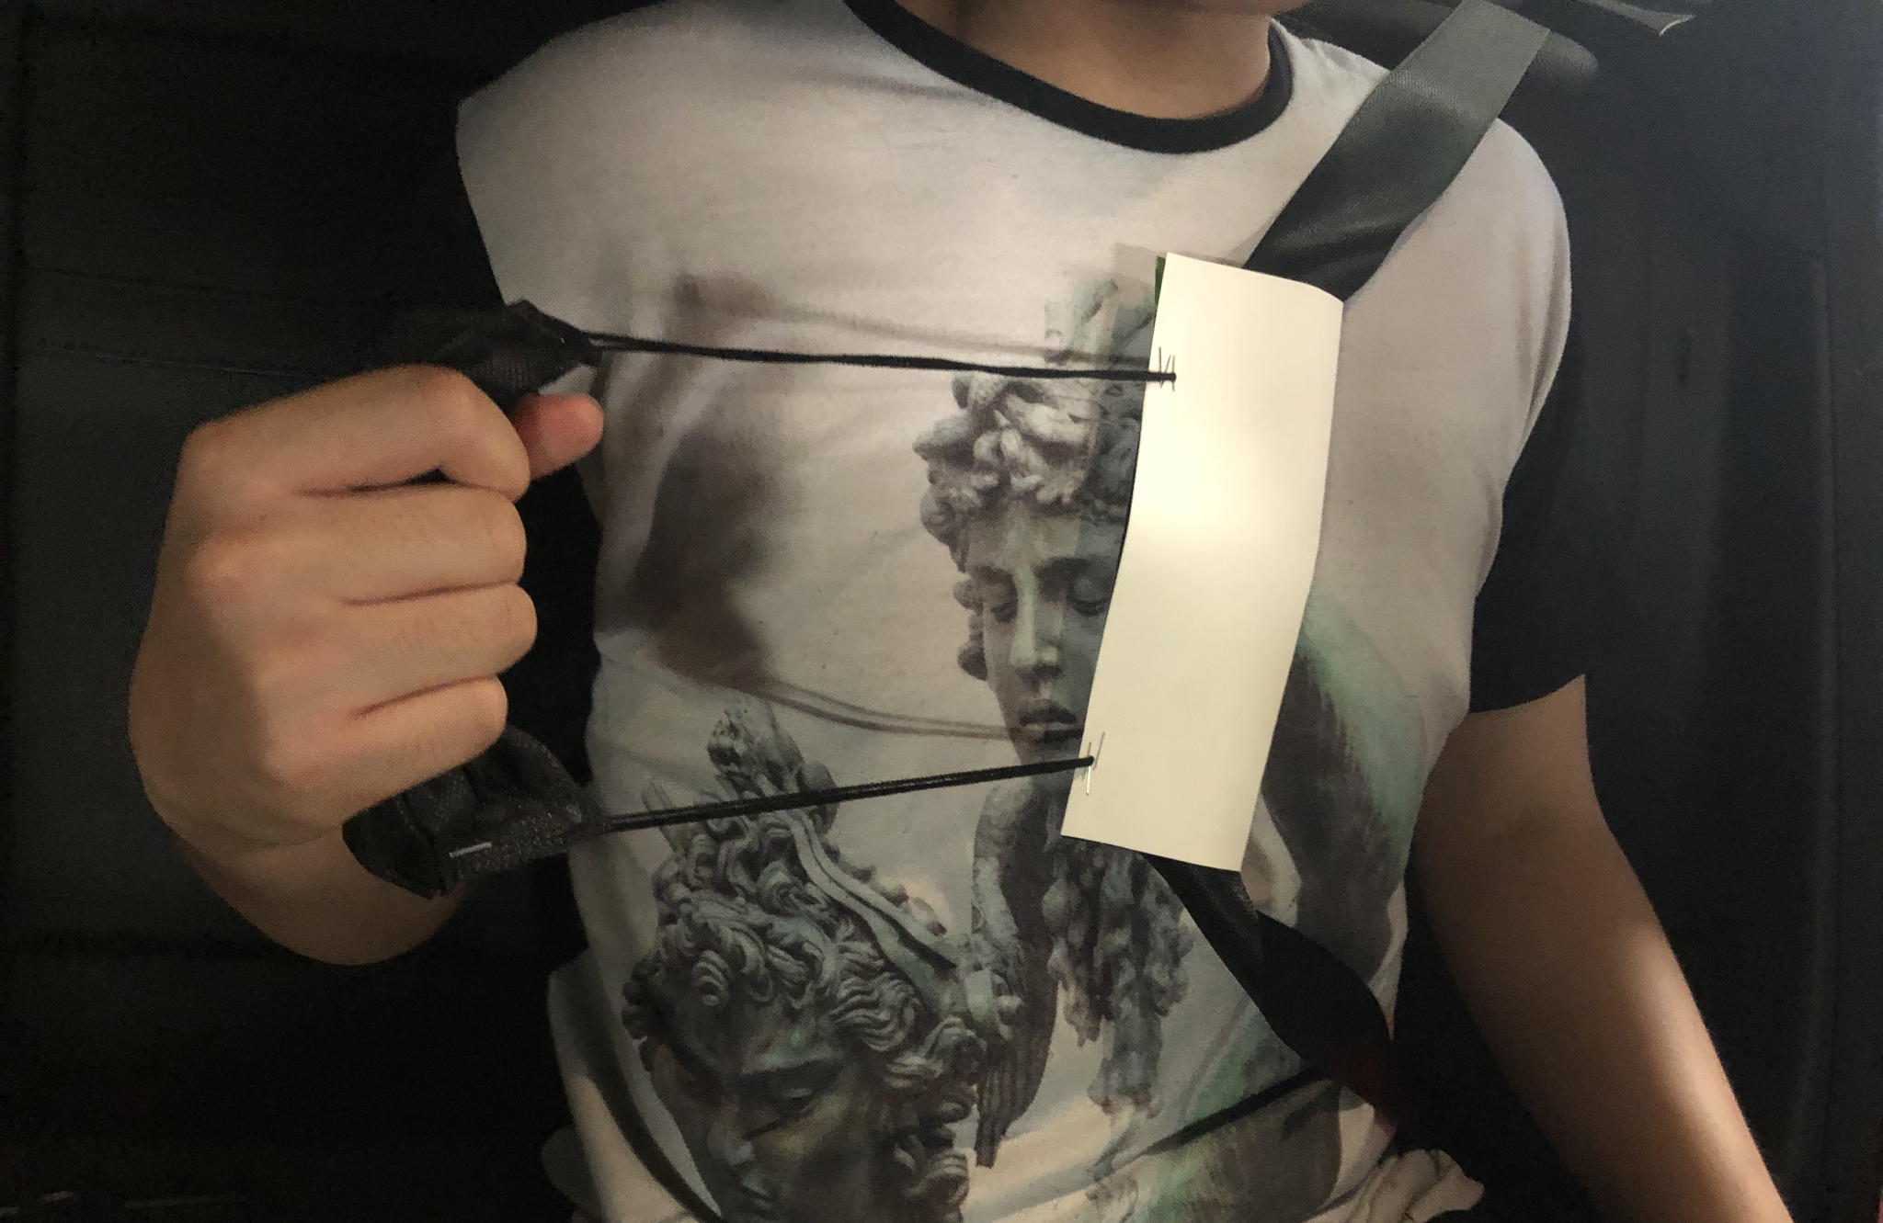
First Prototype

Slide 16
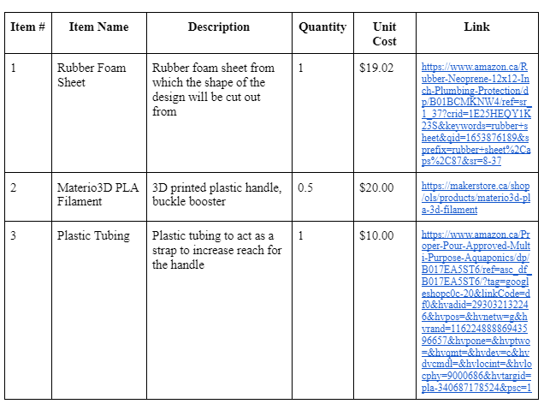
Bill of Materials

Slide 17
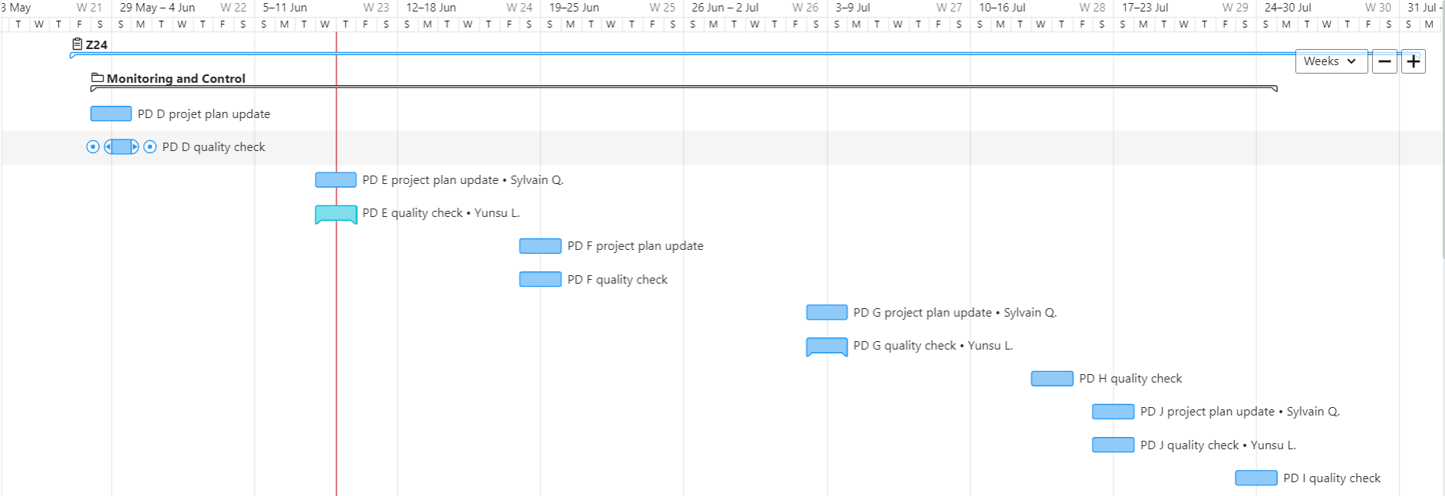
Project Plan

Slide 18
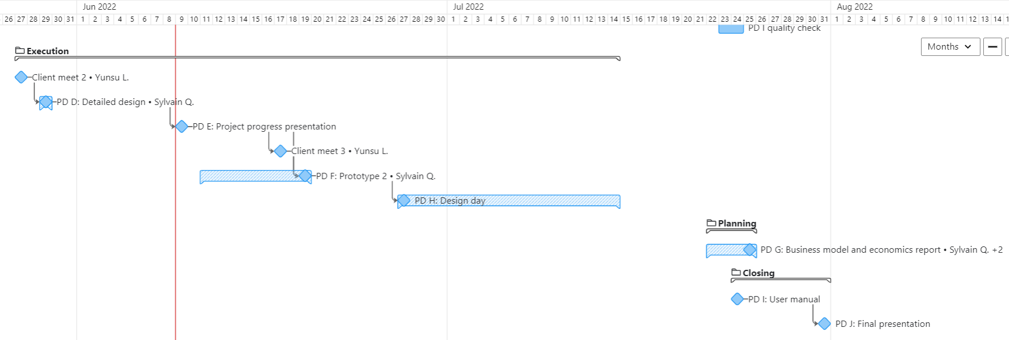
Project Plan

Slide 19
Next Client Meeting
Second prototype
Rigid handle (3D rendering and printing)
Specifications
Feedback on both prototypes

Slide 20
Thank you!
☺

