Slide 1
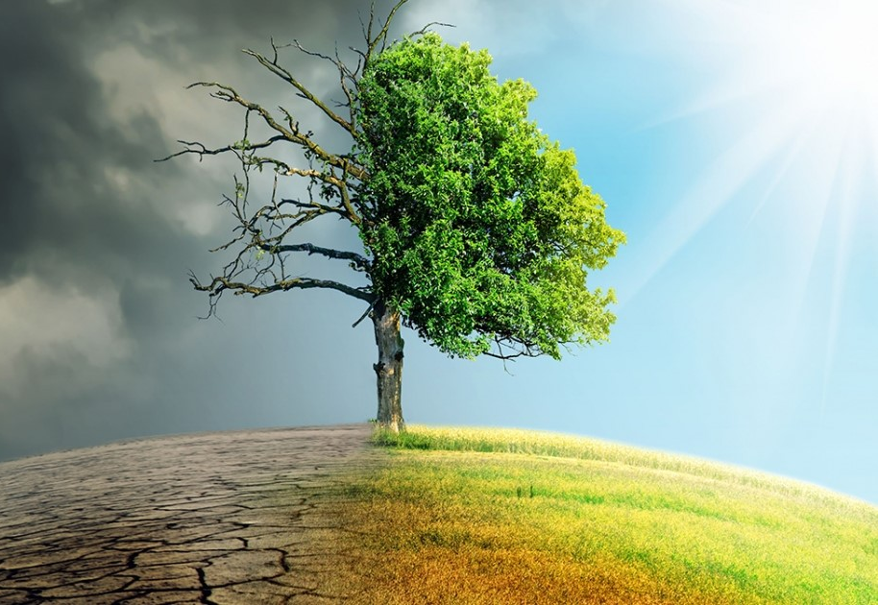
SDG-13 Climate Action The case of India’s forests

Slide 2
SDG-13: Climate Action
The Sustainable Development Goals 13 is one of the 17 goals established by the UN in 2015. They are a set of objectives that should be reached or close to be by the year 2030
SDG 13 titled Climate Action is the goal to Take urgent action to combat climate change and its impacts as the climate crisis continues and increases in severity

Slide 3
Concept
To educate our audience about the real effects of mass-deforestation and increasing CO2 levels.
Increase awareness on environment conservation
Focus : India’s forests

Slide 4
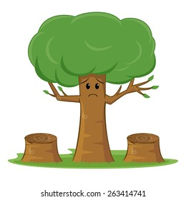
Why India?
Sad case of Over-development.
One of the prominent countries in Asia facing mass deforestation.
Availability of related data.

Slide 5
Our Solution
A children’s book to educate the younger crowd about climate change and climate action.
To tackle one of the targets of SDG-13, integrate climate change into curriculum.

Slide 6
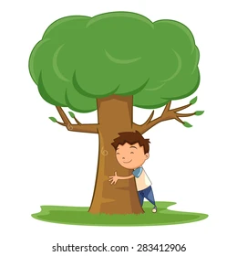
Amit’s Story

Slide 7
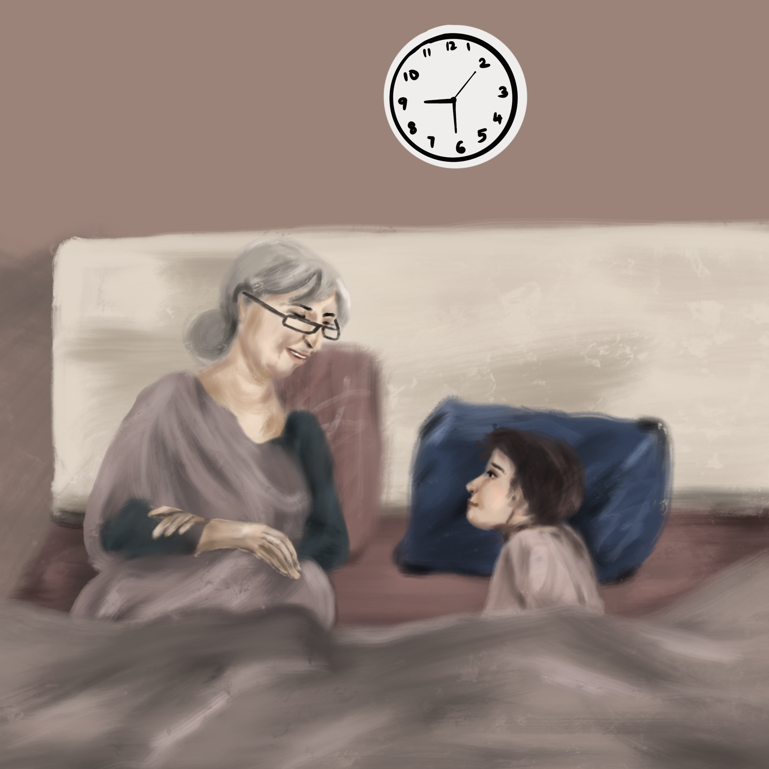
Amit’s favorite time of the day!
Listening to grandma’s bedtime stories

Slide 8
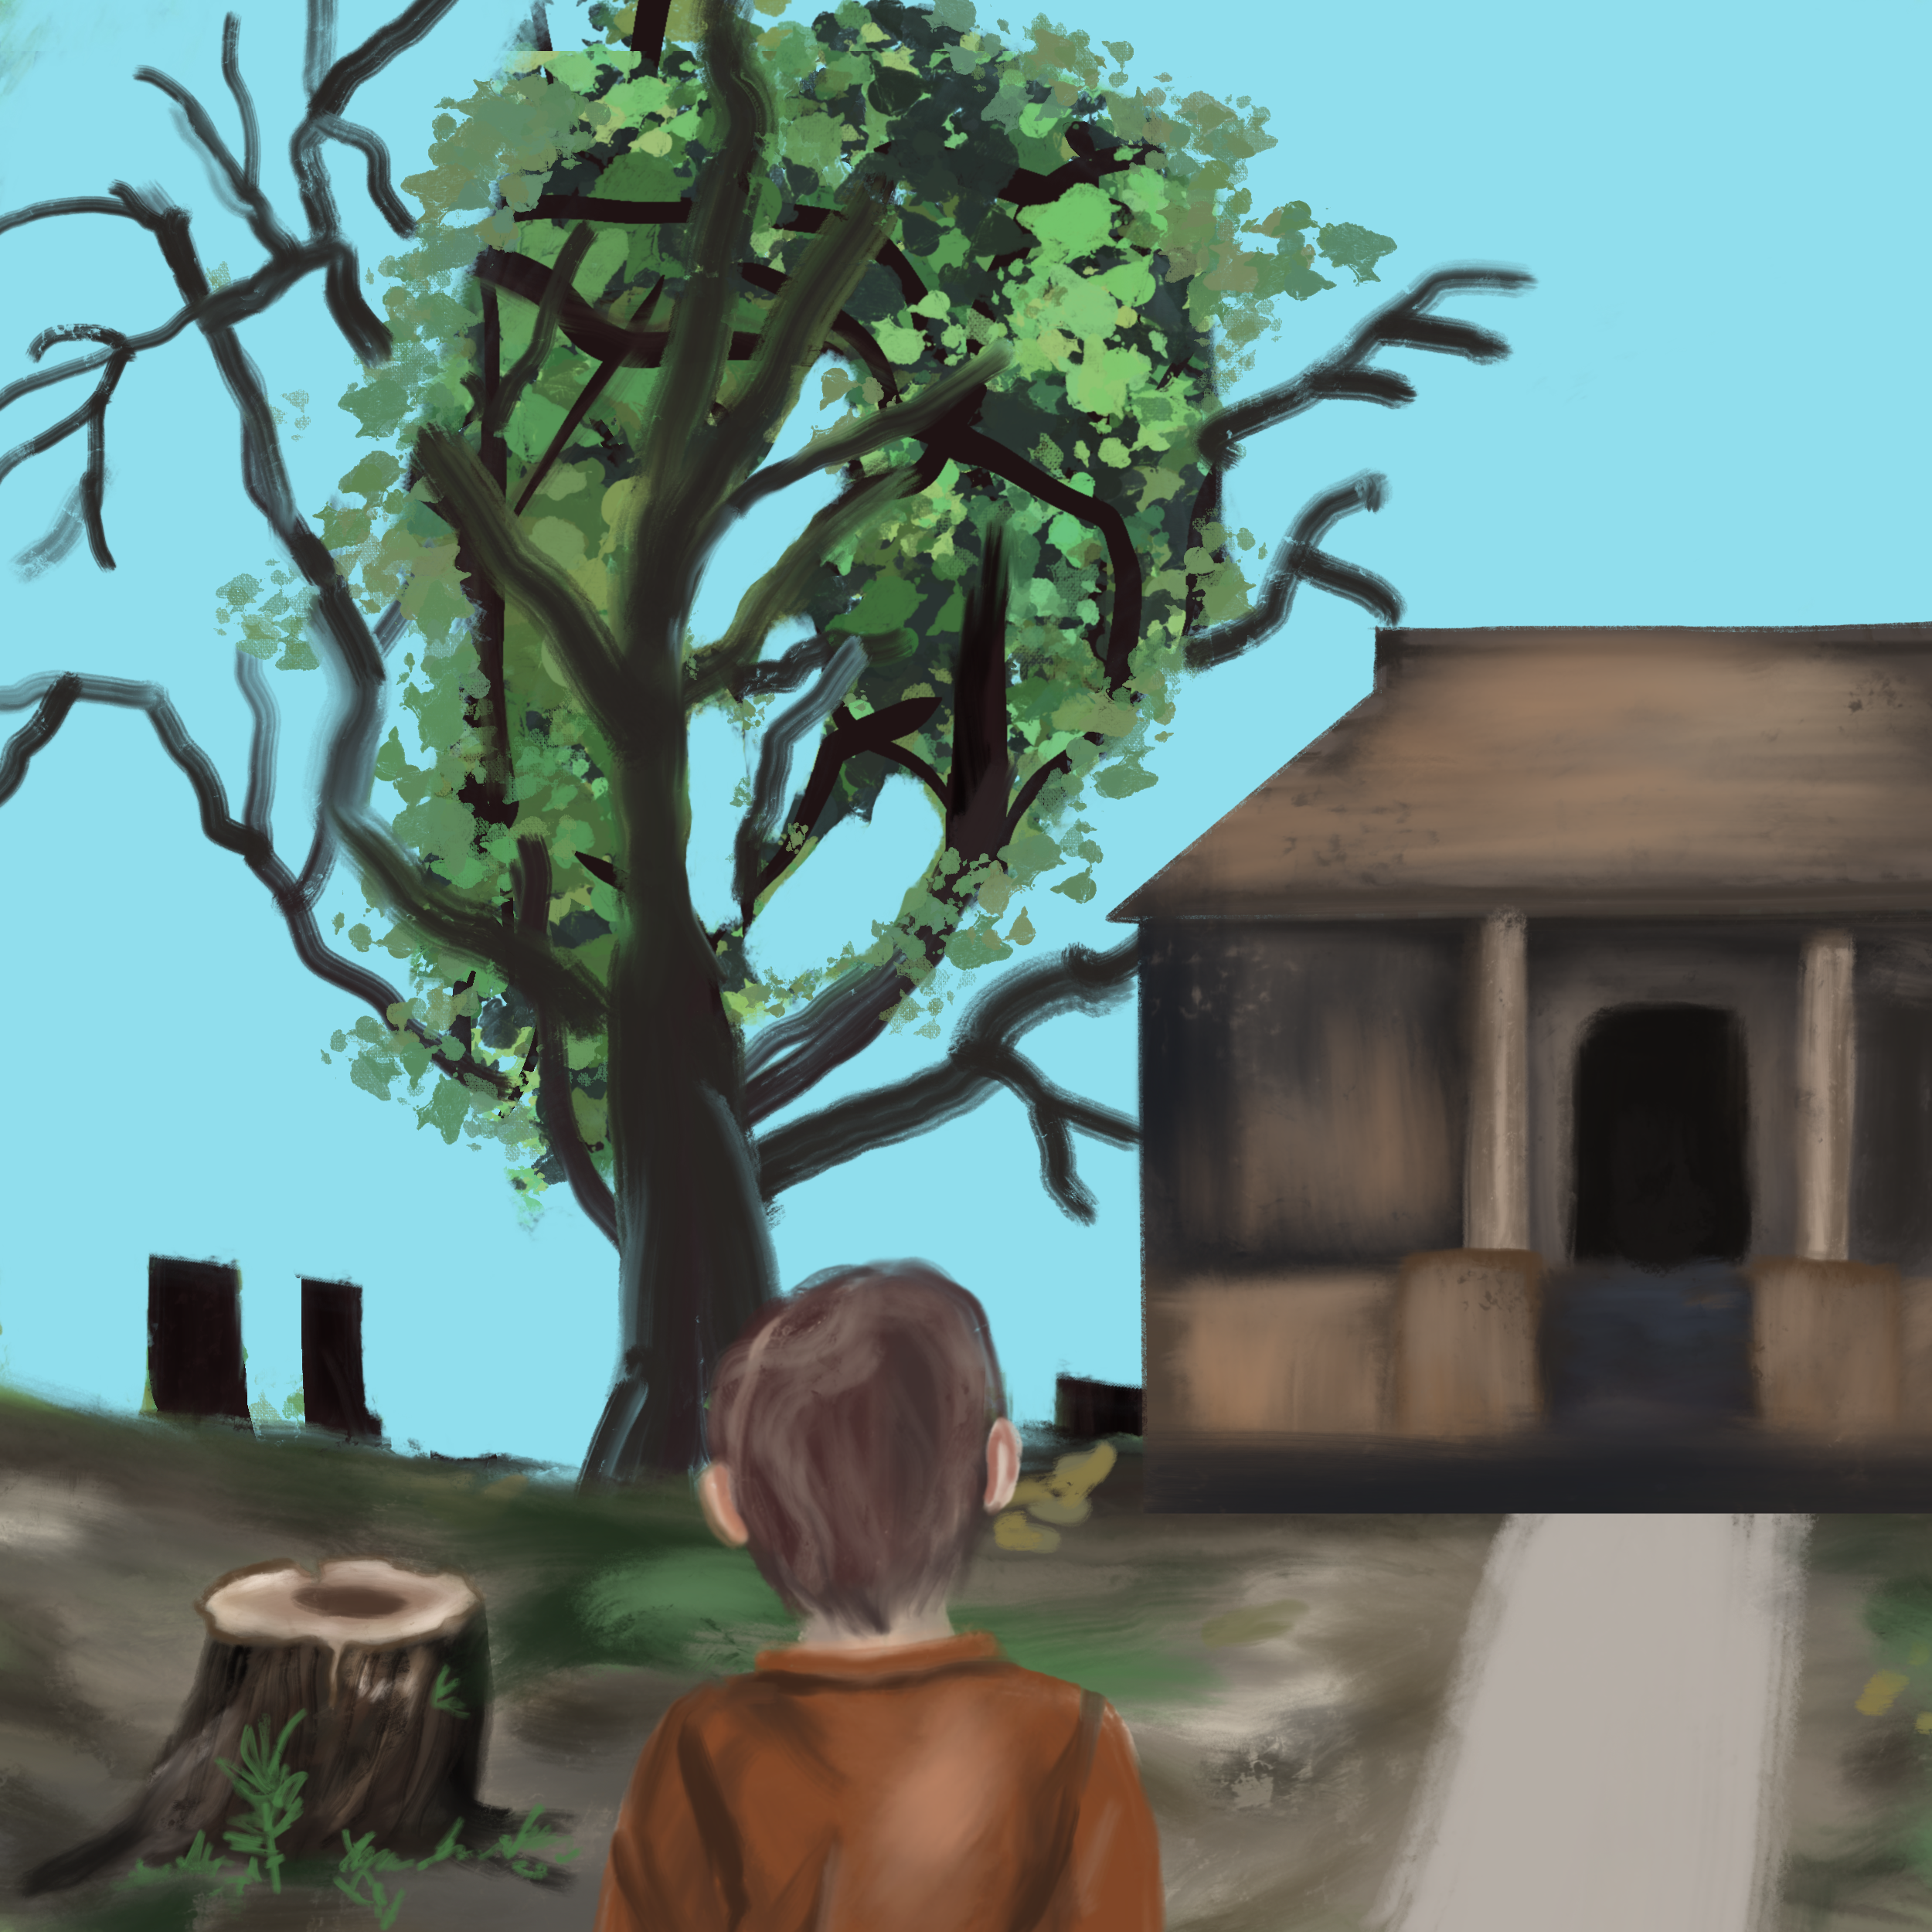
Beautiful trees? Greenery?
I hardly see one tree here!!!
Why are all these trees cut???

Slide 9
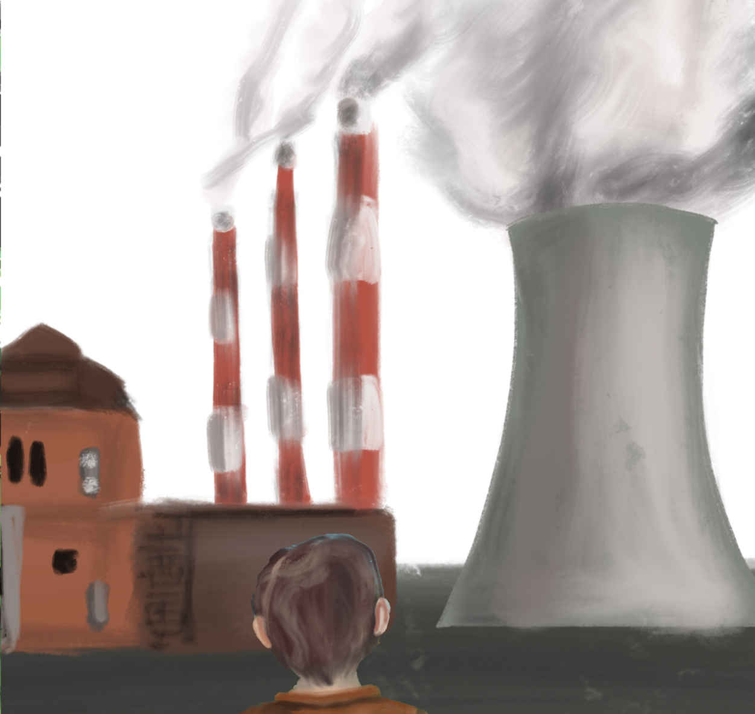
Where are the green fields like grandma told in the story??
I barely see any greenery, there’s smoke everywhere from the factory…..

Slide 10
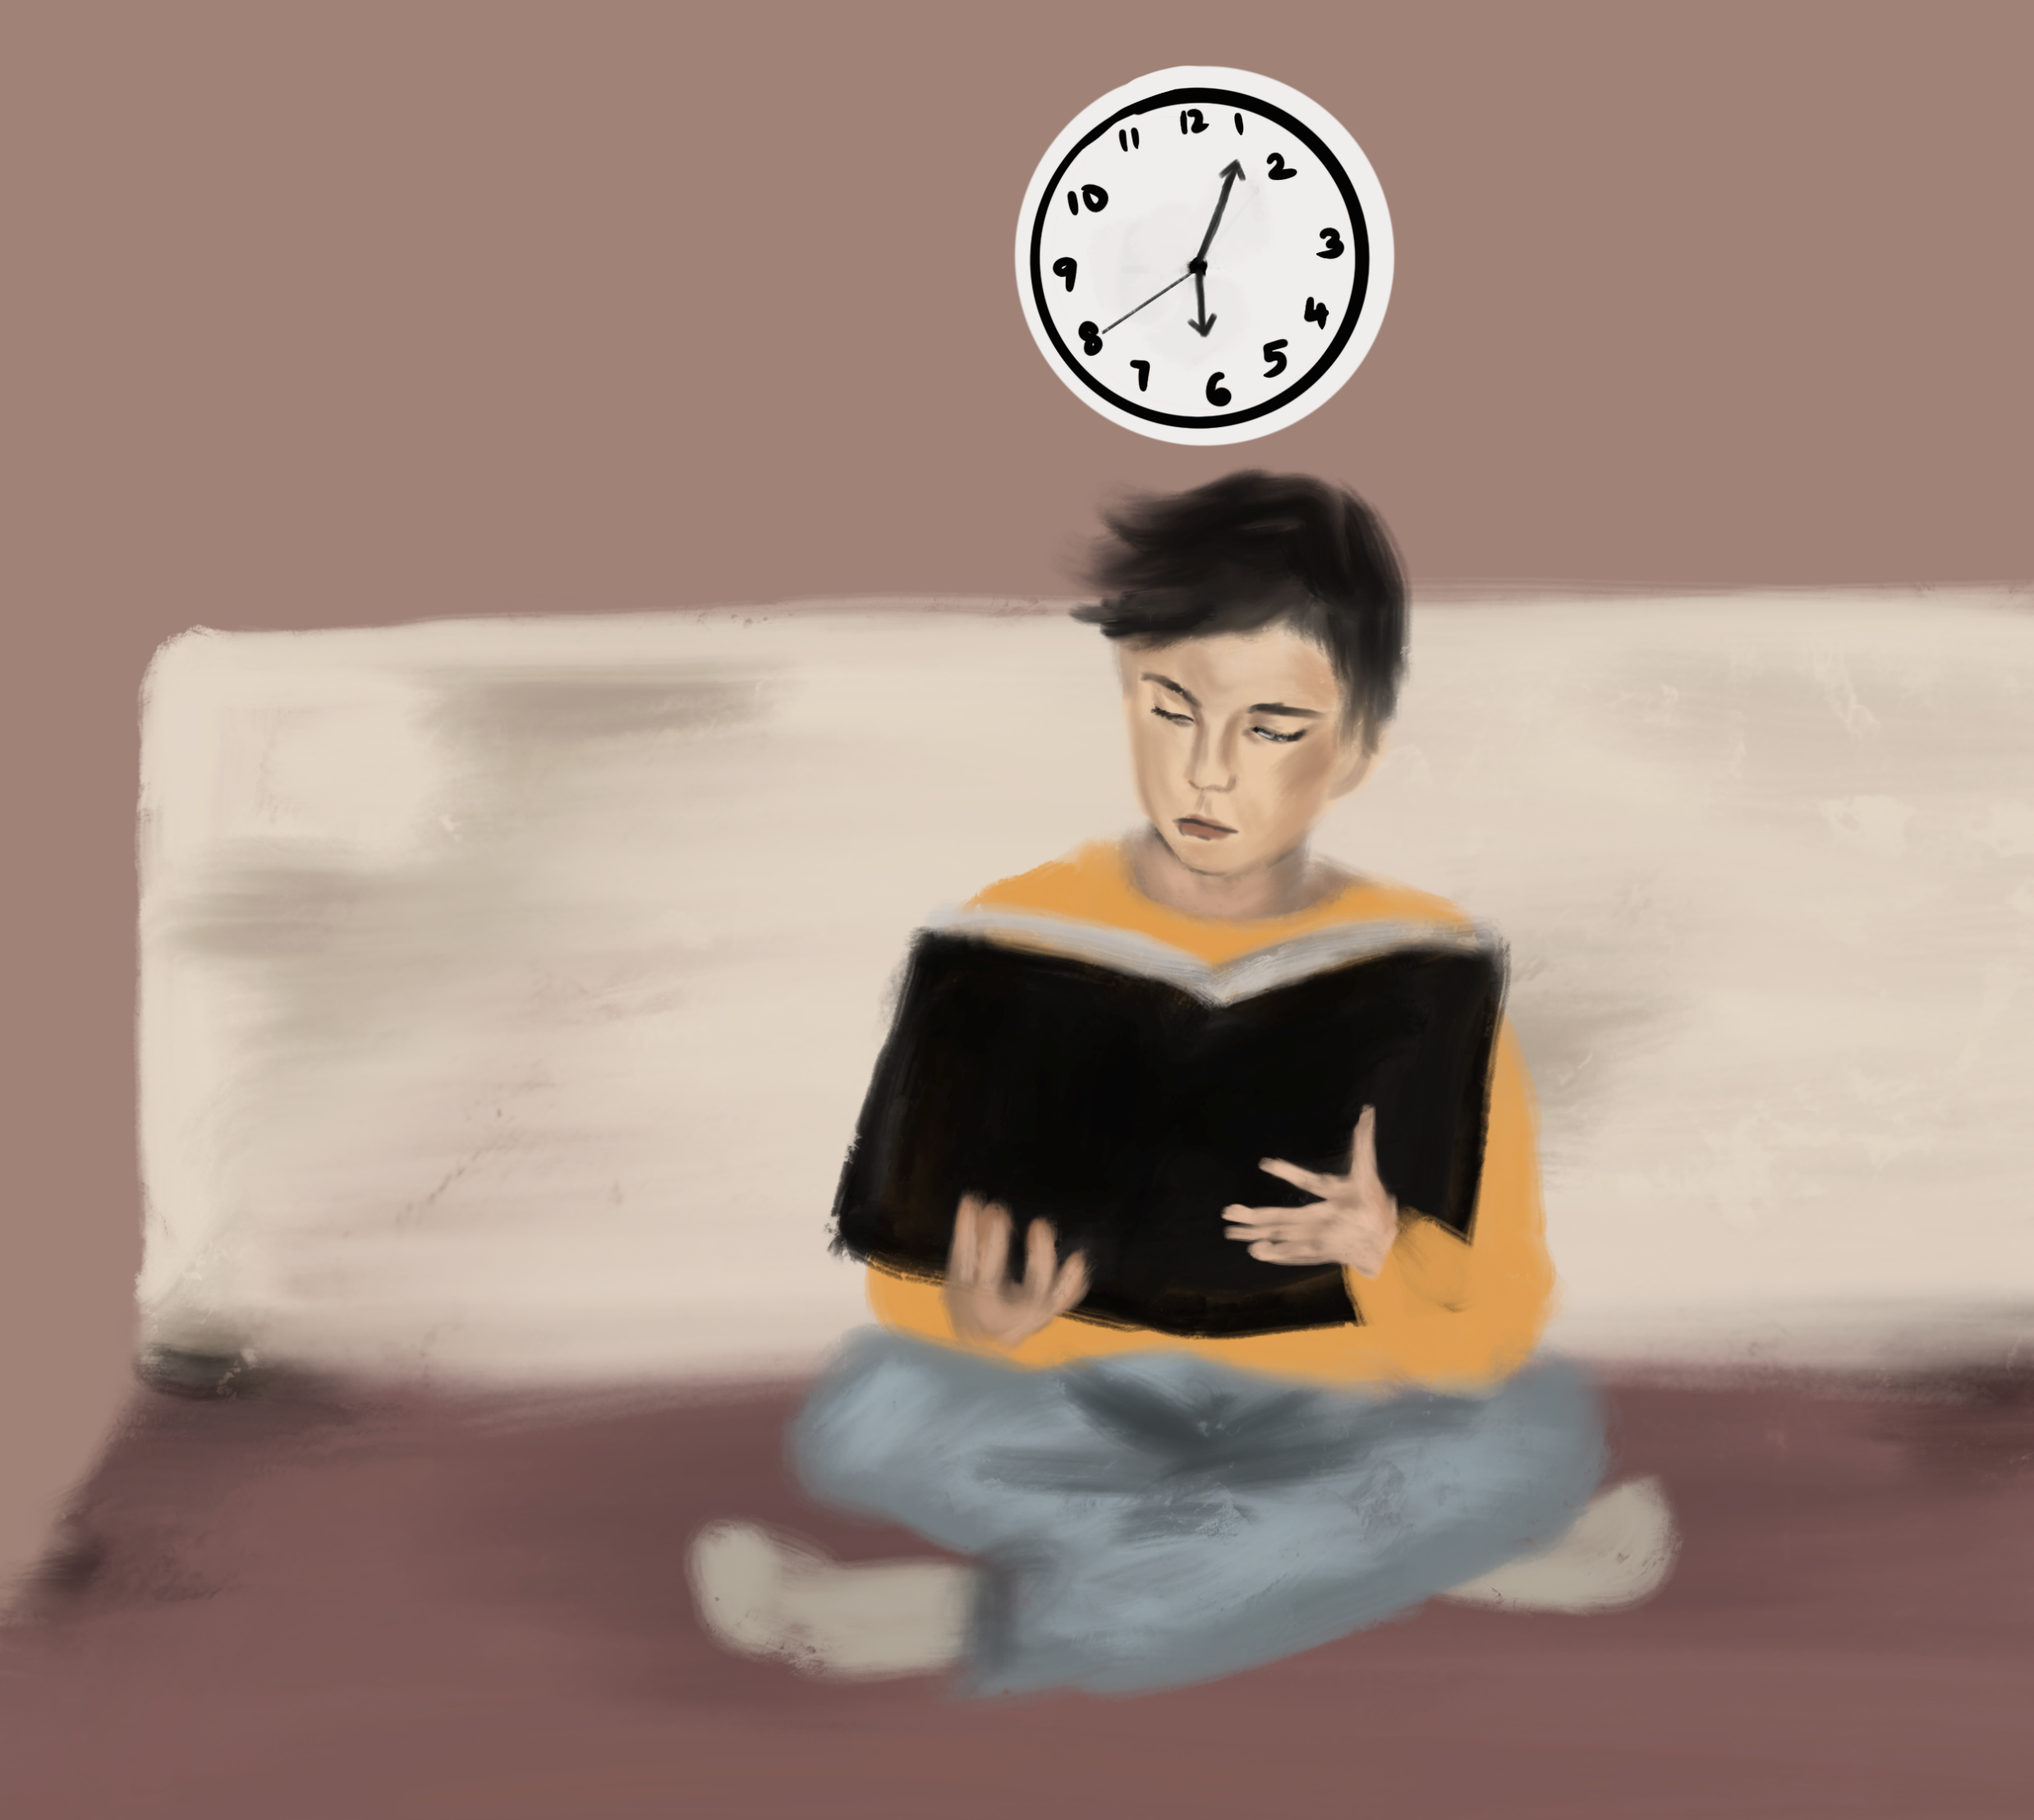
Amit realizes that something is wrong. He goes and reads about deforestation and it’s effects.

Slide 11
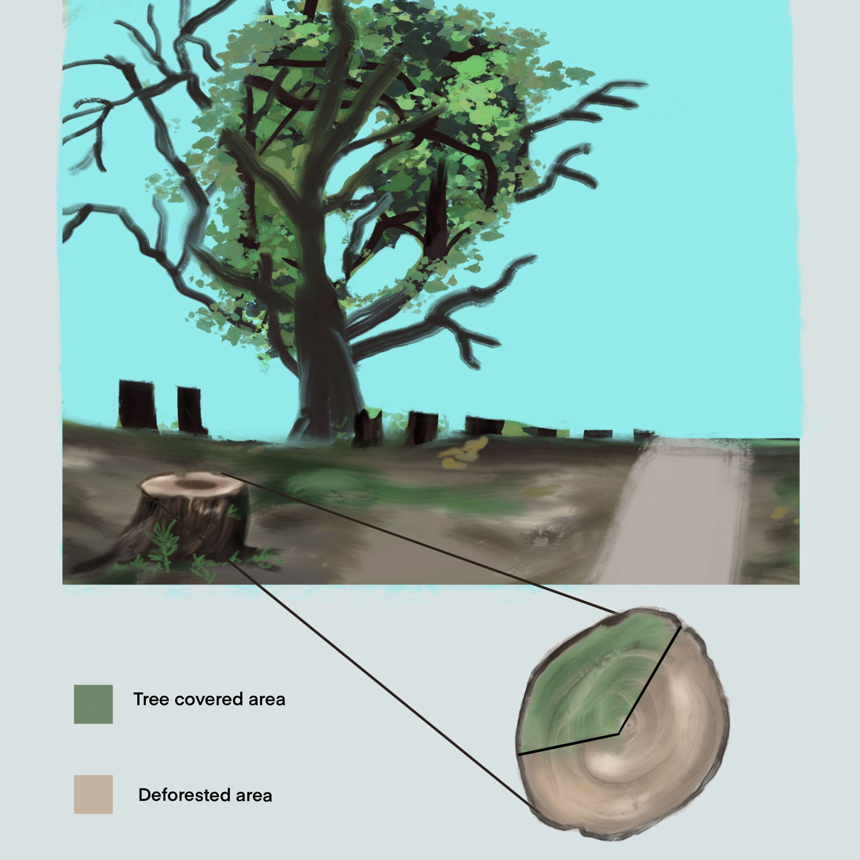
Amit discovers what has been happening!

Slide 12
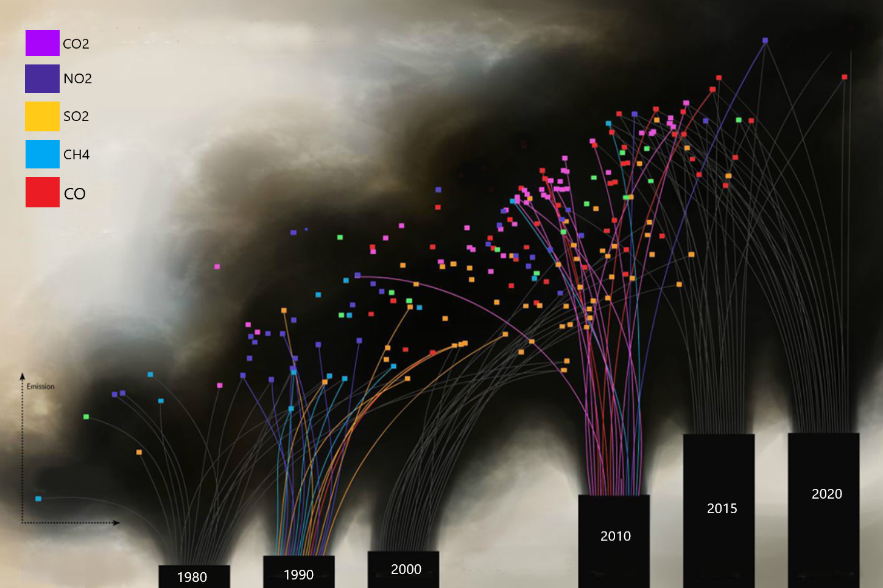
The History

Slide 13
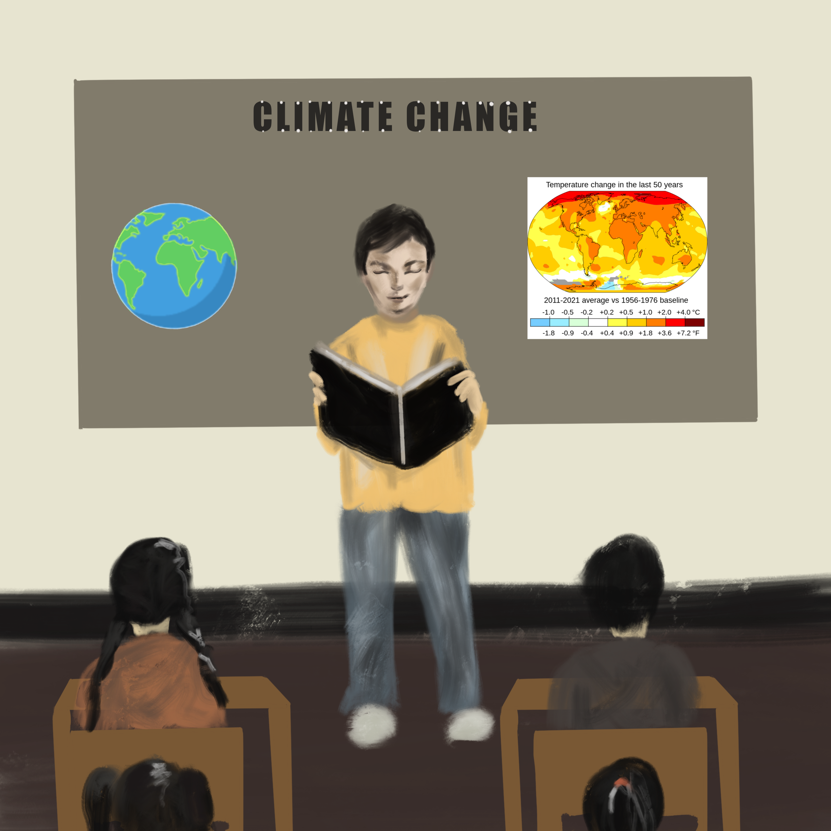
Amit learns about climate change and COP-26 goals and discusses that with his class

Slide 14
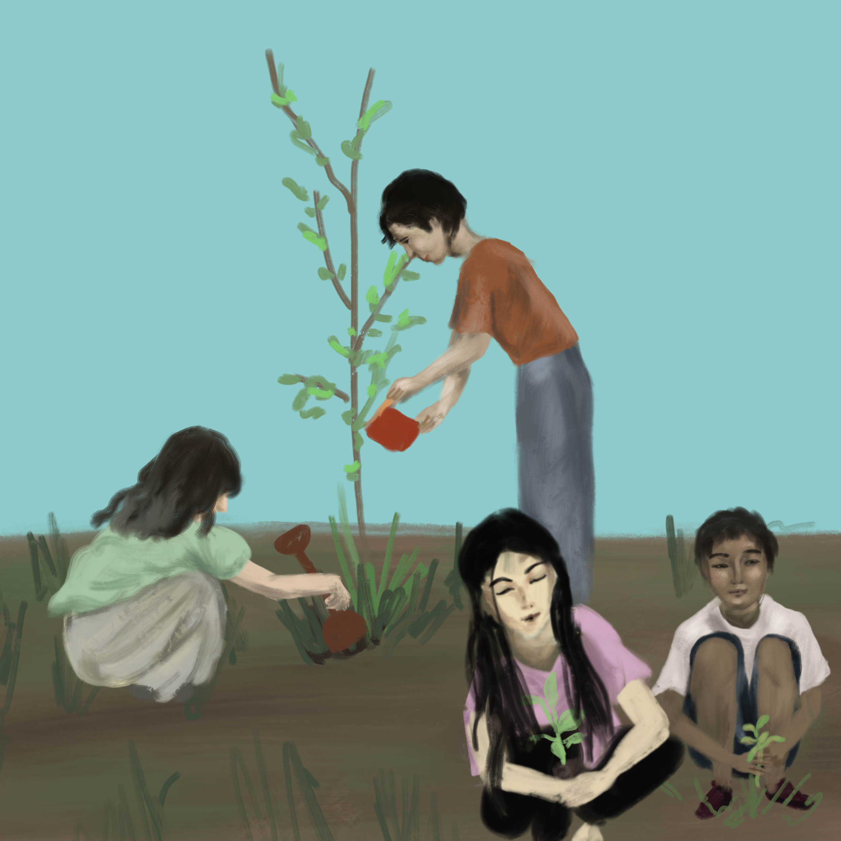
Amit takes the initiative to help reach the goals.
He organizes a tree plantation movement on Earth Day in the school with his friends and classmates and plant more than 1000 trees in one day.

Slide 15
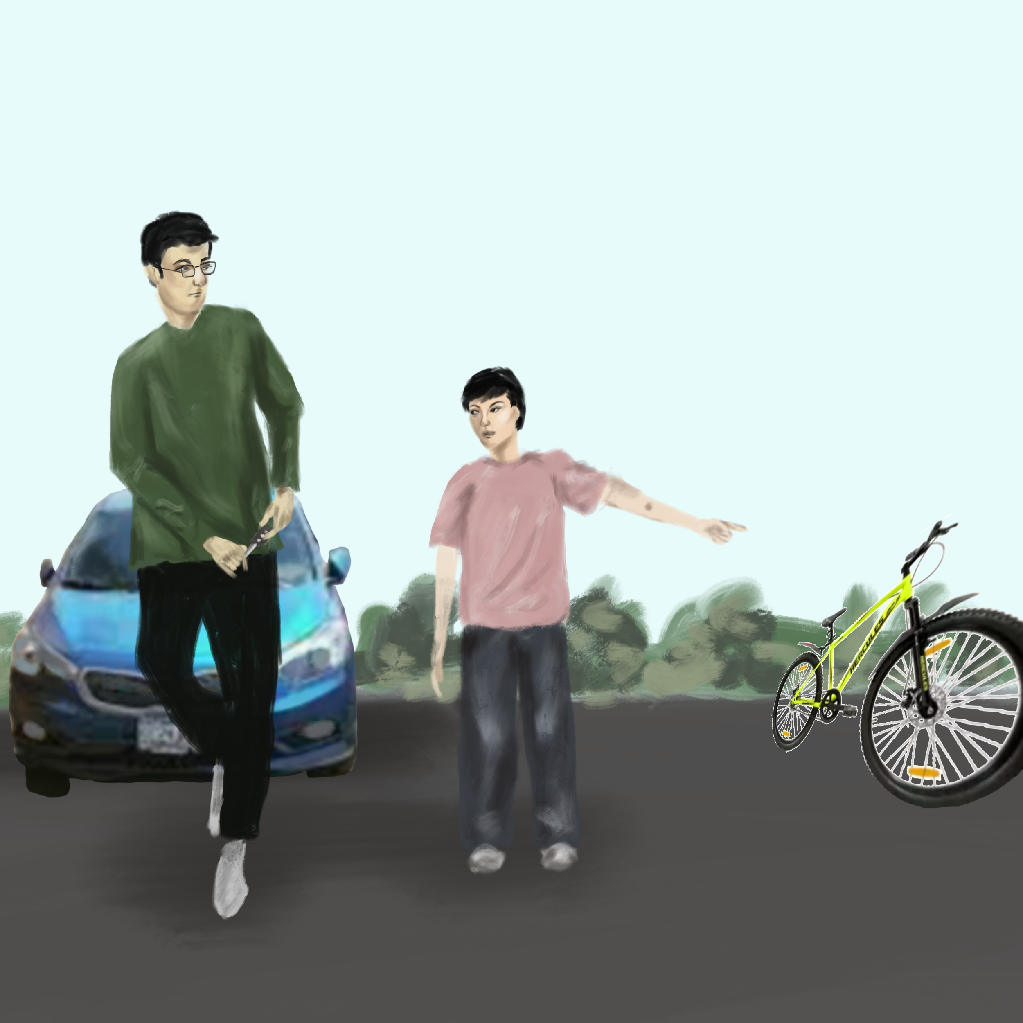
Students also educate their parents to use less polluting alternatives which helps the environment.

Slide 16
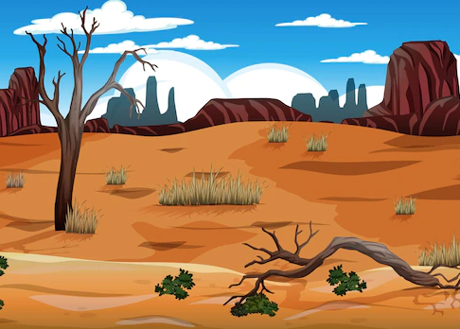
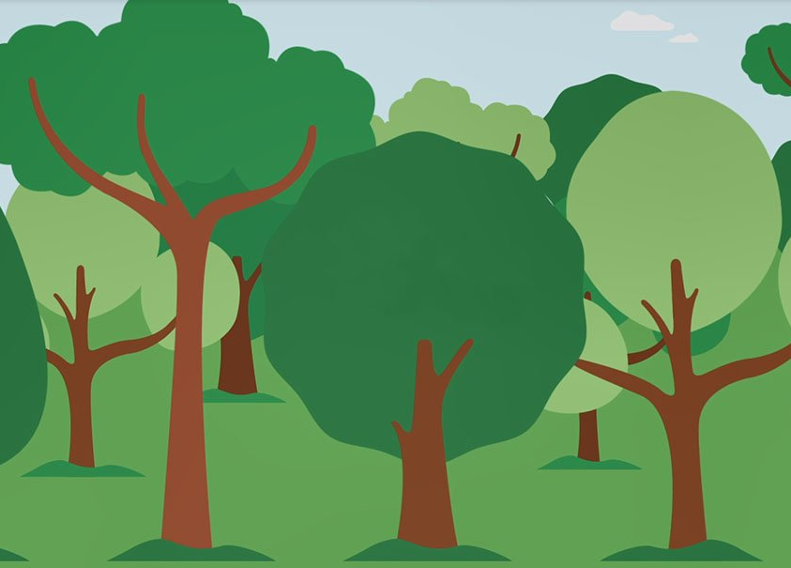
A Small step can go a long way….
Before
After

Slide 17
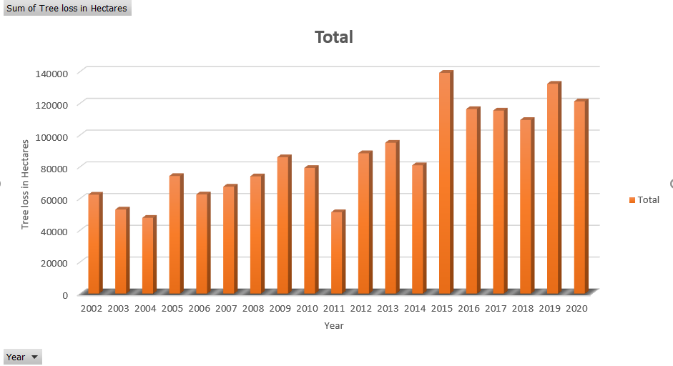
Data
CO2 Emissions and Tree loss over years

Slide 18
Data Sources
https://data.worldbank.org/indicator/EN.ATM.CO2E.KT?end=2018&locations=IN&start=1960&view=chart
https://rainforests.mongabay.com/deforestation/archive/India.htm
https://www.intechopen.com/chapters/66710
https://www.globalforestwatch.org/dashboards/country/IND/

