Slide 1
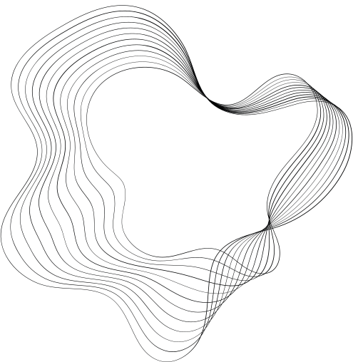


UNHINGED
GROUP 16
UNHINGED
PRESENTED BY JOHN | JORDAN | NICOLAS | RAMIT | WILLIAM | YUHENG

Slide 2


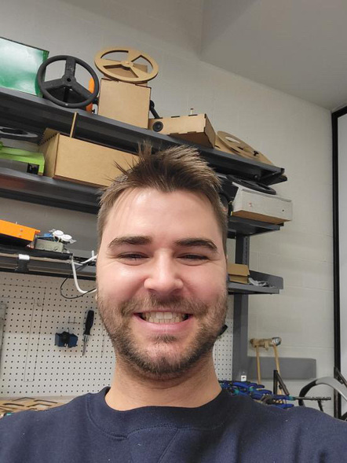
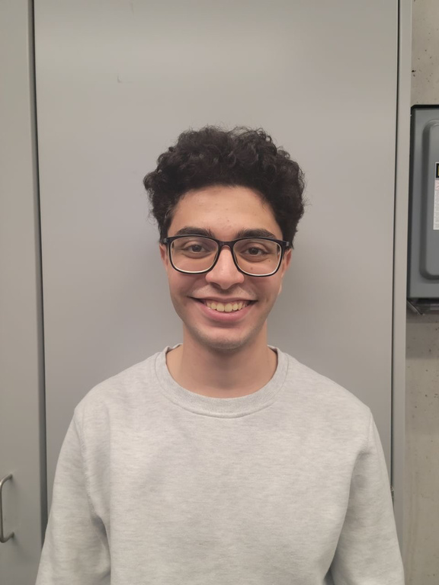
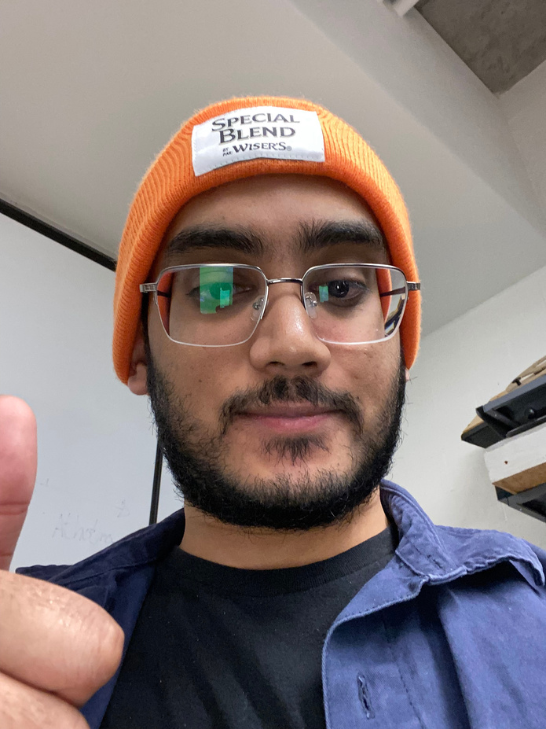
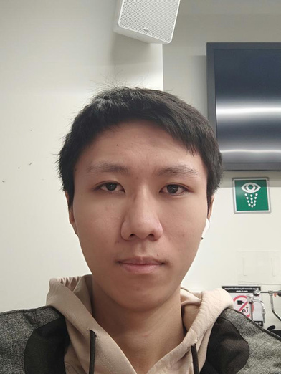

OUR TEAM
Nicolas Alvarez
William Mackey
Jordan DeRose
John Abdelmessih
Ramit Iqbal
Yuheng Wang
Project Manager
Engineer
Engineer
Quality Controller
Designer
Report Writer & Marketer
UNHINGED

Slide 3

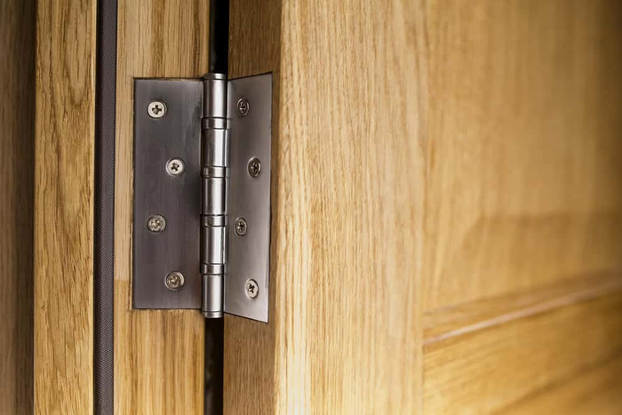
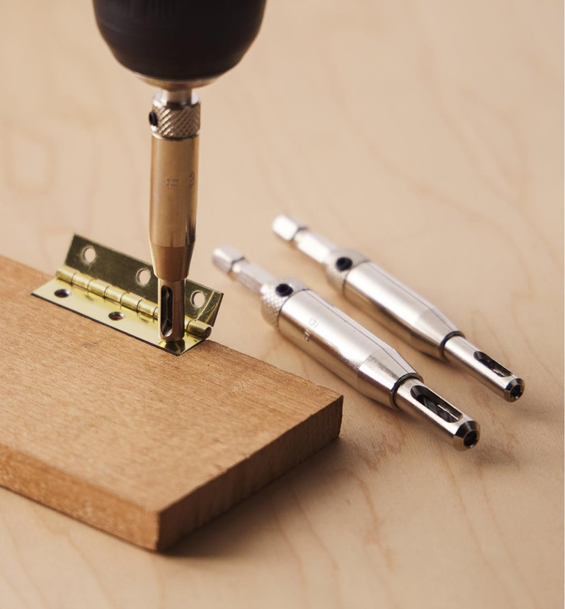
BACKGROUNG
  AMBICO makes doors.
  A single worker spends too much time marking and drilling the holes for the hinges.
  Create a jig for the placement of hinges on the wooden doors.
  The jig must save time to the workers.
  Able to ensure straight drilling/tapping (guides).
  Easy to use.
  Doesn’t damage the wood on the door.
  Light weight.
  Portable/Durable.
UNHINGED

Slide 4
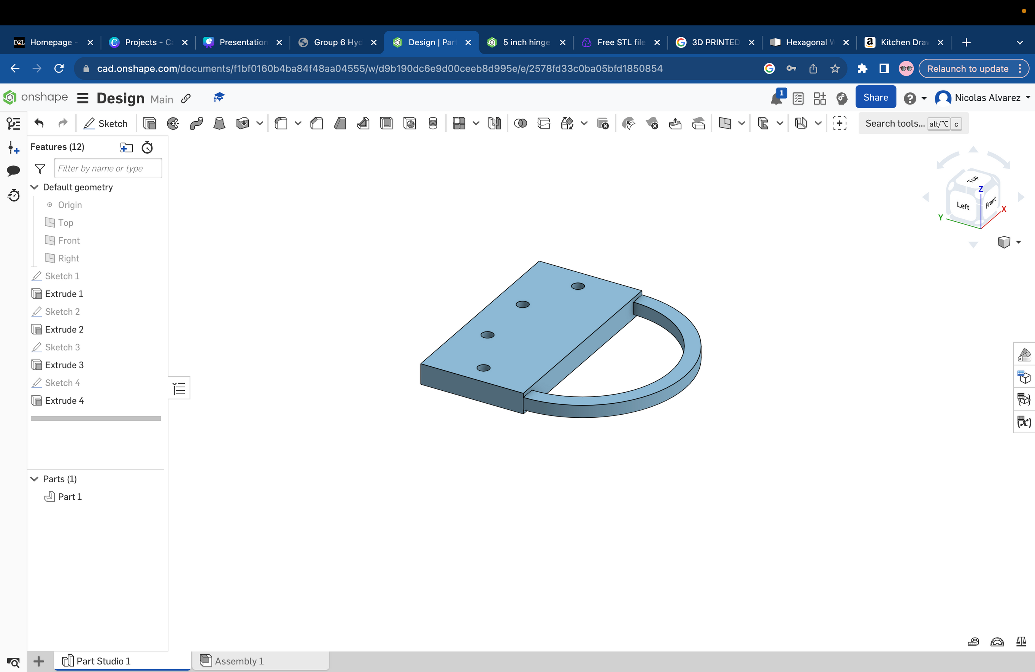
INITIAL IDEAS
UNHINGED
  Simple.
  Two pieces of metal for the two different sizes of hinges.
  Has a handle for the worker to hold while drilling.
  Contains holes that will guide the drilling process.
  It is expected to speed up the processes.
  Due to the material and simplicity, it should last for years.

Slide 5

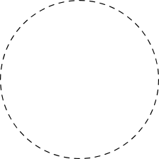
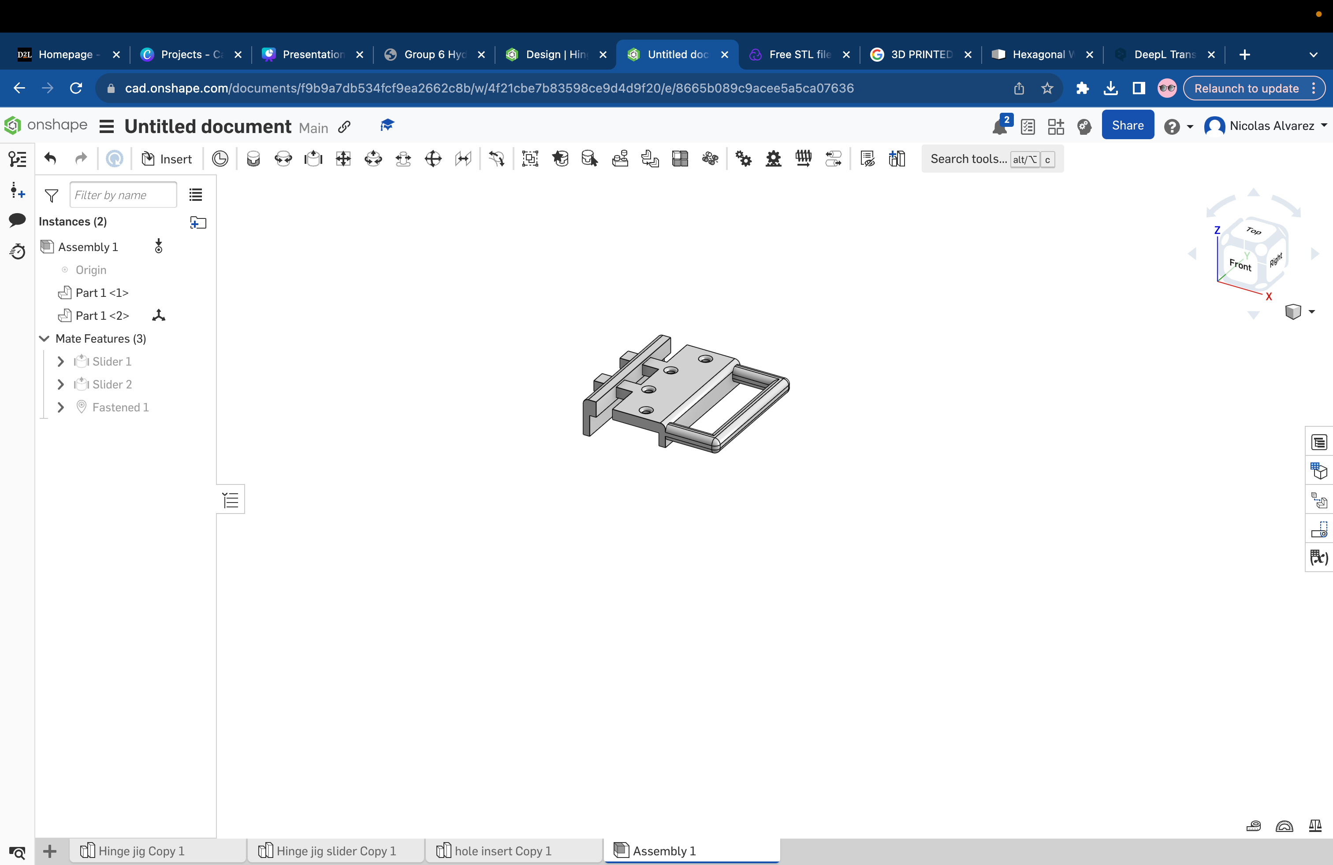

INITIAL IDEAS
UNHINGED
  Easy and practical to use.
  Adjust to any backset size.
  Comes with holes that guides the drilling and tapping processes.
  Uses a foam on the surface where it contacts the door.
  At the end of the clamp, the worker must insert two screws to keep the clamp static

Slide 6
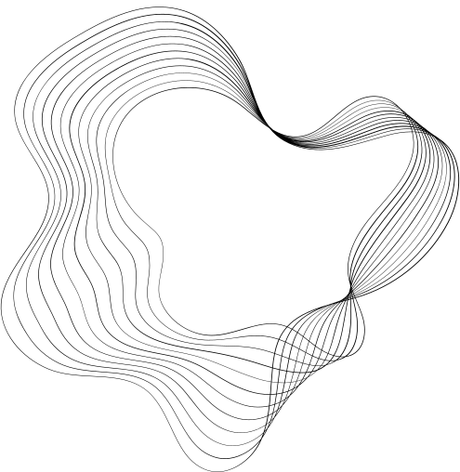

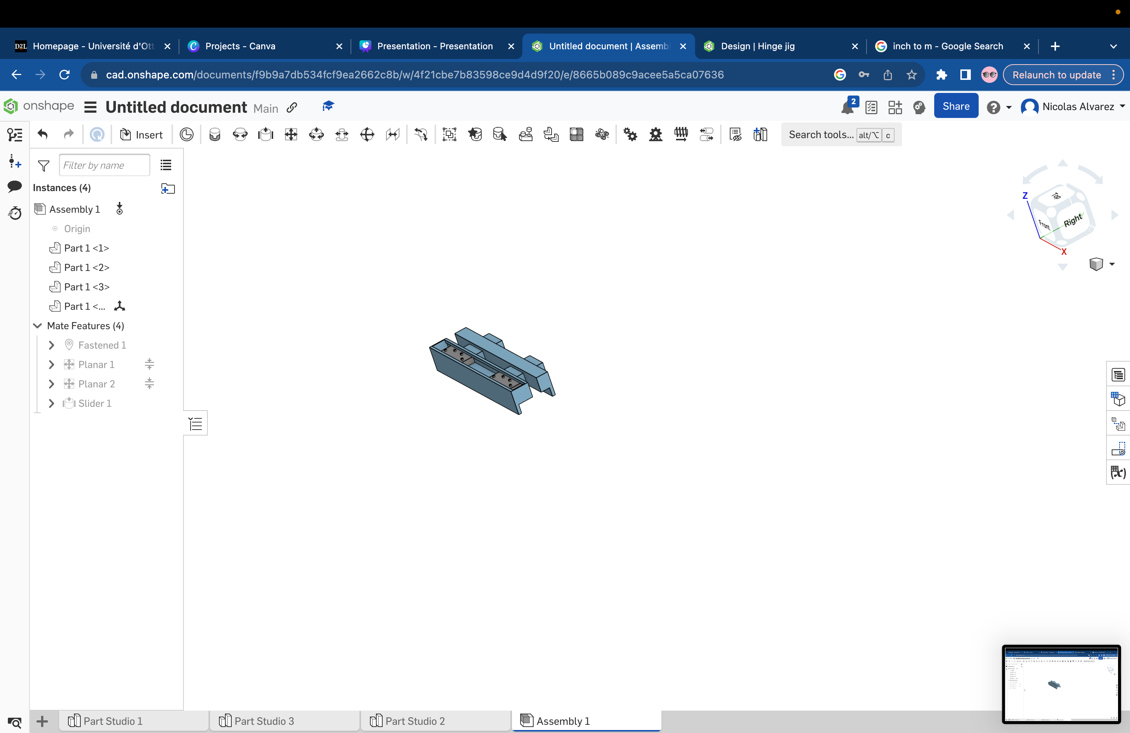
INITIAL IDEAS
  Similar to a sliding door.
  The hinges are set on a track that would allow them to move up and down the jig.
  Uses a foam on the surface where it contacts the door.
  The holes will come out about 1/2''
  Marking process will be eliminated.
UNHINGED

Slide 7
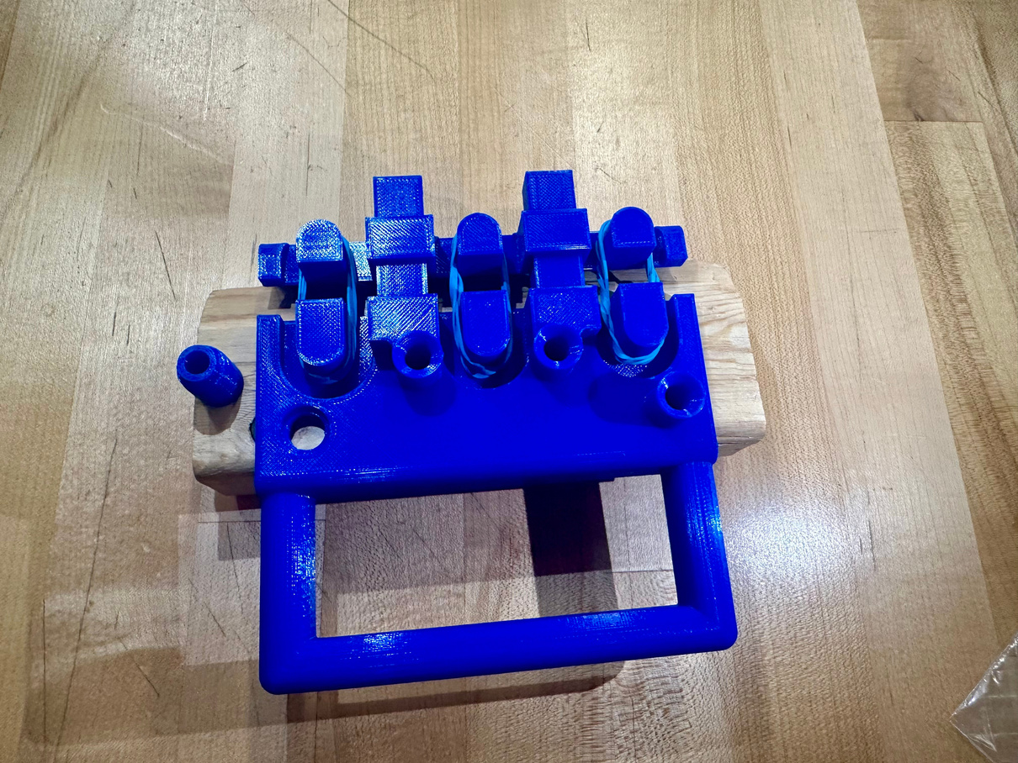
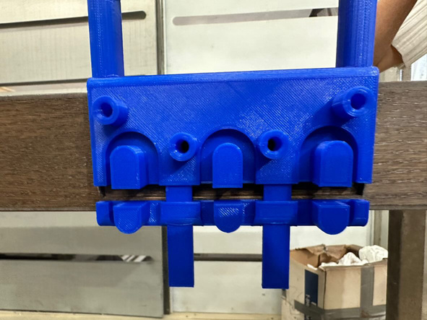
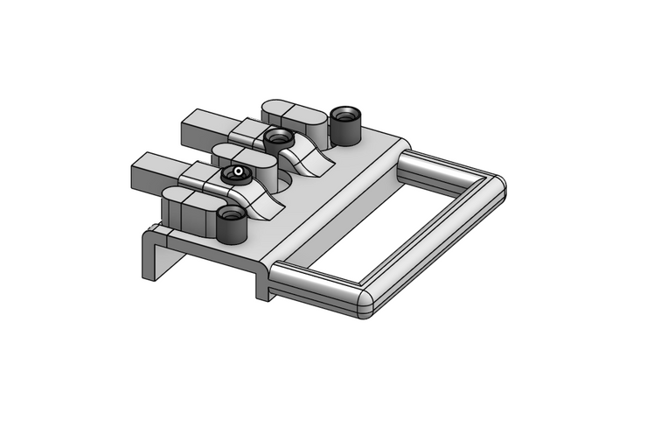
FINAL PROTOTYPE
UNHINGED
  U-shaped clamp design with rubber band mechanism.
  Extended metal nozzles that will guide the drilling process.
  3D printed.
  Dense rubber pad under the clamps to prevent scratching.
  Perfect grip.
  Easy to use with no knowledge or experience.
  Removable nozzles.
  Two different sizes (4.5' and 5') able to adjust to different backsets.

Slide 8

IMPACT
01
02
03
04
TIME SAVING
COST SAVING
NO EXPERIENCE
LAST LONGER
  Removes the need for marking.
  Can be used with one hand.
  Makes possible to make 1 to 2 more doors per day.
  Time = money
  Replace only the nozzles.
  Competitive prices among other projects.
  It’s easy to use.
  Everyone can use the prototype even without experience.
  Reusable materials.
  Metal nozzles last longer.
  Durable materials.
UNHINGED

Slide 9

BILL OF MATERIALS
 | Measurement | Quantity | Unit Price | Final Prize
3D Filament | kg | 1 | $33,90 | $33,90
Elastics | bags | 1 | $1,00 | $1,00
Nuts & Bolts | bags | 1 | $5,00 | $5,00
TOTAL | TOTAL | TOTAL | TOTAL | $39,90
UNHINGED

Slide 10

QUESTIONS?
UNHINGED

Slide 11

THANK YOU FOR YOUR ATTENTION
UNHINGED

