Slide 1
Modular Garden Shelf
Katarina Vrdoljak,
Sophia Cino Zarco,
Roeg Hildebrandt,
Tomas Reeves Alvarez,
Daniel Martial,
Stavan Vyas

Slide 2
FACT
About one in six Canadian children under the age 18 suffer from food insecurities. This unfortunate statistic only grows when it comes to indigenous children.
1 in 6

Slide 3
Challenge
Build a cost-effective and sustainable, modular hydroponic green-house/grow wall.

Slide 4
Solution
Modular Garden shelf

Slide 5
The Garden Boxes
Unique
Tested
Unique sliding design to easily change the height at will.
Can hold up to 30 kg per shelf.
User friendly
Authentic
Very user friendly and versatile.
Built from the heart for the kids.

Slide 6
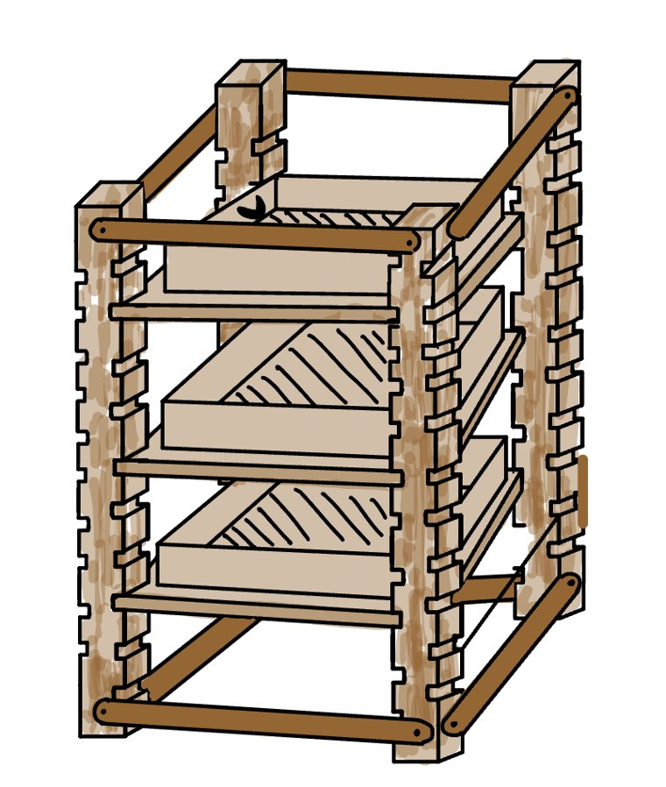
Versatility
This shelf can either be part of one big unit, or with one small modification, be transformed into two smaller units to fit any space.

Slide 7
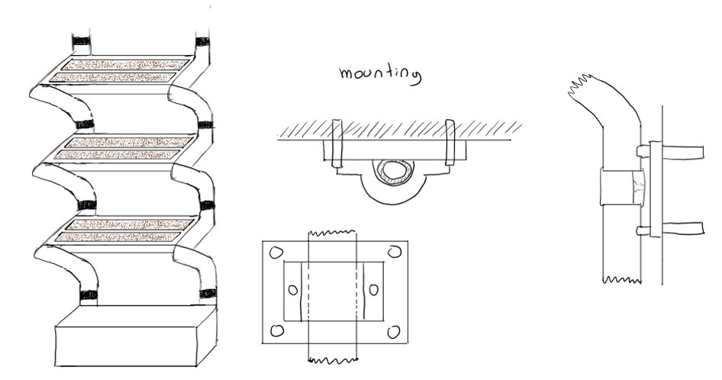
Prototyping

Slide 8
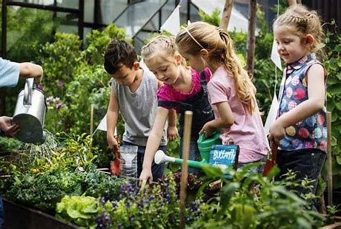
Why choose us?
Built from the heart.
Built in the community center with kids in mind.
Built for the inside, to make sure kids have year-round fresh fruits and vegetables.

Slide 9
The Modular Garden Shelf
Thank you

