Slide 1
Group 14
Erosion Stars

Slide 2
The Problem
Industrial researchers and engineers need a quick, safe, and reliable way to test part lifespan under water erosion.
Dams, boats, and water pumps all rely on some form of spinning part that is exposed to large amounts of force and pressure.
The failure of these parts can damage the larger system.

Slide 3
Need Specification
Reliability | Efficiency | Safety
The system should generate reliable data | The system should be capable of erosion | The system must not be a danger to users.
The experiment results should be repeatable. | Lower experiment time and costs will be beneficial. | The system should not be pressurized or heated.
The flexibility of the system will be beneficial.

Slide 4
Inspirations
Hiroshima University | University of Kentucky | GIW Industries Inc. | American Society for Testing and Materials
Used an air gun to blast particles onto sample. | Blasted concrete samples with pressurized water. | Blasts rotated sample with an abrasive slurry. | Uses a wheel to fling abrasive slurry at sample.

Slide 5
Our Solution
What we propose:
Spin the test component for erosion.
Use a sand slurry to minimize time spent.
Variable rotation speeds.
Variable abrasive-water ratio.

Slide 6
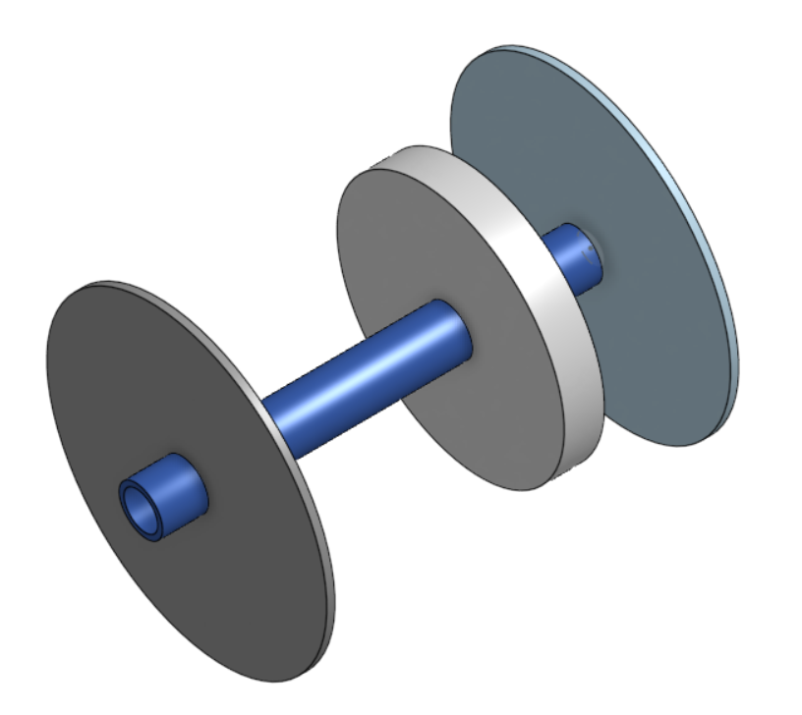
Our Solution
Concept Design:

Slide 7
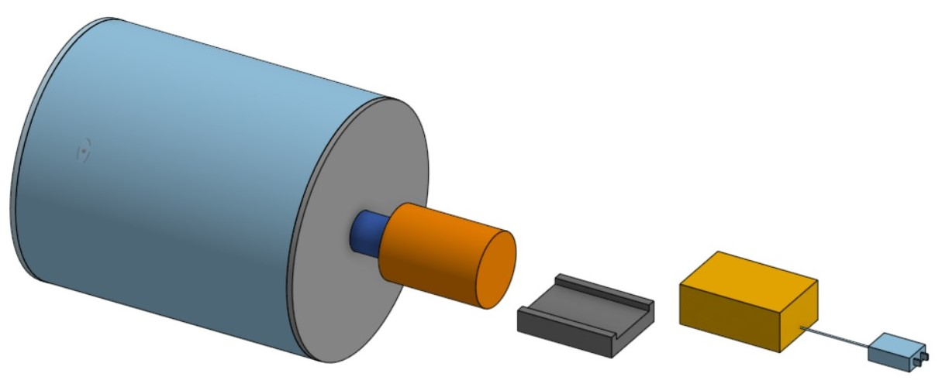

Slide 8
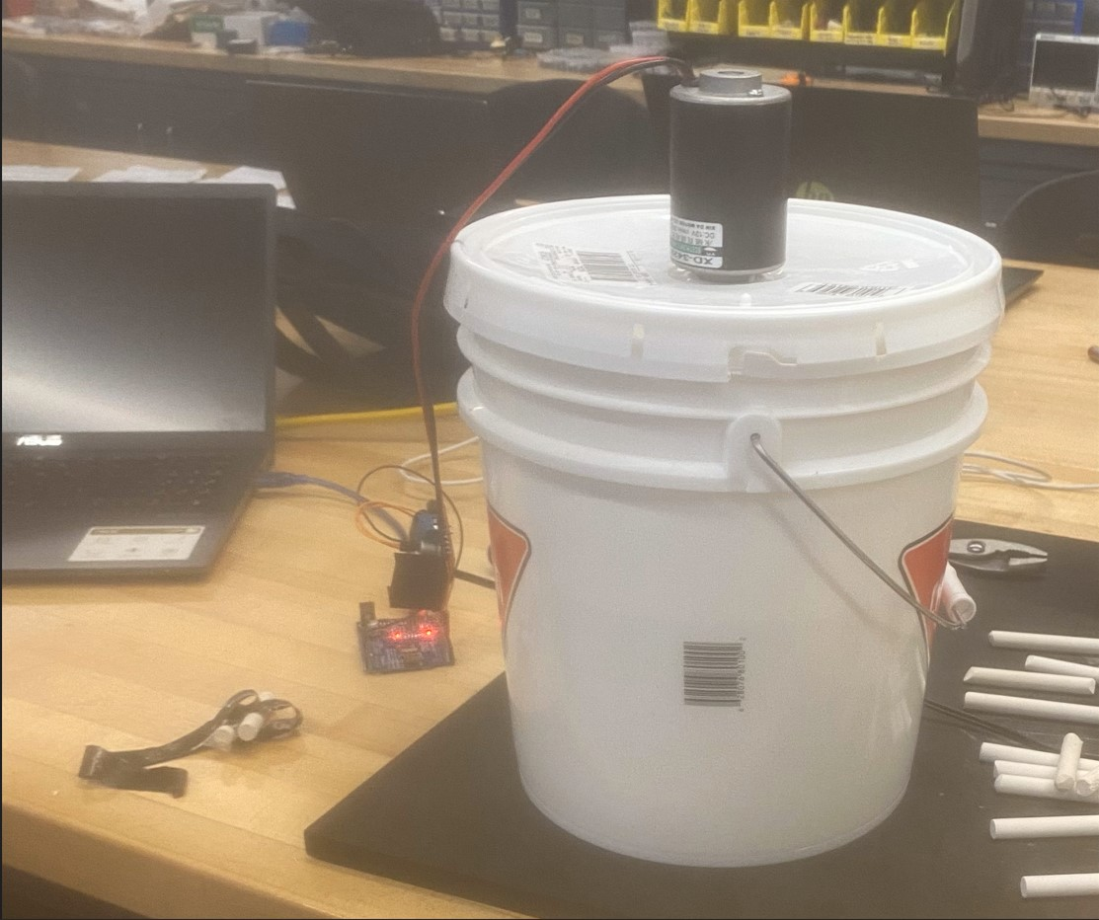
Our Solution
Finished System:

Slide 9
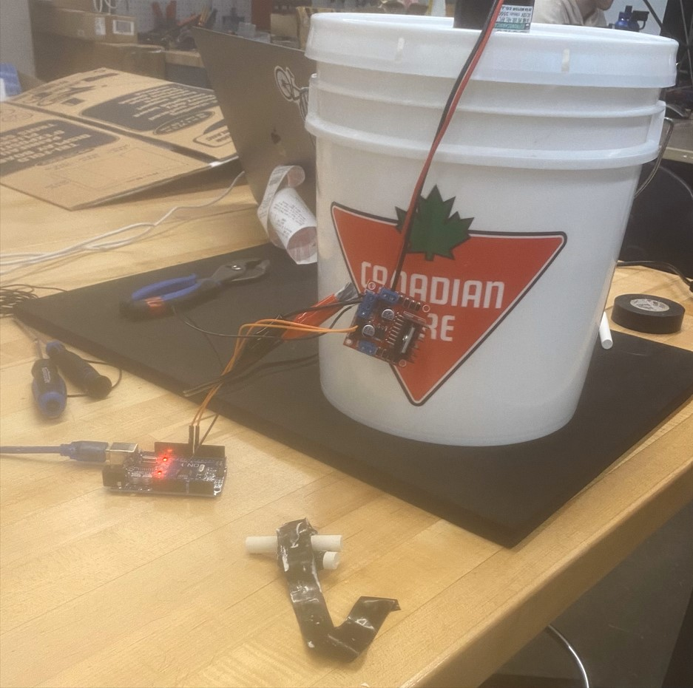

Slide 10
Spendings
Motor | $33.40
Axle | $12.90
Tank | $2.75
Motor Driver | $10.97
Microprocessor | $15.25
Power Adapter | $16.99
Wiring | $4.35
Total:
$96.65

