Slide 1
PRELIMINARY CONCEPTS PRESENTATION
By:
Belmkaddem Ziyad
Boulayad Zakariae
Brou Deva
Saliba Elie
Barroug Elmahdi

Slide 2
SUMMARY
Design criteria for the concept
Problem statement
Certain primitive solutions to the design problem
Decision matrix
Final solution
Your feedback and recommendations

Slide 3
DESIGN CRITERIA
Number | Needs | Design Criteria
1 | The system has a simple and user-friendly interface | Interface
2 | The system can operate independently of human intervention | Autonomy
3 | The system is precise | Reliability
4 | The system keeps track of entry and exit for articles | Access Tracking
5 | The system includes traceable smart chips | Spatial Localisation
6 | The system includes modern methods for digital addition and deletion | Digital Manipulation
7 | The system approves data fully and rapidly | Data Approval Efficiency
8 | The system notifies its users of any inventory modification | Alert
9 | The system can identify items through video recognition | Video Recognition
10 | The system can operate for a long duration of time | Longevity (Months)
11 | The system is affordable | Cost ($ CAD)
12 | The system can detect items from a long distance | Detection range (m)
13 | The system is customisable | Adaptability
14 | The system is portable and extremely light | Weight (lb)

Slide 4
PROBLEM STATEMENT
Our clients, Shared Services for Digital Platforms and Interoperations Canada, are seeking an intelligent, automated, and precise inventory management system for industrial and commercial storage facilities, in order to achieve peak efficiency. It is imperative that this solution is user-friendly and swift, ensuring it doesn't impede the productivity of the forementioned users.
The users, as such, aim to avoid the repurchase of inaccurately cataloged, faulty, or misplaced equipment.
The estimated budget is ~50 $ (CAD).

Slide 5
CERTAIN PRIMITIVE SOLUTIONS TO THE DESIGN PROBLEM
After analysing and interpreting the clients’ needs, based on the statements from the first client meet, our team determined that the spatial localisation of articles and items in-storage is a must. As such, the team put together a performance table for different localisation and tracking tags in the market, to deduce which one is most suitable for that objectif.

Slide 6
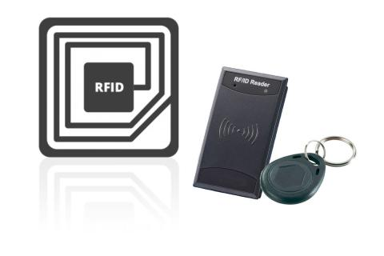
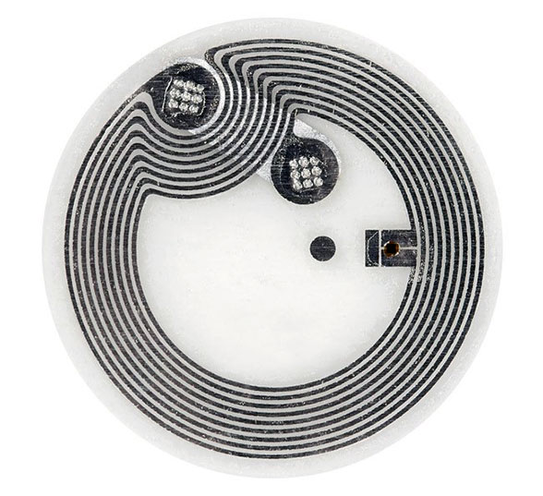
PS 1: The dimensions, longevity, frequency and operational distances of RFID and NFC tags are largely variable, depending on the specifications of the particular system ( antennae, diffusion and reading devices).
PS 2: The displayed prices may or may not be outdated, however the largest deviation does not go beyond ±~10$.
Type of tracking tag | AirTag | RFID tag | NFC tag
Productor | Apple (Foxconn) | ~Variable~ | ~Variable~
Mean Cost | ~30.00$ | ~112.50$ | ~1.00$
Operational Distance | ~10 m | ~10 m - ~100 m (up-to ~460 m for sophisticated chips) | ~0.05 m
Dimensions | 31.9 x 31.9 x 8 mm | -Minimum (read-only): 3 mm -Maximum (read and diffuse): 5 cm | -Minimum: 6 mm -Maximum: 85 mm x 55 mm
Signal Type | Bluetooth | Radio | Radio
Frequency | 2.4 GHz | 125 KHz - 30 MHz | 125 KHz - 30 MHz
Weight | 0.39 oz | 0.06 oz | 0.01 oz
Longevity | 1 Year | 20-50 years | 10-50 years
Attachment | Straps/Adhesive | Adhesive | Adhesive

Slide 7
DIFFERENT PRELIMINARY SOLUTIONS
Each team member was tasked with putting together a comprehensive, homogenous system, dissected into three main concepts, called sub-systems:
Sub-system 1: Data-flow chart
Sub-system 2: Mobile app design (Interface, functions and features, …)
Sub-system 3: Scanner and tag reader

Slide 8
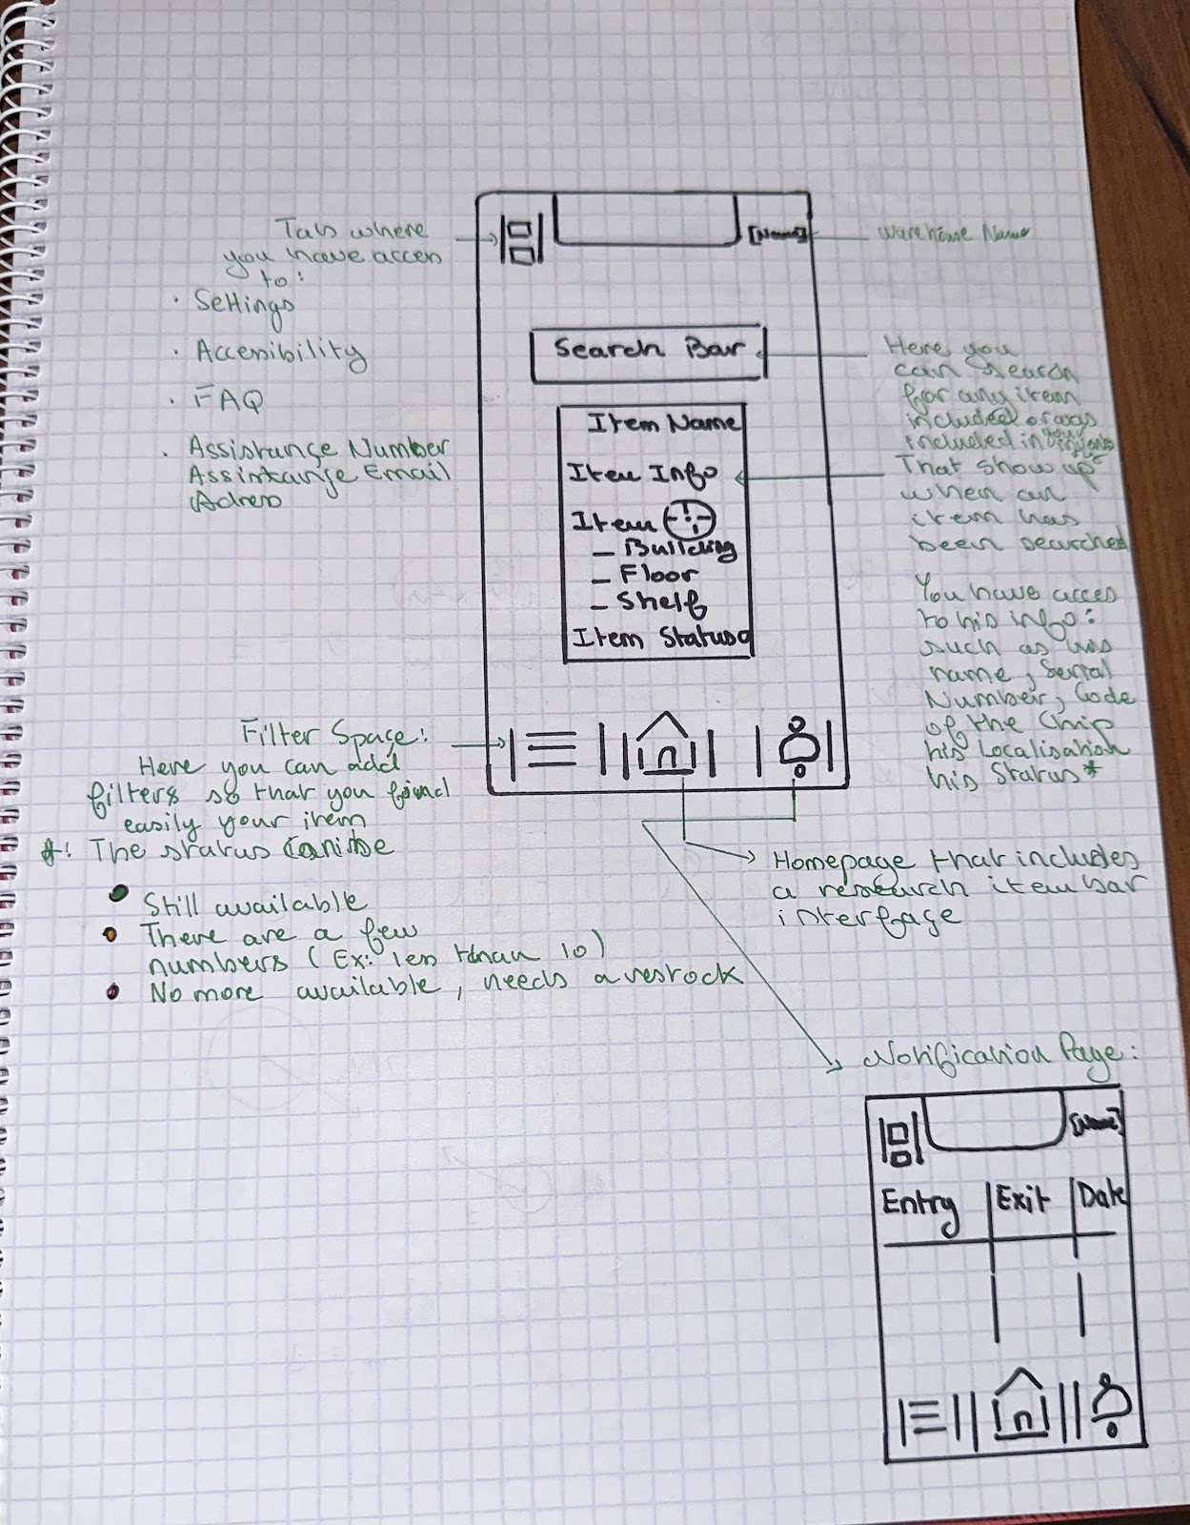
Solution 1: Belmkaddem Ziyad
Sub-system 2

Slide 9
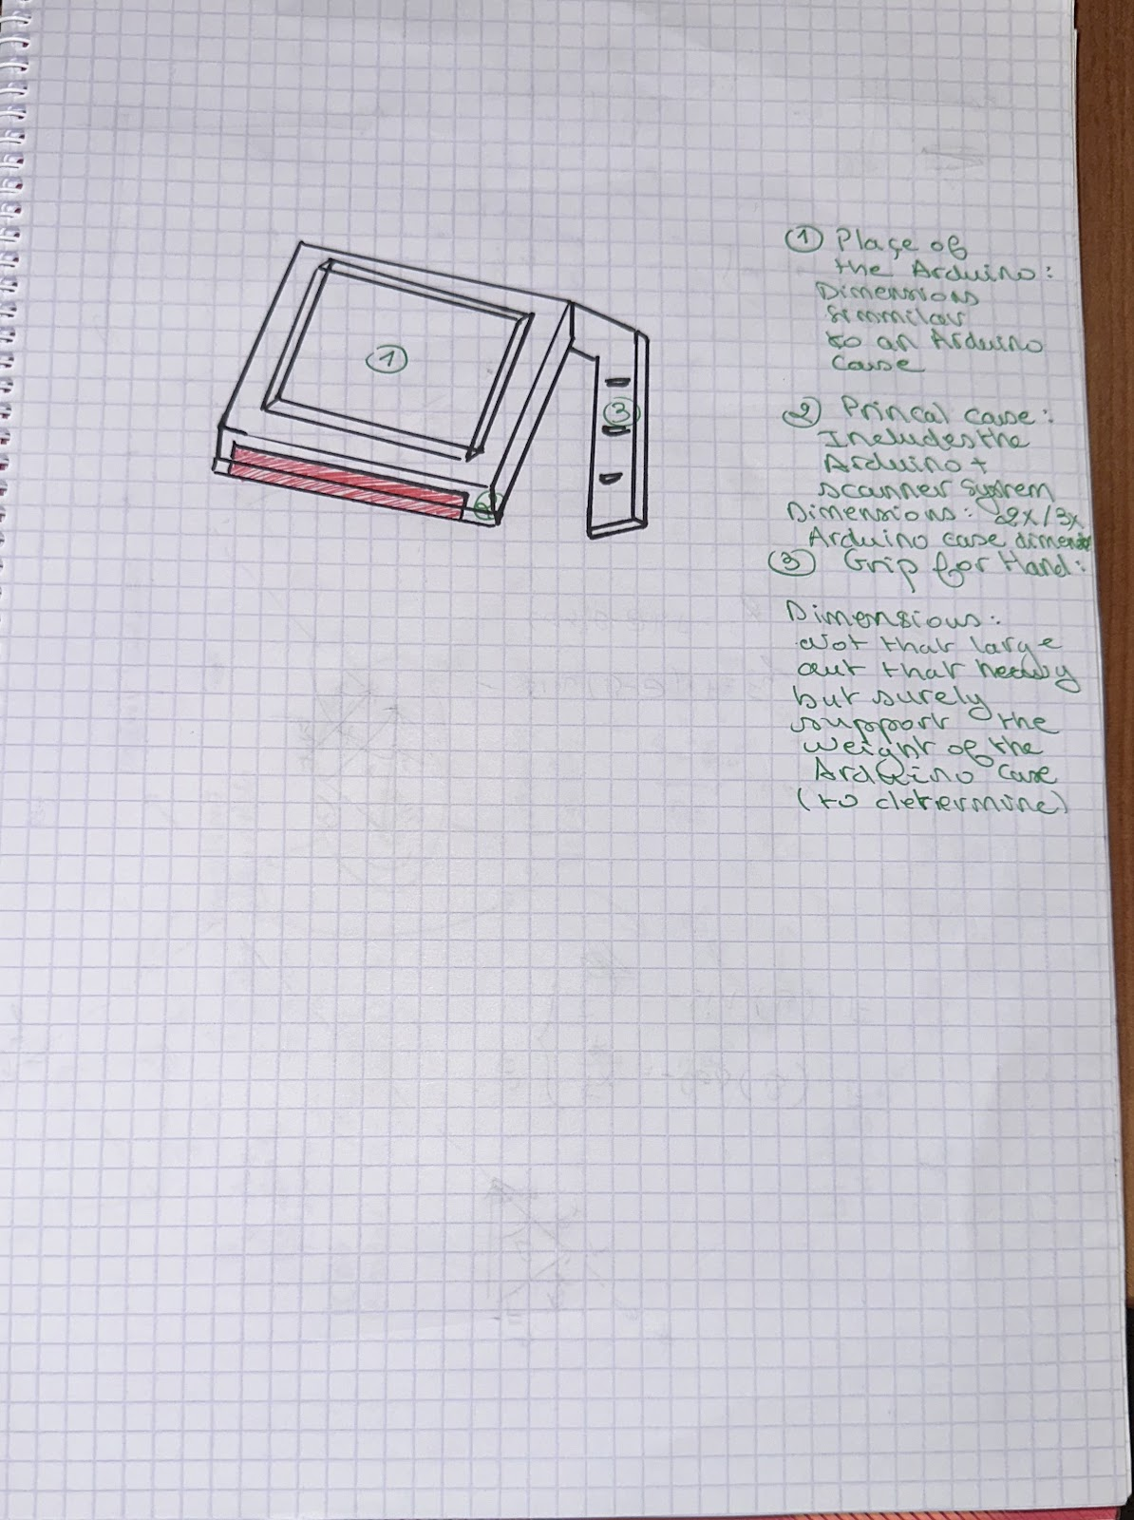
Solution 1: Belmkaddem Ziyad
Sub-system 3

Slide 10
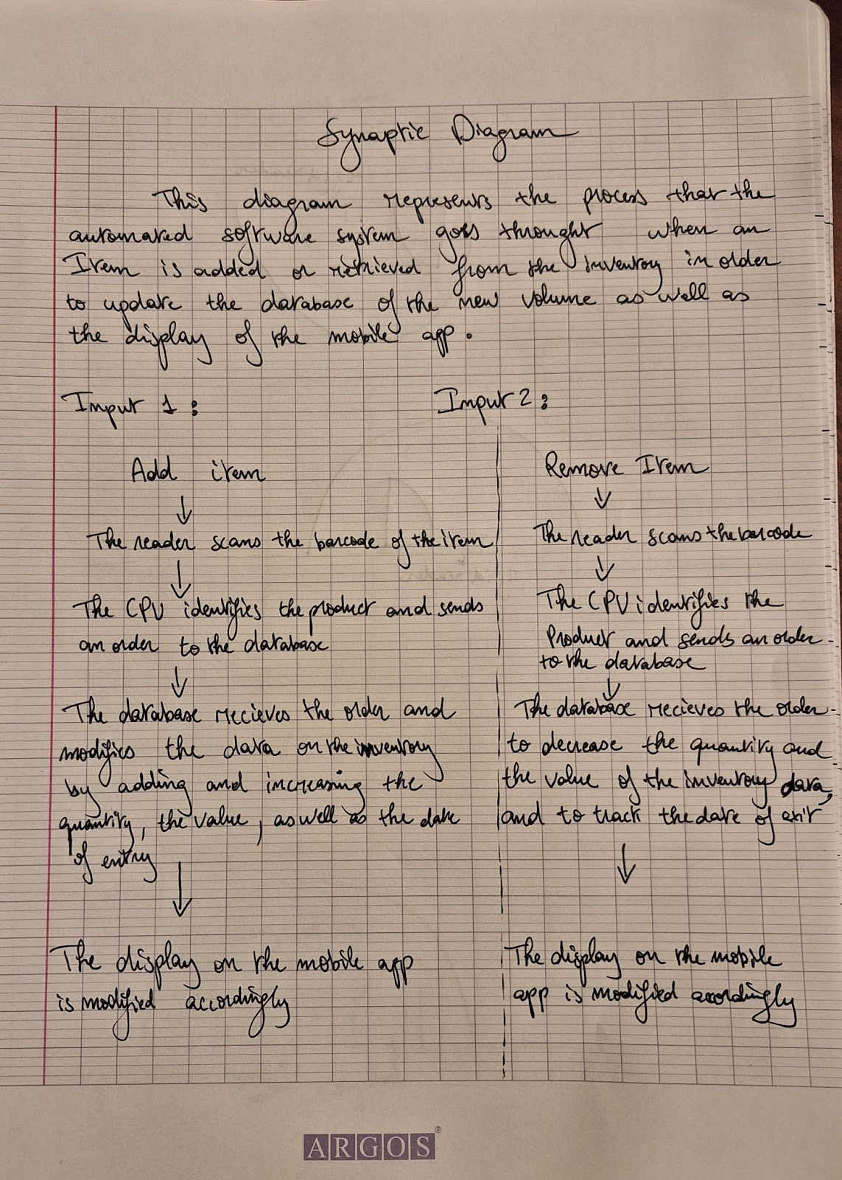
Solution 2: Saliba Elie
Sub-system 1

Slide 11
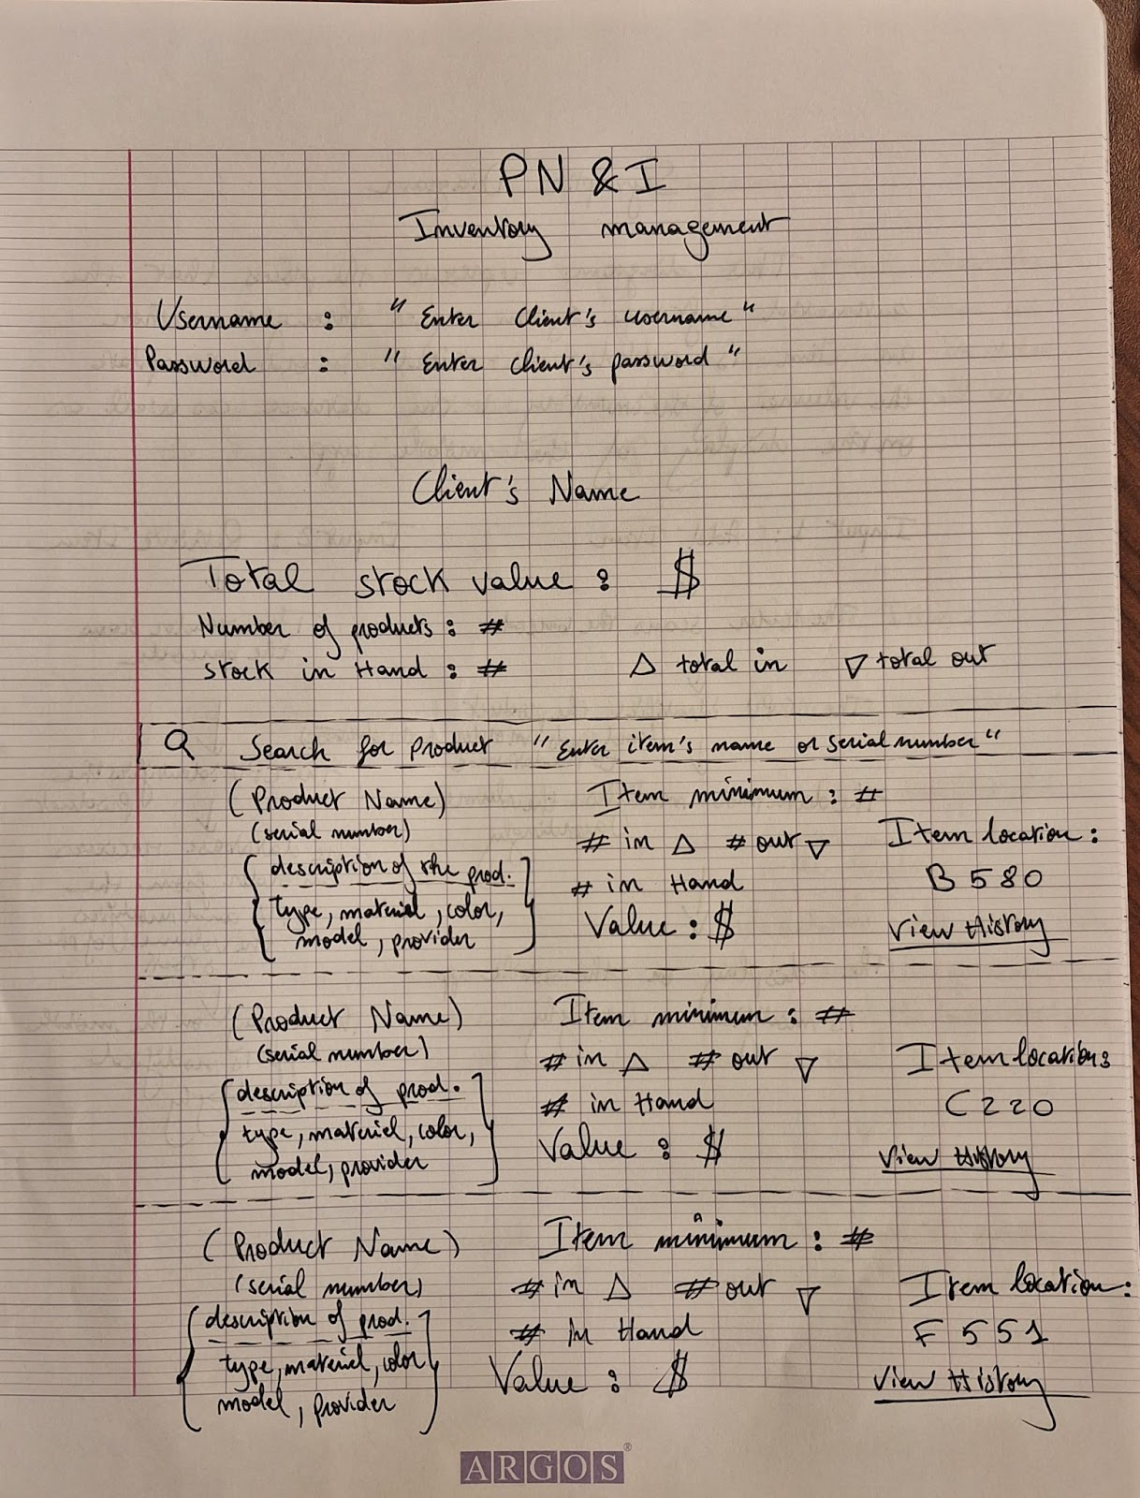
Solution 2: Saliba Elie
Sub-system 2

Slide 12
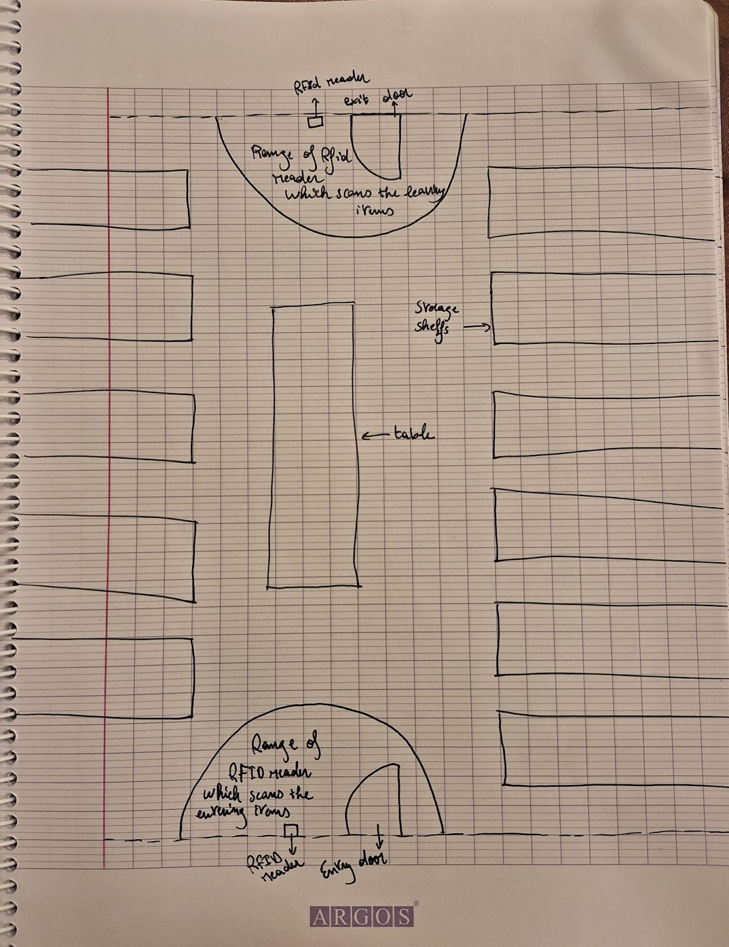
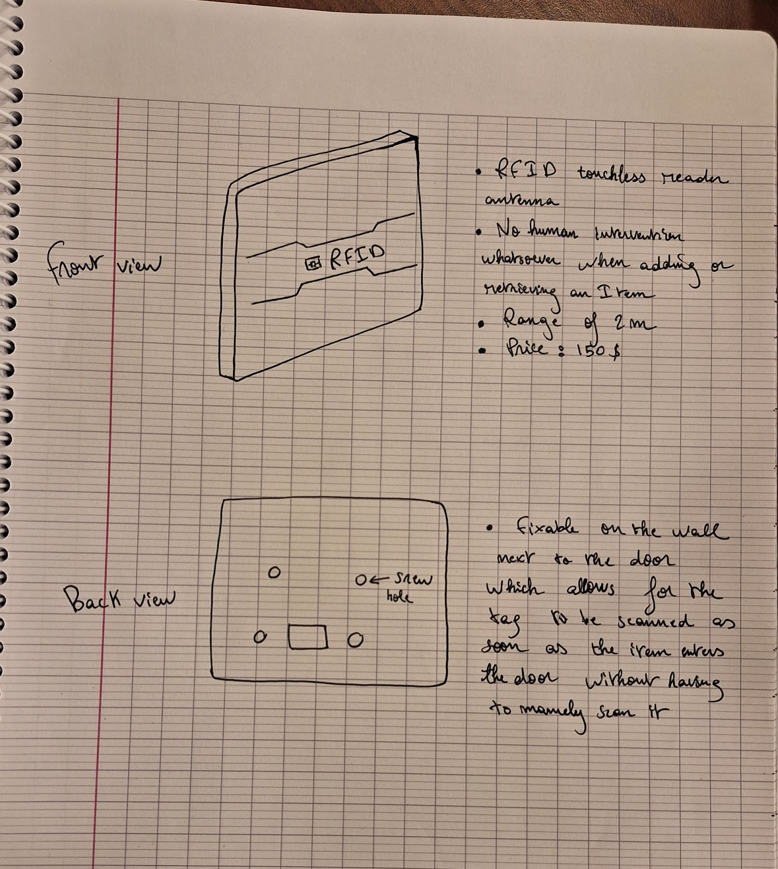
Solution 2: Saliba Elie
Sub-system 3

Slide 13
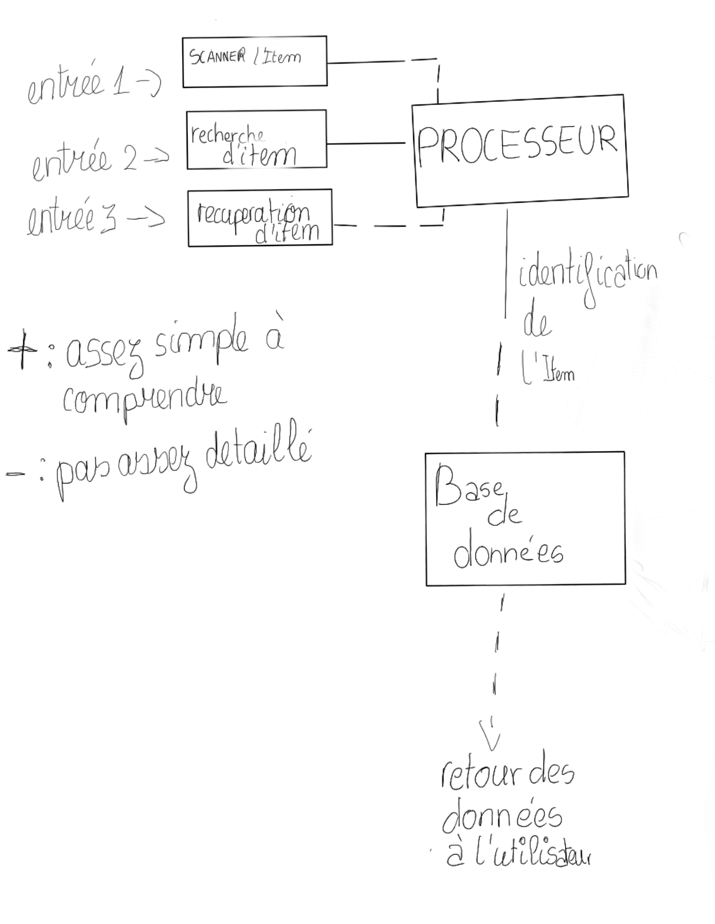
Solution 3: Brou Deva
Sub-system 1

Slide 14
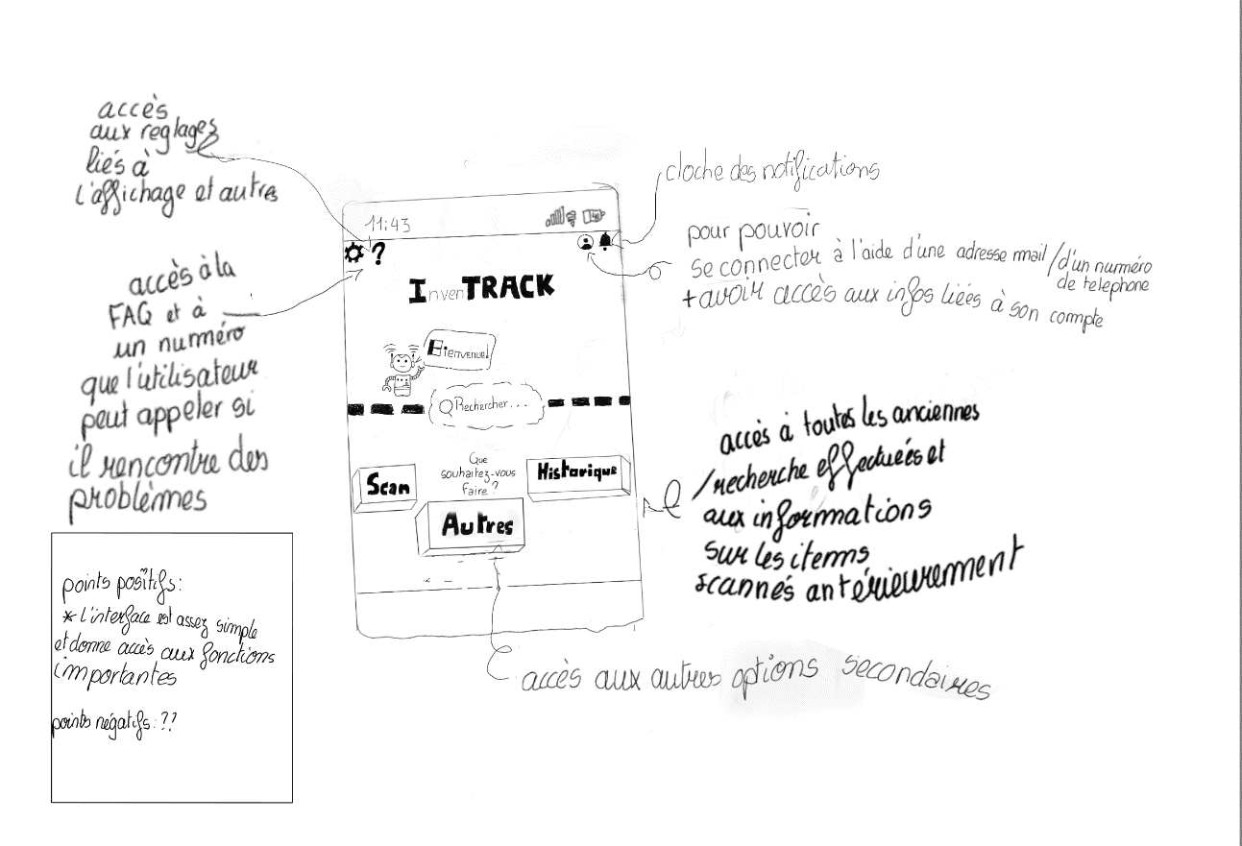
Solution 3: Brou Deva
Sub-system 2

Slide 15
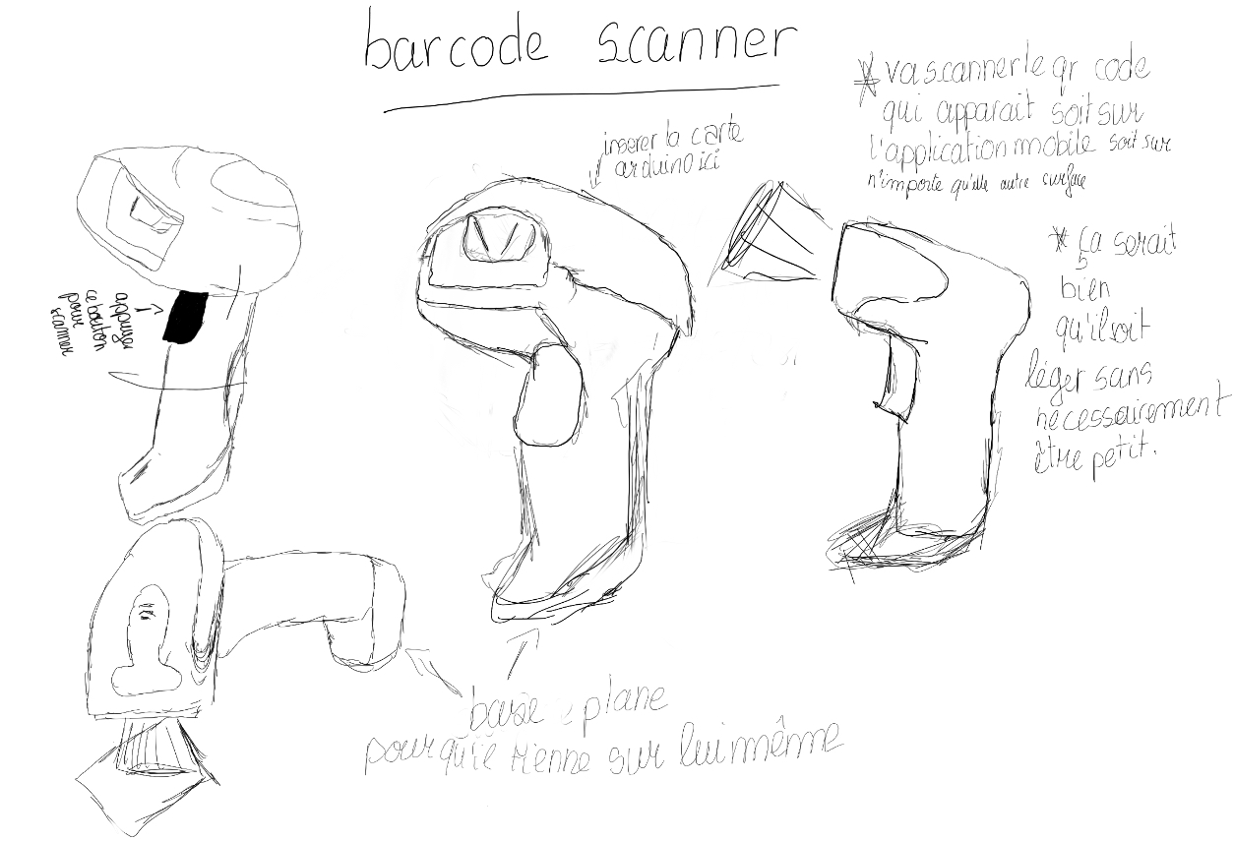
Solution 3: Brou Deva
Sub-system 3

Slide 16
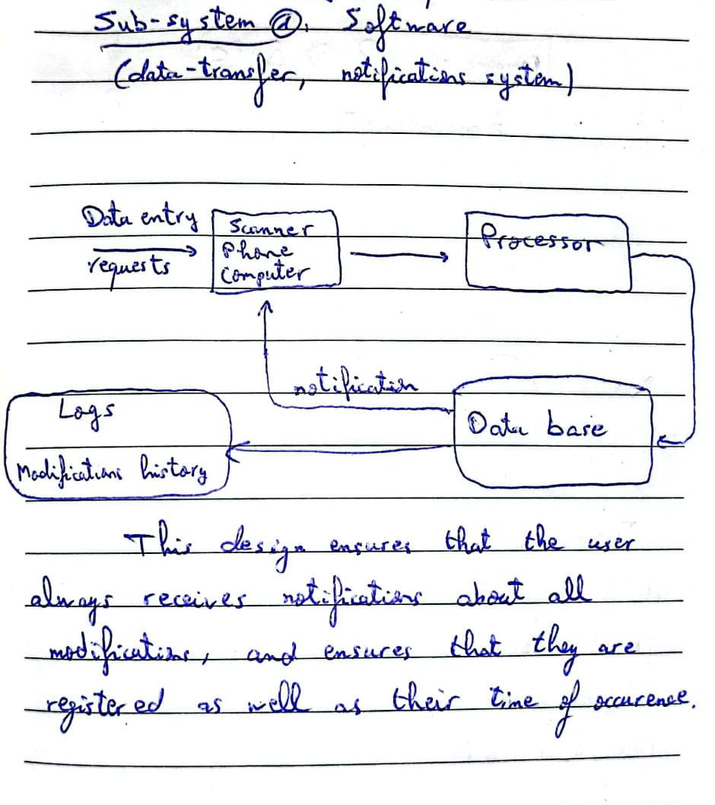
Solution 4: Boulayad Zakariae
Sub-system 1

Slide 17
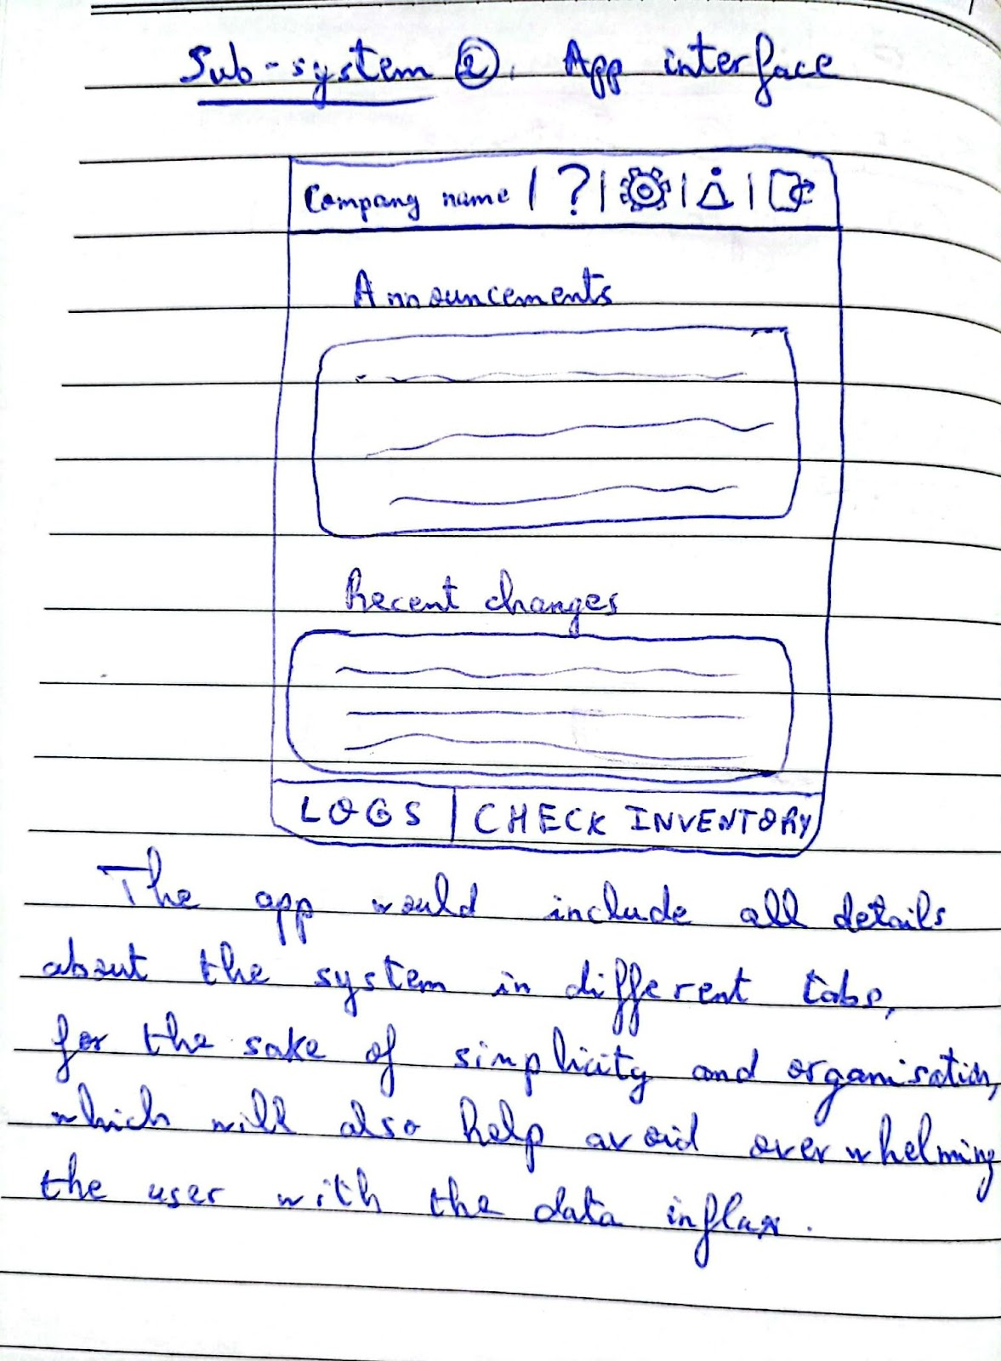
Solution 4: Boulayad Zakariae
Sub-system 2

Slide 18
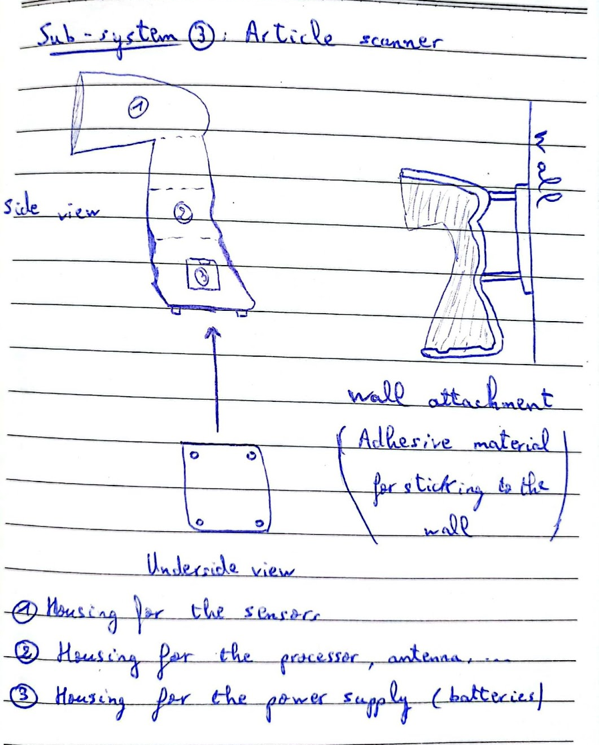
Solution 4: Boulayad Zakariae
Sub-system 3

Slide 19
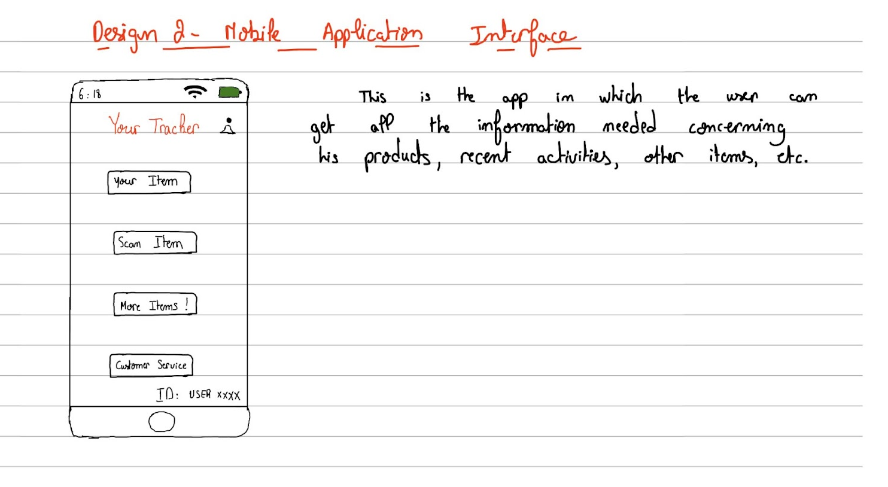
Solution 5: Barroug Elmahdi
Sub-system 2

Slide 20
Solution 5: Barroug Elmahdi
Sub-system 3

Slide 21
DECISION MATRIX
Priority number | Design Criteria | Ziyad’s Concept | Elie’s Concept | Deva’s Concept | Zakariae’s Concept | Mahdi’s Concept
4 | Interface | 2 | 2 | 3 | 1 | 1
5 | Autonomy | 2 | 3 | 2 | 2 | 2
5 | Reliability | 1 | 3 | 1 | 2 | 1
5 | Access Tracking | 3 | 3 | 3 | 3 | 3
5 | Spatial Localisation | 3 | 3 | 3 | 3 | 3
5 | Digital Manipulation | 3 | 3 | 3 | 3 | 3
5 | Data Approval Efficiency | 1 | 3 | 3 | 3 | 1
5 | Alert | 3 | 3 | 3 | 3 | 3
1 | Video Recognition | 1 | 1 | 1 | 1 | 1
3 | Longevity | 2 | 3 | 2 | 2 | 2
4 | Cost | 3 | 1 | 3 | 3 | 3
4 | Detection range | 2 | 3 | 2 | 2 | 2
4 | Adaptability | 3 | 1 | 3 | 2 | 2
2 | Weight | 2 | 3 | 2 | 2 | 2
Total |  | 127 | 147 | 130 | 138 | 123
PS: Priority scale : 5(High priority)→1(Low priority)

Slide 22
FINAL SOLUTION
A redesign of certain elements from Elie’s design, to cover the inconveniences that it may come with: Cost, adaptability, …
We decided to do that by merging Elie’s digital interface with Deva’s, while modifying Elie’s tag reader design.

Slide 23
FINAL SOLUTION
Sub-system 1

Slide 24
FINAL SOLUTION
Sub-system 2

Slide 25
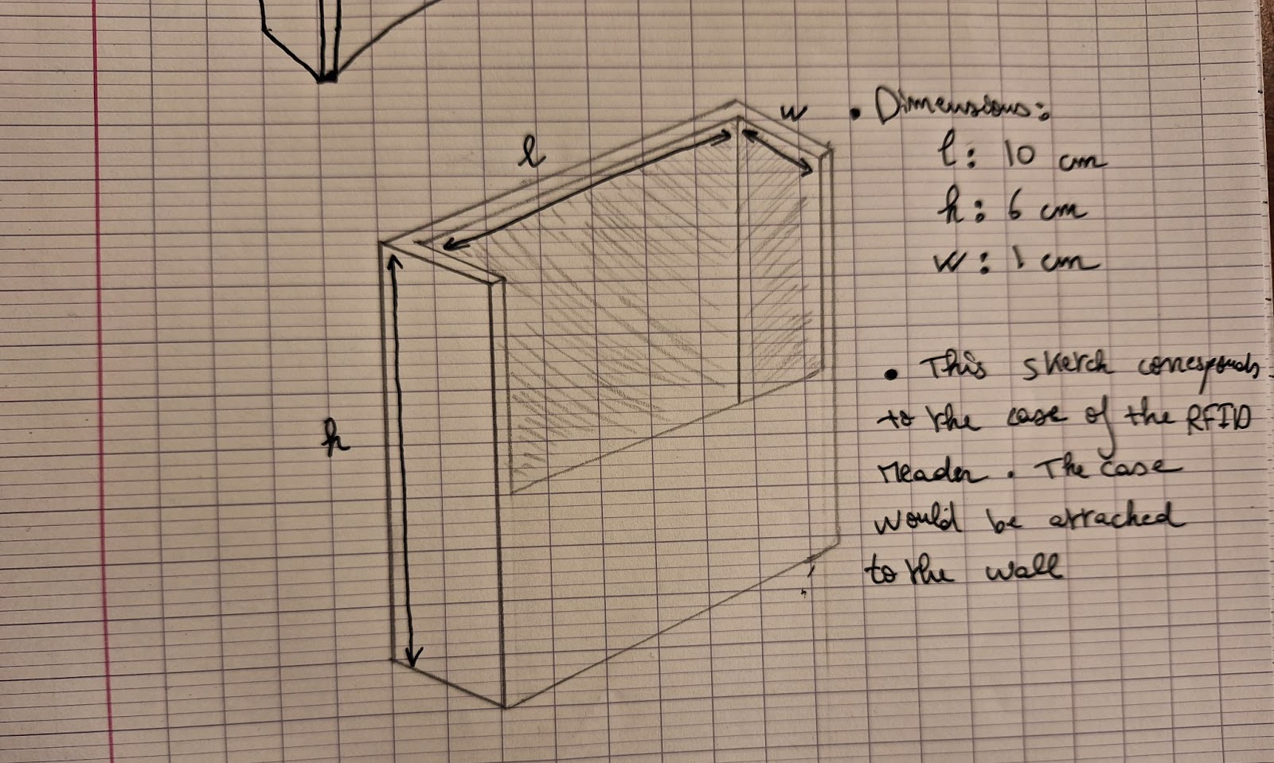
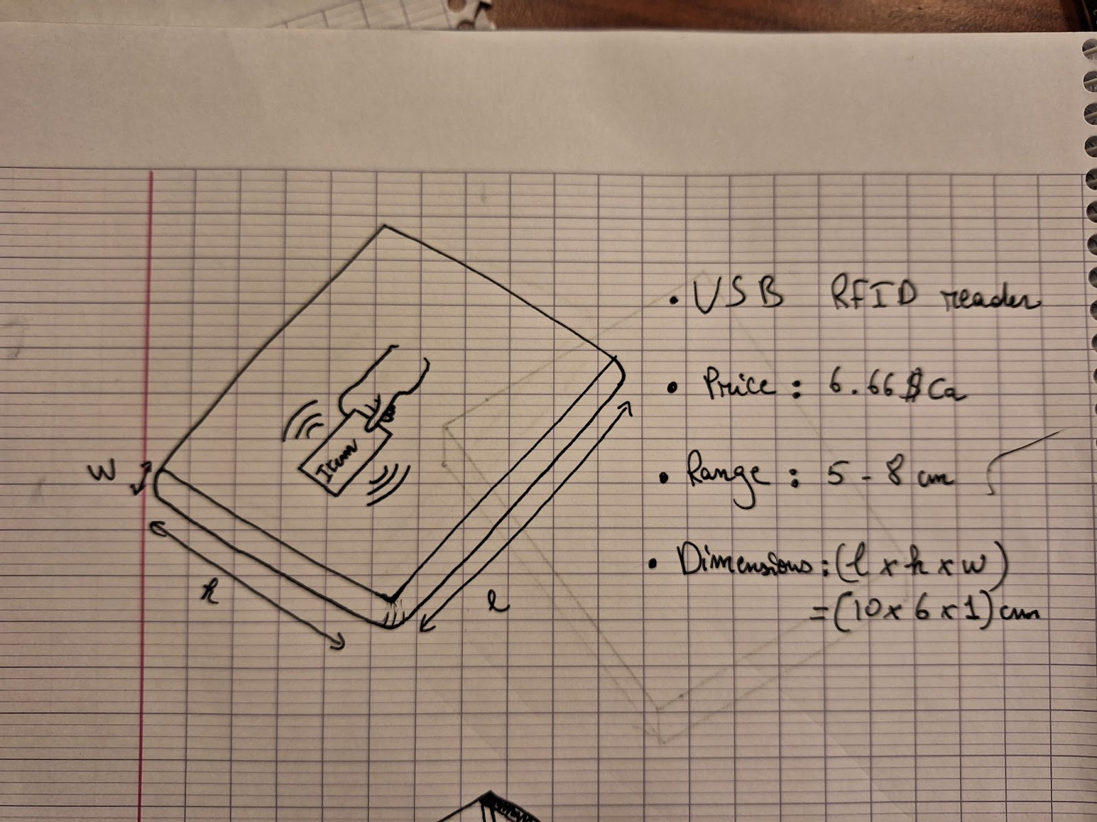
FINAL SOLUTION
FINAL SOLUTION
Sub-system 3

Slide 26
Feedback and recommendations

