Slide 1
Guiding Cane
Team A1 – Qassim, Zach, Kierra, Erika, Nate, Dom

Slide 2
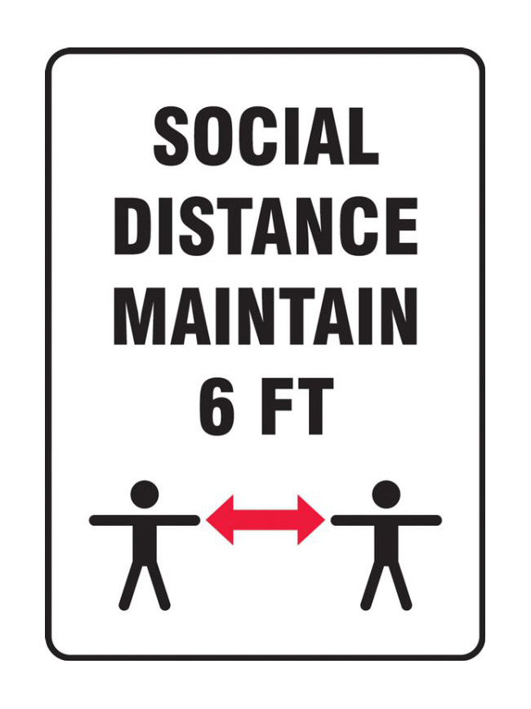
Our client + Needs
Visually impaired client
Navigating around using someone's help
Respecting social distancing guidelines
Notes:
Our client is visually impaired and has been for all their life. They usually use a guiding stick and a guide dog. Our client is active and likes to get around. Before the pandemic, when they’re navigating unfamiliar areas like a grocery store, they would use someone’s help. However, now with covid, when they’re in a grocery store or a building or trying to get around a construction site, they would have to get too close to the people helping them which is not very safe in terms of social distancing regulations. Especially if you are being guided for an extended period of time which puts you at a higher risk.

Slide 3
Problem Statement
A need exists for those who are visually impaired to be safely guided by others, while respecting social distancing regulations, using a portable device that is comfortable, collapsible, and cost effective for owners.
Notes:
Throughout the next few slides, my team members will demonstrate the steps we took to tackle this problem. This includes benchmarking, analyzing the clients needs, creating prototypes and testing.

Slide 4
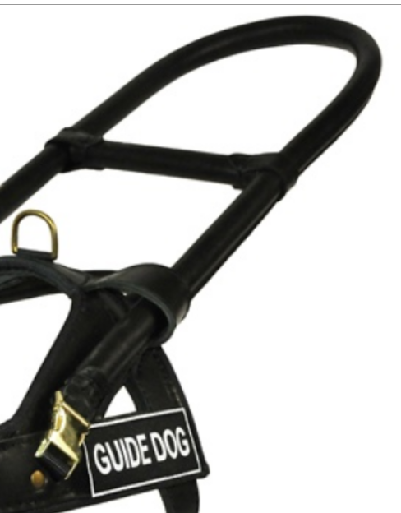
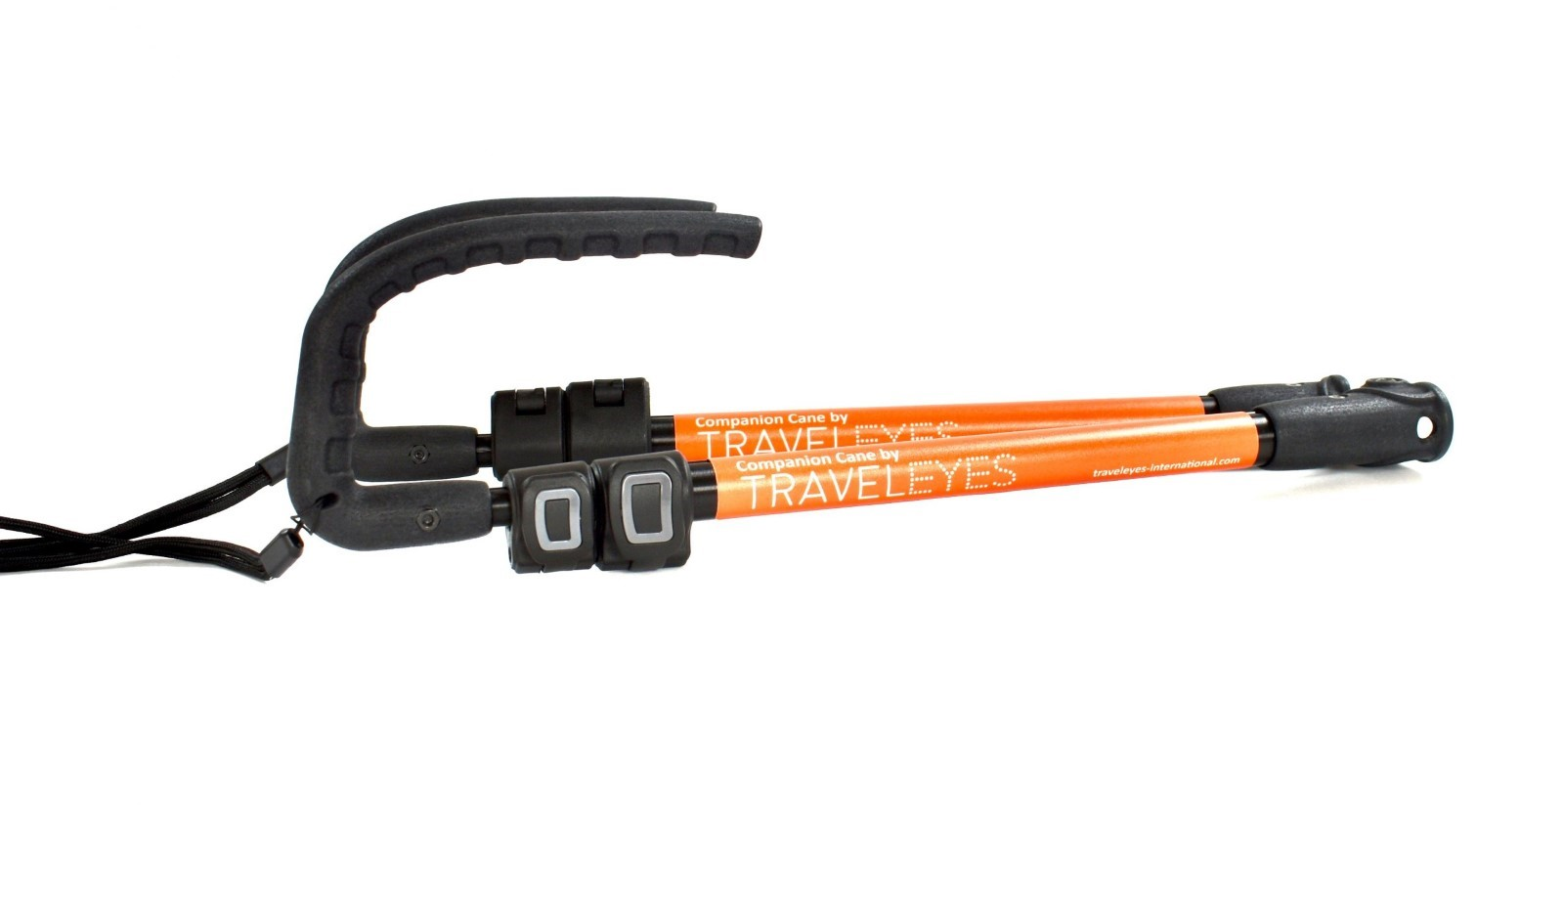
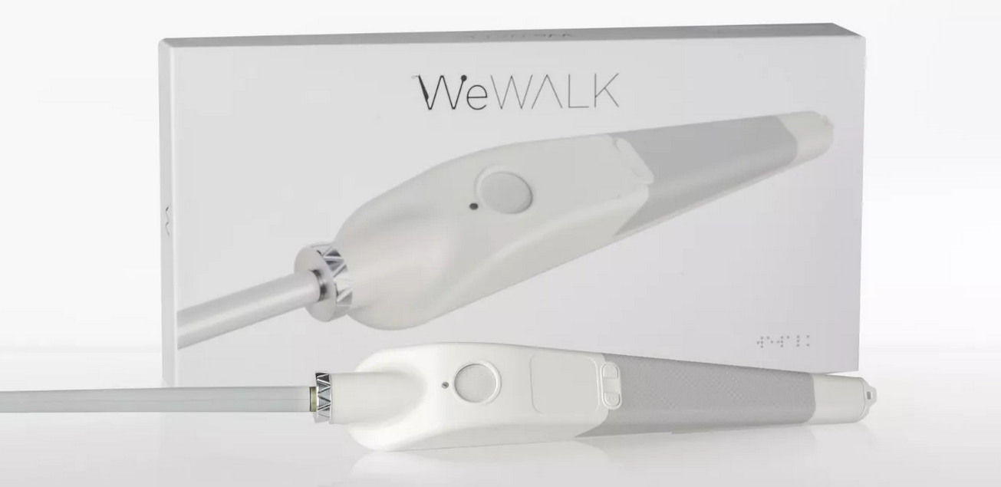
Benchmarking
Product Name | Specs
WeWALK Smart Cane | Cost: $599 USD Product Weight: 280 gr (without power supply) Product dimensions {W x L x H}: 25 mm x 289 mm x 44 mm
TRAVELEYES Companion Cane | Cost: $108.54 USD Product weight: 0.33kg Folded dimensions {W x L x H}: 360 x 95 x 62mm Length: 1500mm fully extended, 360mm folded Material: Aluminum Minimum extension: 700mm
DEAN AND TYLER DT Guide – GuidE Dog Harness Handle | Handle Length: 20 inches Cost: $30.0 (USD) Material: Steel covered in leather (Handle) & Brass plated steel buckles
MORGAN DYNAMIC RESEARCH Telescopic Canes | Extended Length: 48-inches Collapsed Length: 9.5 inches Material: Carbon fiber shaft and Nylon Tip Cost: $95 (USD)
Notes:
Zach

Slide 5
Design Specs
Metrics Description | Range | Unit
Weight of the cane¹ | 3 - 5 | Lbs.
Length of the cane (Extended)² | 180 - 200 | Cm
Length of the cane (Collapsed)³ | 20 - 25 | Cm
Area when compact⁴ | 60 - 100 | Cm²
Handle Length⁵ | 10 – 15 | Cm
Handle Width⁶ | 3 - 4 | Cm
Reflectiveness of the material⁷ | 80-95 | %
Notes:
Zach

Slide 6
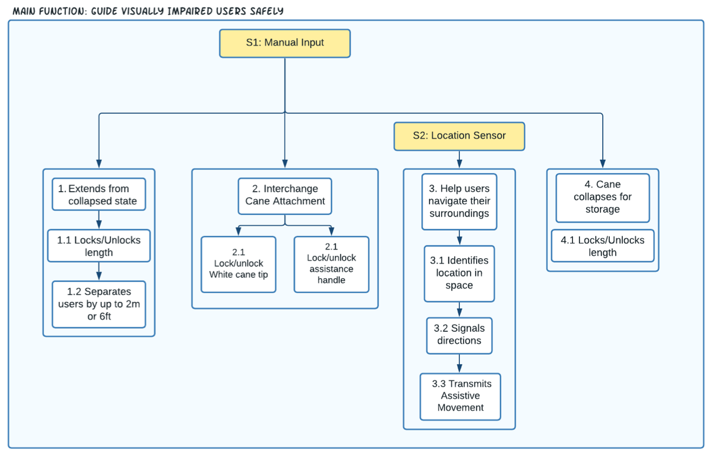
Functional Decomposition

Slide 7
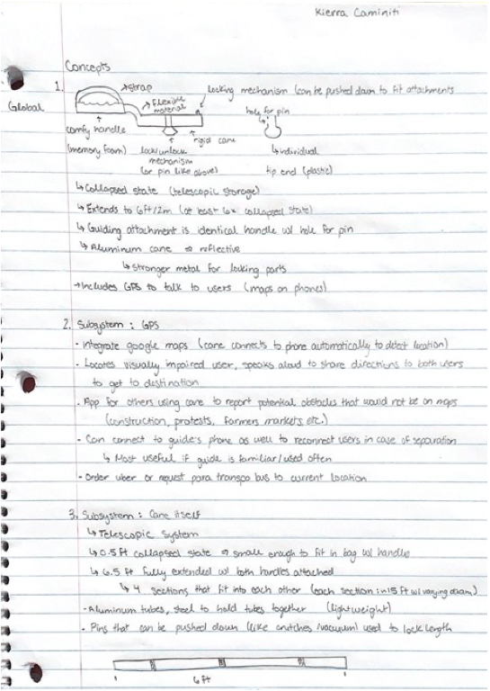
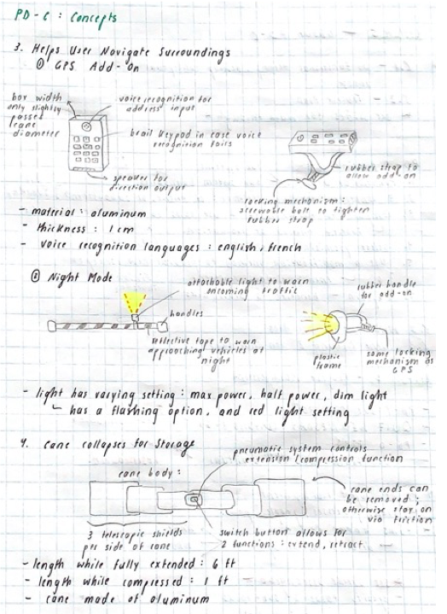
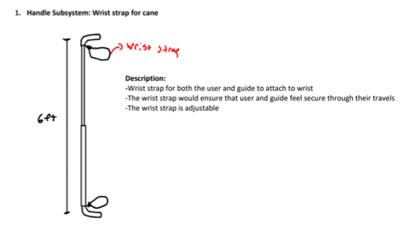
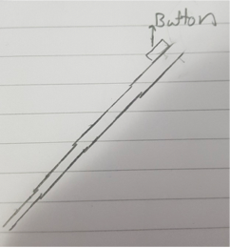
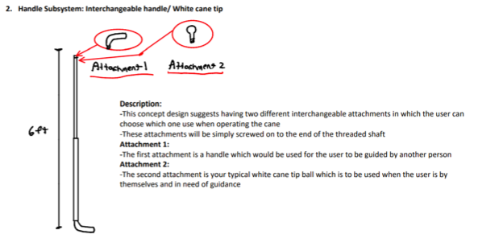
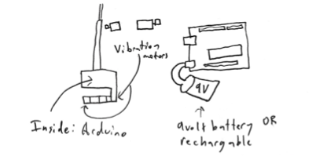
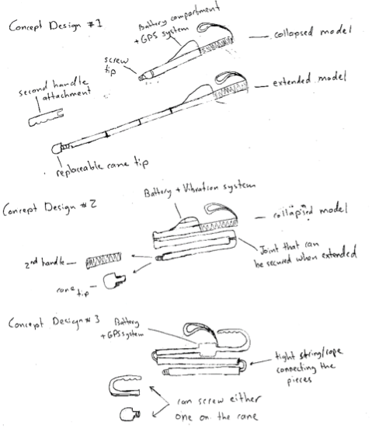
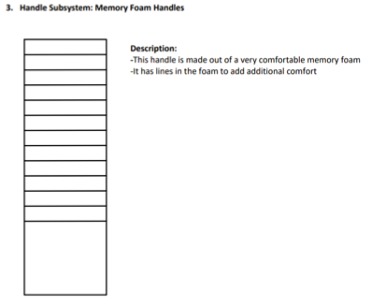
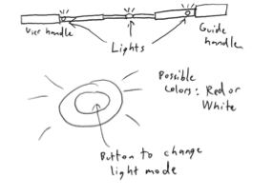
Concept Generation

Slide 8
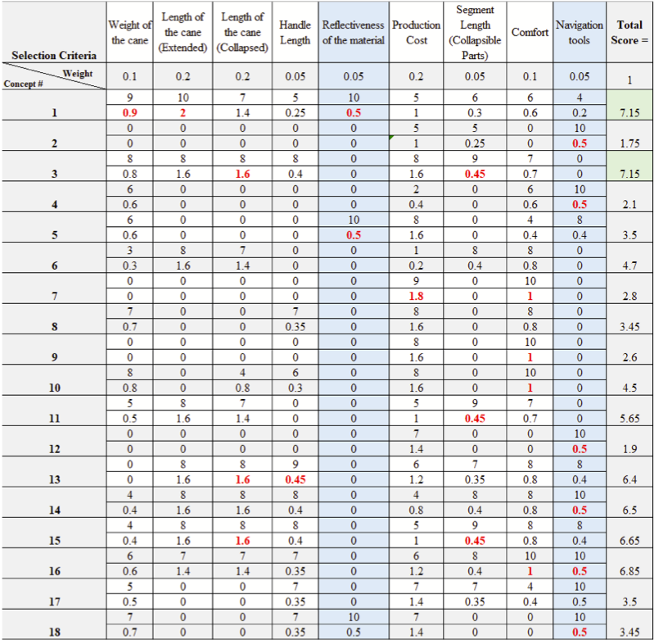

Slide 9
Preliminary Design

Slide 10
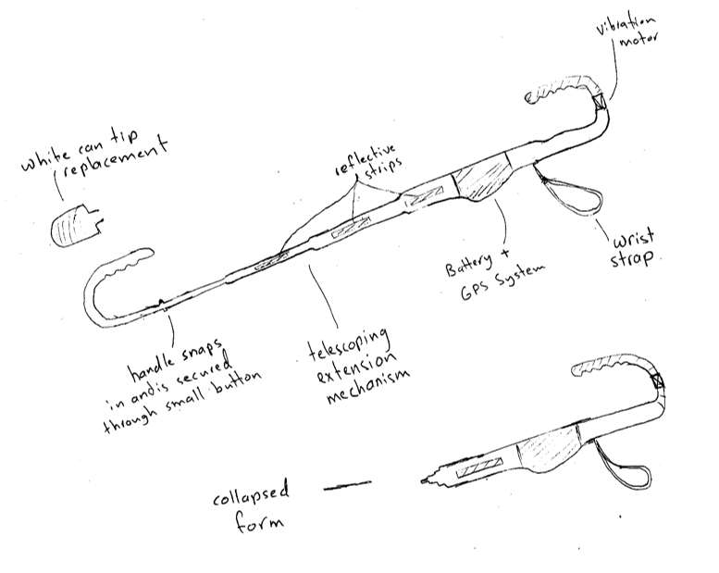
Spring Pins for Securing Ends + Adjusting Cane Length
Navigational Aid
Dual Purposed End
Permanent Handle with Strap

Slide 11
Prototype I
Notes:
Thanks Erika, now I am going to discuss our first prototype

Slide 12
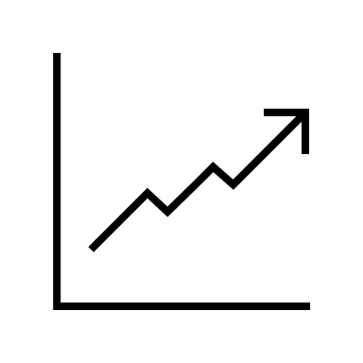
Prototype Identification
Prototype Classification:
Analytical
Comprehensive
Low-Fidelity
Prototype I Goal: The goal of prototype I is to validate any design ideas, as well as provide a basis for some of the system’s targets specs, including length, collapsibility, and weight of the cane.
Notes:
Identification of Prototype I:
1. Prototype Classification:
Analytical: The group decided to make an analytical prototype in the form of a SolidWorks 3D model and technical drawing to get a better understanding of the preliminary dimensions of the device.
Comprehensive: Furthermore, for this prototype we went for a comprehensive model to give a better understanding of what our final prototype may look like.
Low-Fidelity: Lastly, this prototype is low-fidelity since it was easier to execute and took away less “precious” time from the team.
2. Prototype Goal:
Additionally, the goal of prototype I was to validate any design ideas, as well as provide a basis for some of the system’s targets specs, including length, collapsibility, and weight of the cane.

Slide 13
Notes:
In this first view of the cane you can see it in its collapsed form.
As Erika discussed there are two interchangeable attachments that are removed using spring pins

Slide 14
Notes:
In this next view you can see the cane in its fully-extended form with handle attachments for social distance guiding.
This model also gives a clear view of the navigation compartment

Slide 15
Notes:
Equally important our next model shows the cane in self-use mode

Slide 16
Notes:
Lastly, here is a close-up view of the detachable handle with a spring pin lock.

Slide 17
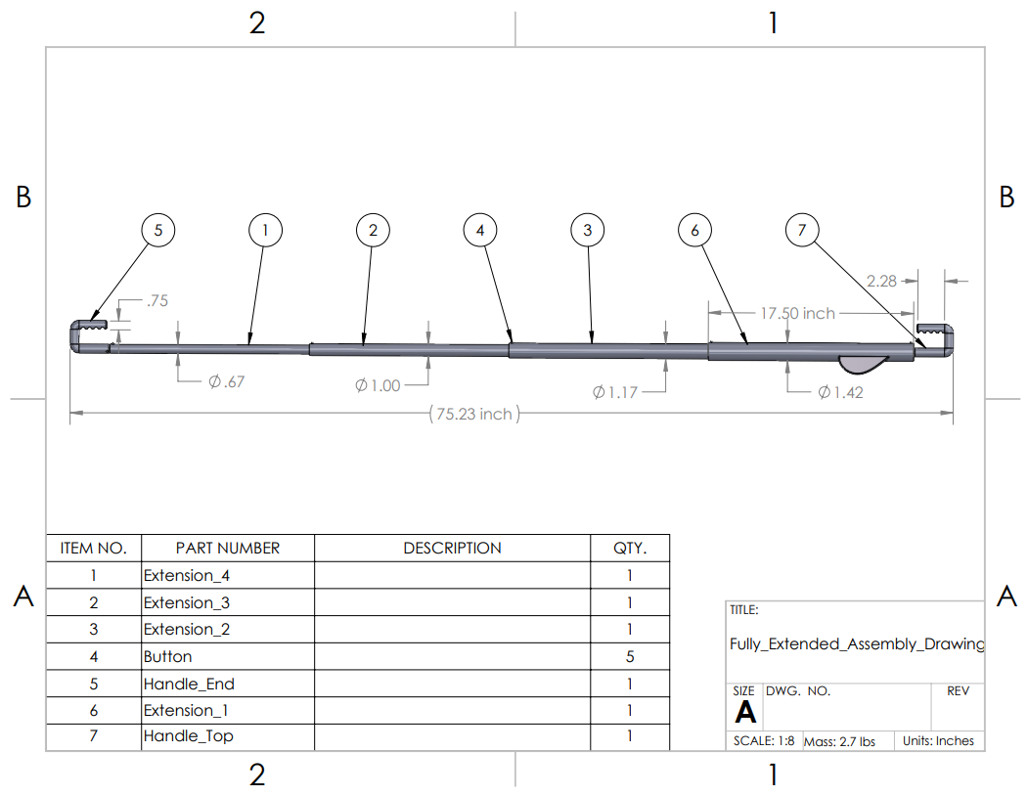
Notes:
Moving on to our technical drawings:
It can be seen that the cane is roughly 6.25 ft and that it weighs in at 2.7 lbs.

Slide 18
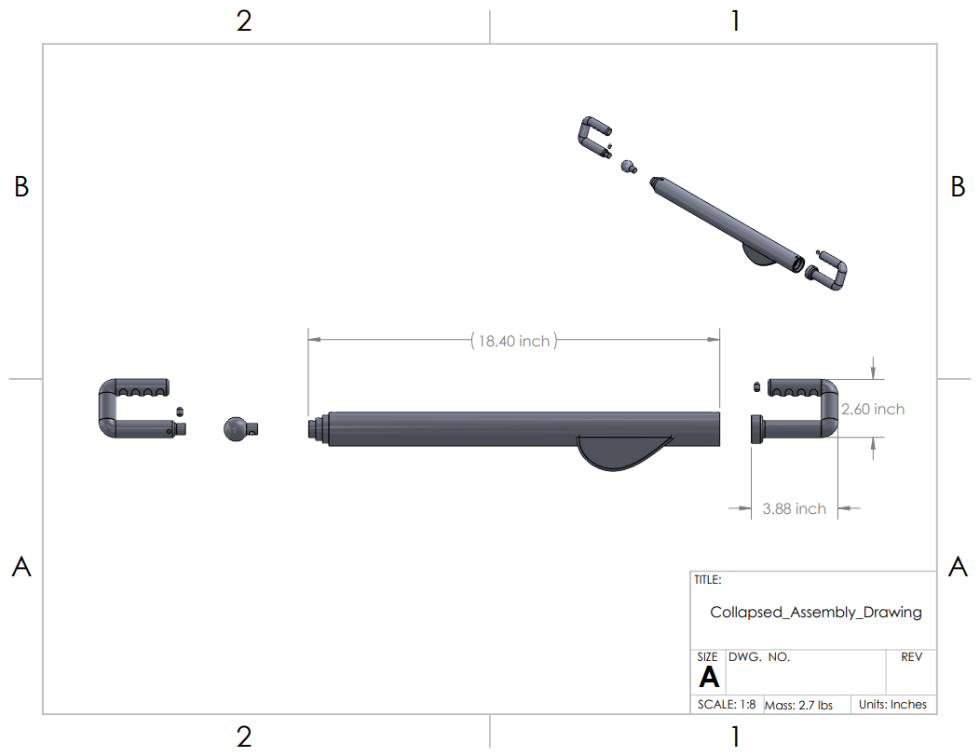
Notes:
Additionally in the collapsed drawing the cane is 1.9 ft with one handle removed

Slide 19
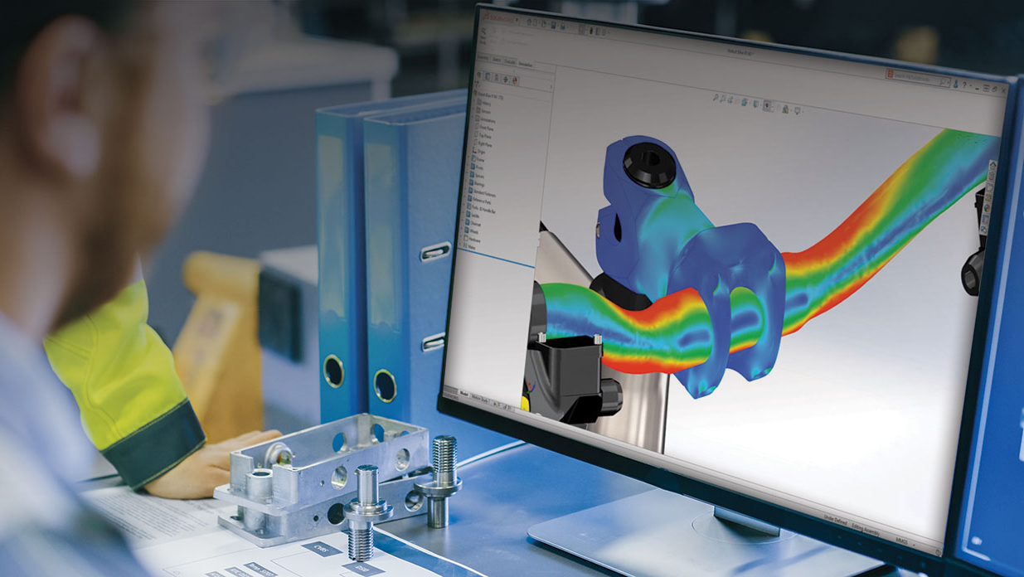
Testing
Notes:
Now I am going to discuss some of the testing we performed

Slide 20
Prototype I Testing Goals and Procedures
This Prototype was Used to Test The Following:
1. Strength & Weight of The Material
2. Size of Parts & Ability to Fit in Design
3. Spring pin Locking Mechanism
4. Handle Removal
Testing Procedure: The tests were carried out through the creation of a CAD model in SolidWorks using dimensioning and selecting a material for each component to obtain a weight calculation.
Notes:
This Prototype was Used to Test The Following:
Strength & Weight of The Material
Size of Parts & Ability to Fit in Design
Spring pin Locking Mechanism
Handle Removal
Testing Procedure: The tests were carried out through the creation of a CAD model in SolidWorks using dimensioning and selecting a material for each component to obtain a weight calculation.

Slide 21
Prototype I Testing Results
Assumption Tested | Testing Method | Expected | Actual
Cane can extend and collapse | Use CAD to collapse telescopic segments into each other and extend them again. | Telescopic segments fit into one another. (Value: N/A) | Telescopic segments fit into one another. (Value: N/A)
 | Measure length of segments. | Segments are between 10 – 25 cm. | 17.5 inch = 44.45cm (Fails)
Cane handle is removable | Use CAD to determine whether the pins fit into the slots (to release). | Spring pin mechanism allows handle to be locked and removed from product. | Spring pins fit into slots to lock
Extended length is acceptable | Measure length of the extended cane | At least 6ft | 6.3 ft = 192 cm
Collapsed length is acceptable | Measure length of the collapsed cane | Max 1.5 ft | 1.9ft = 58 cm
Product’s weight is acceptable | Measure weight of the product with all components, using the correct materials | Between 3-5 lbs | 2.7 lbs without additional equipment
Notes:
To summarize some of the results from our testing:
-The cane was found to extend and collapse with ease, extend to an acceptable length, and to be lightweight
-But one area that failed our tests was the final collapsed length of the cane as we would like for it to be a little bit more portable
I will now let Dom tell you a little bit about some User Feedback and the project plan

Slide 22
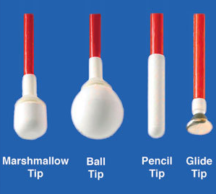
User Feedback
Our client's feedback
Lights and visibility
Use of battery and on/off switch
Areas of Uncertainty
Detachable cane tip
Length of adjustable cane
Shape and size of handle

Slide 23
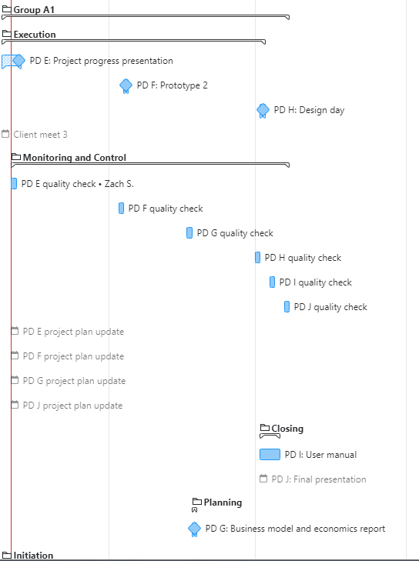
Future Development + Project Plan
Plans for Prototype 2
Aluminium -> Polyvinyl Chloride (PVC)
Collapsible in the middle
Planning on Wrike

Slide 24
Questions?

