Slide 1
Guide2GO
GNG2101 Final Presentation
Presented By: Team A1
Professor: Hannan Annan
Project: Guiding Cane

Slide 2
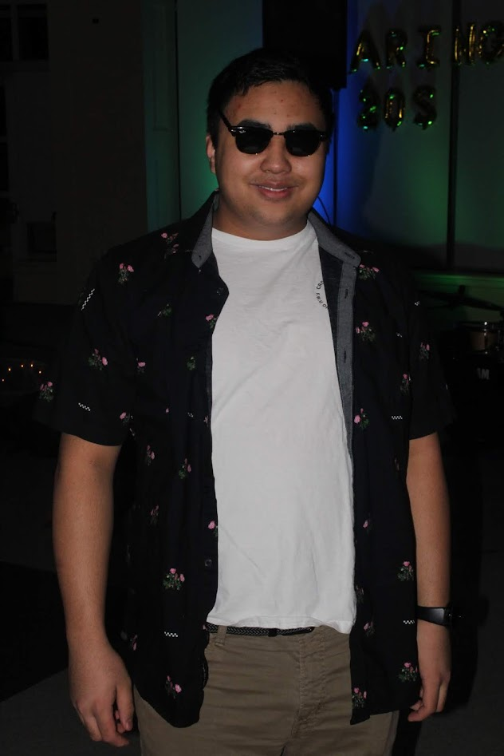
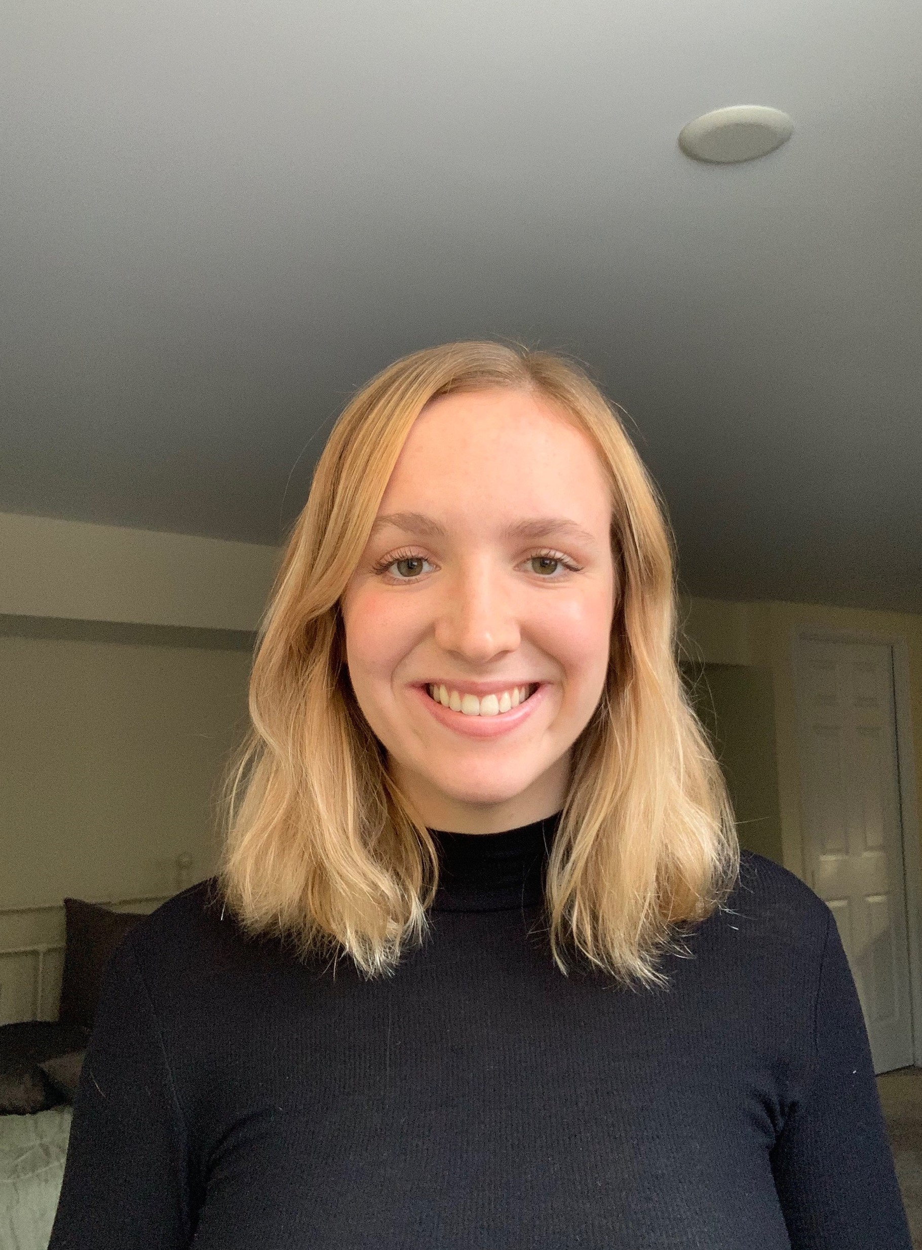
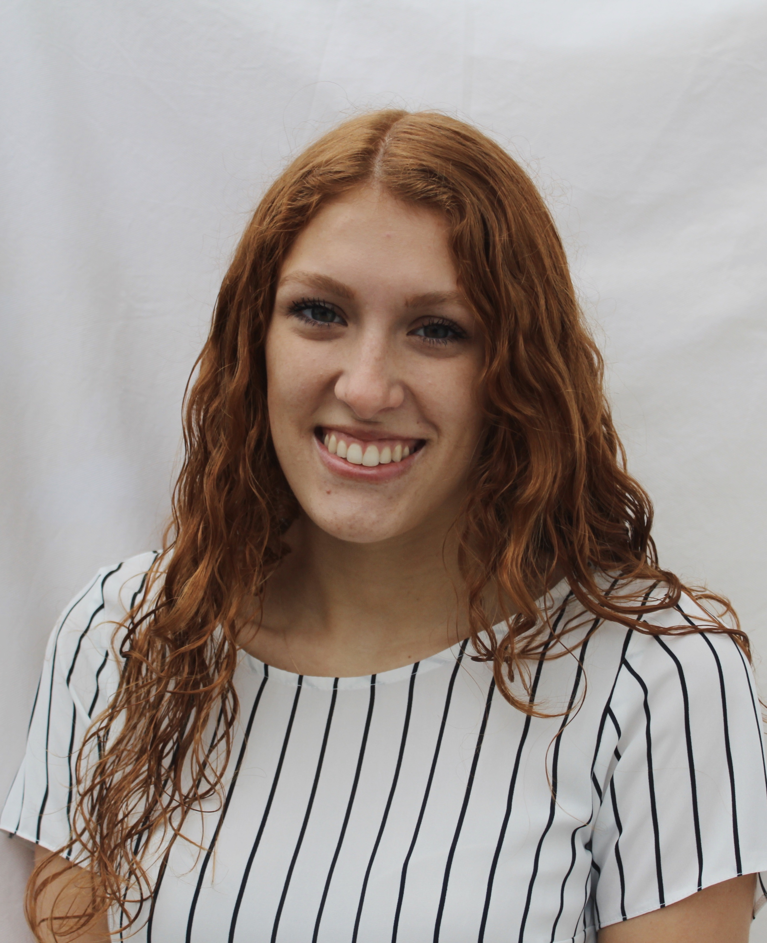
Meet The Team
Nathan Meraw
Program: BMG
Year: Third
Dominic Salas
Program: SEG
Year: Second
Erika Johnson
Program: BMG
Year: Third
Qassim Alkassir
Program: SEG
Year: Second
Kierra Caminiti
Program: BMG
Year: Third

Slide 3
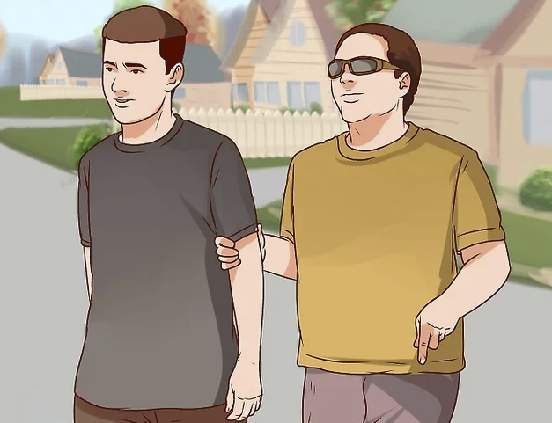
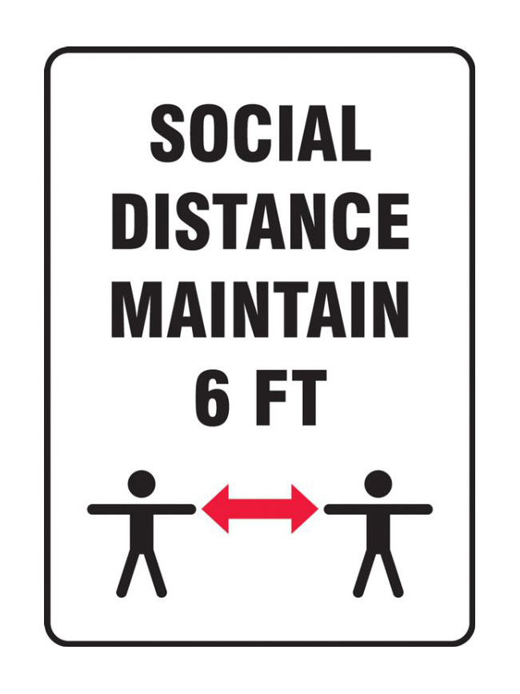
Our client + Needs
Visually impaired client
Navigating around using someone's help
Respecting social distancing guidelines
Notes:
Our client is visually impaired and has been for all their life. They usually use a guiding stick and a guide dog. Our client is active and likes to get around. Before the pandemic, when they’re navigating unfamiliar areas, they would use someone’s help. However, now with covid, they would have to get too close to the people helping them which is not very safe in terms of social distancing regulations. Especially if you are being guided for an extended period of time which puts you at a higher risk.

Slide 4
Problem Statement
A need exists for those who are visually impaired to be safely guided by others, while respecting social distancing regulations, using a portable device that is comfortable, collapsible, and cost effective for owners.
Notes:
Throughout the next few slides, my team members and I will demonstrate the steps we took to tackle this problem.

Slide 5
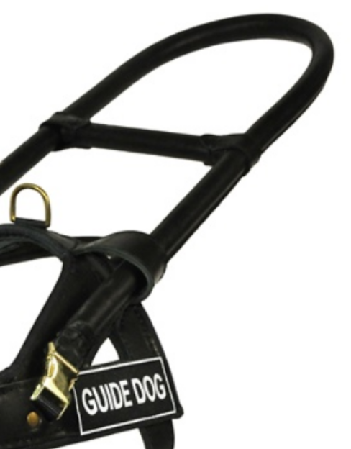
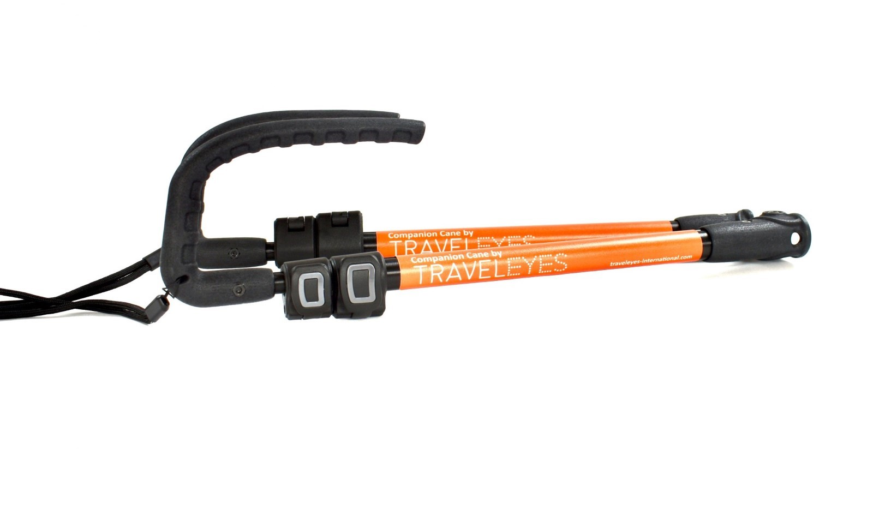
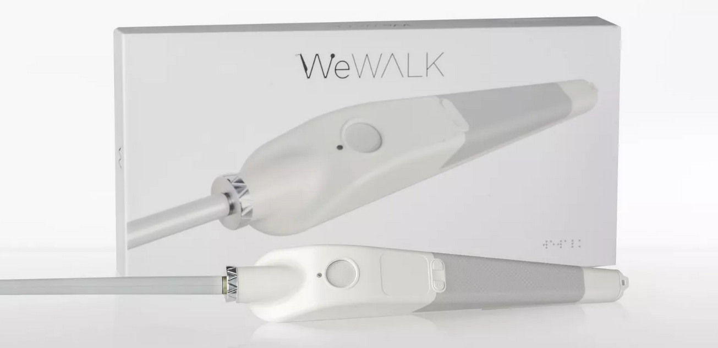
Benchmarking
Product Name | Specs
WeWALK Smart Cane | Cost: $599 USD Product Weight: 280 gr (without power supply) Product dimensions {W x L x H}: 25 mm x 289 mm x 44 mm
TRAVELEYES Companion Cane | Cost: $108.54 USD Product weight: 0.33kg Folded dimensions {W x L x H}: 360 x 95 x 62mm Length: 1500mm fully extended, 360mm folded Material: Aluminum Minimum extension: 700mm
DEAN AND TYLER DT Guide – GuidE Dog Harness Handle | Handle Length: 20 inches Cost: $30.0 (USD) Material: Steel covered in leather (Handle) & Brass plated steel buckles
MORGAN DYNAMIC RESEARCH Telescopic Canes | Extended Length: 48-inches Collapsed Length: 9.5 inches Material: Carbon fiber shaft and Nylon Tip Cost: $95 (USD)
Notes:
One of the first steps we took in developing our product was to look at the products that currently exist in the market in order to get an idea of what we are competing with.
We found these 4 canes, each of them was different in terms of what features they offered. For example we noticed that most canes offered the ability to collapse the cane so we decided to incorporate that into our target specs
Speaking of which, here are the target specs we came up with

Slide 6
Target Specifications
Metrics Description | Range | Unit
Weight of the cane¹ | 3 - 5 | Lbs.
Length of the cane (Extended)² | 180 - 200 | Cm
Length of the cane (Collapsed)³ | 20 - 25 | Cm
Area when compact⁴ | 60 - 100 | Cm²
Handle Length⁵ | 10 – 15 | Cm
Handle Width⁶ | 3 - 4 | Cm
Reflectiveness of the material⁷ | 80-95 | %
Notes:
Here are the target specs that we decided on after reviewing what already exists on the market and what our client needs. The important ones to note are the weight and length. We wanted to ensure that the length is 6 feet to follow the health guidelines and make sure it’s lightweight and portable for the user

Slide 7
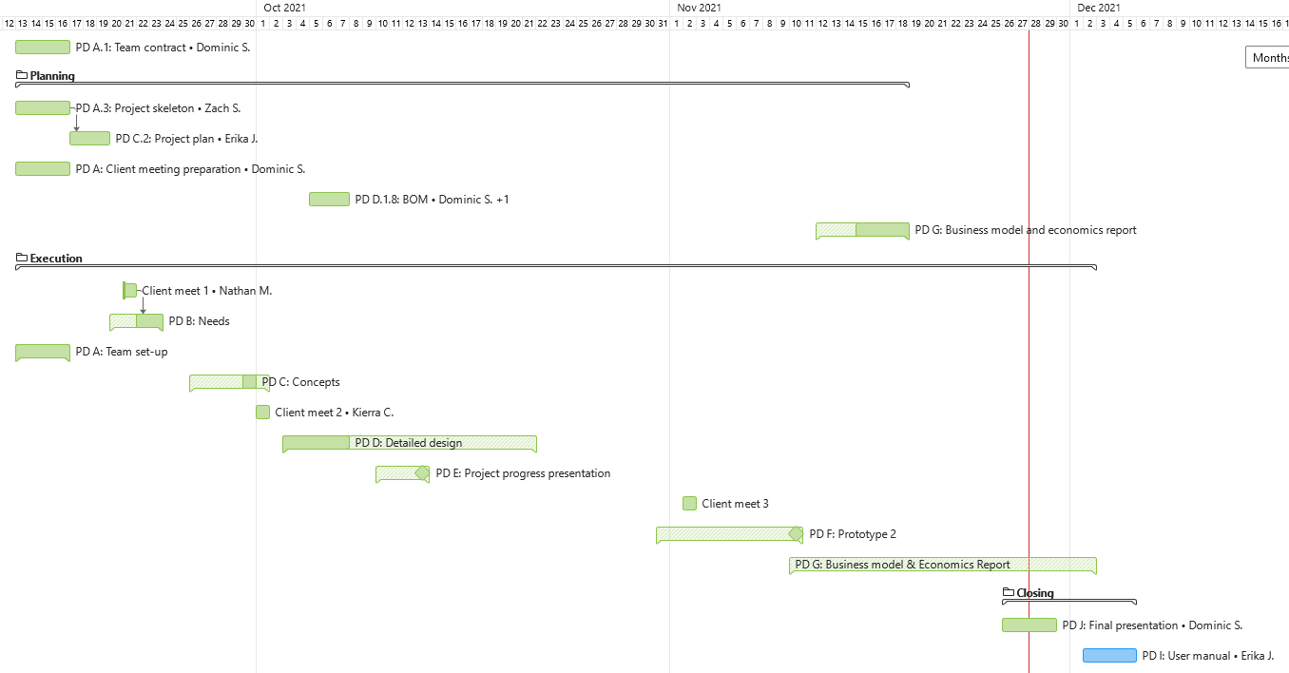
Project Organization
Notes:
WE have been using Wrike to organize and assign tasks to each member and it has worked pretty well for us so far. There are only a few tasks remaining which is exciting!

Slide 8
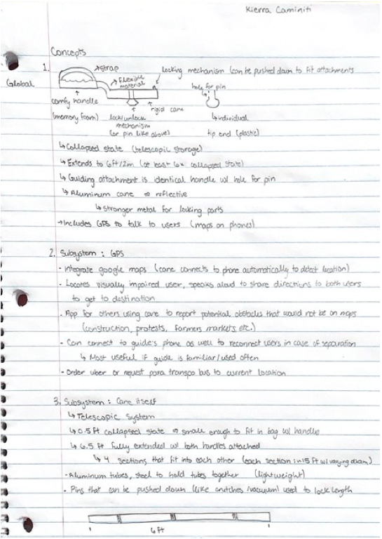
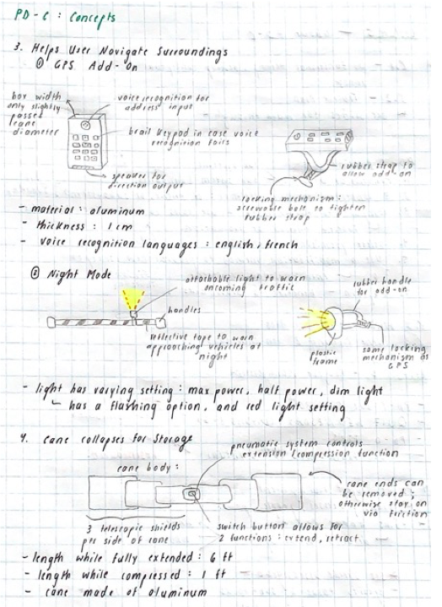
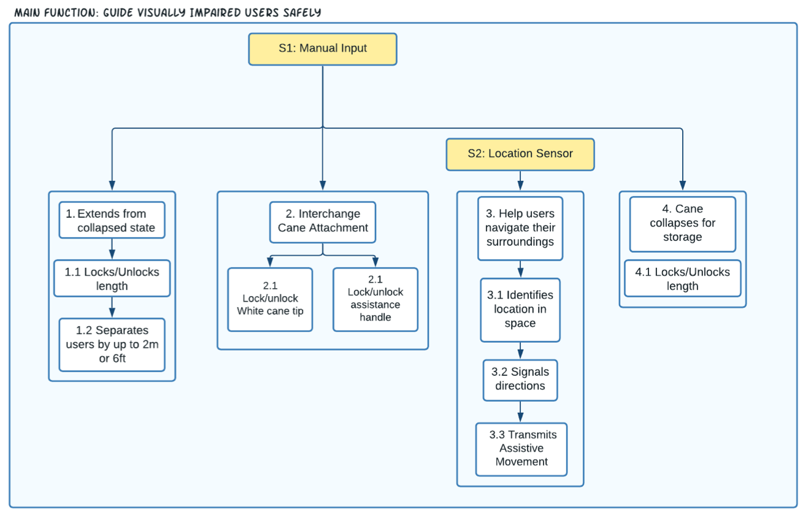
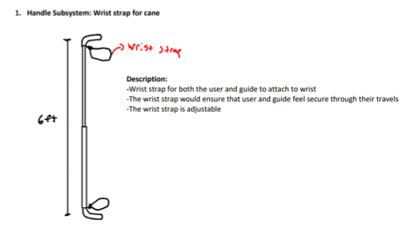
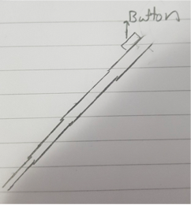
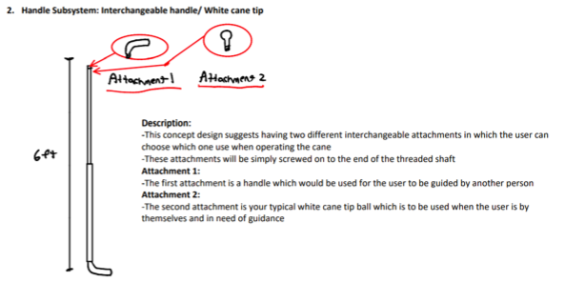
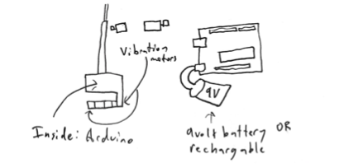
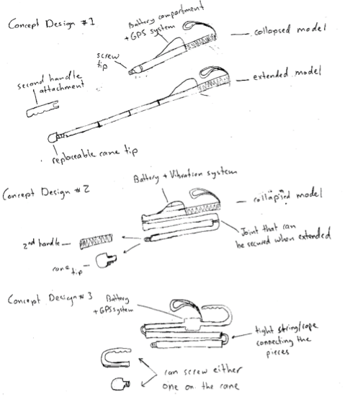
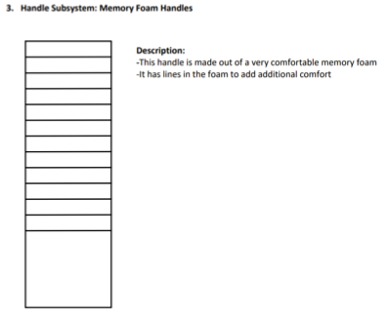
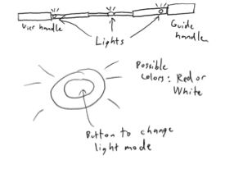
Conceptual Design

Slide 9
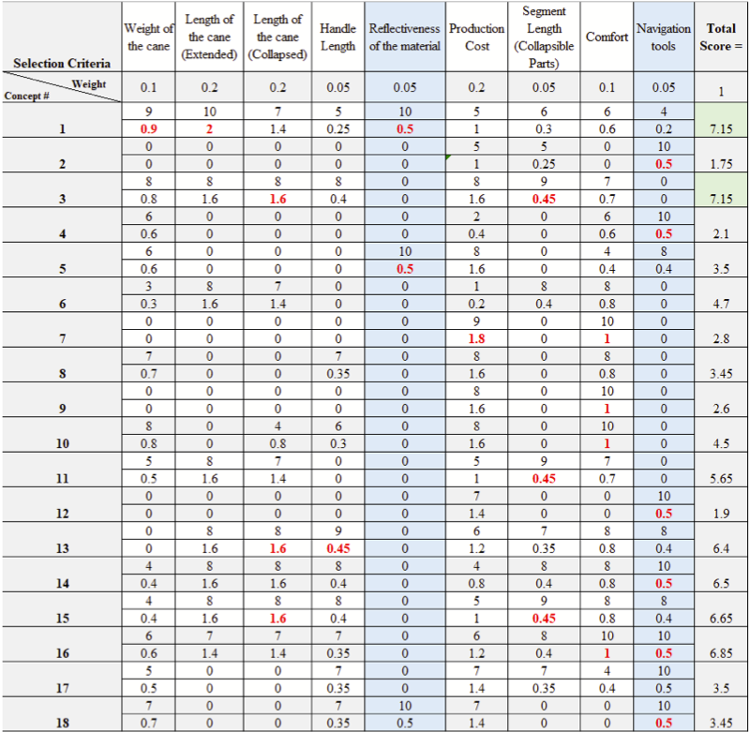
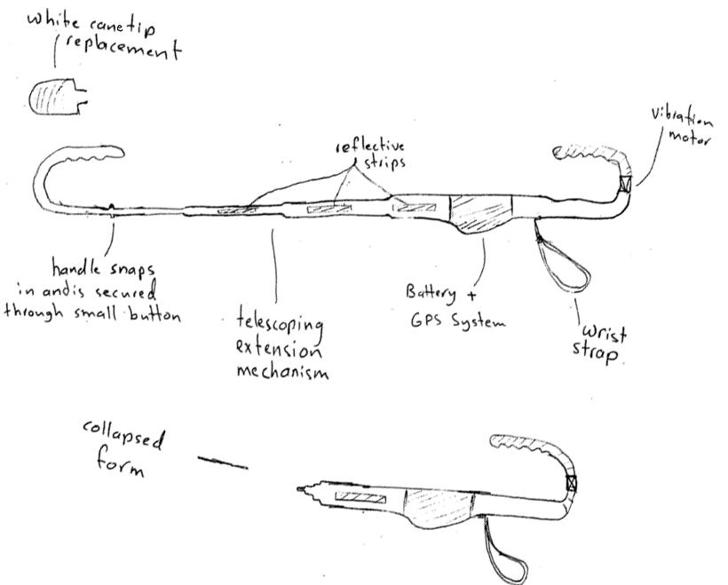
Spring Pins for Securing Ends + Adjusting Cane Length
Navigational Aid
Dual Purposed End
Permanent Handle with Strap

Slide 10
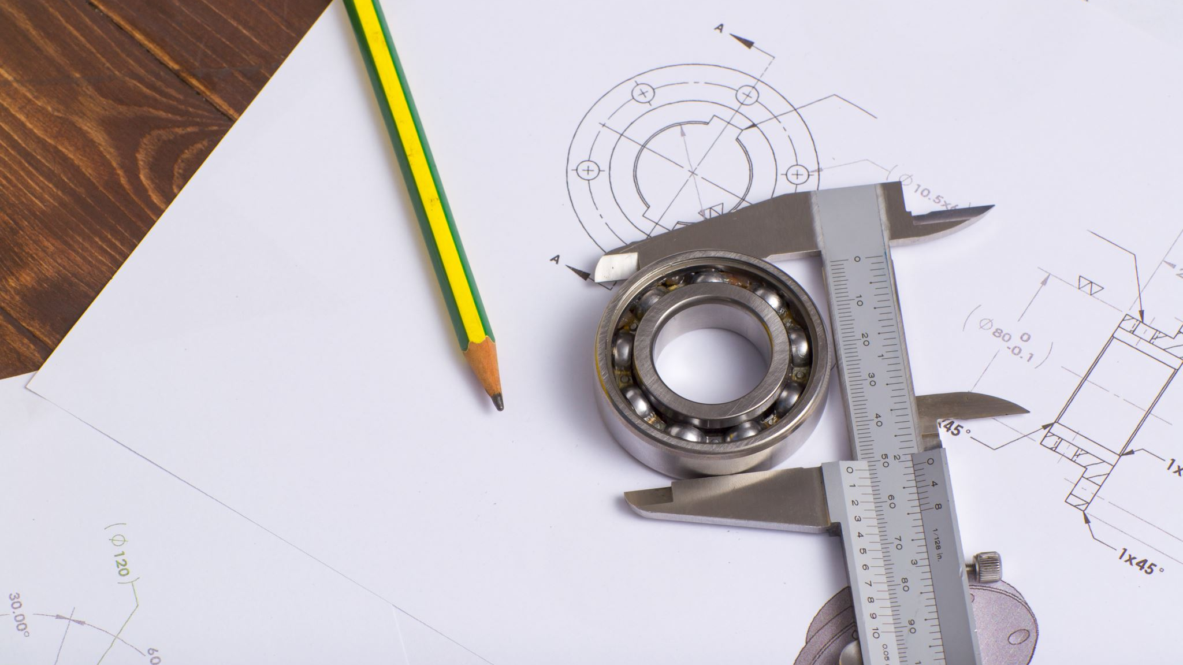
Prototyping
z
Notes:
Thanks Kierra. Erika and I will now discuss our prototyping process and provide a demonstration of our final product

Slide 11
Prototype 1 Identification
Prototype Classification:
Analytical
Comprehensive
Low-Fidelity
Prototype I Goal: The goal of prototype I is to validate any design ideas, as well as provide a basis for some of the system’s targets specs, including length, collapsibility, and weight of the cane.
Notes:
For our first prototype, we decided to create a comprehensive, analytical, low-fidelity prototype on SolidWorks to conserve time and resources, as well as provide an understanding of what our final prototype may look like.

Slide 12
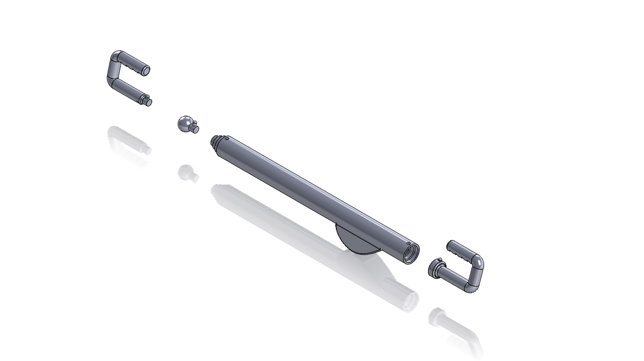
Notes:
Our first SW Model can be seen in these next few images, with this one being the cane in the collapsed state.

Slide 13
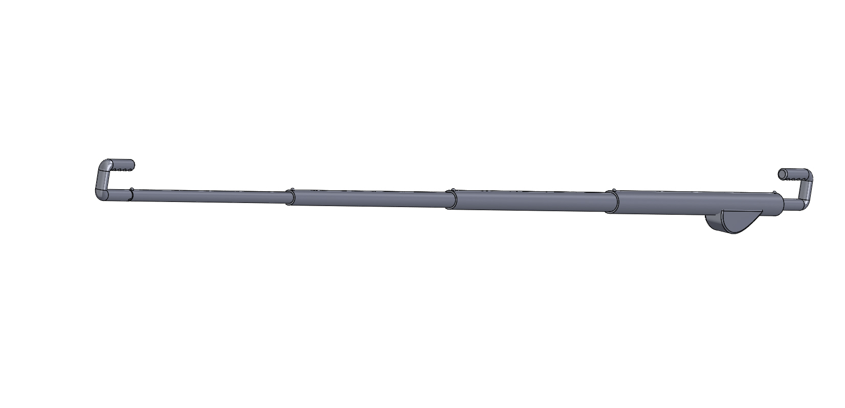
Notes:
The Extended State

Slide 14
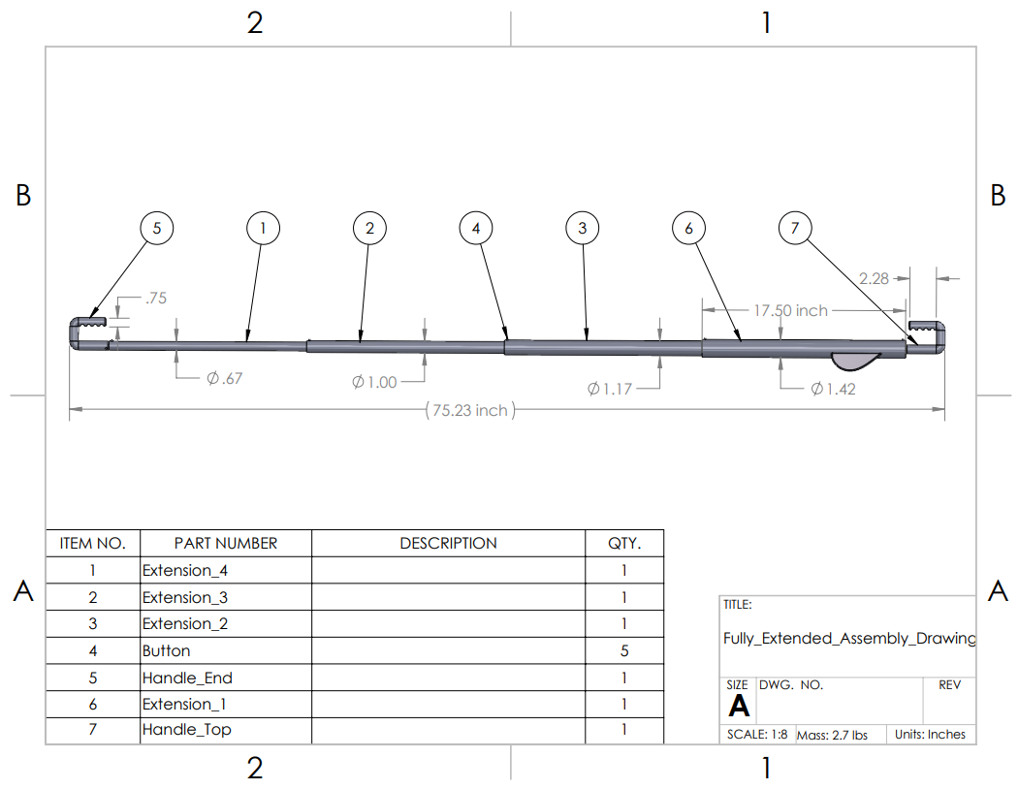
Notes:
And a technical drawing with dimensions

Slide 15
Prototype 1 Testing Results
Assumption Tested | Testing Method | Expected | Actual
Cane can extend and collapse | Use CAD to collapse telescopic segments into each other and extend them again. | Telescopic segments fit into one another. (Value: N/A) | Telescopic segments fit into one another. (Value: N/A)
 | Measure length of segments. | Segments are between 10 – 25 cm. | 17.5 inch = 44.45cm (Fails)
Cane handle is removable | Use CAD to determine whether the pins fit into the slots (to release). | Spring pin mechanism allows handle to be locked and removed from product. | Spring pins fit into slots to lock
Extended length is acceptable | Measure length of the extended cane | At least 6ft | 6.3 ft = 192 cm
Collapsed length is acceptable | Measure length of the collapsed cane | Max 1.5 ft | 1.9ft = 58 cm
Product’s weight is acceptable | Measure weight of the product with all components, using the correct materials | Between 3-5 lbs | 2.7 lbs without additional equipment
z
Notes:
To summarize some of the results from our testing:
-The lightweight cane was found to easily extend and collapse to an acceptable length
-But an area to consider for future prototyping was that the cane should collapse to a shorter length.

Slide 16
Client Feedback
z
Client Feedback:
Have the can be functional at different lengths
Ensure that the handles are light and portable
Inclusion of an on/off switch for the haptic feedback system
Did not want a light on the cane
Notes:
Some of the feedback we received from our first client meeting was that
The cane should function at multiple lengths
The handles should be light and portable
And lastly there should be an on/off switch for the haptic feedback system of the nav

Slide 17
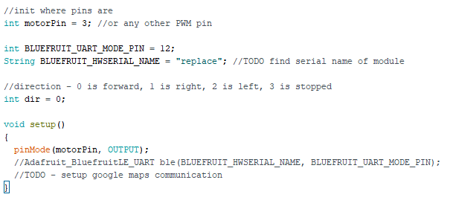
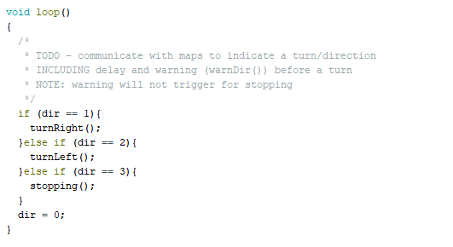
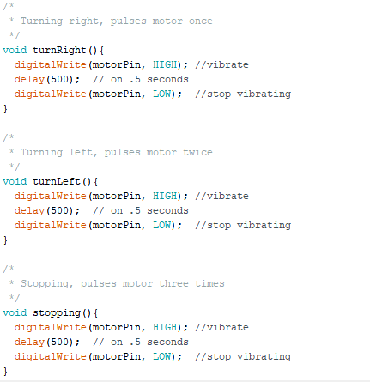
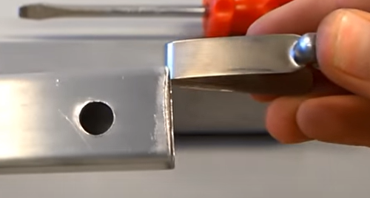
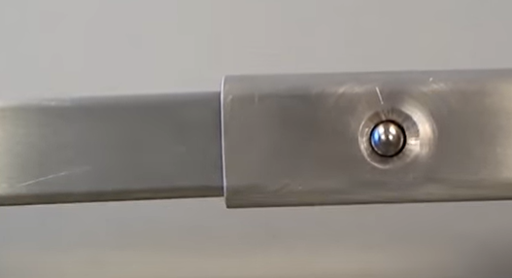
Prototype 2
1. Navigation Subsystem
2. Mechanical Components Subsystem
z
3. Physical Apparatus Subsystem
Notes:
For our second prototype, we decided to prioritize the cane’s navigational system. To do so, we purchased the necessary on/off battery components, and then proceeded to work on our code. At this point, the code could only trigger the motor vibration signals necessary for left and right commands.
We also decided to update our mechanical design by firstly adding a new cane segment to allow for more length variation, and then secondly testing the spring pin locking mechanism to allow for easy cane extension, and removable end replacement.

Slide 18
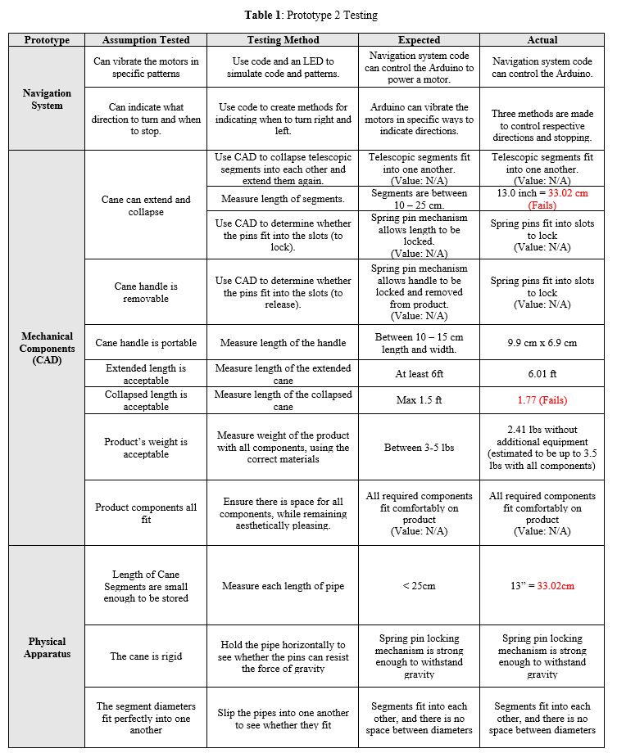
Client Feedback
The cane is "simple and easy to use”
Very approving of our current design
Include PVC instead of carbon fiber to reduce cost
Include a bag for the removable ends for residual dirt collection
Notes:
With regards to the second prototype’s testing, what is important to recognize from the table are the failed assumptions marked by red circles. For our next prototype, we needed to ensure that the cane segments were of shorter length and that the cane could collapse to a length shorter than 1.5ft.
Not to mention, our client had recommendations for our final design. Despite the positive feedback that we had received, with comments including “the cane is simple and easy to use”, it was recommended that we use PVC instead of carbon fiber to reduce the cost of the cane, and that we should include a bag for the removable ends for easy, clean storage.

Slide 19
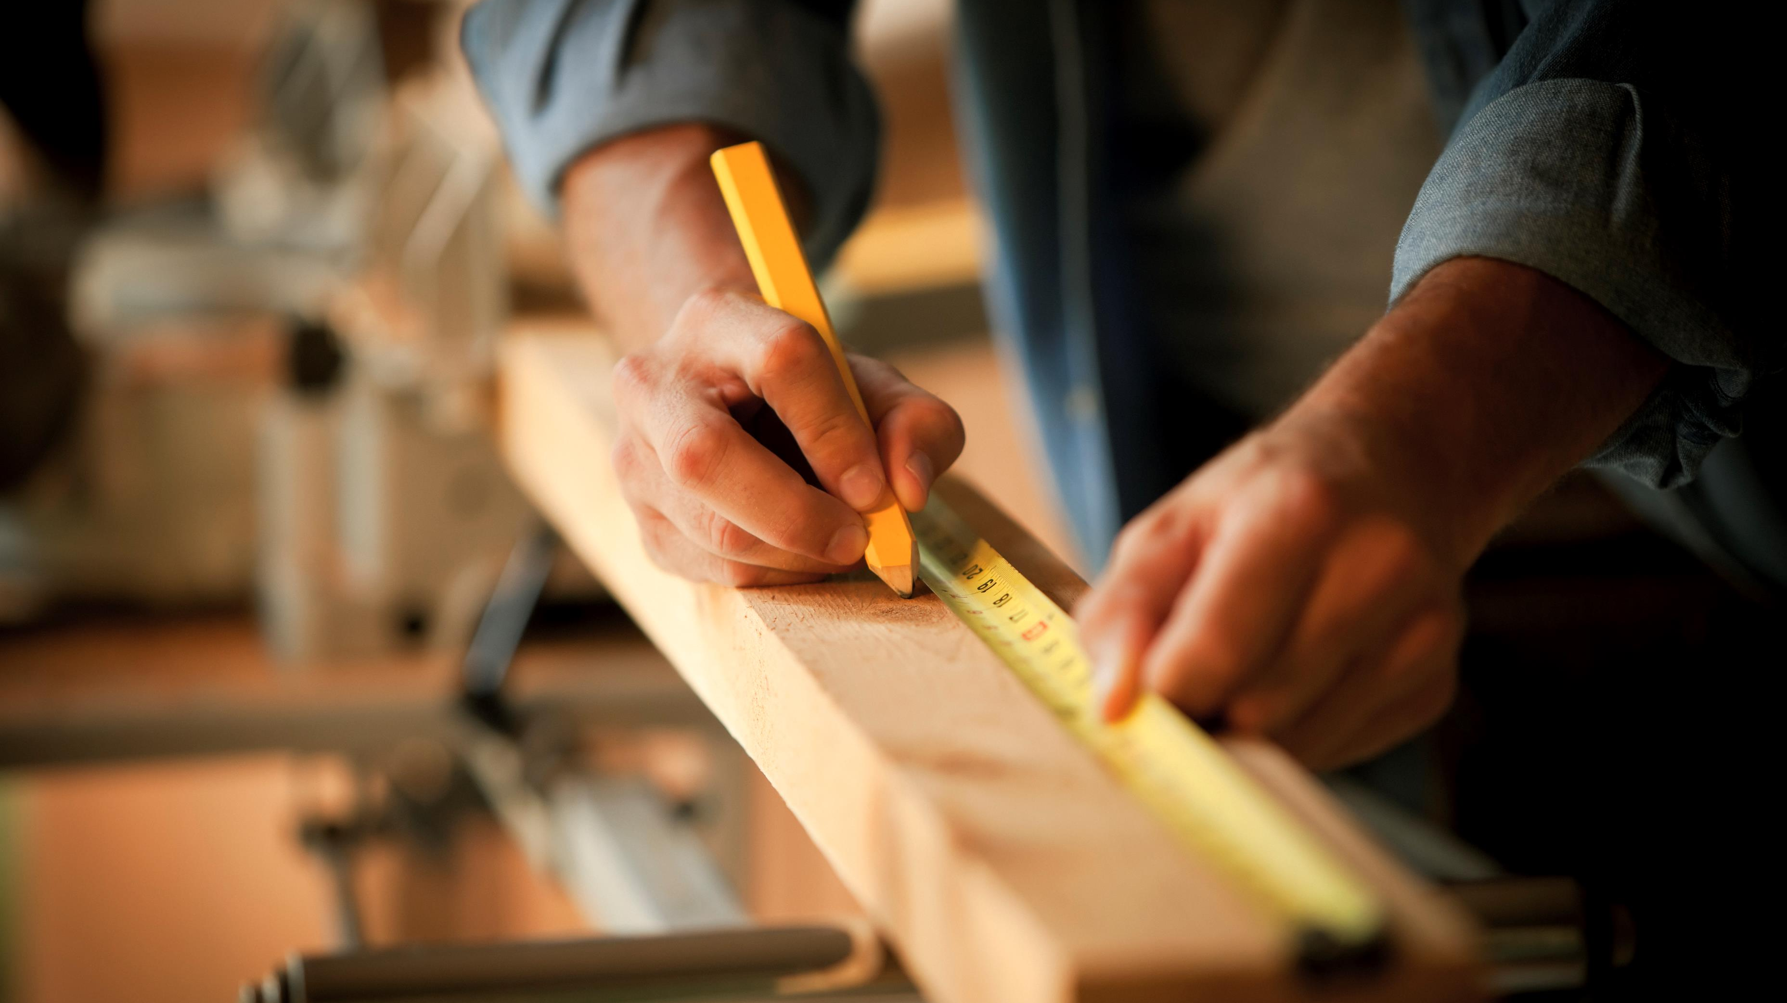
Final Product
z
Notes:
Taking all feedback and failed tests into account, we landed on our final product design.

Slide 20
Insert Video Here With Voice Over
Notes:
Voice Over Script:
First Look at Cane in collapsed Form: (7 seconds)
Here is your first look at the Guide2Go Cane in it’s collapsed state of 1.5 feet in length.
2. Demonstration Extending Cane from Collapsed State and Putting on Attachments: (35 Seconds)
When you are ready to use your Guide2Go Cane you can simply extend the cane to one of the five available lengths. To guide a visually impaired person at a safe social distance of 6ft, extend the cane to its full length, ensuring each of the five cane segments lock in place through the use of the spring push pins.
Now it is time to select your desired attachment. The cane’s end can serve two functions. When being guided by another person, attach the J-shaped handle using the same spring pin locking mechanism. When being used alone, the visually impaired person can replace the end with the marshmallow tip.
3. Close up on Navigation System: (25 seconds)
Here is a closeup of the cane’s navigational system, useful for when the user is being guided by another person.
To power up the system, turn the battery switch to the on position.
One push of the white button sends 1 vibrational impulse to the vibration motor located on the opposite end of the cane. This notifies the user that the guide is about to turn left.
The yellow button transmits 2 impulses, to notify the user to turn right.
5. Demonstration Guiding User with Cane: (20 seconds)
Now for the moment we’ve all been waiting for! In these next few clips we will get to see the Guide2Go social distance cane in action. As seen in the video the cane is wrapped in reflective tape so that the user can be seen by cars at night. It can also be seen that the cane is very versatile as it is able to be used across various terrains.
6. Demonstration with User using in Self-guide Mode: (10 Seconds)
And in this last clip here you can see the cane being used in self-use mode

Slide 21
Final Product Results
Built a functioning dual-purposed cane
6.2ft ∴ Meets social distancing requirement of 6ft
Included a bag for the removable ends
$90.71 ∴ Meets budget of $100
2.4lbs ∴ Meets weight requirement to be <3-5lbs
Notes:
In the end, we were able to create a functioning dual-purposed cane which collapses to a length of 1.5ft, and meets social distancing requirements by being able to fully extend to 6.2ft. To address previous customer requirements, we included a bag for the removable ends, met the $100 budget, with the final development cost being $90.71, and also created a lightweight product that weighs 2.4 pounds total.

Slide 22
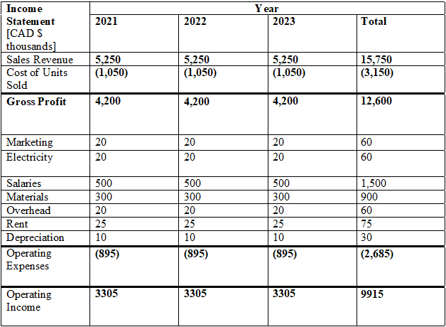
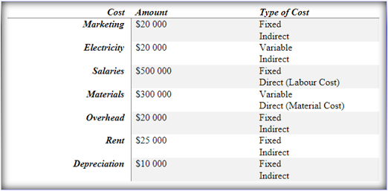
Economics and Business Model
E-commerce business to consumer model
No costs for maintaining a storefront
Convenient and safe (no-contact shopping and delivery)
Customer data collection
Selling in a global market 24/7
Private labelling and manufacturing
Further reduces costs of production
3-Year Income Statement
List of Categorized Business Costs
Notes:
The business model that has been selected for company procurement is the e-commerce business to consumer model. We have chosen this model for several reasons.
Firstly, overall expenses of our business will be less without the need for a storefront
Next, the use of online shopping makes shopping for our product convenient and safe
Additionally, the collection of customer data can help determine our current market and who we should sell to
Lastly, e-commerce helps us sell our product in a global market, 24/7, which will help increase the demand for our specific product.

Slide 23
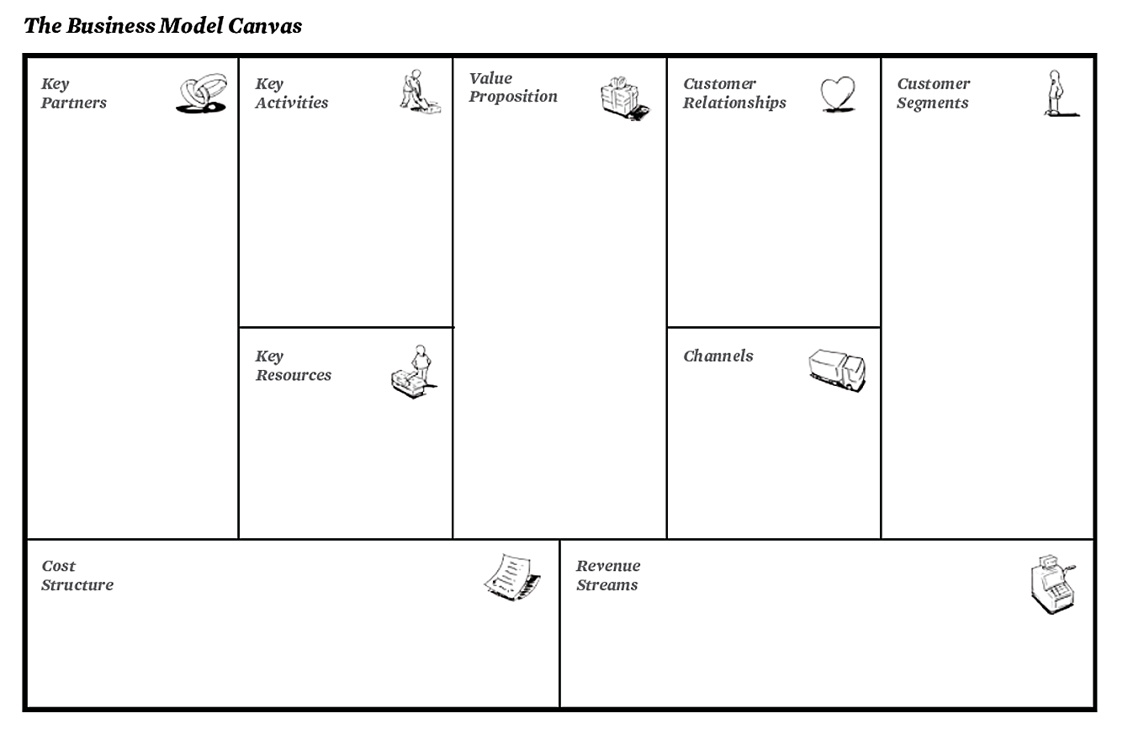
Materials will be outsourced from a company branded Made in China. This ensures that the materials can be bought in bulk at a reduced price, as opposed to expensive local manufacturing. The company also aims to work in partnership with the Canadian Federation of the Blind (CFB). The CFB is a non-profit, entirely volunteer based company that hopes to improve the lives of those that are visually impaired. They are also known to promote independent sellers of tools and technology useful for blind people.
Key activities include R&D of future products as well as marketing, sales, shipping, labelling, packaging, and assembling products.
To build strong relationships between the customers and the company we will put a strong emphasis on communication and seek feedback from our valued customers on ways to develop our cane. We will show genuine care for our customers and treat them with respect in all aspects of the business. The key to this will be by modeling good behaviours from management to employees to customers.
Our company’s cane is intended for use by anyone that is visually impaired. This person can be located anywhere in the world, is of any gender, and is within the skilled working class to upper middle class. The reason for why the individual must at least be of working class is due to the cost of the product being over $100. This is rather expensive, and therefore whoever wishes to purchase the product must have the funds to do so. We also envision that the person purchasing this cane is social, and active. The person must be social if the product is to be used among two people. The customer should also be active since the product is intended to be used while walking or running.
During the current pandemic safe social distancing is a practice that has been suggested from the government for the health of the public. For the case of visually impaired individuals however, the act of being guided usually includes breaking the 6ft social distancing regulation. The product that has been designed addresses the issue and enables the user to be guided from afar.
Key resources for the function of the business include financial assistance, motivated employees, highly knowledgeable management, product materials, private labelers/ manufacturers, outsourced postal service, small office space, and company laptops.
Products will be distributed via the e-commerce distribution method through web sales. The e-commerce distribution method will be used since it allows for lower operational costs, safer way to purchase goods, and is more convenient for customers.
Money will be made once at the time of purchase. The main company revenue will be from sales of our product to individuals or visual impairment rehabilitation corporations (sold in bulk). Additionally, when the company can go public on the stock market another source of revenue would be from dividends. Our business will set pricing based off our market competition, customer value, and cost of production/ materials.
Types of costs have been explained in further detail within section 2. They include marketing, electricity, salaries, materials, over head, rent, and depreciation.
Notes:
This is the business model canvas we have filled out in order to define all properties of our business model.
Our key partners are a non-profit organization focused on improving the lives of the visually impared called the Canadian Federation of the Blind, and our products will be made in China to ensure everything is bought in bulk at a reduced price.
Our value proposition is that our guiding cane is intended for use by anyone that is visually impaired and needs a way to be guided while still socially distancing by 6 ft.
We will maintain customer relationships by emphasizing feedback and communication from employee to customer
Products will be distributed via the e-commerce distribution method, and money will be made at the time of purchase when it is sold to individuals or in bulk to large corporations.

Slide 24
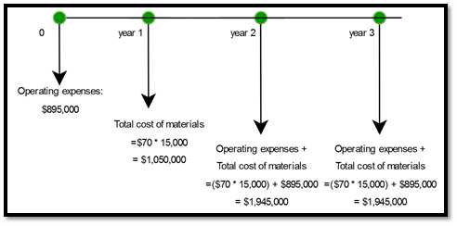
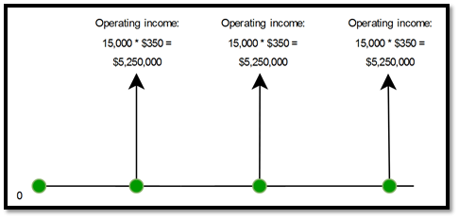
Core Assumptions and Projected Earnings
Net Present Value (NPV) Analysis
Targets a niche group of visually impaired people
Product that can be used for future pandemics
Unique product will attract a larger market
Produces a high quality product at low production costs
Graph of Expenses in 3 Years
Graph of Income in 3 Years
Notes:
To make sure our business model was going to be successful, we also had to make some estimates of the expenses and profits we might make, as well as come up with core assumptions and questions on its feasibility.
One of the core assumptions that we have made in developing our business model canvas is that we are a product-driven business that targets a niche group of users.
Another core assumption is that our product will help visually impaired people socially distance themselves from their guide in other situations similar to our current COVID-19 pandemic.
Additionally, the introduction of a unique product will attract a large market, as we would have little to no competition.
Lastly, our business model plans on maximizing profits, as we produce a high quality product with low production costs.

Slide 25
Lessons Learned & Next Steps
Communication
Consistency
Honesty
Universal Design

