Slide 1
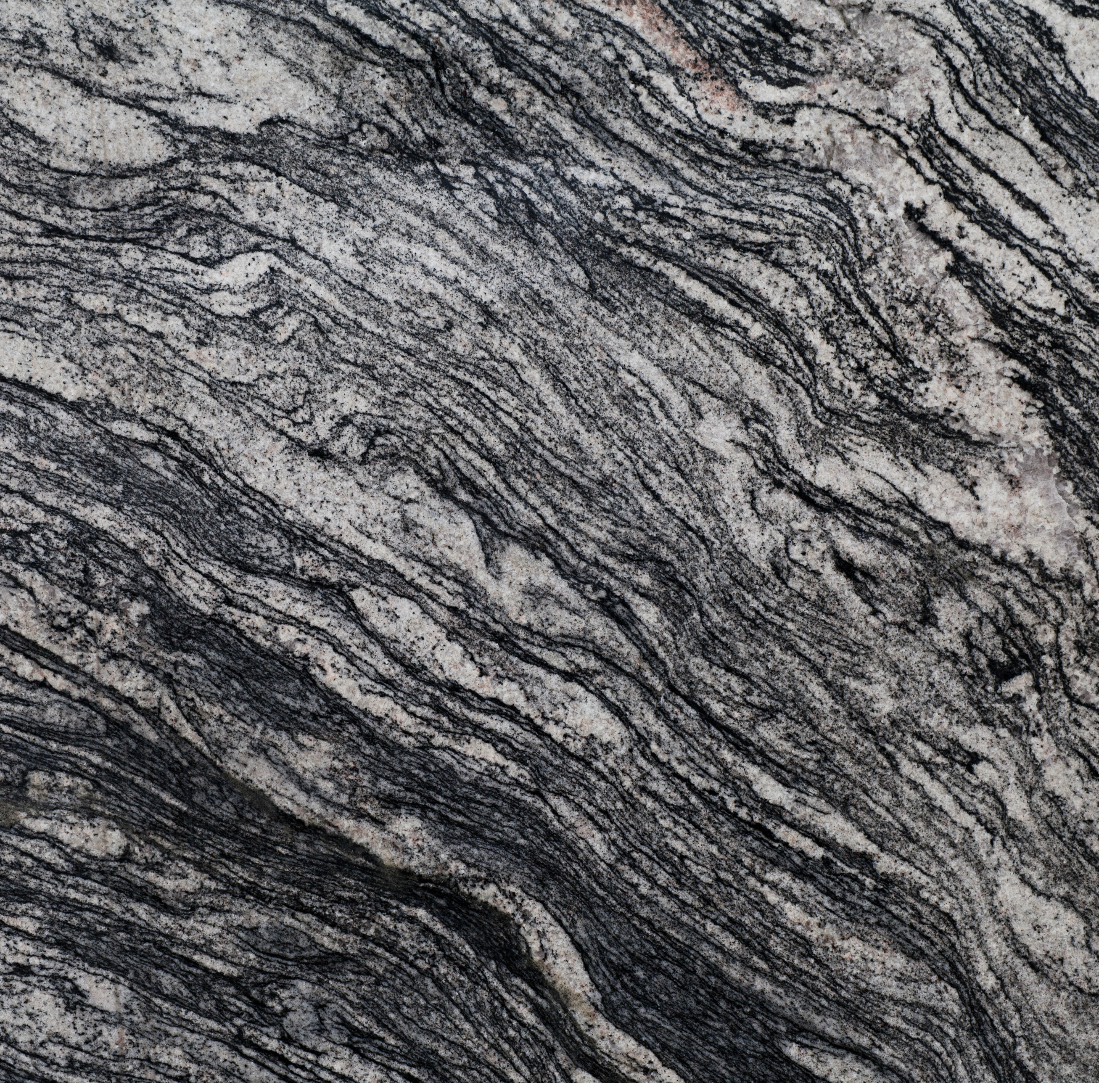
Acceleration rock erosion system
GNG 1103
Group F-12
Avery Taylor (300366472)
Emily Facette (300109170)
Rashad Nesar (300372555)
Annabelle Osazuwa (300361617)

Slide 2
Design Needs
- Designed to be safe - Inexpensive - Stable and able to accommodate a high rotational speed - Durable
- Rotate Components
FUNCTION
- Test a variety of
THEORY AND TESTING
DESIGN
Materials
Temperatures
Diameter of component
Fluid viscosities
Abrasion
Rotational speeds.
- Obtain empirical proof - The process will be repeatable - Erosion should be visible in a week or two after testing - Minimal Maintenance

Slide 3
User Needs
Need
The prototype should be safe to use
The prototype should be flexible enough to test a variety of materials, temperatures, diameter of components, fluid viscosities, abrasion, and rotational speeds
The prototype set up should be used to accelerate erosion testing by rotating components.
Erosion should be visible in a week or two after testing started
Design Criteria
The prototype will have a limiter on how high the speed and temperature can get
A limiting sensor for water temperature will be used. A spout will be installed on the barrel for ease of draining liquids.
The prototype will have a variable speed motor to spin the tested material
A variety of abrasive materials and high temperatures will be tested

Slide 4
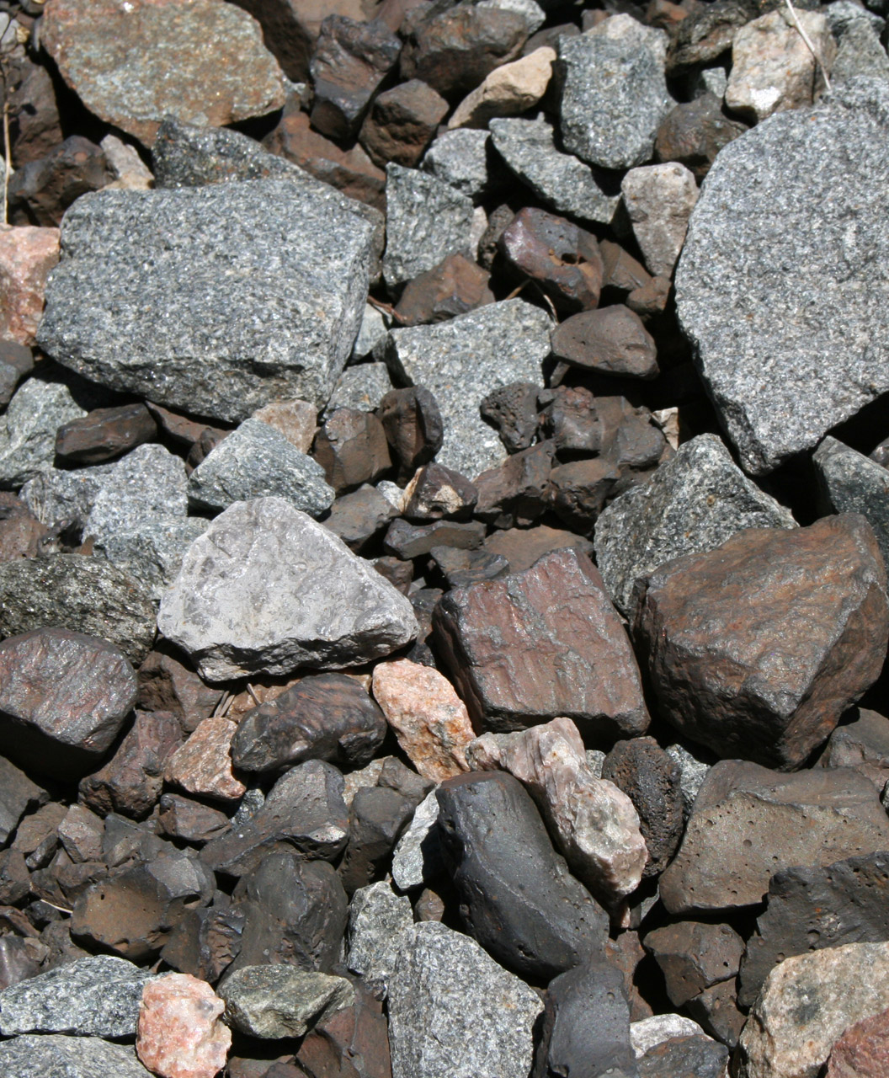
Problem Statement and Goal
Designing and developing an erosion testing system which is:
Safe
Economic
Durable
Stable
The system must be
Flexible
Repeatable
Accommodate different testing parameters.
The goal is to create a design which will allow for a deeper understanding of how different factors affect the rate of erosion.

Slide 5
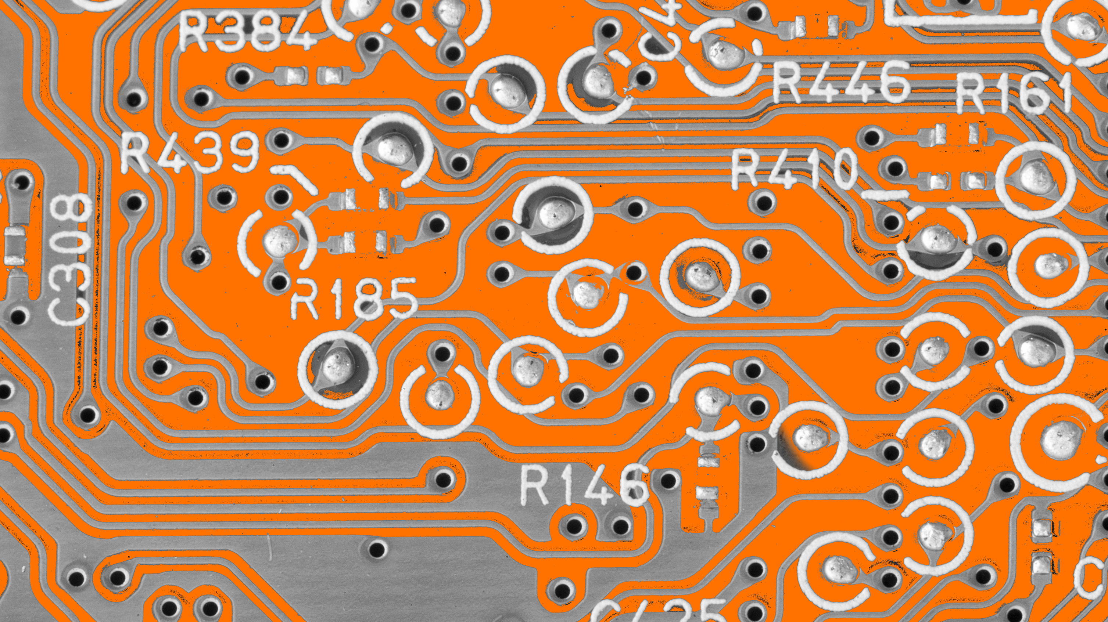
Design Ideas

Slide 6
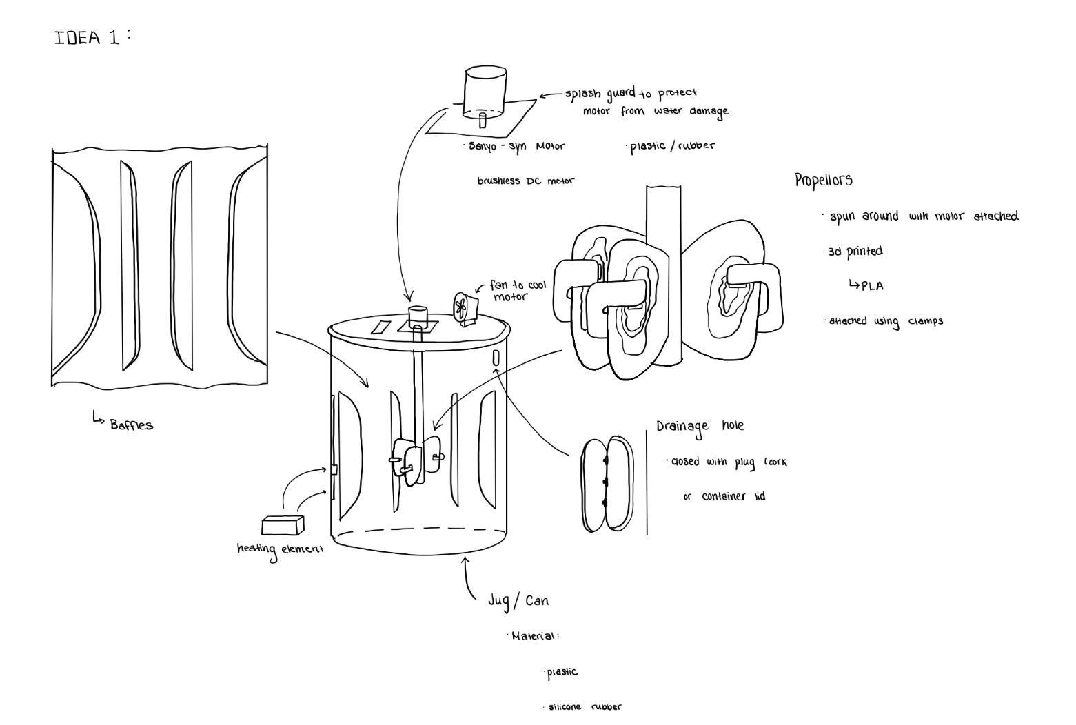
Design Idea 1

Slide 7
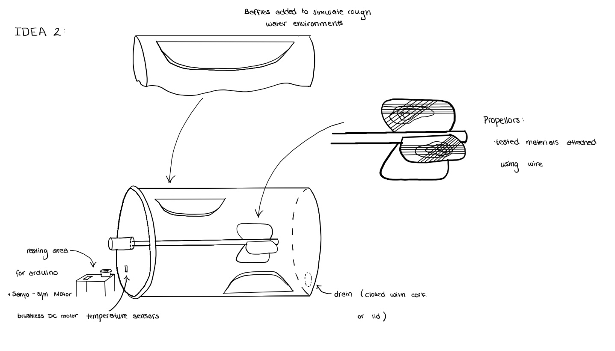
Design Idea 2

Slide 8
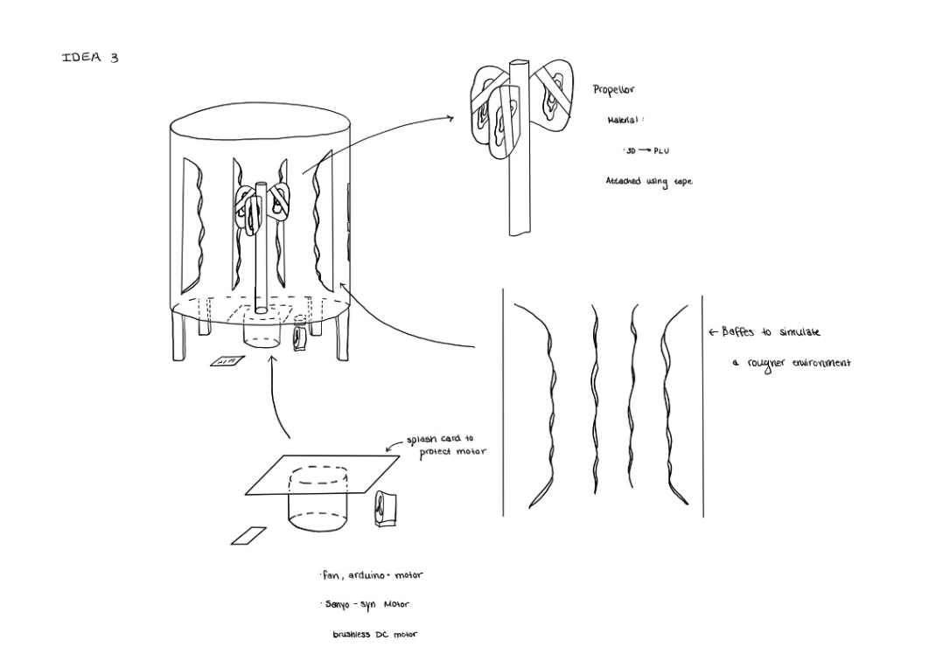
Design Idea 3

Slide 9
Conclusions and Future Works
Design 1
Motor on top
Baffles
Water heater
Plastic Barrel
Clamp for samples
Scheduling
Selection of Parts
Cost Analysis
Prototype construction

Slide 10
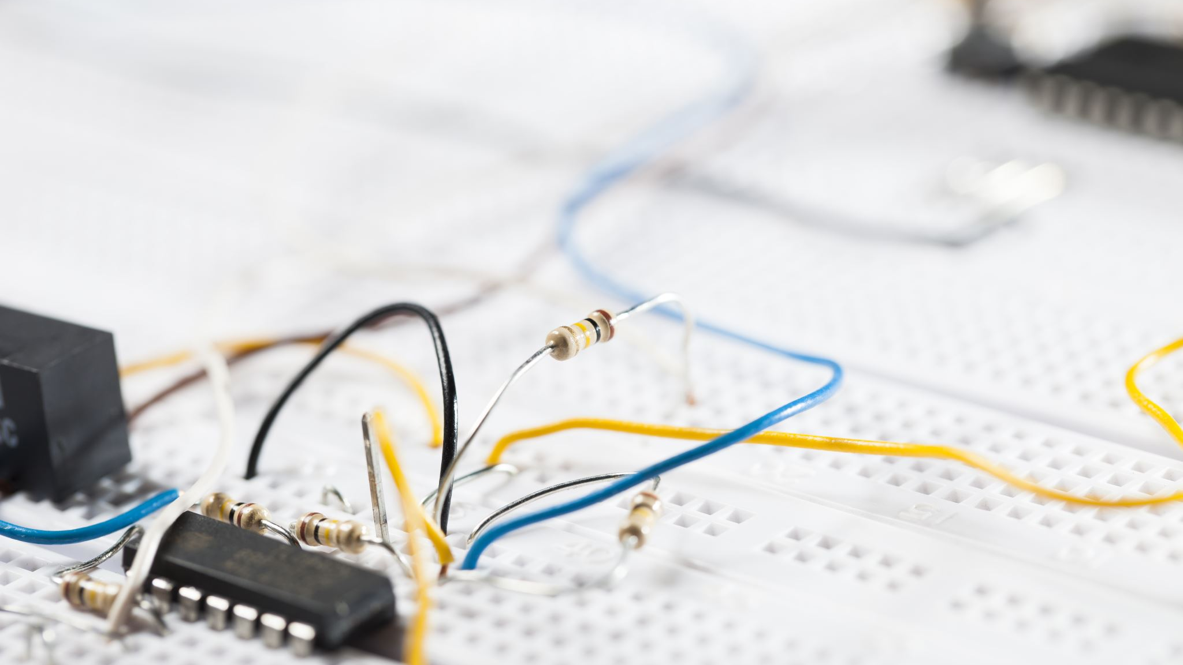
Thank you!
Any Questions?

Slide 11
Our questions for you
1- What did you/do not like from each design? 2- Have we included the features which you had anticipated? And has anything changed since the last meeting in terms of your design requirements? 3- Do the prototypes meet your expected needs/ would you like anything added? 4- Are any other testing parameters to be met?

