Slide 1
Talk Box C13
Kian Mozafarian
Zainab Badawi
Tia El Masry
Notes:
Kian

Slide 2
Introduction
Talk Box is an assistive device meant for people with disabilities
The purpose is to automate the day-to-day tasks i.e. turn TV on/off, turn lights on/off
Create an environment where the device user has the ability to converse with others with ease
Notes:
Kian
The goal of our project, Talk Box, is to build an assistive device that is aimed for people with disabilities. The main functionalities of the device include automating day-to-day tasks and also creating a possibility for the user to engage in a conversation. We hope to develop a product that can be easily upgraded and modified in the future, while also have the ability to be customizable from user to user.

Slide 3
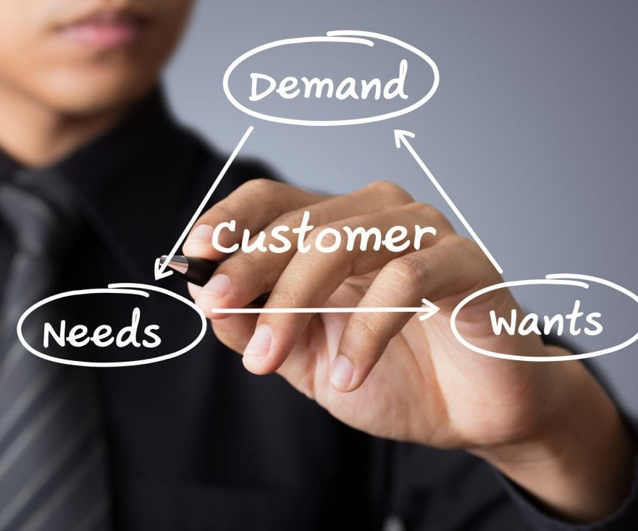
Customer Needs
Device is mountable to wheelchairs
Device is used to converse
Device can interact with smart home devices
Notes:
Tia
The customer needs that we obtained from the client meeting included:
Creating a device that would aid people with disabilities and that would complete simple and customizable daily tasks independently.
The disabilities among the community a lot of the time limits their motor control, therefore their dexterity is an important factor to keep in mind.
Therefore, if for example we were to give the user, a button or a keypad. The buttons must be large, separated from each other, and can be pressed with lowest force required.
The client also believed that there’s a lot of value in using a voice that would say what the user would like.
His overall goal is for us to look for a solution for a whole community not a specific person, therefore we need to think of a product that can by modified and extended for specific users.

Slide 4
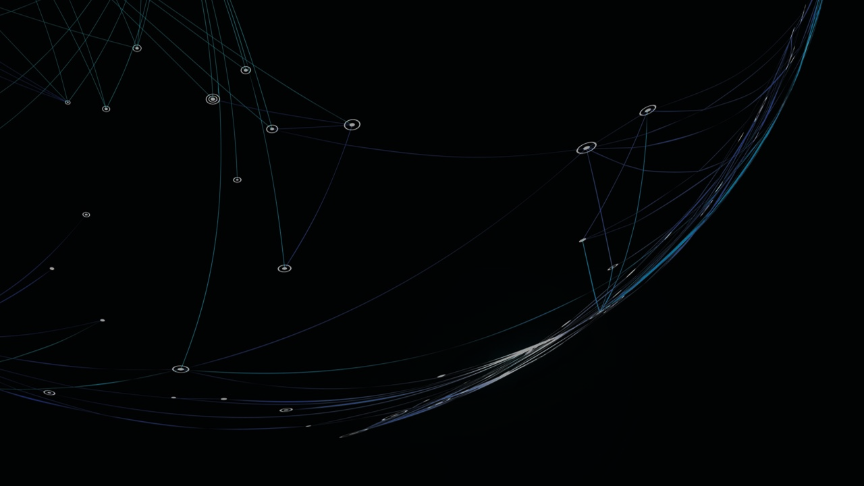
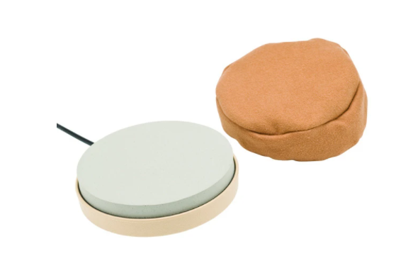
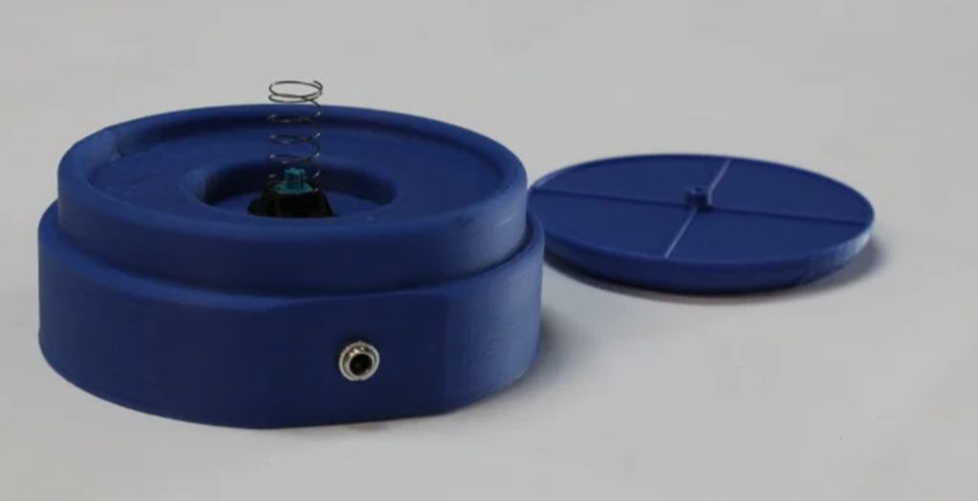
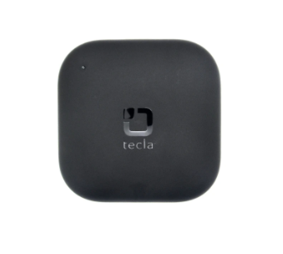
Benchmarking
The Ablenet Pillow Switch
The Adaptive Button
The Tecla APP and the Tecla-e
The Hive Active Smart Plugs and Hub 360
$640
$135
$50
Notes:
Zainab
We are not the only ones trying to solve this problem. Some of the products that already exist are the Alblenet pillow switch, the adaptive Button, The Tecla app, the Tecla-e, and the hub 360.
After comparing theses products with found that the Ablenet pillow switch and adaptive button have a very low activation force required but the Tecla-e did not. However the Tecla-e is the most modular allowing users to add commands using the + button on the Tecla app. A major drawback of the Tecla technology is their price very high price

Slide 5
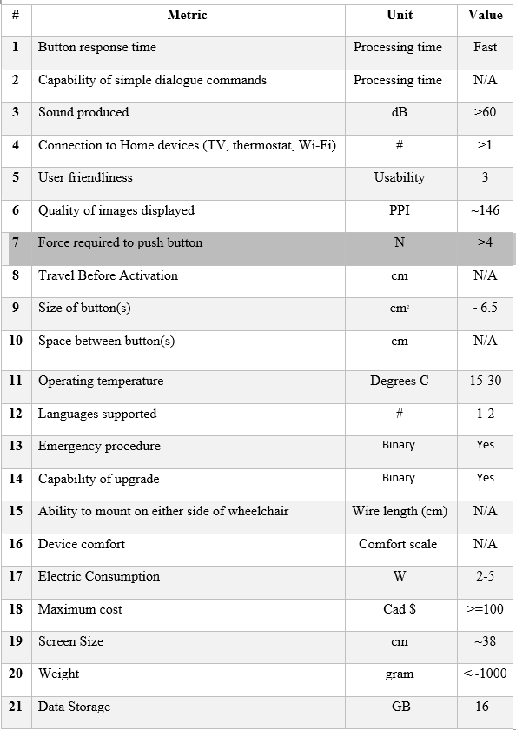
Target Specifications
No detailed requirements were given
Based on conventional information, the targets were set
Not all the targets could be met for this prototype
Notes:
Kian
- Our client had an idea, but there were no specific thresholds that were mentioned with a few exceptions being the cost and being compatible with a wheelchair in terms of power and mounting
- The values displayed are our target values for this project, and they were found through benchmarking different products with similar functionalities
- The final design will try to cover mostly, if not some, of the target specifications by the end. For the sake of prototyping however, the target values may not be reached due to various project limitations

Slide 6
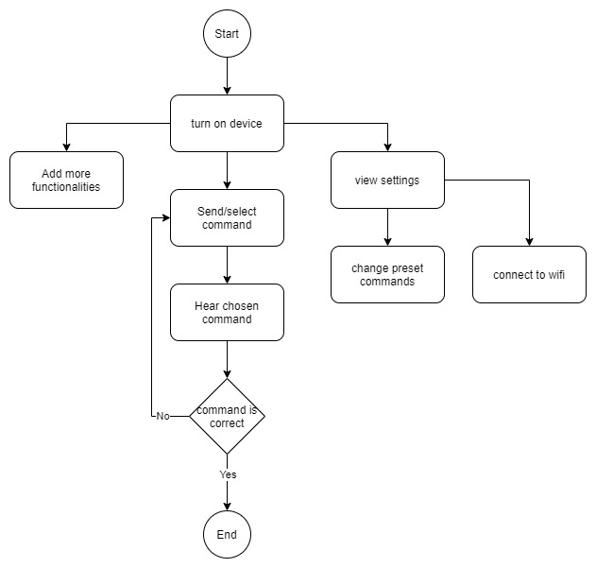
Flow Diagram
The functionalities of the promising solution was divided into achievable and smaller subfunctions
A high level understanding of the client needs was achieved.
Notes:
Zainab
The functionalities of the promising solution was divided into achievable and smaller subfunctions. At the highest level that client needs something that can allow him to turn on device, . We realize that the system needs to rely on a network such that we can update the device wirelessly and that the promising solution will be divided into electrical communication, user interface, and button design and mount.

Slide 7
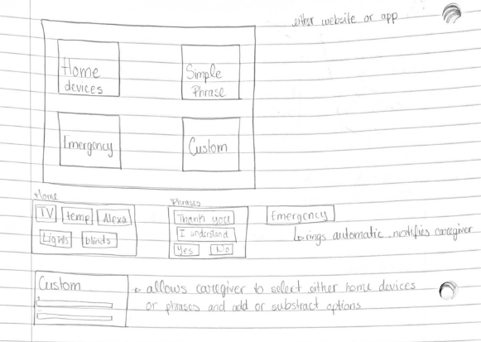
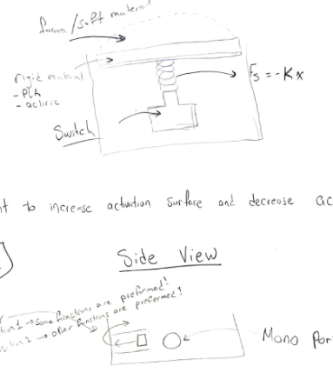
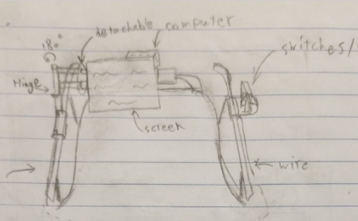
Concepts
Team members proposed sketches
Solutions divergence using SCAMPER
Solutions convergence using analysis and feasibility study
Notes:
Zainab
Each team member used the flow chart as a high level understanding of what the solution should do and poured on their creativity into paper to create 3 concept sketches. Some of the very interesting concepts were the flip phone and morse code buttons. All concepts were then brainstormed further using the scamper method. Finally the solutions were refined using the feasibility study and plugged into the decision matrix.

Slide 8
Decision Matrix
Criteria | Weight | Z1 | Z2 | Z3 | Z4 | T1 | T2 | T3 | K1 | K2 | K3 | K4
Automate simple daily tasks * | 7% | 0 | 3 | 1 | 3 | 0 | 3 | 5 | 0 | 4 | 0 | 2
Includes a simple dialogue commandes | 8% | 0 | 3 | 0 | 2 | 3 | 2 | 4 | 0 | 4 | 0 | 0
Can produce sounds of multiple simple phrases | 8% | 0 | 3 | 0 | 2 | 4 | 3 | 0 | 0 | 0 | 3 | 0
Can access home devices e.g. TV, thermostat | 5% | 0 | 0 | 0 | 0 | 0 | 1 | 0 | 0 | 4 | 0 | 0
Can connect to Wi-Fi | 5% | 0 | 0 | 1 | 0 | 0 | 1 | 0 | 0 | 3 | 3 | 0
Features can be customized by a separate user interface | 8% | 0 | 3 | 3 | 3 | 3 | 1 | 5 | 2 | 0 | 1 | 2
Includes Images/figures representing words/requests | 3% | 0 | 0 | 0 | 4 | 2 | 4 | 5 | 0 | 4 | 0 | 0
Buttons require very low effort to use | 8% | 4 | 0 | 0 | 0 | 3 | 2 | 0 | 0 | 0 | 0 | 3
Buttons are large and separated | 8% | 4 | 3 | 0 | 0 | 3 | 1 | 0 | 0 | 0 | 0 | 3
Is resilient against physical damage from indoor and outdoor factors | 2% | 2 | 2 | 1 | 0 | 2 | 2 | 2 | 4 | 0 | 3 | 2
Supports different languages | 2% | 0 | 1 | 0 | 1 | 1 | 1 | 1 | 0 | 2 | 0 | 0
Has an emergency contact feature | 2% | 0 | 1 | 0 | 0 | 0 | 0 | 4 | 0 | 3 | 0 | 0
Is modular and can be upgraded down the line | 6% | 0 | 3 | 0 | 2 | 2 | 4 | 4 | 4 | 3 | 4 | 1
Is mountable on a wheelchair | 5% | 0 | 1 | 0 | 0 | 0 | 0 | 0 | 5 | 0 | 3 | 2
Can be installed either side of a wheelchair | 5% | 3 | 1 | 0 | 0 | 0 | 0 | 0 | 3 | 0 | 2 | 2
Surfaces are smooth and comfortable for the palm of the hand | 4% | 3 | 1 | 0 | 0 | 3 | 5 | 0 | 2 | 0 | 0 | 3
Uses wheelchair power to operate | 4% | 4 | 4 | 0 | 0 | 2 | 2 | 0 | 3 | 0 | 3 | 2
Is cost efficient/ inexpensive | 10% | 3 | 4 | 2 | 4 | 1 | 1 | 5 | 3 | 3 | 3 | 2
sum | 100% | 1.41 | 2.13 | 0.58 | 1.43 | 1.82 | 1.83 | 2.1 | 1.38 | 1.65 | 1.44 | 1.48
Notes:
Tia
In our decision matrix, we evaluated each of our concepts based on the metrics that we have defined from the customer needs and the weight was determined by the value of importance of that specific metric. All of our sub-concepts that we developed from SCAMPER were added to the main concept and evaluated in the matrix. Using all of these variables we choose 4 designs that we believe satisfy all of our customer needs.

Slide 9
Decision Matrix Takeaways
Electrical Communication
User Interface
Button Design
Other Solutions
Notes:
Kian
We have decided that using a Raspberry Pi is the most beneficial for our project. The Pi offers USB port for future add-ons such as buttons, storage, or any input/output device that’s applicable. Furthermore, it offers a 3.5 mm port for audio purposes, meaning its easy to interchange speakers in the future without any hassle. The Pi also makes it simple to connect a display to it via HDMI port and this also allows for future upgradability. As for the communication between smart home devices and the Pi, it can be described by using HTTP get which uses TCP/IP as its communication method to talk to other devices.
Tia
Secondly, we have the user Interface. Our concept included separating the user interface in 4 categories and they are Home Devices, Simple Phrases, Emergency Features and Customization. The home devices section will be able to connect to smart home devices that the user owns for example a smart TV. The simple phrases section will contain a list of phrases the user can sound out through the speaker with the help of the button. The emergency section allows the user to indicate if they need assistance or medical attention. The custom section allows the caregiver to modify to add or remove the list of phrases depending on the user’s daily activities and it also allows the developer to add more functions to the device as a whole.
Zainab
Thirdly, in terms of our design for the button, we decided to have the button activation surface be a 6 x 8 cm2. The button will use a raspberry pi as its operating system to communicate easier with other devices. Within the button case a speaker grid and a light indicator was designed.

Slide 10
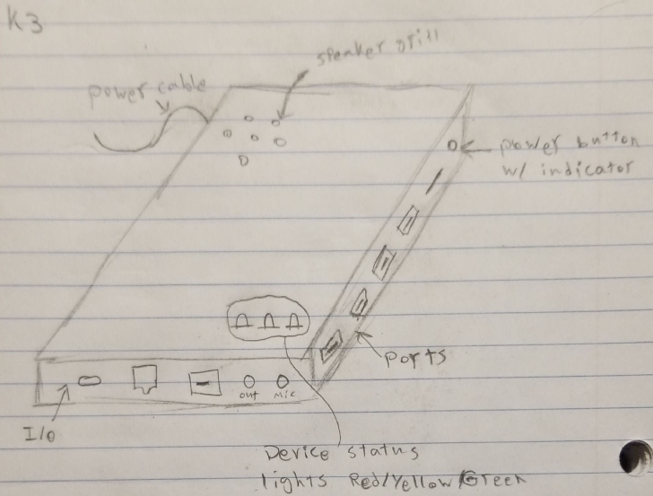
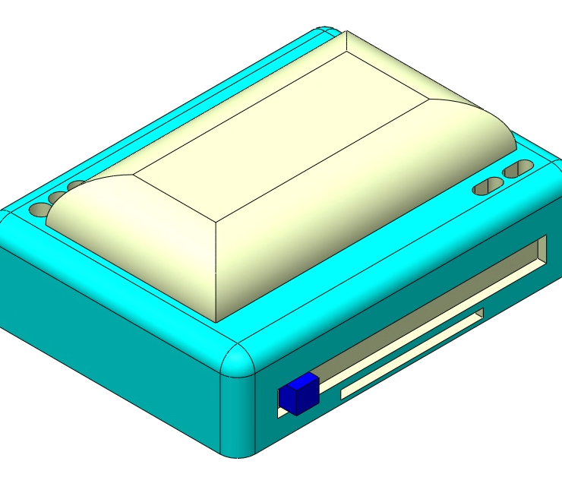
Client Feedback
The Client suggests using a spreadsheet to update commands
The speaker holes are too small
The slider could be problematic
The client does not see much value having LED lights
Notes:
Tia
In terms of the client feedback, that we received from the 2nd client meeting,
He mentioned how the speaker holes are too small and expressed his concern that these small speakers tend to have high pitch which can be irritating
The client also does not see much value in having LED lights as indicators to the button's response
He thinks that the slider is problematic to the user due to the risk of accidental movements that might occur
Finally, the client believes that clicking multiple times for a function would be very difficult for many clients.

Slide 11
Future Plans:
Finish Prototype 1 Analysis
Done
Further Prototyping in Reference to Prototype 1
Feb. 8 – Feb. 18
Start Software Development and Research API’s
Feb. 20 – Feb. 28
Final Design Presentation
March 31 – April 8
Debug and Refine the Final Design
March 10 – March 20
Work and Finalization of Prototype 2
March 1 – March 7
Notes:
Kian
Get 5 key dates: when do you have prototype 1 and prototype done. Troubleshooting on these days and system integration in theses days

Slide 12
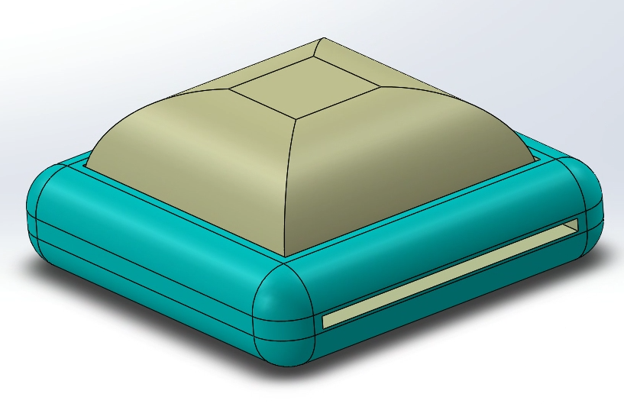
Prototypes
Hardware
Software
Notes:
Our objectives for the first prototype was to test the reactiveness and the force required to select among the options the talk box can perform. And to create a simple method to update the commands sent to the talk box.
The talk box is divided into 2 main components Hardware and Software that are linked using by a Magical Button

Slide 13
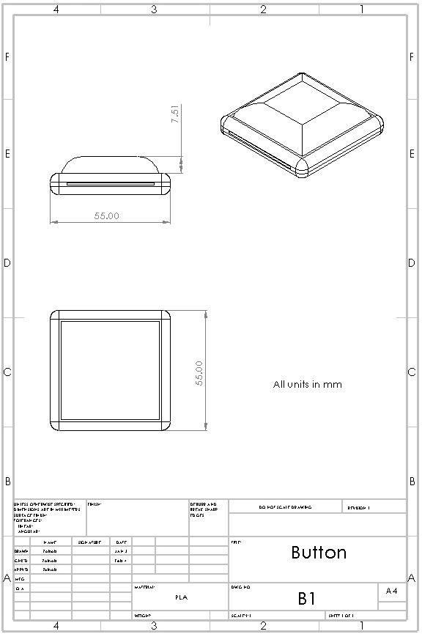
Button Functionality prototype
The Button behavior was prototyped using an Arduino uno, LCD screen, and a Joystick
The Button frame was redesigned on SolidWorks
The Button frame was 3D printed
Notes:
To prototype the behavior of the button, we used an Arduino, LCD screen, and a joystick. The Button frame was then redesigned on solid works to meet the feedback given by the client. Finally the button frame was 3d printed.

Slide 14
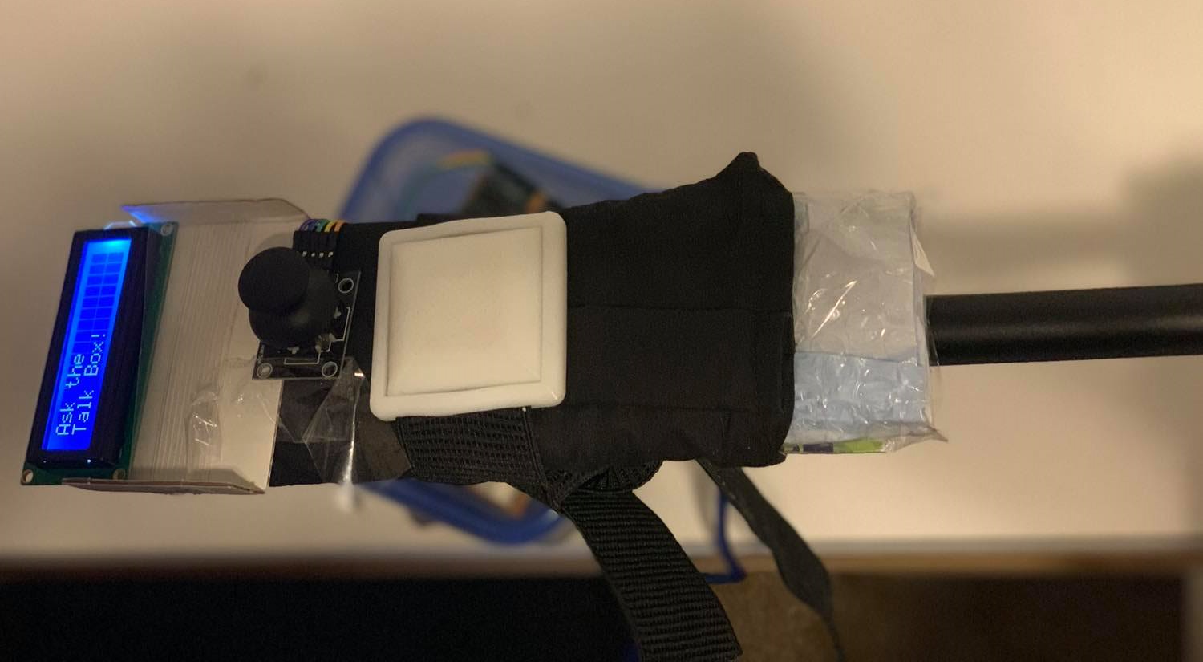
The Prototype mounted on the Wheelchair
Notes:
here is how the components are mounted to the a prototyped wheelchair arm

Slide 15
Notes:
Here is a video that shows how the prototype works! The microcontroller is programmed to only read input when the joystick moves in the horizontal axes. This requires the least amount of wrist movement from the user. Finally the joystick can be pressed downwards to select a command.

Slide 16
Notes:
Tia
In terms of the software prototype, we have created a python program that would essentially read the two files of the different categories like home devices and simple phrases. The program is composed of two simple functions, the first would read the files and create a dictionary of all the contents of both files. The second would return a specific sentence in the dictionary based on the number its given. The program as a whole when it’s run as you can see here, it prompt the user to choose between both categories, then it shows the user all the different options within that category then it prompts the user to select a number, then based on that input the program returns the sentence that corresponds to it and then terminates.

Slide 17
Milestones
Prototype 1
Test Button Functionalities
Test adding new commands
Prototype 2
Build a minimum viable product that meets 70% of clients needs
Design Day
Present the final product to the client along with a 3 min pitch to the judges

Slide 18
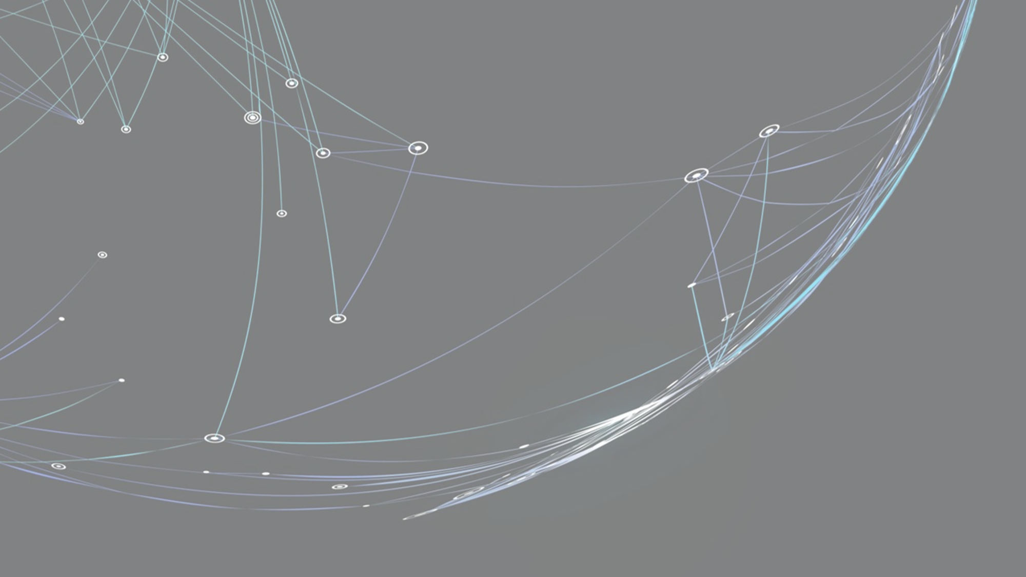
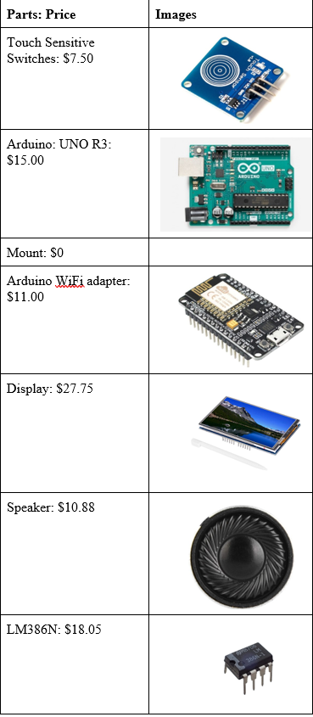
BOM
Arduino Build
Raspberry Pi Build

Slide 19
Lessons learned
Raspberry Pi is more appropriate for this project compared to Arduino
Small Arduino switch buttons are difficult to reduce the force required to activate.
The GitHub repository for this project should be private.
Setting up the project design with smart home system is simpler than initially thought to be.

Slide 20
Thank You For Listening ☺

