Slide 1
GNG 1103 Final Presentation
Group 2 - Lydia Finn, Ali Allouche, Adrian Begic

Slide 2
Our Problem

Slide 3
Summary Of Project

Slide 4
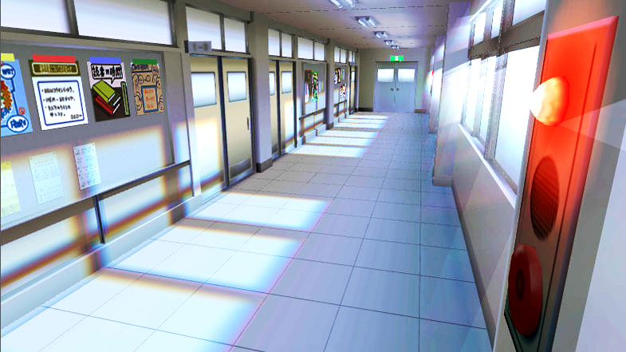
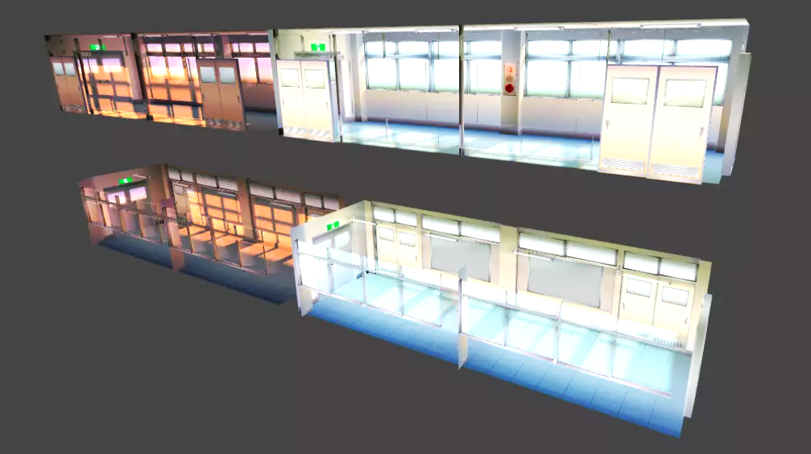
First Environment
Our home screen and starting point

Slide 5
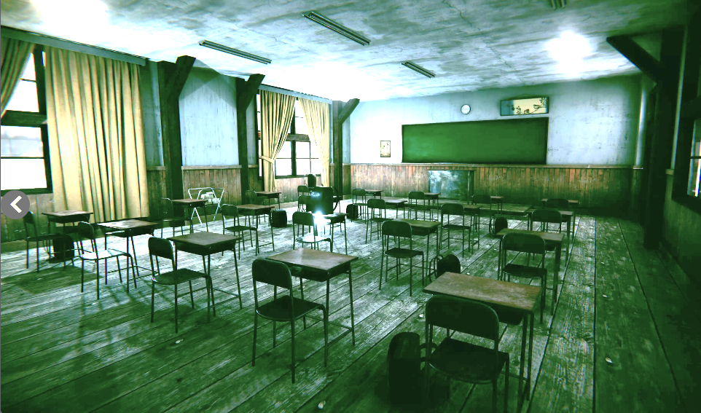
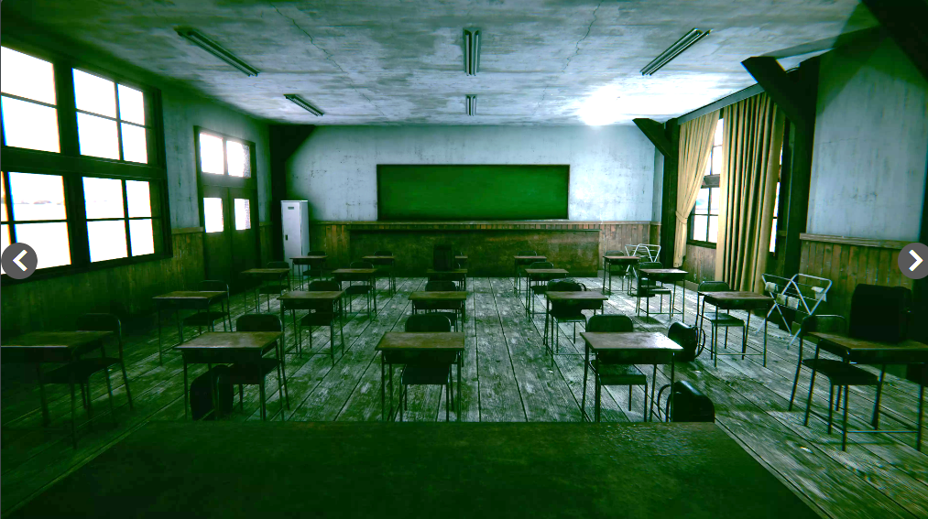
Main Environment

Slide 6
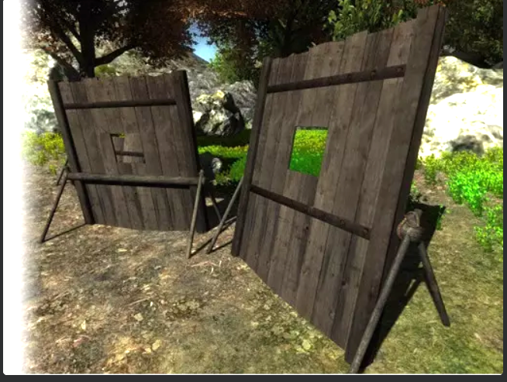
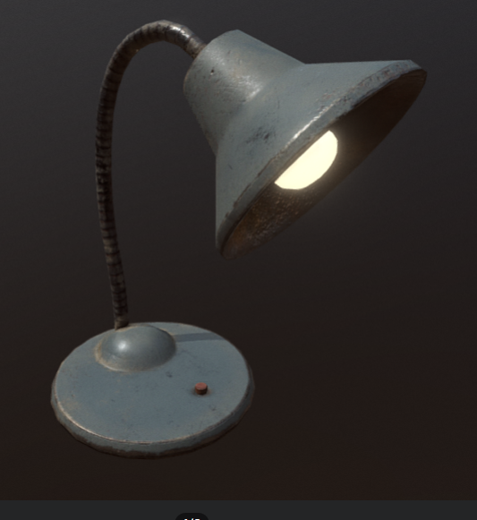
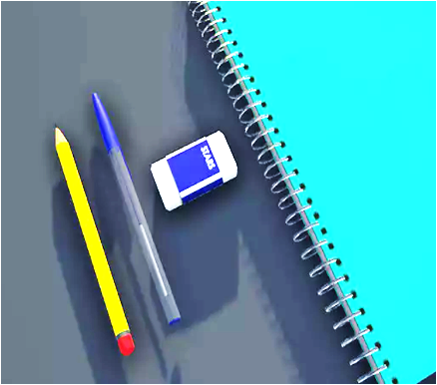
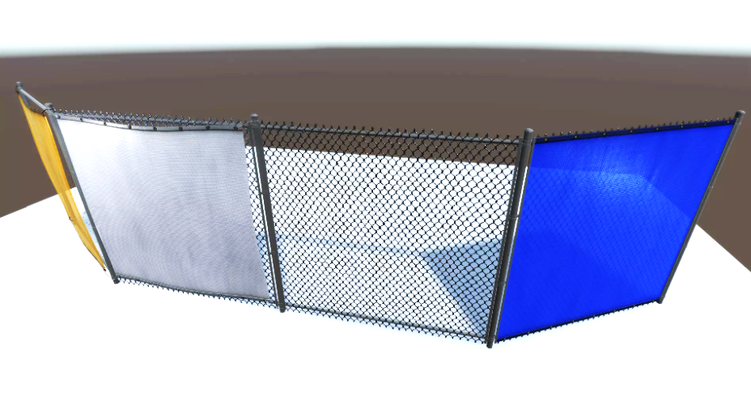
Environmental Additions

Slide 7
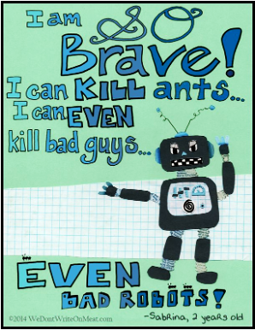
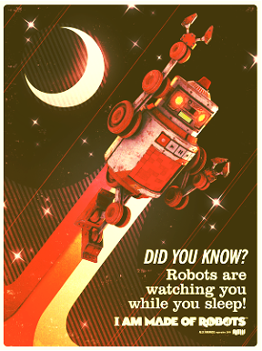
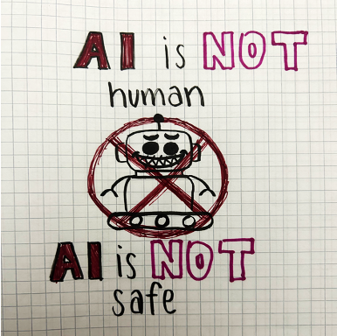
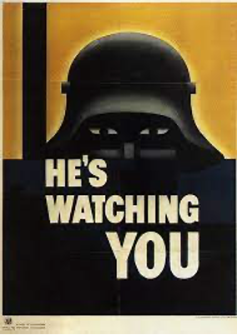
Anti-Ai Propaganda

Slide 8
Choices we made & what we learned

Slide 9
Split into a few categories
Audio
Visual
Rendering
Lighting

Slide 10
Audio
Key Points We Wanted To Address:
Ambience
Spatial Audio
Action Triggered Audio

Slide 11
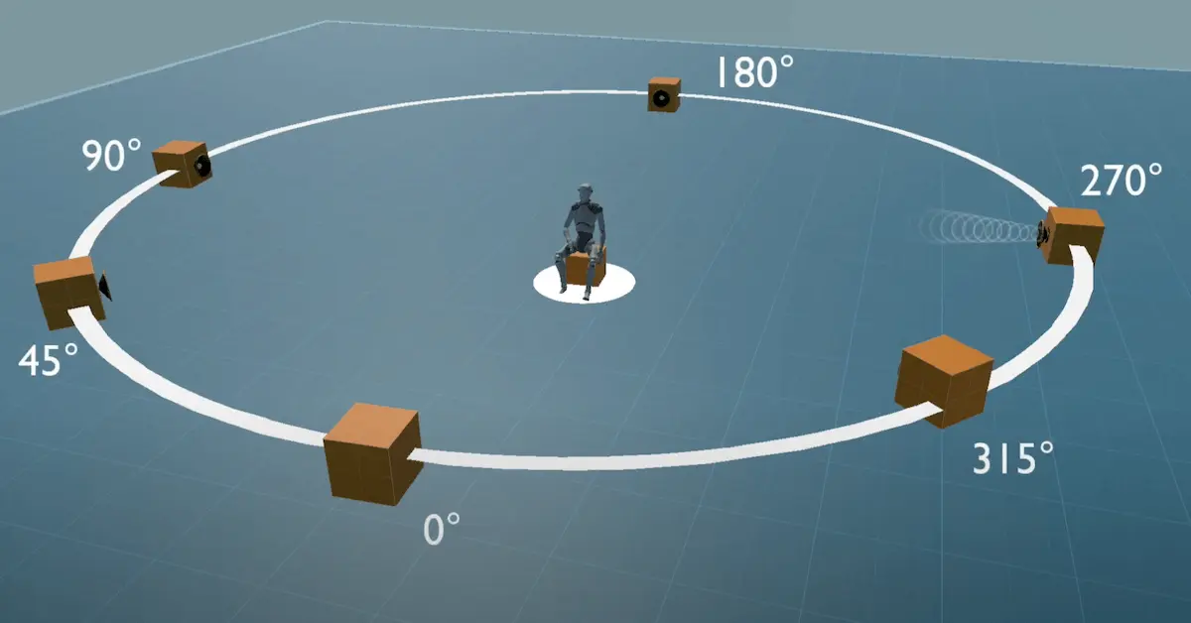

Slide 12
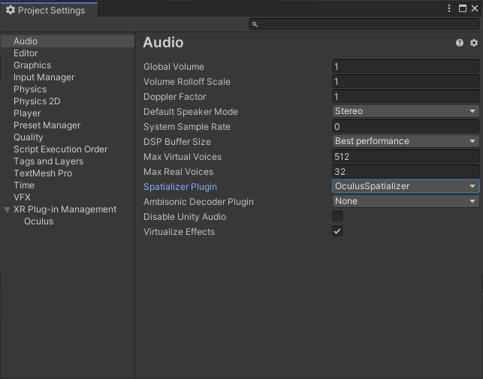

Slide 13
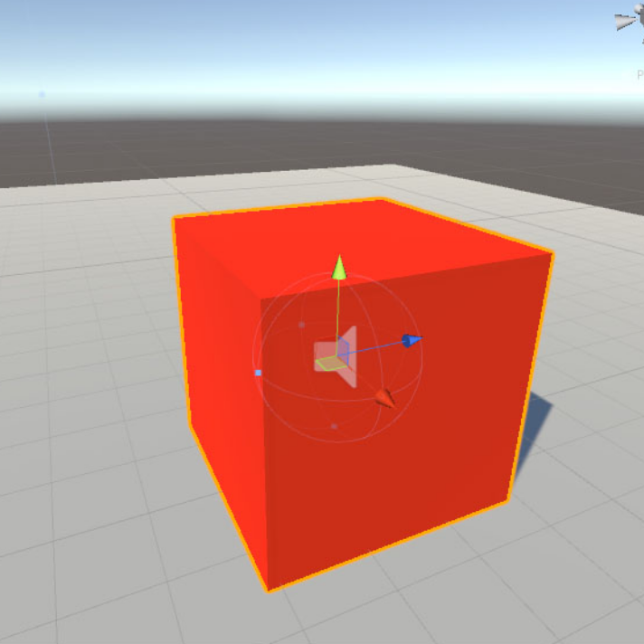

Slide 14
Visual
Our two environments don’t exactly match
Create cohesiveness
Blend robot solutions into existing environments
Propaganda

Slide 15
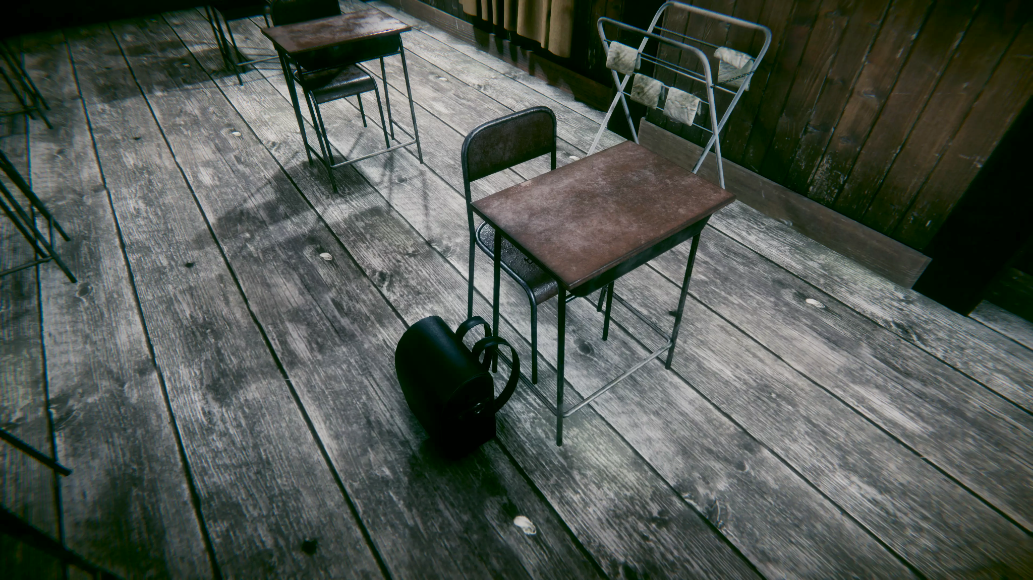

Slide 16
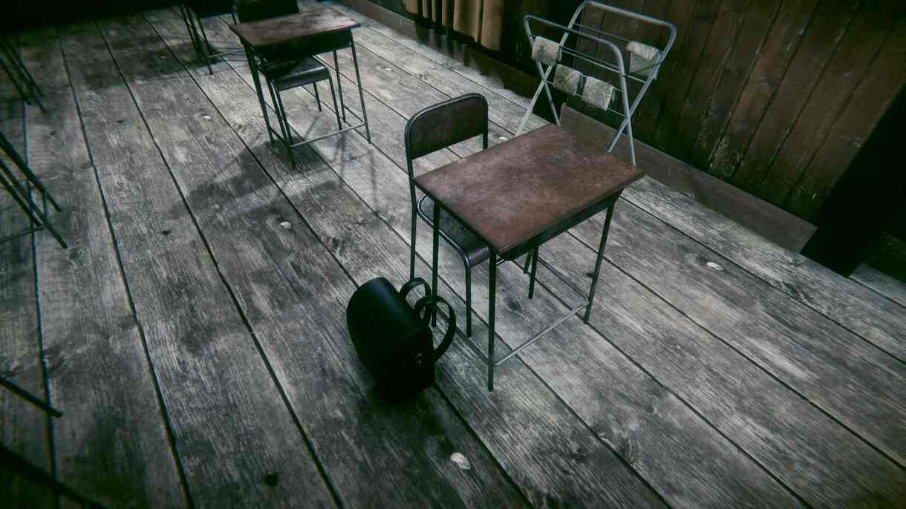

Slide 17
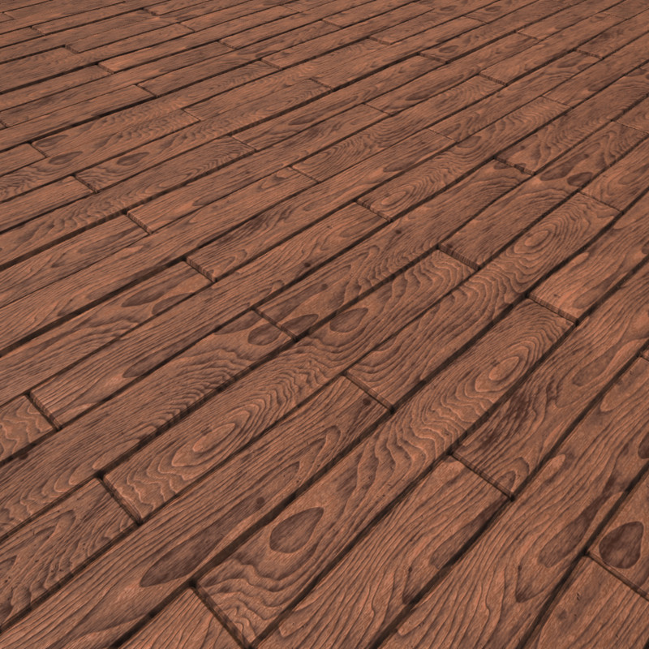
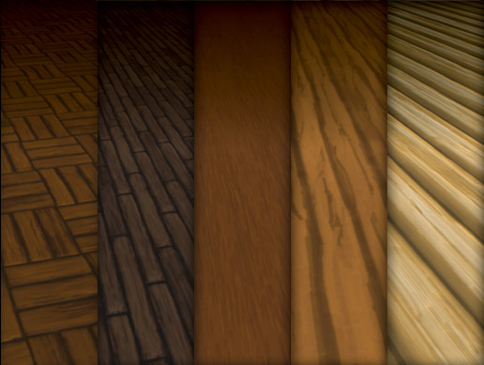

Slide 18
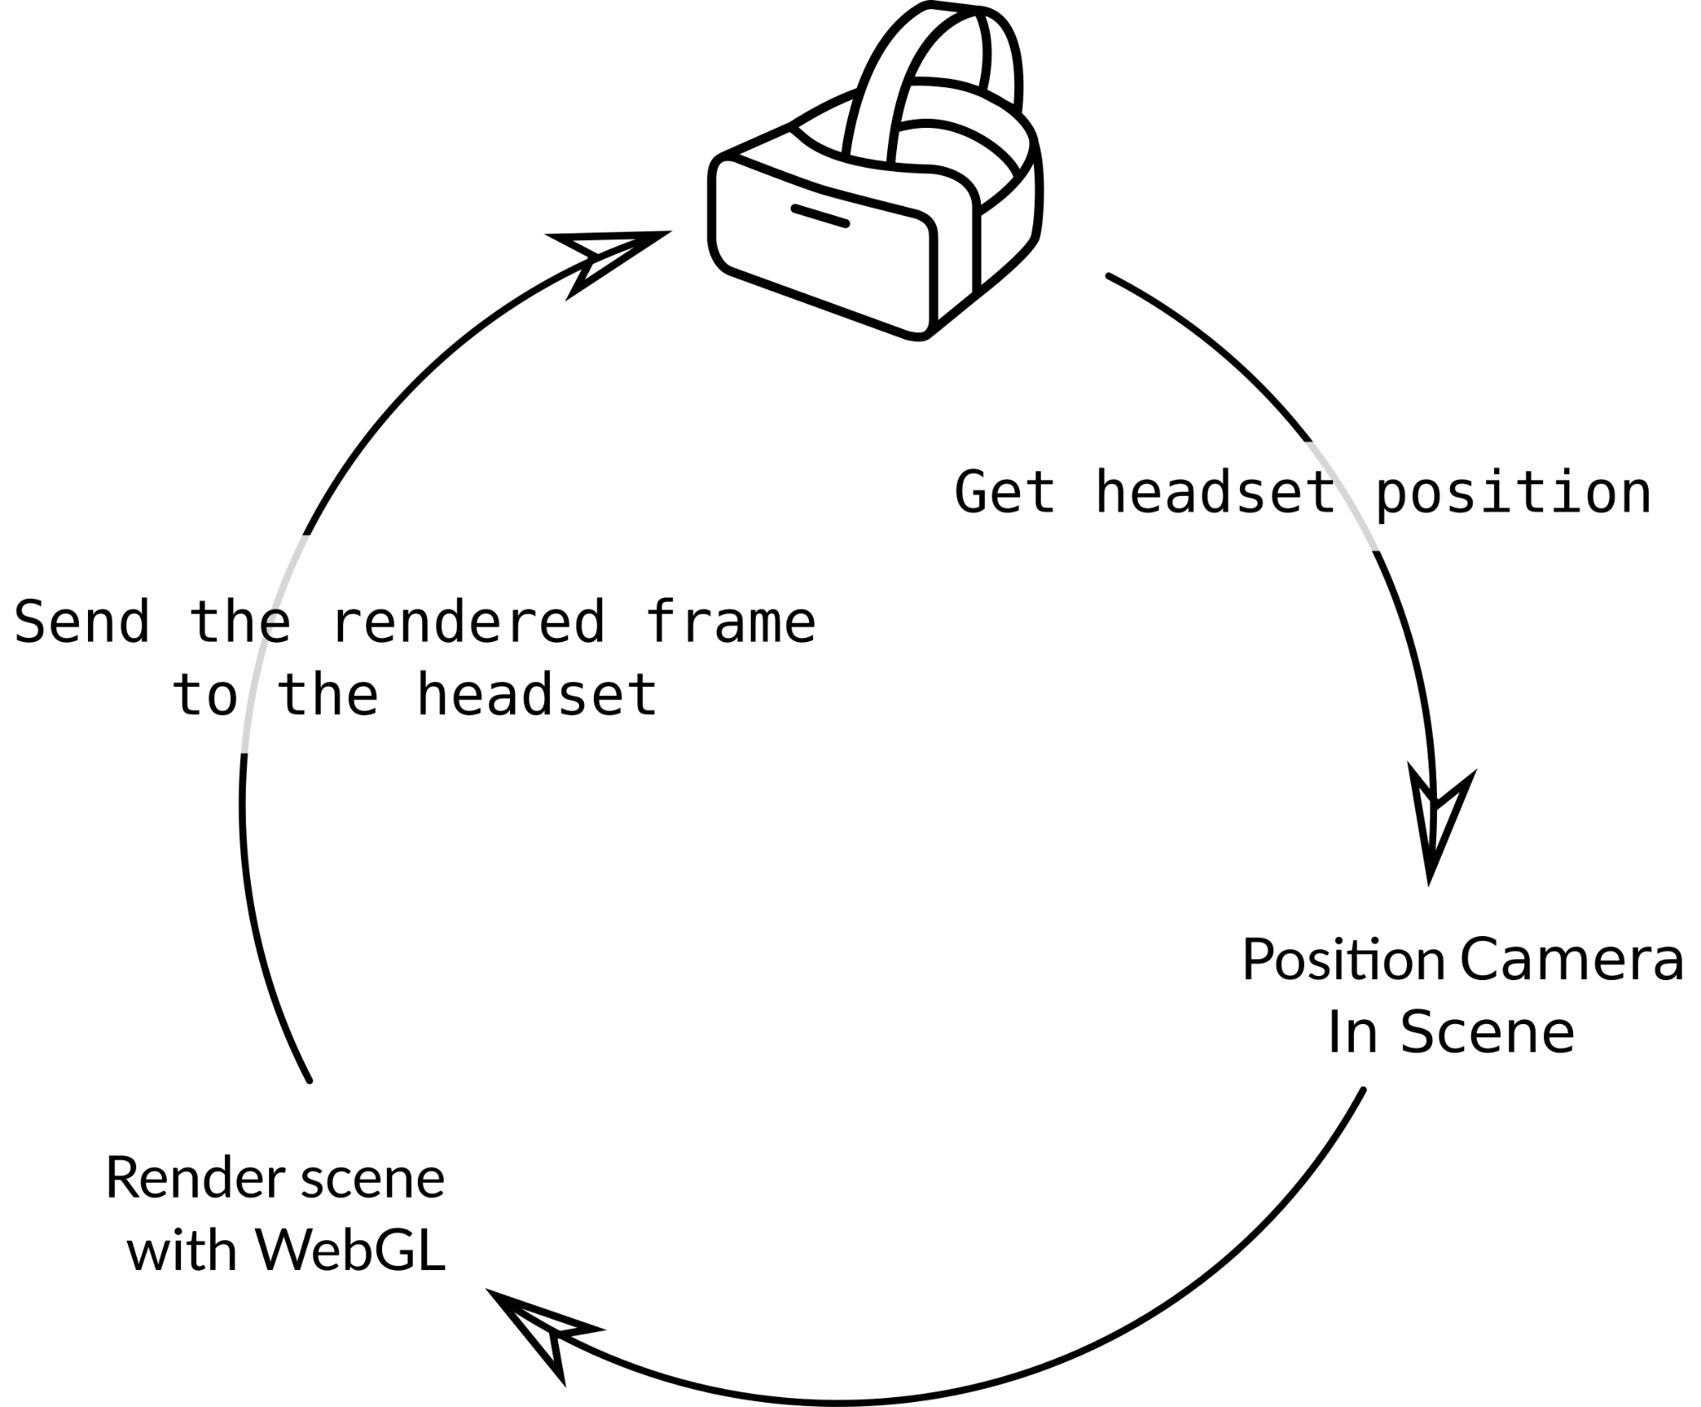
Rendering
What Tricks Can We Use?

Slide 19
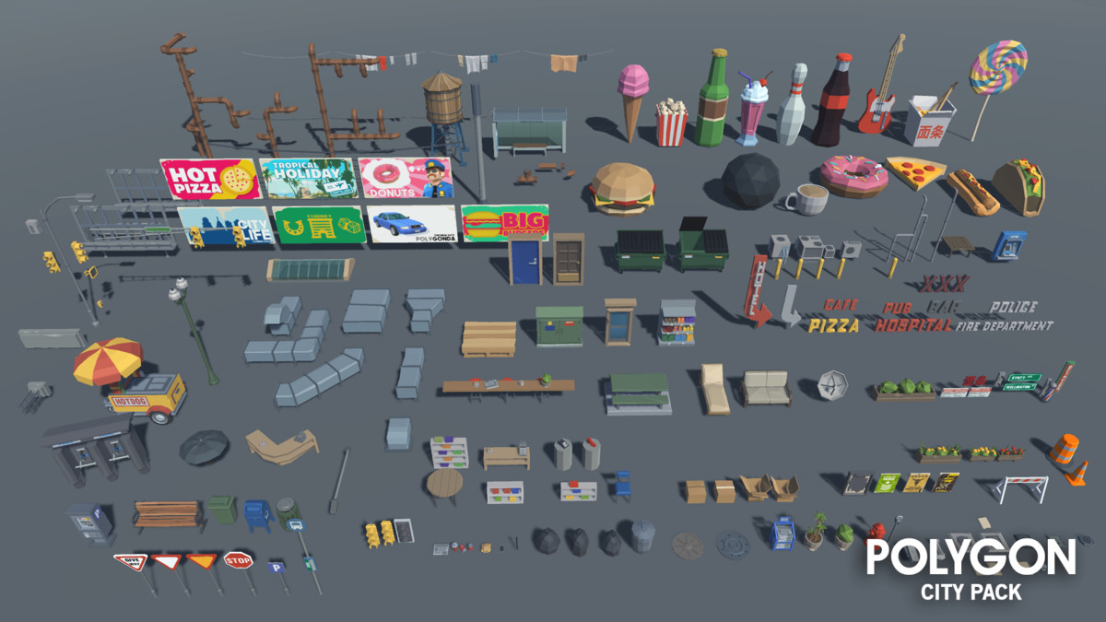

Slide 21
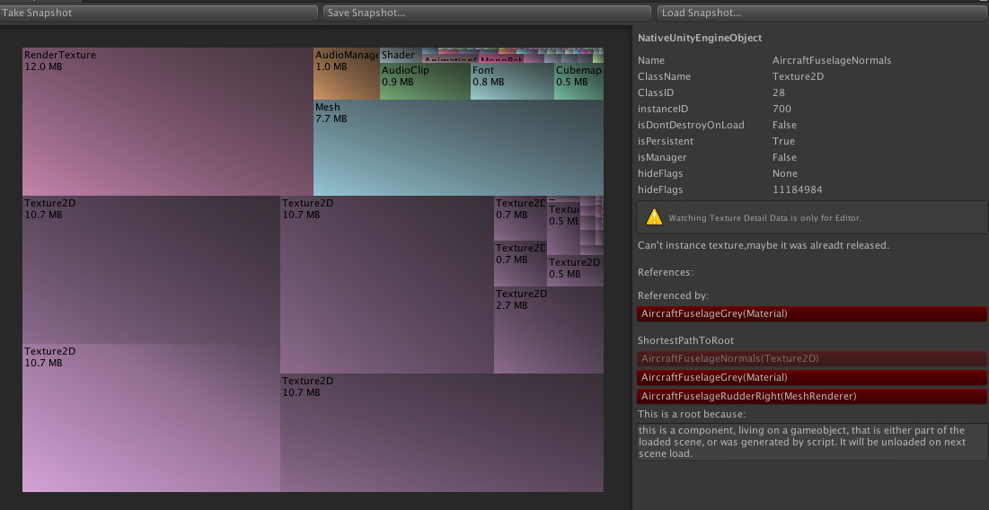

Slide 22
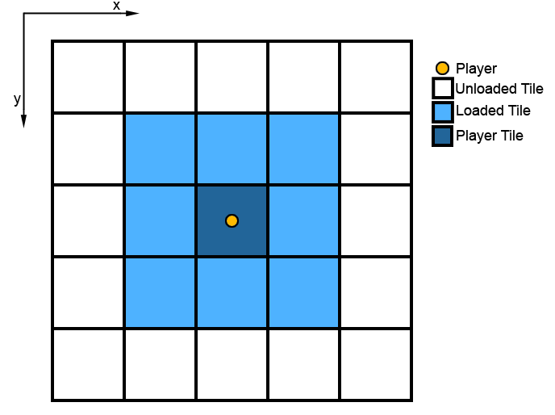

Slide 23
Lighting
Almost dim lighting environment
Bright enough to where it is easy to watch but dim and dark enough to showcase mood

Slide 24
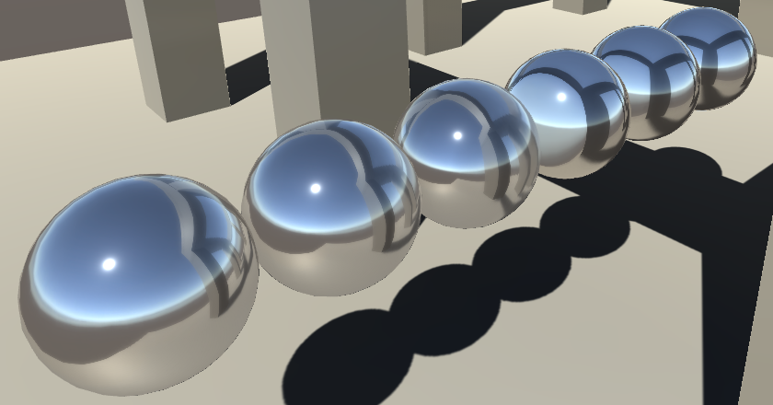
Can use physical assets like lamps
Include lightmaps and reflection probes

Slide 25
Future Work

Slide 26
Adding
Custom Handmade
Assets
Focus On
Performance
Improvement
Polish Details
Throughout
Experience
Fixing Bugs
Currently Present
Timeline

Slide 27
Questions

