Slide 1
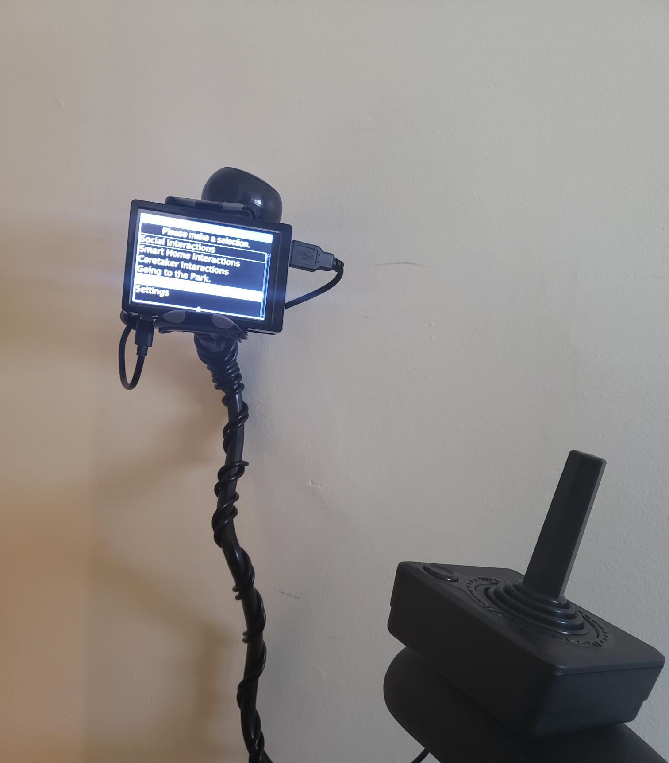
Portable Orator
-TalkBox
Victoria, Chuanzhi, Kaiyi, Michael

Slide 2
Client Needs
Select phrases
Speak the prhrases out loud

Slide 3
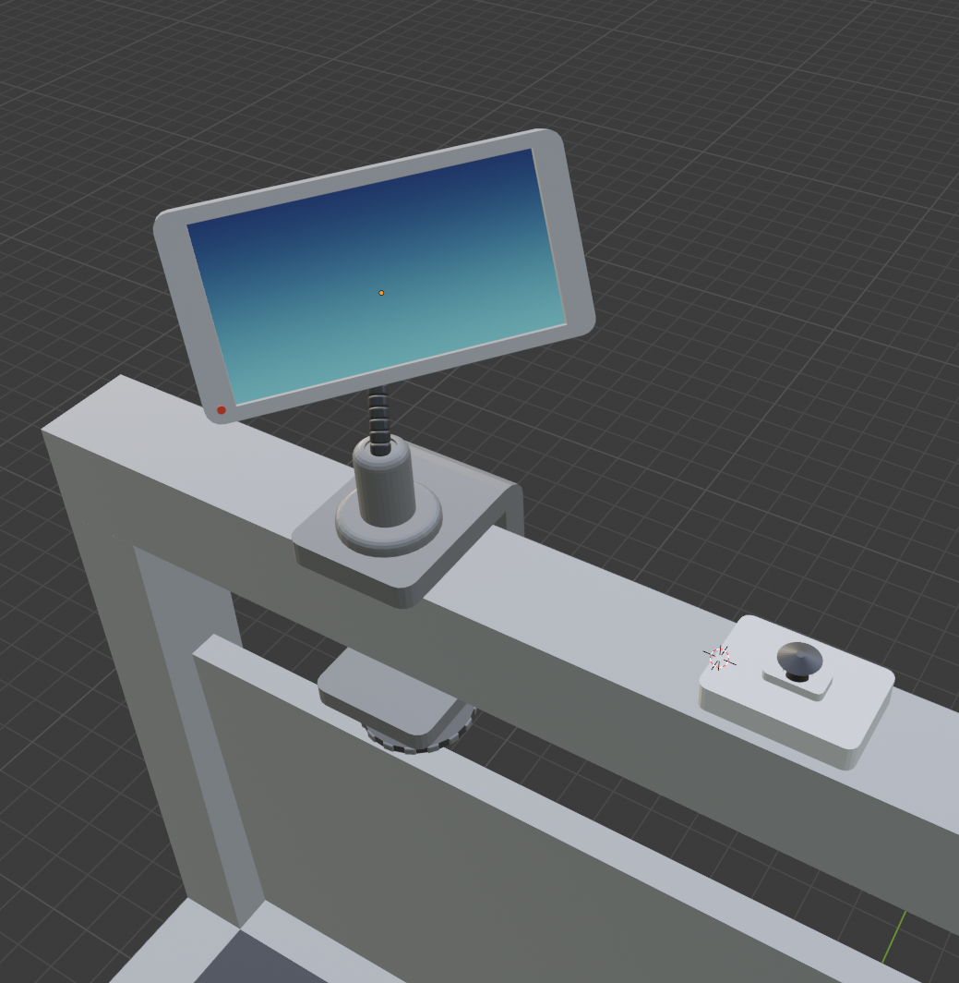
Solution

Slide 4
Freedom of movement

Slide 5
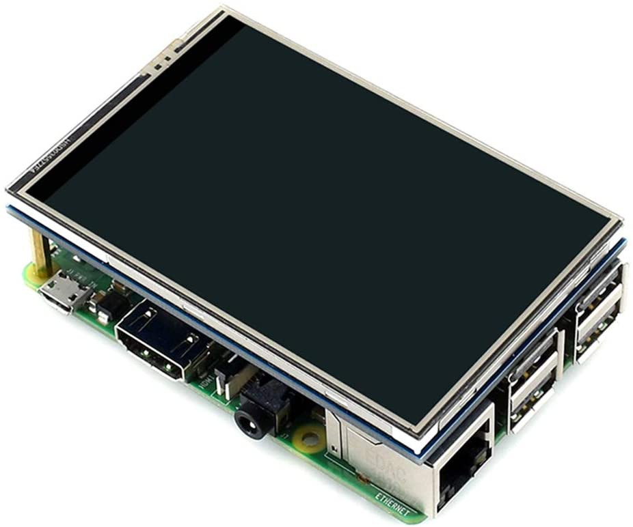
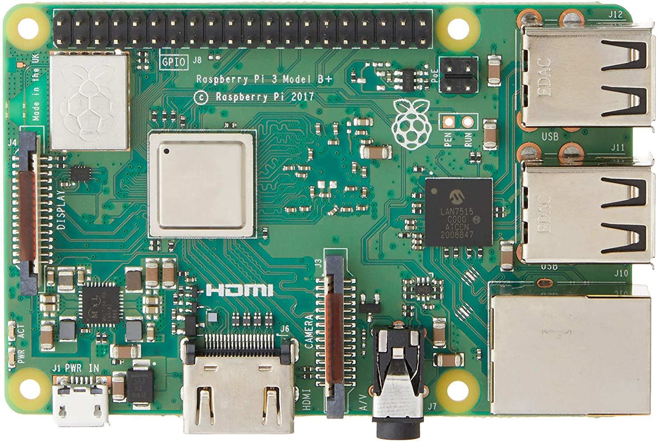
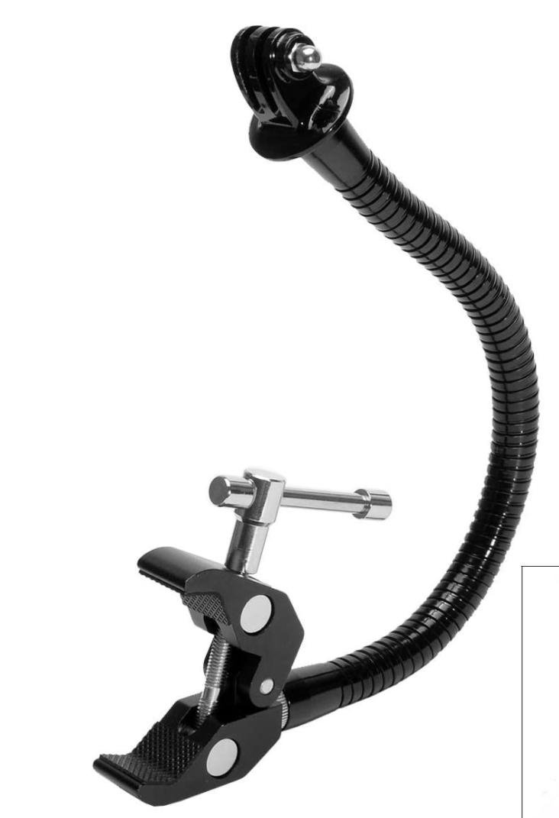
Components
[2]
[1]
[3]

Slide 6
Joystick
[4]

Slide 7
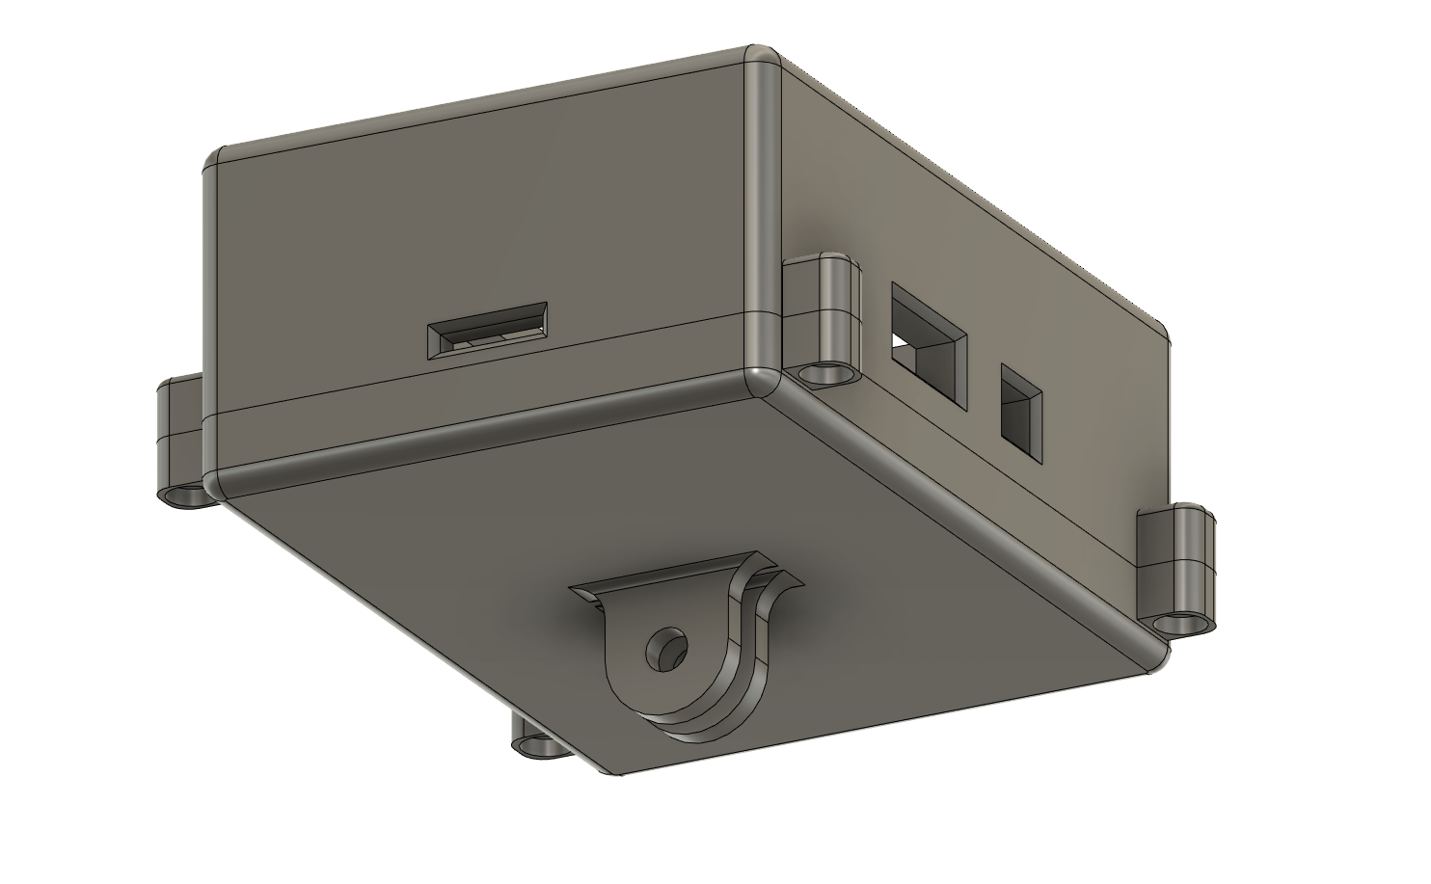
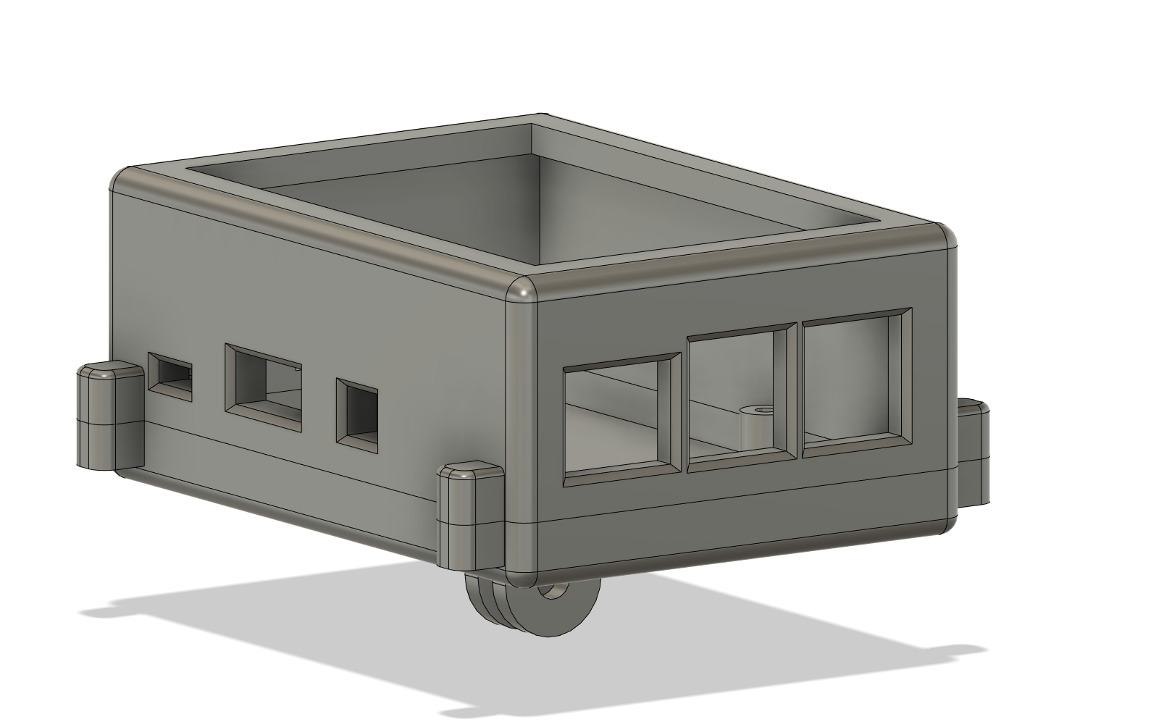
3D Printed Cover

Slide 8
Software and Live Demonstration

Slide 9
THE END - Thank you!

