Slide 1
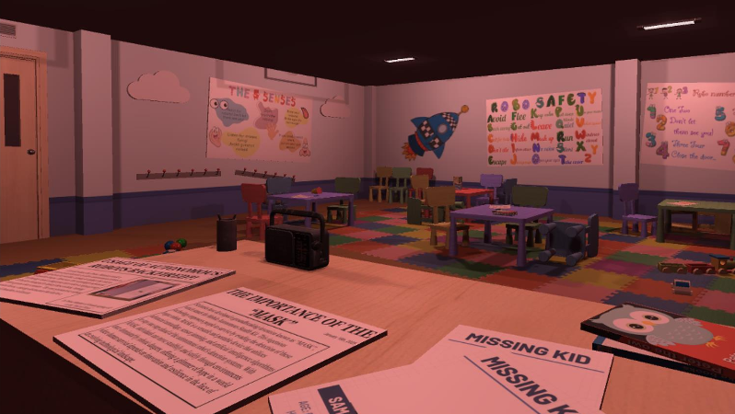
Group 7 : Innovation nation
"Save the children of tomorrow"

Slide 2
Our product
Why?
Children are a common concept
Emotional attachment
How?
Posters around the room
Children's drawings
Radio Broadcast sound

Slide 3
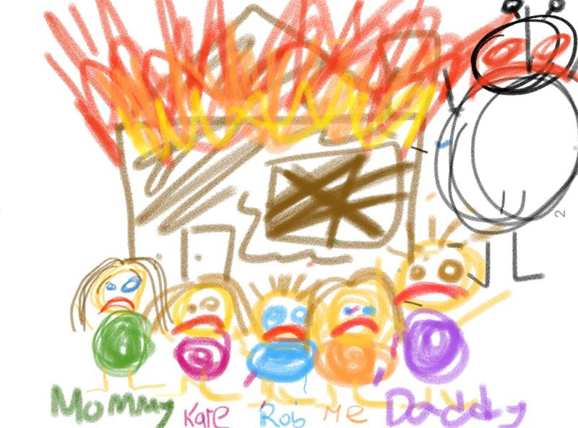
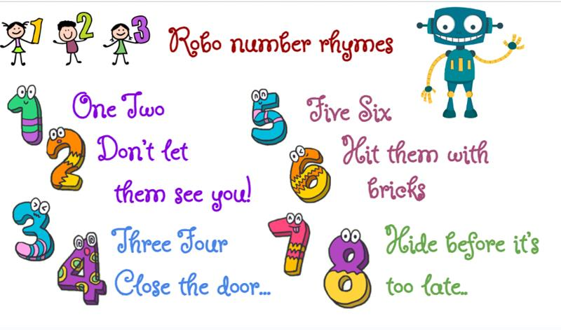
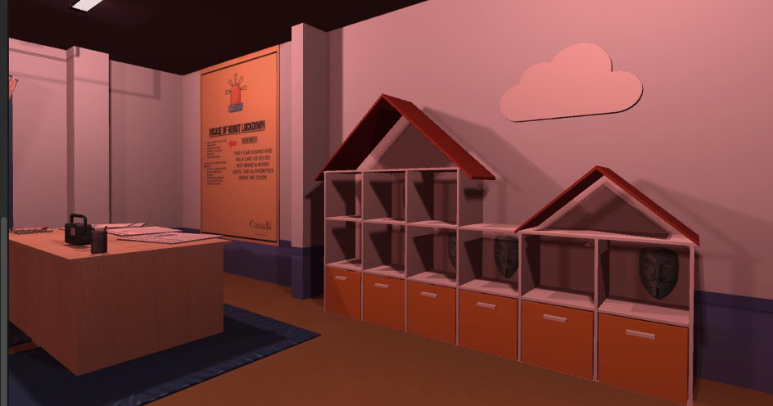
Highlights of our product

Slide 4
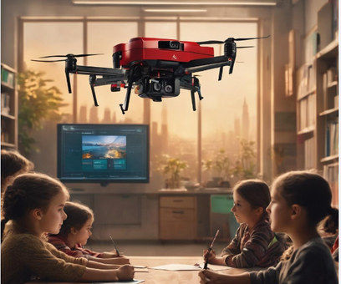
Testing portion

Slide 5
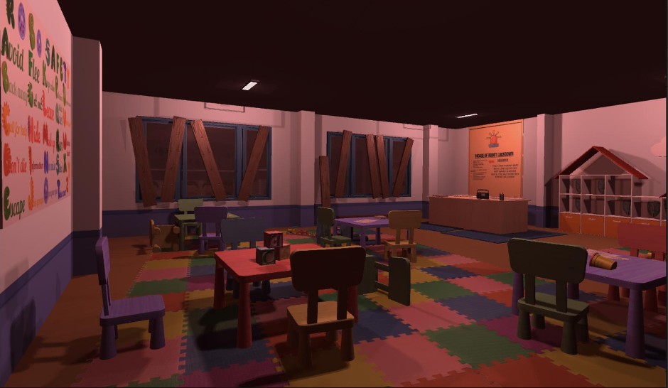
Questions?

