Slide 1
PUSH LIFE Wheelchair Assist
Design Team Sunday Funday : Ope Onipe, Ava Wagstaff, Thomas Tokarczyk

Slide 2

The LIFE Program

Slide 3
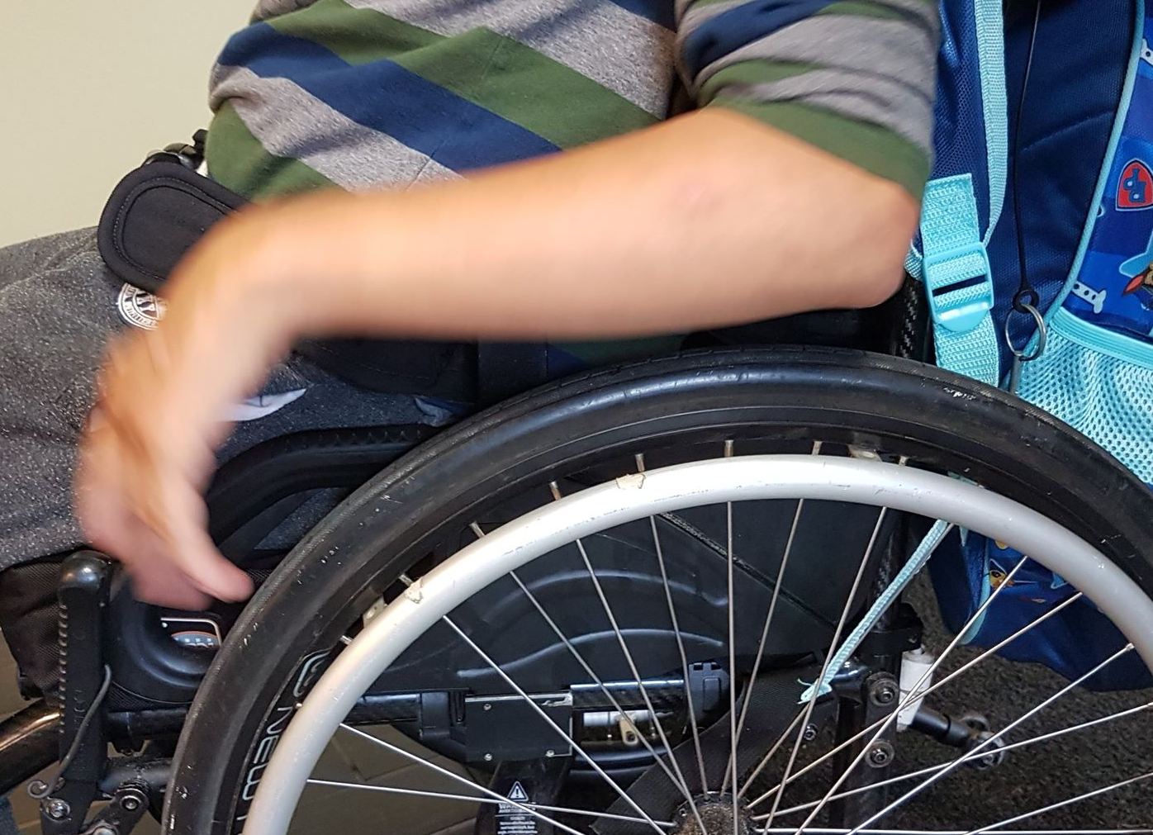
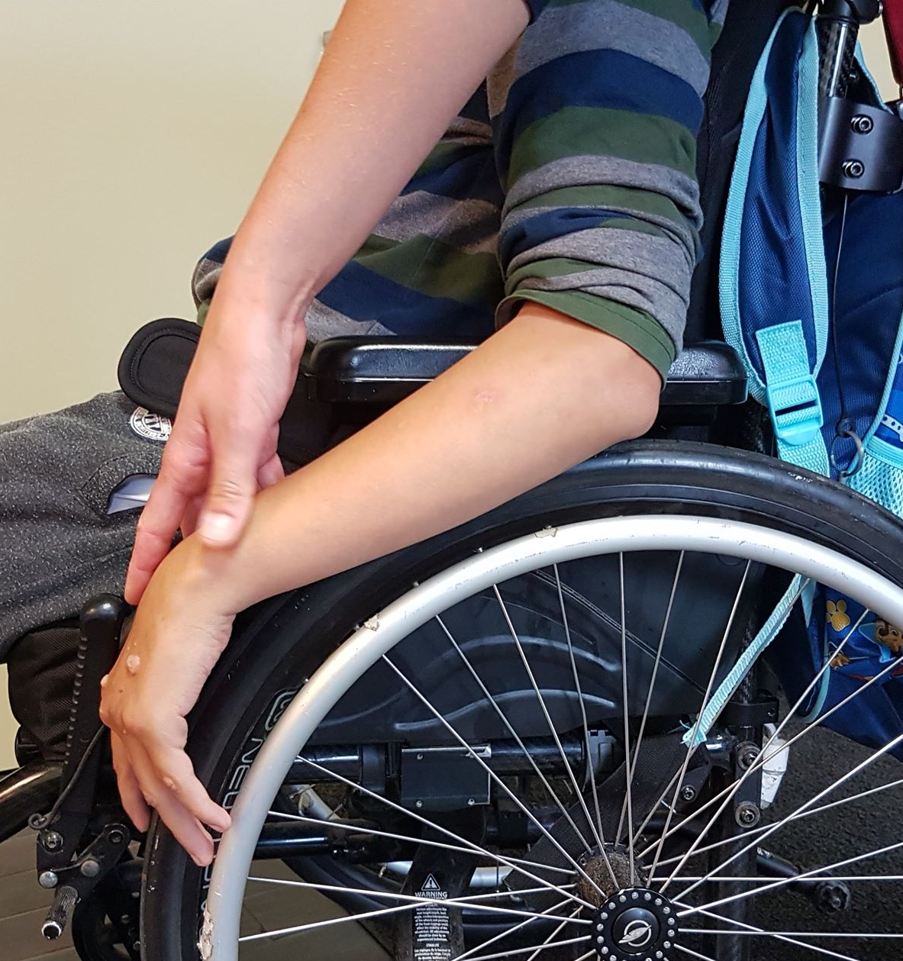
Our Client
Abass
In his early 20’s
Is confined to a wheelchair
Has significant issues moving his left arm and leg
Currently moves with a right leg shuffle, alongside propelling himself forward with his right hand

Slide 4
Problem Statement
Presently, the goal of this project is to provide a cost-effective and one-sided wheelchair attachment for our client, Abass, who unfortunately is only able to move himself and his chair with just one of his legs and arms. Hopefully, this attachment will be sufficient in assisting and further enhancing his motion.

Slide 5
Metrics and Target Specifications
Design Specs | Relation | Value | Units
Cost | < | 100 | CAD
Weight | < | 3 | Kg
Force Required | < | 1.5 | N
Product Life Span | > | 1 | Year
Ease of Use and Reliability | = | Yes | N/A
Self-Sufficient | = | Yes | N/A
Notes:
Acceleration = 0.3 m/s. Force = m x a
Using Design Criteria, established our metrics and target specifications we would use to track project performance

Slide 6
First Client Meeting & Initial Design Ideas

Slide 7
Our Solution
We chose the lever
This was the most optimal solution for our client
Allowed for the most effective motion with least amount of work
The client and his supervisors were most fond of this attachment idea

Slide 8
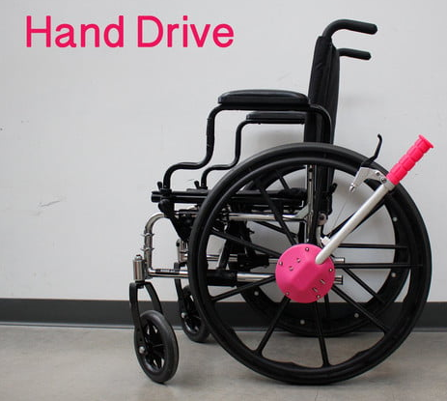
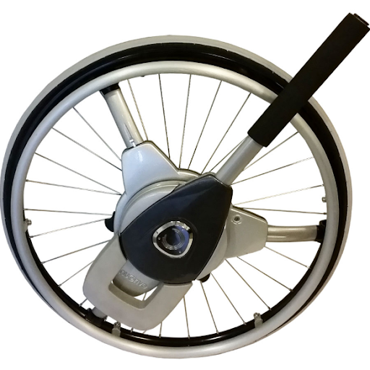
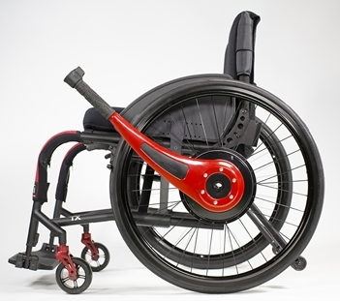
Benchmarking
Hand Drive NuDrive Wijit

Slide 9
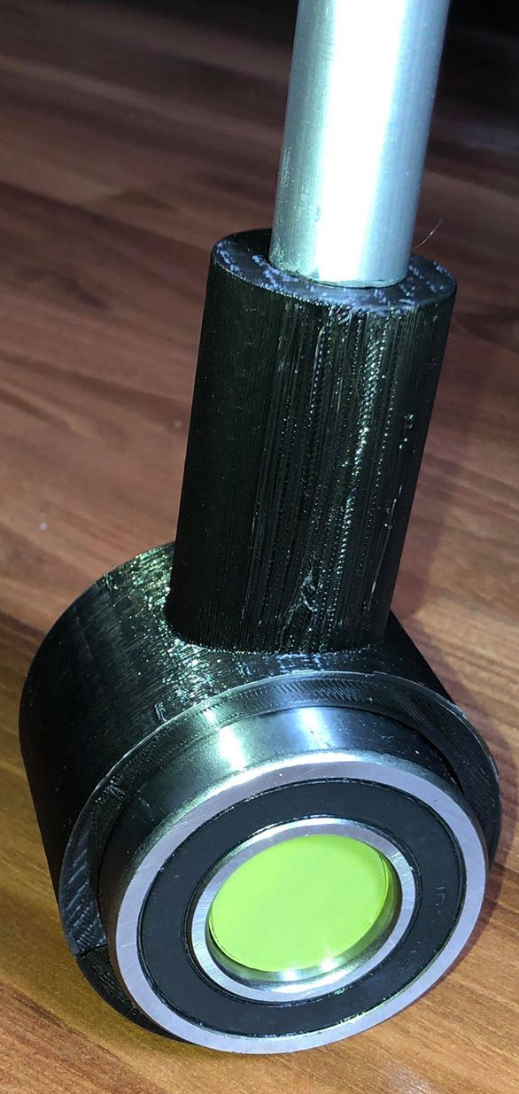
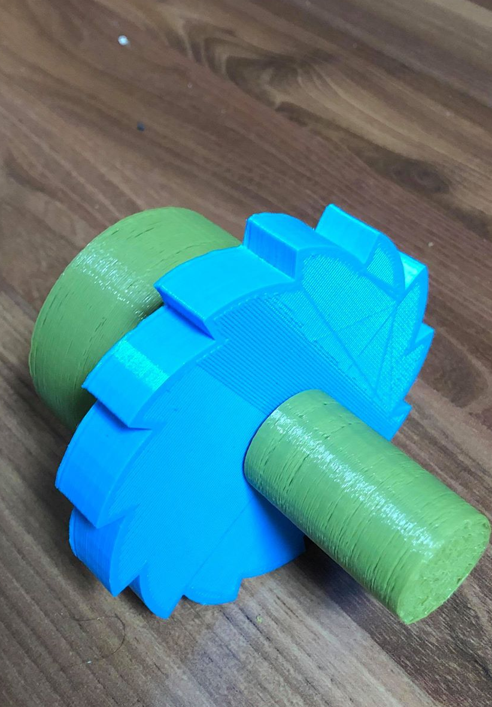
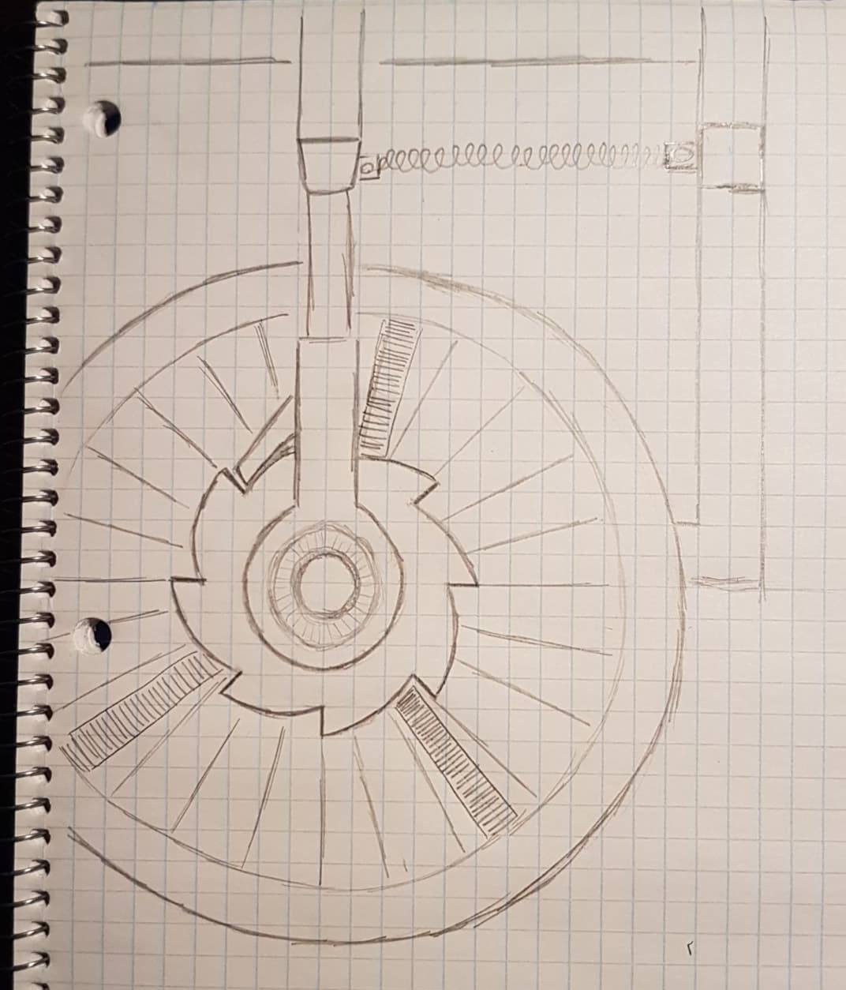
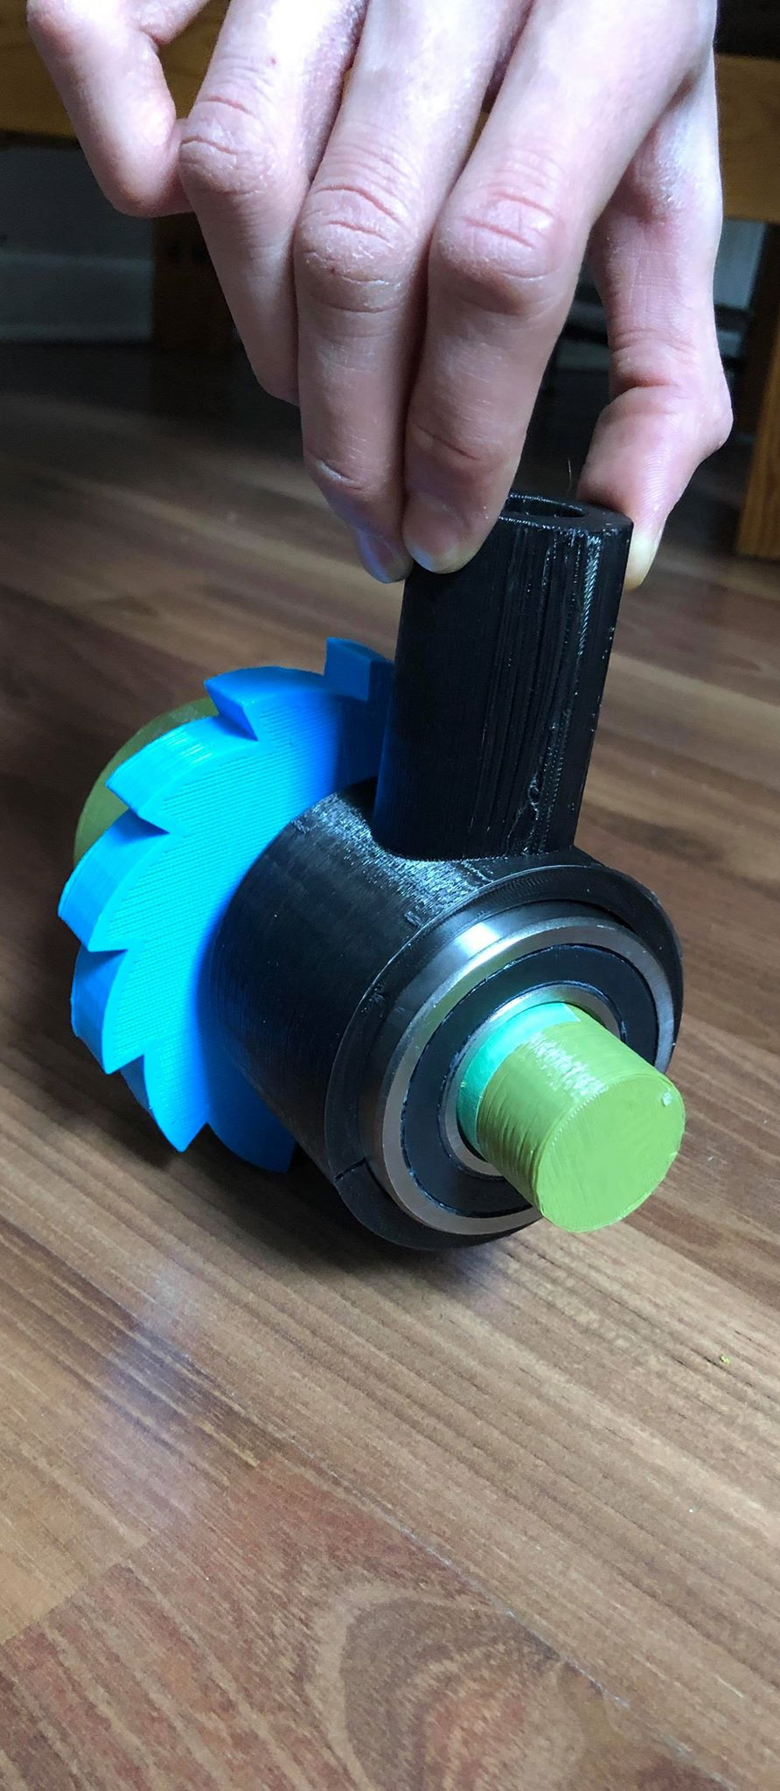
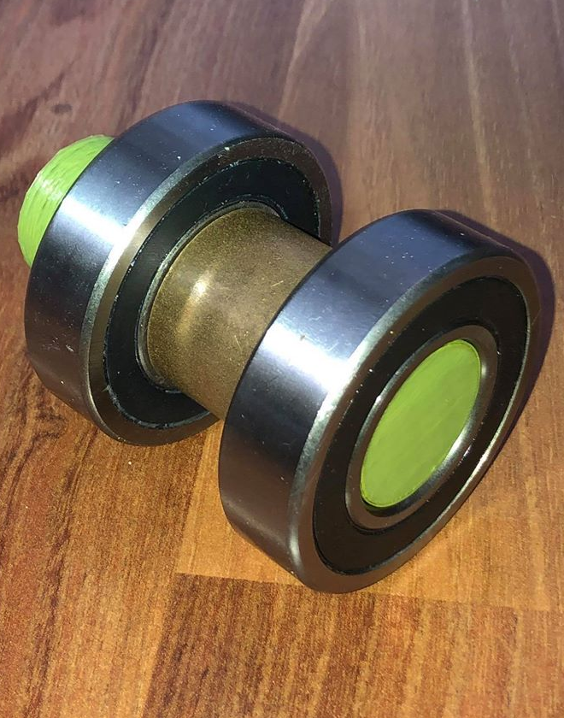
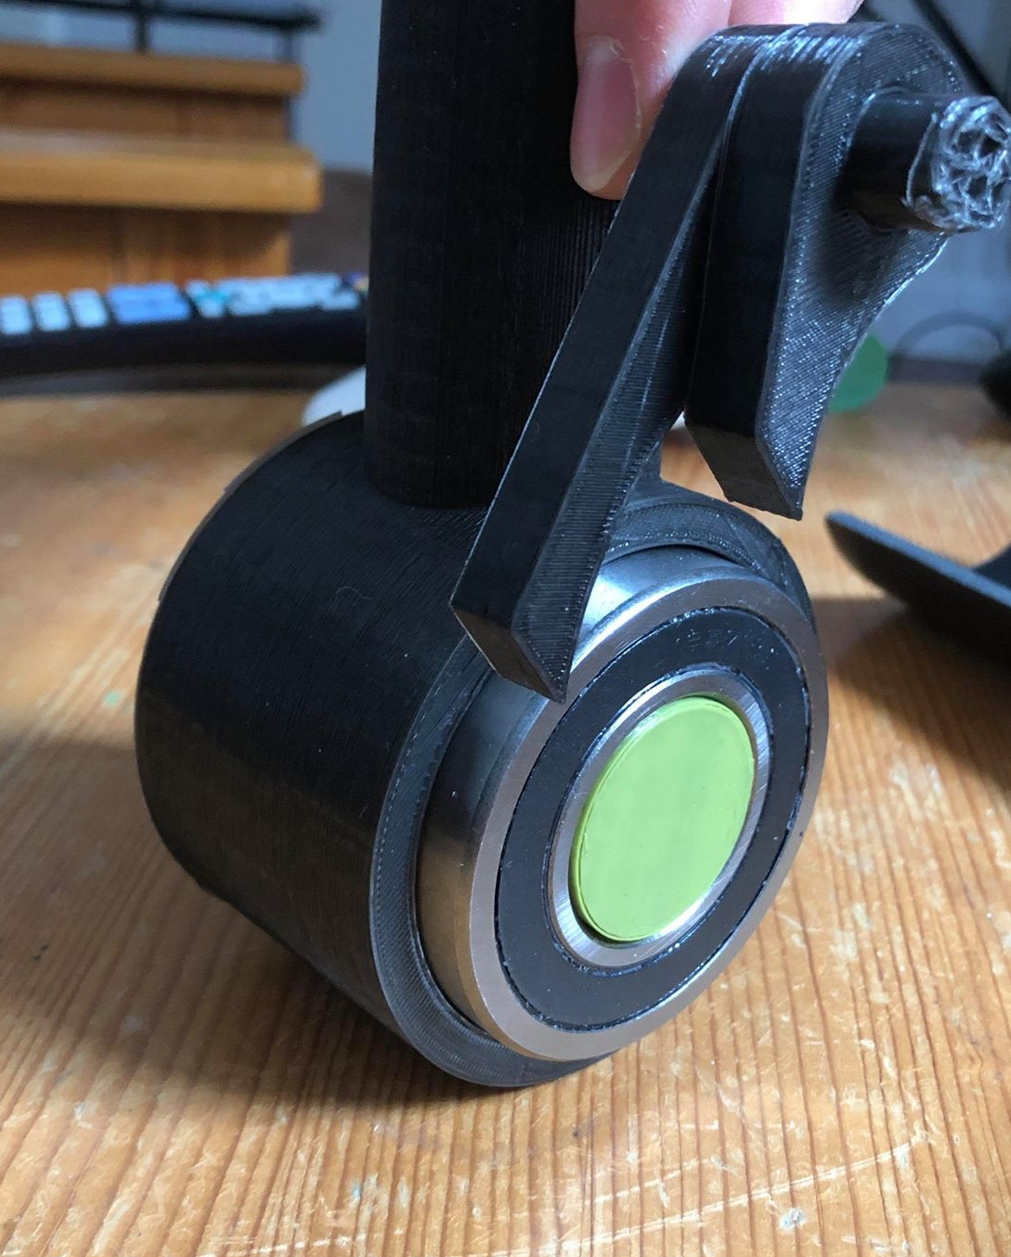
Final Design Idea/Prototypes

Slide 10

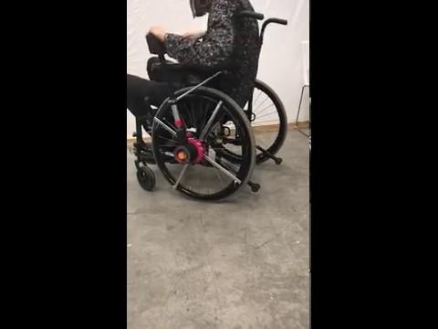

Slide 11
Future Plans
The materials used by us in the creation of this lever are as follows,
  PLA (3D print fill)
  ABS Piping
  Bearing/Spacer
  Aluminum Extension Rod
  O-Rings/Metal Clamp
  JB Weld
This was due to cost and time constraints
Ideally the PLA print would be changed to carbon fibre print at 100% fill to enhance strength, and many components would have also been switched out from 3D printed to metal pieces

Slide 12
Cost
# | Name of Piece | Cost ($)
1 | Bearing (x2) | 35.42
2 | Spacer | 3.50
3 | Spring | 14.78
4 | ABS Piping (1.25” dia $2.12/ft, 3” dia $4.06/ft) | 3.49
5 | Extension Pole | 16.37
6 | Compound Bonding J-B Weld | 13.55
7 | PVC piping, cable and Assortments | 12.69
9 | O - Rings | 9.58
10 | TOTAL | 109.38

Slide 13
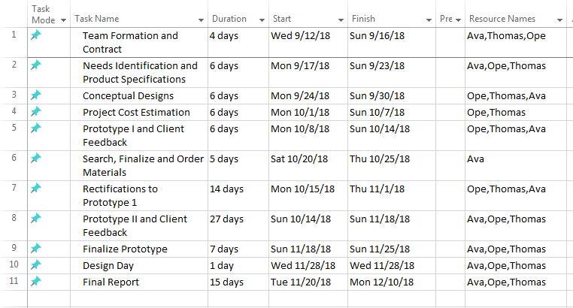
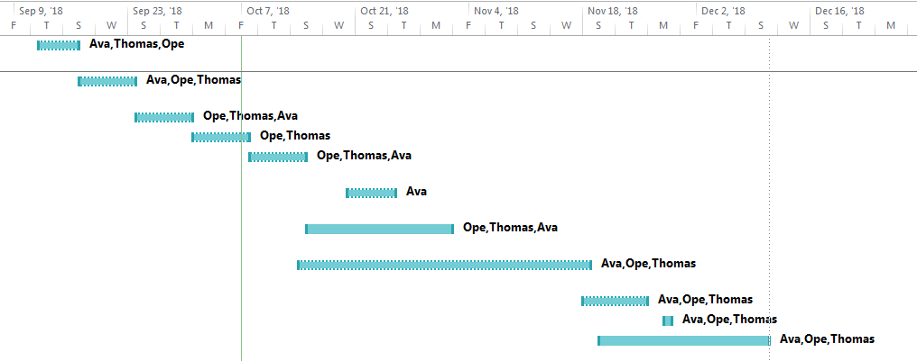
Project Plan - Gantt Chart

Slide 14
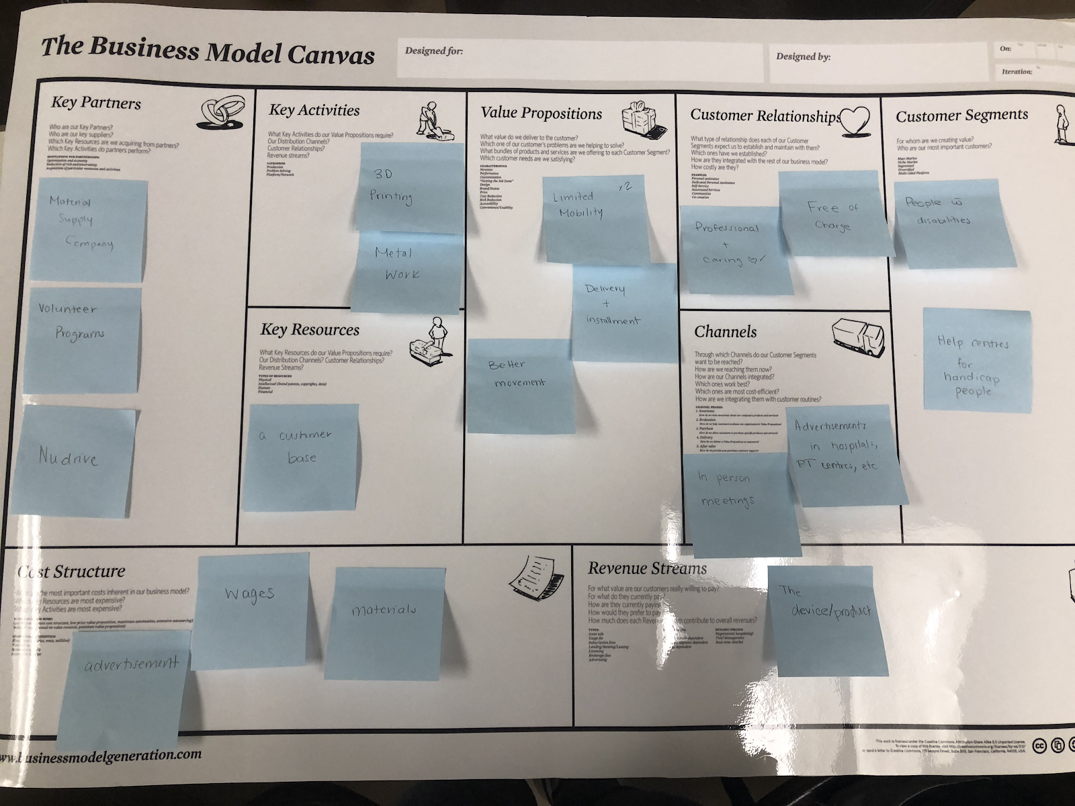
Business Model Canvas

Slide 15
PUSH LIFE
We are here to help give you a push forward into a more mobile future!

