Slide 1
JAMZ Delivery Team A2L (Air 2 Land Delivery) Group A15 Members: Jack Haycock, Nathan Meraw, Jacob Fortin, Ally Alvarado and Enoch Cheng
Faculty of Engineering
GNG 1103A
Professor: David Knox
December 3rd, 2020

Slide 2
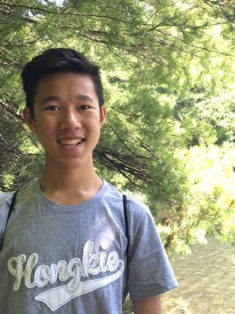
Meet the Air 2 Land Delivery team
Ally
Nathan
Jacob
Jack
Enoch

Slide 3
PROBLEM TO BE SOLVED

Slide 4
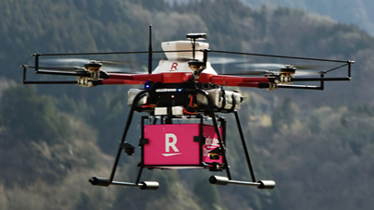
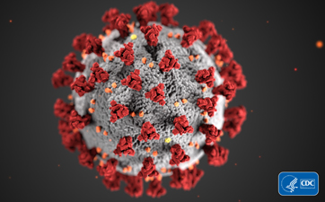
PROBLEM AT HAND
Fulfill the need for a website for autonomous drone delivery
Problem brought about by the COVID-19 Pandemic
Developed into a solution for struggling rural/suburban fast food market

Slide 5
CRITERIA SATISFIED
Login page
Sample Restaurant
Checkout
Search location on map
Categories
FAQ
Contact us if problem

Slide 6
ORIGINAL FEATURES

Slide 7
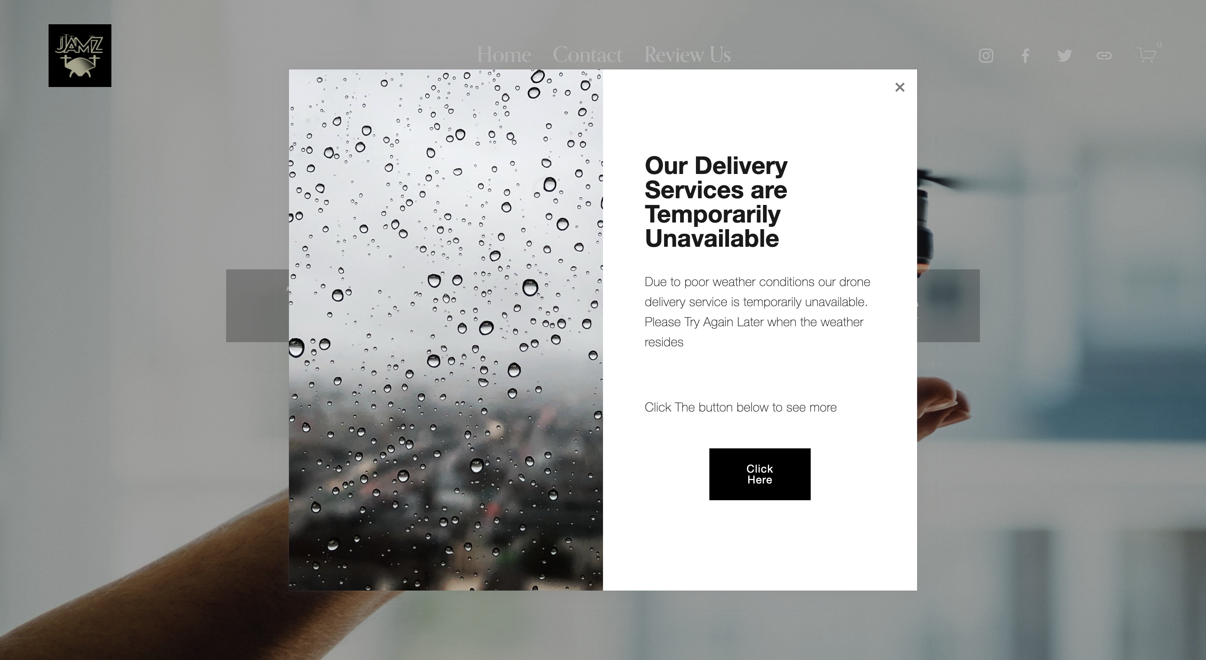
Poor Weather Conditions Pop-Up

Slide 8
Actual weather

Slide 9
Legal Conditions

Slide 10
Terms & Conditions

Slide 11
About us Page

Slide 12
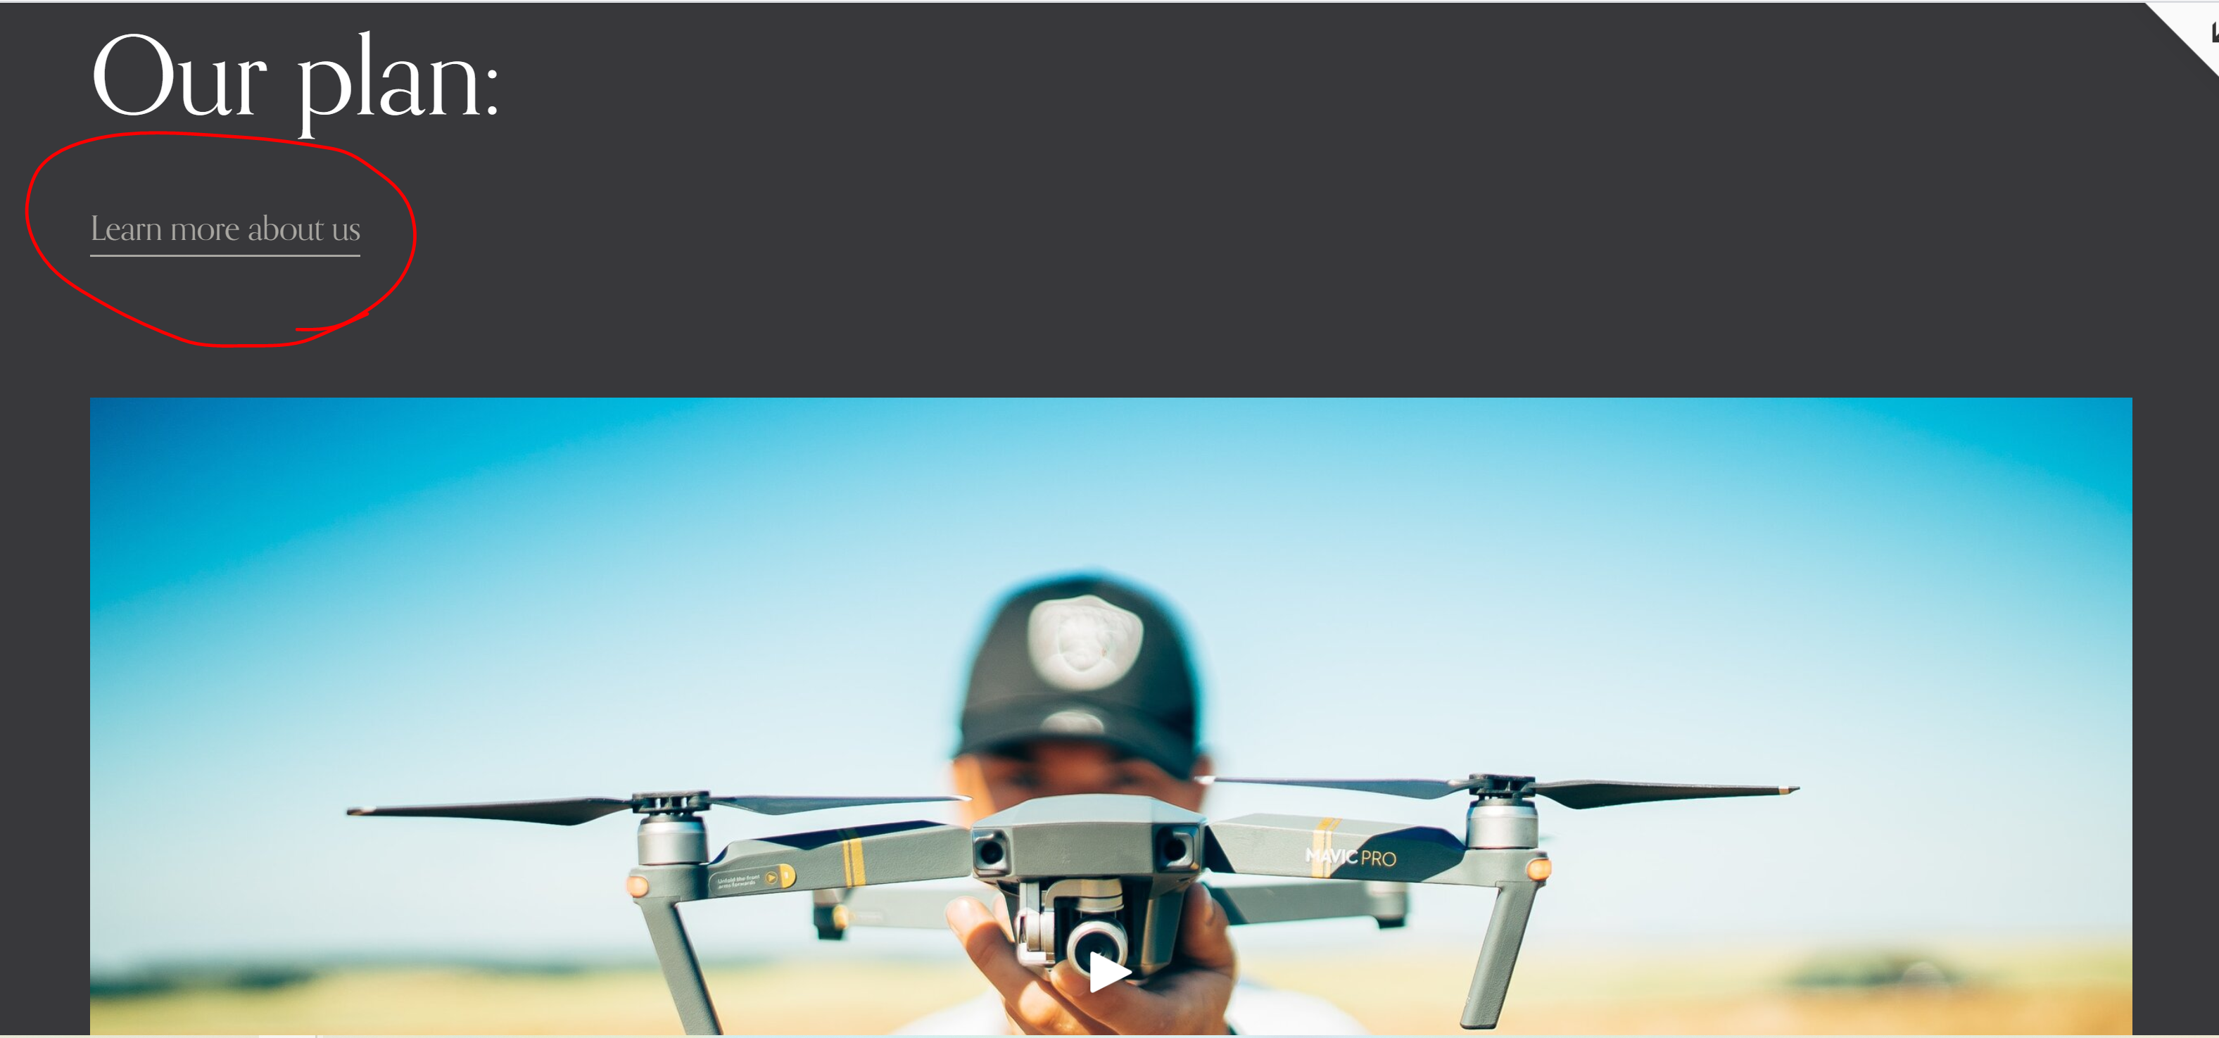
JAMZ Promotional Video

Slide 13
Order Confirmation

Slide 14
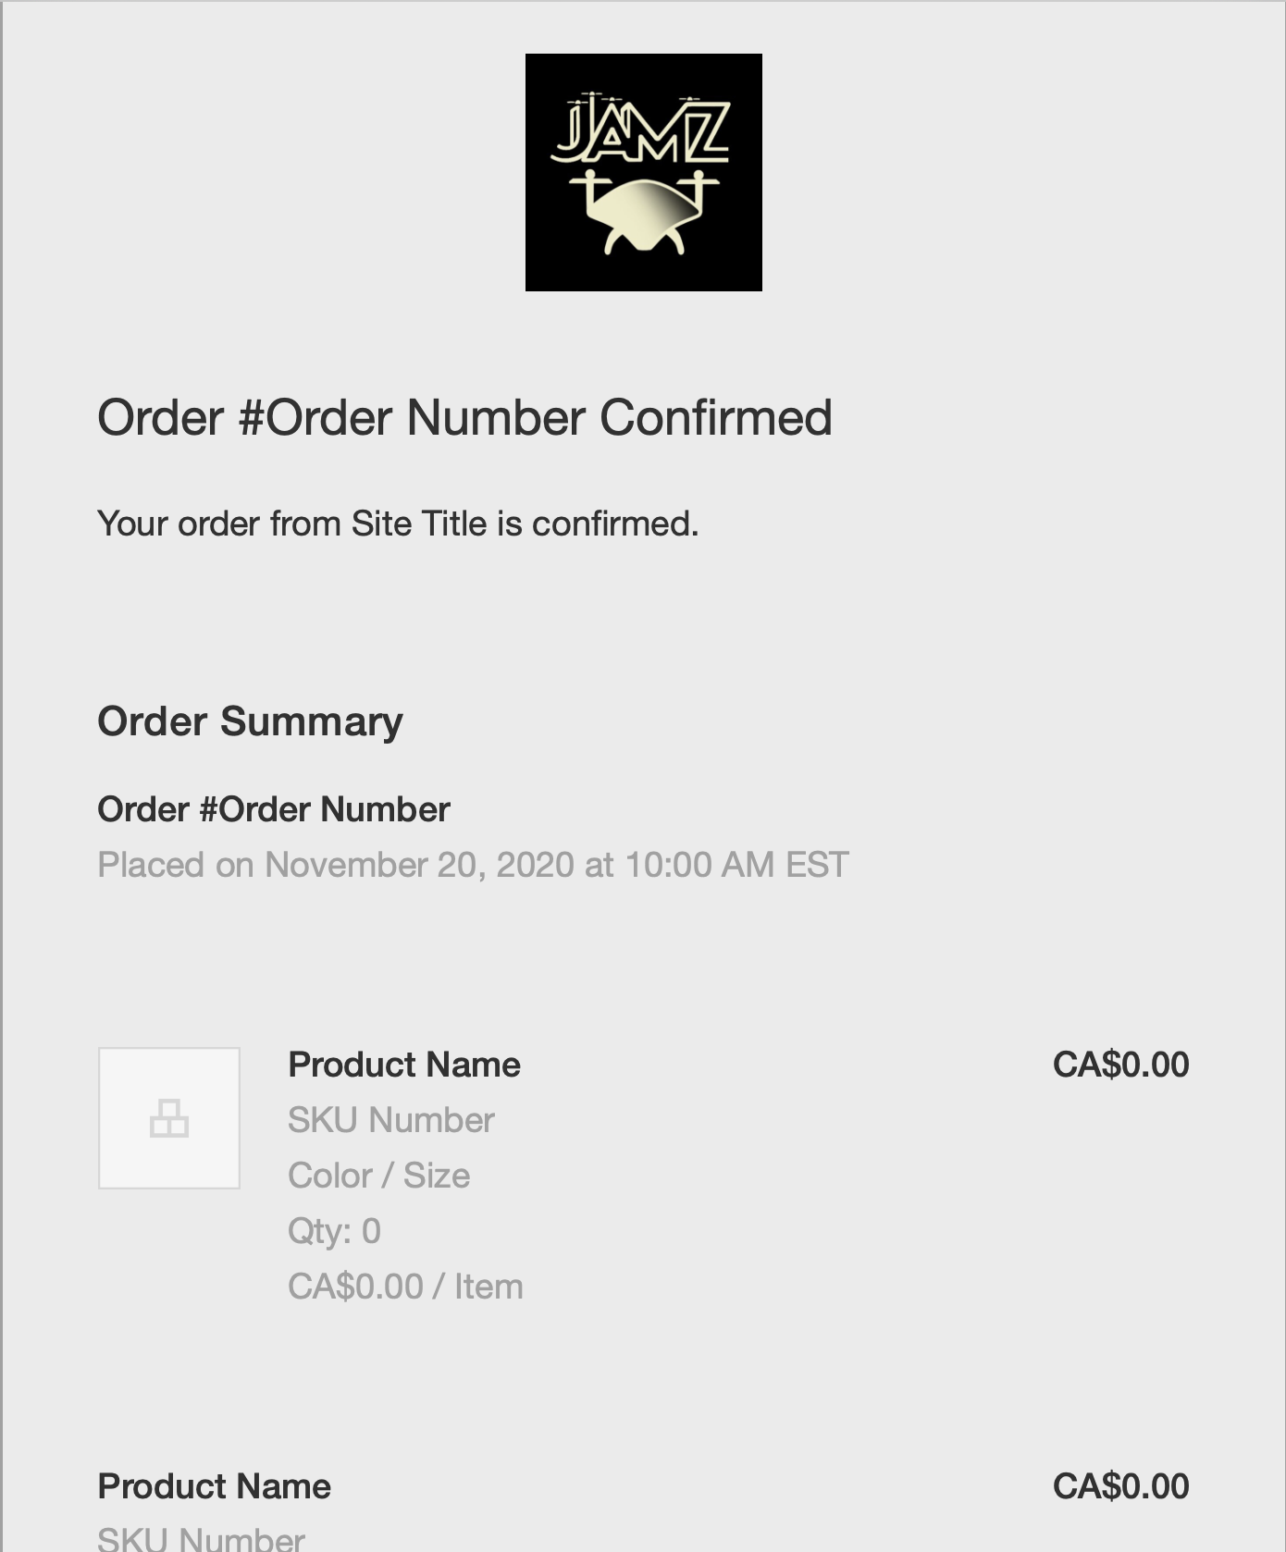
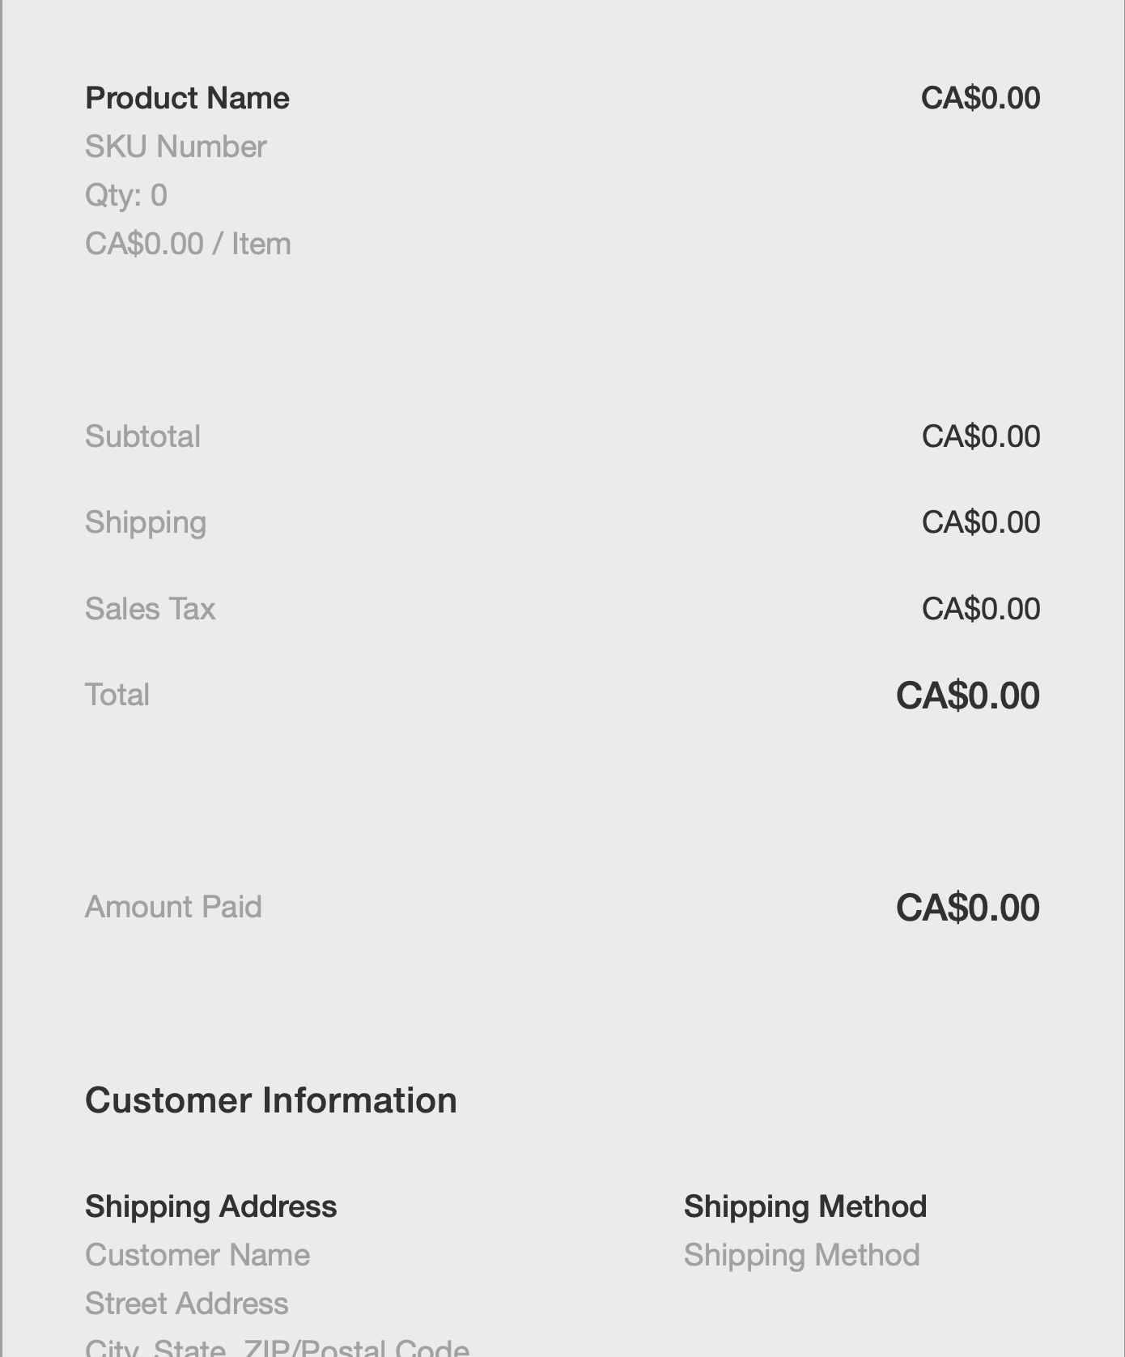
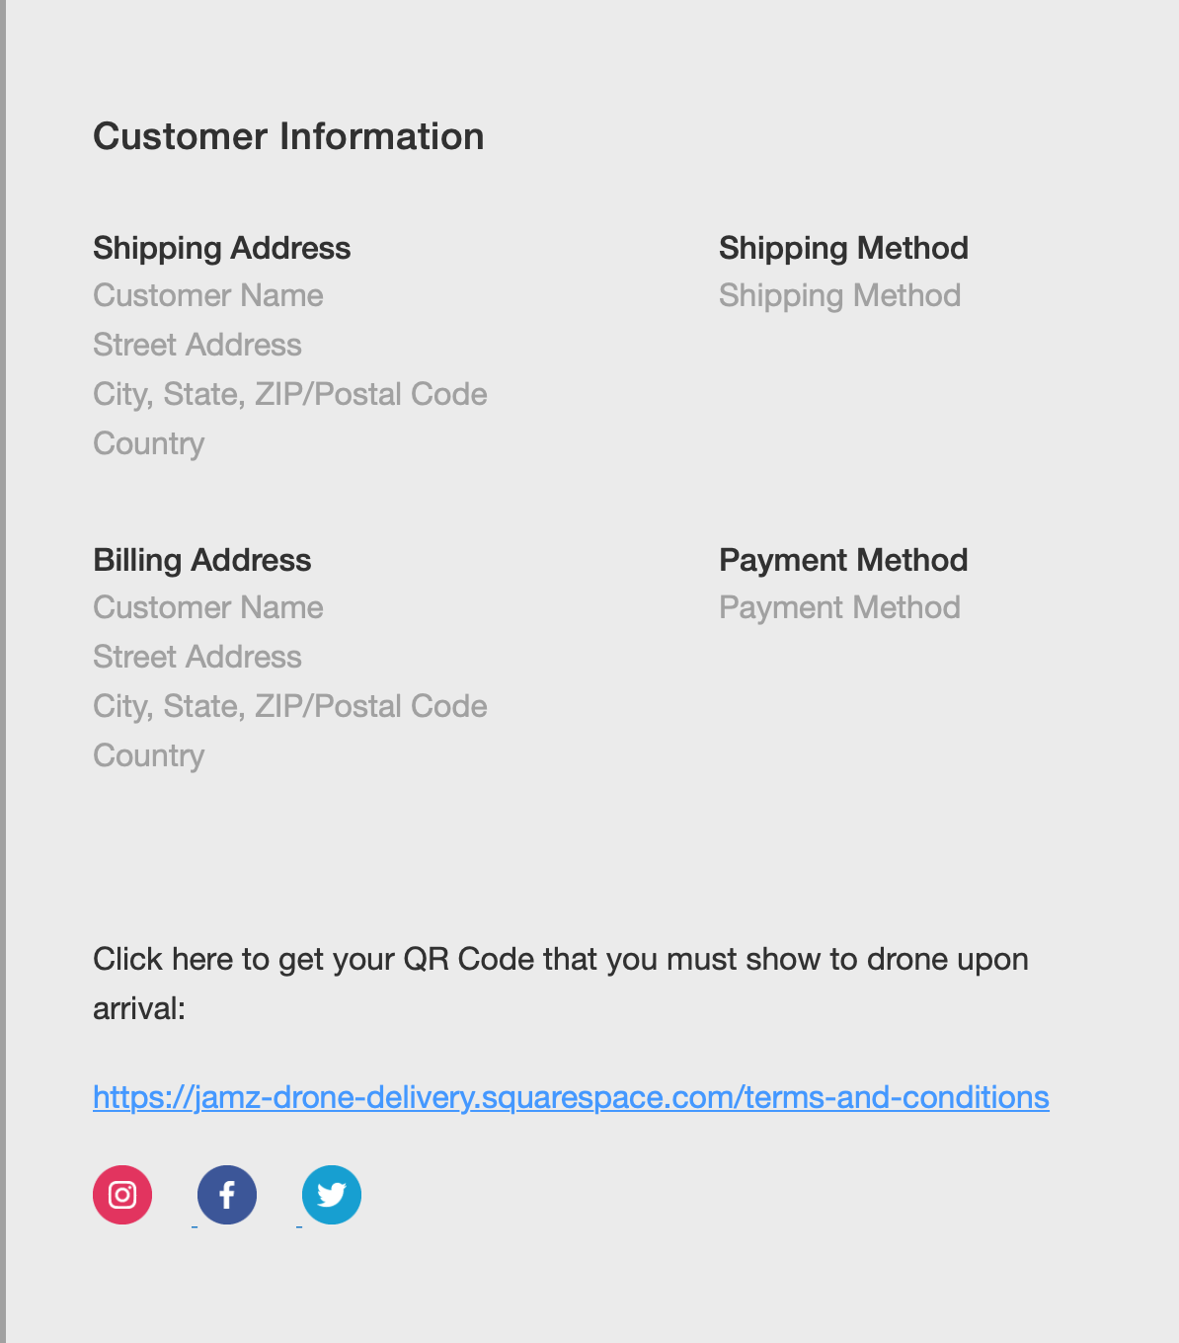
Confirmation Email

Slide 15
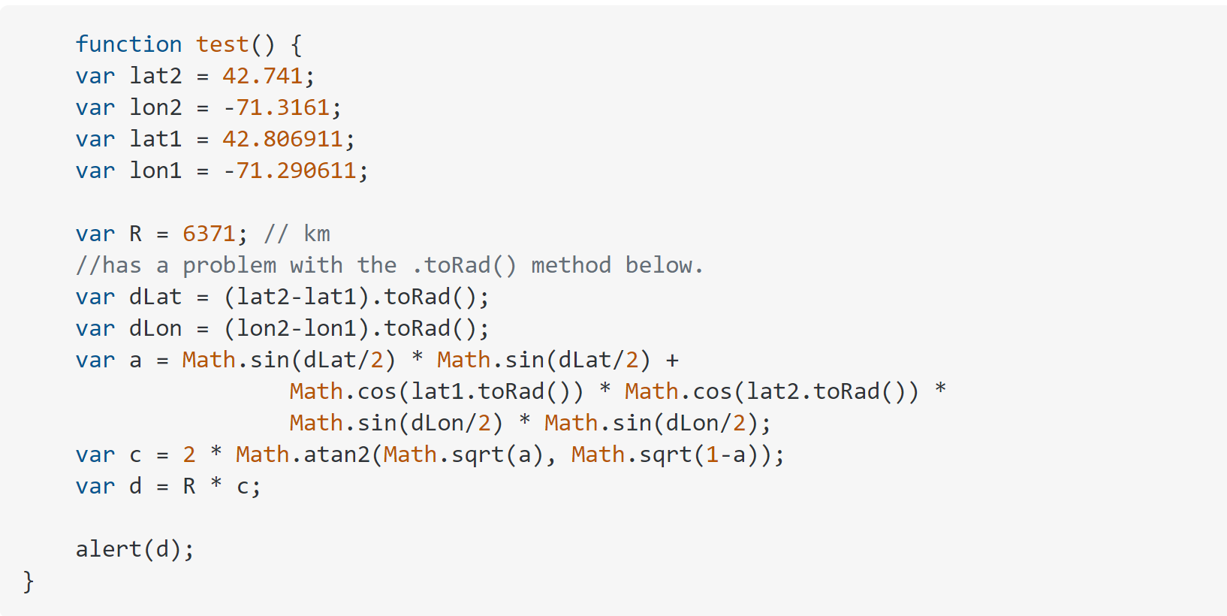
ETA (derived from this code)
https://stackoverflow.com/questions/14560999/using-the-haversine-formula-in-javascript

Slide 16
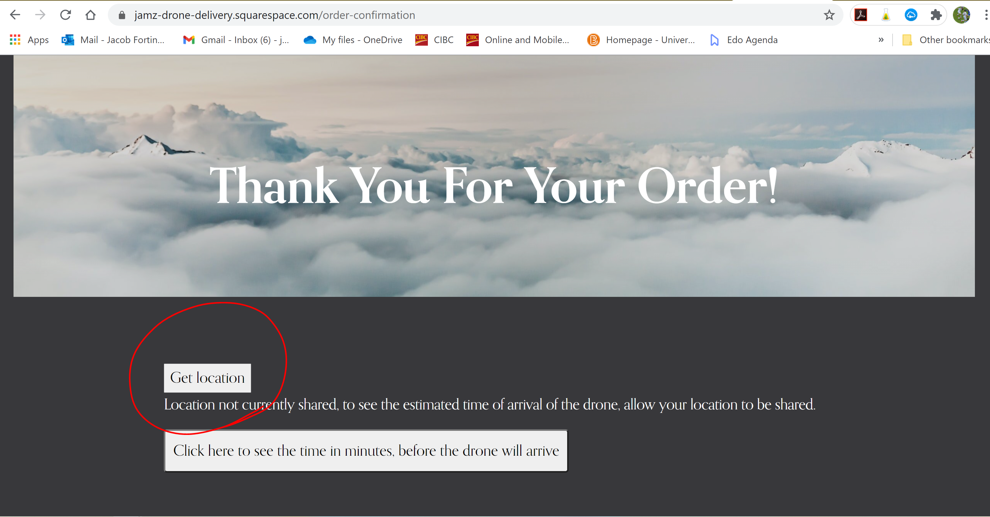
HOW IT WORKS: STEP 1
*Currently using random coordinates to find distance

Slide 17
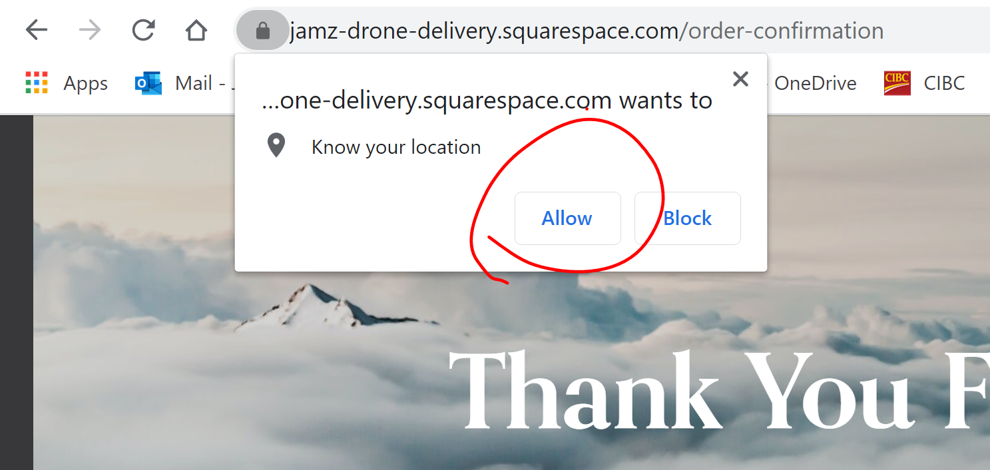
HOW IT WORKS: STEP 2
*Currently using random coordinates to find distance

Slide 18
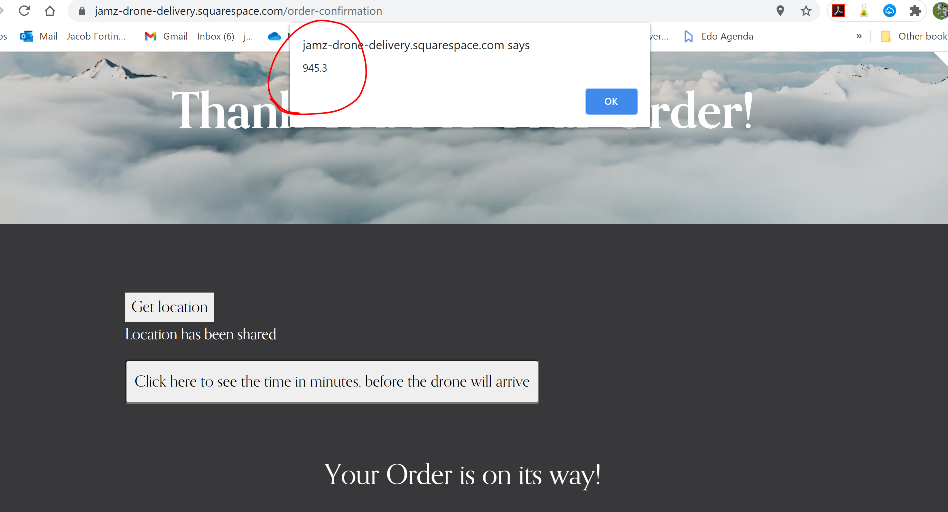
HOW IT WORKS: STEP 3
Click here
*Currently using random coordinates to find distance

Slide 19
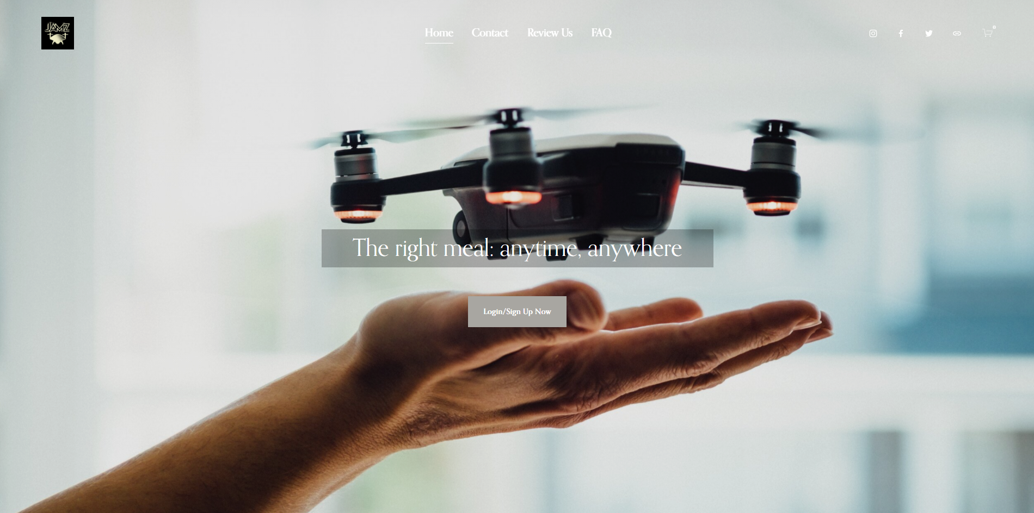
WEBPAGE DEMO

