Slide 1
Midterm
Project Progress Presentation
Team F1.3 Travel Rails
Notes:
kat

Slide 2
Background Information
Customer Needs
Benchmarking
Target Specifications
Initial Design
Feedback
First Design Iteration
Next Steps
Agenda
Notes:
kat

Slide 3
Background Information
Young child with Cerebral Palsy.
Requires fall protection while sleeping.
Does not currently have a solution for compact travel bed rails.
Breathability is critical.
PROBLEM STATEMENT
There is a lack of travel bed rails suited for those who require barriers to prevent them from falling out of their bed. We will provide a solution that is safe, portable, and adjustable for all travel rail needs.
Notes:
Kat

Slide 4
Initial Product Assumptions
Material : readily available and affordable
Parts: easily machined based on availability of machining lab
Rails can withstand lateral forces
Rail size (length and height) is adjustable
Notes:
Ayan

Slide 5
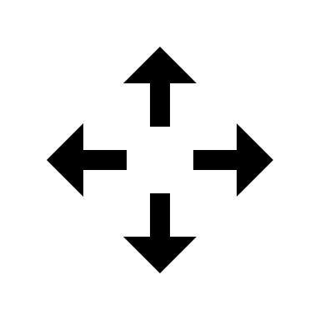
Customer Needs
Fits a wide variety of beds
18-24 inches above the mattress
Easy to Install
Easy to Clean
Breathable
Provides fall protection on 3 sides of the bed
Within budget (<300$)
Portable and Compact
Allows movement in the bed
Safe for flailing limbs
Notes:
Ayan

Slide 6
Benchmarking 1 – Walmart Baby Rails
Weight: 4.5 lb
Volume (L) : unknown
Cost: 65.99$
Material: Breathable fabric and stainless steel
Length: 59 inches
Height: 21.5 inches from point of installation
Breathability: Excellent
Notes:
Mark

Slide 7
Benchmarking 2 – Inflatable Bumper Rails
Weight: 2.2 lb
Volume (L) : 20
Cost: 59.99$
Material: Waterproof PVC
Length: 48 inches
Height: 6 inches
Breathability: Poor
Notes:
Mark

Slide 8
Target Specifications
Metric | Importance | Units | Marginally Acceptable | Ideal
Weight | 3 | lb | <50 lbs | 20 lbs
Length | 4 | Inches | Minimum: 38 Maximum: 80 | Minimum: 38 Maximum: 80
Height above mattress | 5 | Inches | 18 to 24 | 18 to 24
Volume when folded | 3 | L | <60 | <40
Price | 3 | $ | <300 | 100
Breathability of rails | 5 | CFM | >0.22 | 0.25
Time to assemble rails | 3 | Minutes | <15 | <5
Maximum weight supported by rails | 4 | lb | <40 | <75
Notes:
Mark

Slide 9
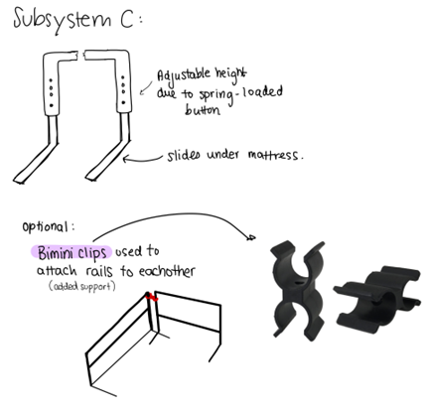
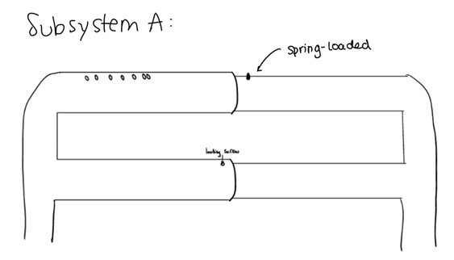
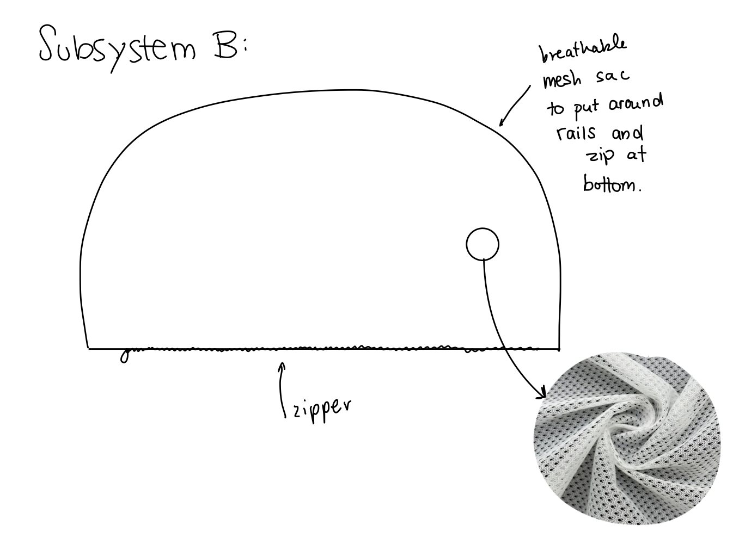
Our initial concept
Notes:
Markos
Comprised of 3 subsections; rail structure, mesh attachment and rail attachment
Rail structure → spring loaded buttons
Mesh attachment → breathable zipper mesh
Rail attachment → spring loaded buttons and Bimini clips

Slide 10
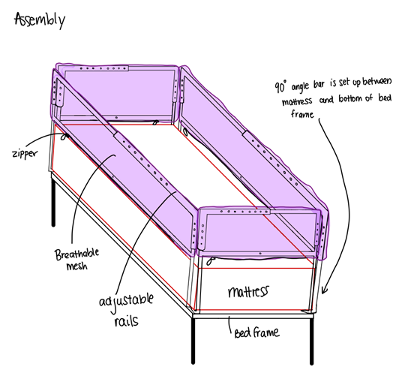
Our initial concept
Notes:
Markos
The assembly of the 3 three subsystems brings us to the initial concept

Slide 11
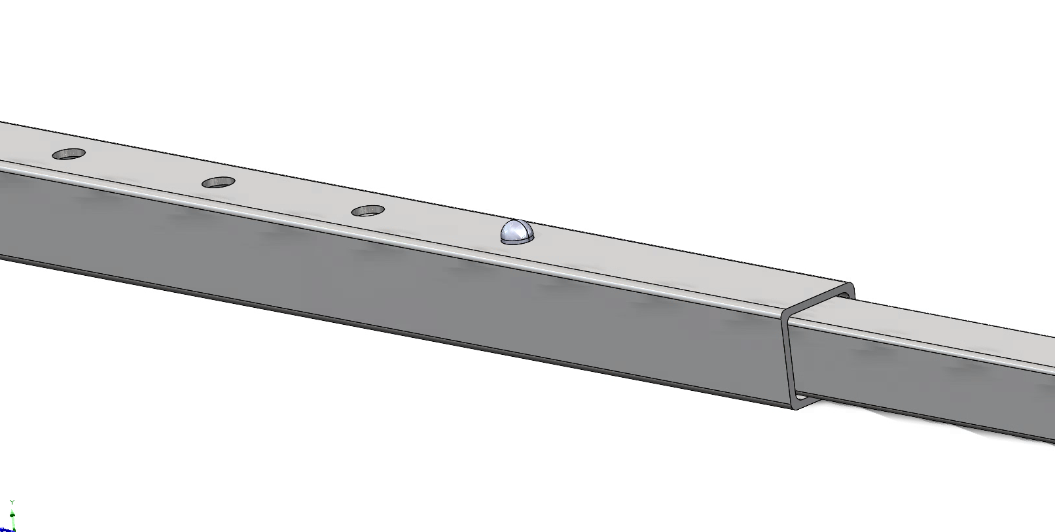
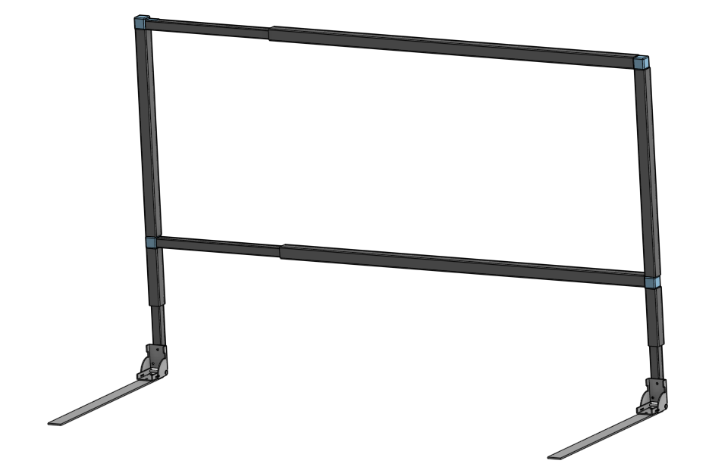
Push-button mechanism
Initial Design
Self-locking hinges
Notes:
Markos → two separate F-beams
Square PVC tubes, height and length adjustable using push button mechanism. Self locking hinge to add rigidity to the rails when inserted under mattress. Held in place by steel rails under bed

Slide 12
Feedback
f
User is average 7-year-old height but weighs 30 lbs.
Withstand both user and 10-year-old sister’s weight.
Bimini Clip Concern
Concerns with using push buttons to adjust
Concerns with square shape of tubes
Concerns with strength of the steel bars under bed
Client
Mentors
Notes:
Client: Ayan Mentor: Annabelle

Slide 13
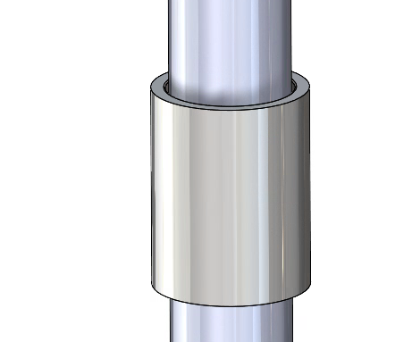
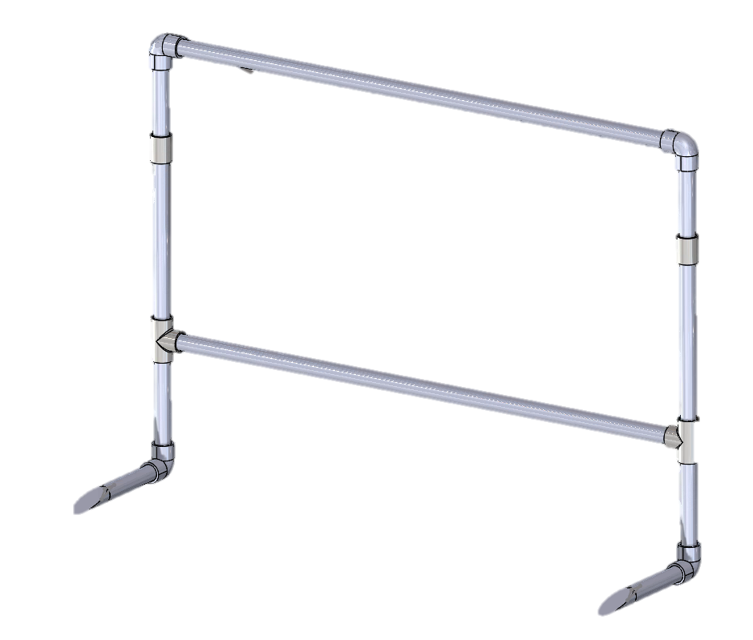
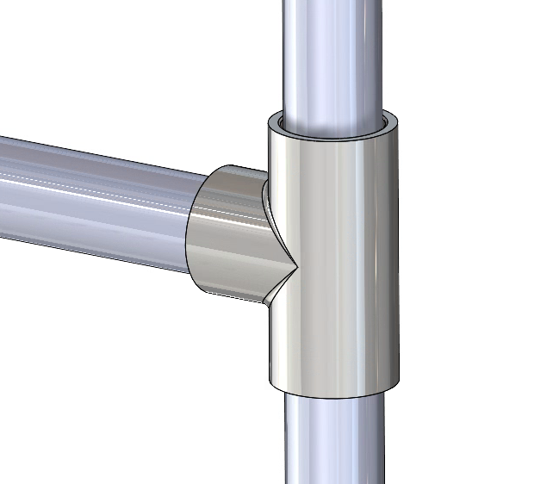
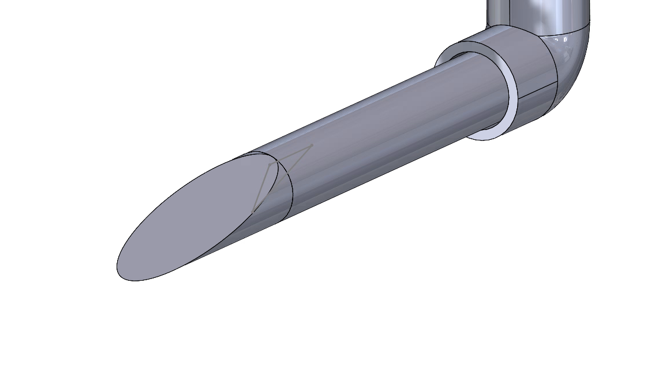
Ability to disassemble rails
Standard PVC fittings
First Design Iteration
3D printed wedge
Notes:
Annabelle + note from Kat
37’’ long, 2 on each side of bed, 30’’ tall to accommodate average mattress heights, std easy to find circular rails. Held under bed by pushing pipes under mattress w/ the help of a wedge – possibility of going back to hinge?
Telescopic rod to connect ends of bed

Slide 14
Modified assumptions
Initial assumptions
Moving forward
Material : readily available and affordable
Based on mentors' advice, selected materials that are more accessible
Rails need to be able to withstand lateral forces
Establish a testing plan to determine the rail's lateral force limits
Parts: easily machined based on availability of machining lab
Consider alternative designs with simpler/easier machining processes
Rail's size (length and height) is adjustable
Remove this constrain and focus on compatibility
Notes:
Markos

Slide 15
Moving Forward
Prototyping
Feedback
Testing
Notes:
/Markos
Feedback
Building on the feedback from both the mentor and the client, this team will continue to process that advice to continue developing the design throughout the prototyping.
Prototyping
We will continue to seek feedback and use it to strengthen our design via iteration. From our current prototype we can see that our design is indeed feasible a
Thus, we need to verify that our design can fulfill the project’s design requirements
Kat
Testing

Slide 16
Simplified Project Plan
Prototype 1
Design Feasibility/Proof of concept
Prototype 3
Mesh Breathability
Prototype 4
Integration (including force bearing testing, assembly, portability testing)
Prototype 5
Assembly (dependent on time and resources at this stage)
Prototype 2
Analytical Testing for Maximum Force Supported
Notes:
Markos + Kat

Slide 17
Gantt Chart

