Slide 1
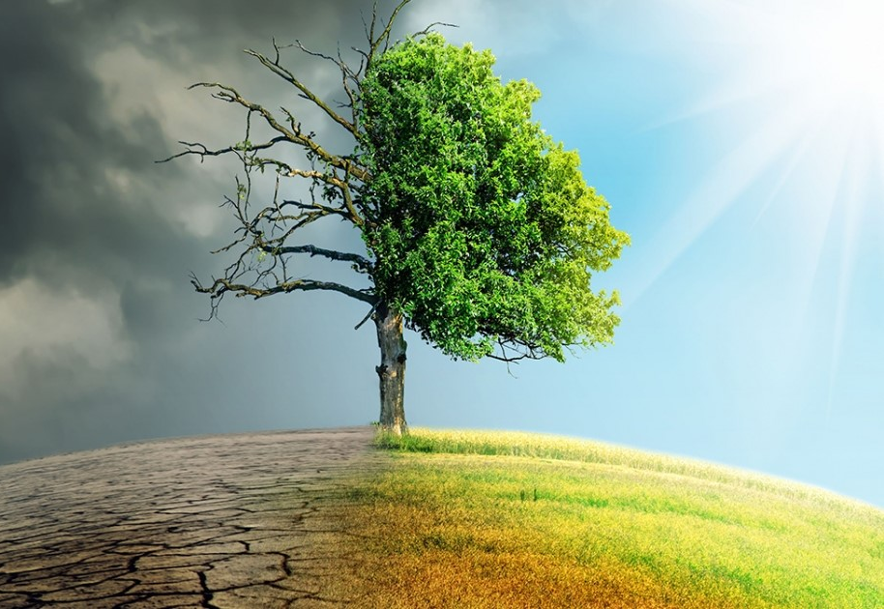
SDG-13 Climate Action The case of India’s forests

Slide 2
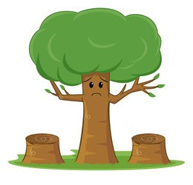
Focus: India’s Forests

Slide 3
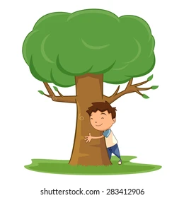
Amit’s Story

Slide 4
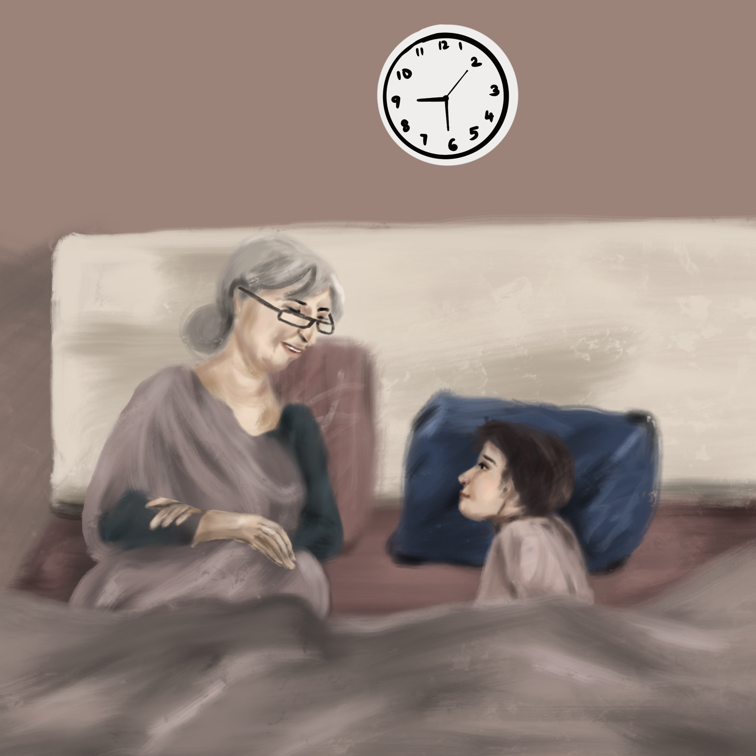
Amit’s favorite time of the day!
Listening to grandma’s bedtime stories

Slide 5
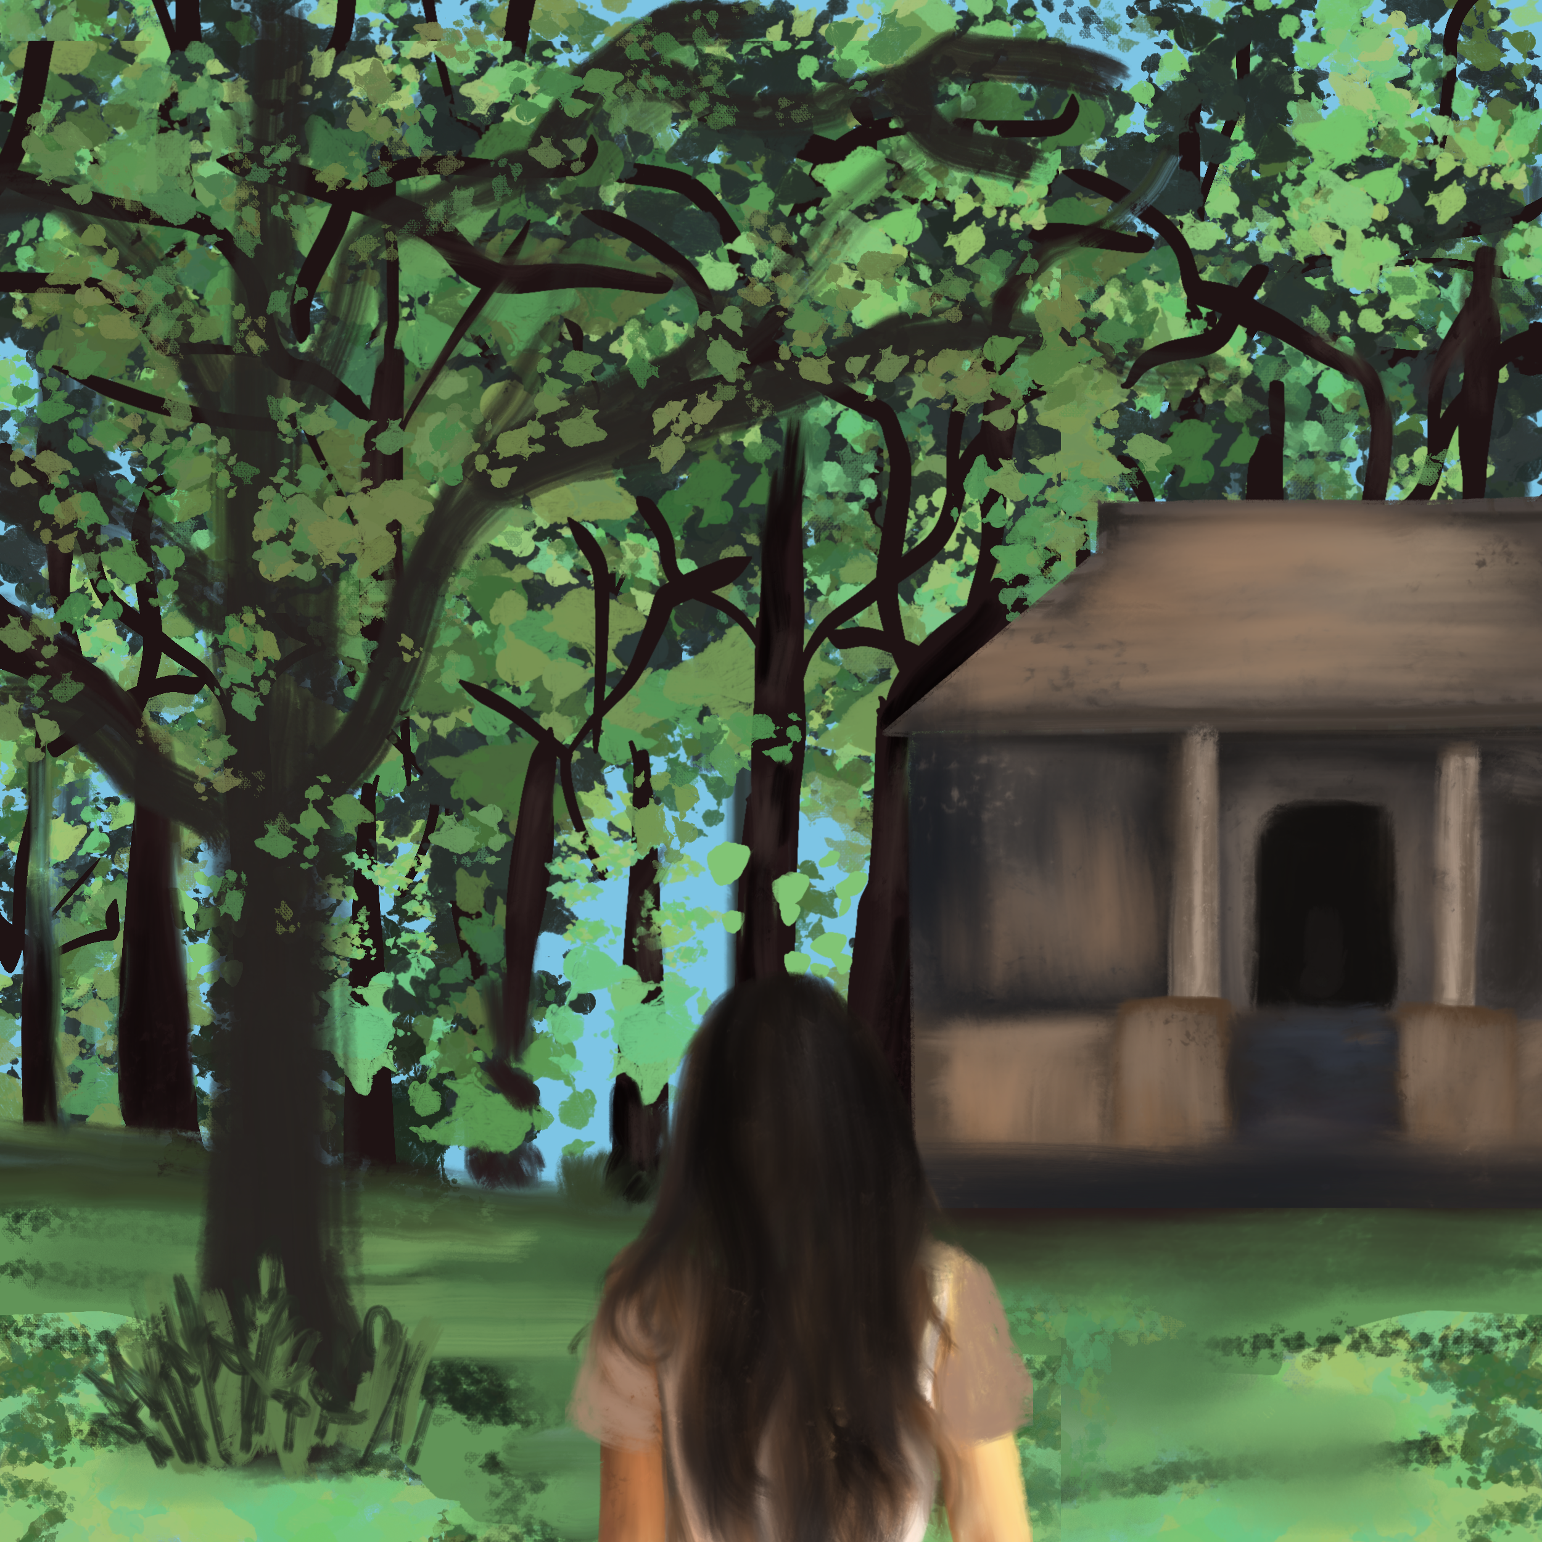
Grandma’s world in the story
The village is surrounded by beautiful trees, green fields and greenery everywhere….

Slide 6
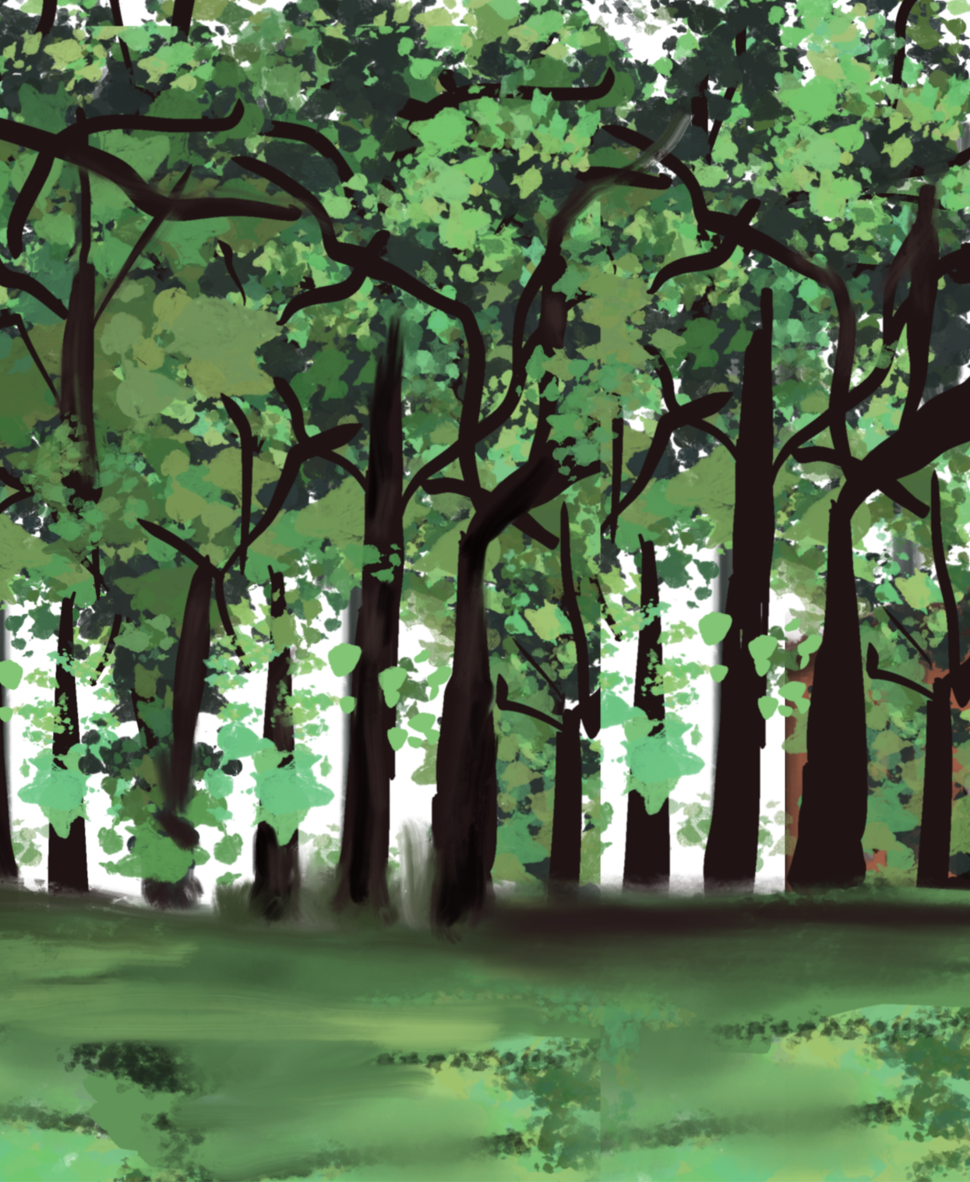
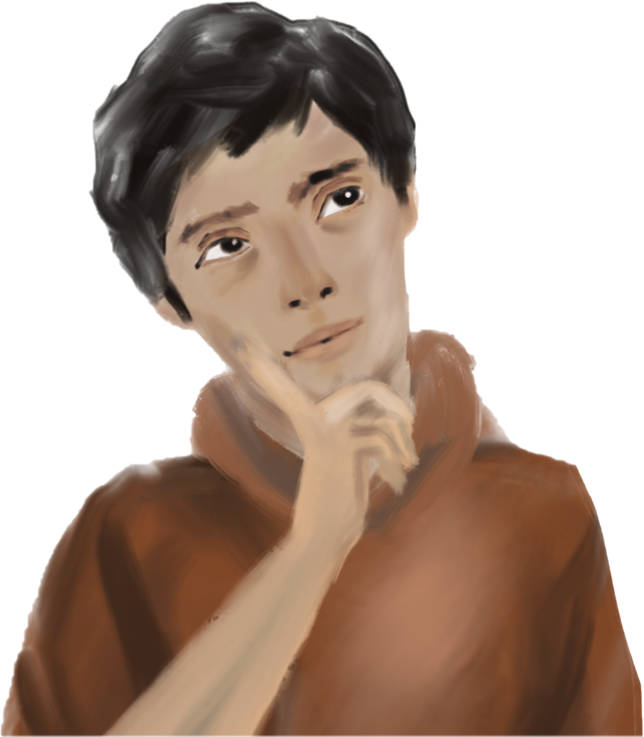
Wow, the greenery would be so beautiful to look at….

Slide 7
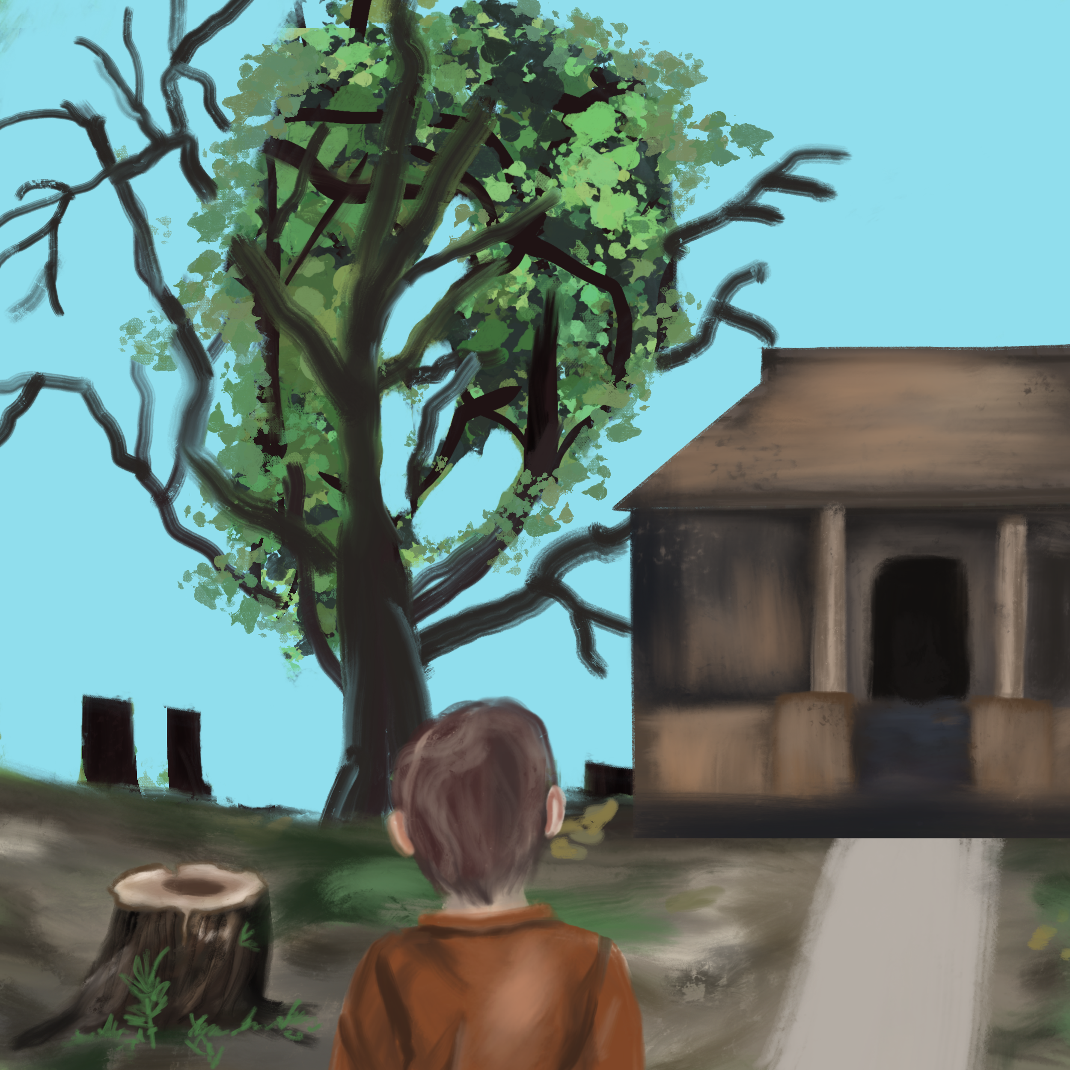
Beautiful trees? Greenery?
I hardly see one tree here!!!
Why are all these trees cut???

Slide 8
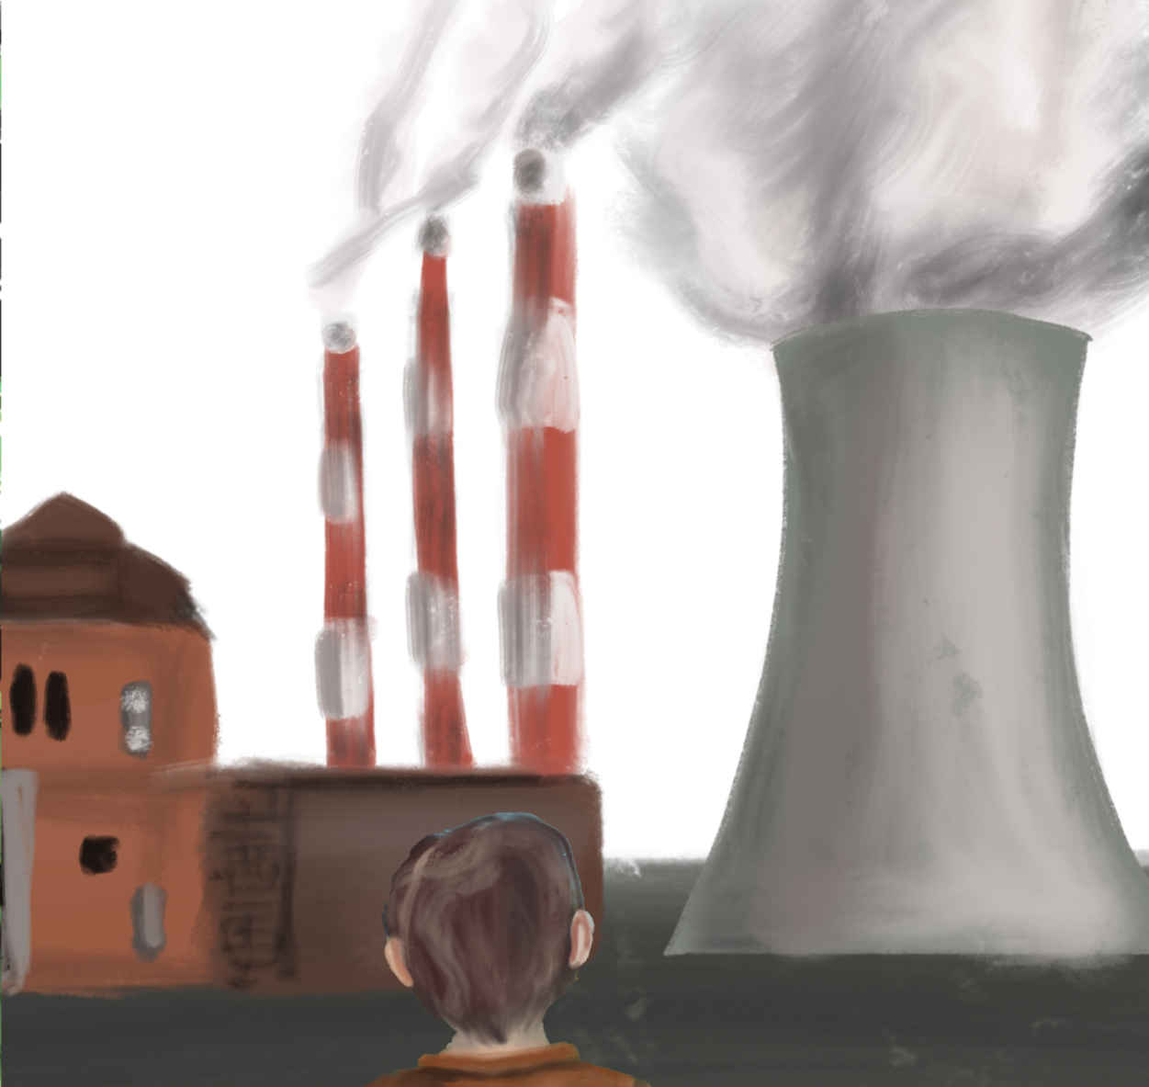
Where are the green fields like grandma told in the story??
I barely see any greenery, there’s smoke everywhere from the factory…..

Slide 9
Then vs Now

Slide 10
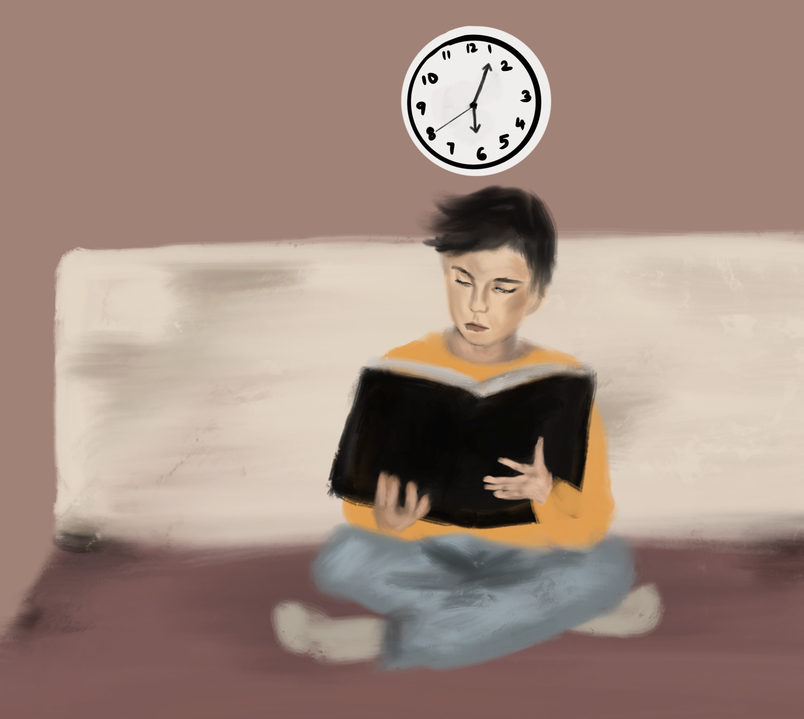
Amit realizes that something is wrong. He goes and reads about deforestation and its effects.

Slide 11
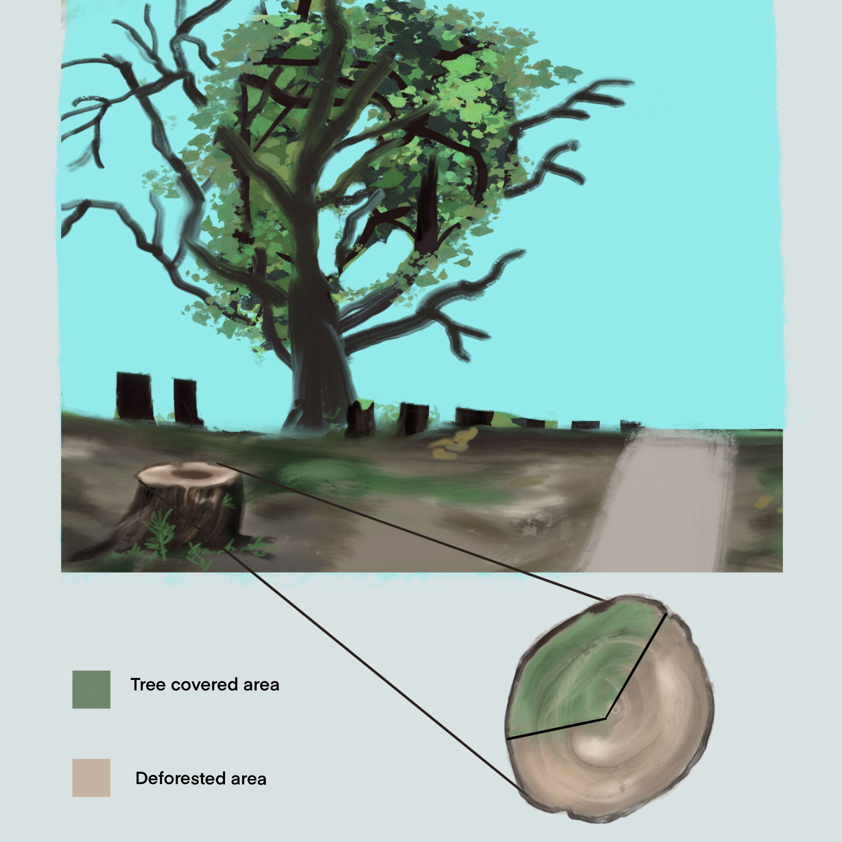
Amit discovers what has been happening!

Slide 12
The History

Slide 13
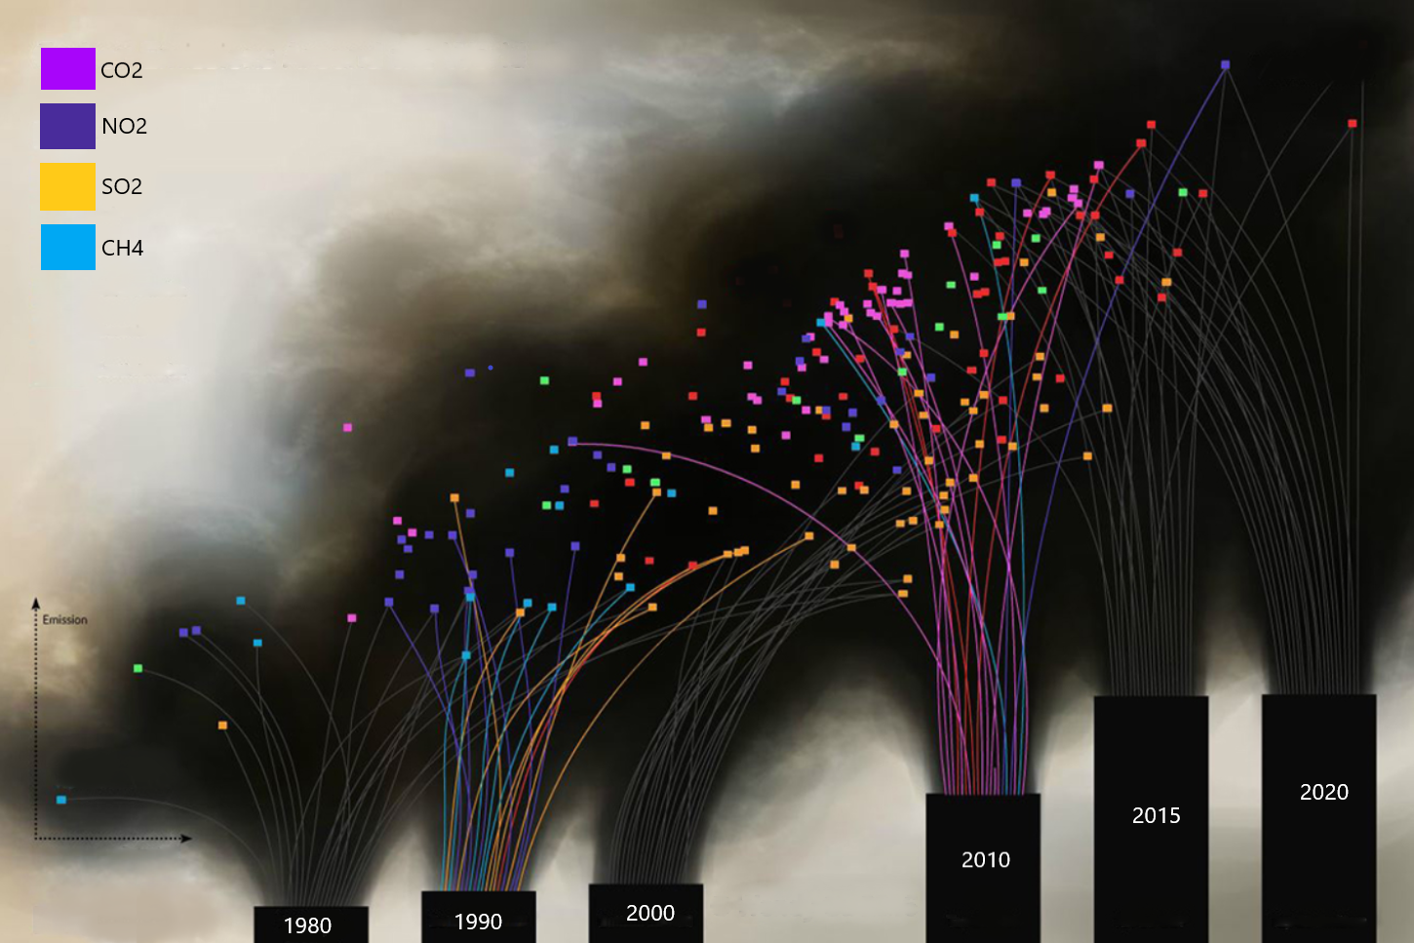
The History

Slide 14
Amit asks himself how can we improve the situation

Slide 15
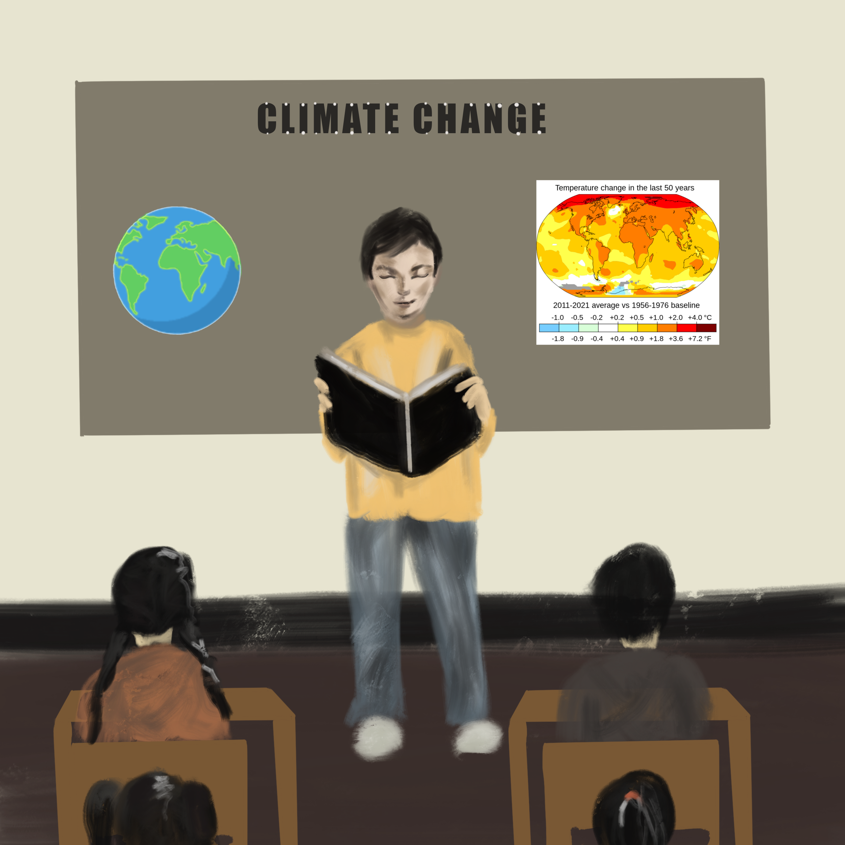
Amit learns about climate change and COP-26 goals and discusses that with his class

Slide 16
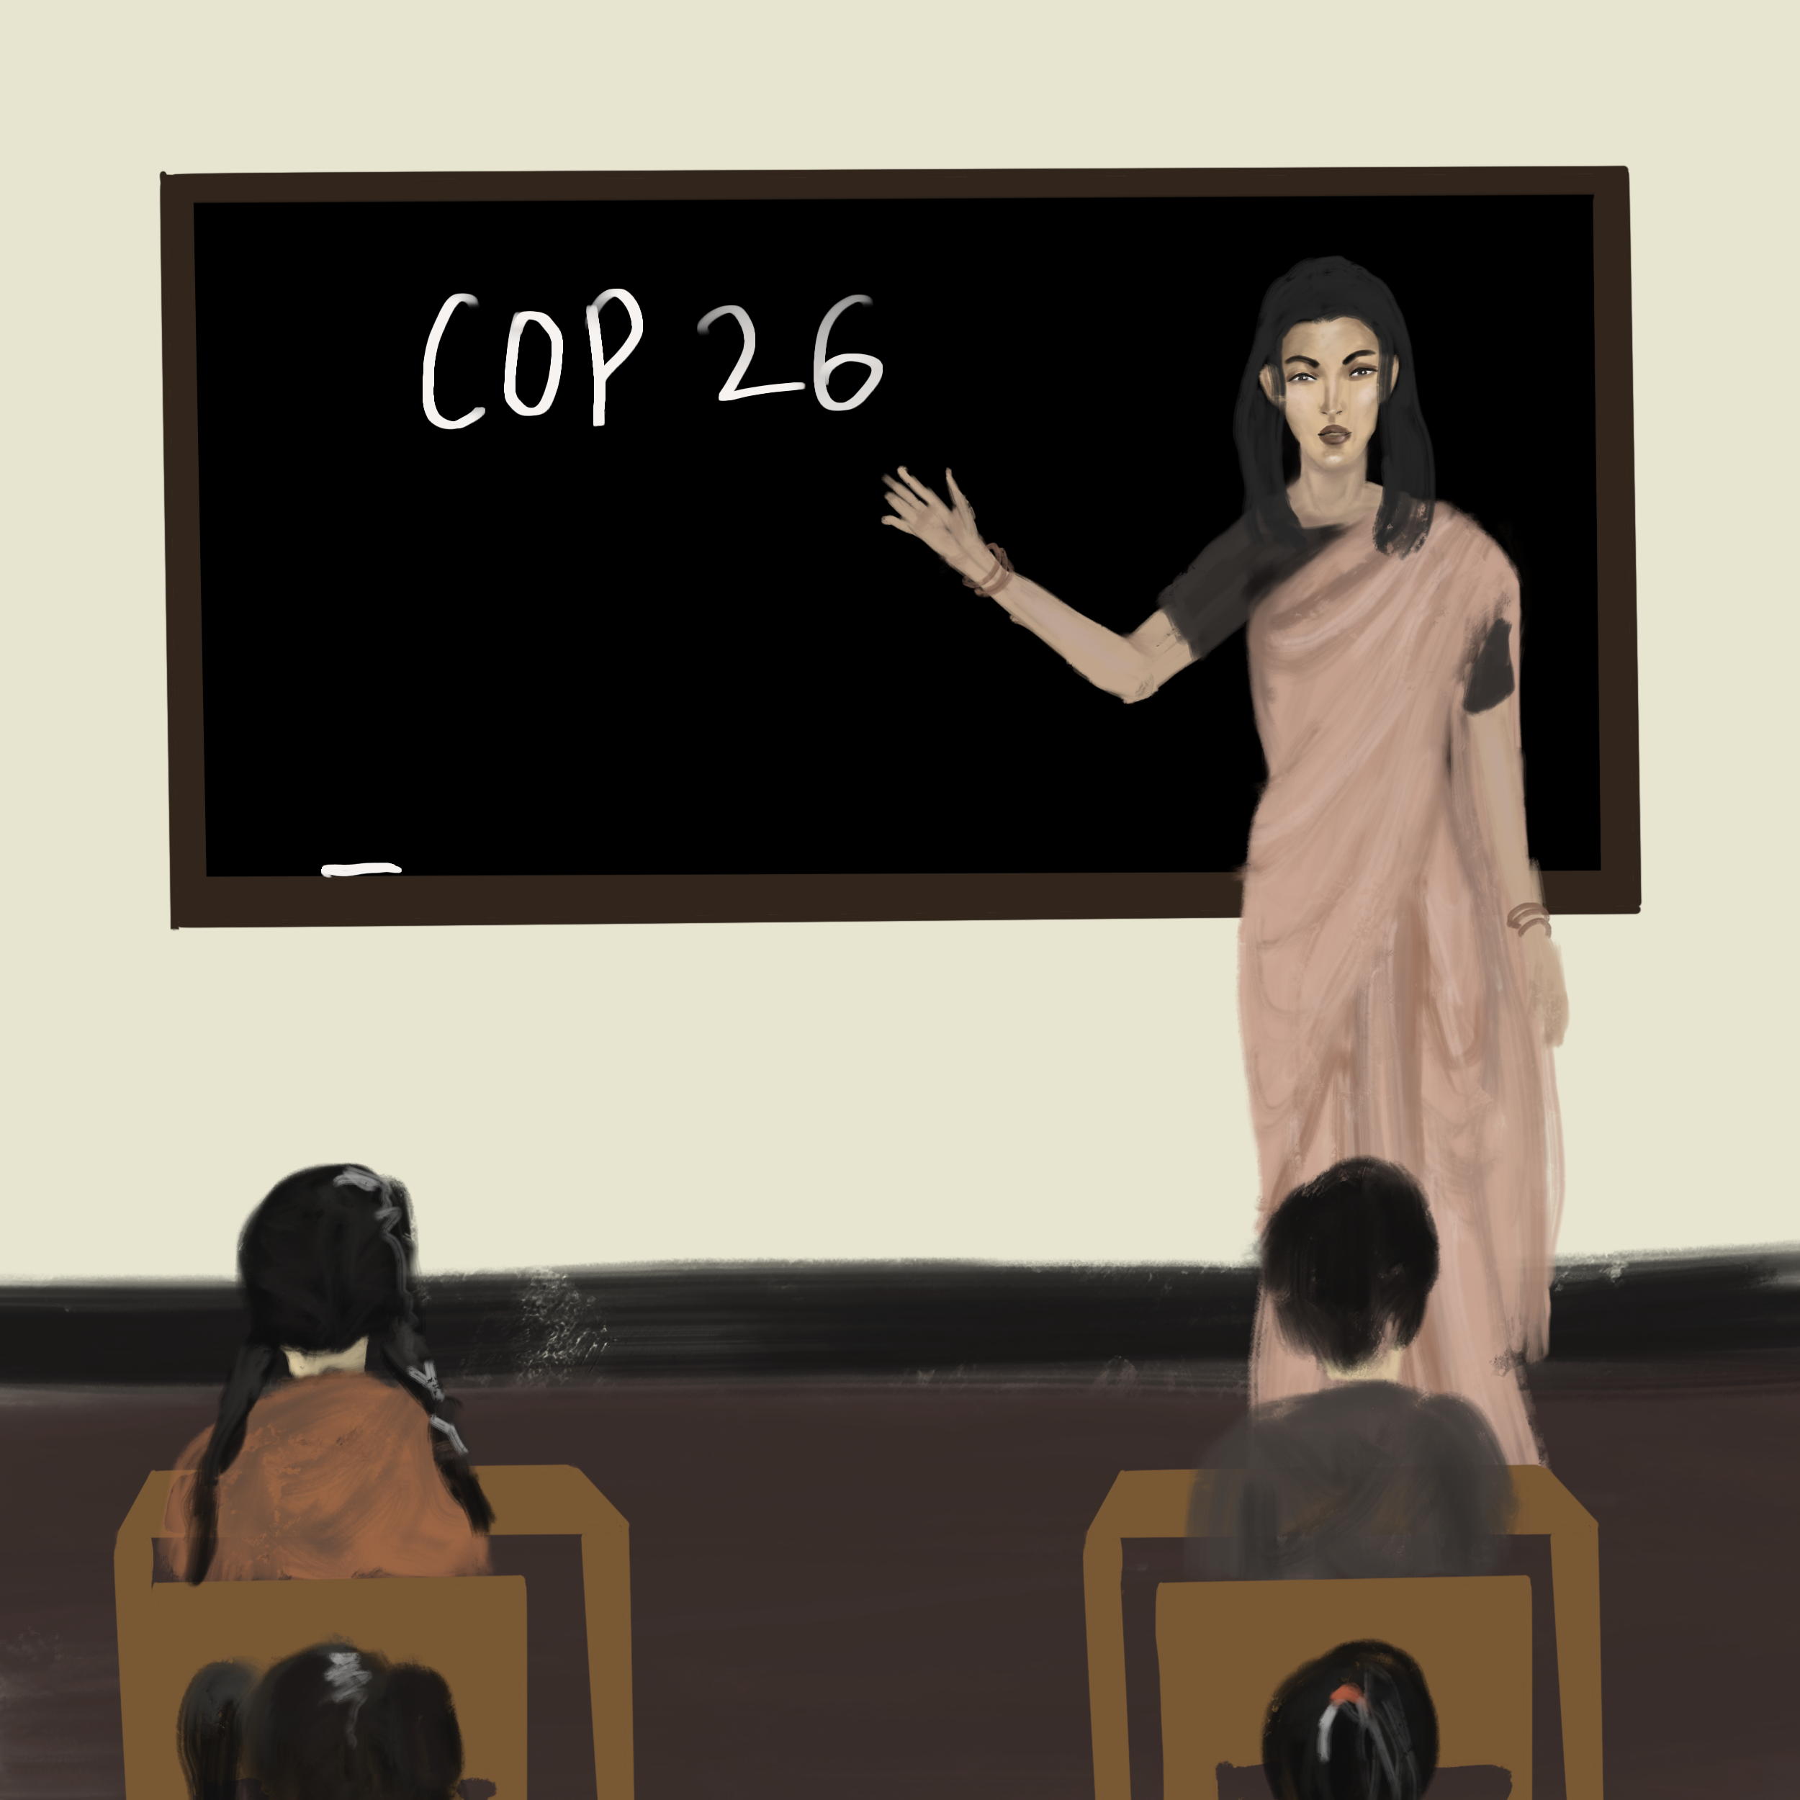
The class learns about COP-26 goals and actions that can be taken to achieve them

Slide 17
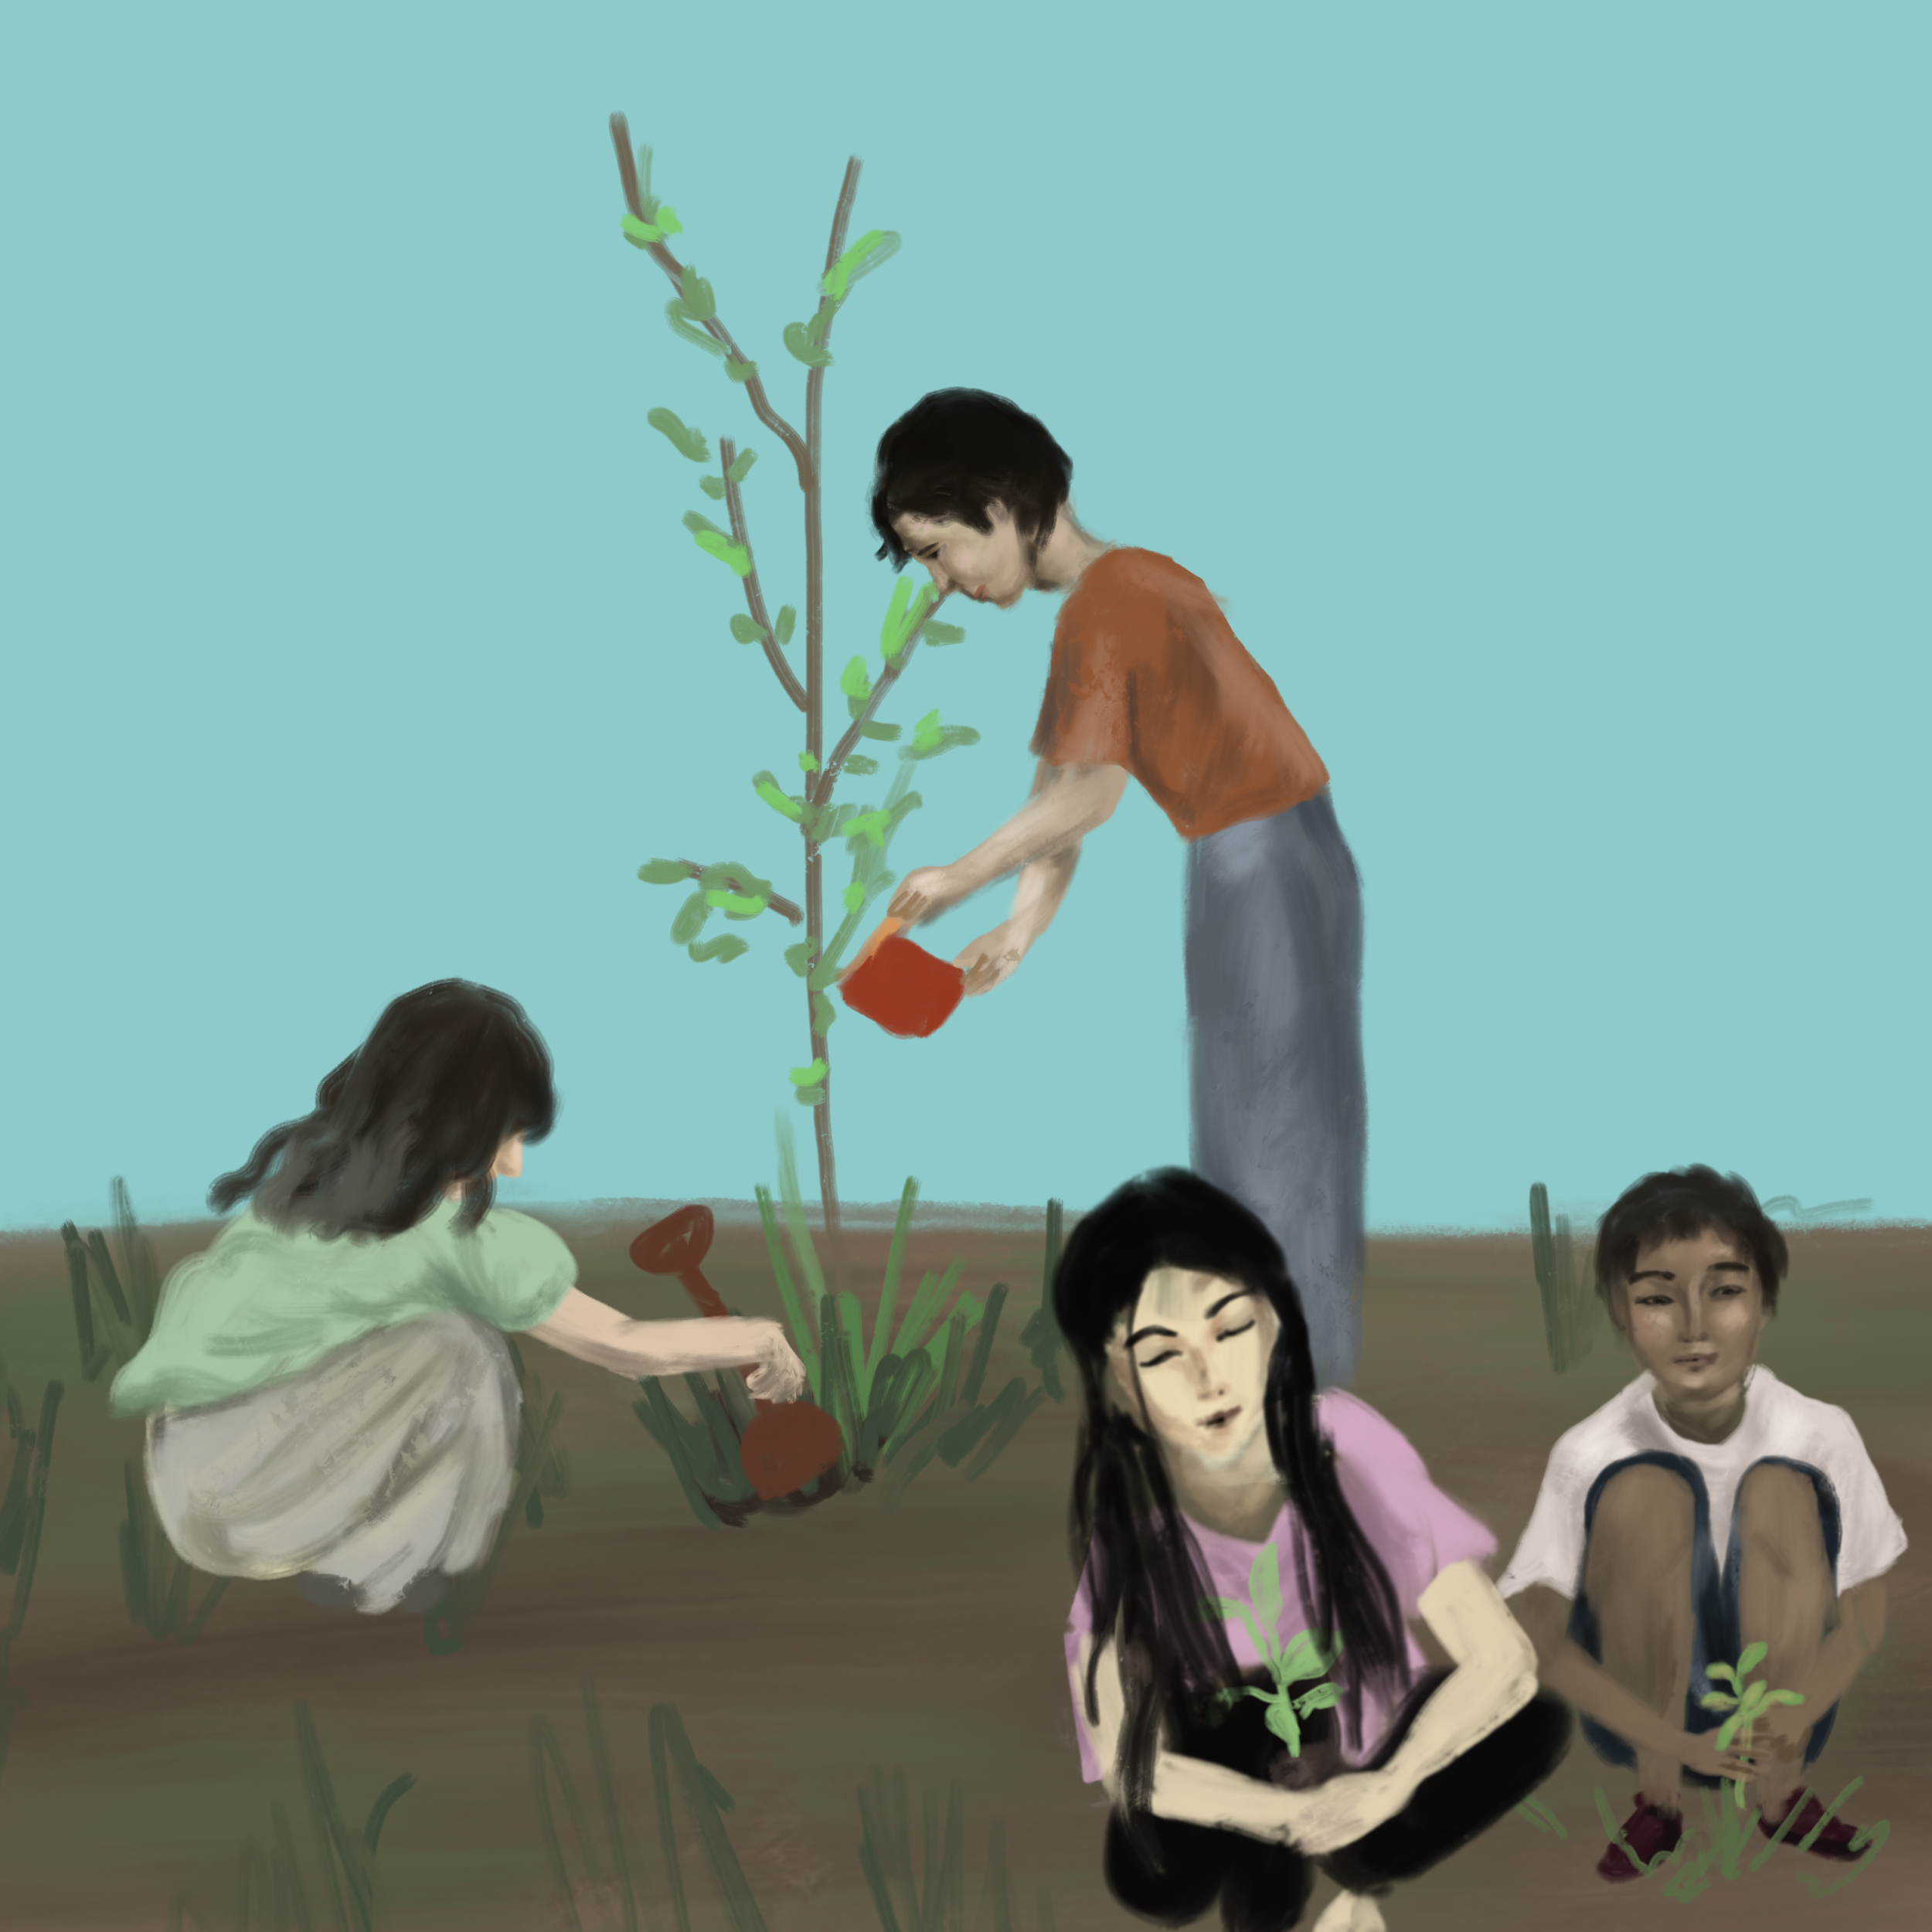
Amit takes the initiative to help reach the goals.
He organizes a tree plantation movement on Earth Day in the school with his friends and classmates and plant more than 1000 trees in one day.

Slide 18
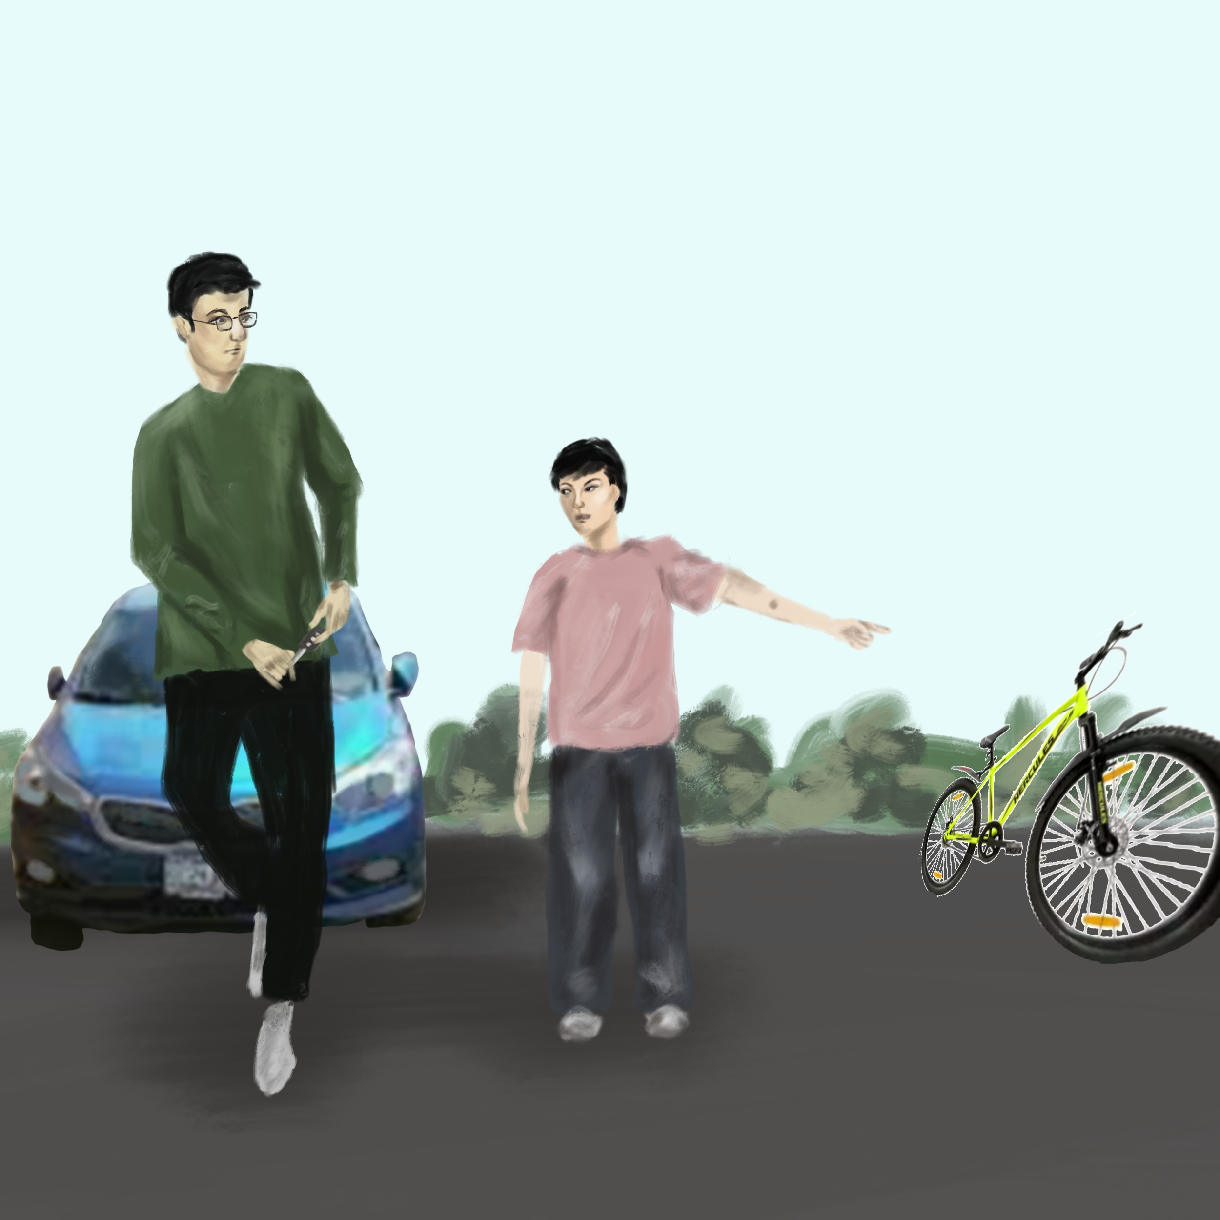
Students also educate their parents to use less polluting alternatives which helps the environment.

Slide 19
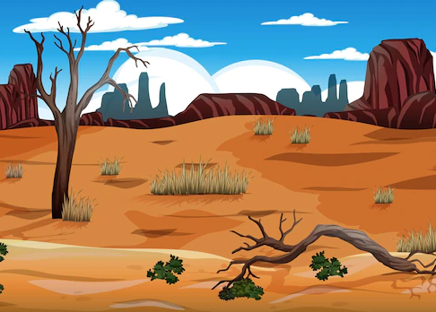
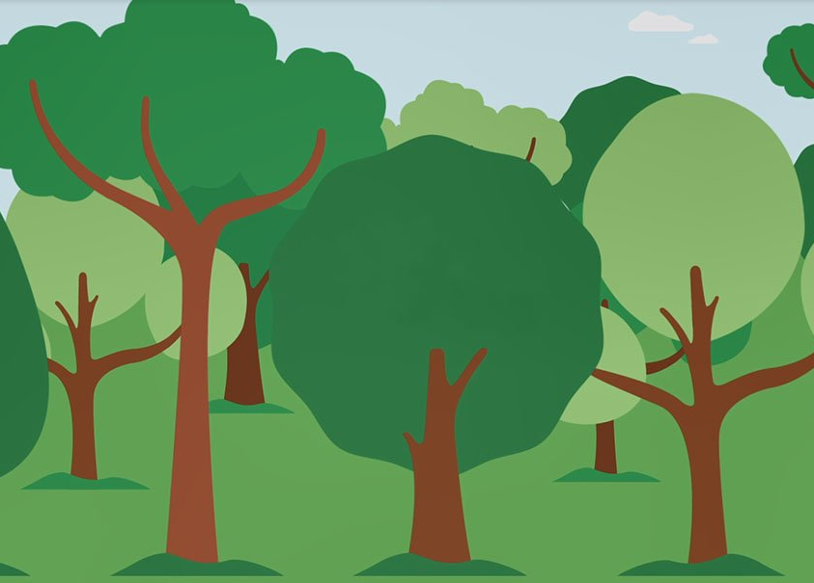
A Small step can go a long way….
Before
After

Slide 20
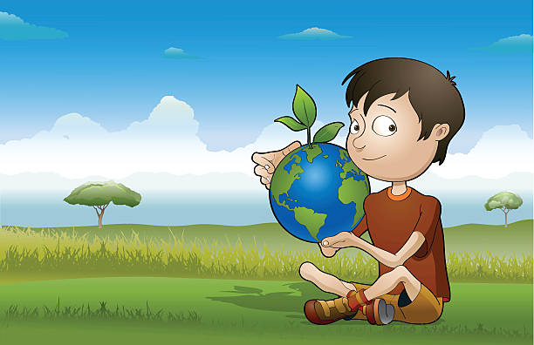
Now is the right time to act!!
It start with us.

Slide 21
This is not the end…..

