Slide 1
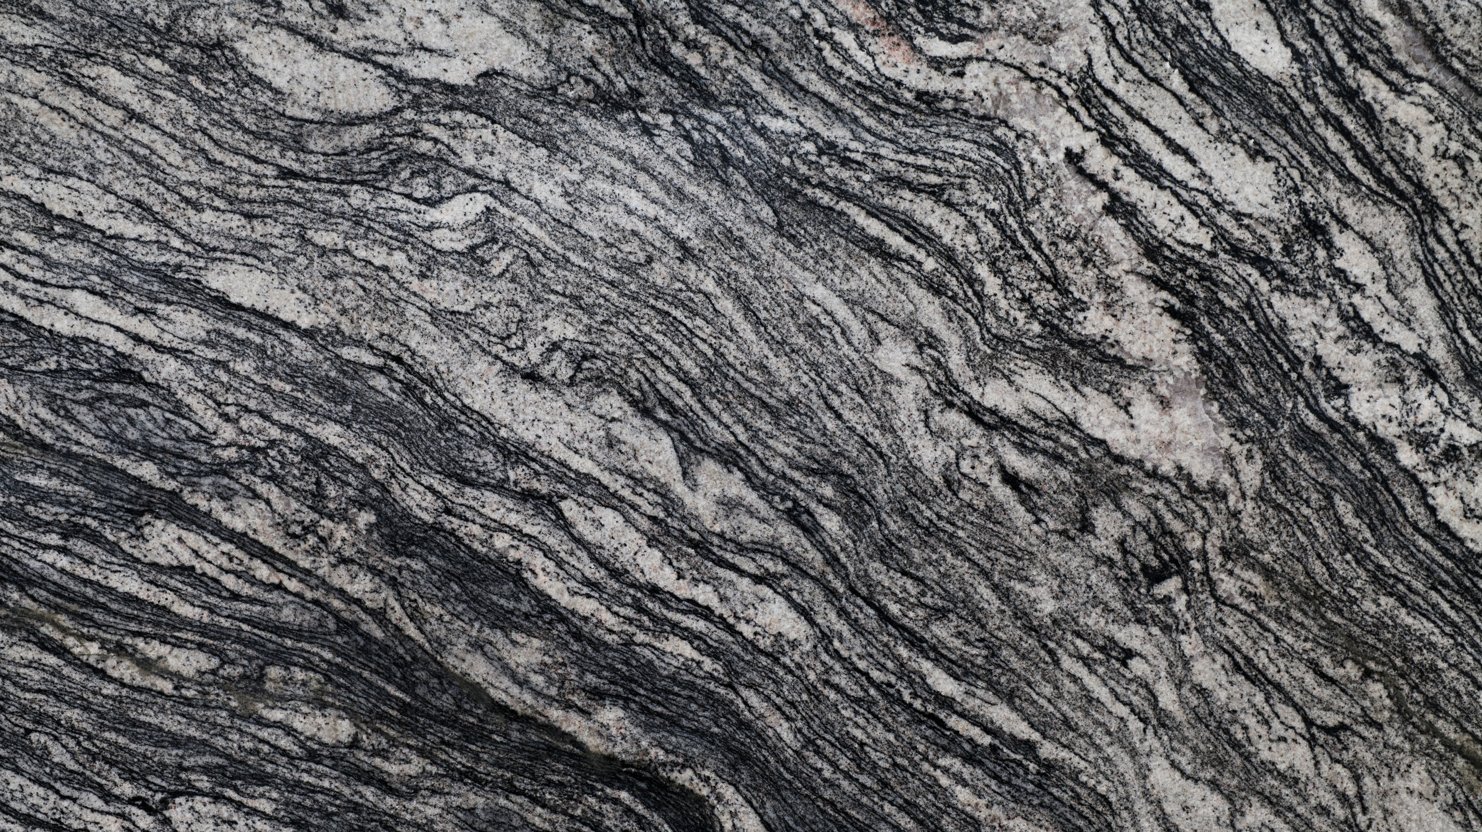
Accelerated Rock Erosion Test System
GNG 1103
Group F-12
Avery Taylor (300366472)
Emily Facette (300109170)
Rashad Nesar (300372555)
Annabelle Osazuwa (300361617)

Slide 2
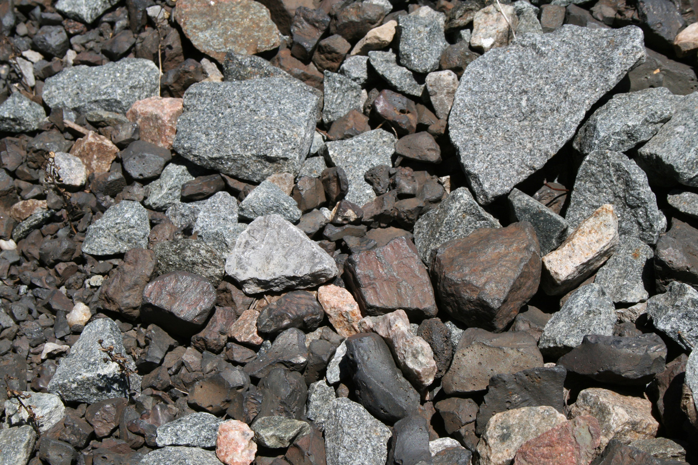
Problem Statement and Goal
Designing and developing an erosion testing system which is:
Safe
Economic
Durable
Stable
The system must be
Flexible
Repeatable
Accommodate different testing parameters.
The goal is to create a design which will allow for a deeper understanding of how different factors affect the rate of erosion, focusing on repeatability.

Slide 3
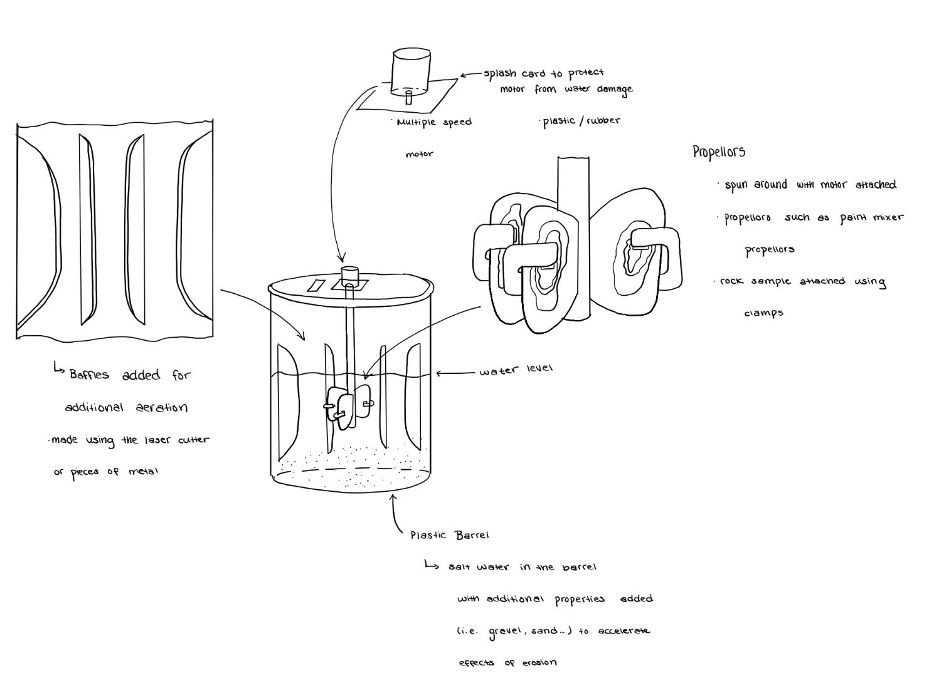
Our design
Design 1
Motor on top
Baffles
Plastic Barrel
Tied on samples
Controlled by Arduino

Slide 4
Our focus
Functionality & Repeatability
The RPM
The weight of the rocks before and after testing
Testing parameters
Risks
Require new/different parts
Availability and quality of the materials
Time constraints
Cost
$100 budget
Inexpensive prototype which will still exhibit erosion

Slide 5
Prototype I

Slide 6
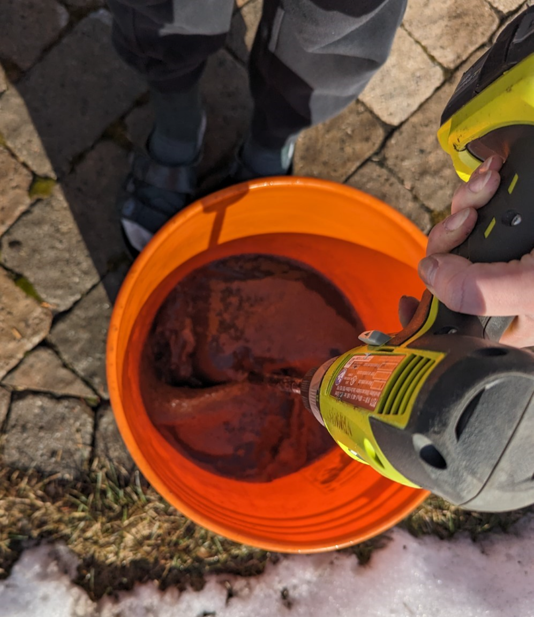
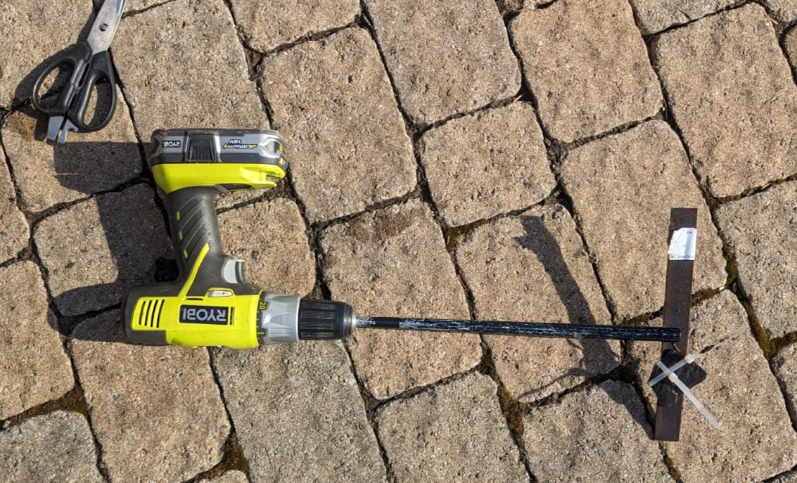
Prototype I
Sample Attachment
Parameters to Test
Salt
Sand/Gravel
Time

Slide 7
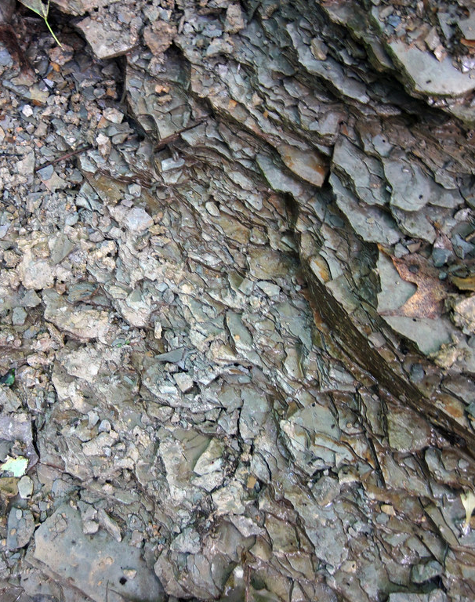
Conclusion
Prototype I
Focused Analytical- Arduino
Focus on repeatability of tests
Focused Physical – Jug Setup and testing parameters
Predict the performance of the sample
This Photo by Unknown Author is licensed under CC BY

Slide 8
Next steps
Prototype II (March 10)
Motor functioning
Powered by Arduino
Reduce uncertainty
Prototype III (March 24)
Motor functioning
Powered by Arduino
Rock sample adhered to the turbine
List of parameters will be tested
Design Day (April 4)

Slide 9
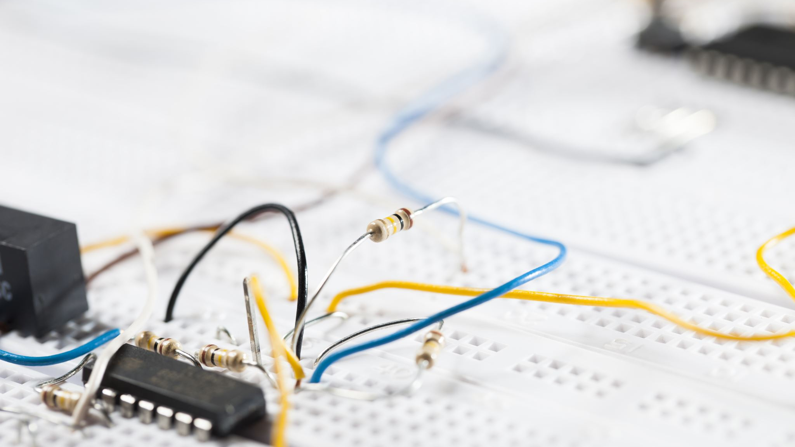
Thank you!
Any Questions?

