Slide 1
ERISH
YOUR BATHROOM FRIEND

Slide 2
Our
Problem
Our user was born with Arthrogryposis
Condition that limits movement
Faces challenges with everyday tasks

Slide 3
So What?
Factors for individuals with Arthrogryposis
Impacts more than just their physical abilities
Affects their independence, quality of life, and self esteem
Device is meant to empower their independence and privacy

Slide 4
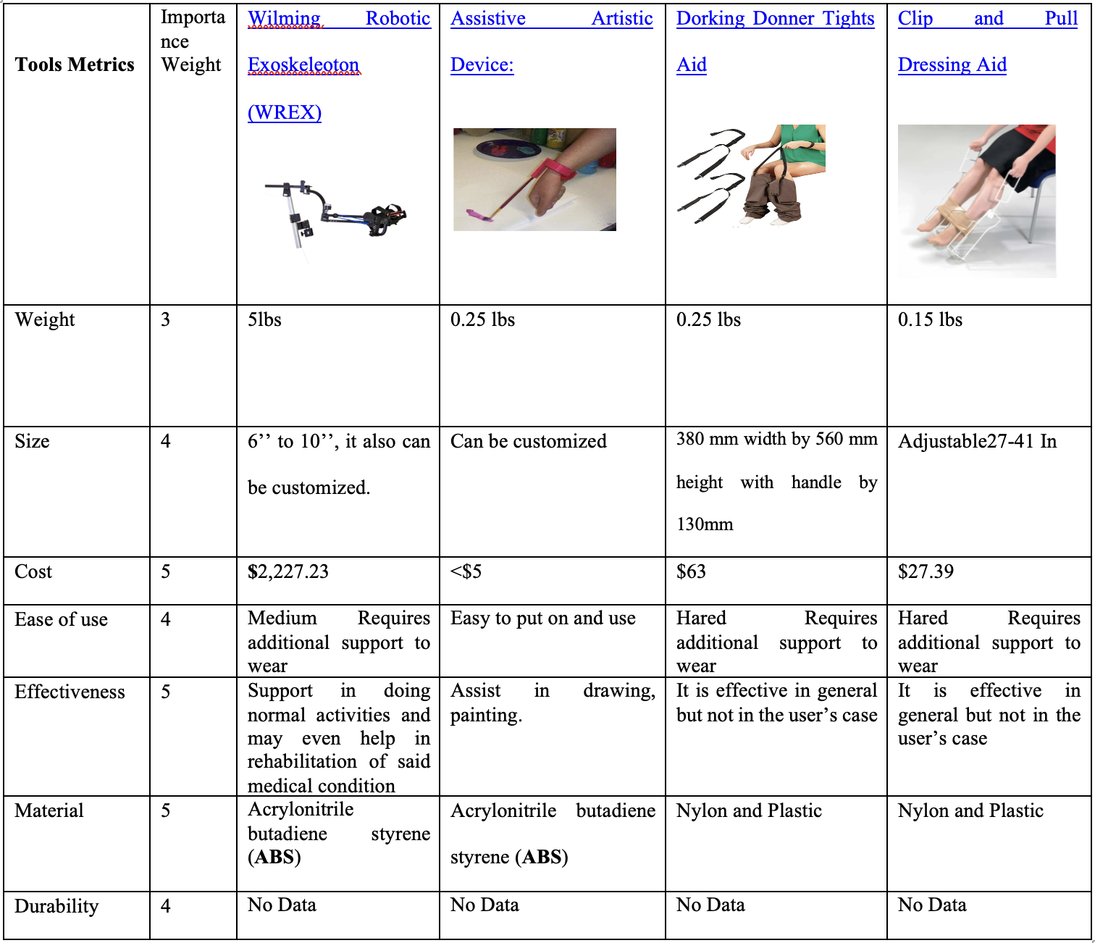
Understanding User Requirements

Slide 5
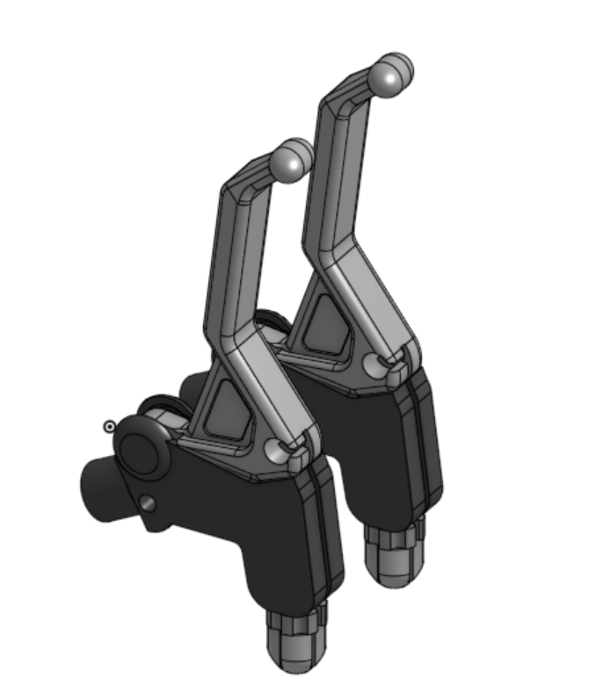
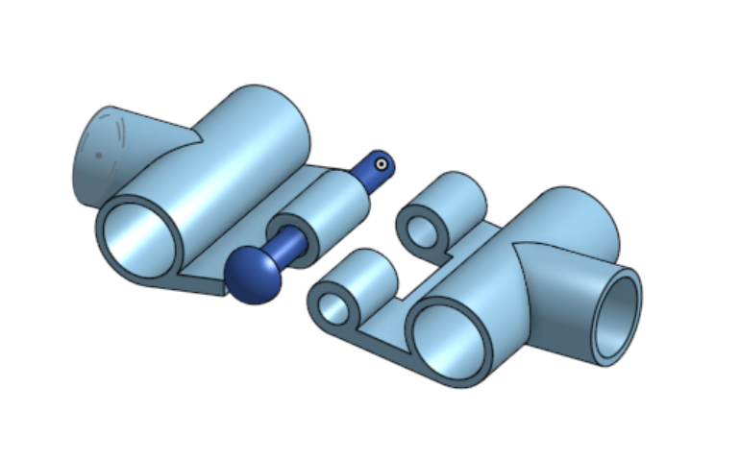
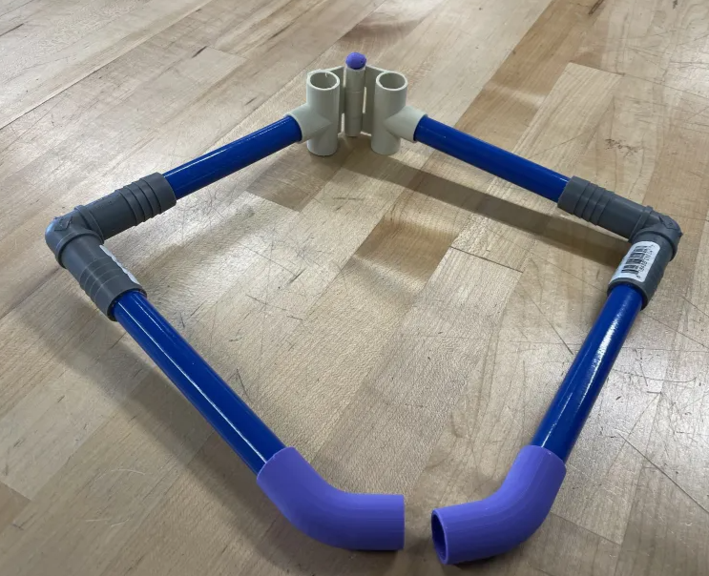
Our Solution
3D Printed Clamps
3D Printed Hinge
3D Printed Triggers
Rectangular Shape
PEX Pipe

Slide 6
Thanks
Do you have any questions?

