Slide 1
Conceptual Design
Group 8

Slide 2
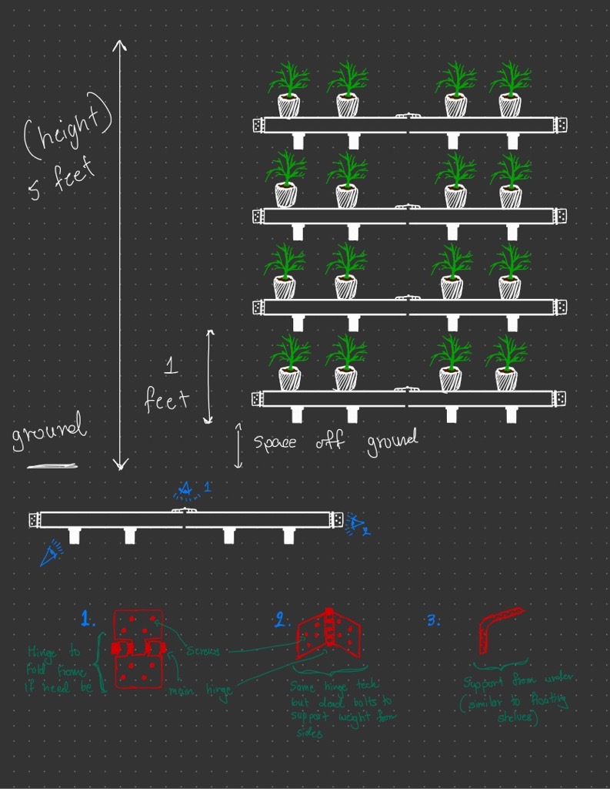
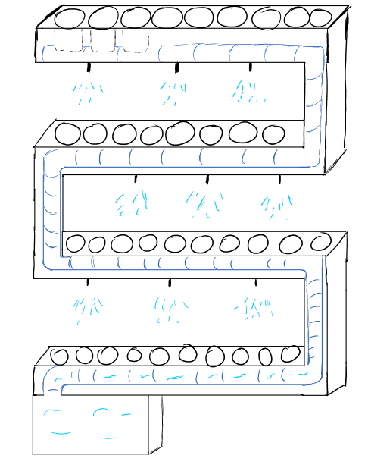
Construction Team’s Independent Designs
Floating Shelves
Snake- Like Style

Slide 3
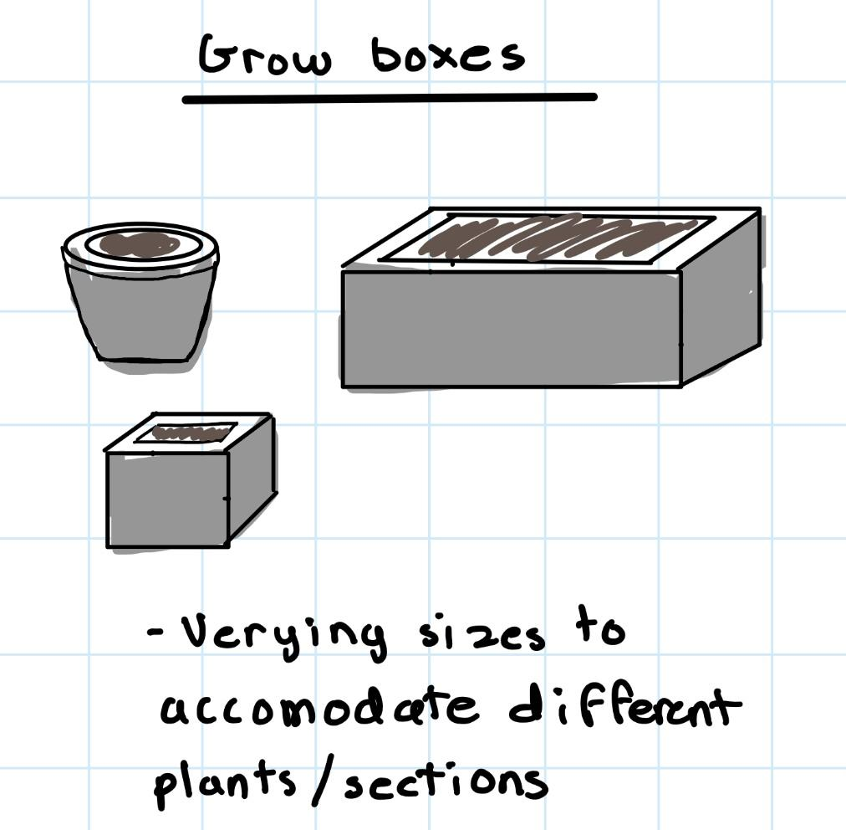
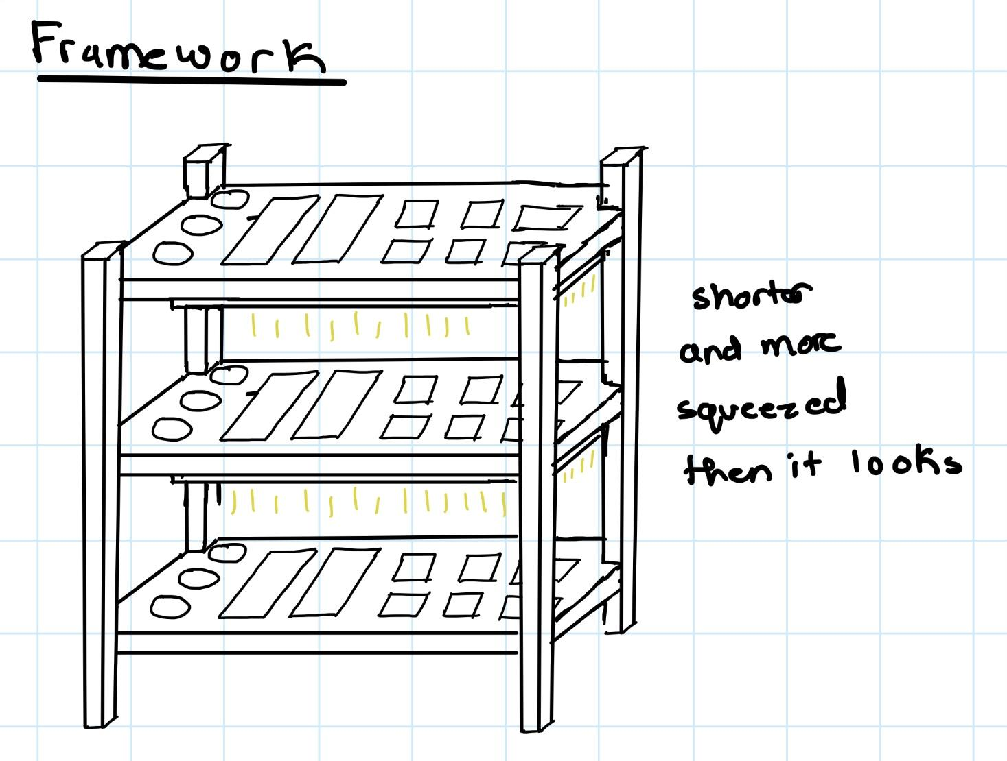
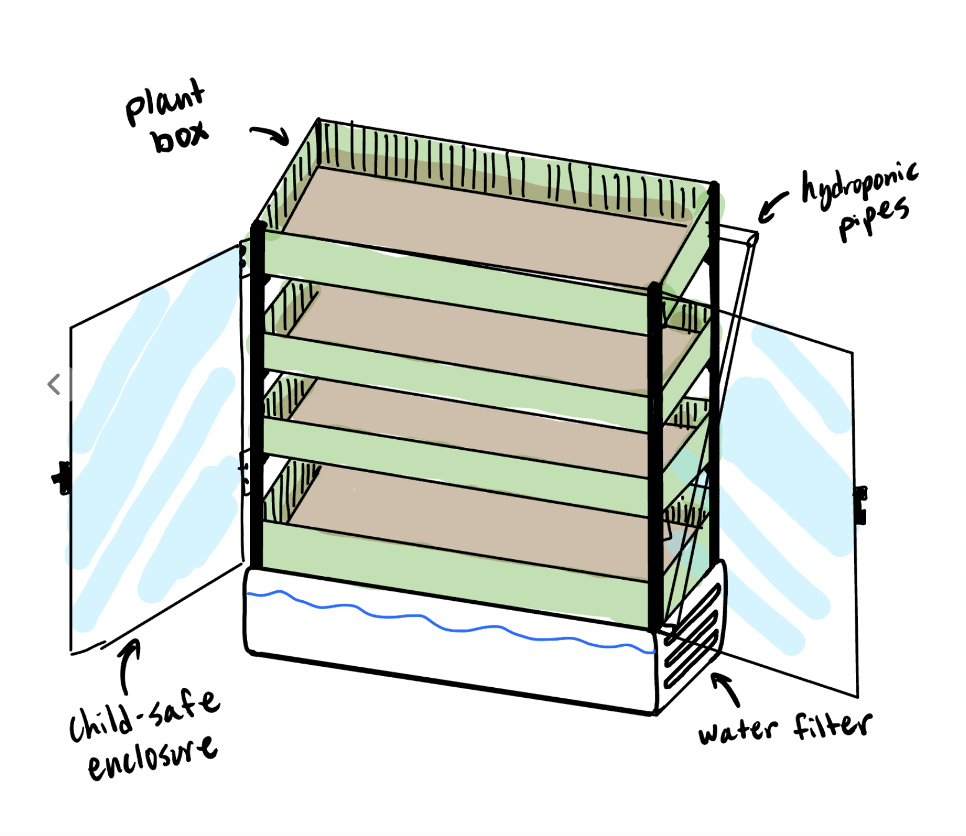
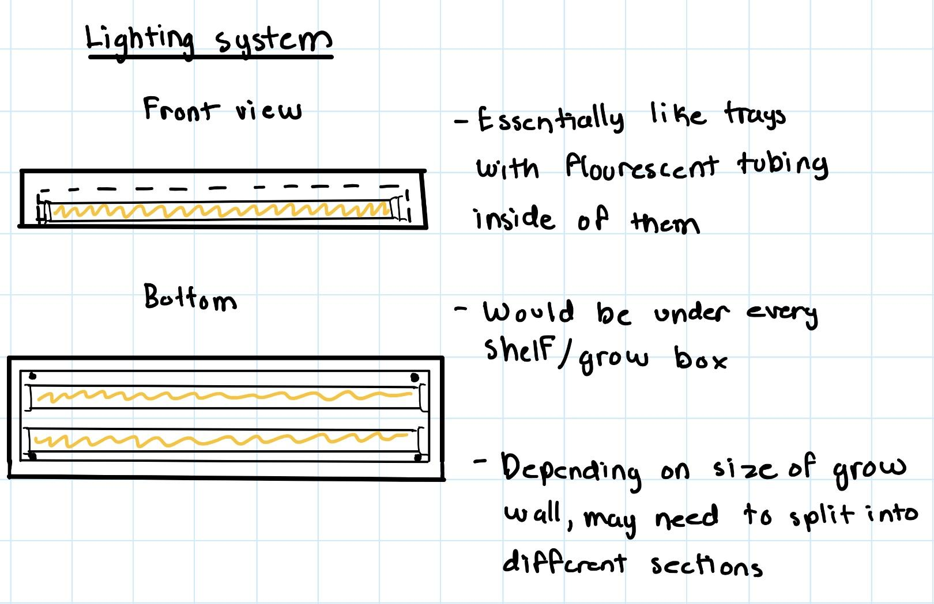
Continued
Modular Garden Shelf
Stackable Grow Wall

Slide 4
3 Final Solutions
After discussing as a group we came up with three combined designs.

Slide 5
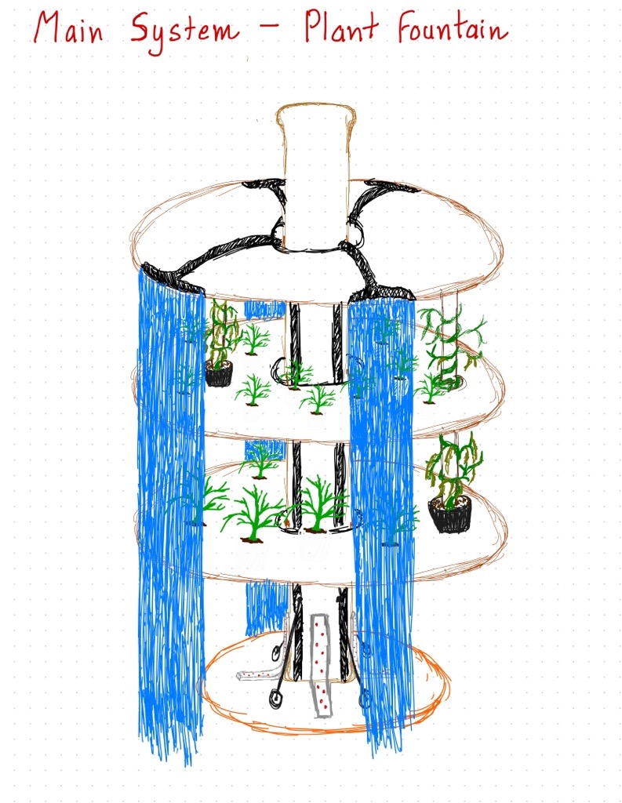
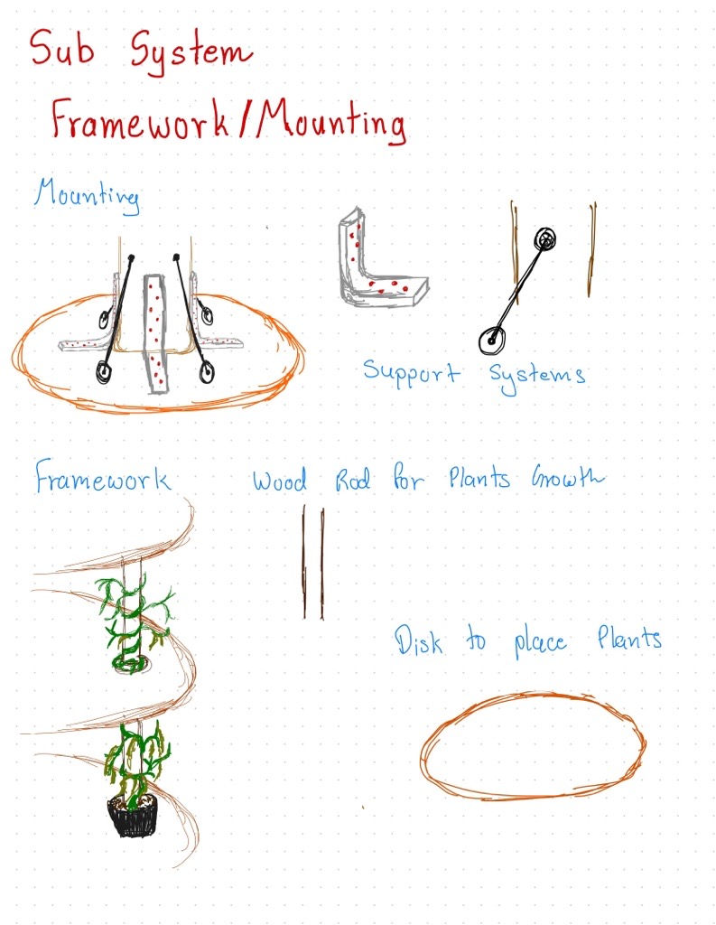
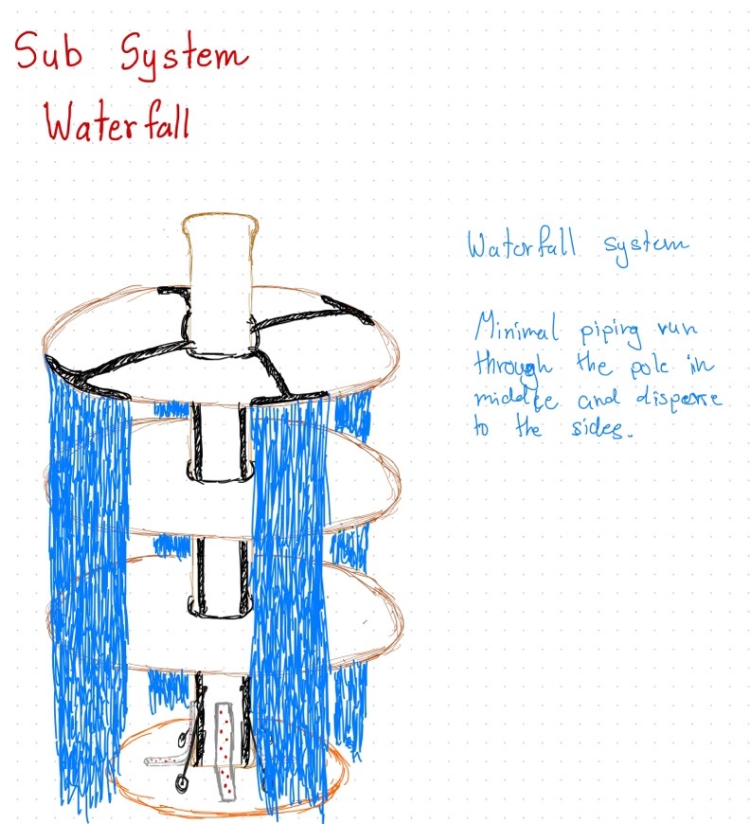
Design #1 -Plant Fountain

Slide 6
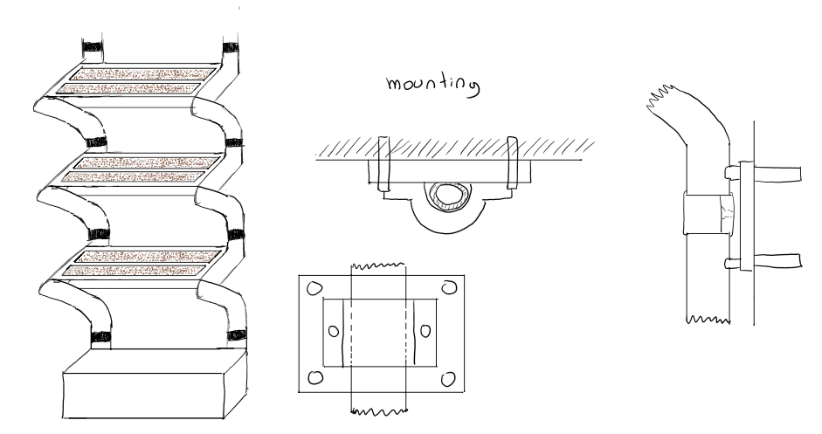
Design #2 Zig-Zag Plant Wall
Lighting System
Full View
PVC Pipe

Slide 7
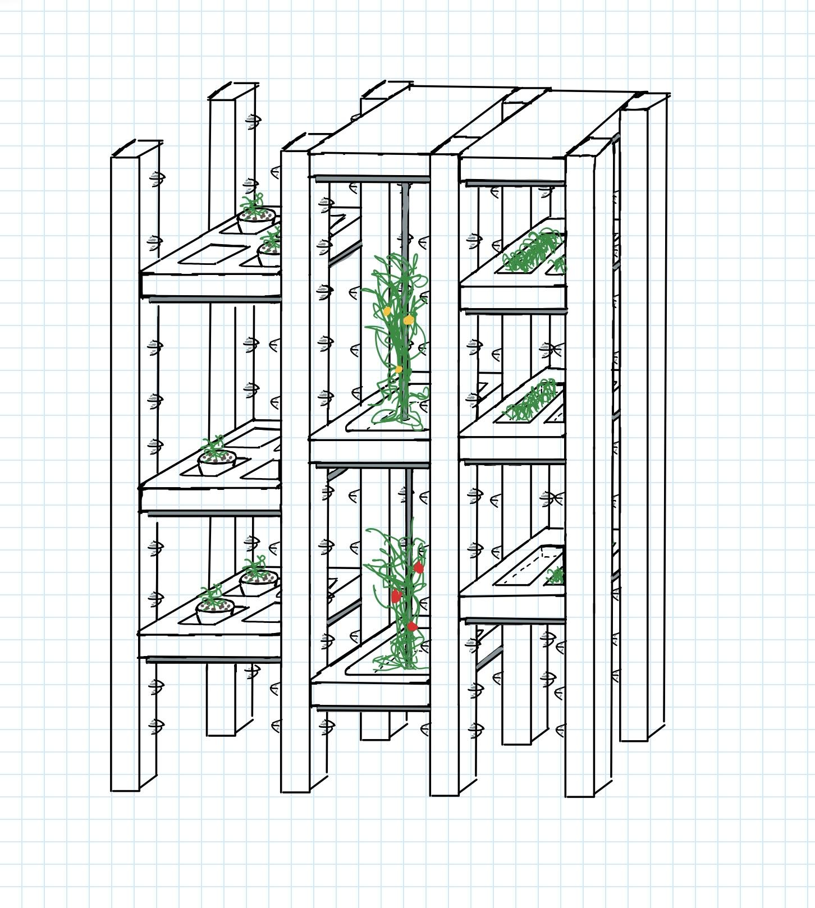
Design #3 Modular Garden Shelf
Adjustable heights
Suitable for various plants
Flexible shelf stack mobility

Slide 8
What are your thoughts?

Slide 9
Advantages and Disadvantages

Slide 10
Design #1
Pros | Cons
Wall mounting. Extendable height to allow for taller or smaller plants. Adjustable lighting. Foldable for easy transportation. Rotatable for easy access to plants in the back. | The telescopic center may be difficult to adjust for height. Hinges may be a point of failure. May be difficult to fit hydroponics/watering systems. Reduced space due to circular planters rather than squares.

Slide 11
Design #2
Pros | Cons
Lightweight: made of low-cost PVC piping. Standard and easy-to-acquire materials to allow easy replacement of damaged components. Possible locations for storage are below the structure. Mounted to the wall. Expandable height and depth to suit needs. 120V socket for lighting. | Piping may be prone to damage if climbed. Shelf-like configuration may be a climbing hazard. Once pipes are cut, the size is unchangeable. Storage on the floor is easy access for youth.

Slide 12
Design #3
Pros | Cons
Easy to remove shelves for limitless configurations and modularity. Wall mounting. 6ft tall. Various box sizes for a broad range of plants. Poles are available for vine-like plants. | Battery operated. Mounting points may wear over time.

Slide 13
Design Criteria
How we based the performance of each design aspect.

Slide 14
Name | Plant Fountain | Zig-Zag Plant Wall | Modular Garden Shelf
Cost (CAD) | < 500 | < 500 | < 500
Size (ft, WxHxD) | 8x6x2.5 | 8x6x2.5 | 8x6x2.5
Modular | Adjustable shelving. Pieces are transportable once disassembled. | Transportable once disassembled. Adjustable shelves with different sized piping. All pieces can be easily stored | Dissemblable. Fully adjustable shelves. All pieces can be easily stored.
Self Sustaining | Hydroponic Water fountain-like-watering system. | Hydroponic Lights on the side supports. Gravitational watering system | Hydroponic Individual lighting system for each plant tray (adjustable lighting)
Sizable for various produce | Suitable for all plant sizes with smaller roots. As well as plants that need some support. | Suitable for all plant sizes with smaller roots. | Multiple shelves that can be placed at any height therefore carry most plant sizes. Middle support for vines and other bushes that need support.
User-Friendly | Easy access to plants. Self watering system. | Some assembly required with tools. Easy and fast watering. Easy access to plants. | Simple design with latches (easy assembly). Lights with easily operated on and off switches. Easy access to plants.
Safety | Ladder-like design. Only one main support. | Narrow. Wall mounted, can be placed out of reach of small children. Slanted ladder like design. | Ladder like design, Small base

Slide 15
Any Suggestions?
We’re open to anything!

Slide 16
Thank you for your time.
If you have any questions and want to reach out, please contact us through our team member Sophia Cino Zarco at scino043@uottawa.ca

