Slide 1
Team S.W.A.A.M.
Robot Arm
Group C04

Slide 2
Who are we?
Notes:
We are S.W.A,A.M. we consist of Shahrayar, Wacira, Ayham, Akem, and Matthew. Our group’s main mission was to create a inverse kinematic robot cleaning and painting over Halifax Class Destroyer Ships.

Slide 3
Our Goal
“An inverse kinematics solver that is easy to use, light-weight, cost-effective, and portable with three degrees of freedom with an end effector that can be interchangeable for different procedures.”
Notes:
As S.W.A.A.M, our mission was to create an inverse kinematic robot that's lightweight, cost effective, and portable. The robot shall have 3 degrees of freedom and an end effector that can interchange with other parts depending on the task at hand.

Slide 4
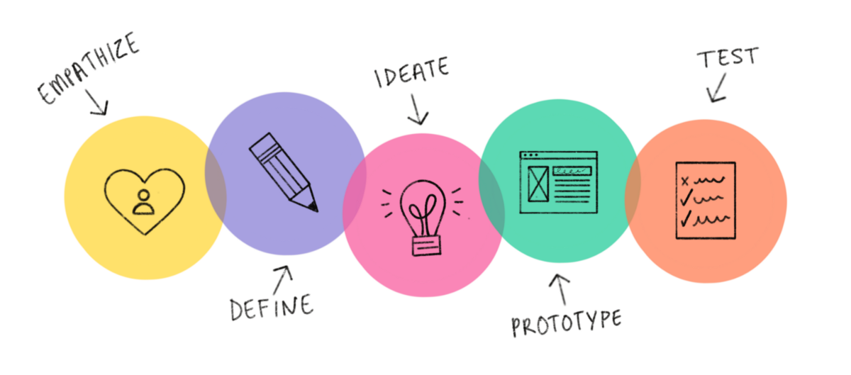
Our Process
Notes:
Throughout the entire Project, we decided to follow the engineering design phase which follows these 3 steps. Empathize, where we try to understand how our client and/or user is feeling. Define, where we create a problem statement that we will follow throughout the process. Ideate, where we create many different concepts for the project. Prototype, where we create certain parts of the final product through different prototypes. And finally, Test, where once we completed our final prototype, we use the product in action to see how it performs.

Slide 5
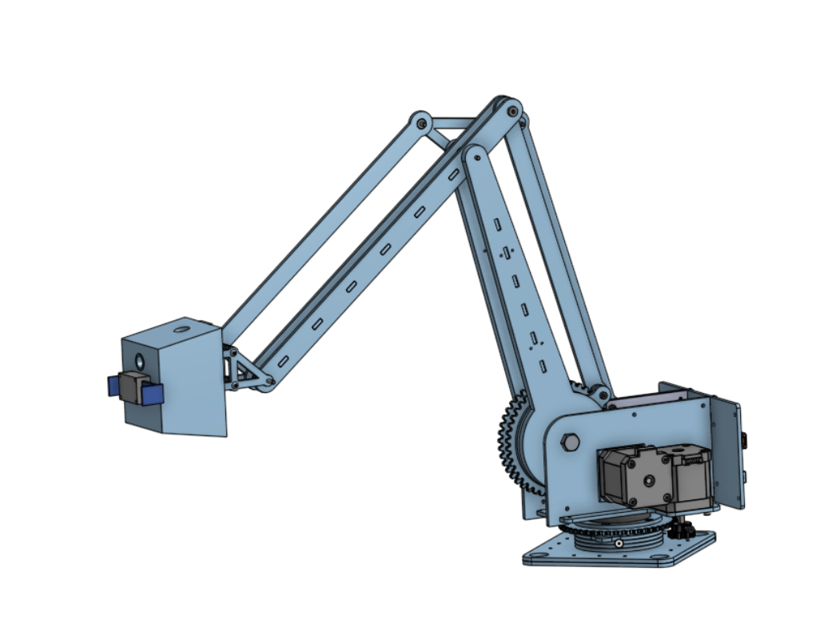
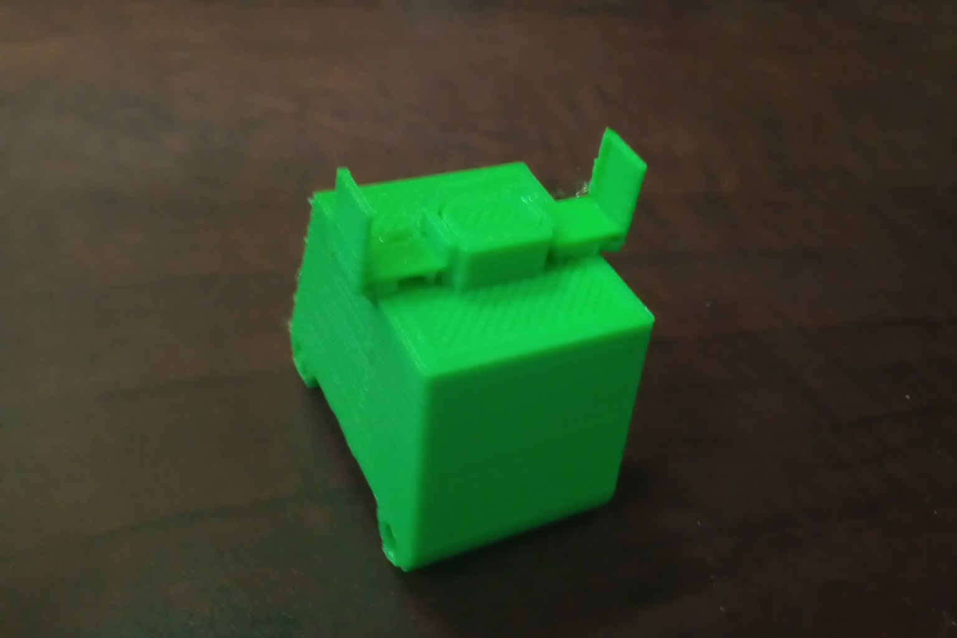
Our Product

Slide 6
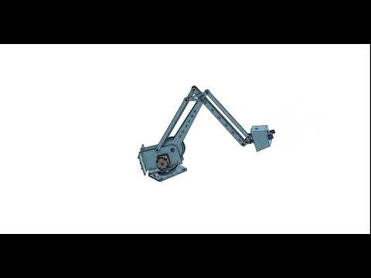
Product Simulation
Notes:
In this simulation, we demonstrate how the robot’s going to move when in practice. As you can see, the arm movements are quite fluid and clean so there should be no issue in the way the robot moves. We also simulated the End effector and how the claw sort of mechanism shall work. With the use of springs in the effector itself, it has elastic properties, allowing it to have a strong grip.

Slide 7
Why us?

Slide 8
Time for Questions

