Slide 1
Statistics On Inventory Management Systems:
Where Does The Issue Lie?
“Businesses using RFID have a greater 95% inventory accuracy”
“Inventory Distortion results in an approximate loss of $1.1 Trillion”
“Human Error is the leading problem in 50% of warehouses”

Slide 2
Automated Inventory Management System
Presented by 24 BEES
BARROUG EL MAHDI, BELMKADDEM ZIYAD, BOULAYAD ZAKARIAE, BROU DEVA, SALIBA ELIE

Slide 3
Table of contents
Design Process
Empathy and Definition
Design Criteria and Technical Design Specifications
Research related to scannable tags / tracking options
Conceptualization
Preliminary solutions to the problem statement
Final solution
Detailed Design of the final solution
Material Naming and Equipment Used
Prototyping and testing
Prototype 1
Prototype 2
Conclusion
Lessons learned
What’s next ?

Slide 4
Empathy and Definition

Slide 5
Identification of client needs
Number | Needs
1 | The system has a simple and user-friendly interface
2 | The system can operate independently of human intervention
3 | The system is precise
4 | The system keeps track of entry and exit for articles
5 | The system includes traceable smart chips
6 | The system includes modern methods for digital addition and deletion
Questions asked during the client meet:
What are three attributes that you see greatly enhancing the product’s effectiveness?
Have you ever encountered a seriously impeding issue, originating from an inadequate inventory management system? If so, what were the extents of its damage, and how would you see it being prevented?
[2]
EMPATHY AND DEFINITION
CONCEPTUALIZATION
PROTOTYPING AND TESTING

Slide 6
Interpreted needs and design criteria
Number | Needs | Design Criteria
7 | The system approves data fully and rapidly | Data Approval Efficiency
8 | The system notifies its users of any inventory modification | Alert
9 | The system can identify items through video recognition | Video Recognition
10 | The system can operate for a long duration of time | Longevity (Months)
11 | The system is affordable | Cost ($ CAD)
12 | The system can detect items from a long distance | Detection range (m)
13 | The system is customisable | Adaptability
14 | The system is portable and extremely light | Weight (lb)
Number | Needs | Design Criteria
1 | The system has a simple and user-friendly interface | Interface
2 | The system can operate independently of human intervention | Autonomy
3 | The system is precise | Reliability
4 | The system keeps track of entry and exit for articles | Access Tracking
5 | The system includes traceable smart chips | Spatial Localisation
6 | The system includes modern methods for digital addition and deletion | Digital Manipulation
[3]
EMPATHY AND DEFINITION
PROTOTYPING AND TESTING
EMPATHY AND DEFINITION
CONCEPTUALIZATION
CONCEPTUALIZATION
PROTOTYPING AND TESTING

Slide 7
Design specifications
 | Design Criteria | Relation (=, < or >) | Value | Units | Verification Methods
 | Functional Requirements
1 | Longevity | > | 12 | Months | Analysis
2 | Detection range | > | 50 | m (meters) | Tests
3 | Frequency | = | 30x10 | Hz (Hertz) | Tests
4 | Signal type | = | Radio | N/A | Tests
5 | Transmission speed | < | 30 | ns (nanoseconds) | Analysis
[3]
EMPATHY AND DEFINITION
CONCEPTUALIZATION
PROTOTYPING AND TESTING

Slide 8
Design specifications
 | Design Criteria | Relation (=, < or >) | Value | Units | Verification Methods
 | Non-Functional Requirements
7 | Attachment | = | Adhesive | N/A | Tests
7 | Video Recognition | = | No | N/A | N/A
8 | Alert | = | Yes | N/A | Tests
9 | Reliability | > | Yes (~95) | % | Tests
10 | Interface | = | Yes | N/A | Code debugging tools
11 | Autonomy | = | Yes | N/A | Tests and code debugging tools
 | Constraints
12 | Cost | < | 50 | $ (CAD) | Estimation and checks
13 | Dimensions | < | 20x20x5 | mm (millimeters) | Analysis
14 | Weight | < | 0.50 | oz (ounces) | Analysis
[3]
EMPATHY AND DEFINITION
CONCEPTUALIZATION
PROTOTYPING AND TESTING

Slide 9
Problem statement
“Canada's Shared Services in Digital Platforms aims to provide depot managers with an automated, fast, accurate, easy-to-access and intelligent inventory management system, in hopes of minimizing financial and temporal losses. All within a budget of ~50$ (CAD)”
[2]
EMPATHY AND DEFINITION
CONCEPTUALIZATION
PROTOTYPING AND TESTING

Slide 10
Research related to the tracking chip
AirTag | RFID | NFC
"The AirTag worked every time I tried it. One of the AirTag's few flaws is that you can't use it to ping your linked iPhone or iPad. Competing trackers do offer this feature." -www.pcmag.com | "RFID is an emerging technology that is increasingly being used in supply chain management. It plays an important role in supporting logistics and supply chain processes because of their ability to identify, trace and track information throughout the supply chain. The technology can provide suppliers, manufacturers, distributors and retailers precise real time information about the products." -www.sciencedirect.com | "It does not require search and pair procedures like bluetooth and other methods to establish connectivity. [...] It can only work in shorter distances which is about 10-20 cm." - www.rfwireless-world.com
[3]
EMPATHY AND DEFINITION
CONCEPTUALIZATION
PROTOTYPING AND TESTING

Slide 11
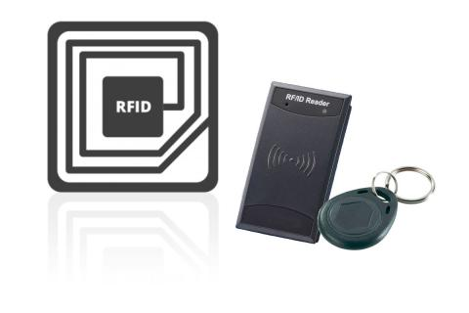
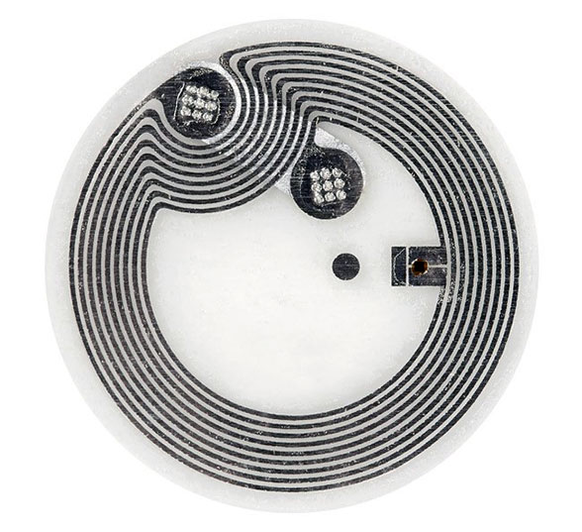
Research related to the tracking chip
Type of tracking tag | AirTag | RFID tag | NFC tag
Productor | Apple (Foxconn) | ~Variable~ | ~Variable~
Mean Cost | ~30.00$ | ~112.50$ | ~1.00$
Operational Distance | ~10 m | ~10 m - ~100 m (up-to ~460 m for sophisticated chips) | ~0.05 m
Dimensions | 31.9 x 31.9 x 8 mm | -Minimum (read-only): 3 mm -Maximum (read and diffuse): 5 cm | -Minimum: 6 mm -Maximum: 85 mm x 55 mm
Signal Type | Bluetooth | Radio | Radio
Frequency | 2.4 GHz | 125 KHz - 30 MHz | 125 KHz - 30 MHz
Weight | 0.39 oz | 0.06 oz | 0.01 oz
Longevity | 1 Year | 20-50 years | 10-50 years
Attachment | Straps | Adhesive | Adhesive
[3]
EMPATHY AND DEFINITION
CONCEPTUALIZATION
PROTOTYPING AND TESTING

Slide 12
Conceptualization I : Preliminary solutions to the problem statement

Slide 13
Sub-system 1 : Framework
A
2
3
A
A
4
[4]
EMPATHY AND DEFINITION
CONCEPTUALIZATION
PROTOTYPING AND TESTING

Slide 14
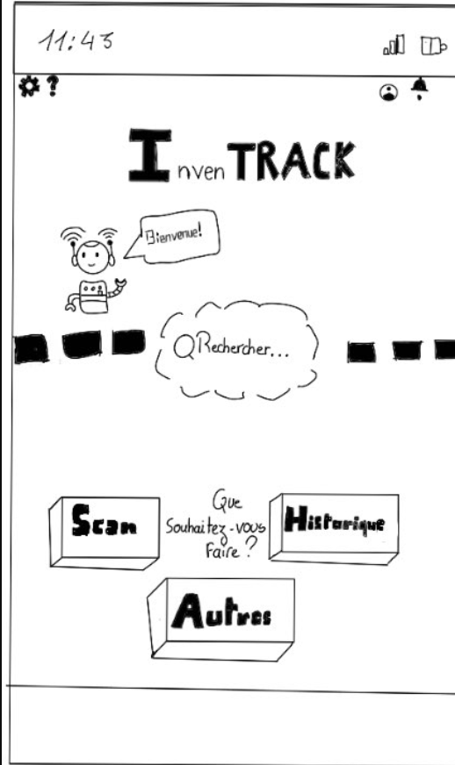
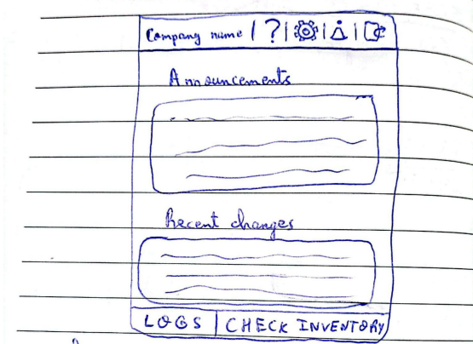
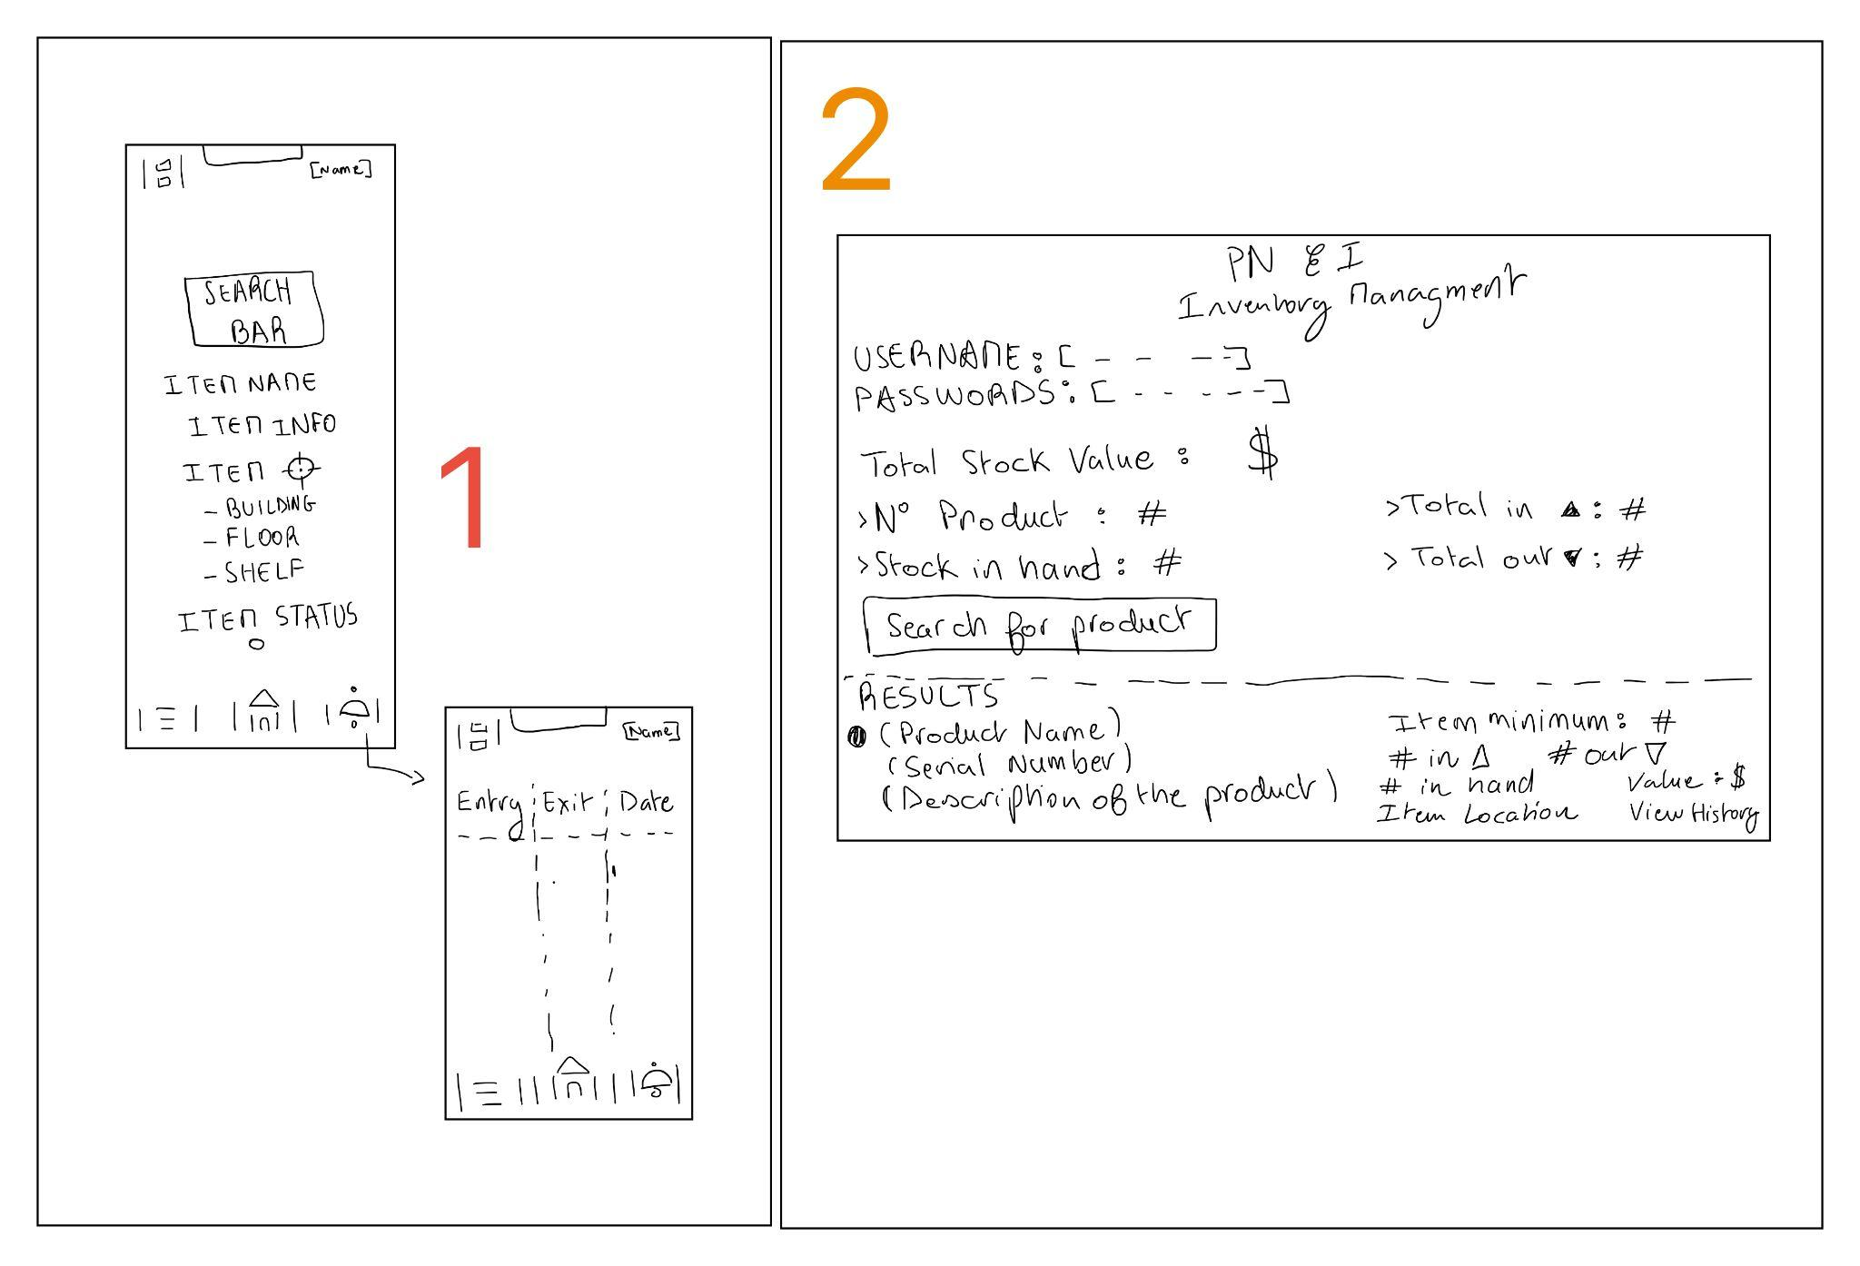
Sub-system 2 : Mobile app interface and features
4
3
5
[4]
EMPATHY AND DEFINITION
CONCEPTUALIZATION
PROTOTYPING AND TESTING

Slide 15
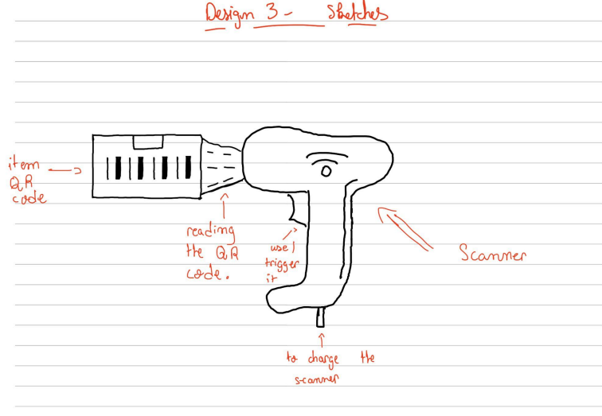
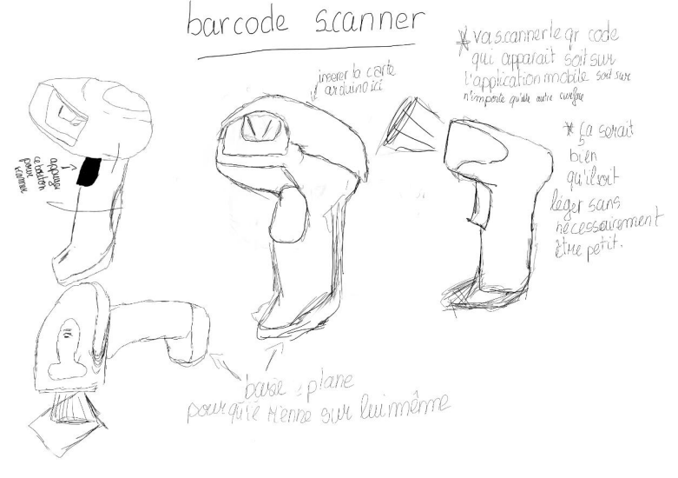
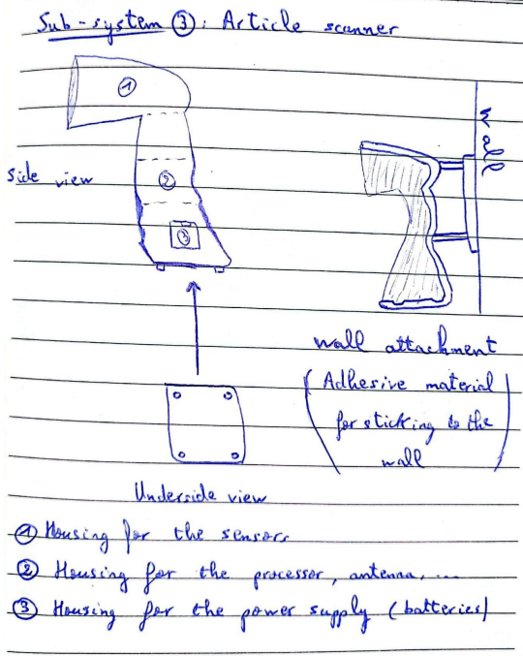
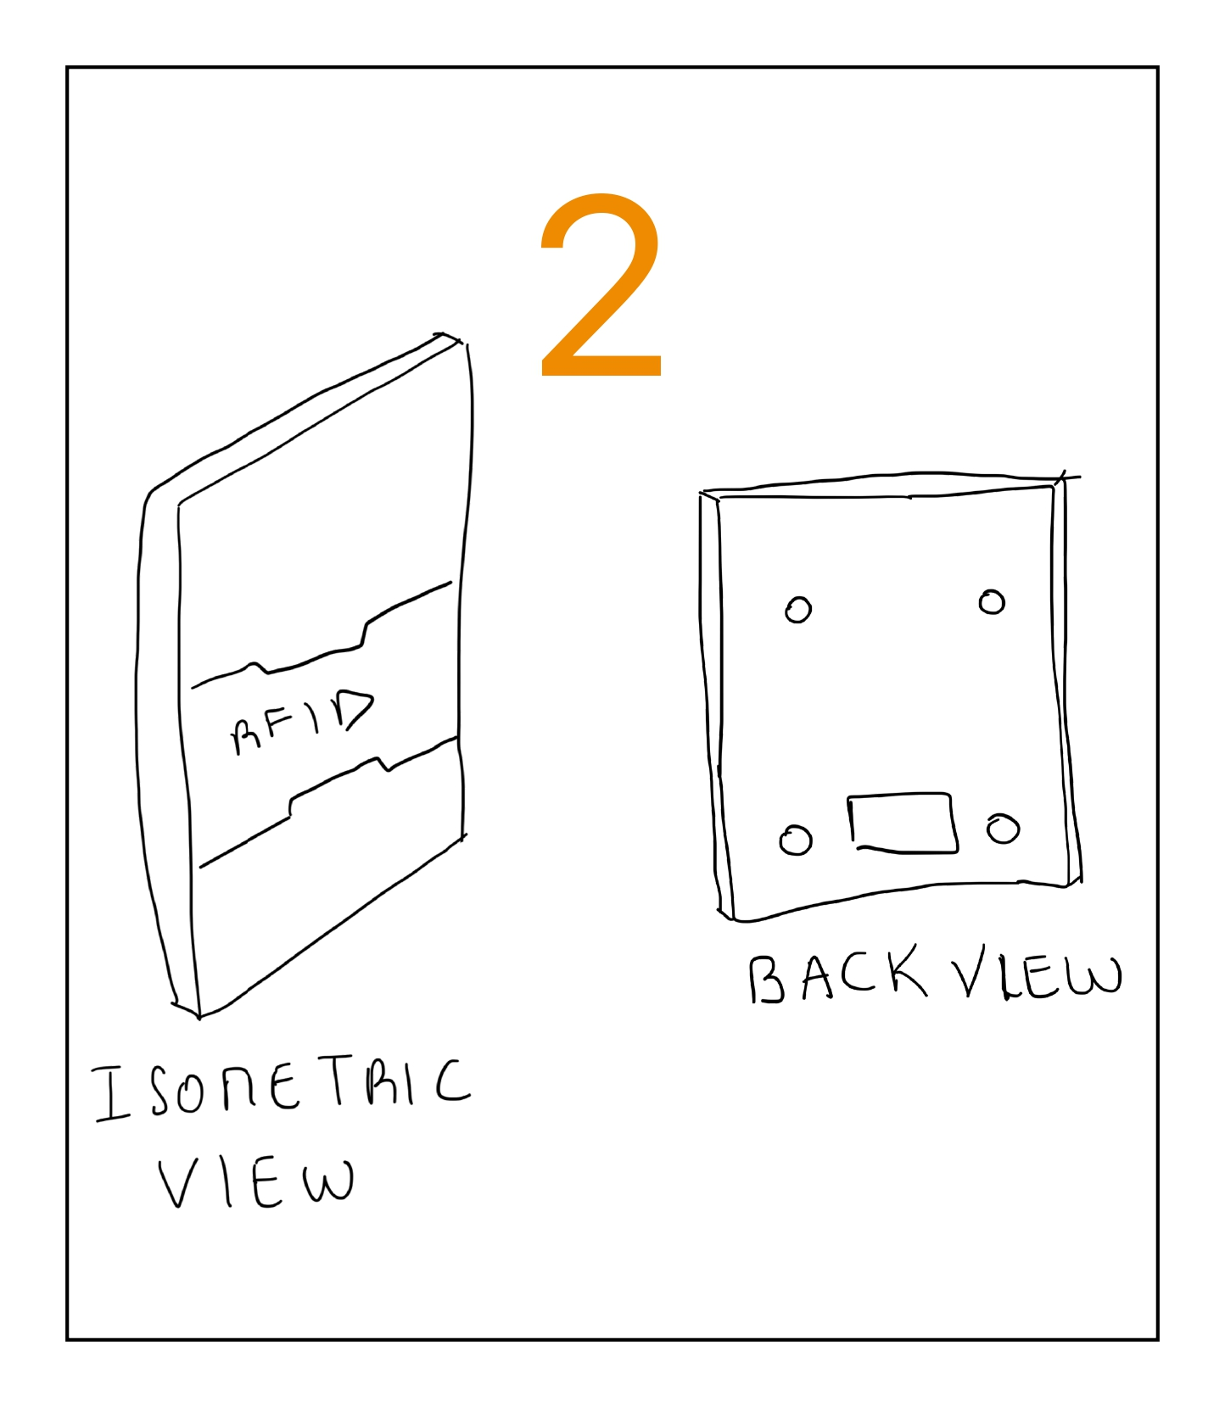
Sub-system 3 : Scanner design
1
5
4
3
[4]
EMPATHY AND DEFINITION
CONCEPTUALIZATION
PROTOTYPING AND TESTING

Slide 16
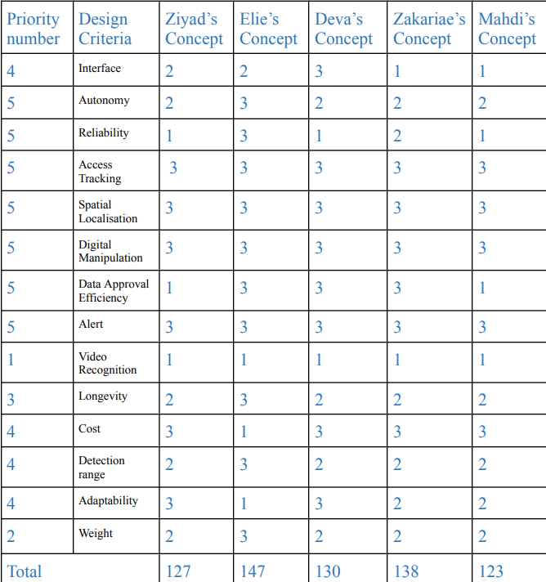
Decision Matrix
1
2
3
5
4
5
Higher priority
1
[4]
EMPATHY AND DEFINITION
CONCEPTUALIZATION
PROTOTYPING AND TESTING

Slide 17
Conceptualization II :
Final Solution

Slide 18
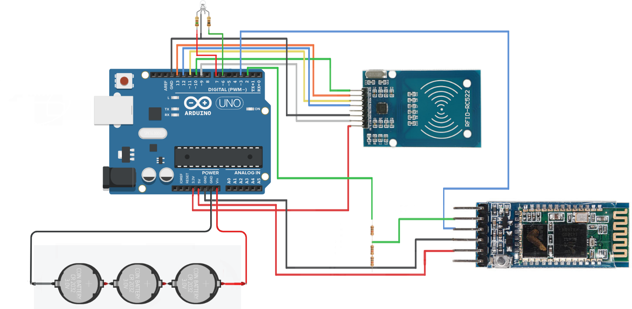
Final Solution : Electrical Layout
Four main components:
Arduino UNO for a microcontroller and main processing unit.
RFID RC522 reader for detecting RFID tags. (5cm range)
HC-05 Bluetooth module for transmitting data directly to the nearest relay. (30m range, allows for portability and more work flexibility)
9V Lithium battery power supply.
LED light:
Green for successful scan
Red for failed scan
Final circuit
[7]
EMPATHY AND DEFINITION
CONCEPTUALIZATION
PROTOTYPING AND TESTING

Slide 19
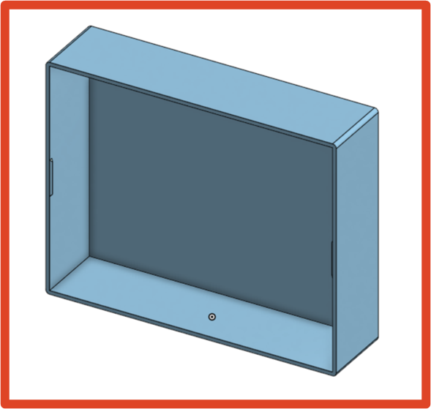
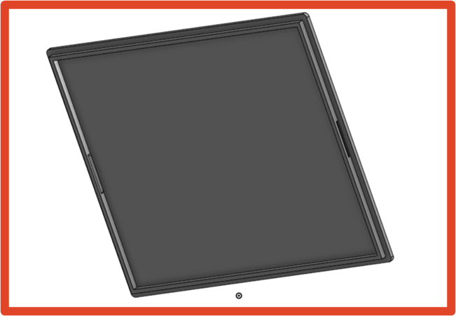
Final Solution : Electronics Casing
3D printed box, serves as a container and fixture for all of the electrical components.
Easily but firmly closed using a simple lid design.
Small and easy to handle (12 cm x 8 cm x 3 cm)
Made out of strong yet light PLA.
Case overview
Cover overview
[7]
EMPATHY AND DEFINITION
CONCEPTUALIZATION
PROTOTYPING AND TESTING

Slide 20
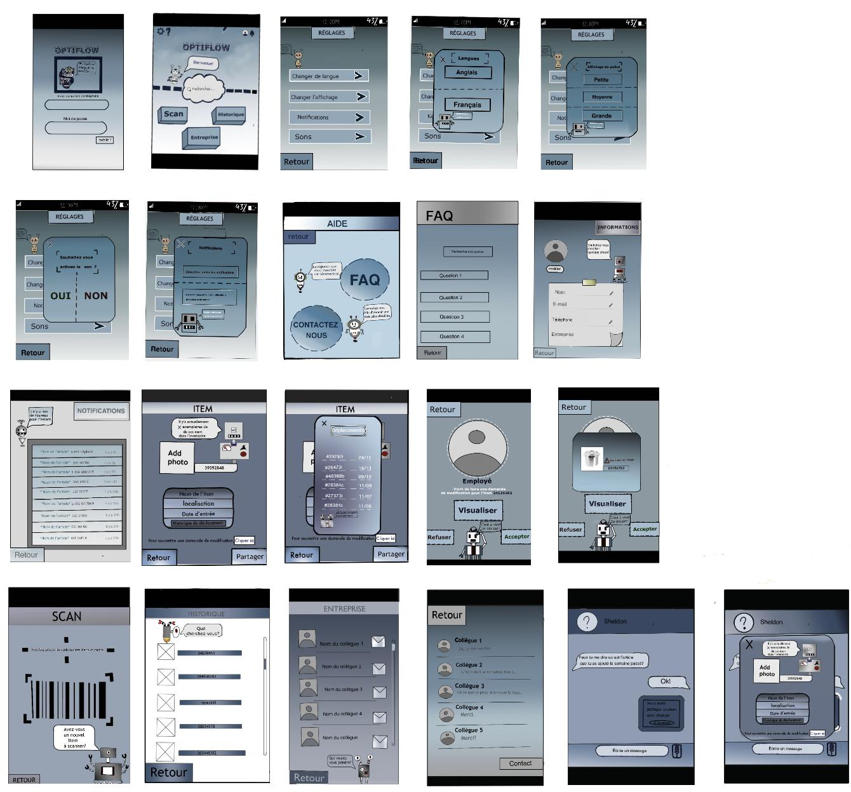
Final Solution : Mobile App
Notifications system.
Secure account and profile-oriented design.
User-oriented approach, focused on providing as many learning resources as possible.
“Insta-Scan” capability.
Turns your mobile phone into a portable relay for the RFID data through Bluetooth connectivity. (Acts as a Cloud-RFID reader intermedium)
Provides quick workplace communications as an additional feature, while prioritizing professionalism.
Allows instant access to inventory logs, inventory contents, statistics and entry/exit times and dates.
Wireframe Design
[7]
EMPATHY AND DEFINITION
CONCEPTUALIZATION
PROTOTYPING AND TESTING

Slide 21
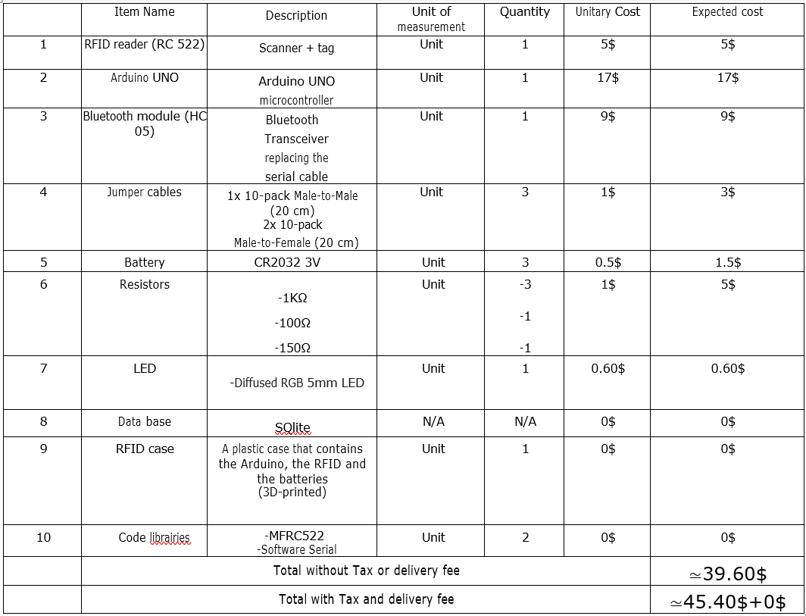
List of material and total cost
[5]
EMPATHY AND DEFINITION
CONCEPTUALIZATION
PROTOTYPING AND TESTING

Slide 22
Prototyping and testing

Slide 23
Iterative prototyping and testing process
Prototype 1 (Partially comprehensive, hardware only)
Prototype 2 (Partially comprehensive, hybrid)
Refining and overcoming initial design flaws through trial and error
Proof of concept
Prototype 3 (Complete, hybrid)
Display full functionality, verify compatibility and proper communication between all sub-systems
[6]
EMPATHY AND DEFINITION
CONCEPTUALIZATION
PROTOTYPING AND TESTING

Slide 24
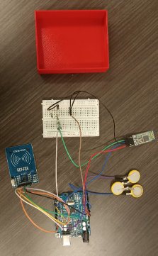
Prototype 1
Consisted of:
3D printed 10*8*2.5 cm³ PLA casing
Arduino UNO R3 (Clone)
16x jumper cables
RC522 RFID Reader
HC-05 Bluetooth module
2x Resistors (1kΩ and 2kΩ)
3x CR2032 Lithium-ion batteries
Breadboard
[6]
EMPATHY AND DEFINITION
CONCEPTUALIZATION
PROTOTYPING AND TESTING

Slide 25
Prototype 1
Tests | Results
PLA permeability of radio waves emitted by the RFID reader (critical functionality). | The PLA material was determined to be very permeable; No effect on tag detection range when casing is placed between it and the RFID reader.
RFID reading and detection range, reading speed. | -Average reading and detection range: ~3.5 cm -Average reading speed: ~1.5 s
[6]
EMPATHY AND DEFINITION
CONCEPTUALIZATION
PROTOTYPING AND TESTING

Slide 26
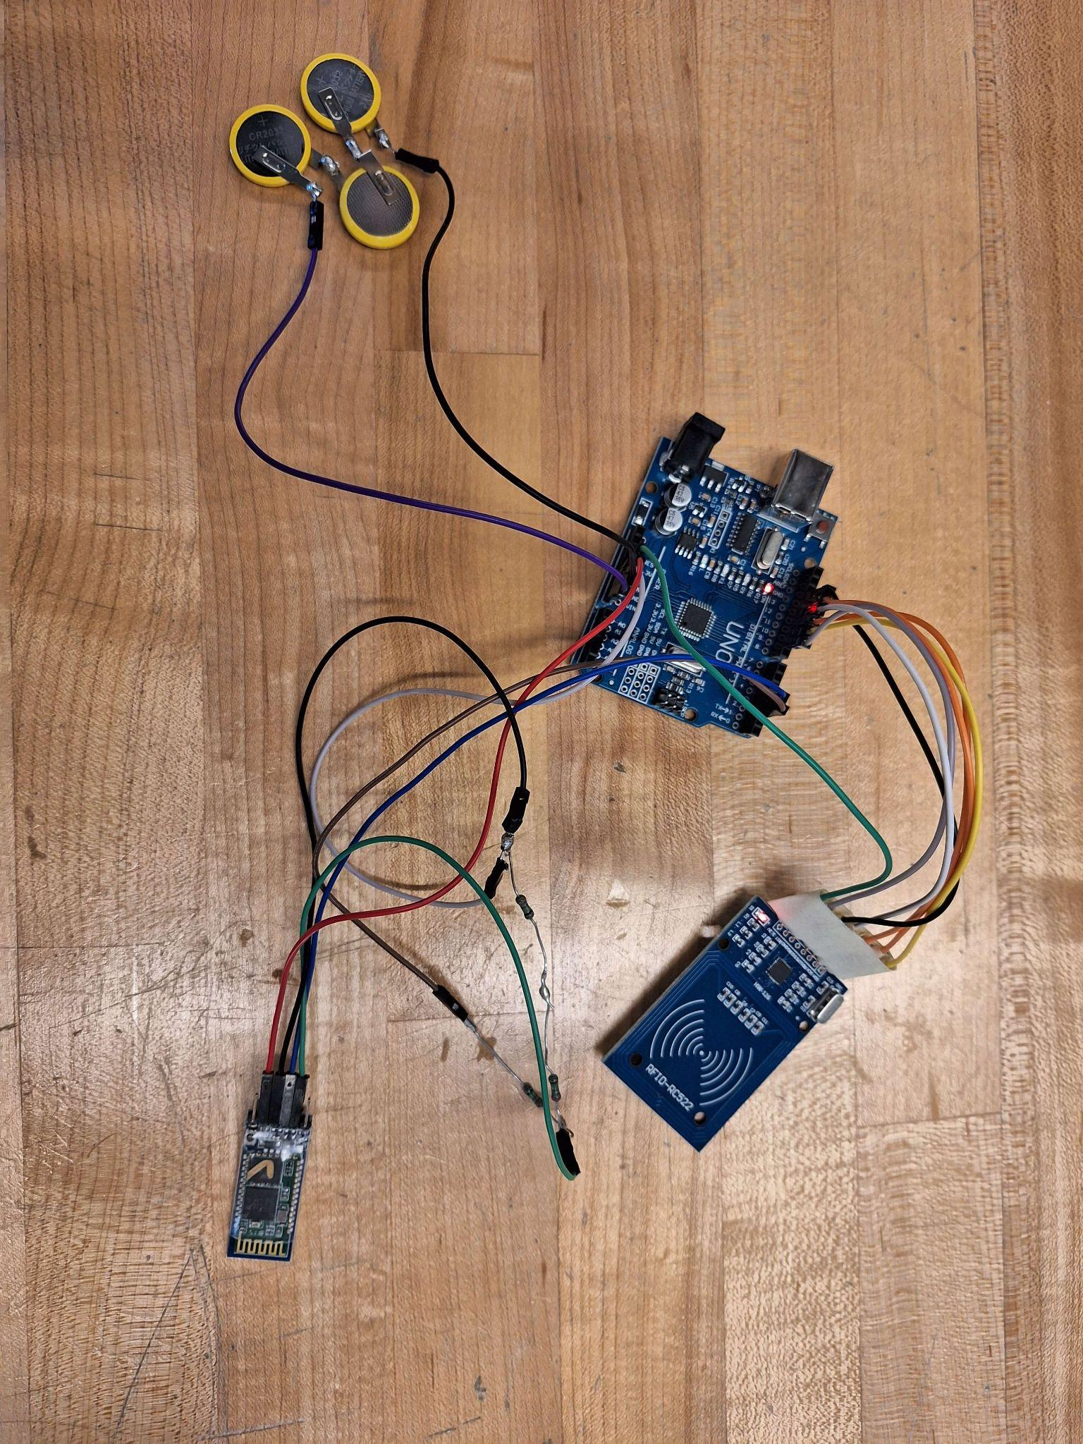
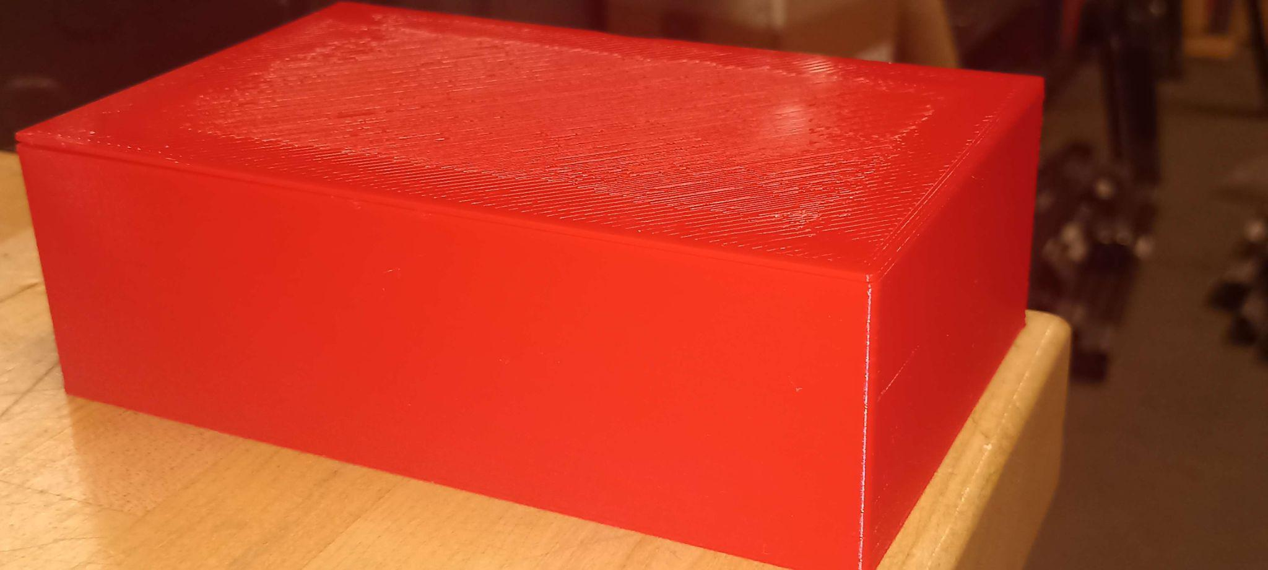
Prototype 2
Consisted of:
3D printed 16*10*5 cm³ PLA casing
Arduino UNO R3 (Clone)
16x jumper cables
RC522 RFID Reader
HC-05 Bluetooth module
3x Resistors (1kΩ)
3x CR2032 Lithium-ion batteries
What’s new?
Breadboard was ditched (space economy)
Larger casing
[7]
EMPATHY AND DEFINITION
CONCEPTUALIZATION
PROTOTYPING AND TESTING

Slide 27
Prototype 2
Tests | Results
Bluetooth module range and connection reliability. | The HC-05 module was projected to have a range of around ~30 m, which was determined to be advantageous for a small-to-medium depot/warehouse. -Actual range determined: ~18m
Arduino code operability. | RFID tag/card contents successfully transmitted to the nearest Bluetooth hotspot.
Battery life. | While the batteries functioned nominally for the first prototype, we later discovered that Lithium ion coin battery cells suffer from significant self-discharge. -Time until completely non-functional if not stored properly: <3 days
[7]
EMPATHY AND DEFINITION
CONCEPTUALIZATION
PROTOTYPING AND TESTING

Slide 28
Conclusion : Lessons Learned
Importance of team coordination.
Importance of RFID and Automated inventory systems in companies and businesses.
Always consider the metrics to use during digital modeling.
Internal conflicts within a team should not be avoided but confronted.
Analysis is a major part of prototyping.
From the problems encountered regarding the power supply issues, and the mobile app development environment, we’ve learned that it is best to start with the most complex systems first, in order to guarantee time availability.

Slide 29
What’s next?

Slide 30
Conclusion: Gantt Diagram
 |  | SEPTEMBER |  |  |  | OCTOBER |  |  |  | NOVEMBER |  |  |  | DECEMBER
# | Tasks | W1 | W2 | W3 | W4 | W1 | W2 | W3 | W4 | W1 | W2 | W3 | W4 | W1 | W2 | W3 | W4
1 | Team and project contract
2 | Client requirements and problem statement
3 | Design criteria |  |  |  |  |  |  |  |  |  | You are here!
4 | Design ideas, analysis, planning
5 | Prototype 1, testing
6 | Prototype 2, testing
7 | Prototype 3, testing
8 | Design day materials
9 | User manual
10 | Project closure

Slide 31
Conclusion : Prototype 3
Verifying, as well enhancing, app interface user-friendliness through testing, relying on feedback from selected test-users.
3D printing a new electronics compartment design.
Developing code to link the app interface with the Arduino via the HC-05 Bluetooth module.
Increasing longevity by finding a more efficient power supply, without sacrificing the portability and adaptability of the device, and overall system in general.

Slide 32
Thank you for your Attention!
Special thanks to Deva Brou and Ziyad Belmkaddem for their extra effort on the logo

Slide 33
References
[1] https://softwarepath.com/guides/inventory-management-statistics
[2] Deliverable B
[3] Deliverable C
[4] Deliverable D
[5] Deliverable E
[6] Deliverable F
[7] Deliverable G

