Slide 1
SuperSpeak C13
Kian Mozafarian
Zainab Badawi
Tia El Masry

Slide 2
Problem
More than 440,000 Canadians suffer from speech disabilities
The dependency on caregivers is highly increased completing simple daily tasks
Over 1 million Canadians with dexterity disability have an unmet needs for everyday activities
Notes:
Increasing aging population have depend on caregivers to complete simple daily tasks

Slide 3
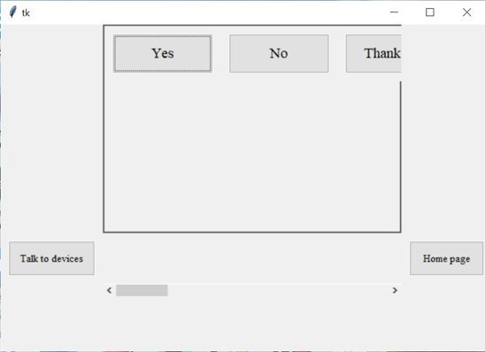
Our Solution
User Interface home screen
Talk to people selection page

Slide 4
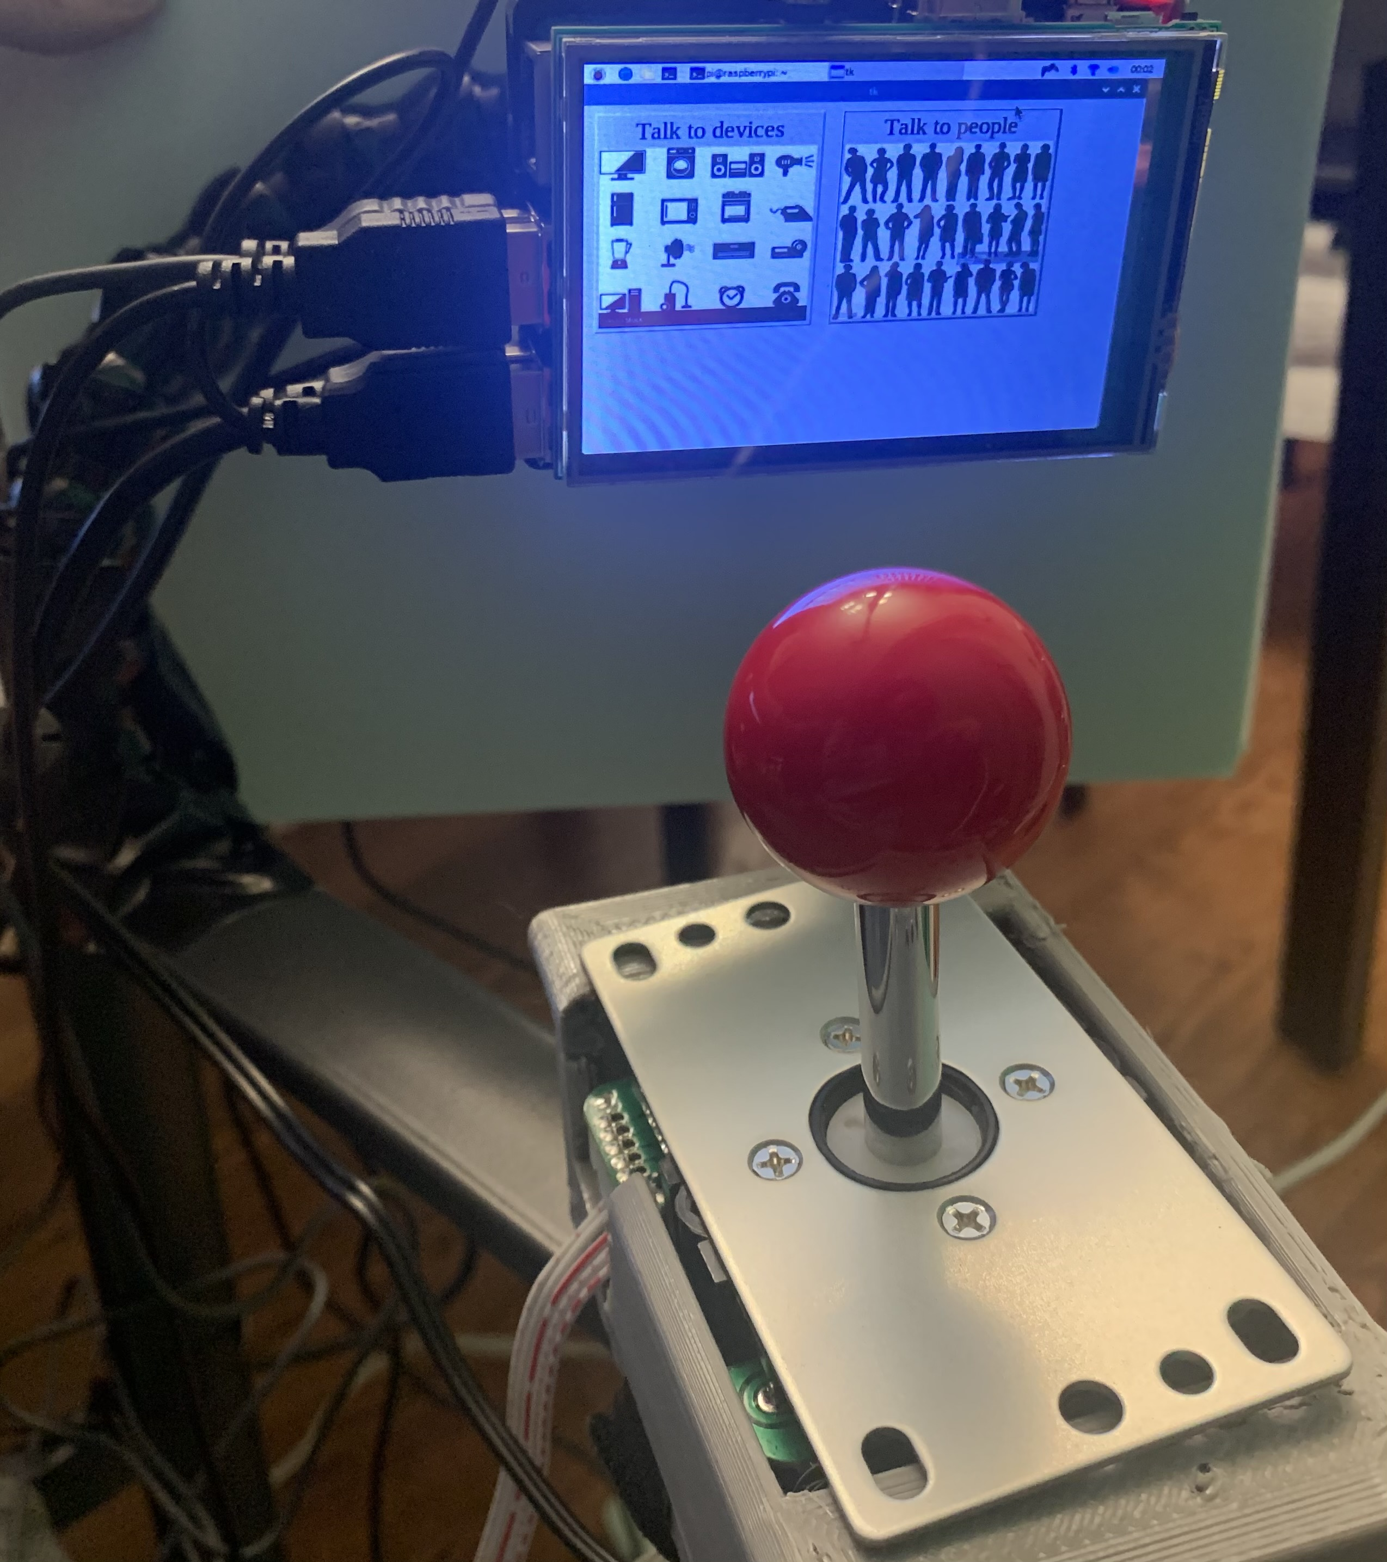
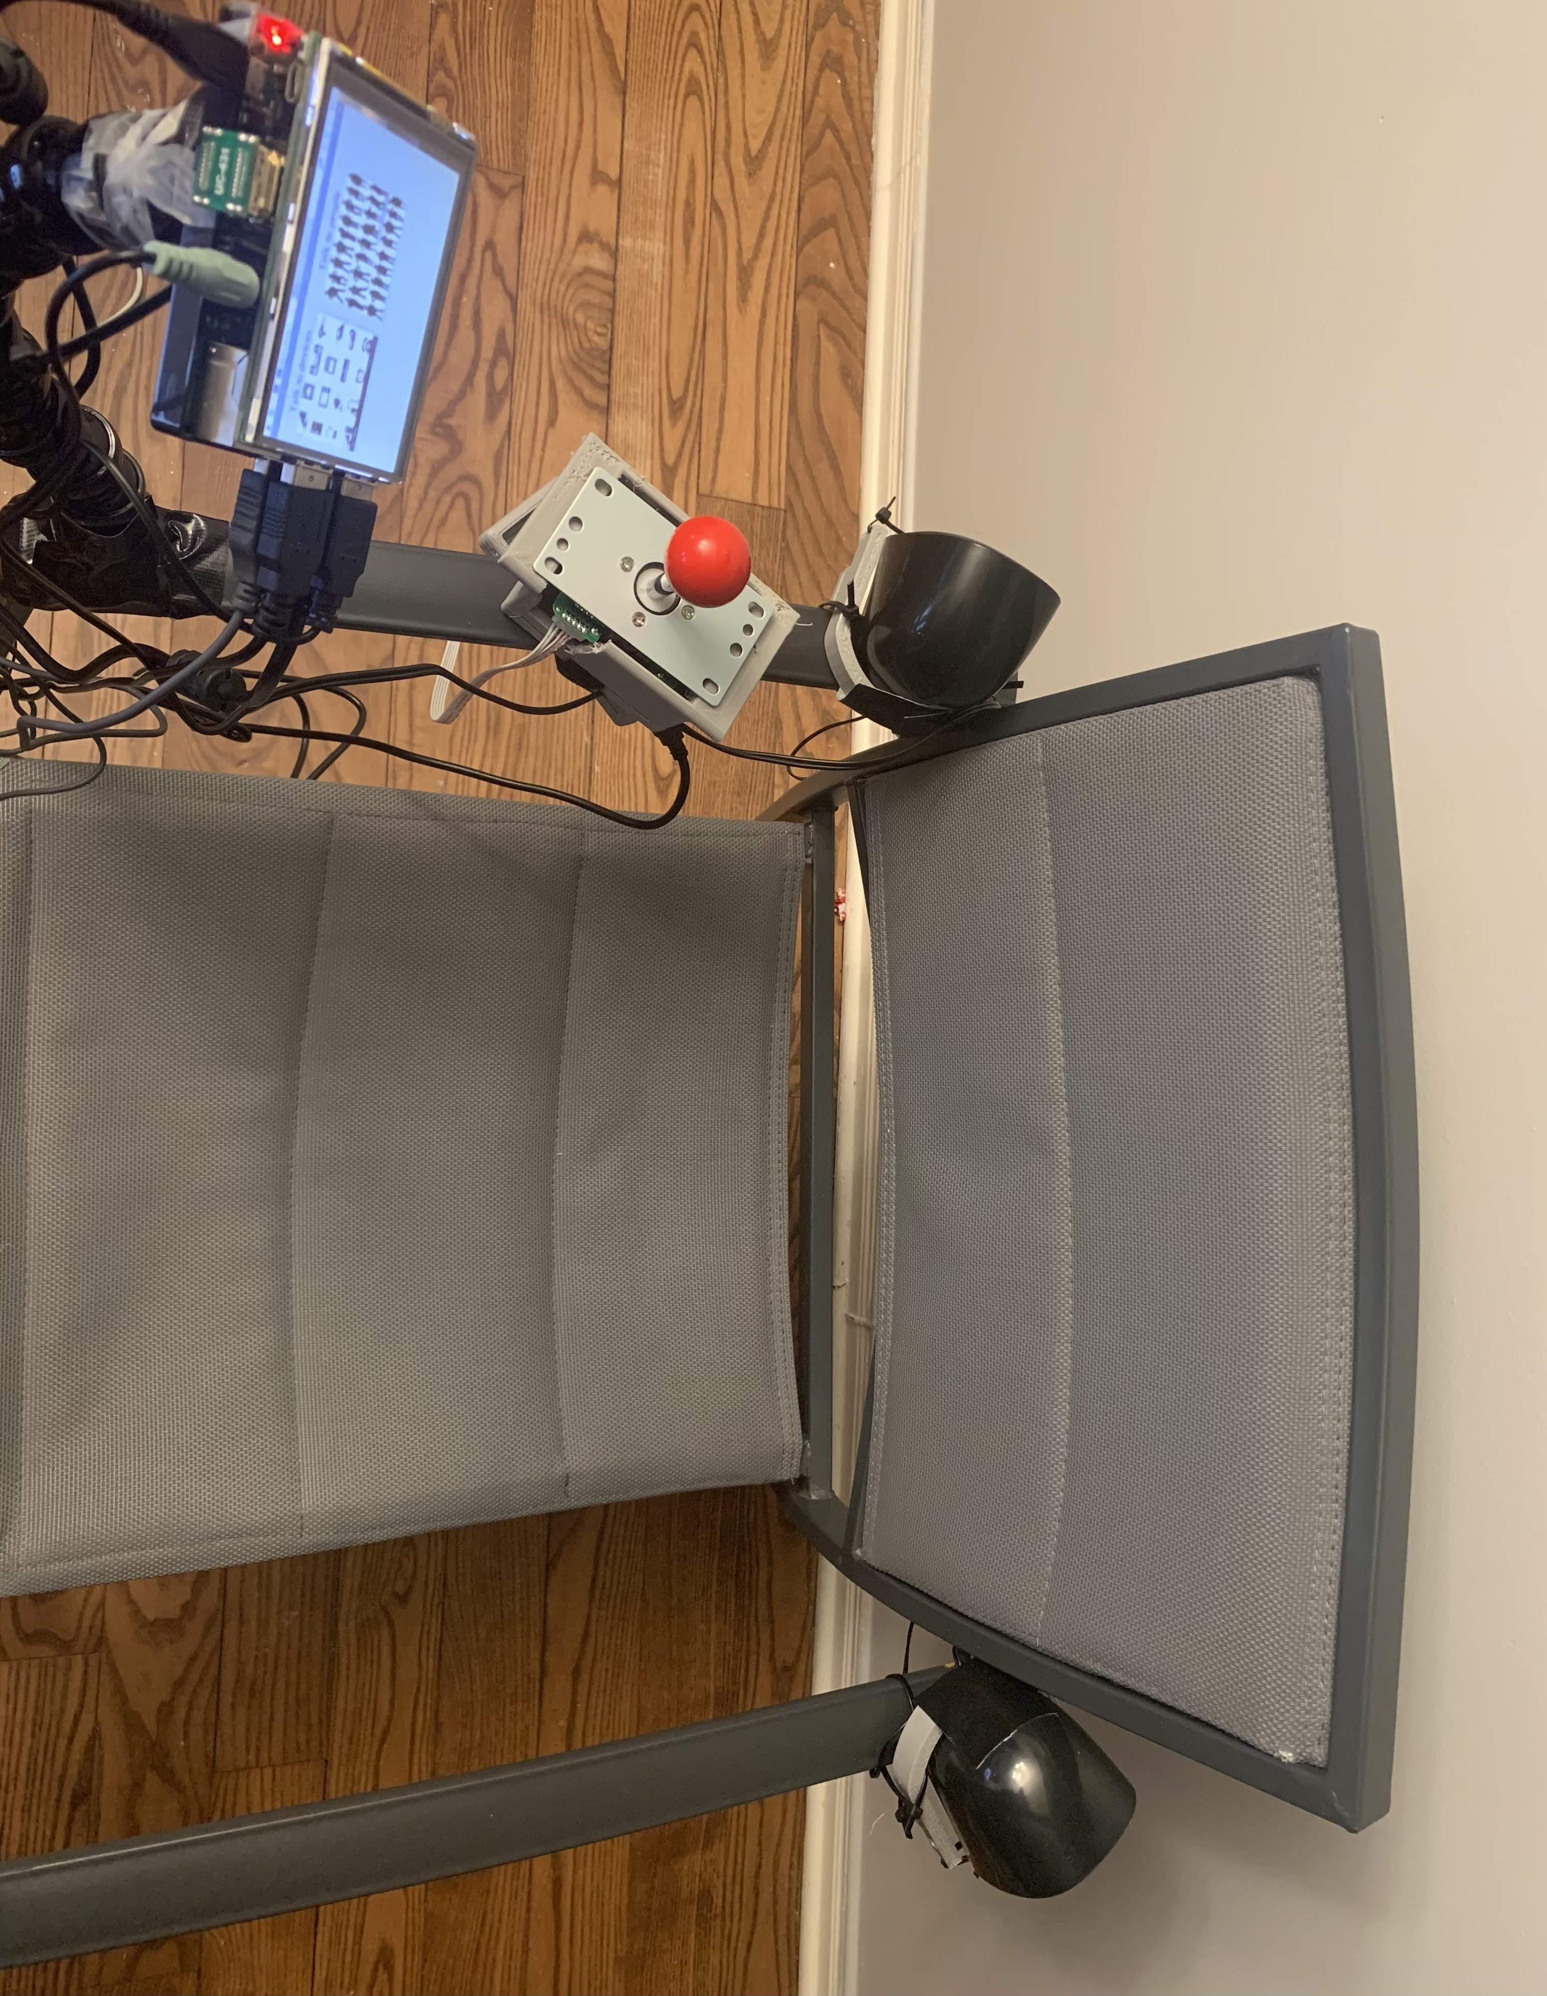
Our Solution
Joystick & Interface
Caregiver Interface
Mount

Slide 5
Webpage access from any device to update the device
Display of icons and phrases
Communication with smart devices
Features

Slide 6
Prototype
http://zainabbadawy.com/index.php
A life demostration was placed on top of this slide duing the presentation using OBS studio

Slide 7
Future Development
Integration with multiple languages and accents
Adding a security wall and a login page to the caregiver interface
Tuning the device to be recognized by multiple devices
Improving the looks of the caregiver page

