Slide 1
Design Day Team Chem Eng
Colby Driscoll, Ty Kaloczi, Sam Batu, Kris Gandhi
March 31st , 2022.

Slide 2
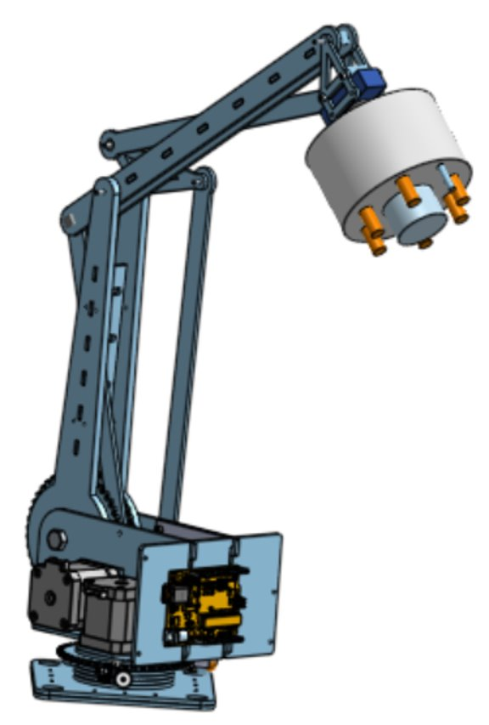
Problem Statement
“Provide a creative inverse kinematics program to safely pilot a 3 DOF robotic arm that works cohesively with multiple end-effectors. we will design an end effector which can effectively carry out the scanning of surfaces that are to be painted, all of which being operated by a single low-skilled crewmember through a simple user interface."

Slide 3
User Requirements
Needs ​ | Priority Level​ (1 Lowest, 5Highest) ​
Maneuver complicated spaces ​ | 5 ​
End effectors must be easily removed and attached ​ | 3 ​
Easily piloted and simple interface ​ | 5 ​
Weigh less than 20 lbs. or broken down into pieces less than 20 lbs. That are easy to carry. ​ | 4 ​
Scan working area and compute the path and approach needed ​ | 4 ​
Self-contained lighting on the camera end effector ​ | 3 ​
Safe to be around ​ | 4 ​
Piloted by one operator (Assume operator has no technological training) ​ | 4 ​
Operate in an autonomous state once a task is set by the operator ​ | 3 ​

Slide 4
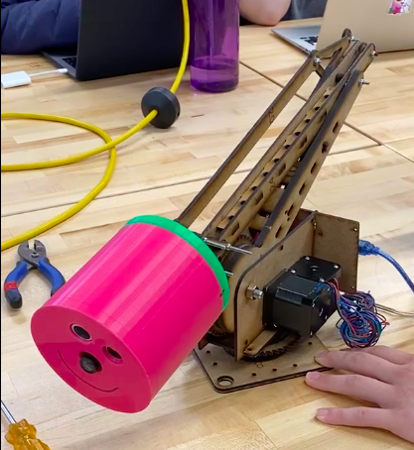
Light and Camera End-Effector
Consists of camera, LED's and ultrasonic sensor

Slide 5
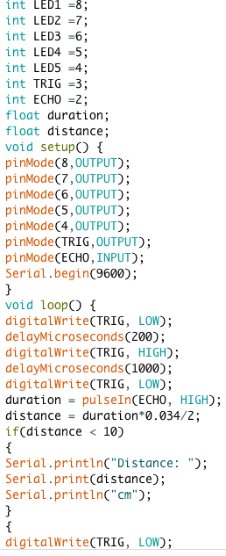
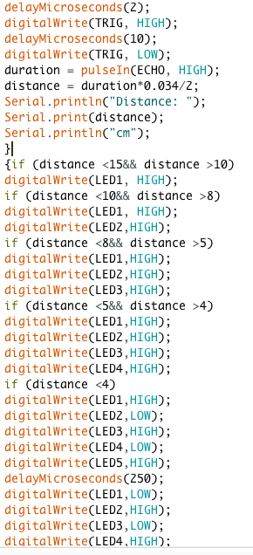
Light and Camera End-Effector

Slide 6
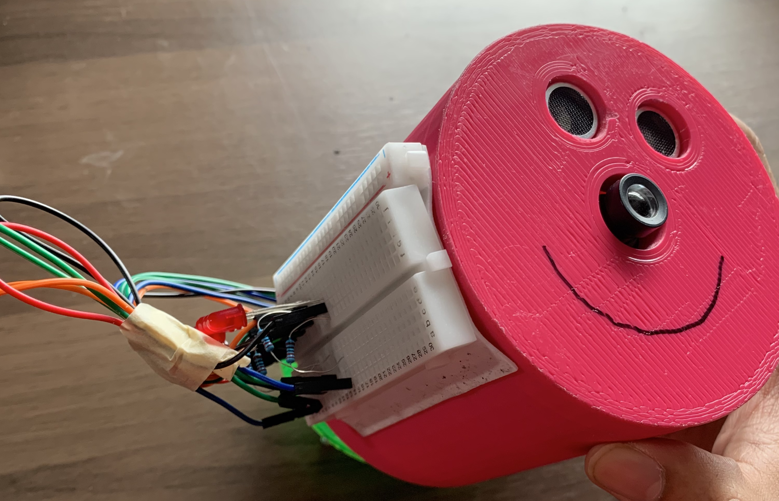
Safety

Slide 7
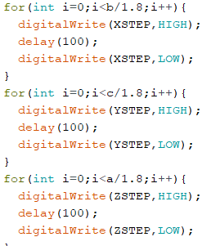
Inverse Kinematics

Slide 8
Arm Functioning

Slide 9
UI

Slide 10
Thank you For Listening

