Slide 1
PBATS
Maria van Scherrenburg
Nwike Cosiagwu
Vlad Romanenko
Isaac Mitchell
Brain Paltin

Slide 2
A need exists for a system that can track and analyze the kinematic properties of a Padel ball for athletes to improve their performance. This solution must use cameras to track the ball into a 3D environment.

Slide 3
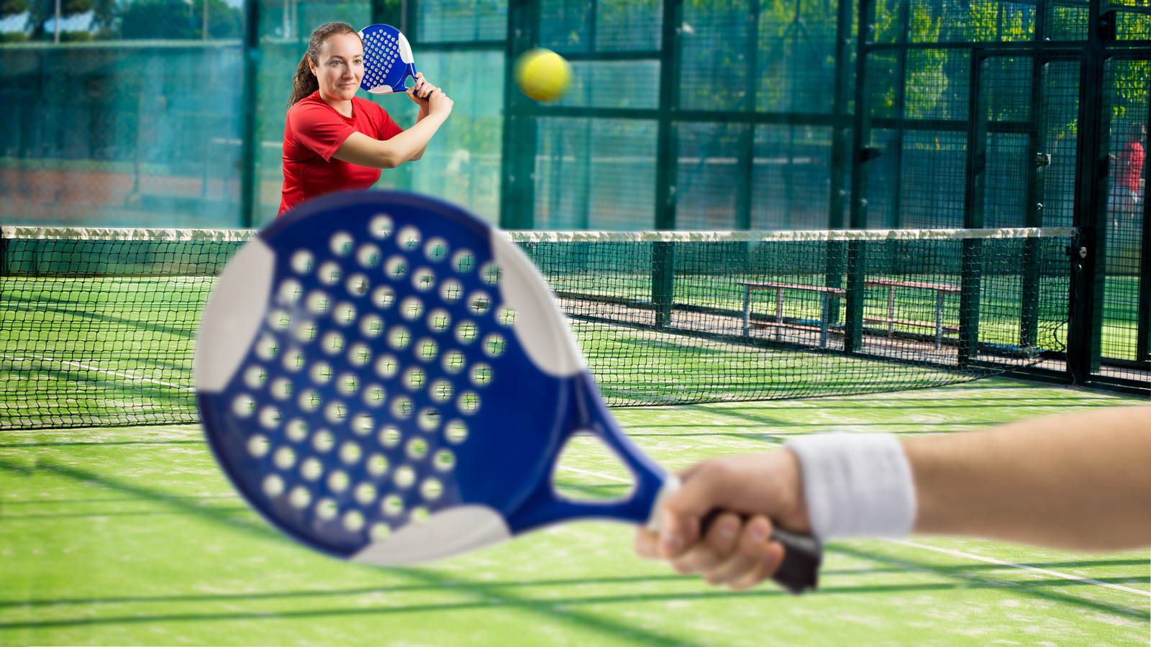
Padel Ball

Slide 4
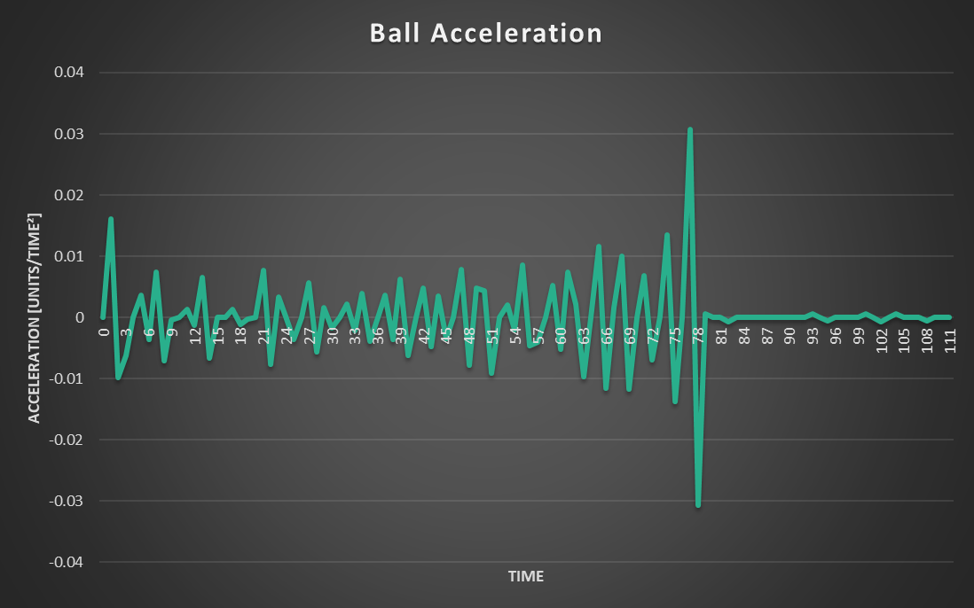
Analysis

Slide 5
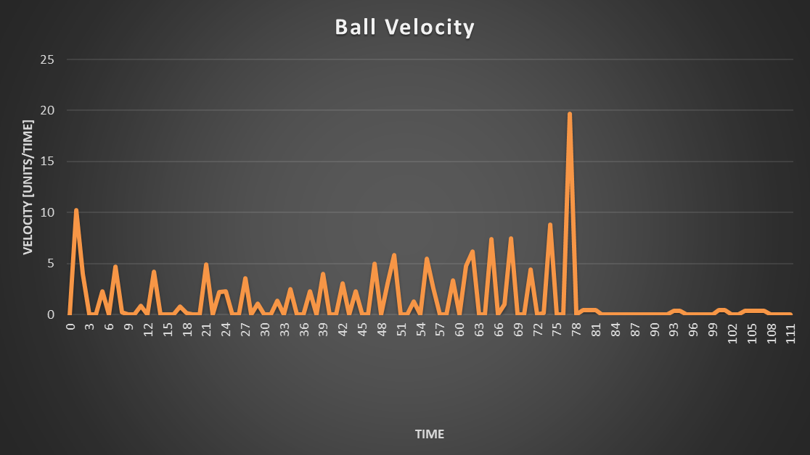
Analysis

Slide 6
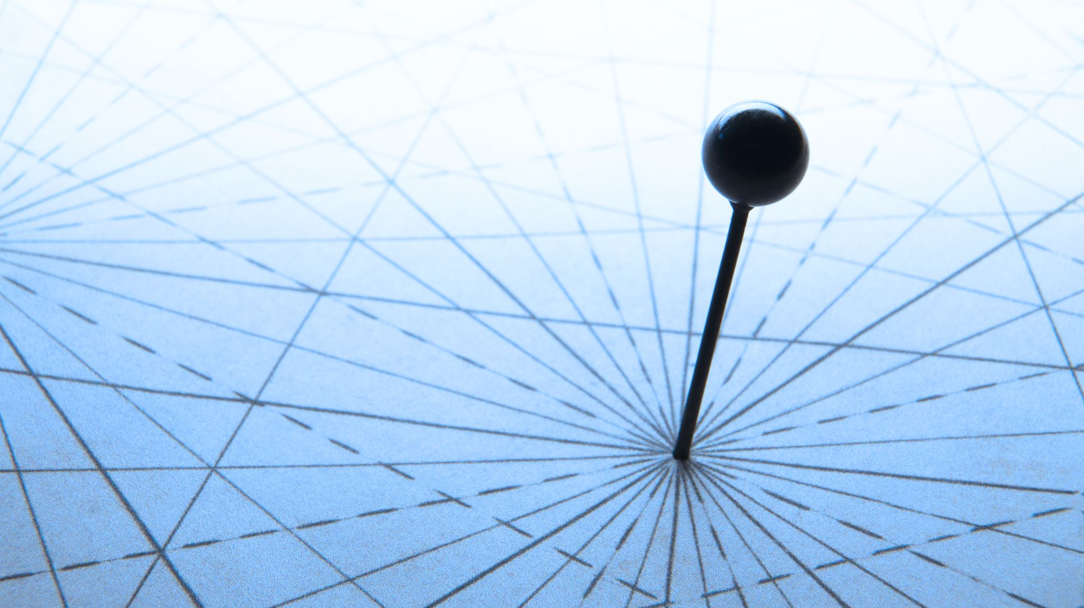
Tracking

Slide 10
System

Slide 11
Questions?

