Slide 1
Group 7 (Hydroponics) The High Rollers Final presentation – GNG1103
By: Alec Fraser, Cyrille Zakaria, Jacob Olaveson, Khalid Al-Satari, Matas Minkstimas, Nicole Milman
Cyrille

Slide 2
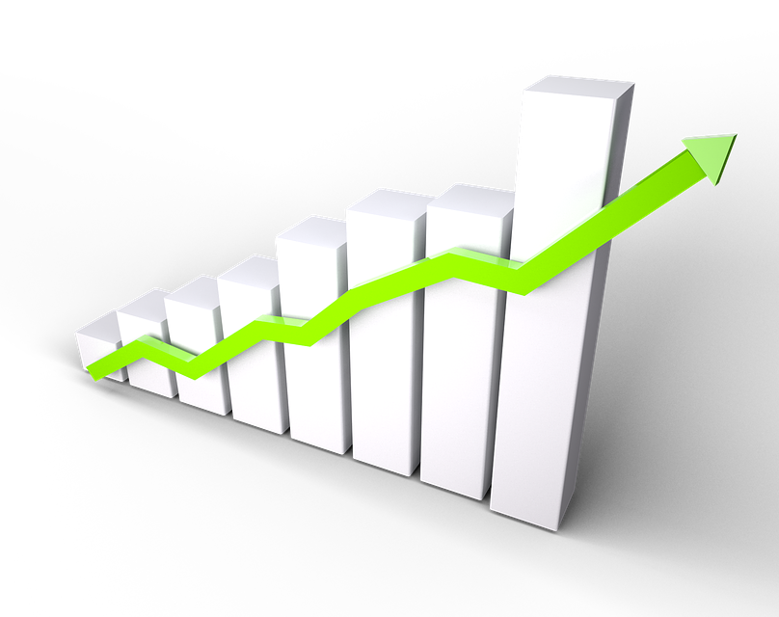
Contents
Team Building
Design process
Client feedback
Prototyping
Final product
Conclusion
Cyrille

Slide 3
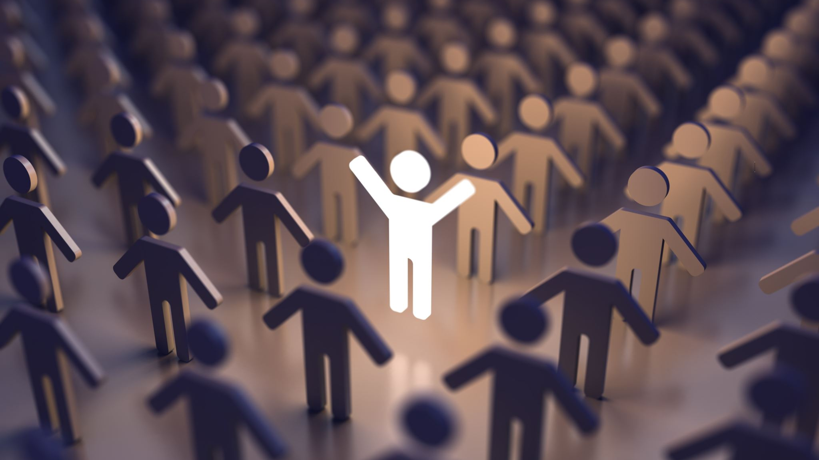
Team building
Alec
Notes:
So, to get us started I figured we'd touch on how much we've grown as a team throughout the process.

Slide 4
Getting to know each other…
Lab times, calls for deliverables
Prototyping and "constructing"
Constructive criticism
Feedback
Efficient and productive work together
Alec
Notes:
At first, just like most of the other teams I assume, we were all strangers to each other. However, throughout the lab time and the long discord calls for the deliverables, we were able to create a strong enough bond with each other that when it came time to get going, and construct we were able to do it productively and cooperate efficiently. We have a lot of positive debate, we give quite a bit of positive criticism and feedback to each other when we can.

Slide 5
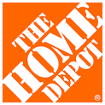
Our struggles along the way
Continuous changes to the budget
Home depot hopping
Finding time to work on the project together
Alec
Notes:
Firstly, continuous changes to the budget significantly delayed us. For starters, we first realized we had to make a cut of around 400$ to our original budget. Then, once we reached a budget of around that goal, we realized more parts were needed and some were not. This delayed us since we then had to return items, and buy new ones, or wait for them to arrive.
We went and bought the parts at home depot ourselves, but they seemed to have a shortage in anything we needed so we ended up visiting quite a few before having everything we needed for the final prototype you all will see later.
It was tough to find time to work on the project together, since some tasks require tiny bits of knowledge from everyone, and one persons absence can delay the entire process.

Slide 6
How we have improved as a team
Time management
Communication
As mentioned,
Constructive criticism
Feedback
Efficient and productive work together
Alec
Notes:
Despite these struggles, we've been able to improve significantly as a team as well. Right from the get go, we were forced to learn that this project was going to be quite time consuming, and as the deadline came closer, out time management and communication skills improved. From scheduling calls more in advance, to learning to constantly check discord throughout the day in the likely event someone has something to ask. As I previously mentioned, during our construction, I am of the opinion that we gave quite a lot of constructive criticism and feedback to each other that ultimately lead to us being efficient enough to get the job done.

Slide 7
Design process
Nicole

Slide 8
5 W’s of our project
Who are we Designing for?
The Client and the First Nations community
What are we Designing?
We are responsible for the Irrigation/Hydroponic system for the Grow wall
When are we Designing?
We have been committed to this project ever since the beginning of the semester
Where are we Designing?
We have been designing and sketching on pen and paper, virtual paper and on 3D models
Why are we Designing?
We are designing to fulfill the clients needs and to learn the engineering design process
Nicole

Slide 9
Problem Statement
Our client needs effective, low-cost and environment friendly greenhouse systems in order to produce fast-growing crops for indigenous communities in Canada.
Nicole

Slide 10
Organized User Needs
Importance of needs
Need | Importance
The greenhouse should be modular | 5
The greenhouse should be expandable | 3
The greenhouse should be rodent proof | Inuit Center: 1 (indoor) and 3 (outdoor) Madahoke Farm: 5 Private residence: 5
The greenhouse should be user friendly and kid-friendly | Inuit Center: 5 Madahoke farm: 4 Private residence: 4
The greenhouse should optimize production of earlier-mentioned crops | Inuit Center: 3 Madahoke farm: 5 Private residence: 5
The greenhouse should be easily transportable (parts fit in minivan, two person carry, easy assembly) | 3
Reliable/sustainable material (winter and wind resistance, rust etc...) | 4
Aesthetic (igloo...) | 1
Environment friendly (no fertilizers, minimal invasiveness) | 3
Low cost | 2
Nicole

Slide 11
Teamwork Diversity
3 sub-teams
Irrigation system: Nicole Milman, Matas Minkstimas, Alec Fraser
Responsible for integrating an autonomous watering system on the grow wall
Grow lights: Jacob Olaveson, Cyrille Zakaria
Responsible for providing a smart artificial lighting system for the grow wall
Pot Design: Khalid Al Satari
Responsible for a solution for the design of plants and pots on the different levels of the grow wall
Matas

Slide 12
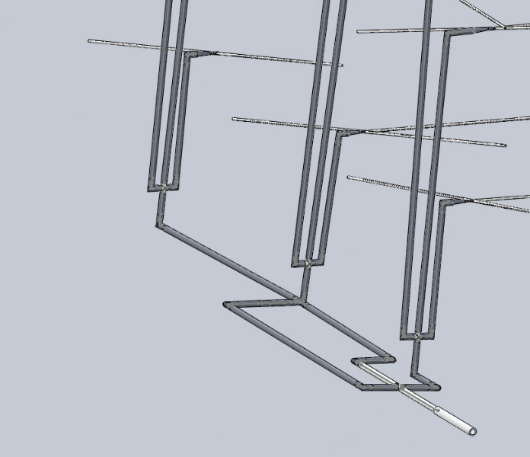
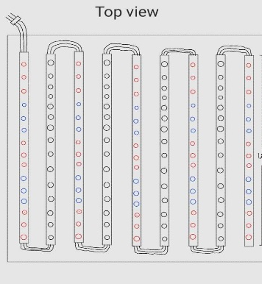
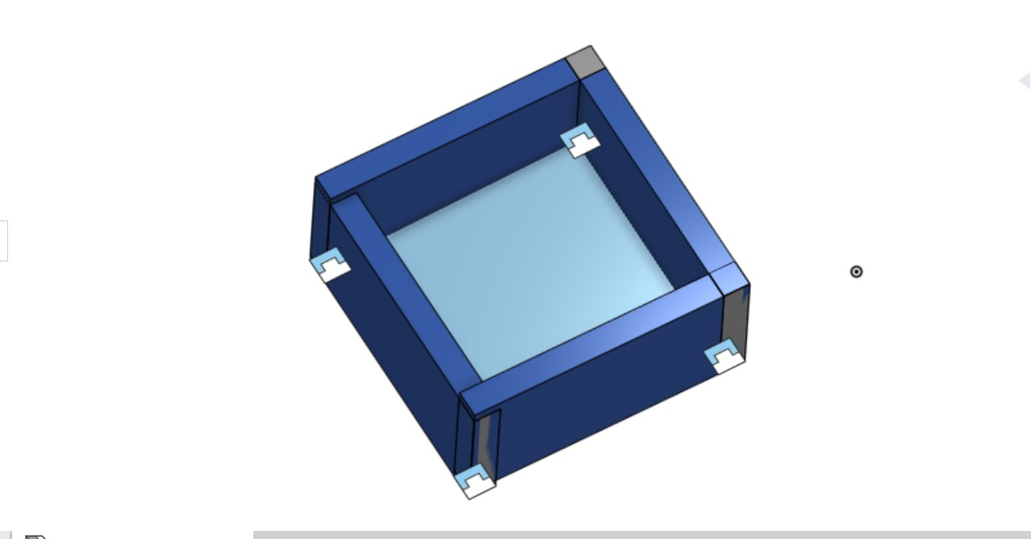
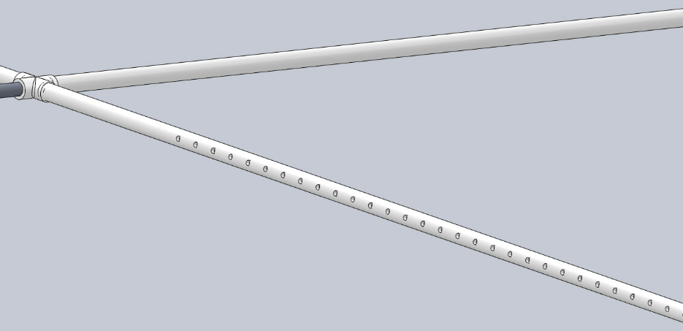
Initial brainstorming ideas
Matas

Slide 13
Client feedback
Jacob

Slide 14
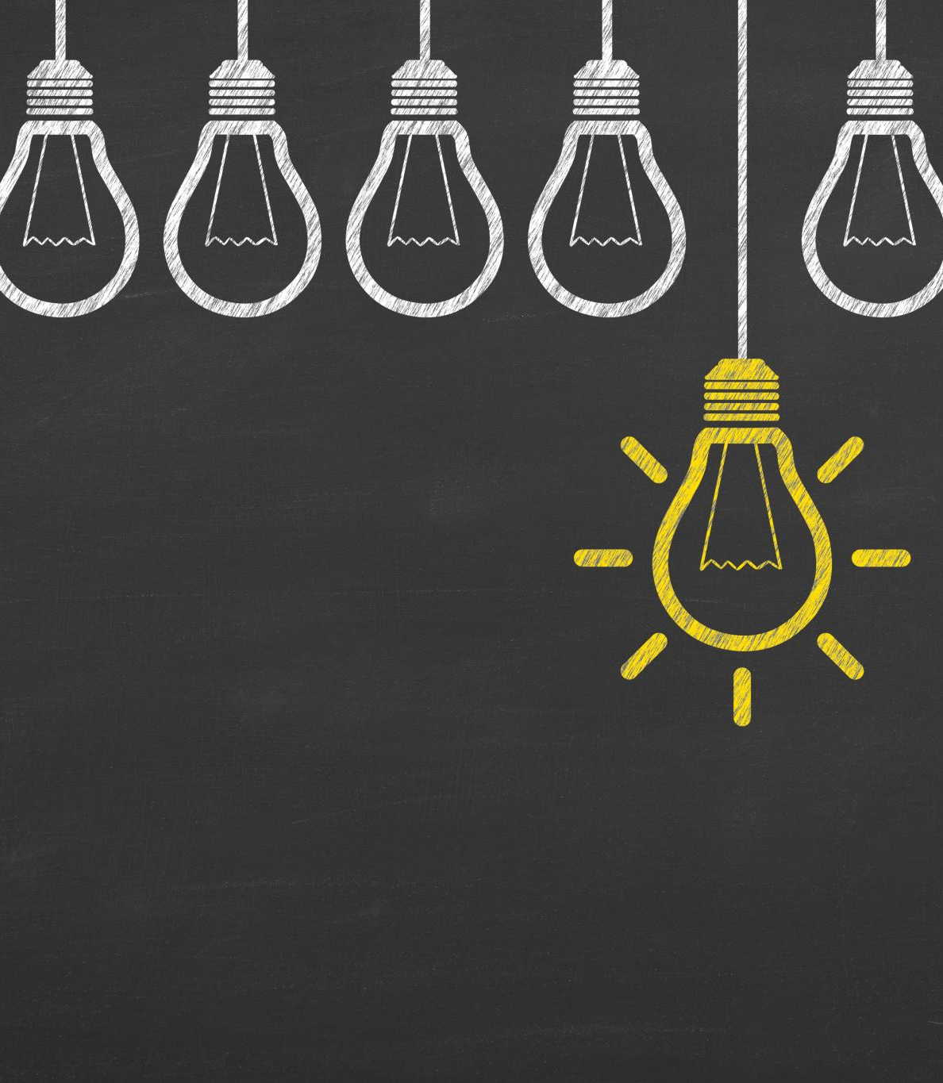
Feedback received from the client
More interaction from the students but since kids might not always be there in the summer, an automated option is also a good idea
The lighting system – LED is lower maintenance and longer lasting, she likes the idea of controlling with her phone. She might like the cycle (sunrise, sunset) idea
Prefers sections, gives the children options about what they want to grow
We would use a pump to bring water to higher elevations, no tank
No battery, weird system
12 kids in a class roughly
Jacob

Slide 15
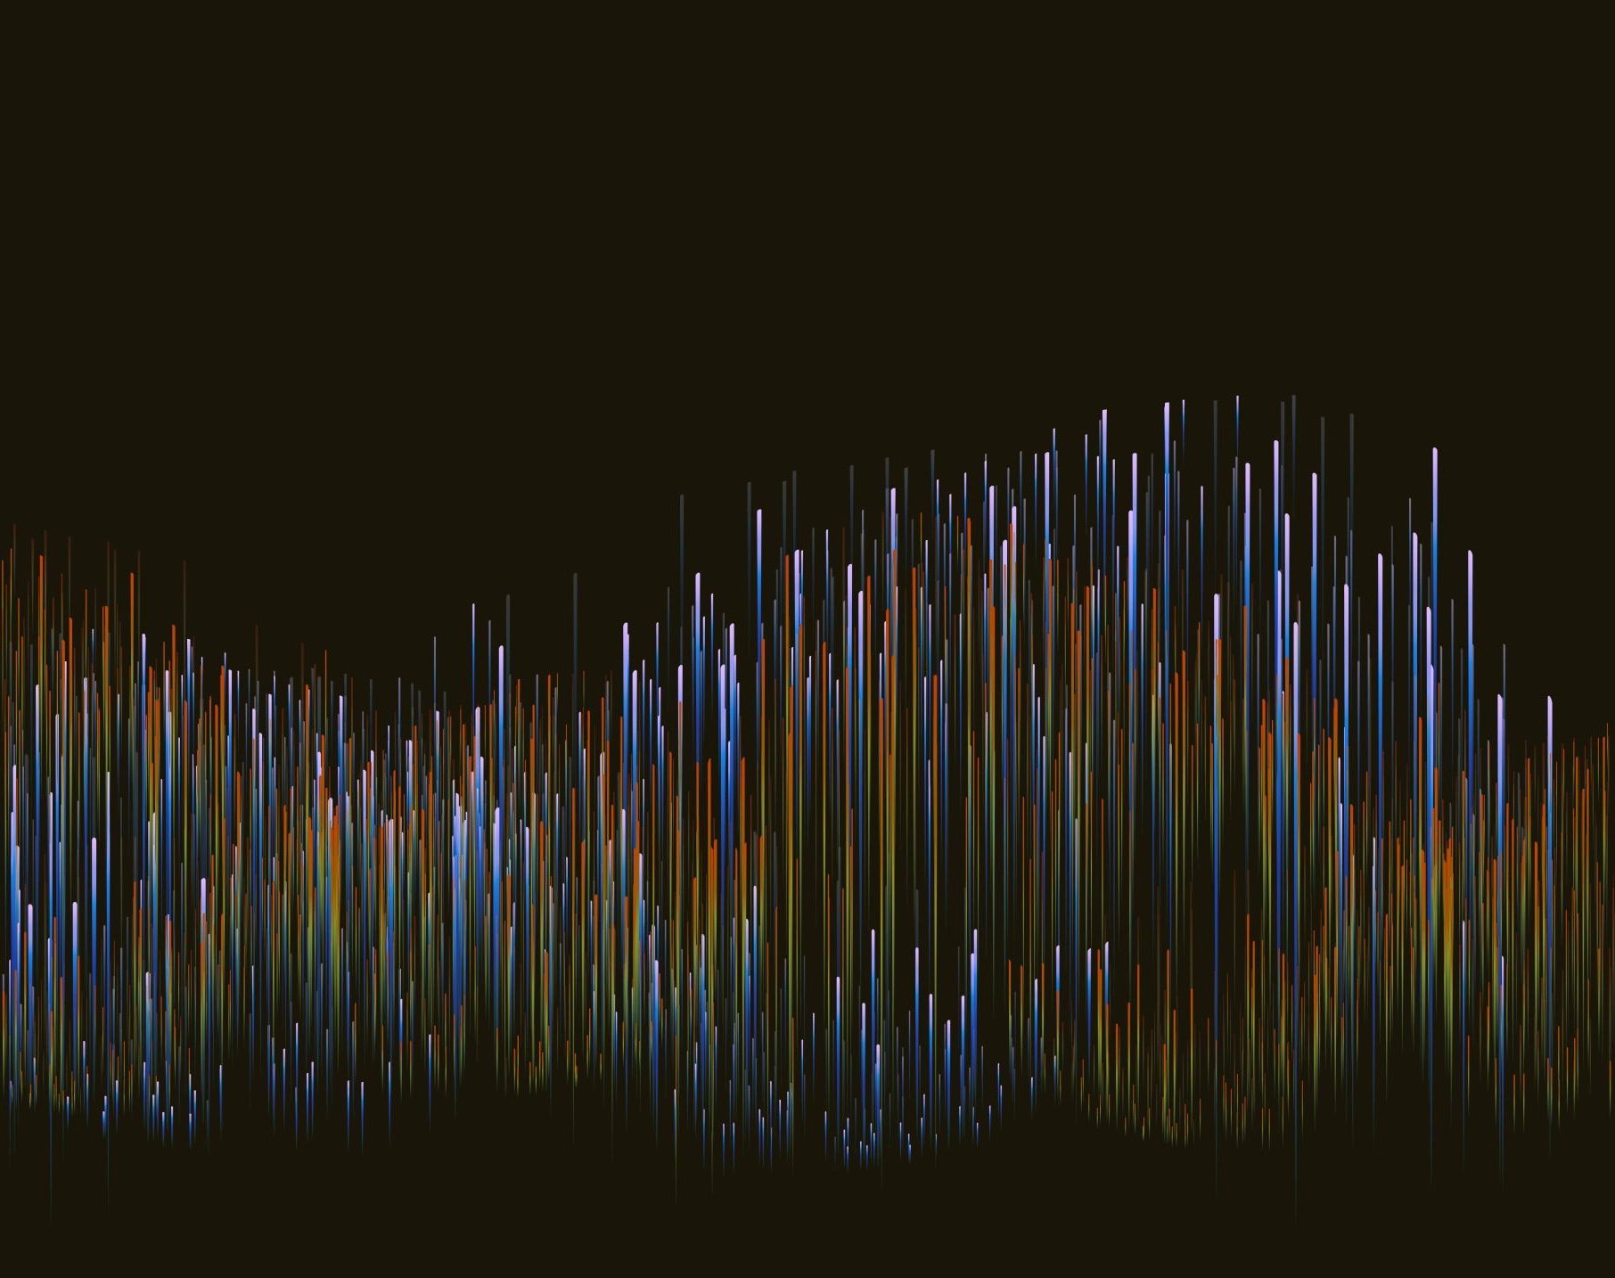
Prototyping
Jacob

Slide 16
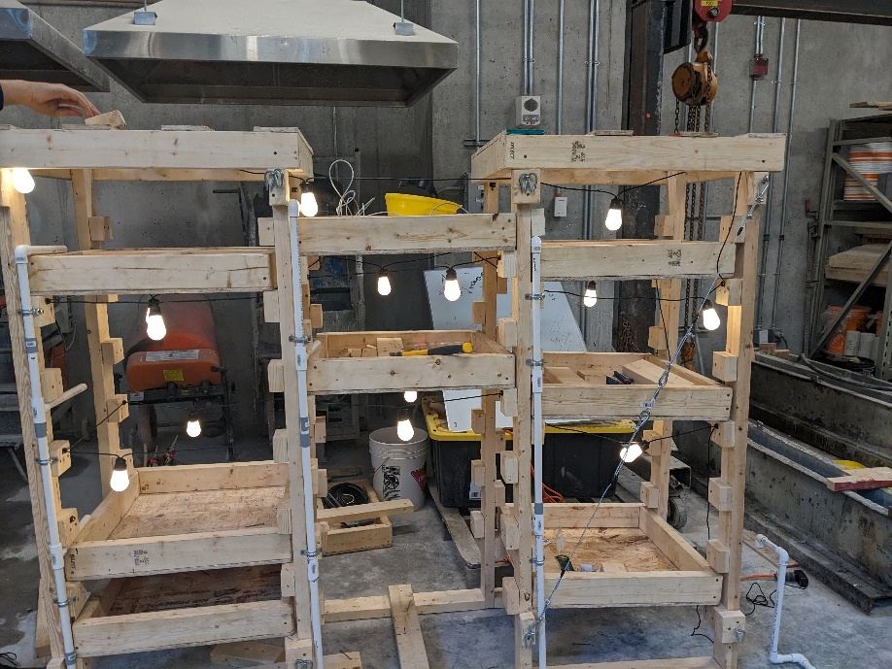
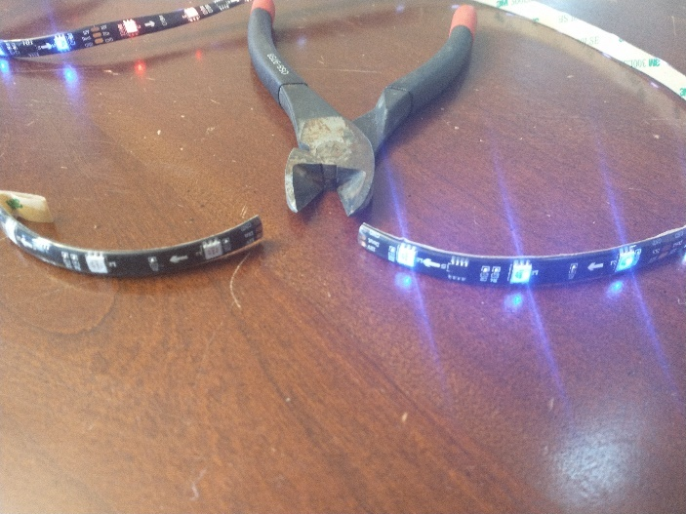
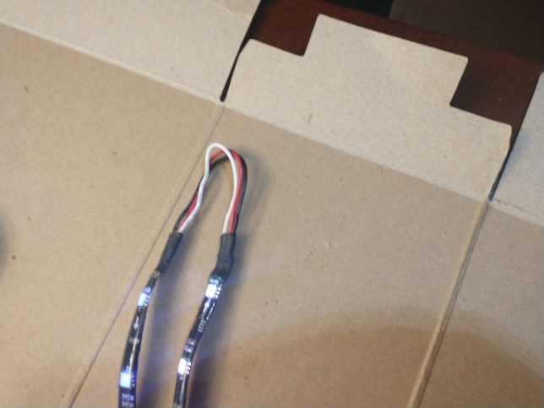
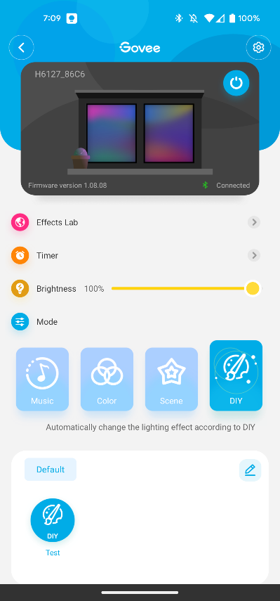
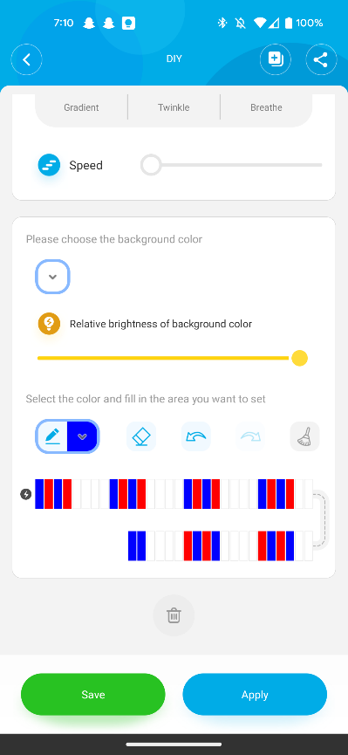
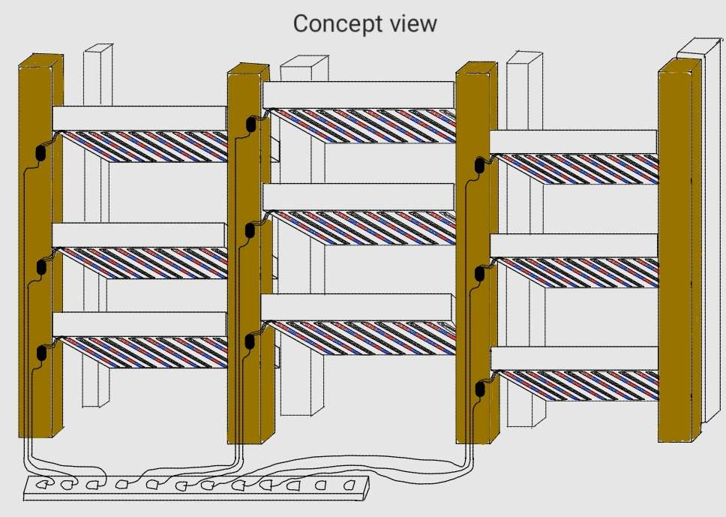
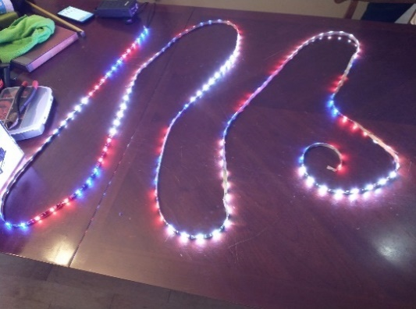
Grow Light Prototype’s
Jacob

Slide 17
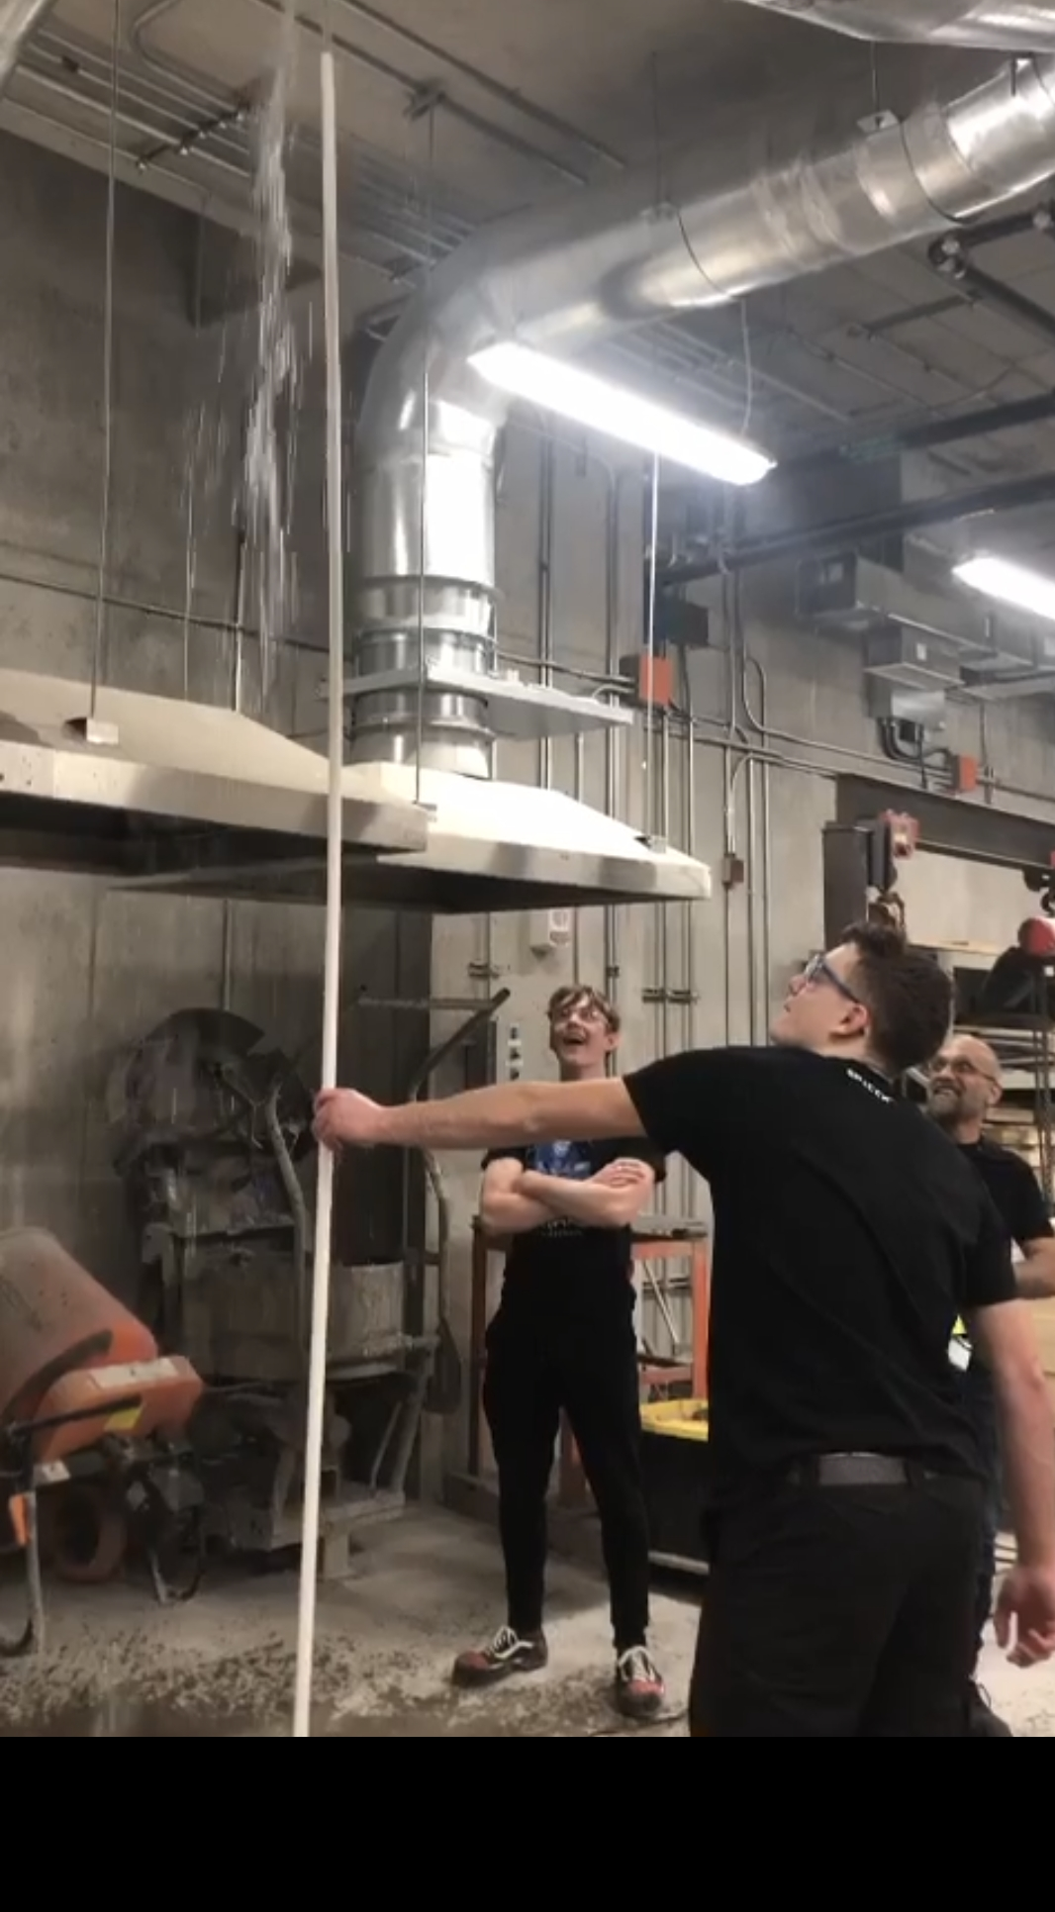
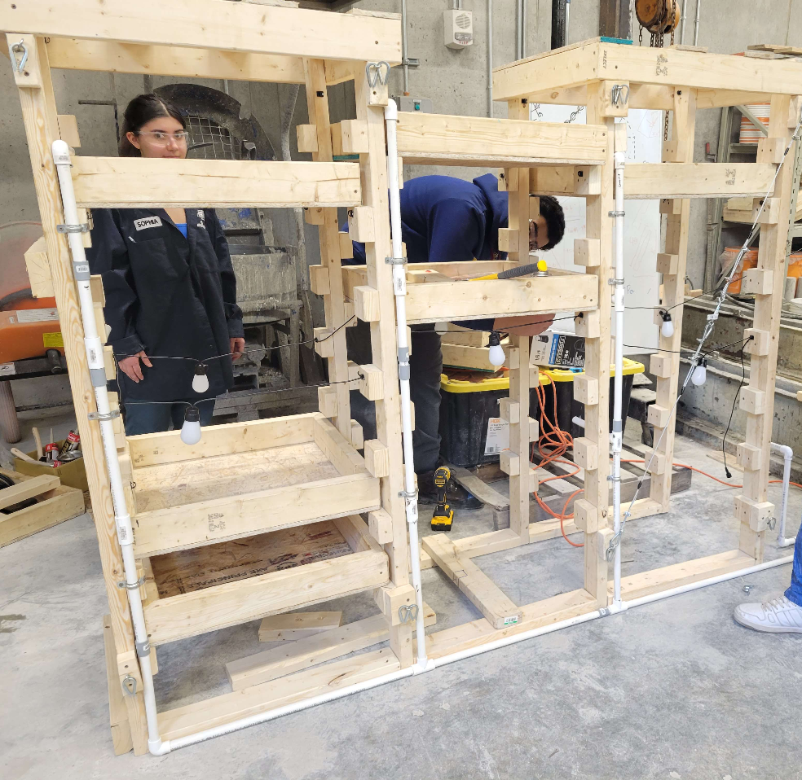
Irrigation system’s Prototype’s
CAD Model
Bernoulli's and flow rate calculations
Pump testing
Alec
Notes:
First, we did a CAD Model of our entire irrigation system. This allowed us to better visualize everything and sort out inconsistencies in our design.
Bernoulli's and flow rate calculations for pump strength, to know if the pump we planned on buying was strong enough. From which we concluded our pump was indeed strong enough.
Pump testing with PVC and perforated polyethylene tubing. So, once we bought our pump we hooked it up to 10ft PVC with perforated tubing, just to get a general idea of whether or not the pump was somewhat as strong as we had calculated. It was actually stronger.

Slide 18
Pot and Plant Design Prototype’s
Khalid

Slide 19
Final Product
Matas

Slide 20
Matas

Slide 21
Conclusion
As a team we have designed, prototyped and built a product which we are proud of and hope the client also appreciates.
As our first major project as beginner engineers, we have enjoyed this first opportunity to explore our capabilities and will take what we have learned into our futures.
We would like to thank the audience for its attention and the professor and his team for this class.
Cyrille

Slide 22
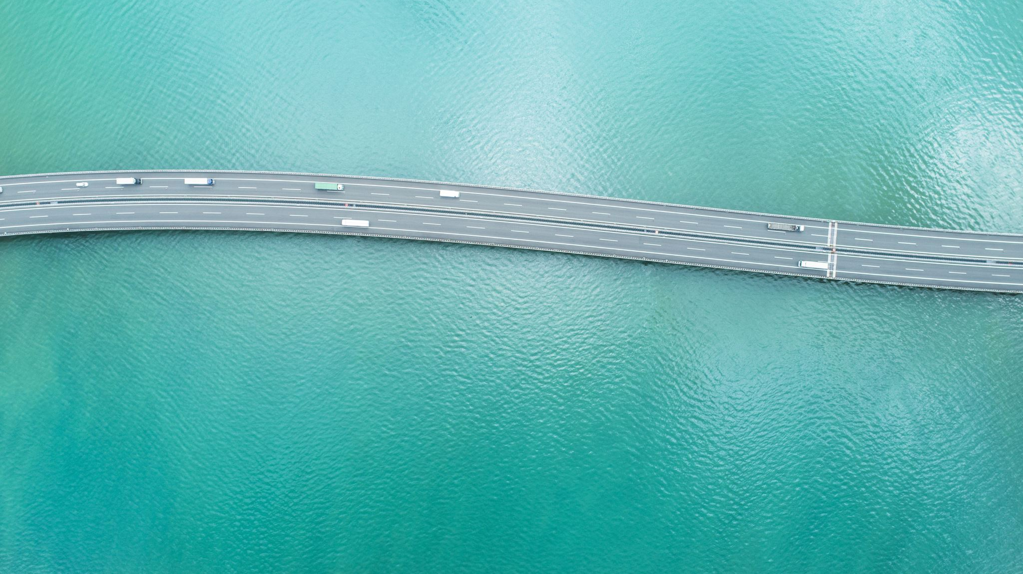
Thank you
Cyrille

