Slide 1
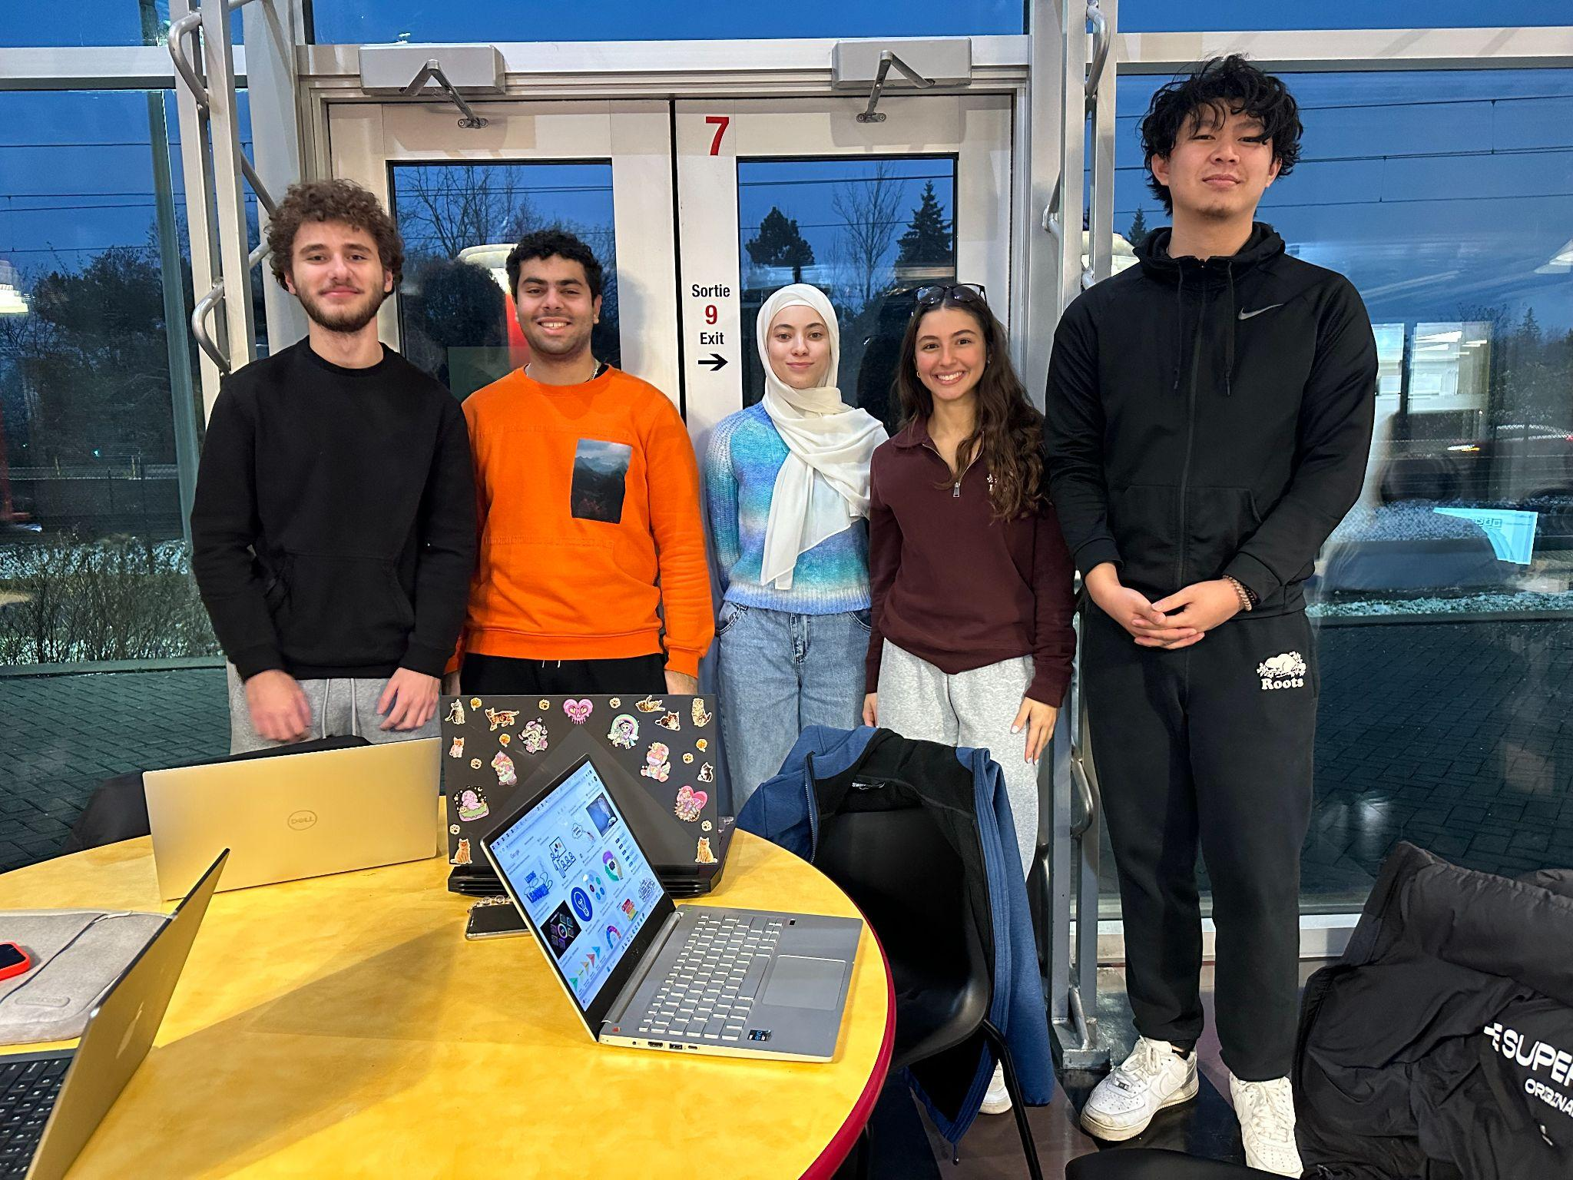
10-10
Sami Al-khawaldeh, Amanda Doku, Jordon Li, Fatima-El-Zahra Hamimed, Mahmoud Zourob

Slide 2
CLIENT
TARGET AUDIENCE
NEEDS
MINES ACTION CANADA
Humanitarian foundation whose main cause is the prevention of AI weapons entering military and conventional use
Representatives and international decision makers who pass policy on the rules of war (politicians, government off
A virtual reality experience that demonstrates the dangers of AI weaponry
Notes:
Research about autonomous robots to prepare to ask questions at first client meeting
Considered other target audience but client specified that

Slide 3
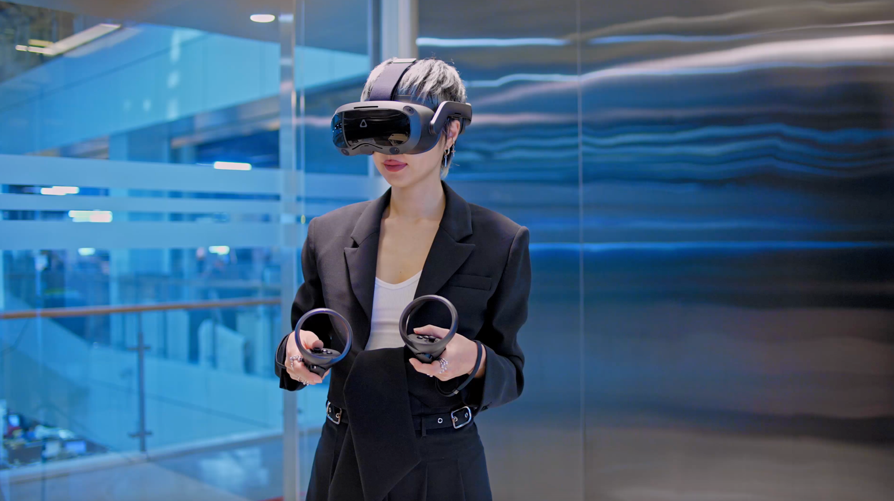
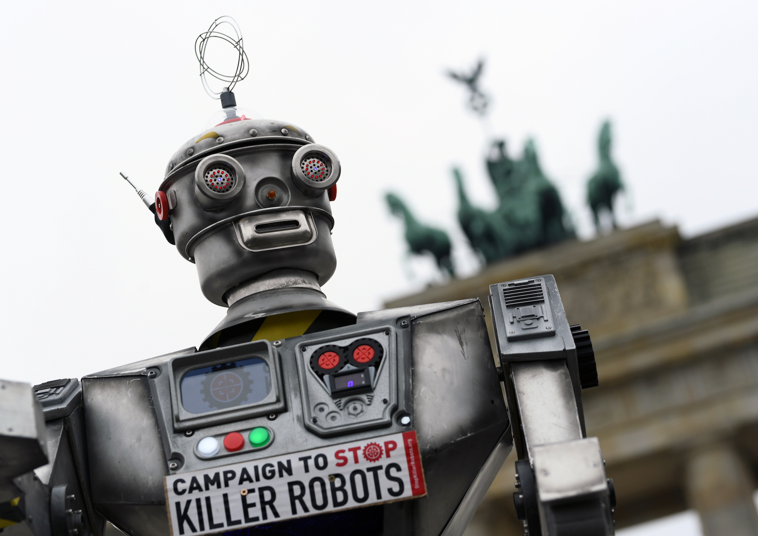
PROBLEM
Simplicity
No elaborate story lines/ video game interactions
Short & Concise
30 to 60 second video
Maintain continuity
Non-Graphic
Should be appropriate for 13+
No gore, blood, swearing
Realism & Relatability
Casual audience should be able to relate
Time period is present or near future
Environment is recognizable
Emotional Impact
Induce fear, curiosity, concern for movement
Immersiveness
Shows realistic ways how people would avoid facial recognition, robot detection
PROBLEM STATEMENT
Mines Action Canada needs a short, realistic, and emotional virtual reality experience to demonstrate the dangers of autonomous weapons, in order to encourage immediate measures against their use.
FOCUS: Facial Recognition

Slide 4
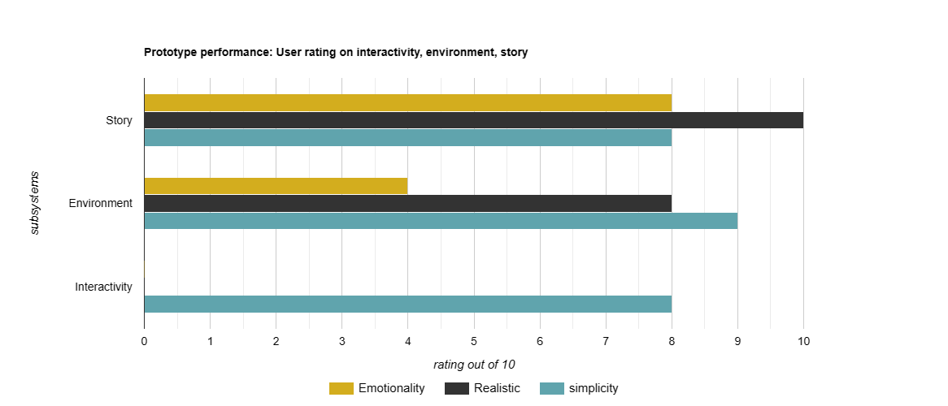
Phase 2: Testing Results and Analysis

Slide 5
VR DEMO
Questions?

