Slide 1
Grow wall Hydroponics team High Rollers – GNG1103
By: Alec Fraser, Cyrille Zakaria, Jacob Olaveson, Khalid Al-Satari, Matas Minkstimas, Nicole Milman
University of Ottawa
Notes:
Hello everyone, we are the High Rollers Hydroponics Team, our team's design is for a grow wall, as opposed to a greenhouse like all the other hydroponics teams. I'm Alec, and with me I have Cyrille and Nicole. Let's get started!

Slide 2
What was the problem?
Our client is a part of an indigenous community who teaches youth.
She needs to teach the youth how to grow and nurture plants in order to help the environment.
Problem Statement:
Our client needs an effective, low-cost and environment friendly grow wall systems in order to produce fast-growing crops for indigenous communities in Canada.

Slide 3
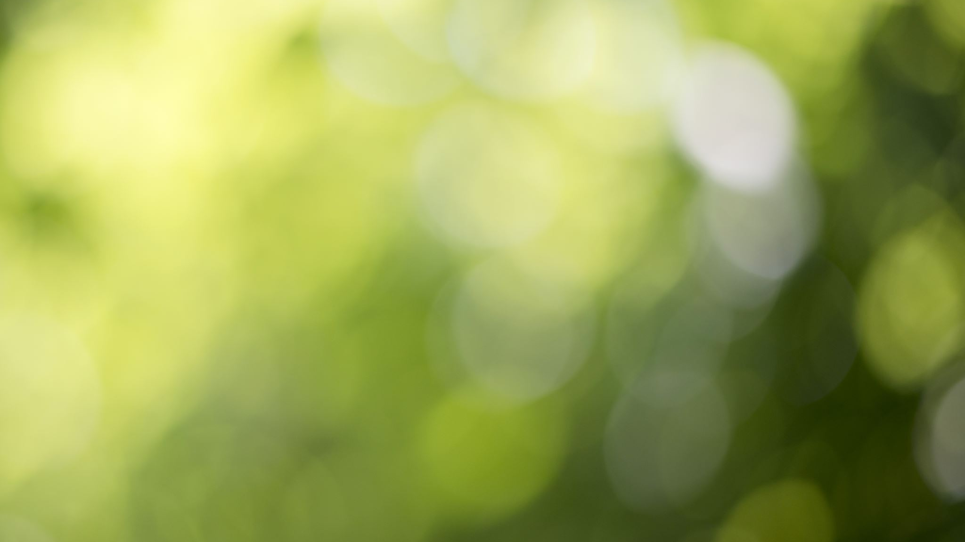
Why is this important?
Environment
Education
Responsibility
Future

Slide 4
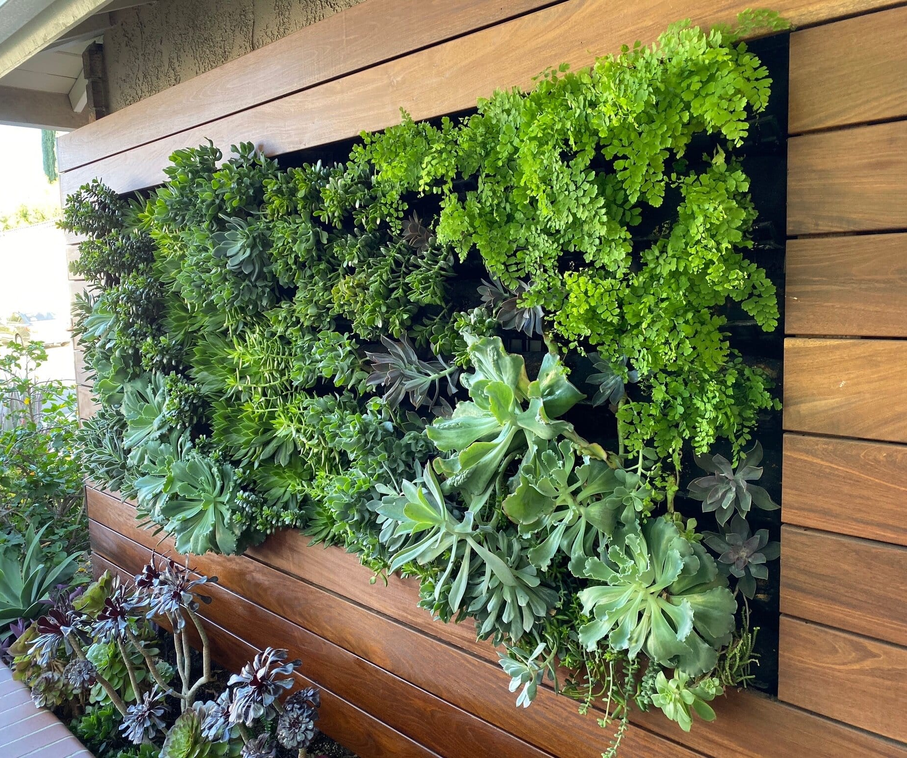
Current solutions

Slide 5
Our solution
Different because...
Strength + modularity / customizability
App (Wi-Fi) control
Tons of planting space
3 valves / shelf.
Notes:
Differentiates itself from other solutions by having an impressive combination of features like
a durable, well-built irrigation system while also having adjustable shelf height, making it exceedingly modular. Each of these PVC pipes is fully cemented at every junction, and screwed in at several instances, then tightly fitted between shelves to make sure they themselves, or any water, is not going anywhere.
lights that can be controlled through an app over Wi-Fi.
almost 65ft square feet of planting space, without the pot dividers.
3 valves per shelf, which will help save water and energy, while also increasing modularity, and customizability
All of the features I've just mentioned combined with the fact that it is low-cost and environment friendly, setting it apart from the rest and making it greatly needed, and much more useful to the user.

Slide 6
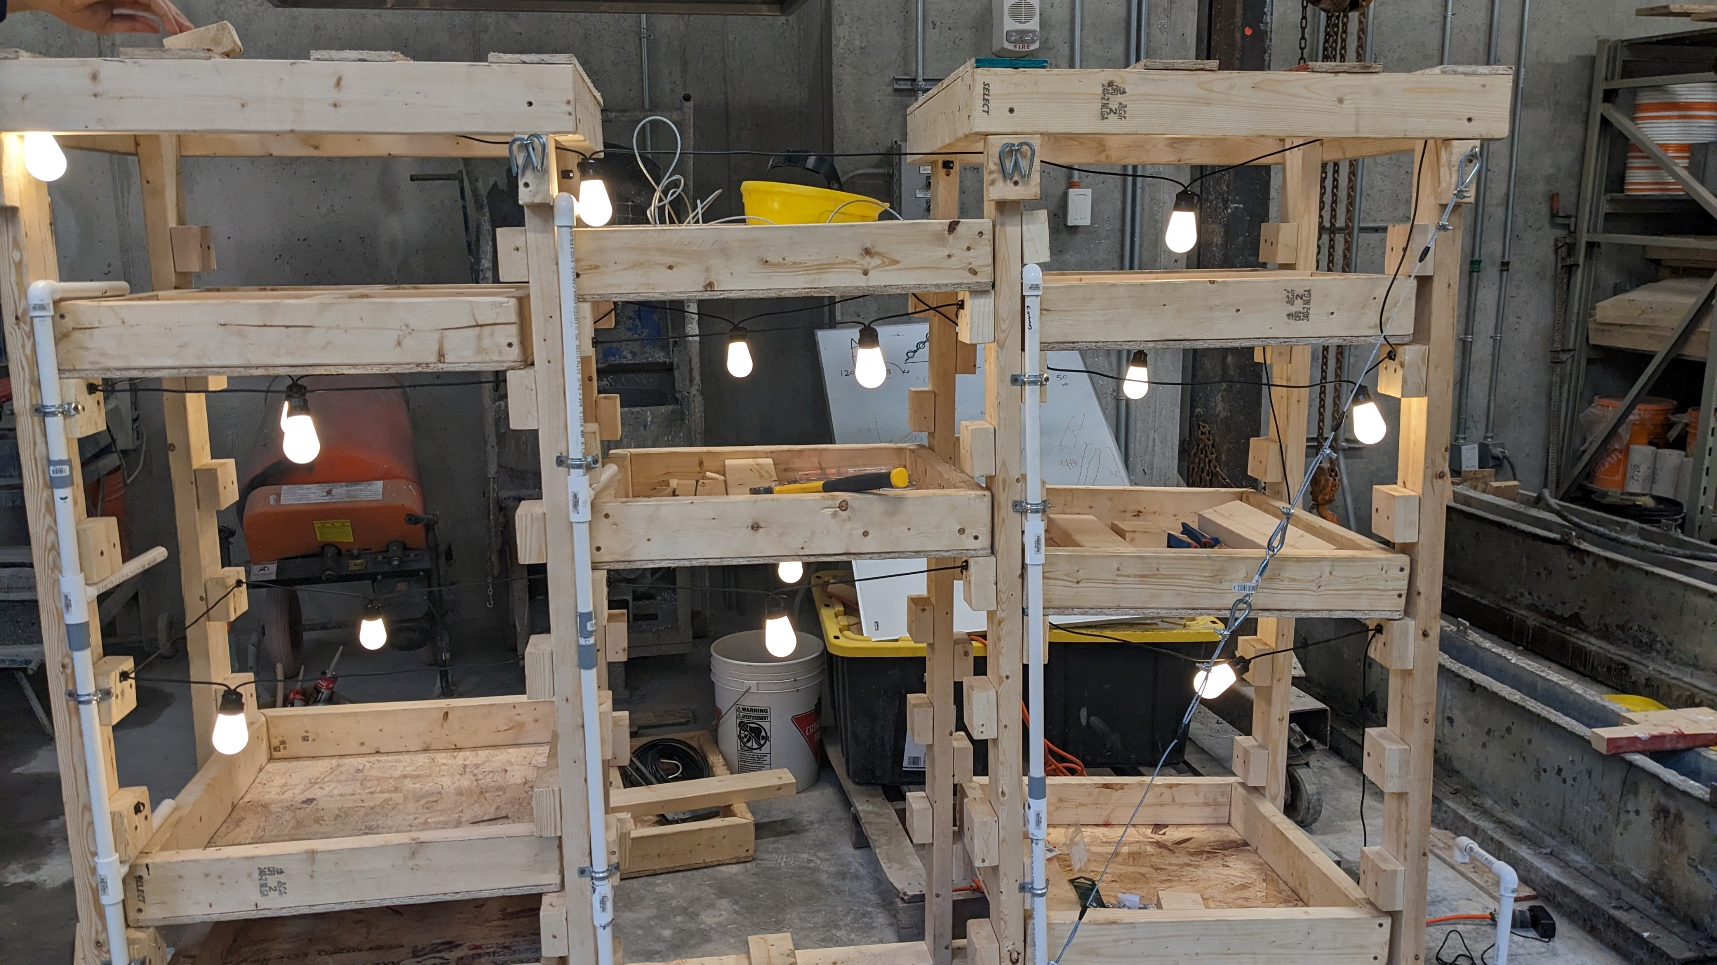
Here's A Quick Demo Any questions?

