Slide 1
RecycleBuddy
Khadij, John
Nicoll, Sebastian
Senathirajah, Abera
Shouldice, Michael
Todd, David

Slide 2
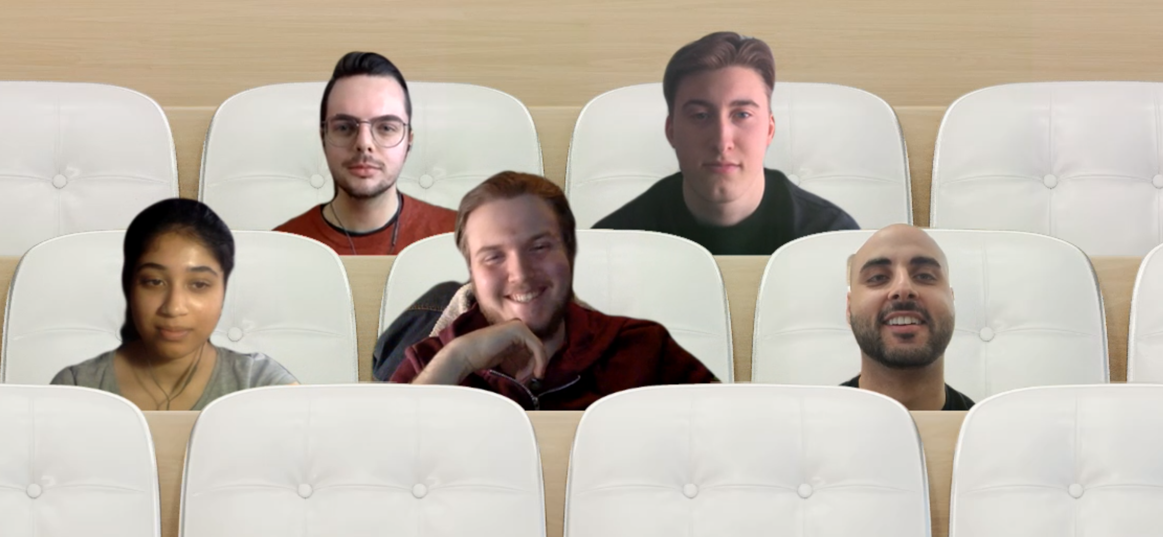
RecycleBuddy
Waste management needs to be improved at the consumer level.
Our team has created an AR app that scans items to help users determine where they should go.

Slide 3
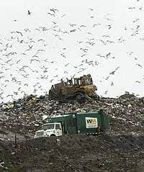
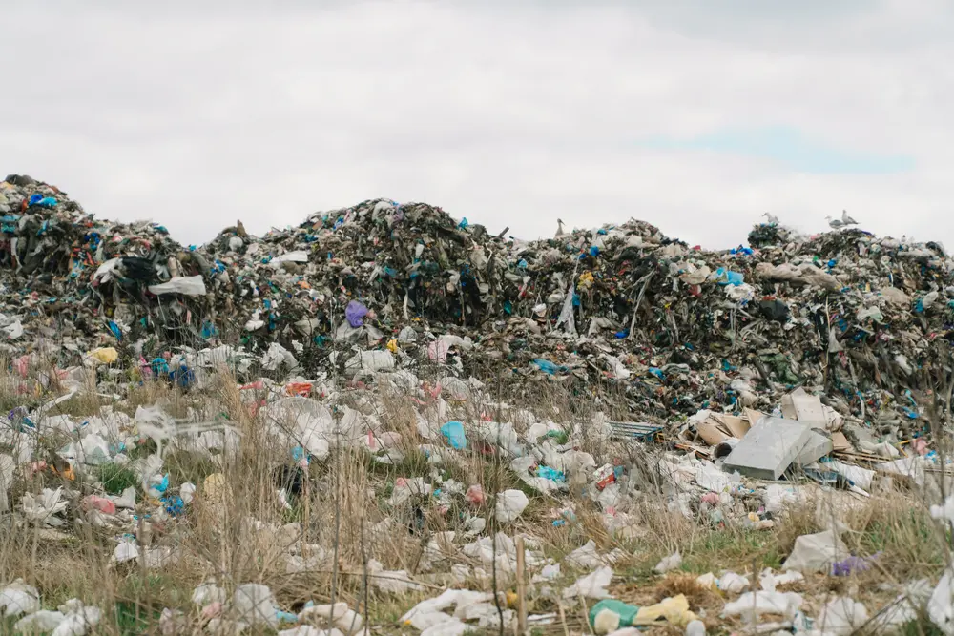
Why is this important?
In 2017 Canada produced the most annual waste (globally) - totalling 1.3B metric tonnes
Average Canadian produces 673 kg of waste per year or 1.8kg a day
Canadians only recycle 16% of their total waste
The amount of global waste is increasing annually
Notes:
Canada produces most waste in the World, United States ranks third (usatoday.com)
Canada among worst waste-producing countries: study – RCI | English (rcinet.ca)
EnviroStats: Recycling in Canada (statcan.gc.ca)
Mismanaged waste 'kills up to a million people a year globally' | Plastics | The Guardian
Ottawa Must Plan for Garbage | Unpublished Ottawa
Ottawa Junk Removal Vs. Taking Junk To The Ottawa Dump | Capital Junk

Slide 4
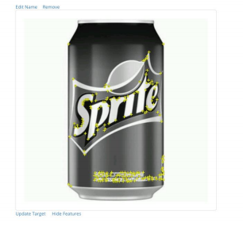
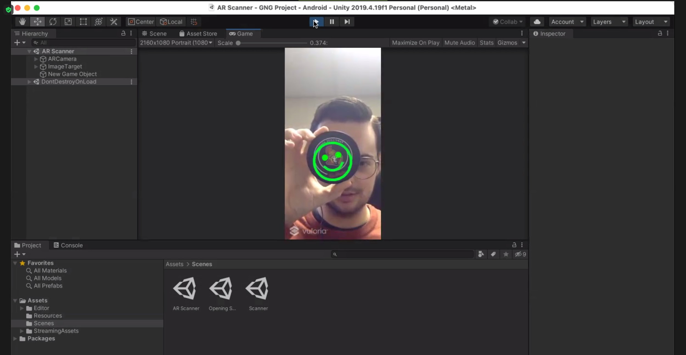
How the app works
-Image database in Vuforia
-Scanning/ image tracking software in Unity
-Scanned item is compared to image and solution is given

Slide 5
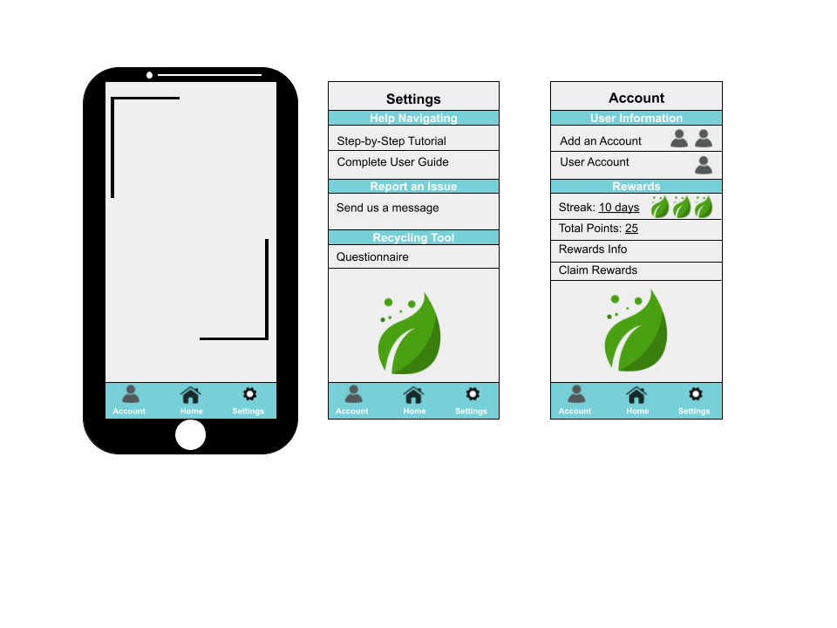
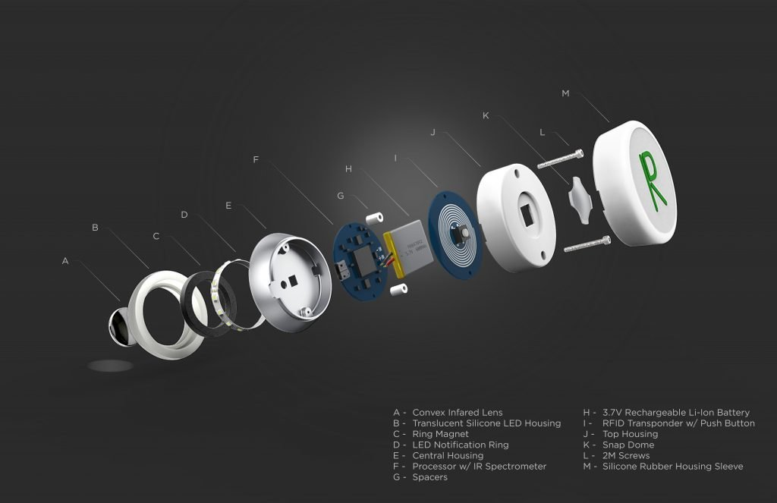
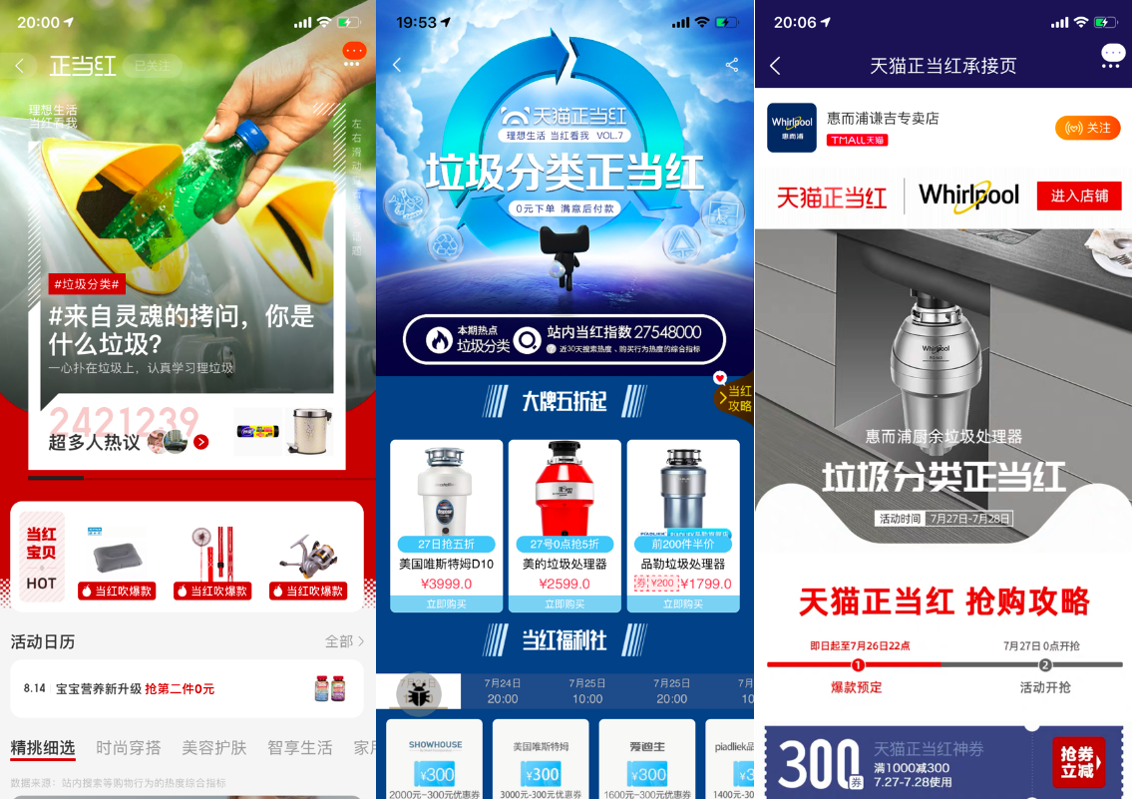
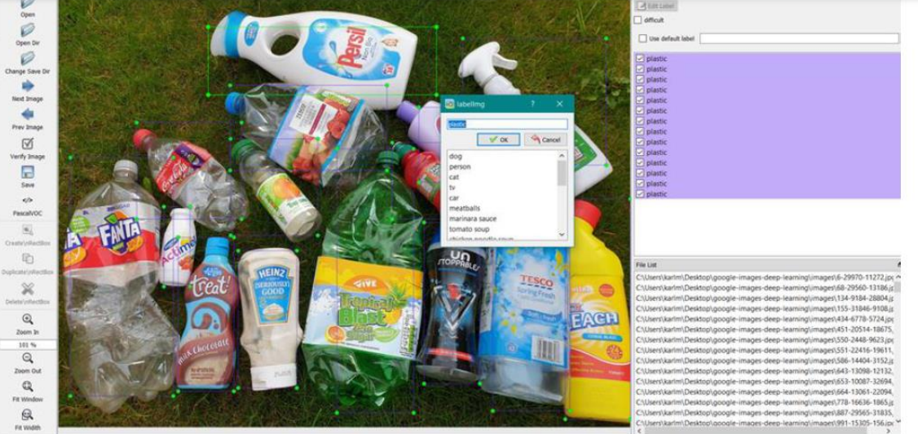
Benchmarking
Criteria | RecycleBuddy | COHDA Recycling Identification Device | Taobao / Alipay App / Scanner | Liverpool Hope University App
Performance Time | Avg. 17sec Various age groups tested | “Immediate” | N/A | “…too slow to be commercially viable”.
Dimension & Size | 31.7mb | Physical product. Fits inside palm of hand. Dimensions N/A. | Taobao 256.4MB Alipay 255.7 MB | App. Size N/A.
Complexity | Recognizes item: 3 actions Doesn’t/user tries again: 4 actions Manual search: 6 actions | 1 decision/ interaction | N/A | N/A
Effectiveness | 75% | N/A | N/A | 92% success rate
Cost (Cost to create - implementation cost and maintenance not included) | $0 | “Low cost” | $0 | Under 175 CAD (100 GBP to CAD)
Notes:
[1]“‘Trash-Recognition’ Tech Sorts Out Recycling Woes.” Alizila.com, 31 July 2019, https://www.alizila.com/alibabas-trash-recognition-tech-sorts-out-recycling-woes/. [2]Taobao Marketplace Overview. https://www.alizila.com/wp-content/uploads/2019/09/2.- Factsheet-Taobao-Marketplace-EN.pdf. [3]Alipay Profile, Trends and Insights – China Internet Watch. https://www.chinainternetwatch.com/tag/alipay/#:~:text=Alipay%20is%20China%27s%20leadin g%20online,the%20course%20of%20a%20year. Accessed 30 Jan., 2021. [4]Carufel, Richard. “Local vs. Global Brands: Nearly 75% Of Global Consumers List Brand Origin as Their Key Purchase Driver, Nielsen Reports.” Agility PR Solutions, 3 May 2016, https://www.agilitypr.com/pr-news/branding/local-vs-global-brands-nearly-75-globalconsumers-list-brand-origin-key-purchase-driver-nielsen-reports/. [5]Ward-Foxton, Sally. “AI Speeds Object Recognition for Recycling.” Embedded.com, 19 Oct. 2020, https://www.embedded.com/ai-speeds-object-recognition-for-recycling/

Slide 6
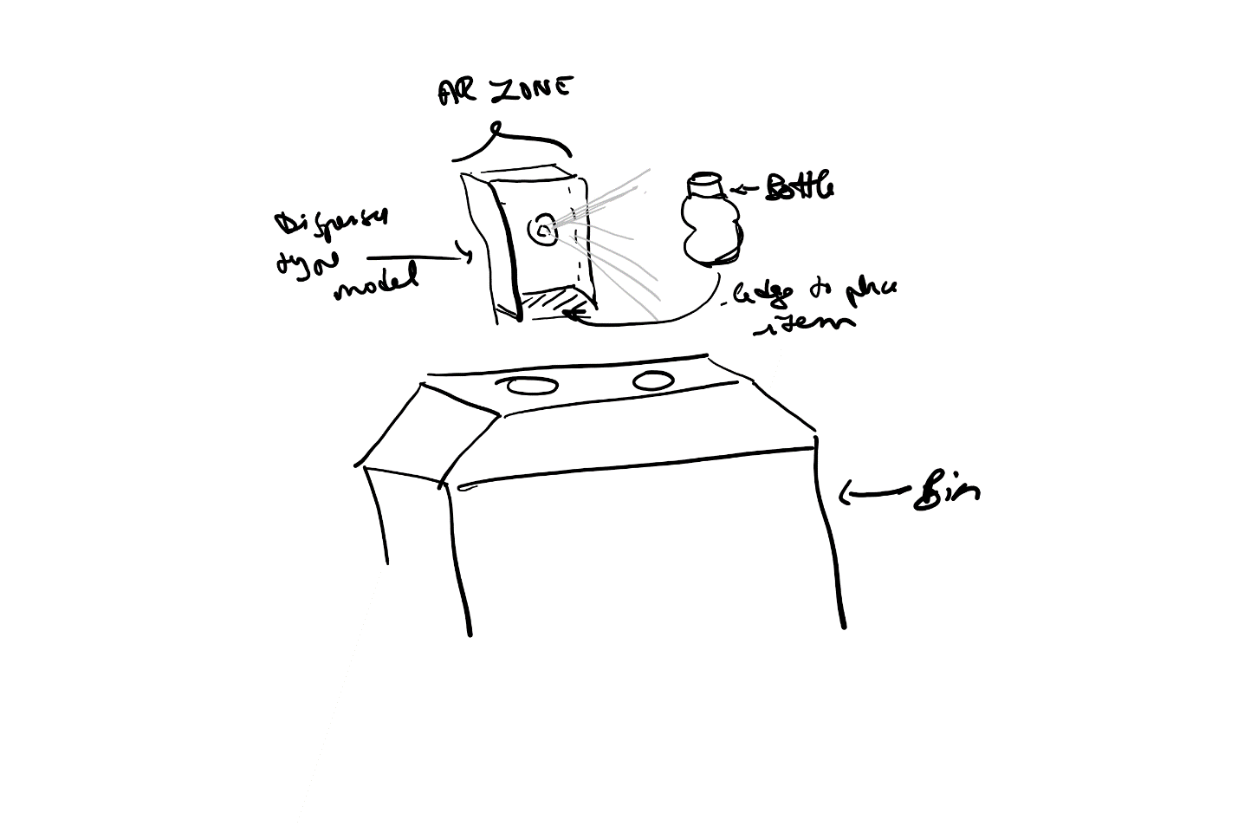
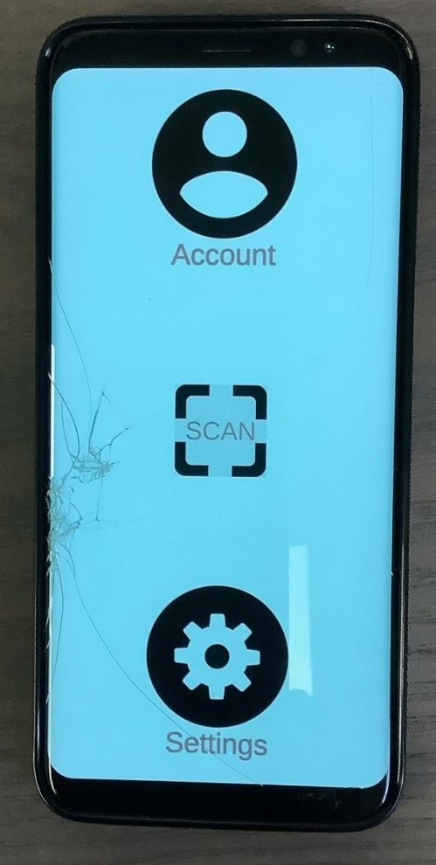
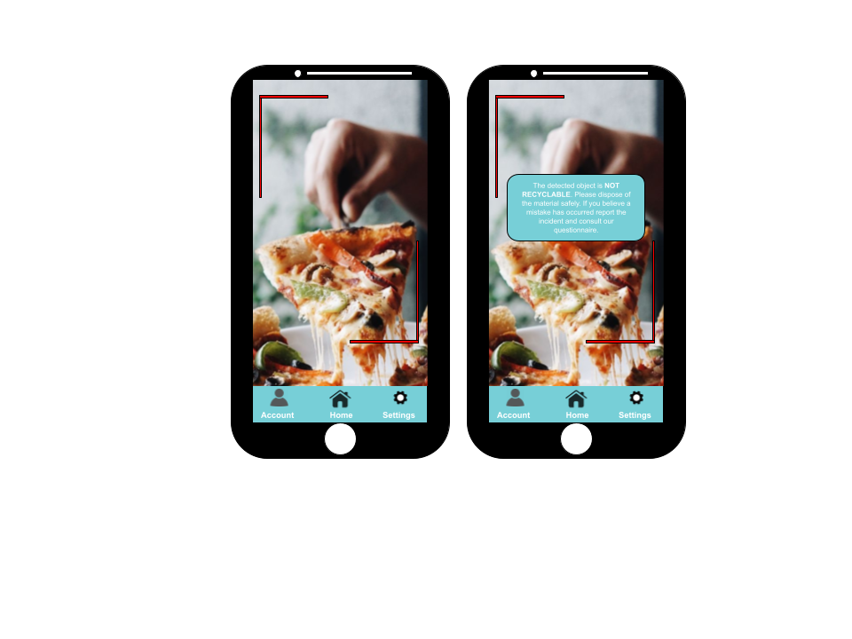
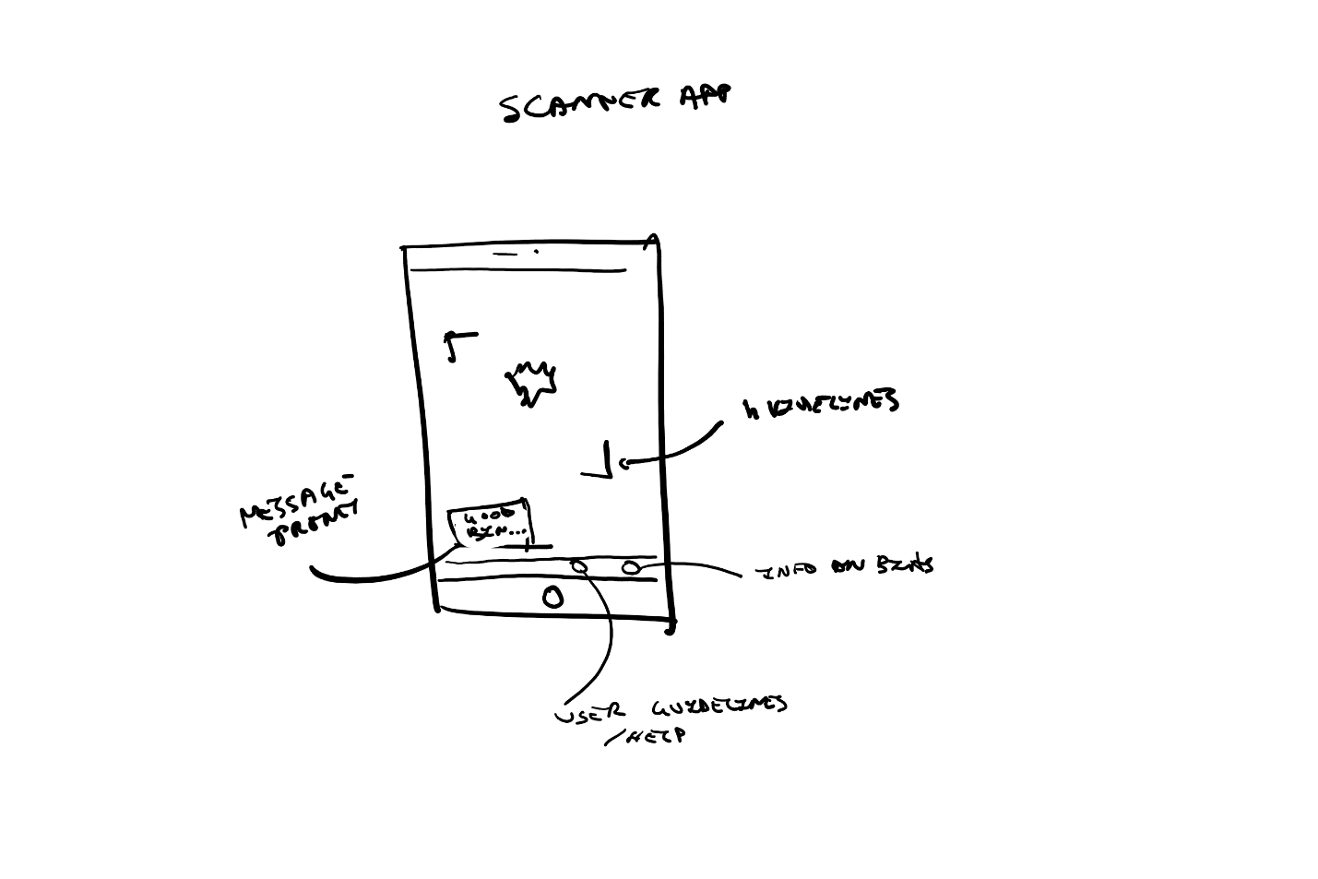
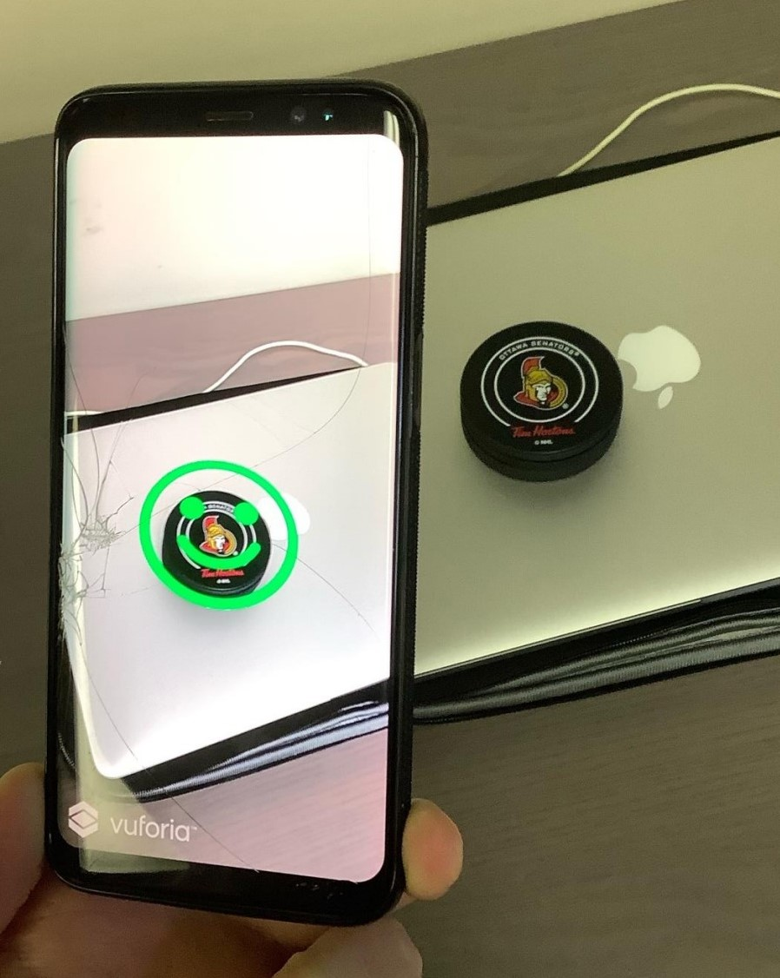
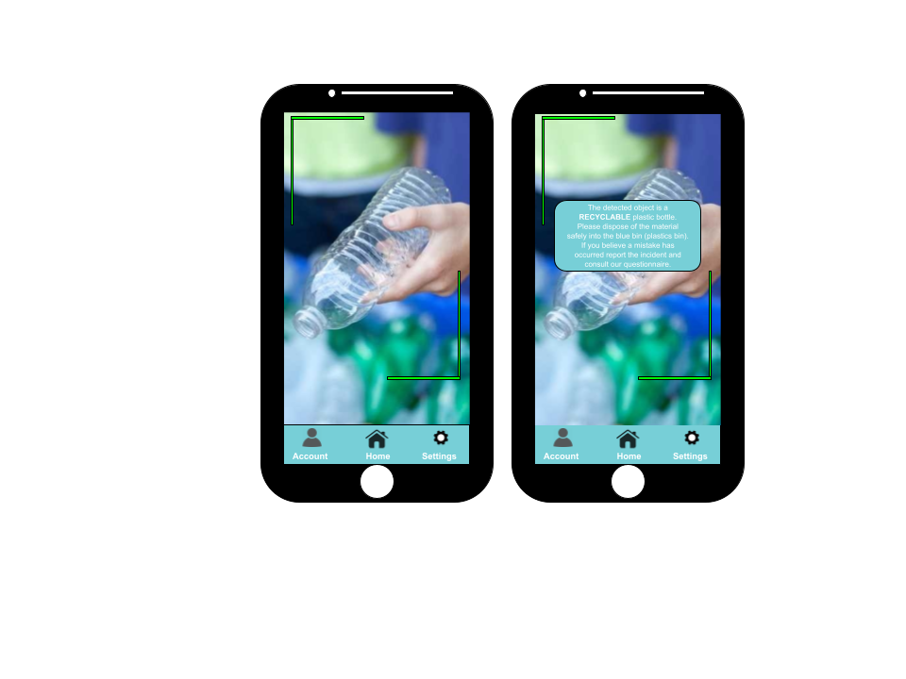
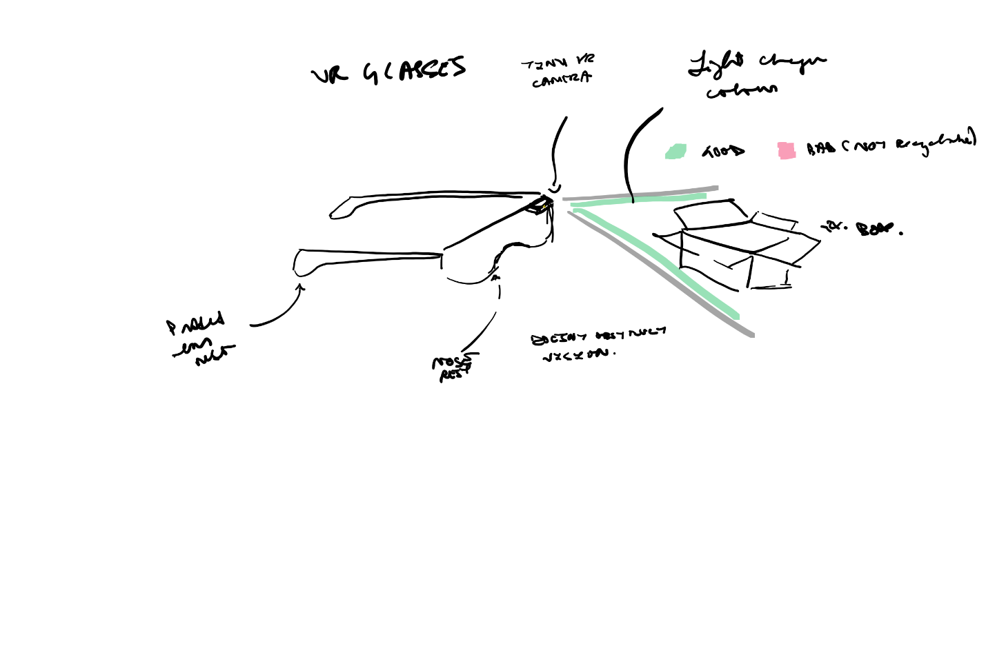
Concept Sketches
First Prototype
Second Prototype

Slide 7
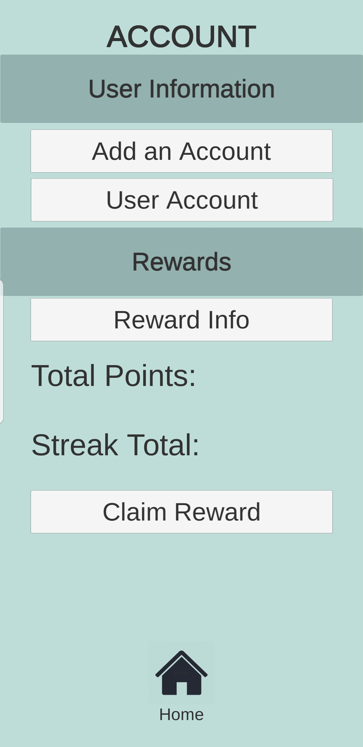
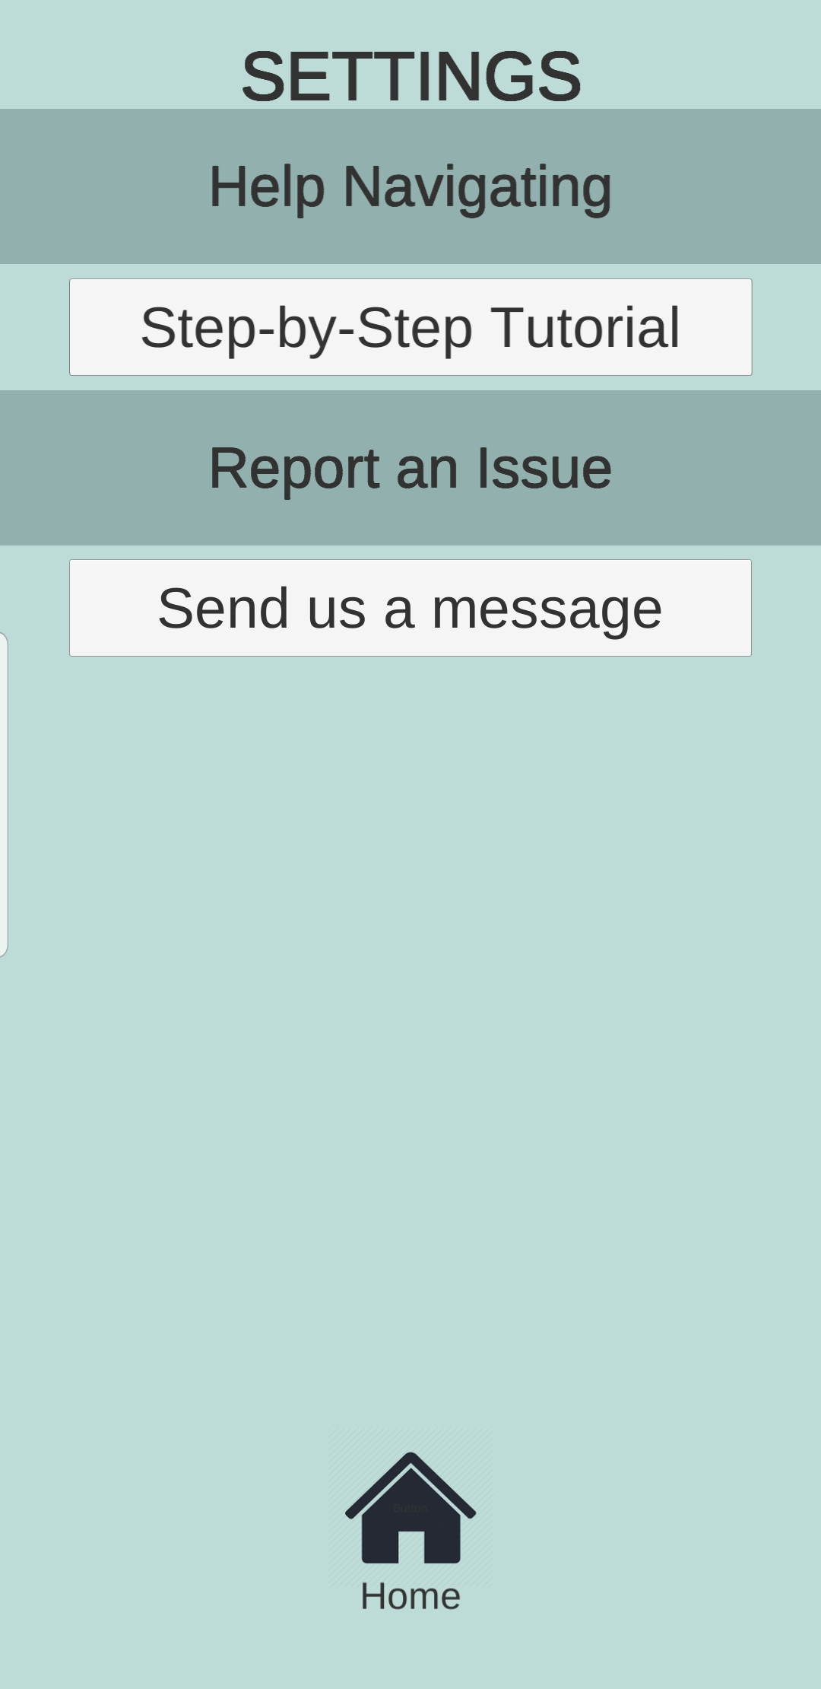
Final Prototype
NB: There will be a live demo following this slide.
Features:
-Object scanner
-Account and settings page
-Report issue function
-User tutorial
-Rewards system (creating account, streak counter, claiming rewards function)

Slide 8
Conclusion
RecycleBuddy is dedicated to reducing waste at the consumer level. The AR app solves the issue by helping the user place the item in the appropriate place using AR scanning technology.
We would like to sincerely thank you for listening to our presentation! Thank you from the RecycleBuddy team!

Slide 9
Future Objectives
-Expand image database
-Improve image tracking efficiency (through database)
-Refine various pages/aesthetics
-Expand rewards system

Slide 10
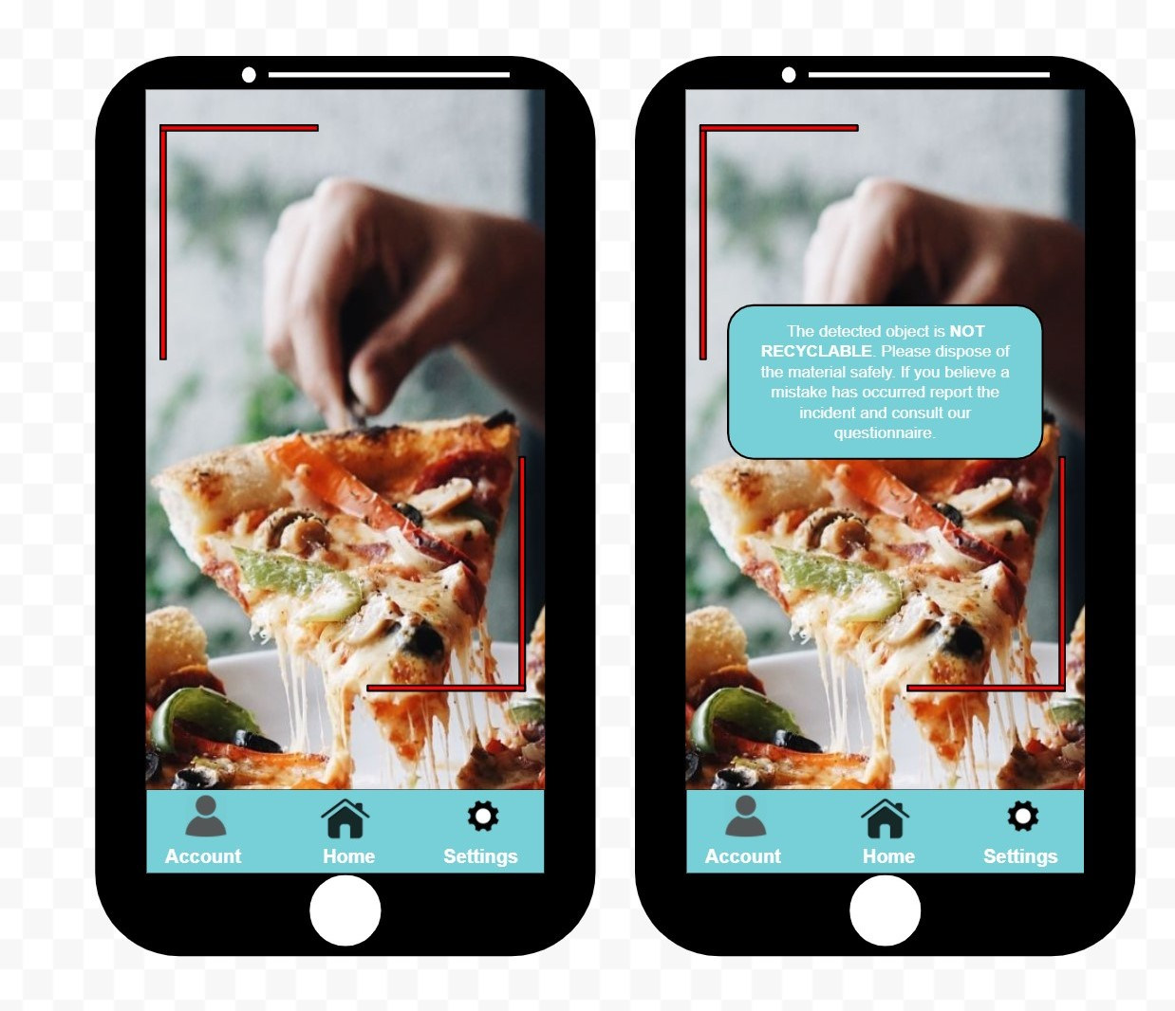
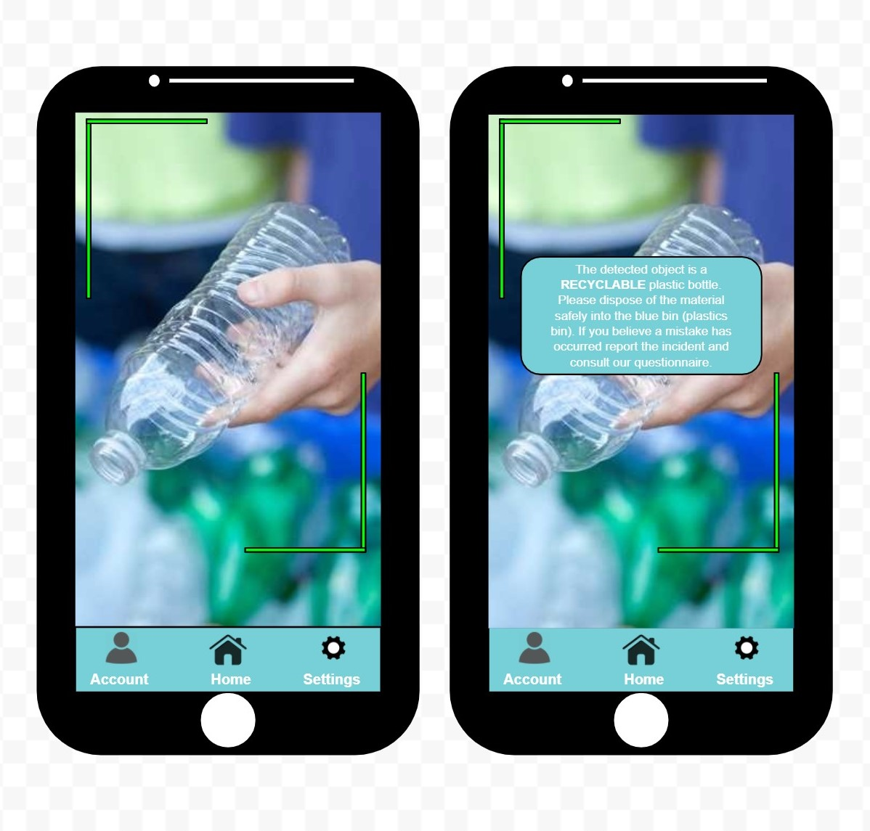
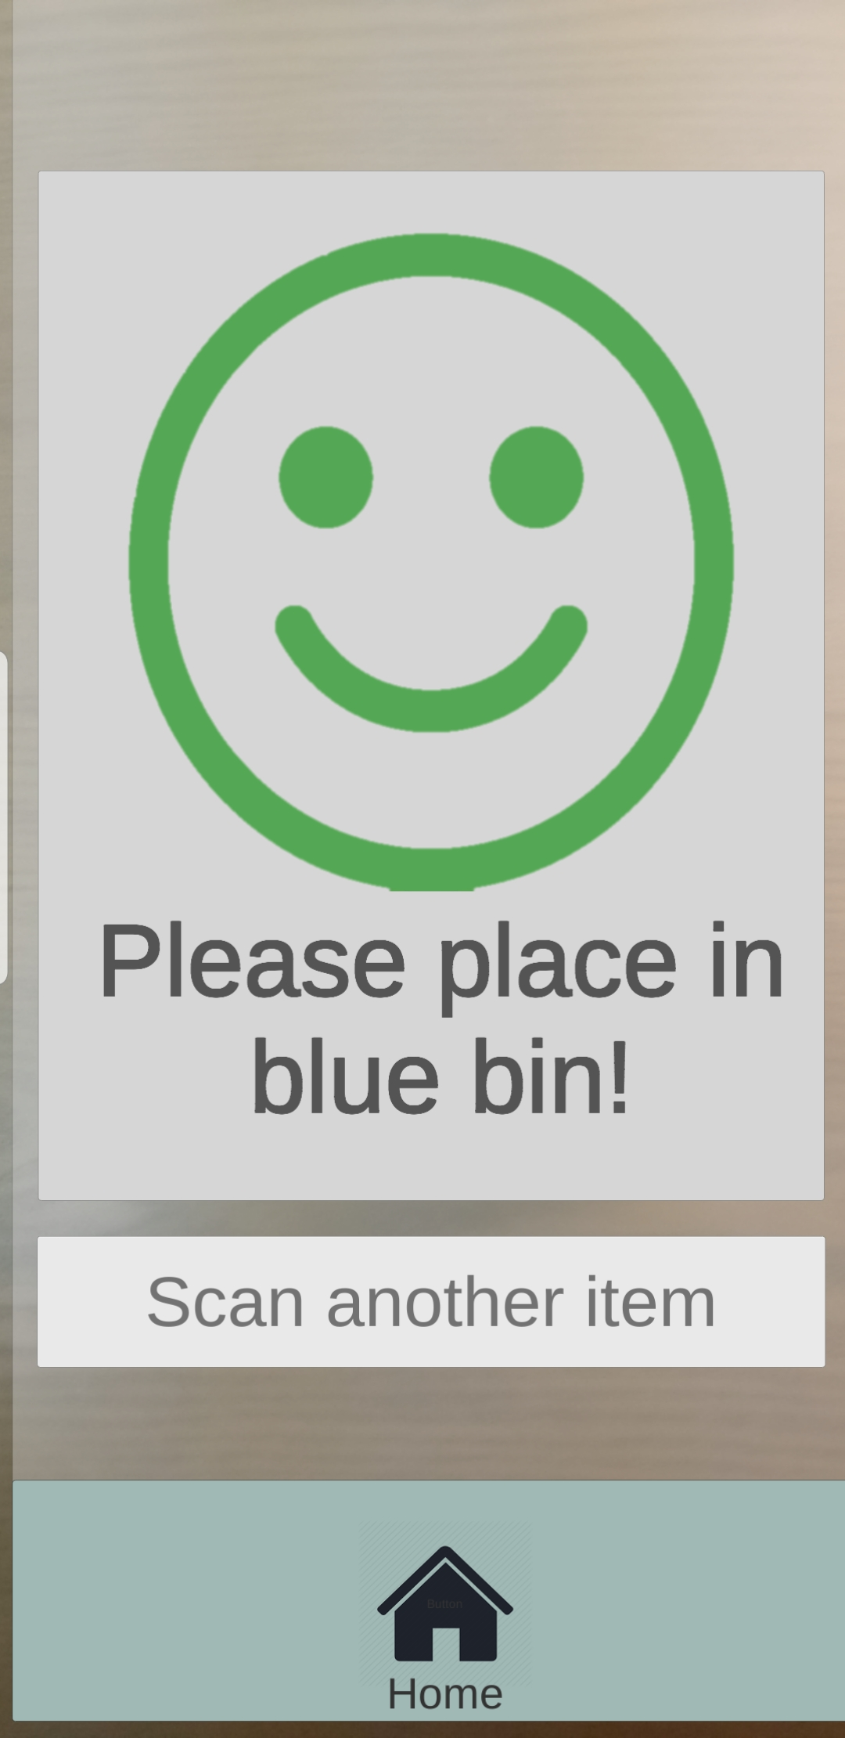
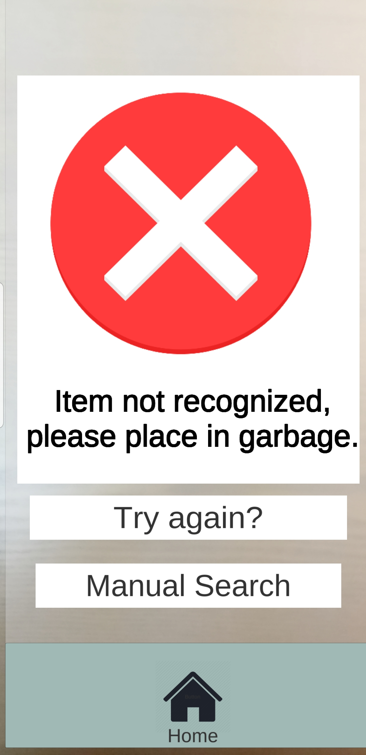
Lessons Learned
Initial Idea
-Must be extremely user friendly
-It must be obvious whether the item is recyclable
-A larger image database is needed to be more efficient/effective
-Concept must be simple
Final Concept

Slide 11
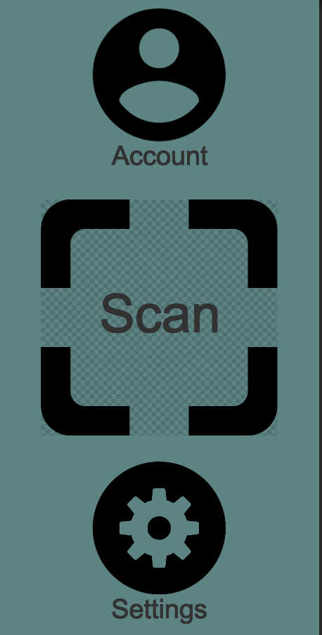
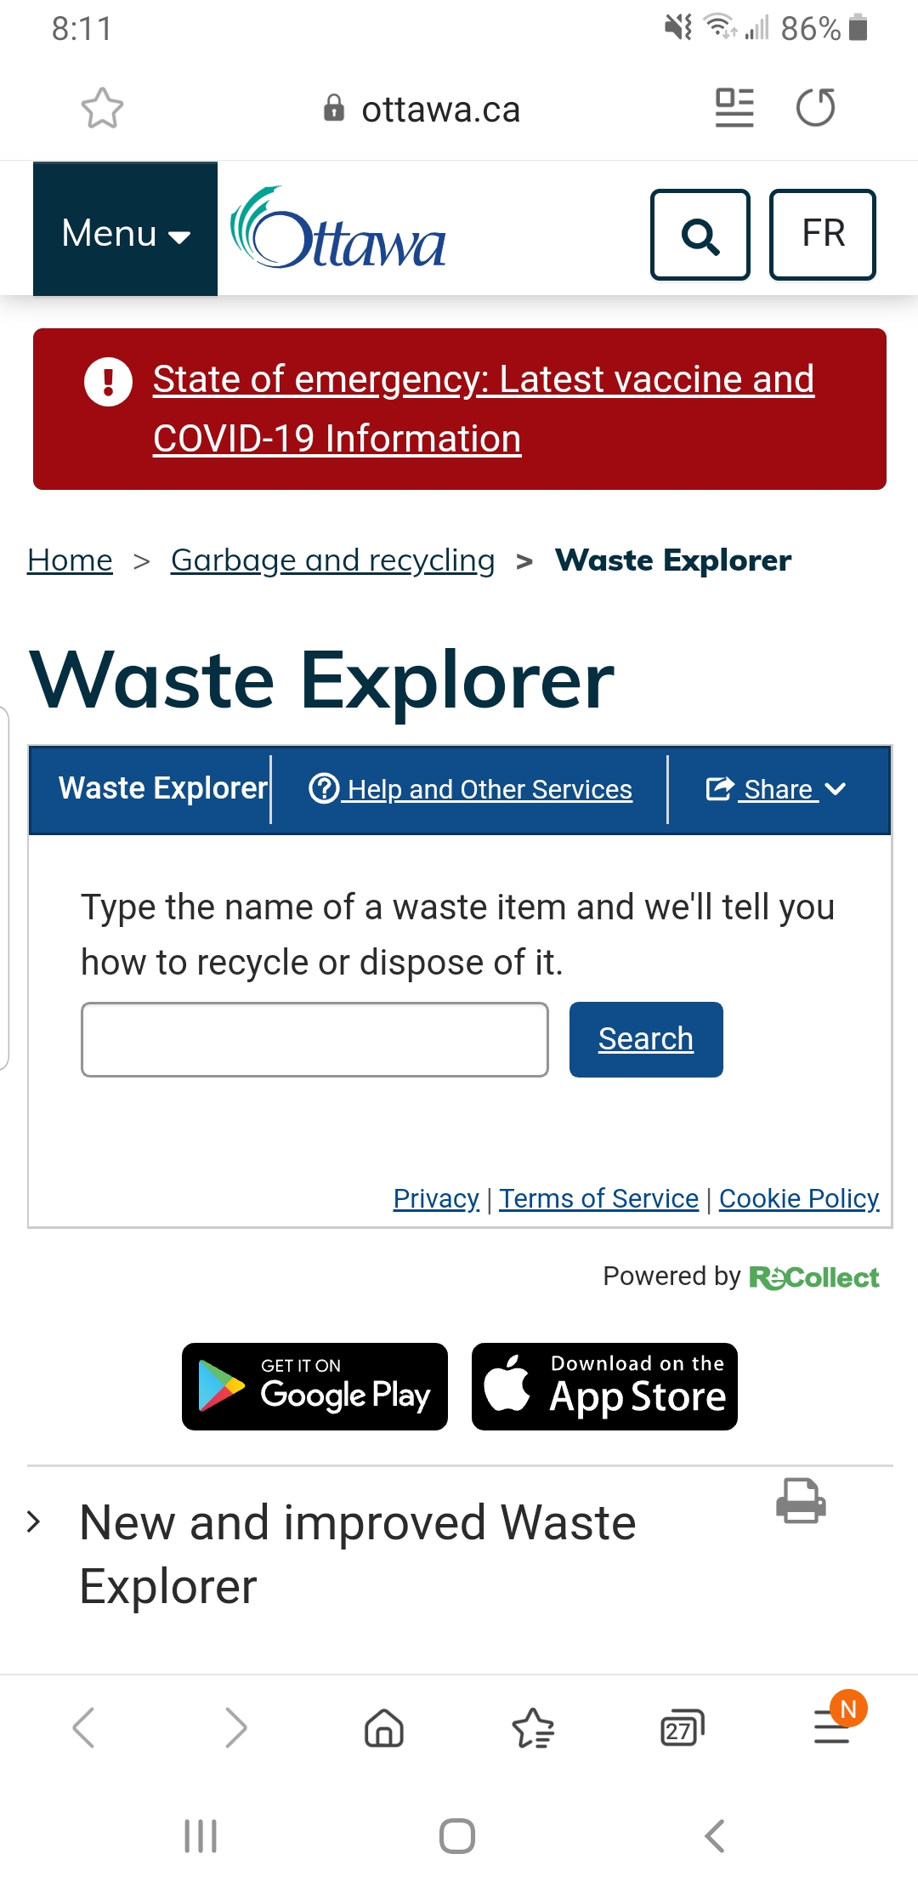
Final Prototype

Slide 12
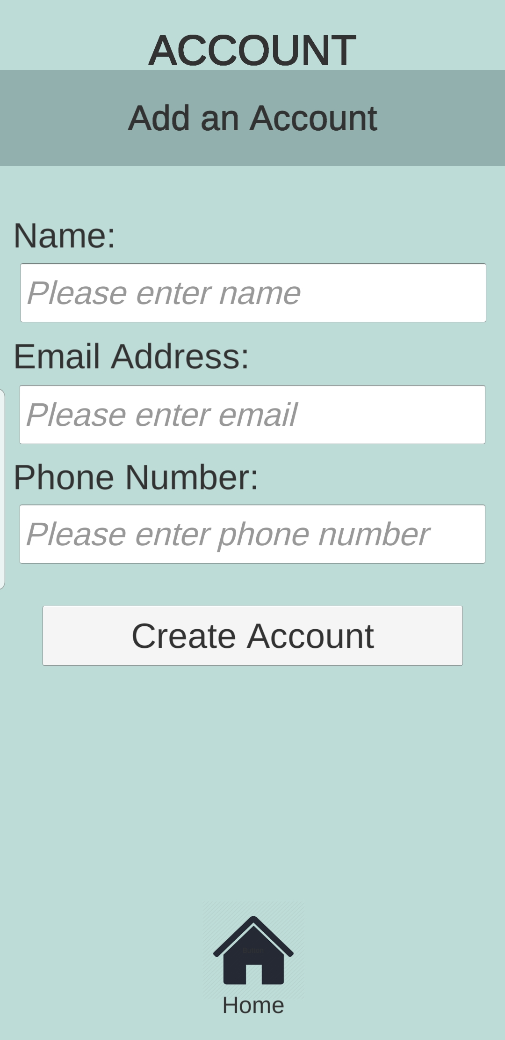
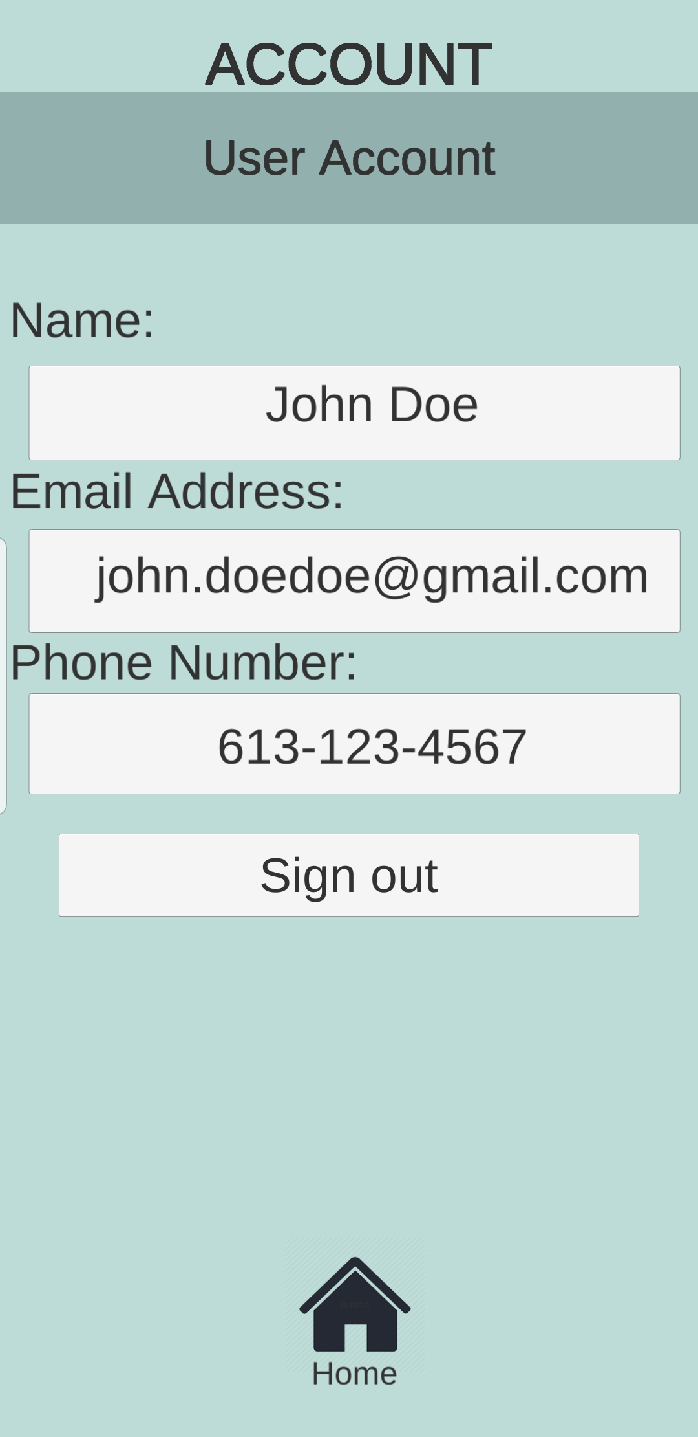
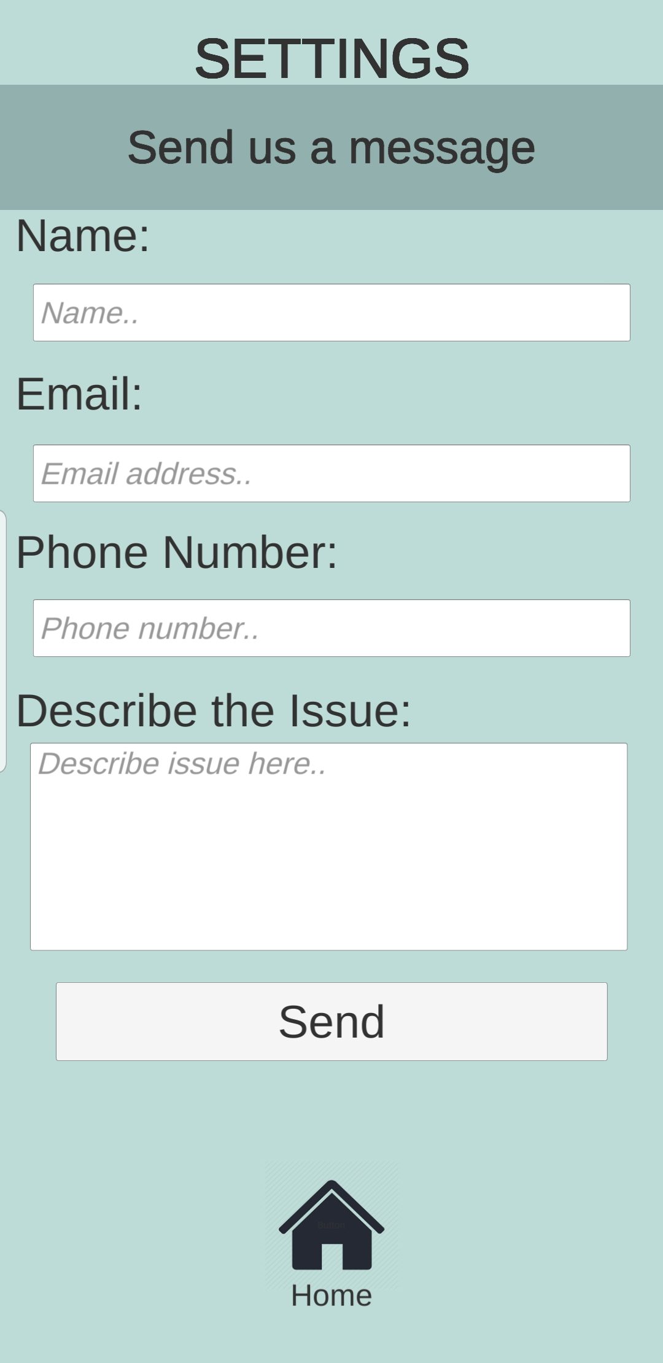
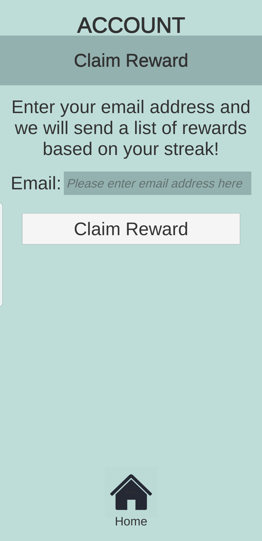
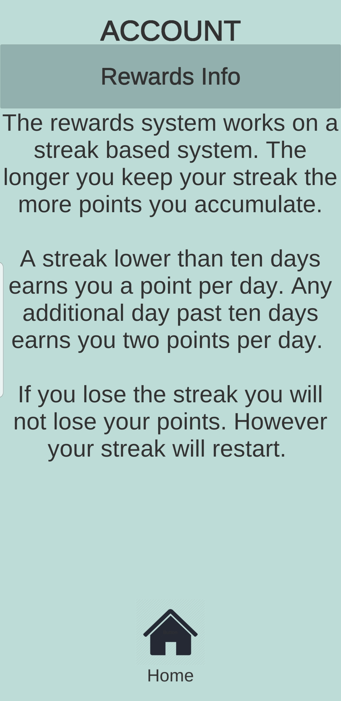
Final Prototype

Slide 13
Reward System
Based on user streak
Rewards info page explains the system to the user
List of possible rewards sent to email address (user can choose)
Partner with local sustainable brands (future objective)

Slide 14
Benchmarking - Expectations
Criteria | Benchmark | Final Product
Size and Dimension (mb) | 100mb | 31.7mb
Efficiency (%) | 90% | 75%
Performance time (sec) | 30sec to 60sec | Avg. 17sec Various age groups tested
Complexity (# actions) | 5-8 actions | Recognizes item: 3 actions Doesn’t/user tries again: 4 actions Manual search: 6 actions
Cost ($ CAD) | $100 | $0 (cost to create - implementation cost and maintenance not included)
Green - Exceeded goal Yellow - Met goal Red - Fell below goal

