Slide 1
Recycling Application Prototype I
Notes:
Branden

Slide 2
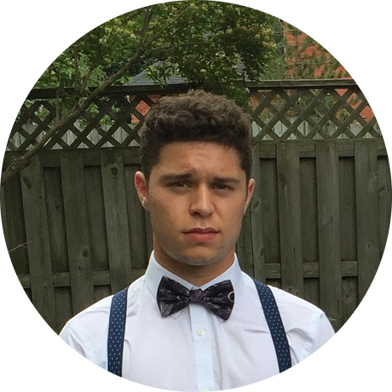
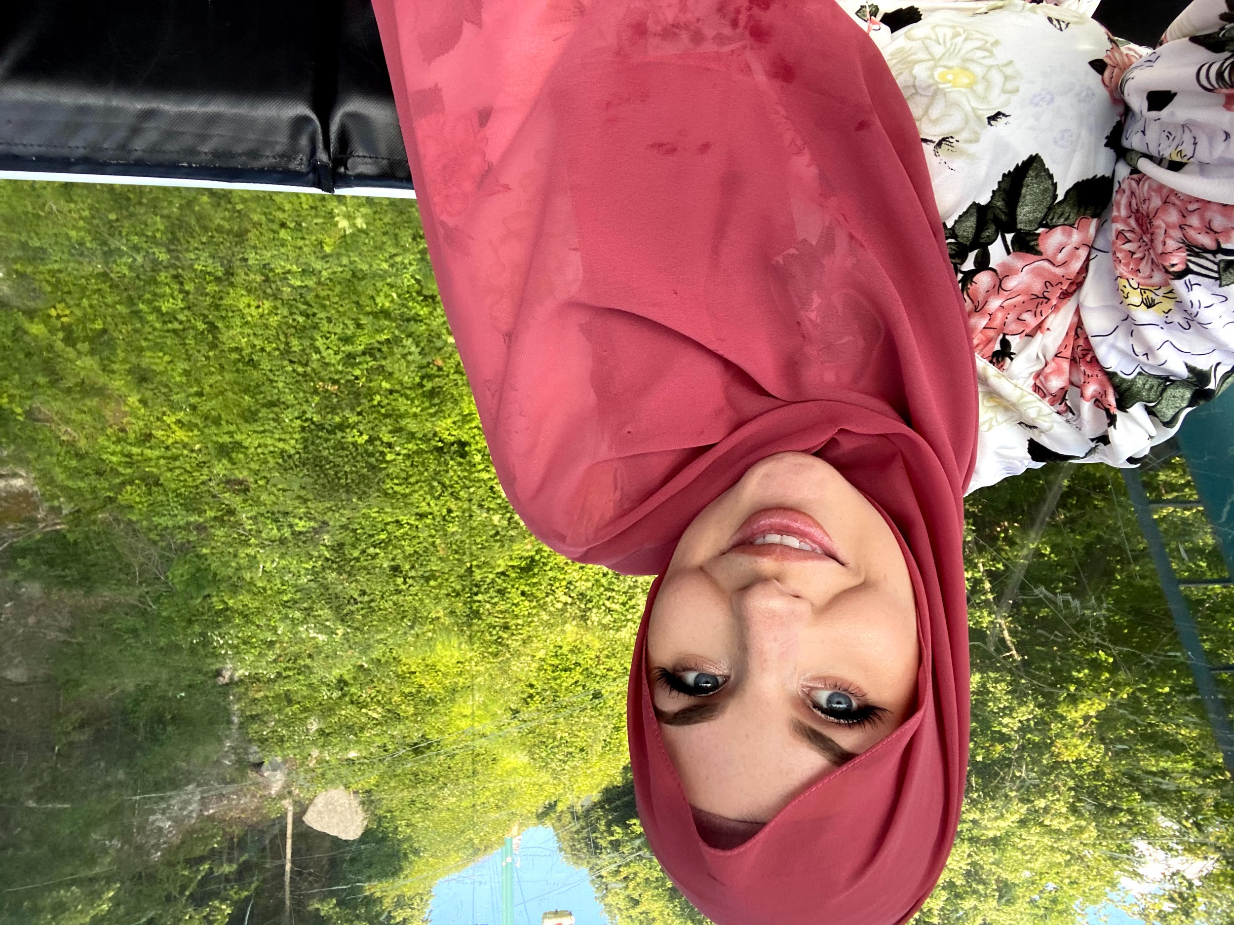
Our Team
Branden Leung BASc. Electrical Engineering
Monica Harada BASc. Electrical Engineering
Ethan Leung BASc. Electrical Engineering
Alexander Fournier BASc. Chemical Engineering
Keera Moretti BASc. Chemical Engineering
Notes:
Branden (Introduce ourselves in order of picture)

Slide 3
The Problem
Misplacement of waste into the incorrect bins
Resulting in inefficient recycling and overflow of landfills
Improper recycling
Cross contamination of garbage and recycled products ending up in the incorrect facility
Negative environmental impacts
Notes:
Branden

Slide 4
Client Needs
What we gathered from the first client meeting
Notes:
Keera

Slide 5
Interpreted Needs
Needs Priority
Categorize and differentiate different types of garbage into their recycling categories
Application to have a 95% accuracy/success rate when analyzing a garbage item
User friendly, widely available and targeted towards all mobile device users
Must comply with recycling regulations for the city of Ottawa
Cost effective solution
Notes:
Keera

Slide 6
Project Progression
Concept and design brainstorm individually
Gather information from client
Start to build and test basic application
1
3
5
2
4
6
Needs and problem statement
Concept and design elimination, organization, refinement with group
Finished Product
Notes:
Keera

Slide 7
USER STATISTICS
5,200,000,000 mobile users
World Wide
31,380,000 mobile users
In Canada
80% items in landfills
Can be recycled
Notes:
Branden

Slide 8
Current Design
Augmented Reality App
Designed in Unity
Local Database
Notes:
Ethan - AR app through Unity

Slide 9
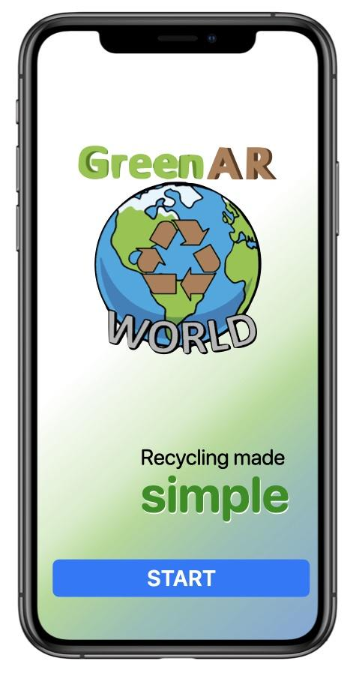
Introduction Screen
Minimalist Concept
Team Slogan
Simple Start Button
Notes:
Ethan - Gradient Green background

Slide 10
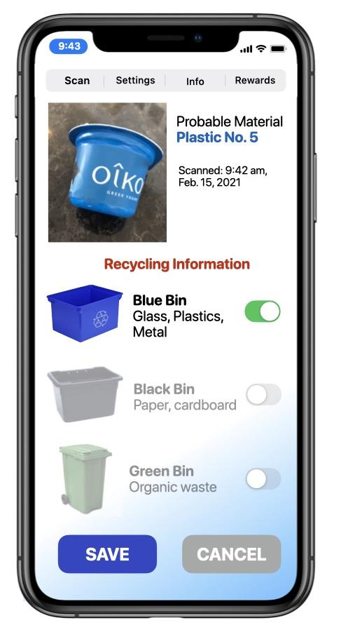
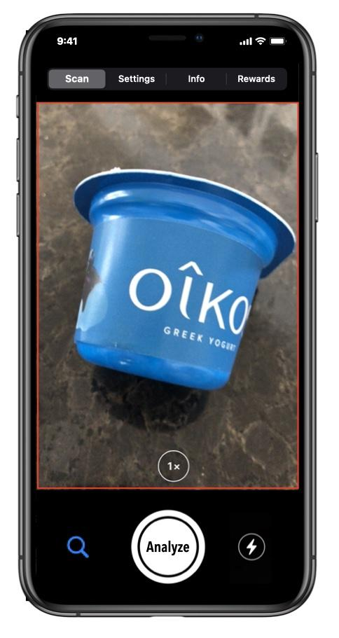
Main Screen
Augmented Reality Design
Large Camera view, with an Analyze, Search, and Flash toggle.
Bar Menu along the top, with Settings, Info, and Rewards menu access.
Analyze button will display disposal information.
Notes:
Ethan

Slide 11
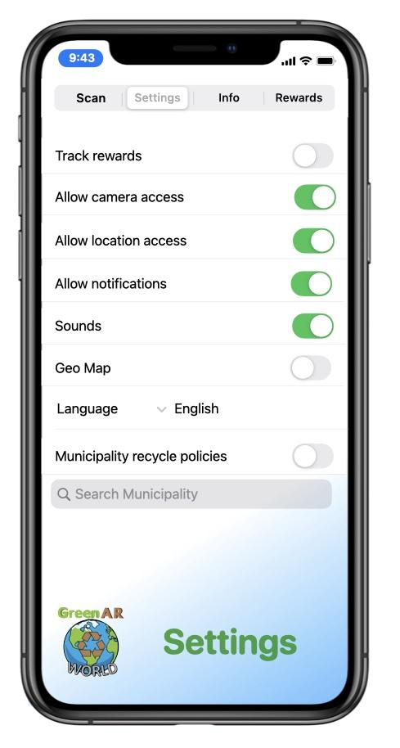
Internal Settings
Options for Rewards Tracking.
Basic system access.
Language selector.
Geo-map capability
Notes:
Monica
-not over complicate settings
-easily navigate between menus as seen on the top
-

Slide 12
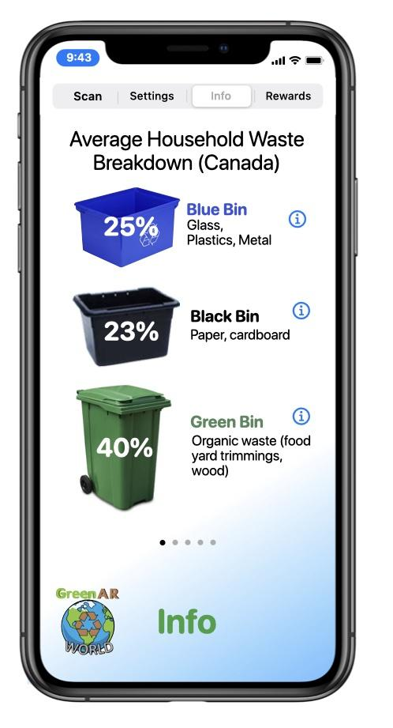
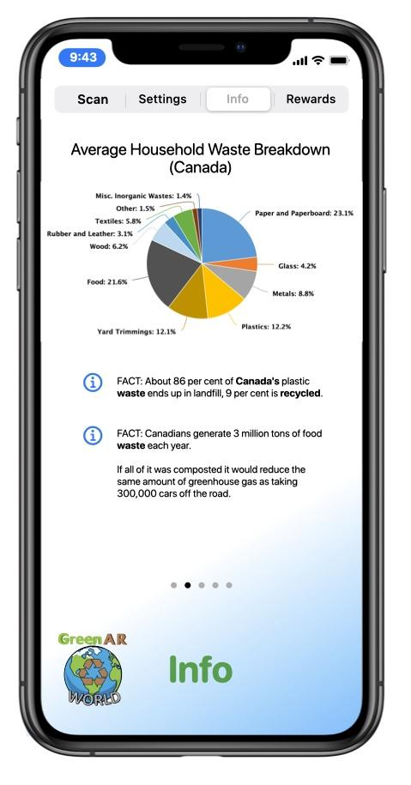
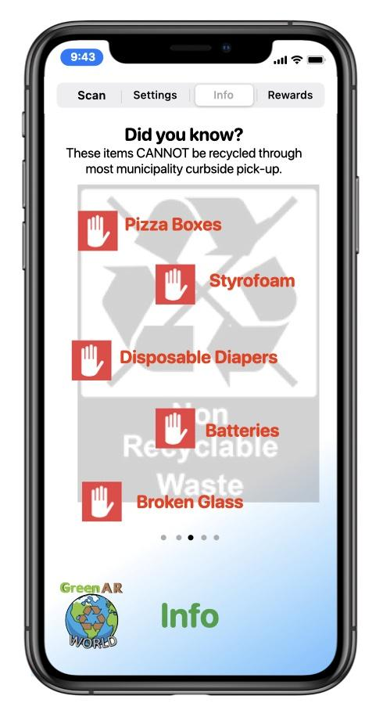
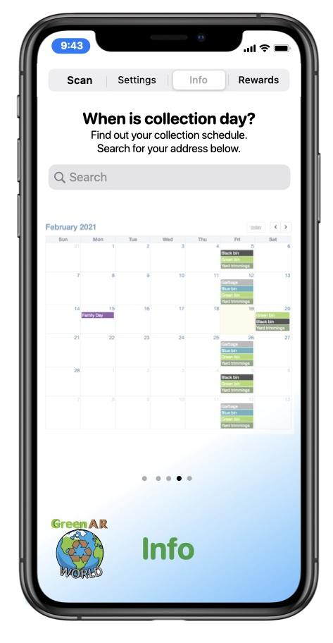
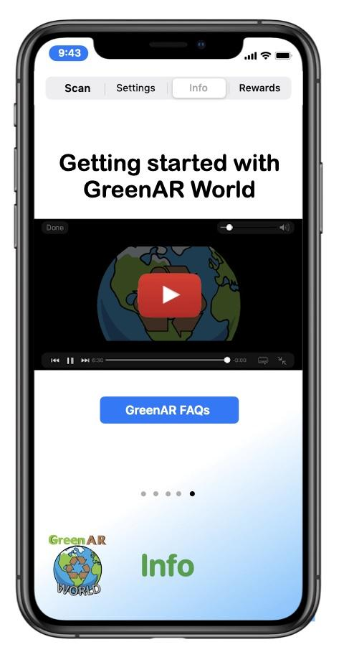
Information Menu
Relevant statistics regarding waste disposal
A collection schedule relevant to your location.
A tutorial video for new users of the app.
A FAQ’s link.
Notes:
Monica
-statistics of proper waste disposal and recycle in the city, country, world
-average household garbage disposal breakdown
-page specifically to emphasize what garbage cannot be recycled through municipality curbside pick up and what specific disposal methods need to be used
-implement garbage disposal schedule if area specified
-tutorial

Slide 13
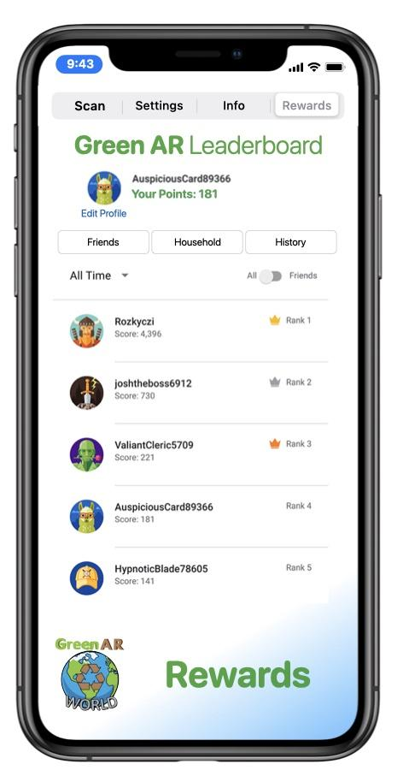
Rewards Screen
Leaderboard
All users
Friends
Households
Profile
Medals Acquired
Total Points
Recycling History
Friends
Add and view your friends stats.
Household
Add friends or family to a household to compete against other households.
Notes:
Alex

Slide 14
Our Questions
What rewards do you recommend offering to application users?
Are the menu options/screens sufficient enough for this application to be appealing to users?
Does it seem user friendly?
Are there any improvements you recommend we make?
Any additional comments?
Notes:
Alex

Slide 15
THANK YOU FOR YOUR TIME
Any feedback or questions?
Notes:
Branden

