Slide 1
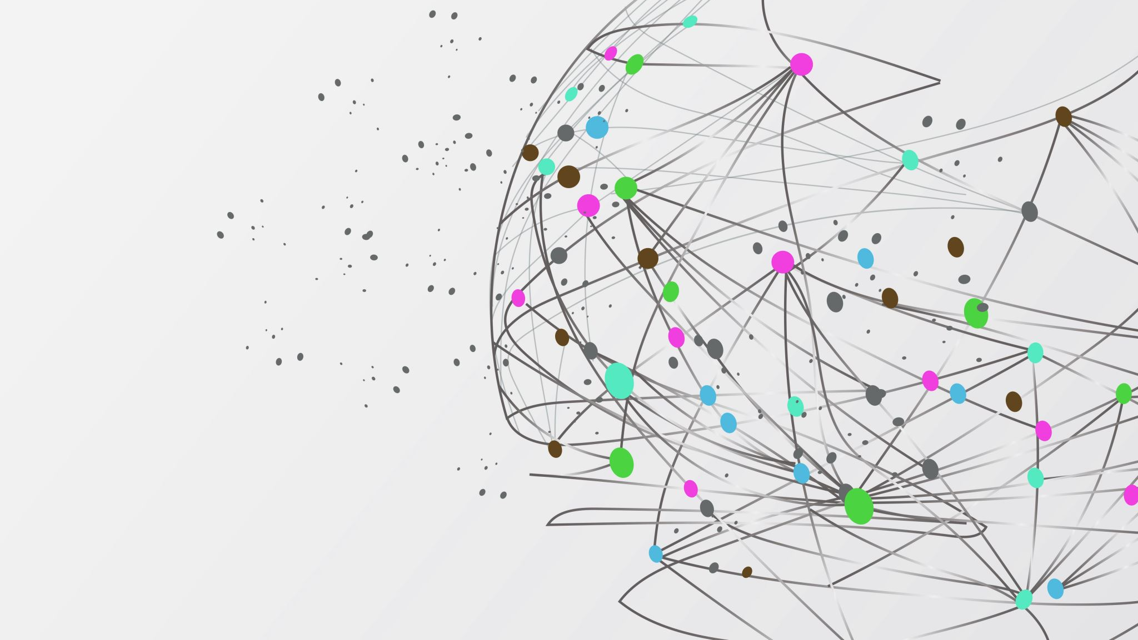
K-Bots: A VR Experience
Group 8
Eunyho Jung George Lai Anuar Magauya Ines Senhadji Ronan William Thomas

Slide 2
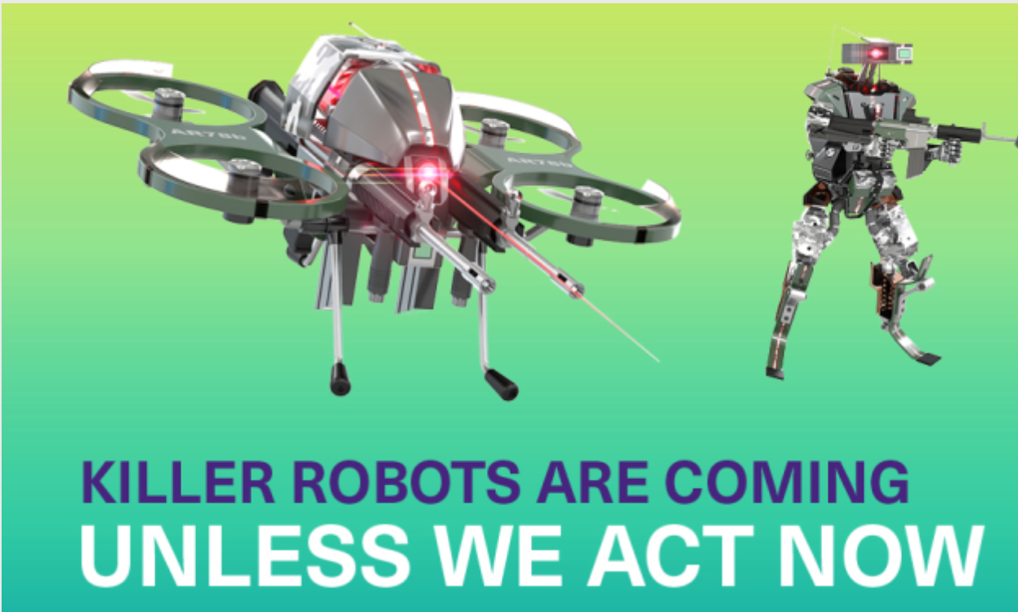
Project Summary
Mines Action Canada seeks a story-driven VR video to persuade politicians to ban autonomous weapons.
Illustrate the impact on non-combatants and the vulnerable.
Emphasize the morality of giving the right to kill to a robot

Slide 3
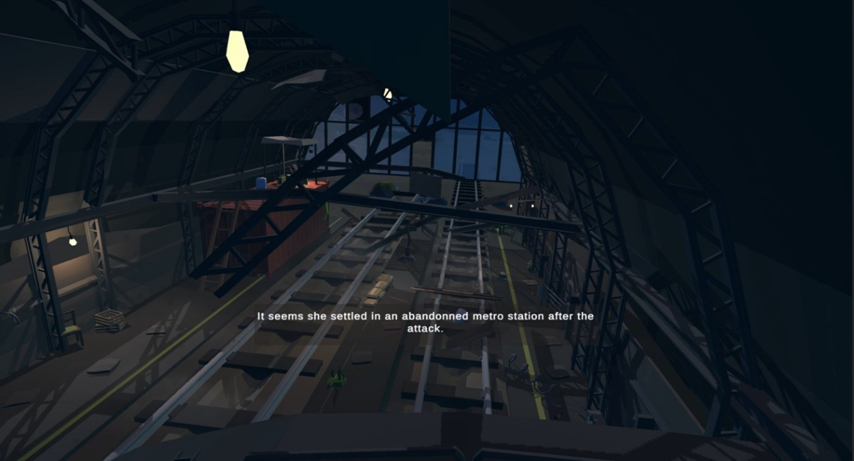
Chosen Concept
Setting: Underground Metro
Characters: Main playable character and NPC
Plot: One lonely survivor underground, reminiscing on the past and how things came to be this way. Eventually is found by automated killer robots.

Slide 4
Decisions Made
Low poly style
Simple, easy to integrate objects of varying detail
Found a good base (metro station) which was already in low poly
Changes to plot
New perspective from ghost of person with disabilities, friend of survivor
Survivor was a designer for the k-bots
Previously from the POV of the survivor

Slide 5
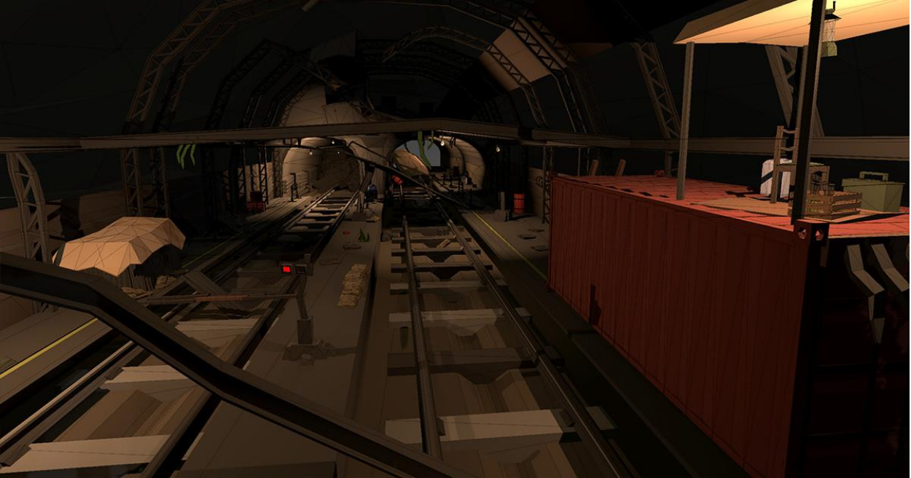
Trials and tribulations
Prototype I
Stable VR environment - Metro station setting + Controllable Player
World interaction - Grab objects and trigger UI events with Oculus controllers
No major bugs, but areas for improvement identified:
- Environment detailing needed:
- Roof, better fog, improved collision detection.
- Player movement refinement:
Smoother turning (right joystick pan view).
Faster movement, responsive

Slide 6
Prototype 2 :
Introduction of animated NPC to prototype.
Animated characters require further work on movement and distortion fixing.
Cinematic mode achieved using Cinemachine
Built-in camera controller
Added subtitles during cutscenes
Bug fixes and improvements:
More detailed box colliders added to differentiate ground vs platform elevation
Nighttime skybox added for atmospheric effect
Lighting adjustments made to increase visibility

Slide 7
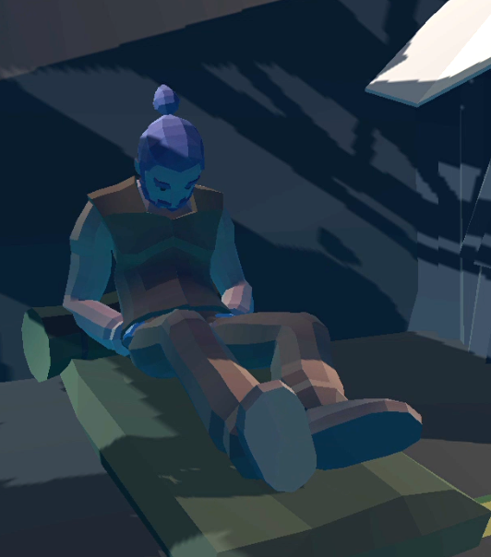
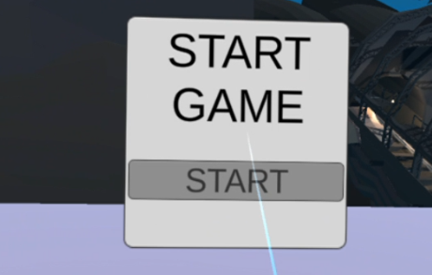
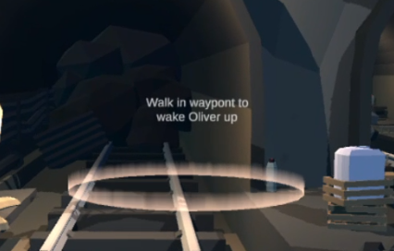
Prototype 3
New story line from the perspective of a ghost
Improved NPC
Fitting low poly style, better animations
Working game menu
Objective waypoints to trigger events
- Used for cutscenes, animation changes, and dialogue

Slide 8
Future work
Audio Enhancement:
High quality audio for immersive storytelling and emotional impact
Implement radio cues for world exposition.
Scene Timing:
Ensure segments are correctly timed for video integration.
Fine-tune timing within the game for optimal pacing
Character Development:
Further flesh out the disabled character's role in story.
Integrate disabled character more deeply into the storyline.
Technical Optimization:
Address gameplay glitches for environment stability.
Ensure all textures are visible for a polished appearance.

Slide 9
Lessons learned
Importance of Effective Design Processes
Balancing Individual Strengths and Team Dynamics
Notes:
Importance of Effective Design Processes
Time management and proper planning
Iterative process -> no hesitation to change plans and go back

Slide 10
Conclusion
Our VR environment is set in a metro station and emphasizes the vulnerability of people with disabilities and the responsibility of k-bot production
Through our prototypes, we learned the importance of proper planning, time management, and the strength of iterative design thinking.
There is still much work to do for design day, but progress should be smooth sailing from now on due to our clear plans

