Slide 1
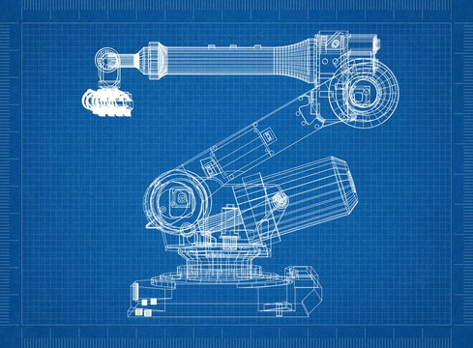
C2.2 RoboGrip
A collection of our group's overall experience when designing and developing this product.

Slide 2

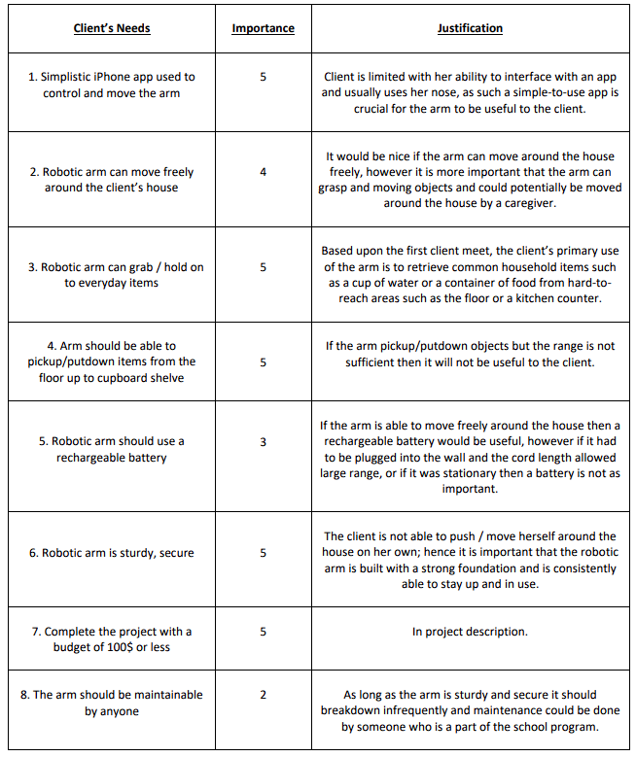

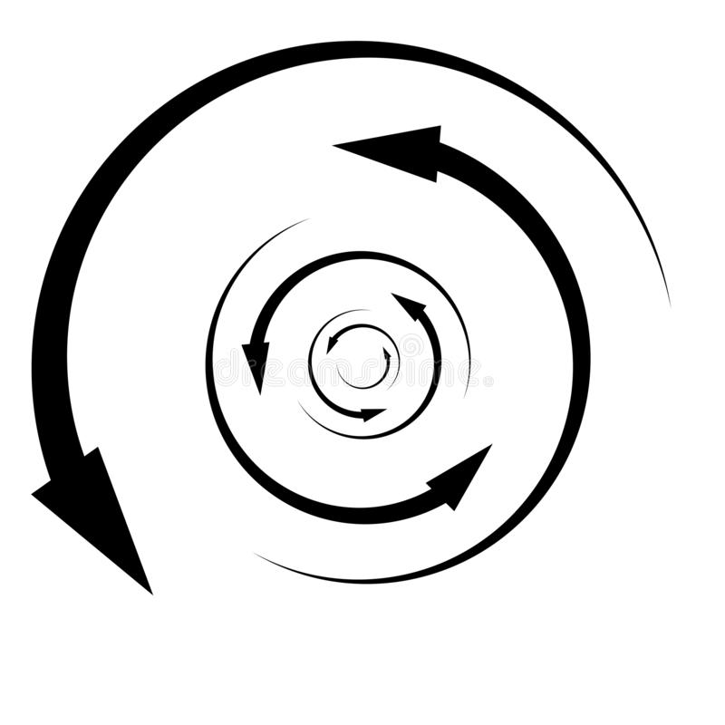
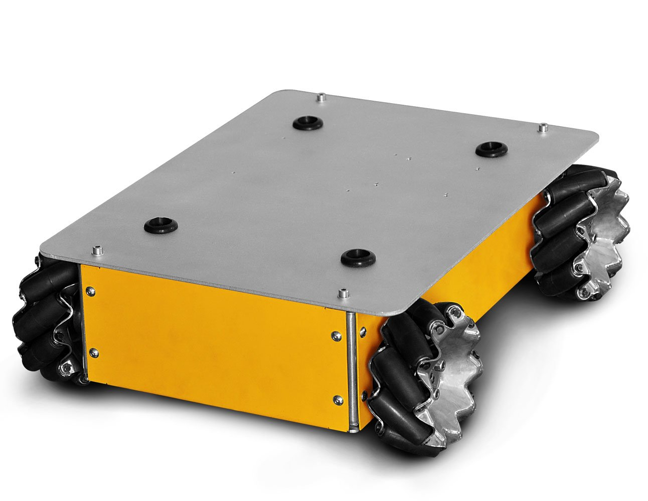
CUSTOMER NEEDS
Problem:
Client has difficulty moving around & picking up household items
Main Priorities:
Easy-to-use iPhone app design
Arm can reach counter ; pick up / put down household items
Robot can move freely around client’s home
Budget was later upgraded to $300

Slide 3
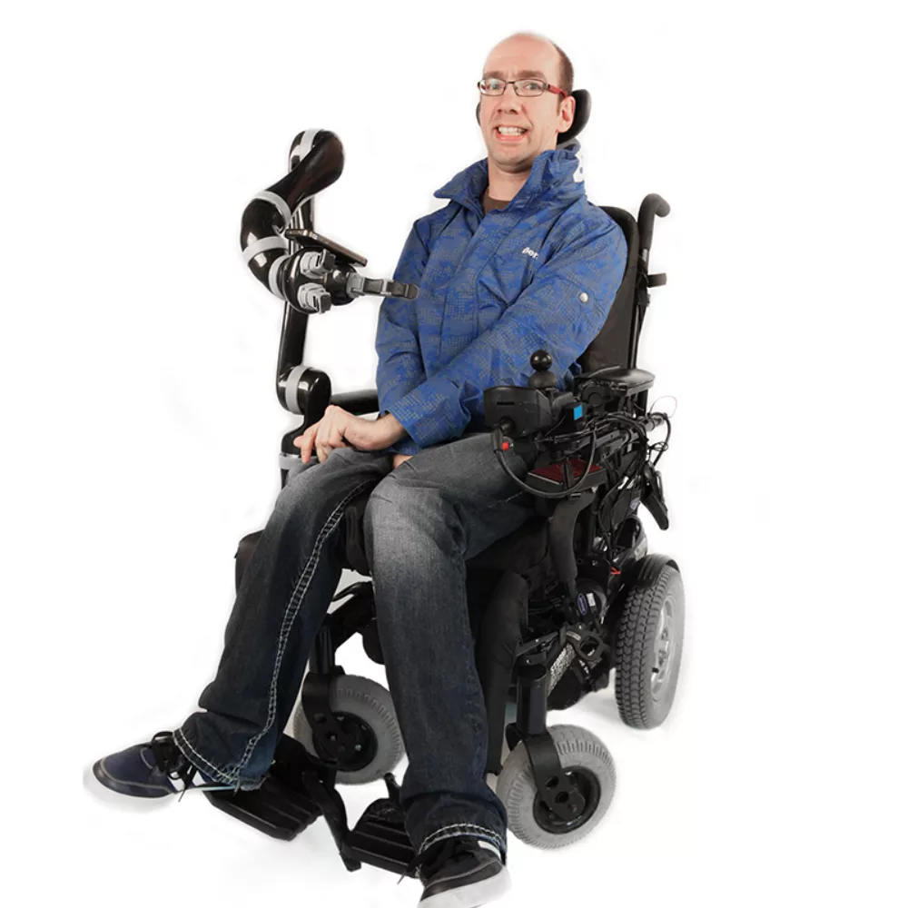
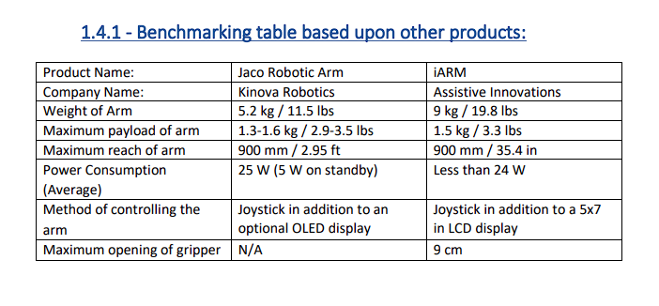
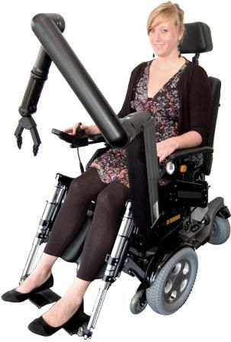
BENCHMARKING & SIMILAR PRODUCTS
Two other similar products: Jaco Robotic Arm and iARM
Both are unable to freely move around
Jaco
iARM

Slide 4
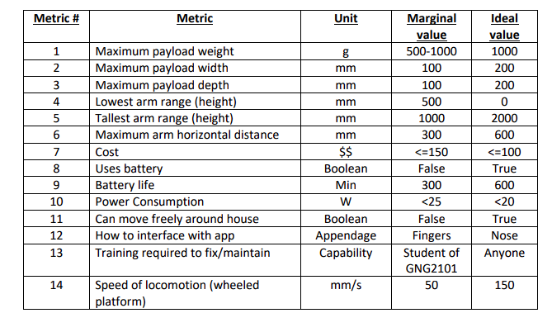
TARGET SPECIFICATIONS

Slide 5
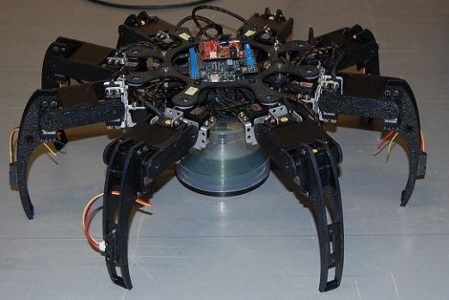
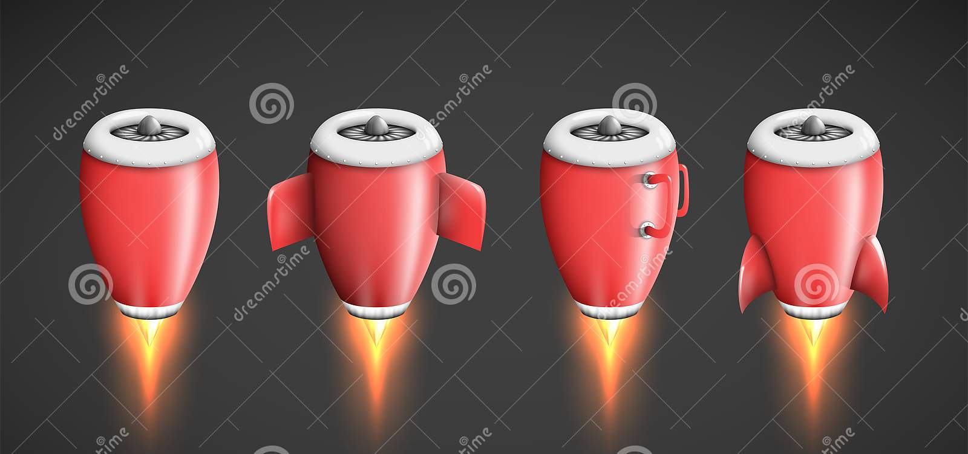
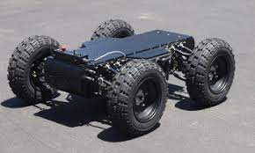
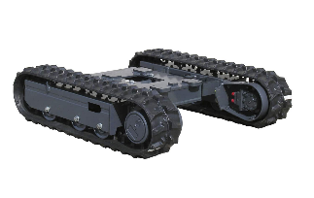
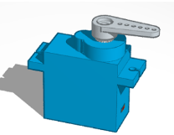
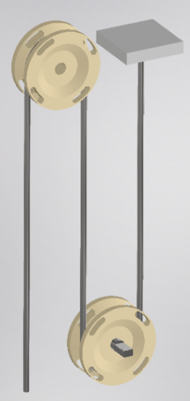
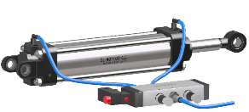
GENERATED CONCEPTS & IDEAS
Method of Locomotion:
Method of Arm Movement

Slide 6
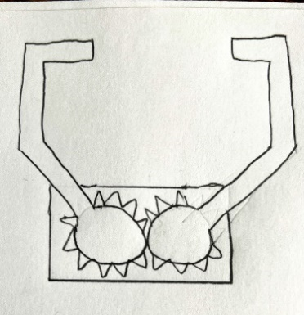
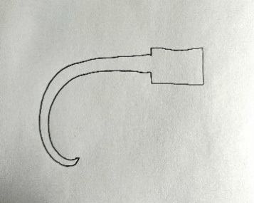
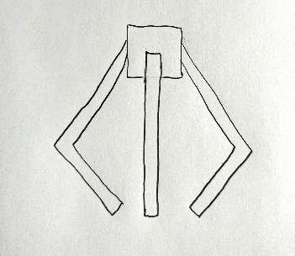
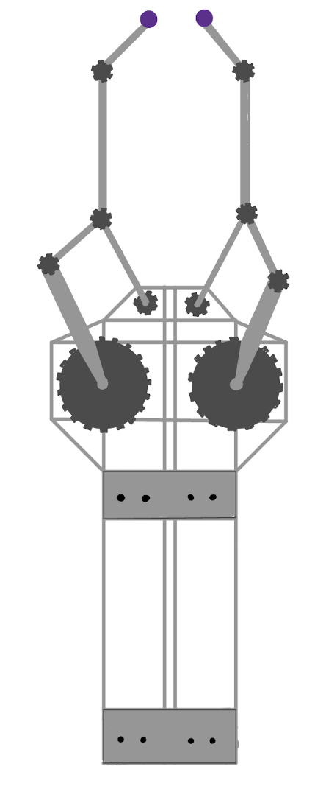
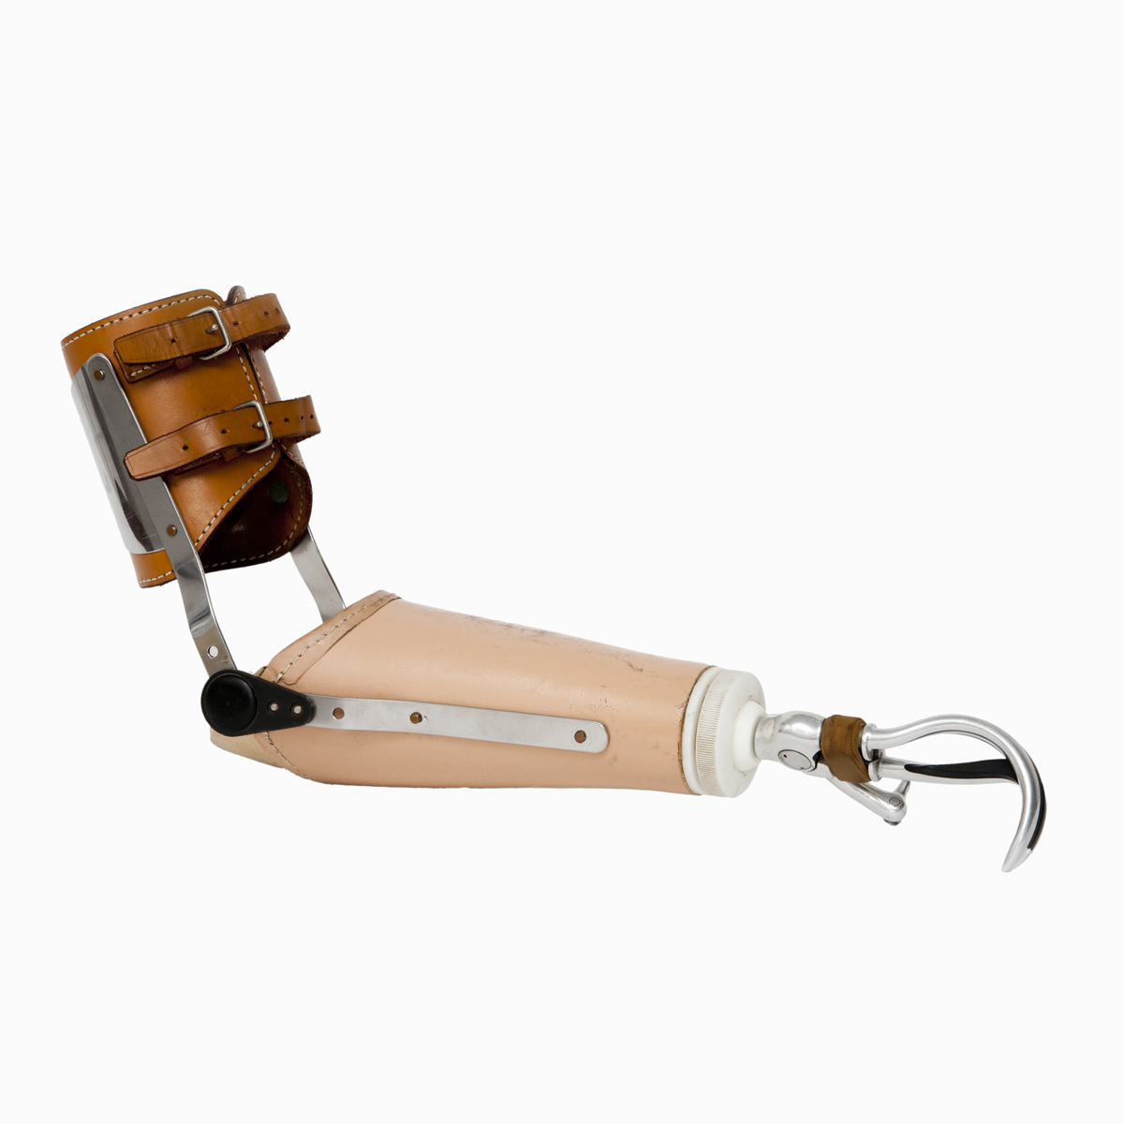
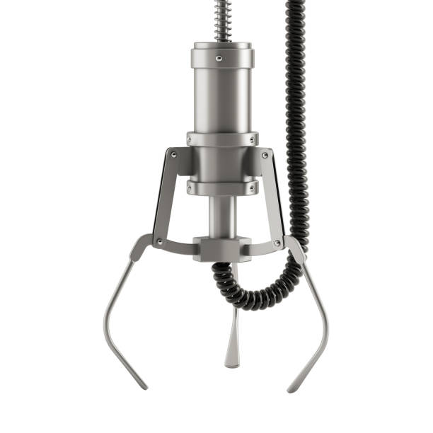
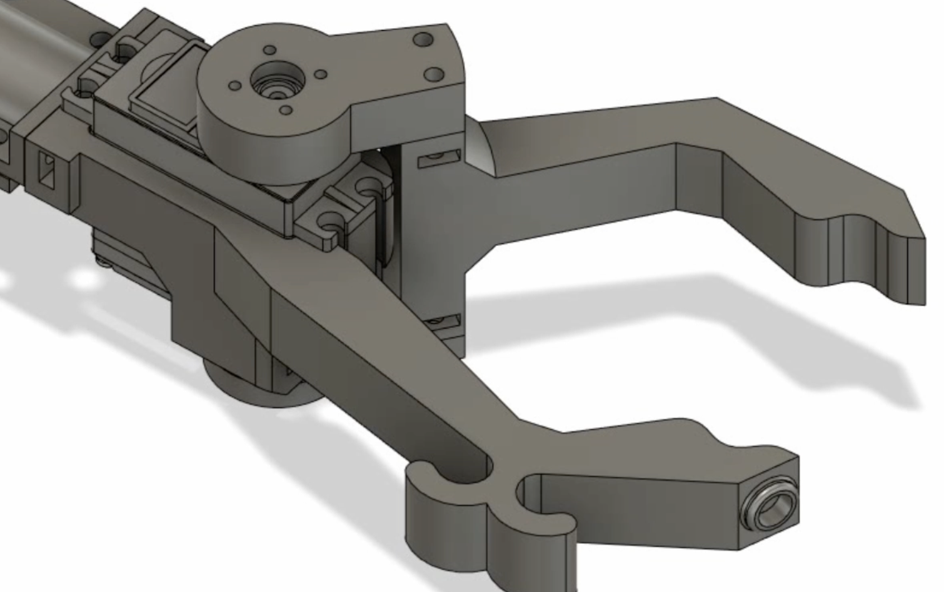
GENERATED CONCEPTS & IDEAS
Hand Mechanisms:

Slide 7


ECONOMICS AND SUSTAINABILITY

Slide 8
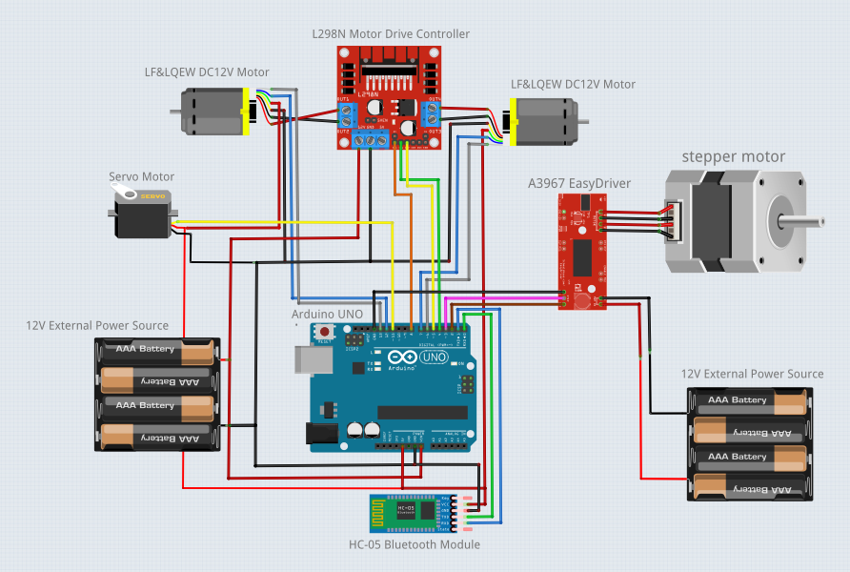
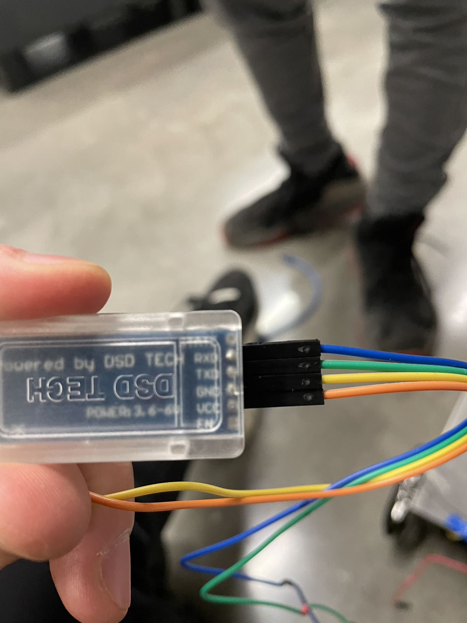
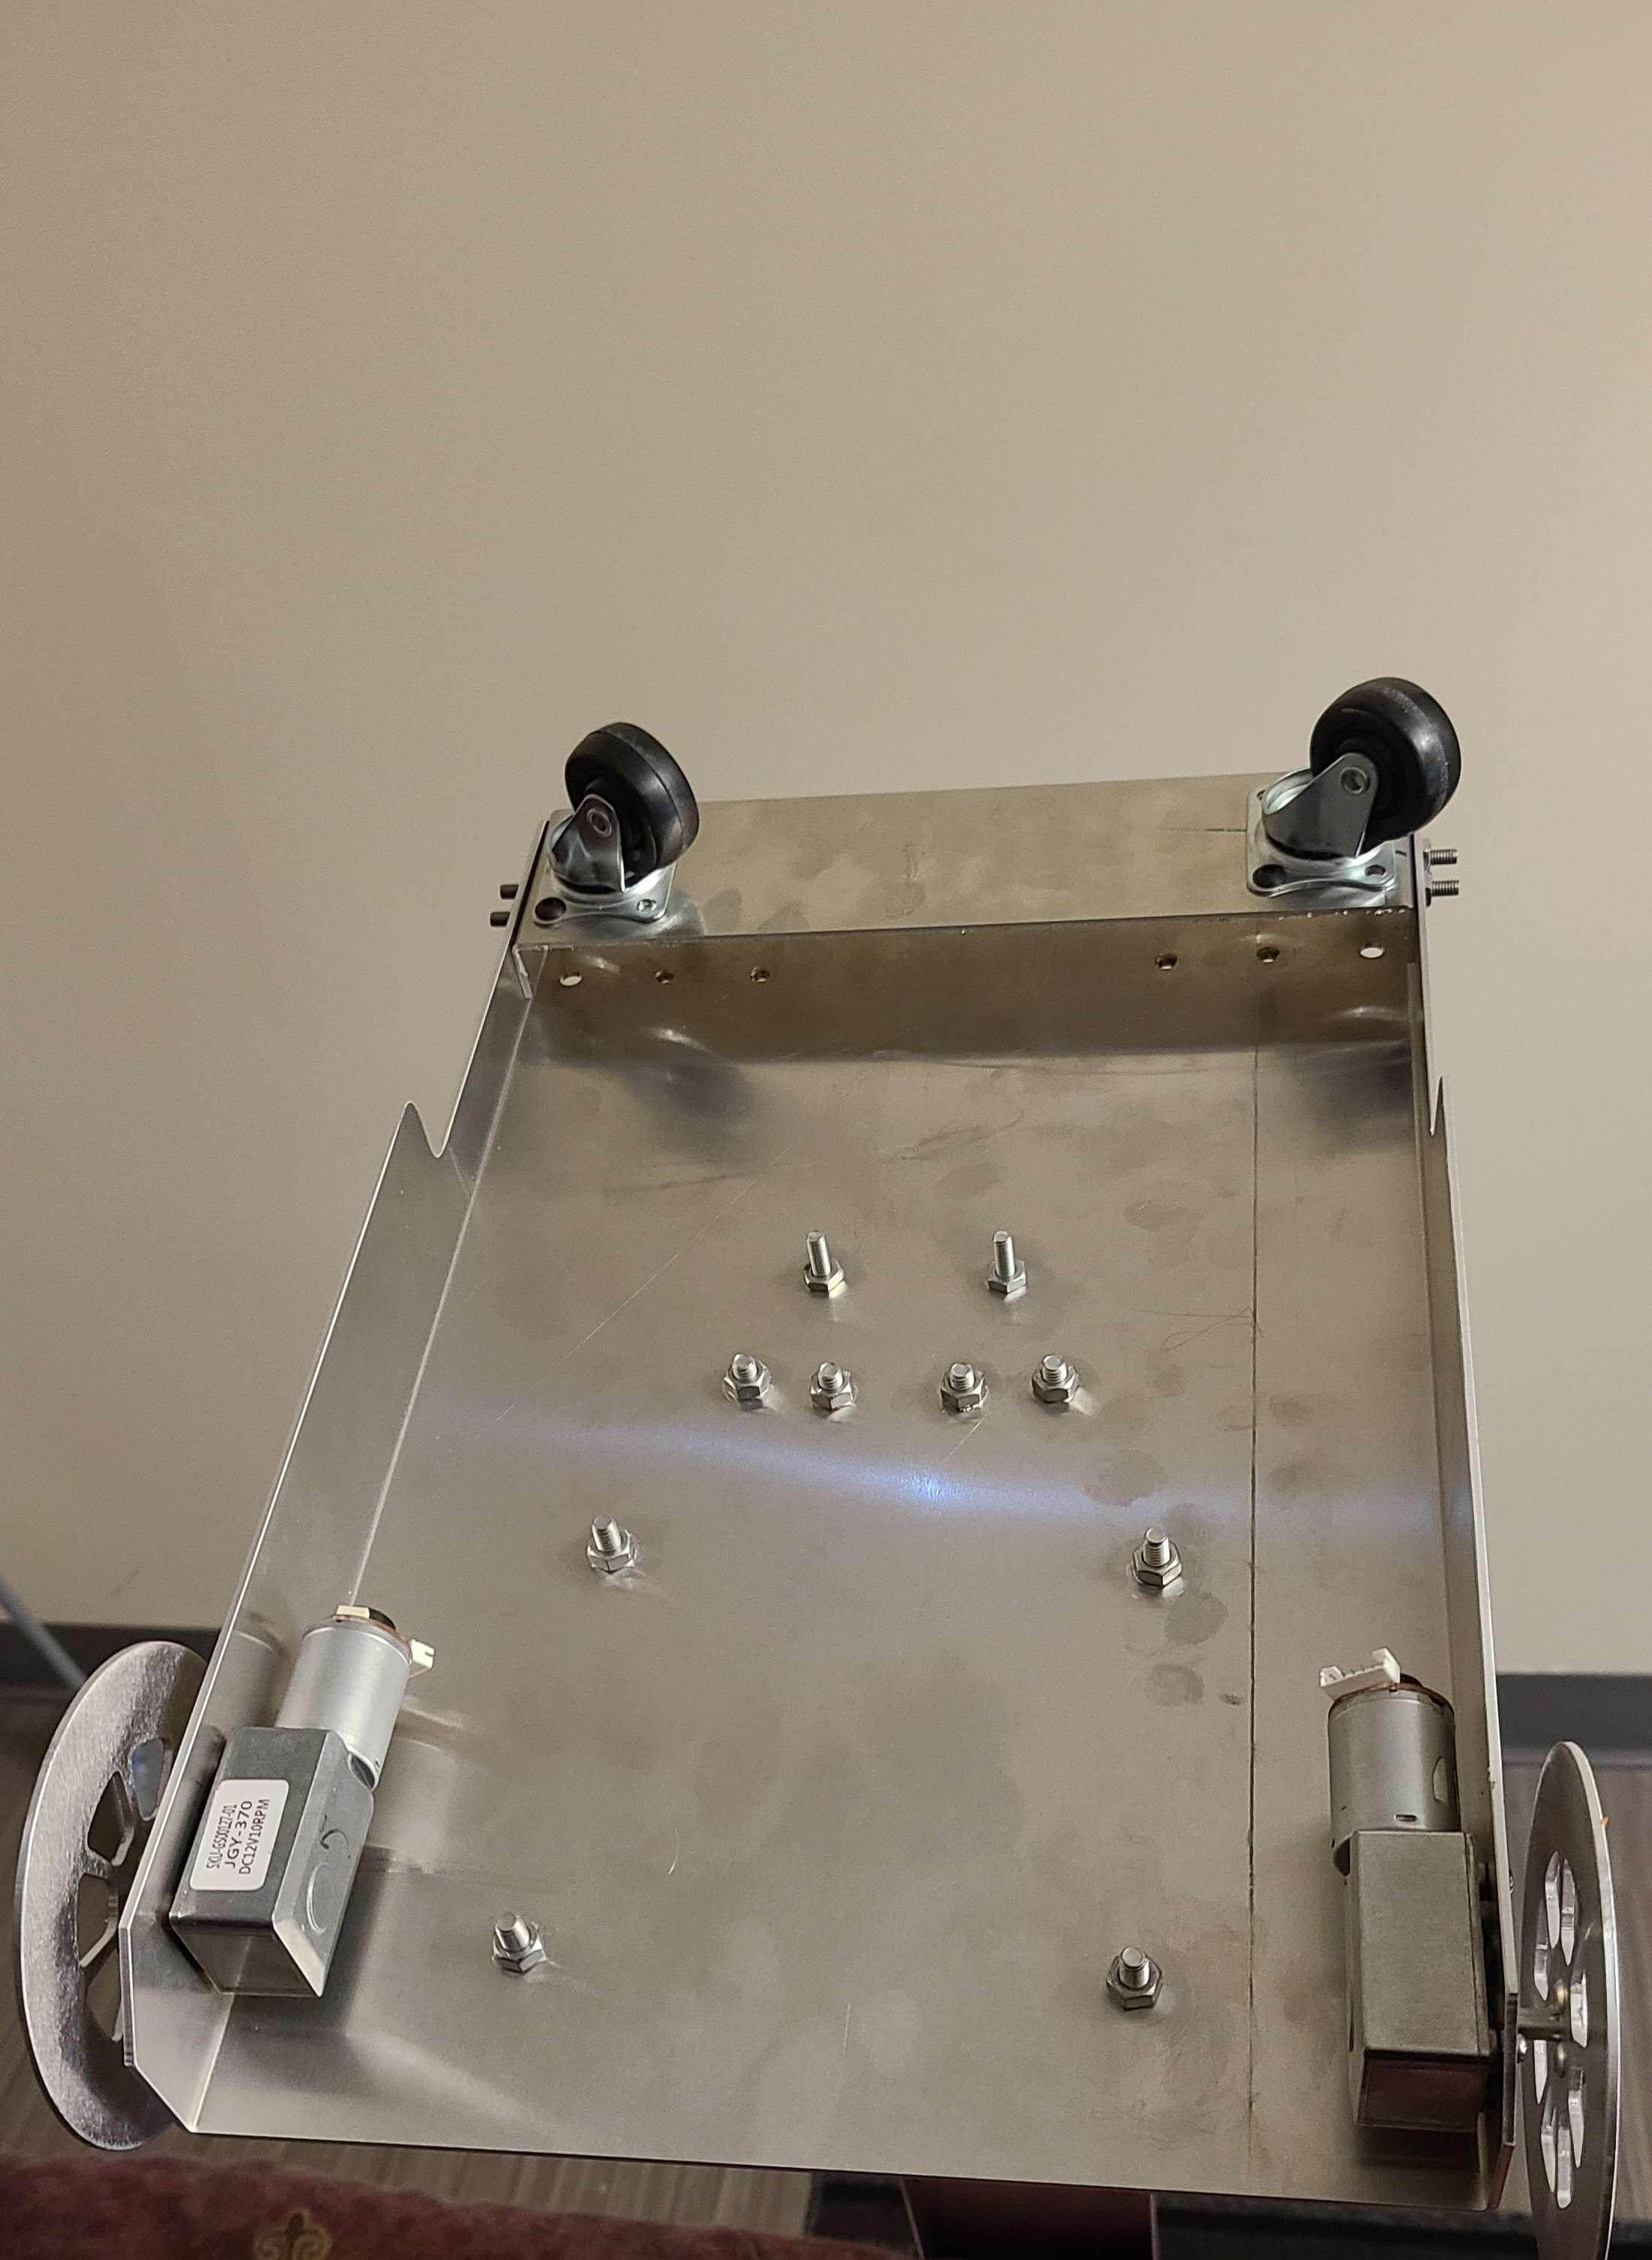
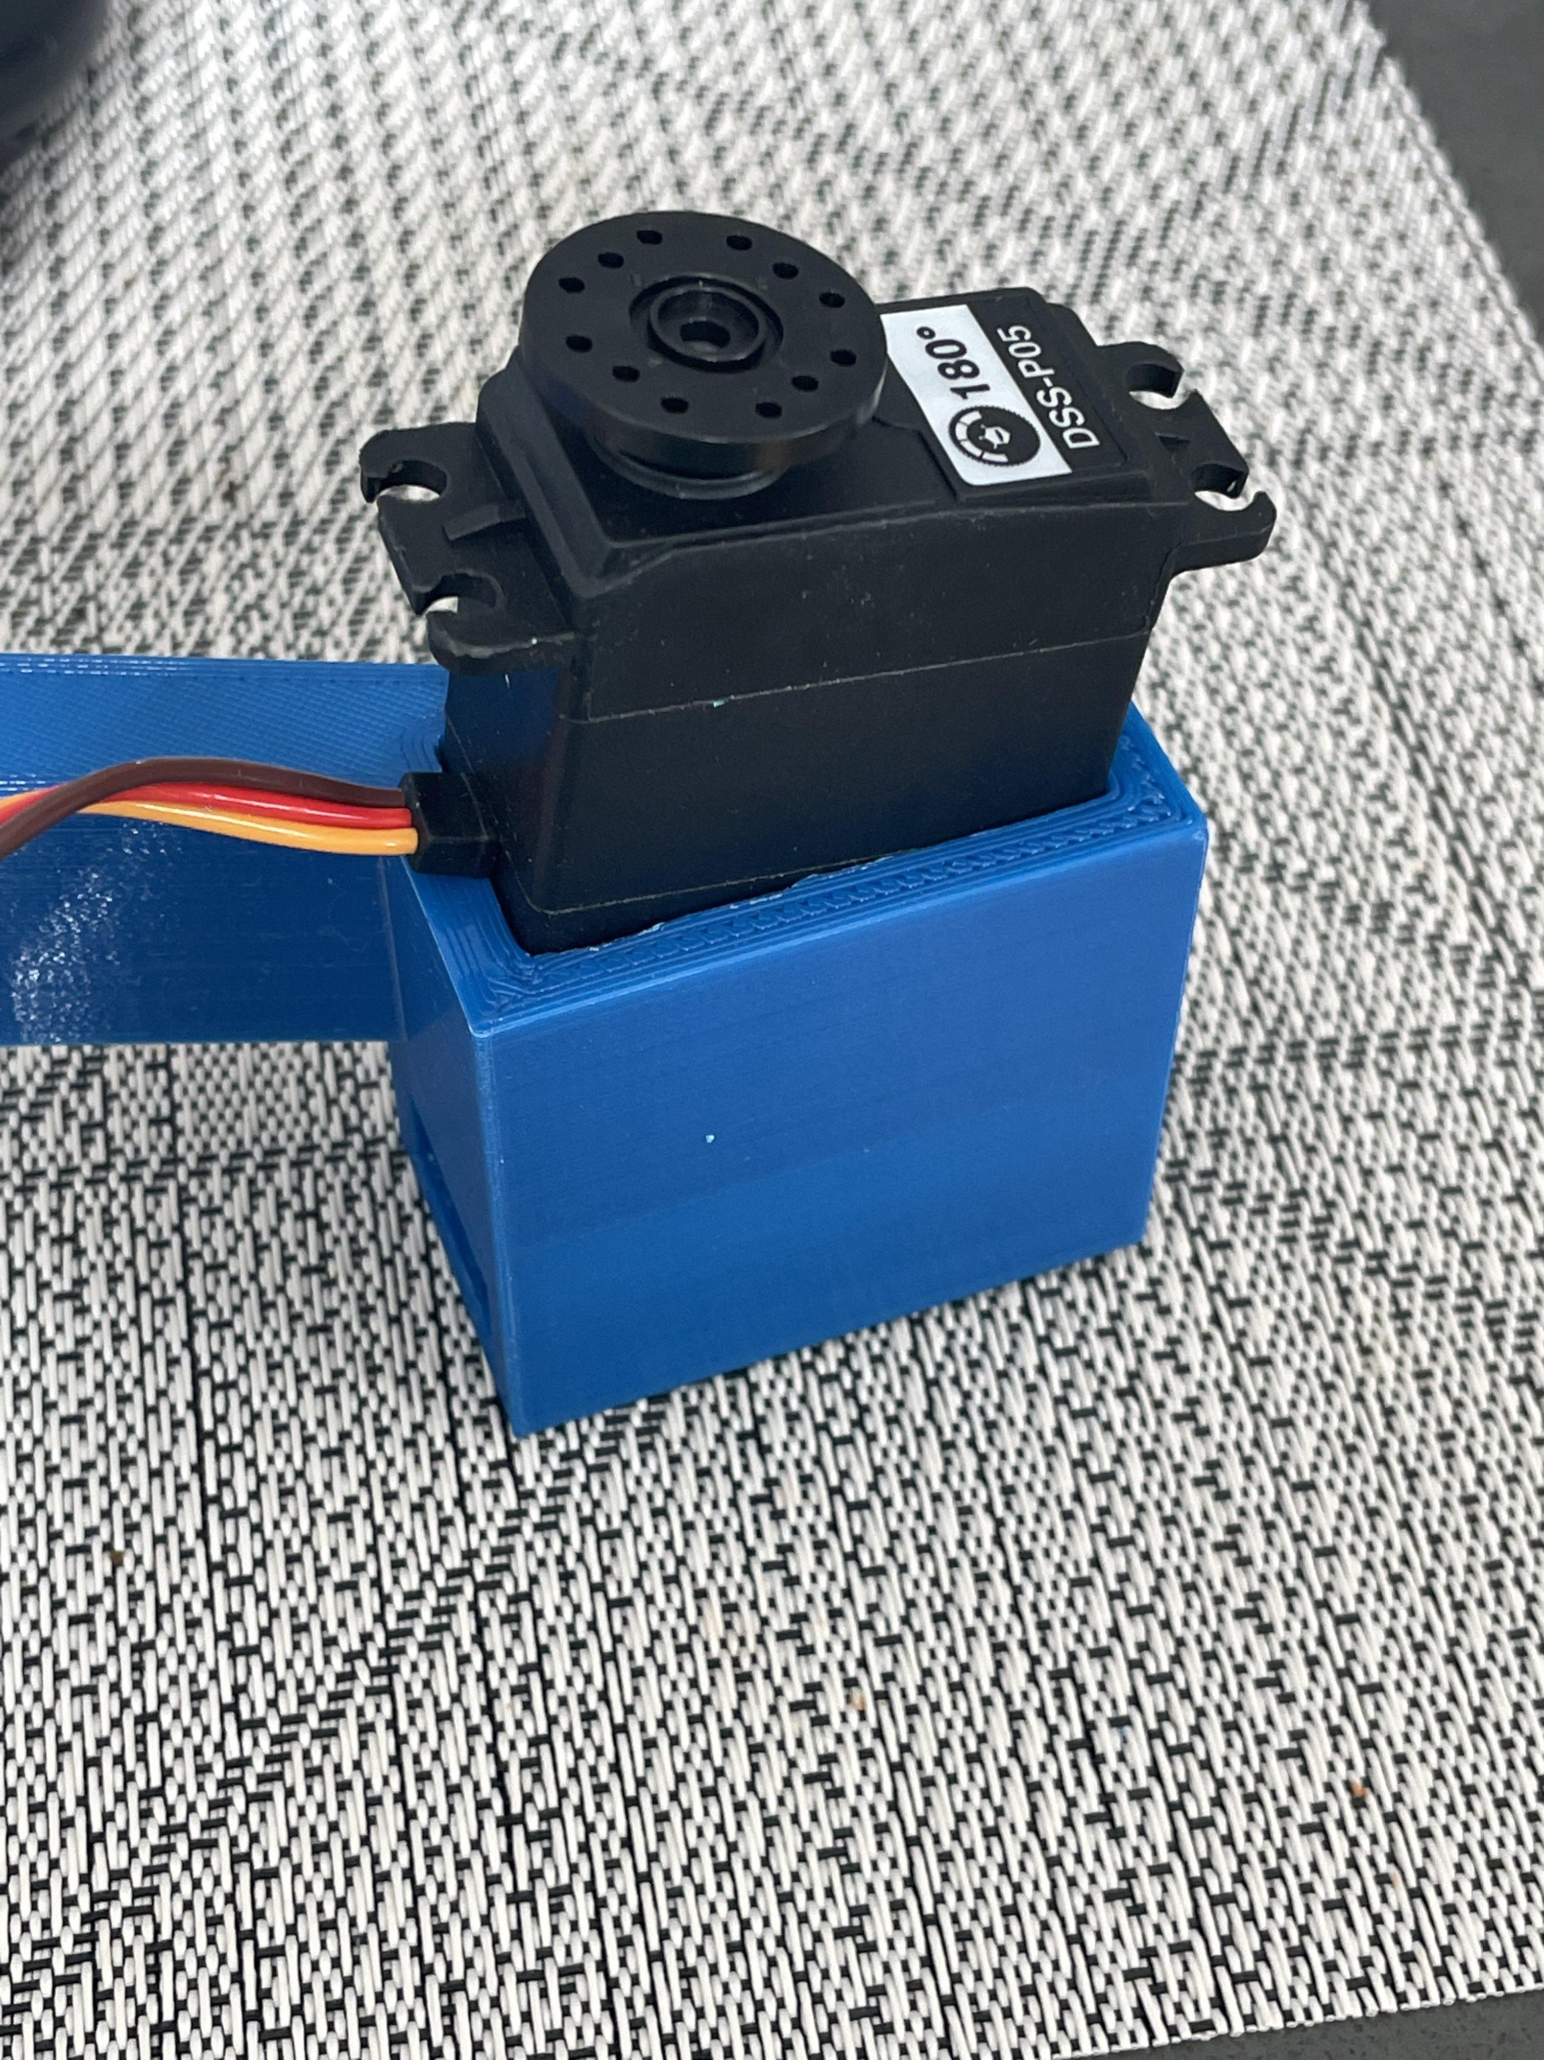
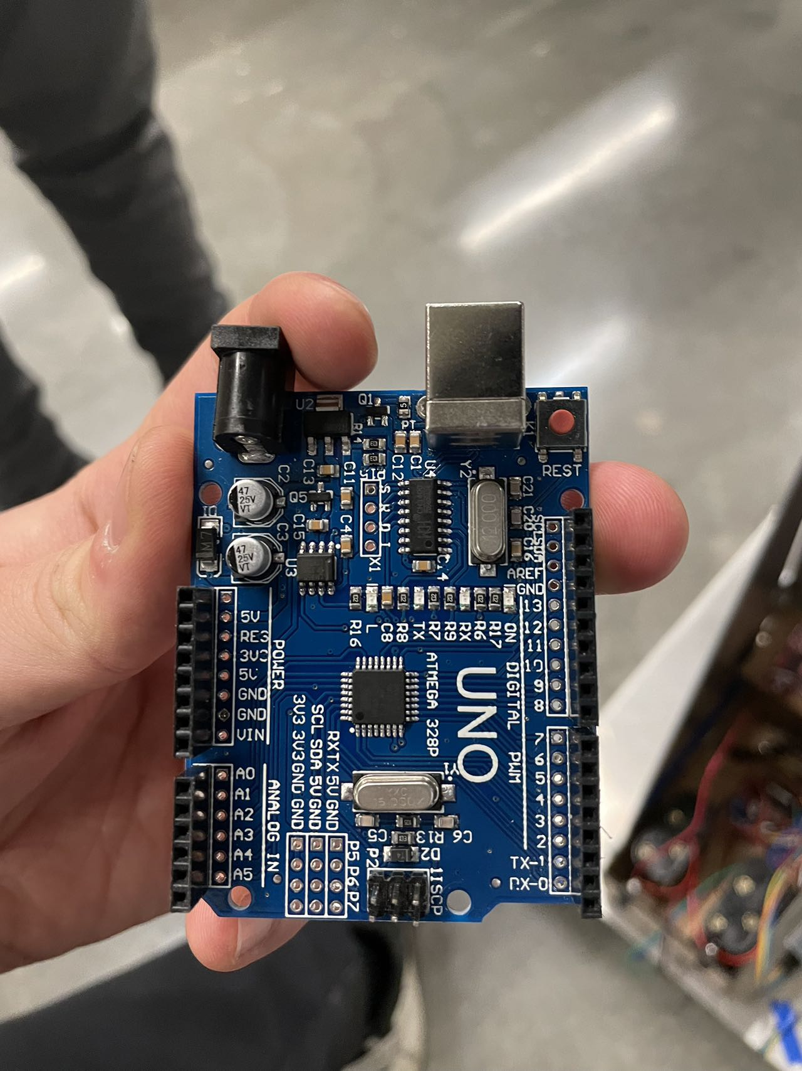
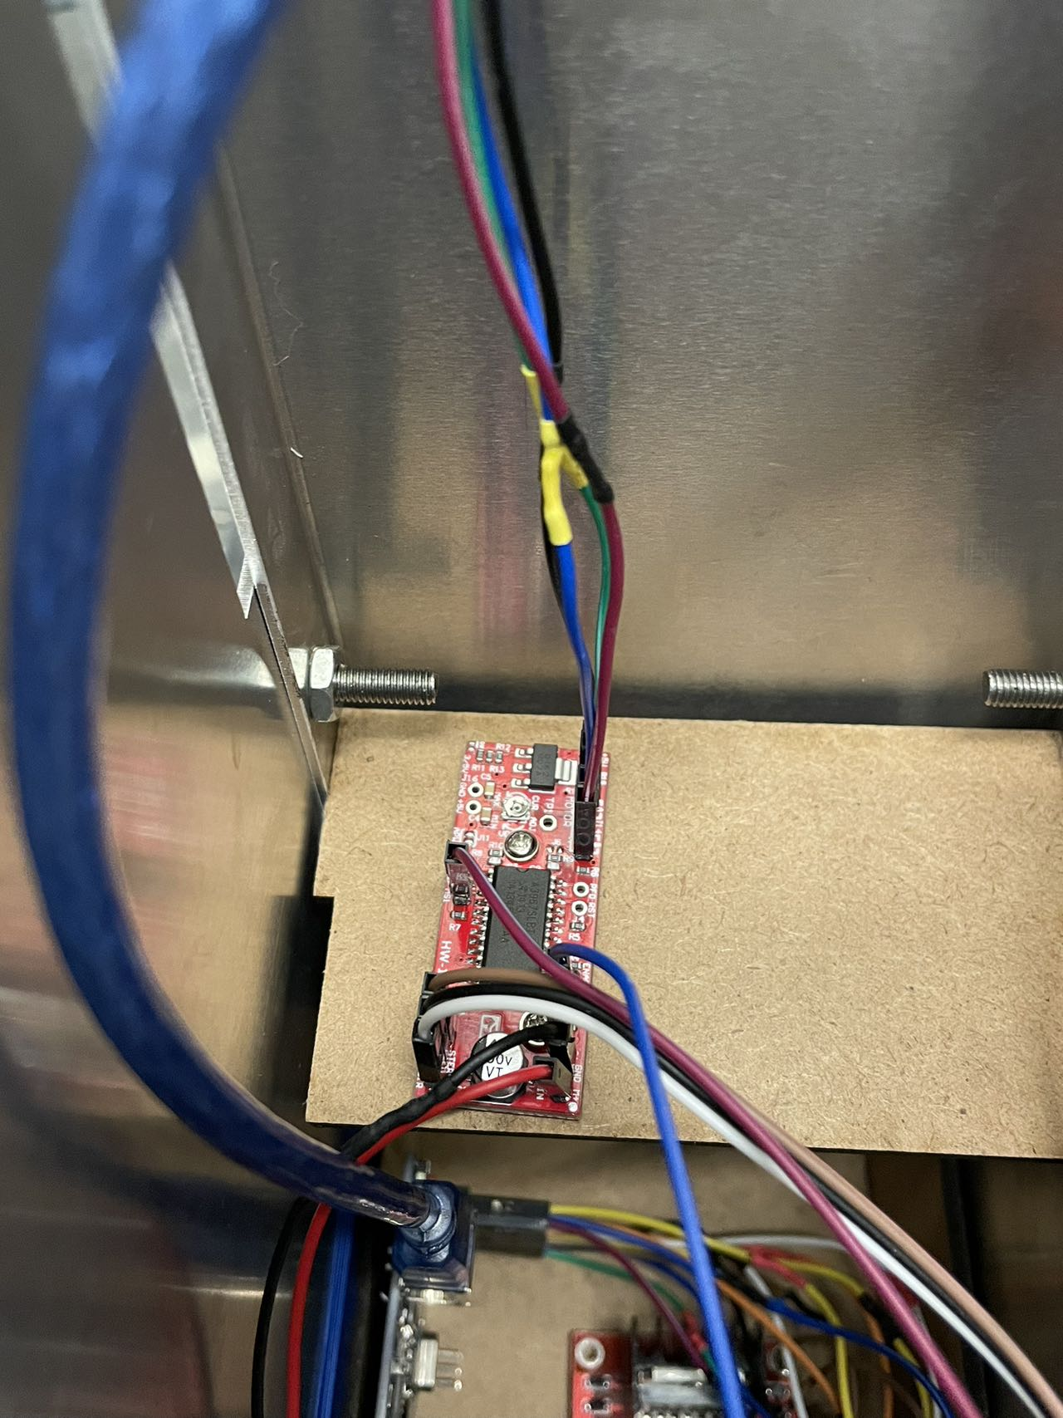
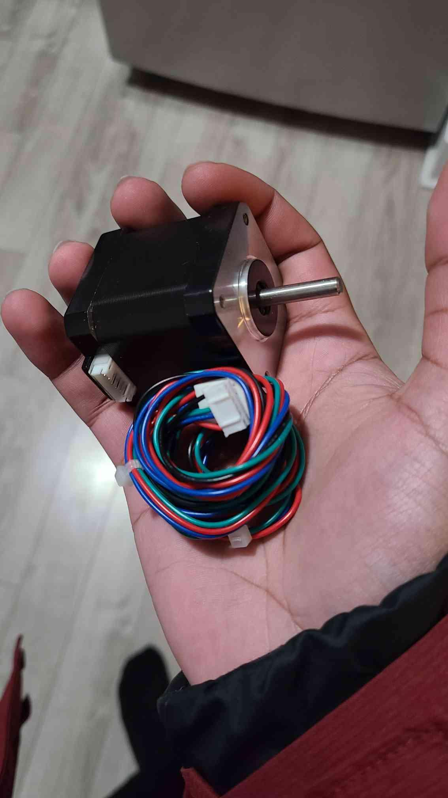
Electrical Section
IDEAS & CONCEPTS:
Using Arduino for controller
Stepper motor chosen for vertical arm motion
Servo motor for claw grabbing and release
DC motors for locomotion

Slide 9
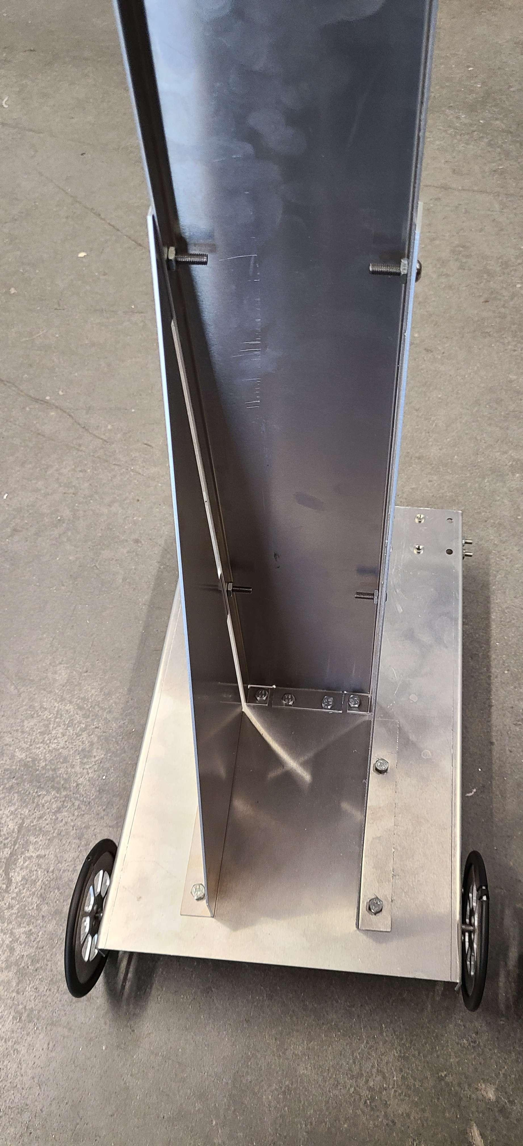
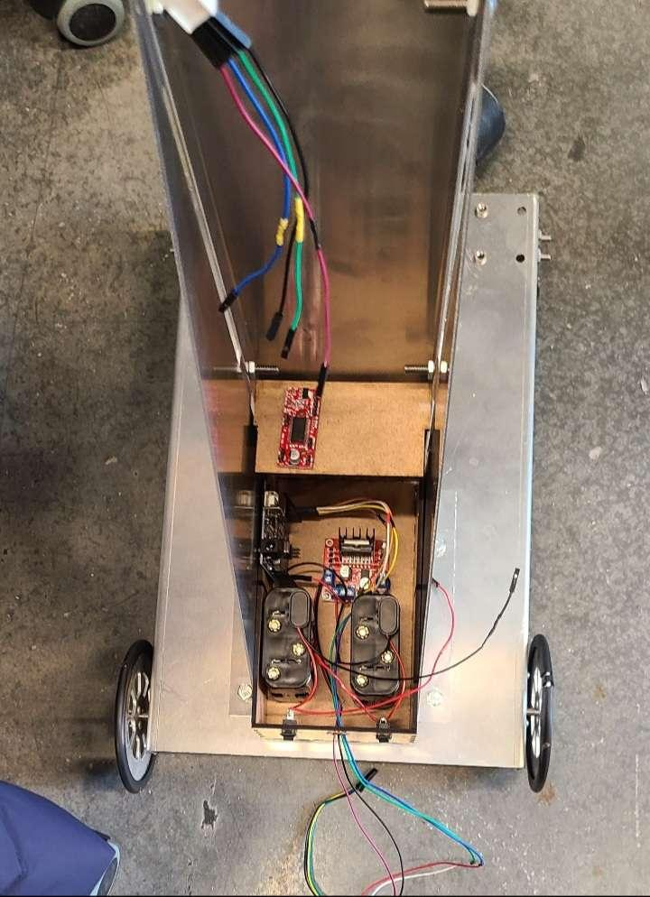
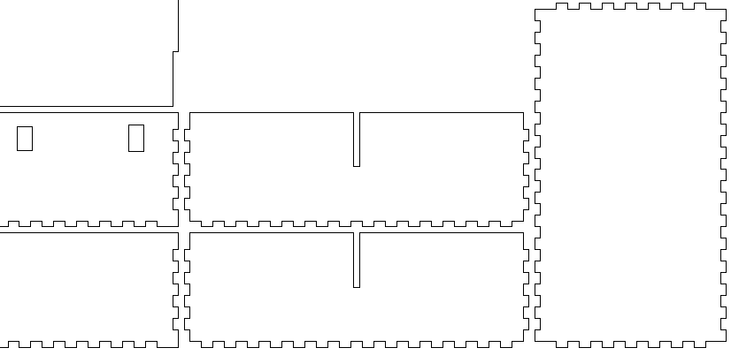
Electrical Section
DECISIONS MADE:
Splitting up the power supply for stepper motor and DC motor to ensure enough current to drive them
Designing a box that contains all electronics to avoid the contact with the metal
Separated Battery Sources
Blueprint of the box for Laser Cutter

Slide 10
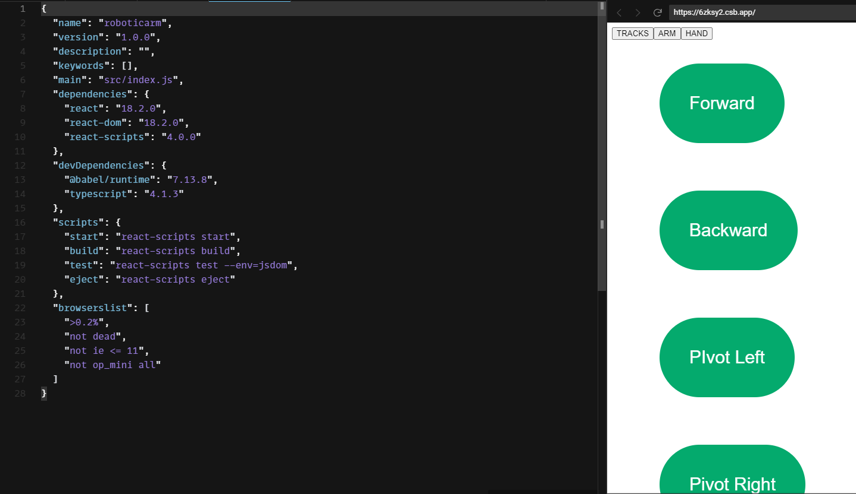
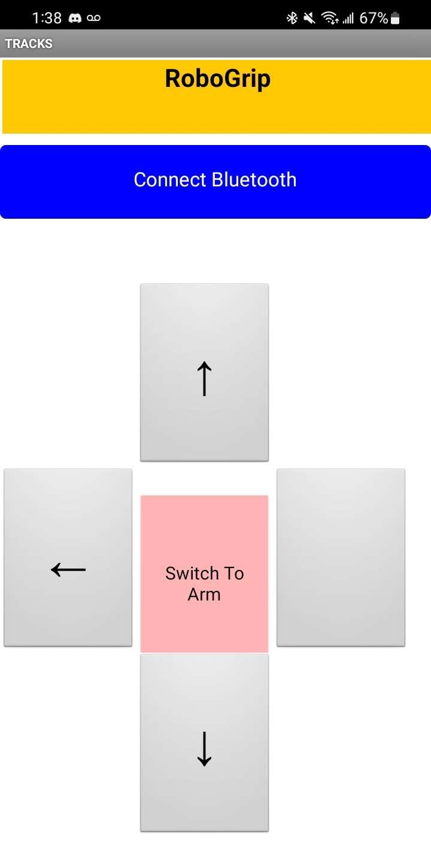
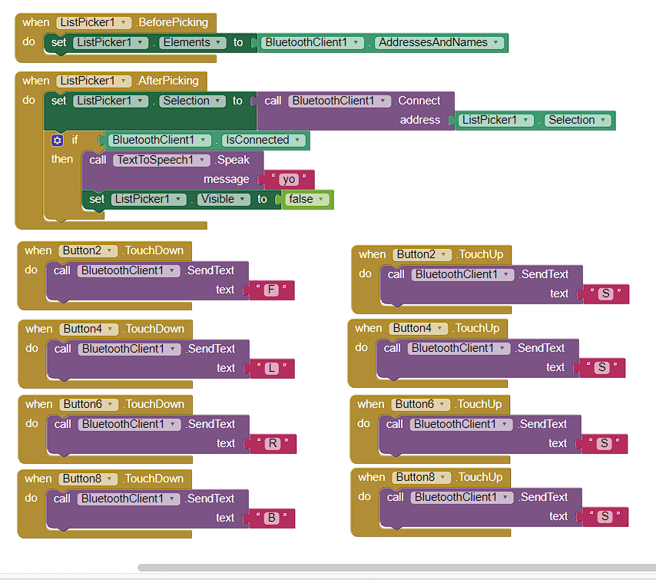
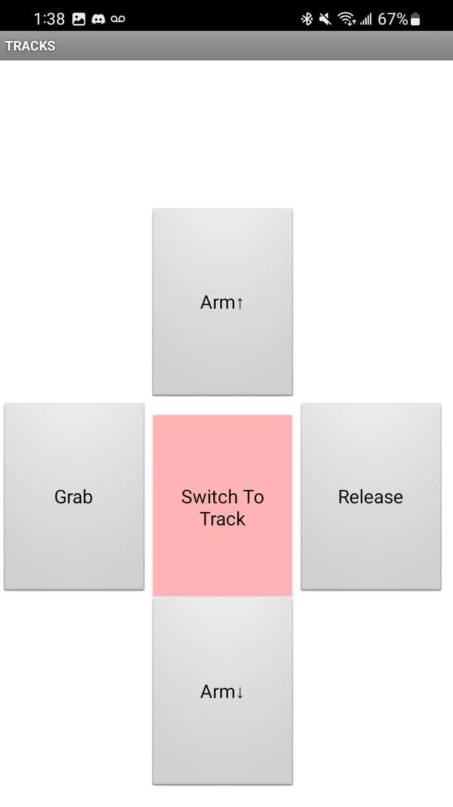
Software Section
IDEAS & CONCEPTS:
Using Bluetooth for communication between app and Arduino
Two pages design for mobile app, one for cart movement, one for arm and claw motion
DECISIONS MADE:
Switching from JavaScript to MIT App Inventor for simplicity

Slide 11
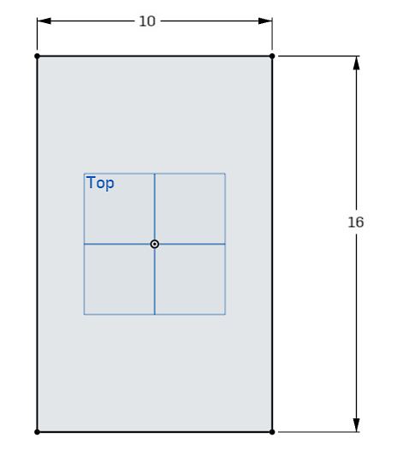
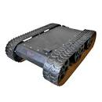
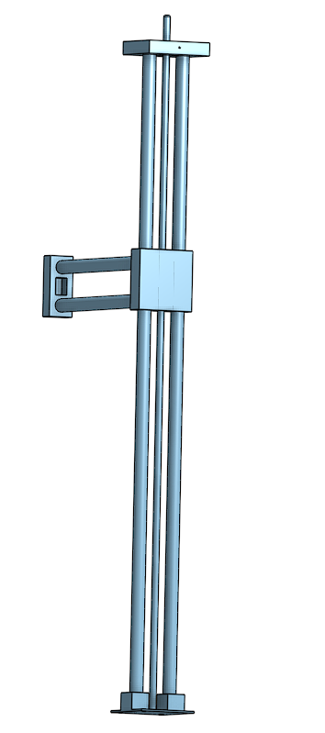
Mechanical Section: Chassis
IDEAS & CONCEPTS:
Use of a base with large surface area
Use of tracks for movement, provides precise steering on the spot
Initially using 2 ball screws for the 2 vertical and horizontal axes of arm, in addition to using two support pipes alongside the ball screw

Slide 12
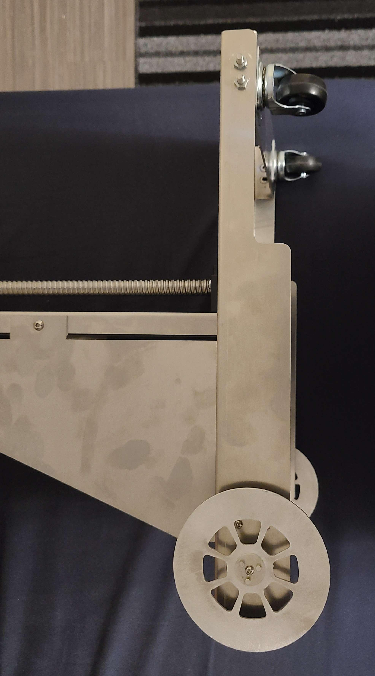
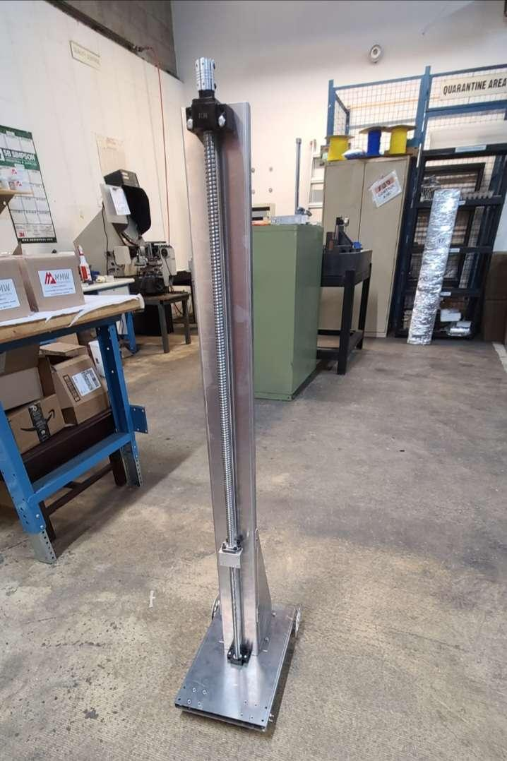
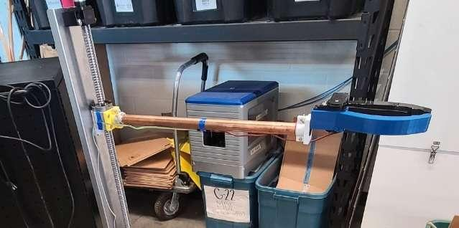
Mechanical Section: Chassis
DECISIONS MADE:
Using two conventional wheels in the back, then using two casters in the front that provide steering
Using only one ball screw for vertical axis, and using a lengthened rod for the horizontal axis
Large use of aluminum to construct the main chassis due to availability and simplicity of obtaining/working with

Slide 13
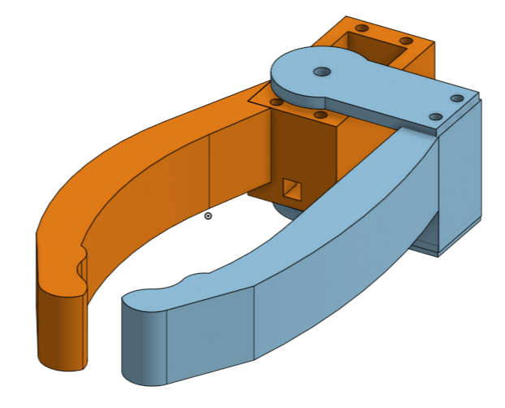
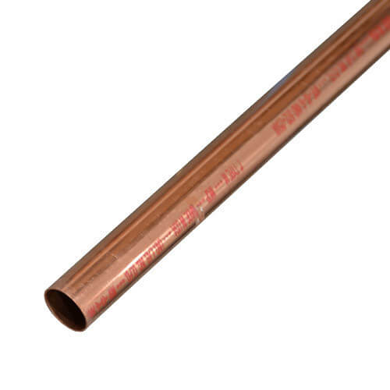
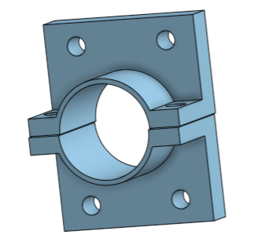

Mechanical Section: Claw
IDEAS & CONCEPTS:
Narrowed down to Servo Motor or Dual Gear Design
PVC or Copper as arm
DECISIONS MADE:
Decided on Servo Motor Design
  Dual Gear Design would be over complicated ; especially when it comes to 3D printing
  There were similar designs online we could work off of
Copper Piping was chosen as it was stronger, sturdier, & at the time easier to find at our aspired diameters
Notes:
In terms of the arm and claw, we narrowed down our options to two main concepts: Servo Motor or Dual Gear Design & PVC or Coppers piping. After careful consideration we decided to go with the servo motor design and copper piping as it was determined best suitable for this project and our constraints.
The servo was chosen because although the dual gear design would be effective it would be very hard to design fully on our own in the amount of time we had to create it. In addition, 3D printing gears from experience is extremely difficult and hard to be precise with. There were also many past designs on makerepo and online which incorporated the servo idea hence it was a rather trustworthy route to follow.
The coper piping was chosen because it is stronger, sturdier, nad was at the time easier to find at our desired diameters.

Slide 14
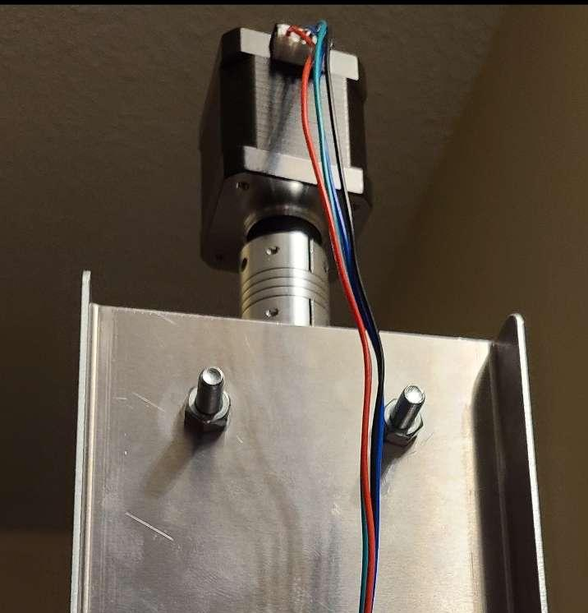
TRIALS & TRIBULATIONS
Initially finding out the motors lacked the torque to turn the ball screw
Fragile connections of wires (sometimes breaking)
Multiple 3D prints of same part (Claw, Arm mounts)
Entire electrical system broke down (unknown issue) the night before design day, got fixed after reconnecting all wires.

Slide 15
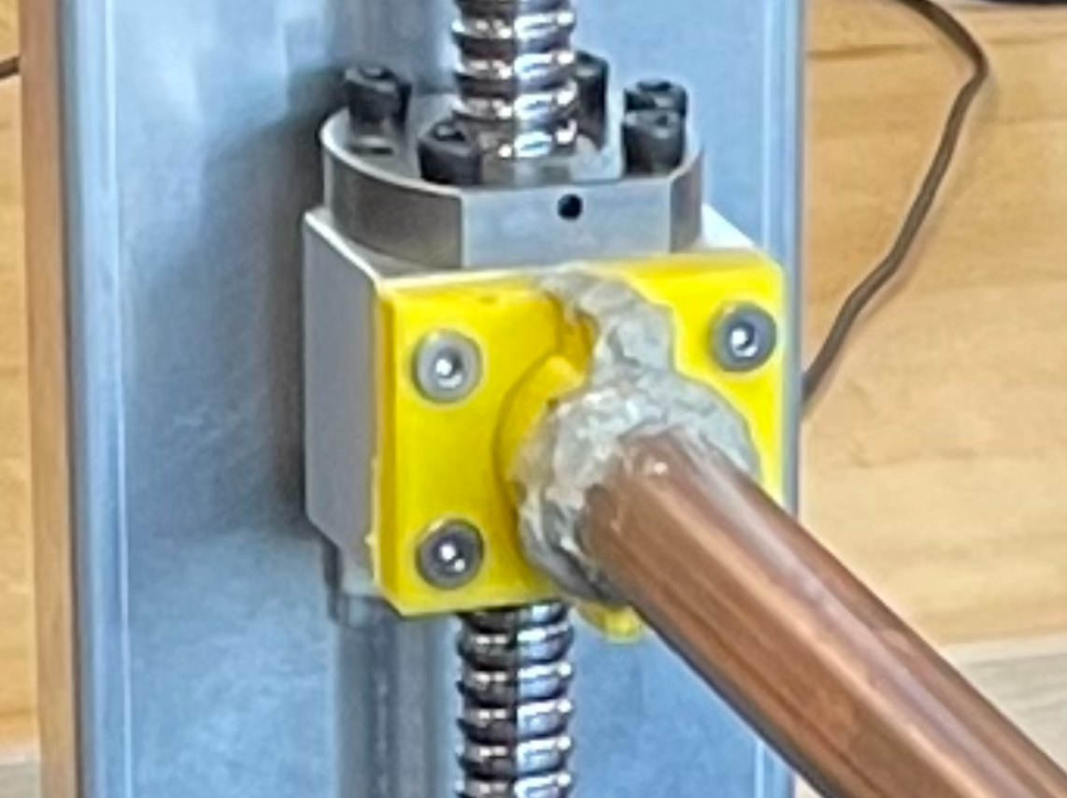
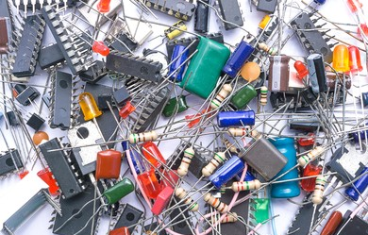
LESSONS LEARNED
Always prepare backup parts (electronics) in case of failure during the testing and assembly process. (Arduino fired during testing)
Make sure to prepare well thought ideas in advance before implementing them (using silicone to mount the arm to the chassis, initially proceeding without a proper mount for motor)
Set even more time in advance for planned obsolescence. There will always be failure and mistakes.
A proper pin layout and connection prototype can be helpful during the the assembly process for electronics.
Notes:
Moving onto lessons learned…
It is firstly important that …

Slide 16
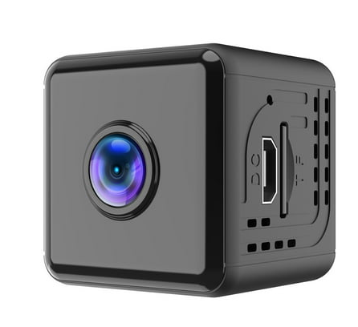
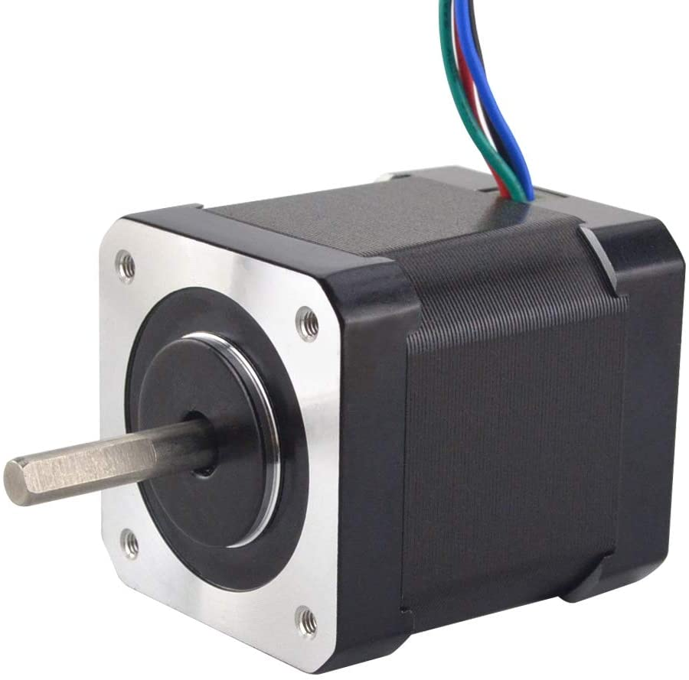


FUTURE WORK
Add Camera.
Install higher speed motors.
Further improve the strength & sturdiness of arm to hand component.
Reach out to similar clients for further input.
NEMA 17

Slide 17

THANK YOU / MERCI !

