Slide 1
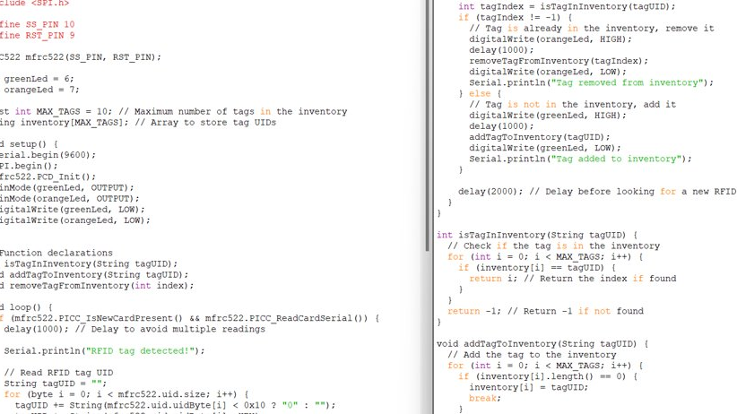

Slide 2
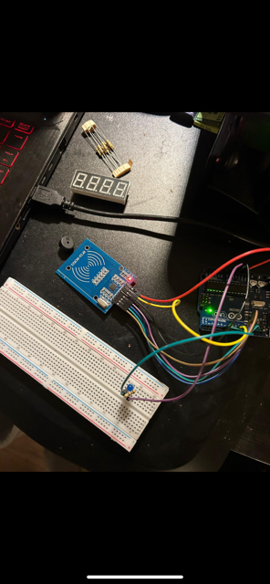

Slide 4
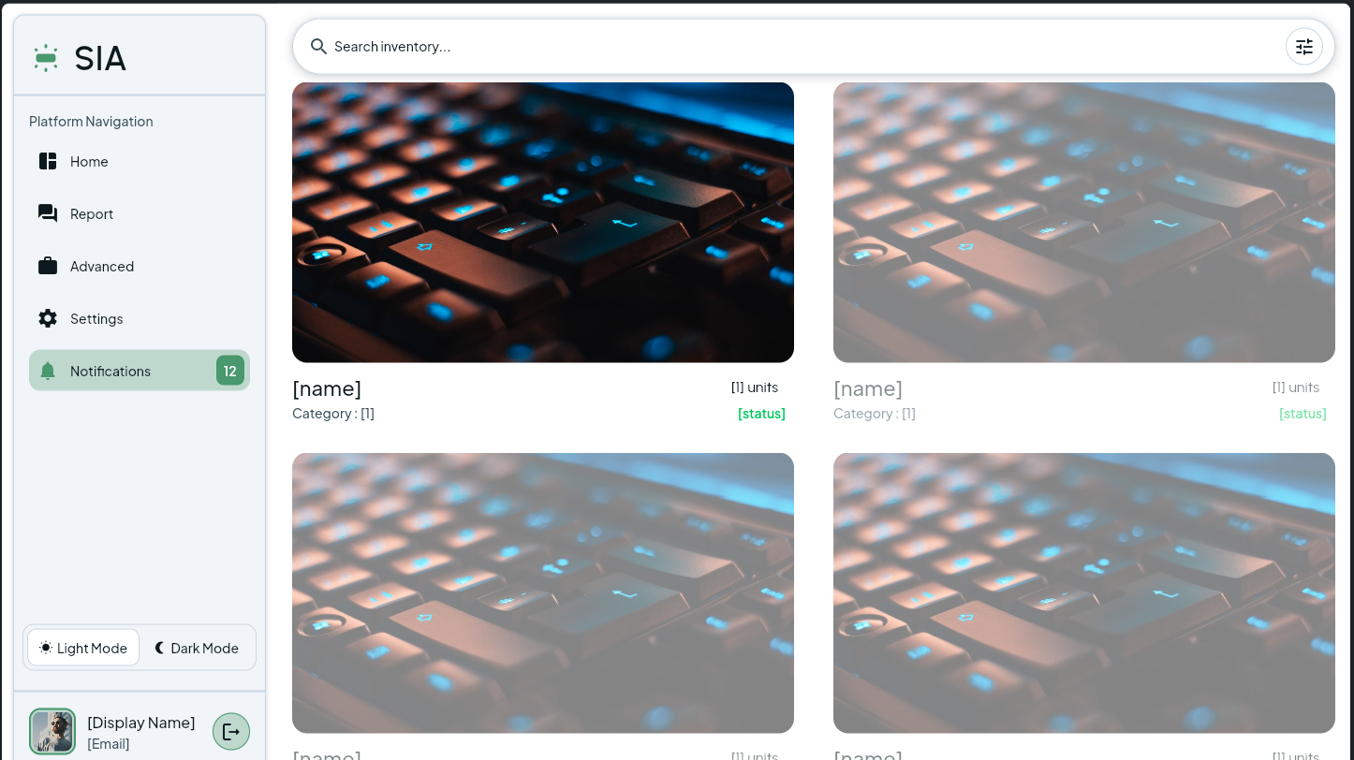

Slide 5
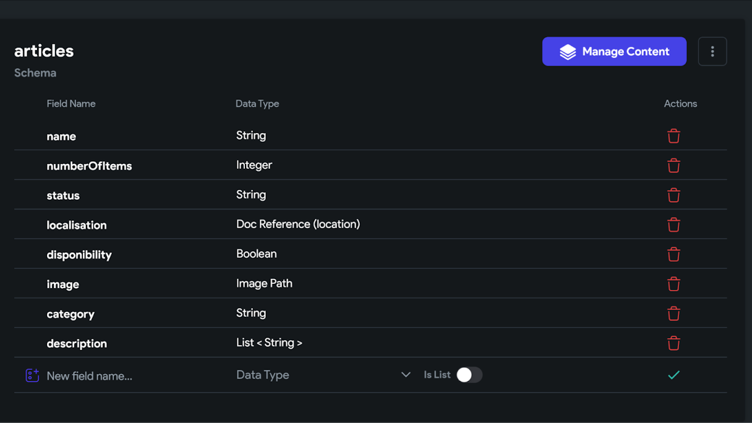

Slide 6
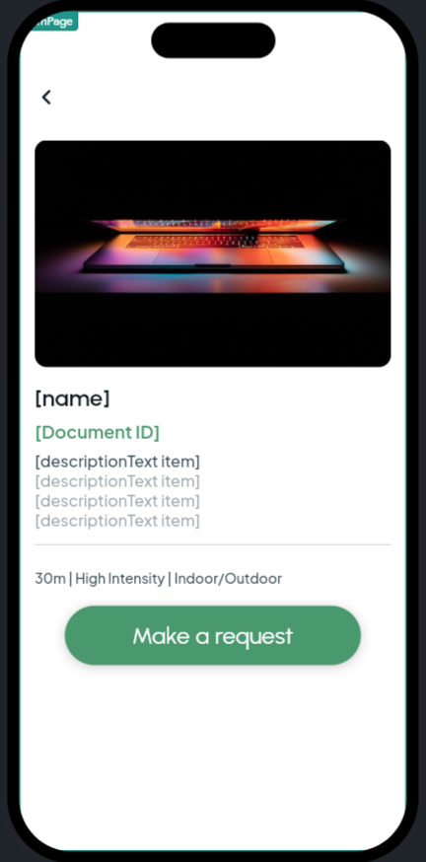

Slide 7
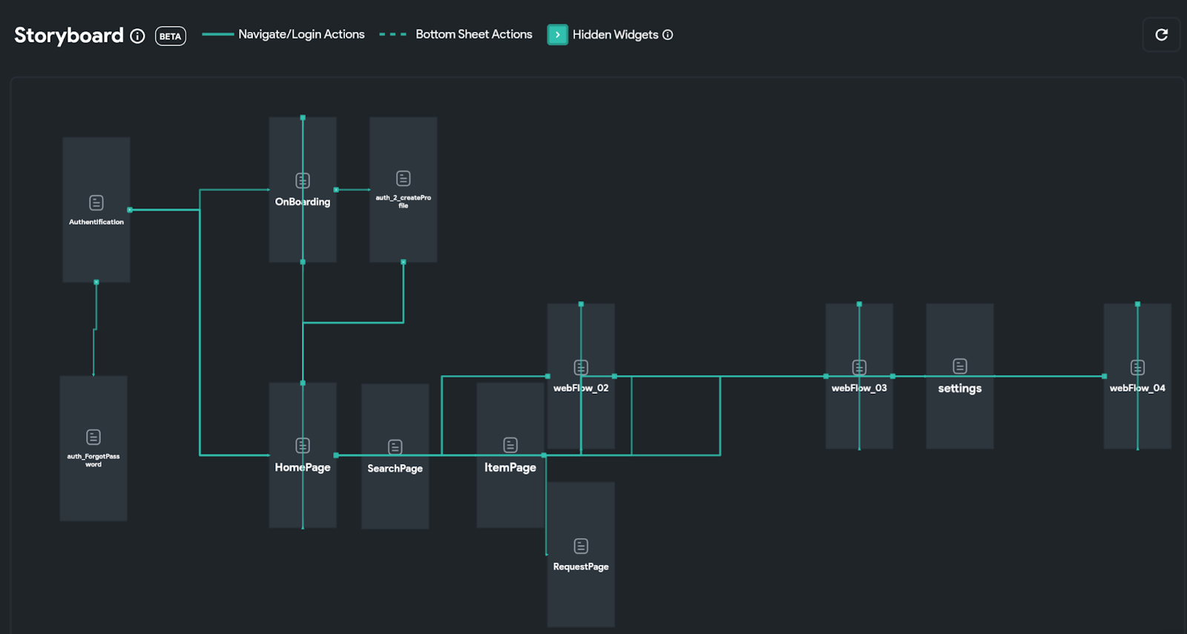

Slide 8
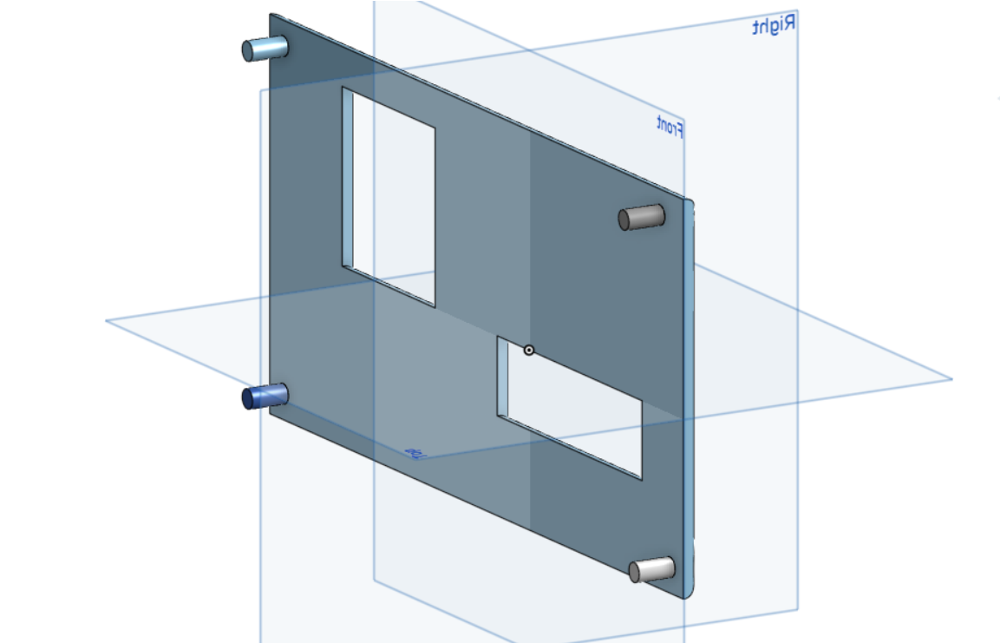
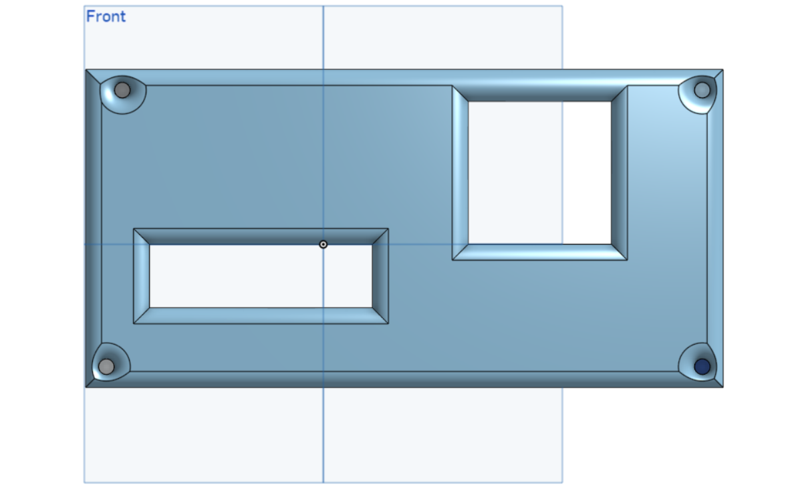
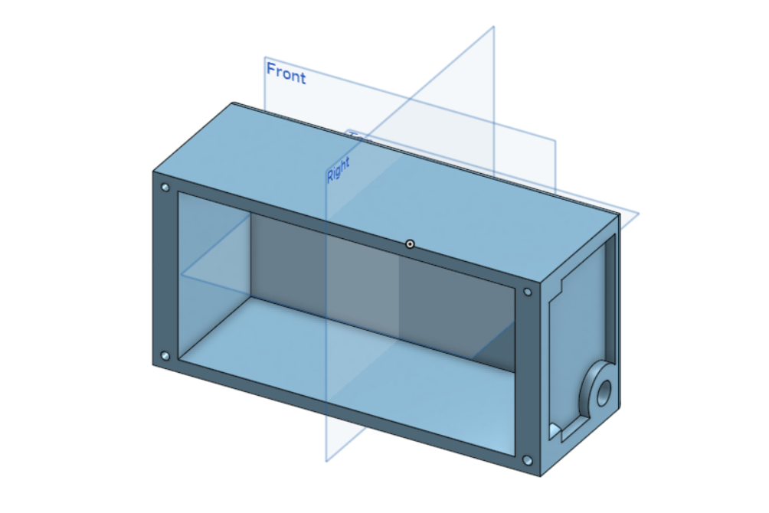
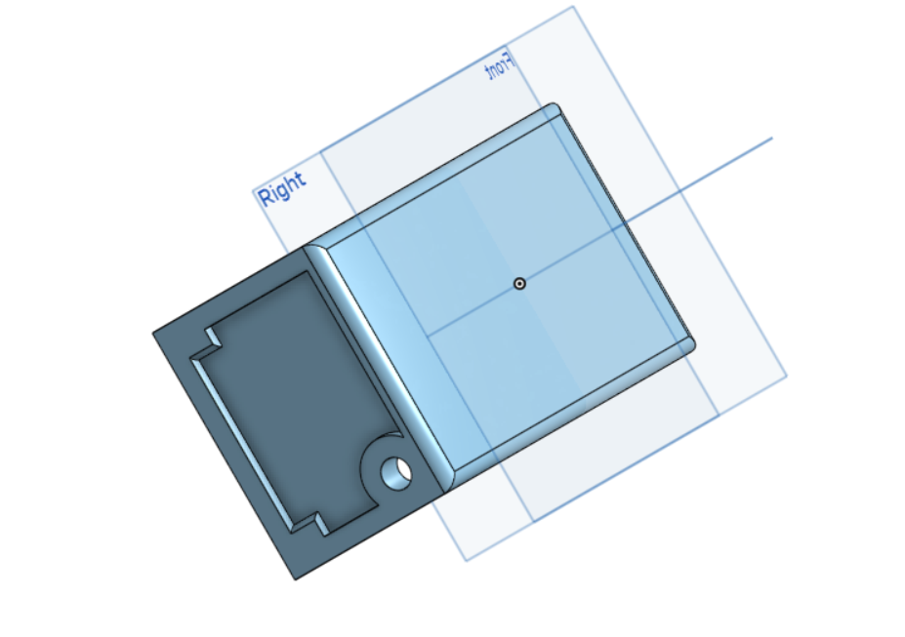

Slide 9
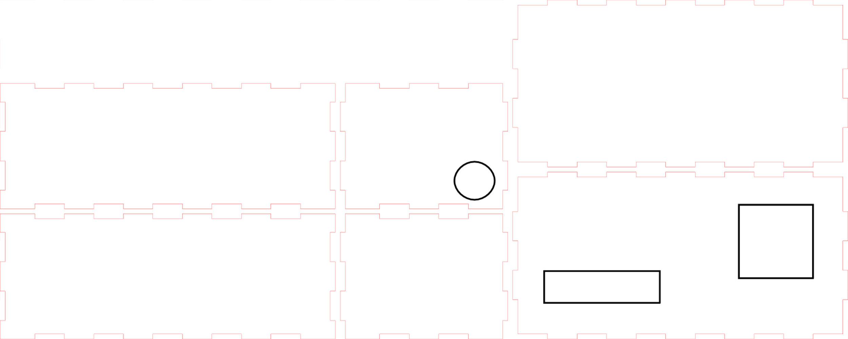

Slide 10
N˚ | Nom de l’item | Description | Quantité | Coût unitaire | Coût étendu | Lien
1 | Arduino Uno | ATmega328P | 1 | 21.99$ (kit) | 21.99$ | https://www.walmart.ca/en/ip/For-Arduino-Uno-R3-Diy-Kit-R3-Board-Breadboard-Lafvin-Starter-Kit/PRD43LHM7B1OOBS?skuId=43LHM7B1OOBS&offerId=399A2325CBB44F35BFC68598A3B72B7A&cmpid=SEM_CA_32475_4VJJEVAFXN&utm_id=SEM_CA_32475_4VJJEVAFXN&utm_medium=paid_search&utm_source=google&utm_campaign=always_on&gclsrc=aw.ds&&gclid=Cj0KCQjw4vKpBhCZARIsAOKHoWQDKD2fjVlArGblOE7xoB5WJb2E76HdqCym-kl_p1yWc_PjhE4dNn0aAtfaEALw_wcB&gclsrc=aw.ds
2 | Breadboard | sans soudure | 1 | inclus ( arduino)
3 | Fils | 22awg / 0.64mm | 7-8 | inclus( arduino)
4 | RFID tags | LLC 360 1 kB 13.65MHz | 5 | 4.51$ | 4.51$ (dépend des stock) | https://www.digikey.ca/en/products/detail/adafruit-industries-llc/360/5353590
5 | Lecteur RFID | MFRC522 13.65 MHz | 1 | 8.09$ | 8.09$ | https://www.walmart.ca/en/ip/Peggybuy-RC522-RF-Module-Card-Reader-RFID-Kit-13-56MHz-Mifare-RF-for-Arduino-Raspberry-Pi/1IHCDM1ODJM8?skuId=0ZWNWT6OQ2A4&offerId=05973B0F5C3C3F8CA9D435B70FA029B1&cmpid=SEM_CA_33355_HQH88E2IHJ&utm_id=SEM_CA_33355_HQH88E2IHJ&utm_medium=paid_search&utm_source=google&utm_campaign=always_on&gclid=Cj0KCQjw4vKpBhCZARIsAOKHoWQghiJHjTy7VQ4olT_QhBlRN9VZIaiGNNSBoZnVJSuFlXFDjL6FoLMaAsFKEALw_wcB&gclsrc=aw.ds
6 | RFID antenna | W3580 13.65 MHz | 1 | 10.91$ | 10.91$ | https://www.digikey.ca/en/products/detail/pulse-electronics/W3580/4169646?utm_adgroup=&utm_source=google&utm_medium=cpc&utm_campaign=Pmax%20Shopping_Promotions_IoT&utm_term=&utm_content=&utm_id=go_cmp-20662290658_adg-_ad-__dev-c_ext-_prd-4169646_sig-Cj0KCQjw4vKpBhCZARIsAOKHoWQHqja57m9zvCmDe_eFRqgEIH411X-j3dKRtdu54a9dFCxriG5hDKcaApa3EALw_wcB&gclid=Cj0KCQjw4vKpBhCZARIsAOKHoWQHqja57m9zvCmDe_eFRqgEIH411X-j3dKRtdu54a9dFCxriG5hDKcaApa3EALw_wcB
 | Coût totale du produit |  |  |  |  | 45.5$ (51.5$ avec tax)

Slide 11
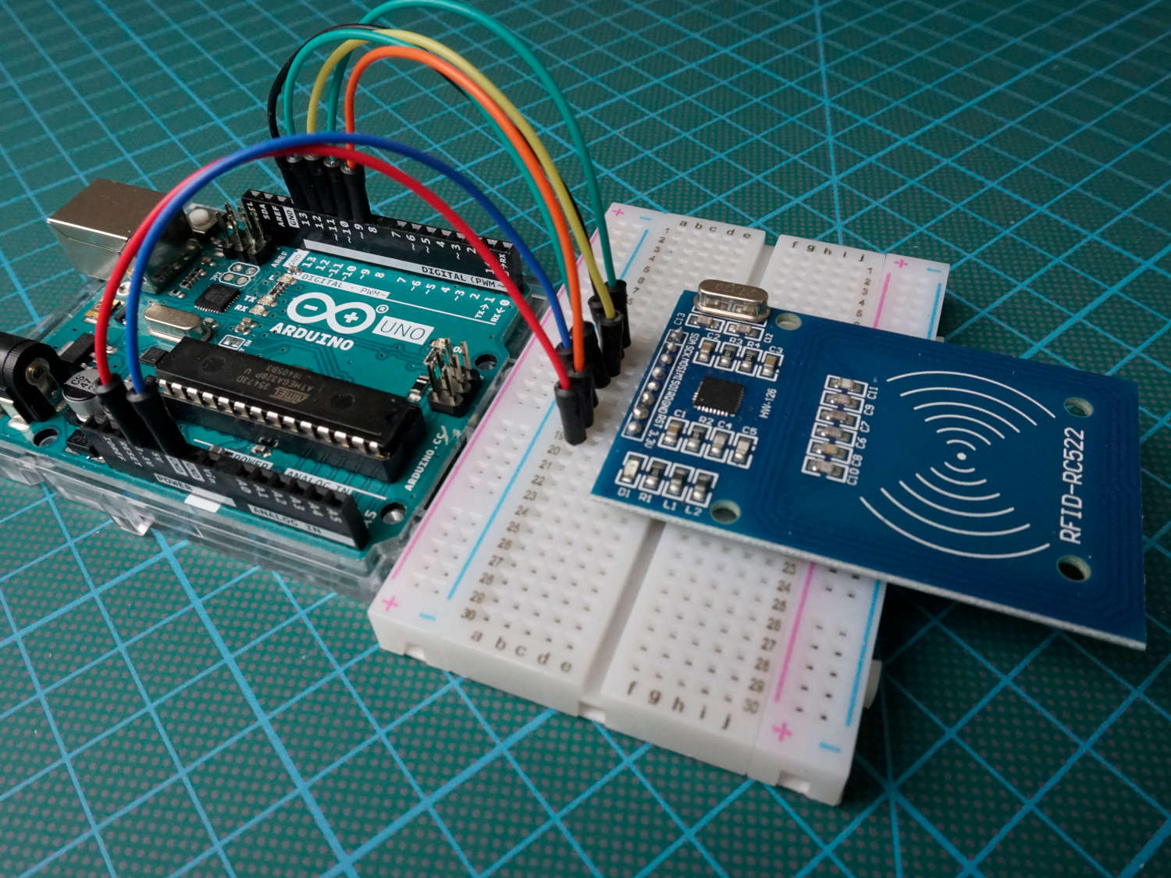

Slide 12
FA22
Xavier Bouchard
Queen Irakoze
Haldun Cavusoglu
Mey azzaoui

