Slide 1





UNIVERSITY OF OTTAWA DESIGN DAY
FULLY ACCESSIBLE SYSTEM FOR TRAVEL
RAILS
Group F1.3
Katrine, Annabelle, Ayan, Mark and Markos

Slide 2


Agenda
1. Executive Summary
2. Assumptions
3. Initial Design Concept
4. Current Design
5. Business Analysis
6. Next Steps

Slide 3
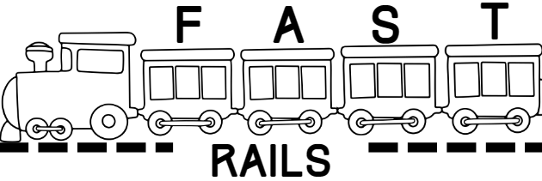

Executive Summary
Problem
There is a lack of travel bed rails suited for those who require barriers to prevent them from falling out of their bed.
Solution
Produce a rail that is safe, portable, and adjustable for all travel rail needs.
KPI
Breathability, Cleanability, Portability, Safety and Affordability
Finances
Included is the triple bottom-line canvas business model and bill of materials for the final prototype

Slide 4

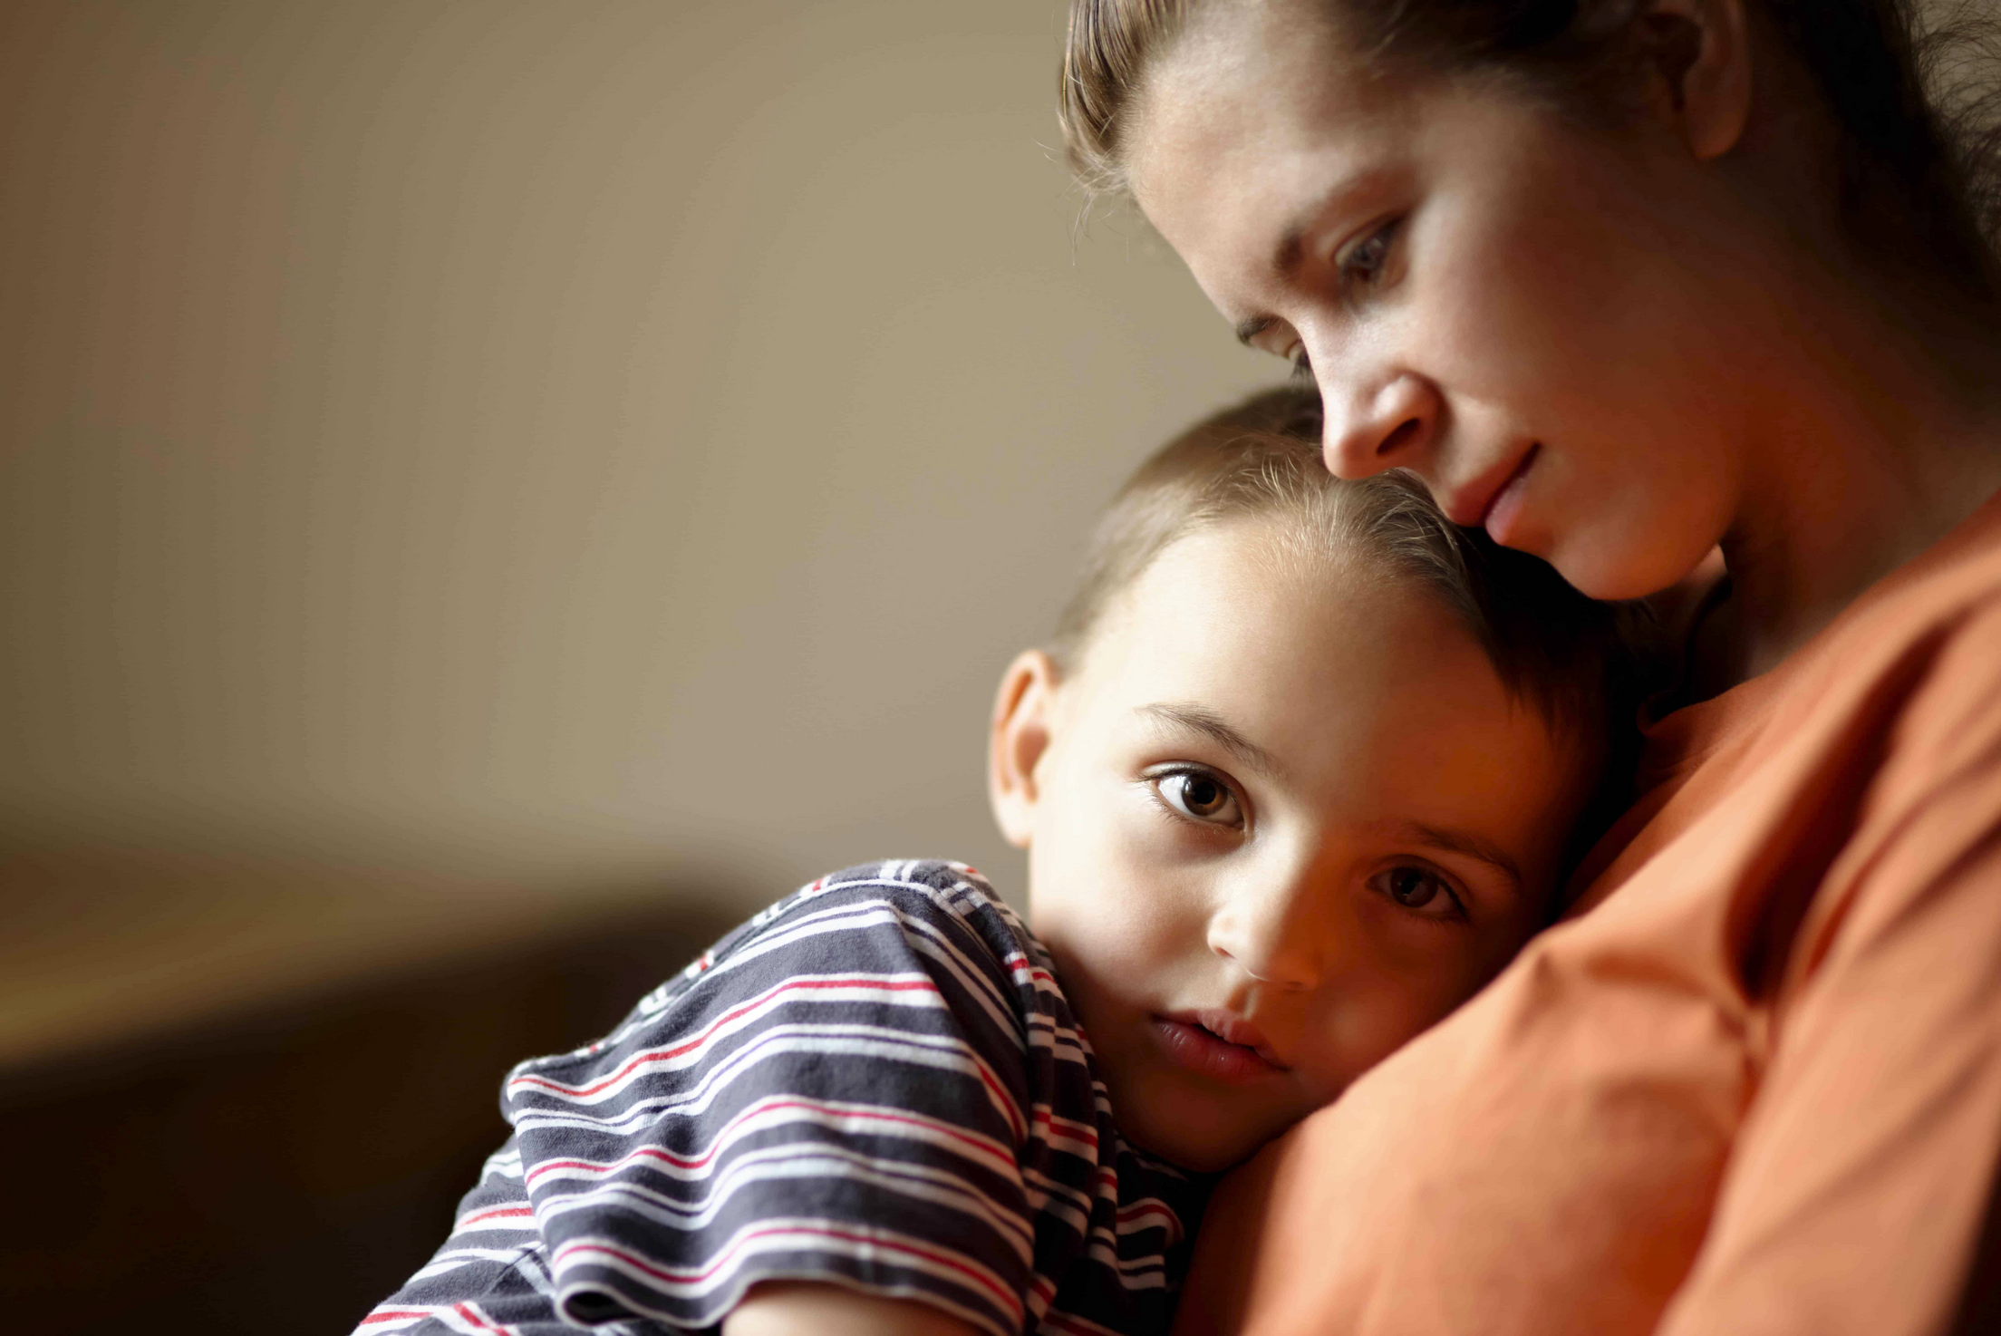

Background information
•7 year-old with Cerebral Palsy.
•Requires fall protection while sleeping.
•Does not currently have a solution for compact travel bed rails.
•Breathability is critical.
PROBLEM STATEMENT
There is a lack of travel bed rails suited for those who require barriers to prevent them from falling out of their bed. We will provide a solution that is safe, portable, and adjustable for all travel rail needs.

Slide 5

Assumption
Material
Parts
Force
Size
Readily available and affordable
Easily manufactured or machined based on machine lab availability
Can surpass lateral force threshold
Rail can accommodate to most bed sizes

Slide 6
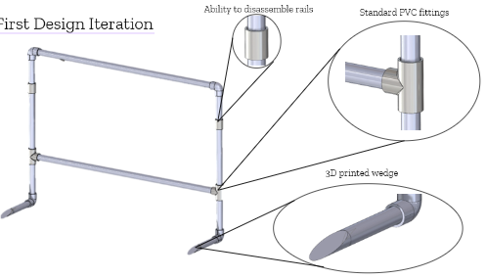

First Design Iteration
Standard PVC fiting
Easy to dissemble joints
3D printed wedge

Slide 7
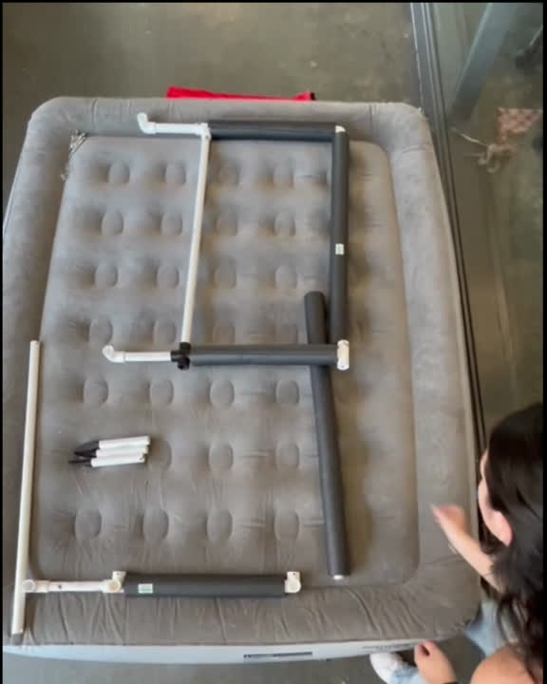
Current Design

Slide 8
KEY PARTNERS | KEY ACTIVITIES | VALUE PROPOSITION | VALUE PROPOSITION | CUSTOMER RELATIONSHIPS | CUSTOMER SEGMENTS
Manufacturing company (to make the rails themselves) Government Agencies (for funding and grants) Hospitals/Medical Institutions (for product awareness and distribution) Stores (regular distribution) Continuing and Long Term Care facilities | Seek out partnerships/business agreements with healthcare providers Raising awareness Online advertising | Increasing accessibility for those in need of bed rails during travel Allowing users to travel more safely and independently | Increasing accessibility for those in need of bed rails during travel Allowing users to travel more safely and independently | Same side network effects (healthcare providers to users/customers) | Caretakers Individuals who require bed rails when travelling
Manufacturing company (to make the rails themselves) Government Agencies (for funding and grants) Hospitals/Medical Institutions (for product awareness and distribution) Stores (regular distribution) Continuing and Long Term Care facilities | Key Resources | Increasing accessibility for those in need of bed rails during travel Allowing users to travel more safely and independently | Increasing accessibility for those in need of bed rails during travel Allowing users to travel more safely and independently | Channels | Caretakers Individuals who require bed rails when travelling
Manufacturing company (to make the rails themselves) Government Agencies (for funding and grants) Hospitals/Medical Institutions (for product awareness and distribution) Stores (regular distribution) Continuing and Long Term Care facilities | Website | Increasing accessibility for those in need of bed rails during travel Allowing users to travel more safely and independently | Increasing accessibility for those in need of bed rails during travel Allowing users to travel more safely and independently | Bought online and in person store at common distributors, as well as trade shows Distributed through shipping to the location | Caretakers Individuals who require bed rails when travelling
COST STRUCTURE | COST STRUCTURE | COST STRUCTURE | REVENUE STREAMS | REVENUE STREAMS | REVENUE STREAMS
There are several costs that need to be considered. The procurement costs, manufacturing processes, transportation, and marketing/ social media | There are several costs that need to be considered. The procurement costs, manufacturing processes, transportation, and marketing/ social media | There are several costs that need to be considered. The procurement costs, manufacturing processes, transportation, and marketing/ social media | The main revenue stream would be people travelling and in need of portable safety rails around the bed. This includes a wide range of people (with permanent, situational and temporary disabilities) such as children, elderly, differently-abled people and more. | The main revenue stream would be people travelling and in need of portable safety rails around the bed. This includes a wide range of people (with permanent, situational and temporary disabilities) such as children, elderly, differently-abled people and more. | The main revenue stream would be people travelling and in need of portable safety rails around the bed. This includes a wide range of people (with permanent, situational and temporary disabilities) such as children, elderly, differently-abled people and more.
SOCIAL AND ENVIRONMENT COST | SOCIAL AND ENVIRONMENT COST | SOCIAL AND ENVIRONMENT COST | SOCIAL AND ENVIRONMENT BENEFITS | SOCIAL AND ENVIRONMENT BENEFITS | SOCIAL AND ENVIRONMENT BENEFITS
Cost to people who don’t have insurance or can’t afford the product. They are at a disadvantage to their peers | Cost to people who don’t have insurance or can’t afford the product. They are at a disadvantage to their peers | Cost to people who don’t have insurance or can’t afford the product. They are at a disadvantage to their peers | Benefit: provide safe sleeping conditions to people who at risk of falls, allow for people with disabilities to travel more freely, without worrying about safe sleeping conditions in hotels/guest rooms | Benefit: provide safe sleeping conditions to people who at risk of falls, allow for people with disabilities to travel more freely, without worrying about safe sleeping conditions in hotels/guest rooms | Benefit: provide safe sleeping conditions to people who at risk of falls, allow for people with disabilities to travel more freely, without worrying about safe sleeping conditions in hotels/guest rooms
Business model

Slide 9
bILL OF Materials
ITEM # | ITEM NAME | ITEM DESCRIPTION | PRICE PER UNIT($) | QUANTITY | TOTAL PRICE($)
1 | PVC tubing (outer) | Outer PVC tubing (5ft) | 29.05 | 2 | 58.1
2 | PVC tubing (inner) | Inner PVC tubing (5ft) | 20.43 | 2 | 40.86
3 | Self locking hinge | Self locking hinge | 11.29 | 1 | 11.29
4 | Spring loaded button | Spring loaded button inside rod | 7.66 | 1 | 7.66
5 | Mesh | Mesh cover for rails (sold by yard) | 6 | 3 | 18
6 | Zipper | Zipper to close mesh | 10 | 1 | 10
7 | Elbow connector | Elbow connector for tubing | 0 | 2 | 0
8 | Pins | Pins to lock rails together | 10.03 | 1 | 10.03
9 | Steel bar | Bar for under mattress | 10.98 | 1 | 10.98
10 | Rubber pads | to prevent slipping on mattress | 11.97 | 1 | 11.97
 |  |  |  | TOTAL: | 178.89

