Slide 1
Revised prototype description and summary of significant changes
Team Opioid Overdose Monitor
Ayham AlAkhras – Varsha Srinivasan – Min Ju Kim

Slide 2
Design Requirements
Cost effective (100 CAD budget)
Monitors blood oxygen level and respiratory rate reliably
Lightweight and small
Discrete
Editable emergency contacts
Quick response to overdose indicators
Long battery life

Slide 3
Subsystems
Electrical
Varsha
USER INTERFACE
Ayham
SIGNAL PROCESSING
Min ju

Slide 4
Design Solutions
Idea approved by client

Slide 5
Prototypes
Circuit diagram and simulation
Ergonomic prototype
User interface drawings
User interface software
Signal processing prototype
Physical circuit prototype
Comprehensive prototype

Slide 6
Where We Stand Now
Circuit designing completed, assembly in progress
Circuit parts received
User interface prototype is analysed
Ergonomic prototype is developed
Met with client for design approval
Overall, on track to create a working comprehensive prototype for design day

Slide 7
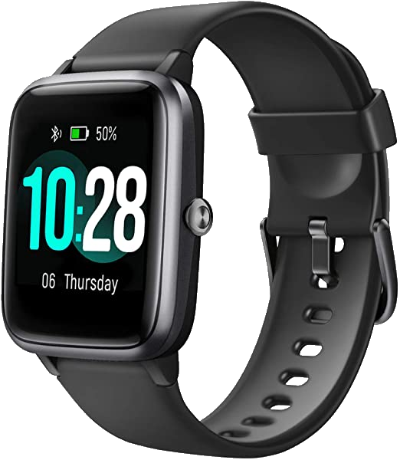
Expectations vs Reality

Slide 8
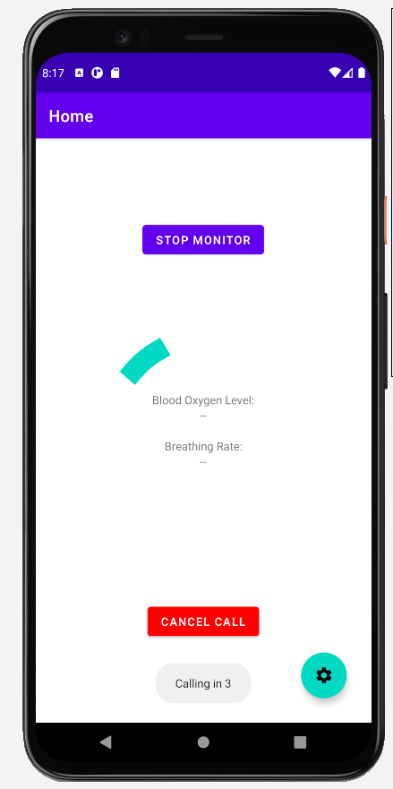
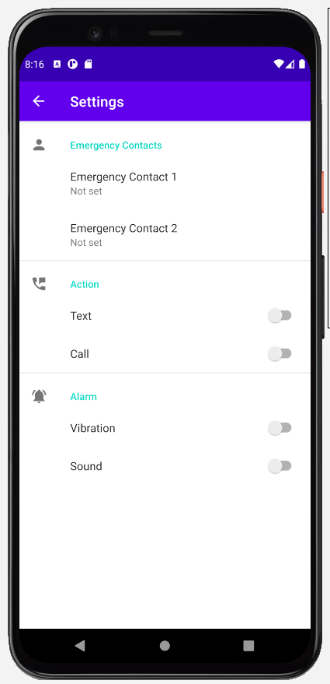
Expectations vs Reality

Slide 9
Short term Plan
Deliverable E requirements
Plan of attack
Provide the detailed description of our global concept
Modifications and justification of design
Complete new prototypes
Documentation and Testing
Update Prototype test plan
Discuss if any changes are needed with team in the weekly meeting.
Use the test results from deliverable D
Complete remaining three prototypes
Update the shared report as testing is carried out
Update Gantt Chart on Wrike

Slide 10
Long Term plan
Design Day
Plan of Attack
Specialty Skill (March 14th onwards)
Final Project presentation (March 29th)
Design Day(April 8th)
Prepare the personal projects and teach the same to peers through MS teams calls.
Follow the deliverable structure on Brightspace diligently to meet deadlines and requirements and regular follow ups with client.
Have a great time on design day.

Slide 11
Thank You! Any questions?

