Slide 1
Everlasting Circle

Slide 2
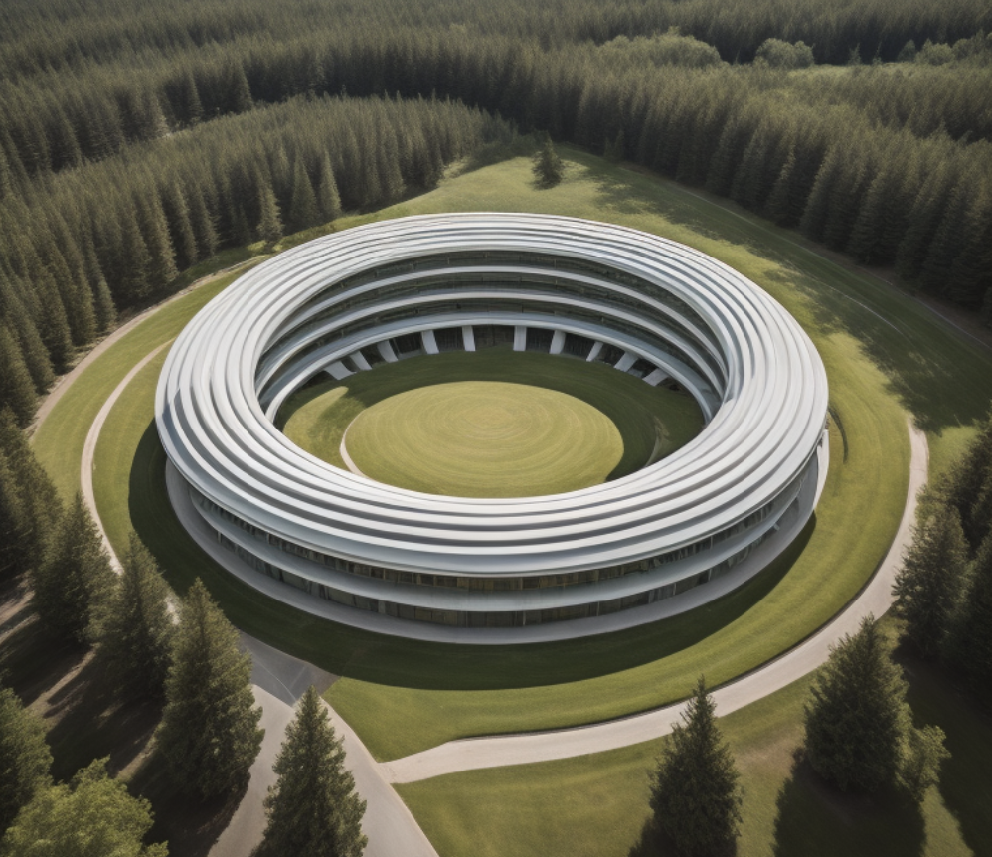
Jonathan Augustine Soliman, Rowan Kovacs, Ben Olaveson, Rotimi Akalusi
Group A04-13
GNG 1103 – Engineering Design
Professor Muslim Majeed

Slide 3
A need exists for the Algonquins of Pikwakanagan Neyagada Wabandangaki Guardian Program to acquire a building for laboratory work and processing, and community events and involvement, which would reflect the values of their community and will act as a multifunctional space for the work done by the Guardian Program.
Problem Statement

Slide 4
Concept
The concept we devised capitalizes on the idea of integrating elements of nature into various communal work areas. This trend has seen a boom in recent years as it promotes a healthier, more creative workplace.
‘The perfect testing and lab facility’

Slide 5
Inspiration
Our Design’s idea was inspired by the Medicine Wheel.
●A Circle represents no Start or End
●Represents Good Health
●Symbolizes Longevity
●Represents Perfection
●Represents natural phenomena (The Sun, Eyes, etc.)
●An appropriate reflection of Indigenous Culture
‘Where the idea came from, its cultural significance and reason for choosing’

Slide 6
Economics
We developed Price Estimates of implementing the design that we have come up with. This value is based on about 11310 square feet of the building, its interior elements and layout, and the land that it will occupy: $2,262,000
From RS Means
‘Estimated pricing of materials, land value, and service access’

Slide 7
Considerations
Various considerations pertaining to the sustainability and longevity of this laboratory were put into place. The vision for the building was for it to become a focal point in the region, encouraging community involvement
‘Health and safety, environmental and community considerations’

Slide 8
How it came to be
Deliverable D
Sketch 1
Deliverable F
Prototype 1
Deliverable G
Prototype 2
‘A timeline with each model corresponding to a deliverable’
Deliverable H
Prototype 3
Deliverable I
Final Design

Slide 9
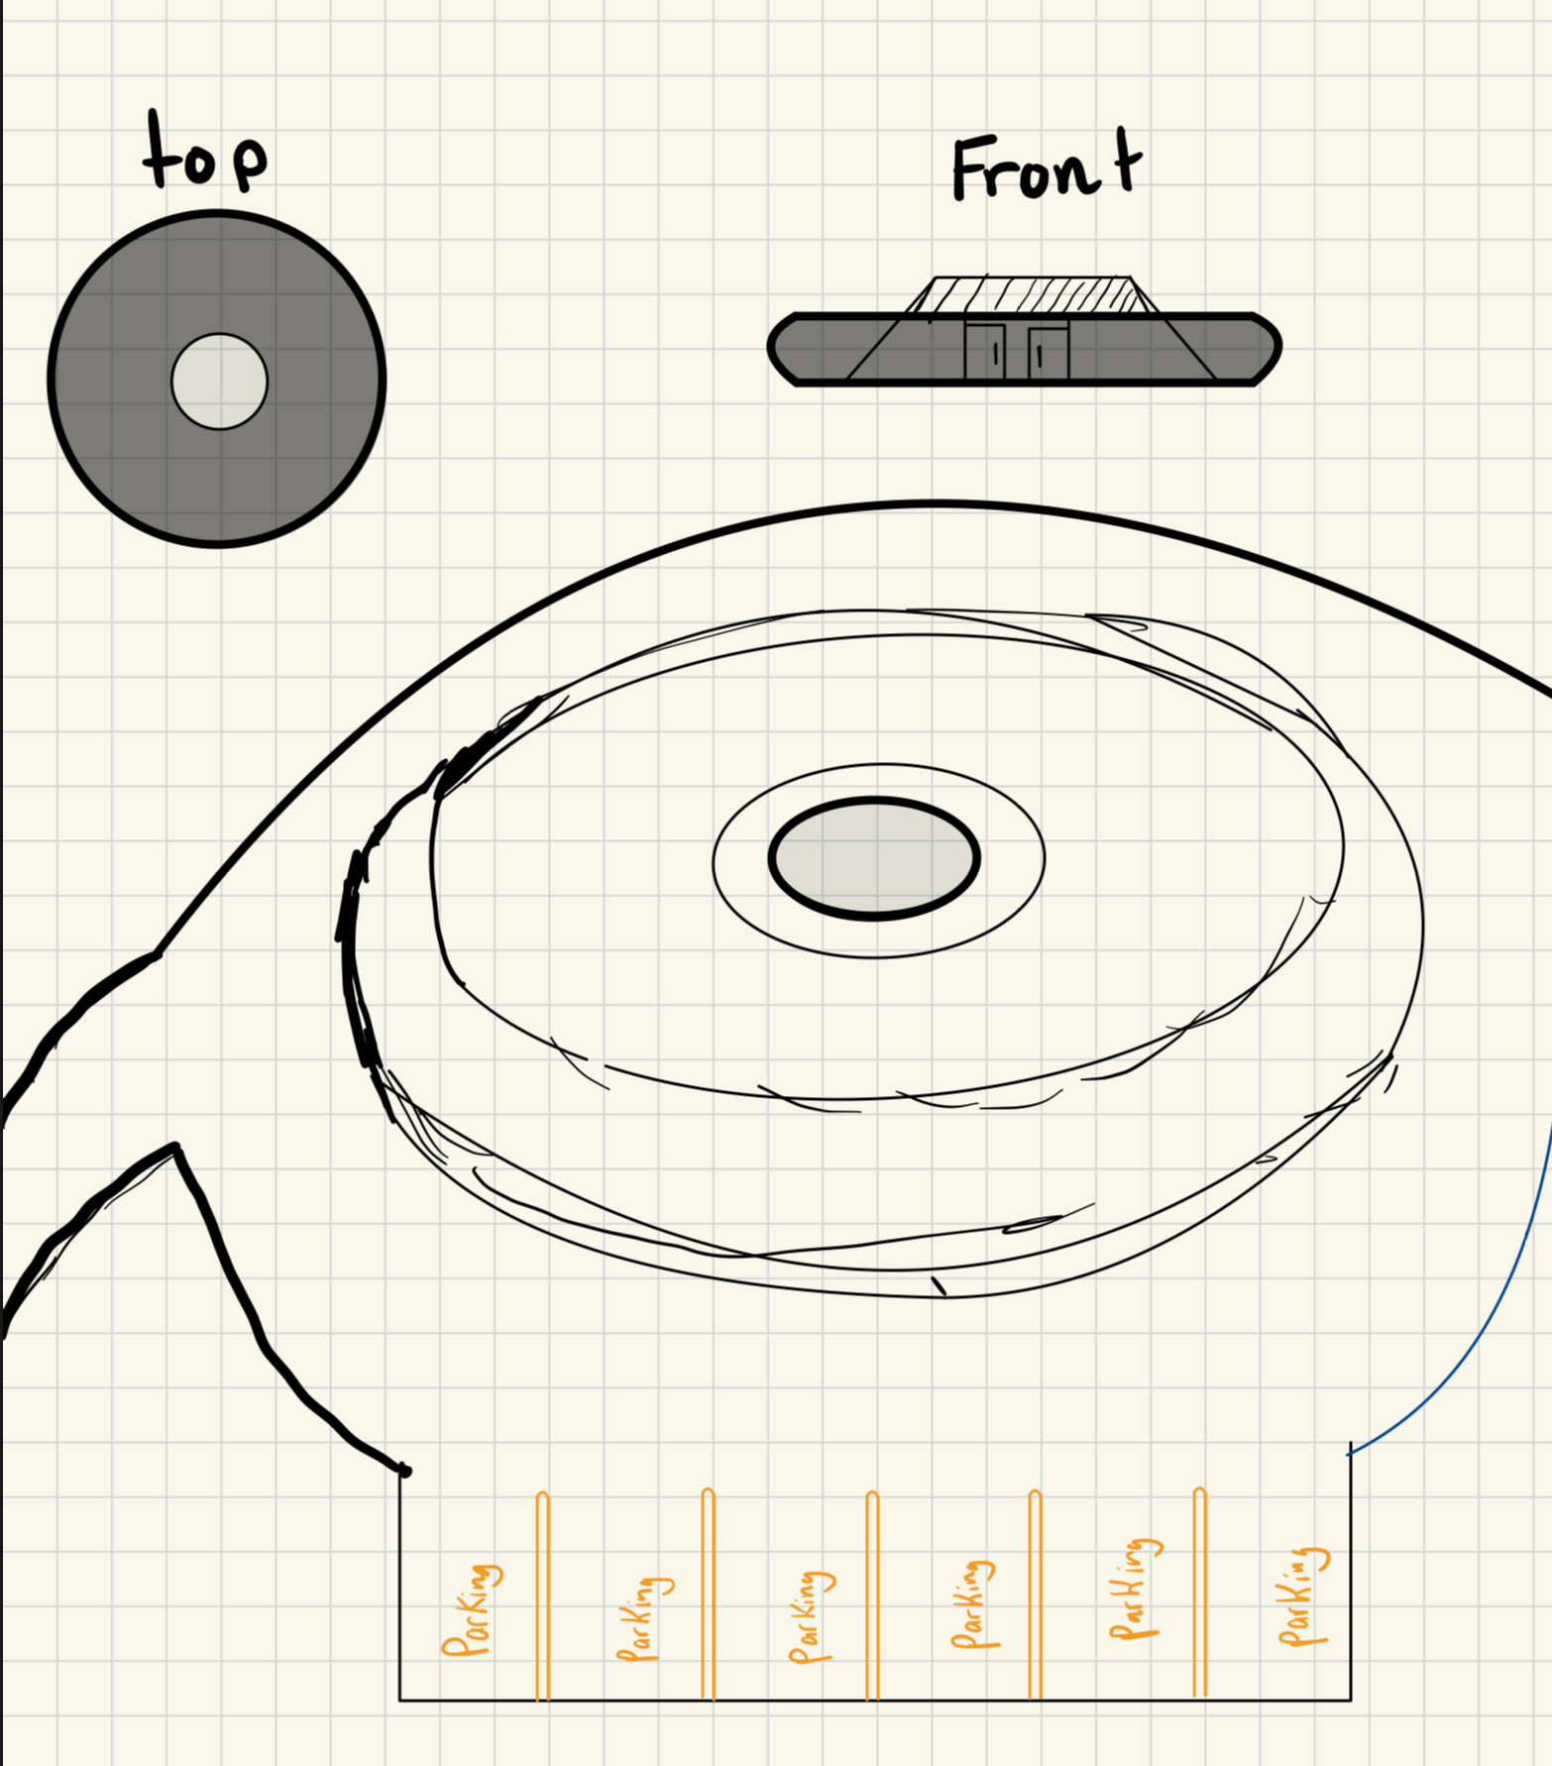
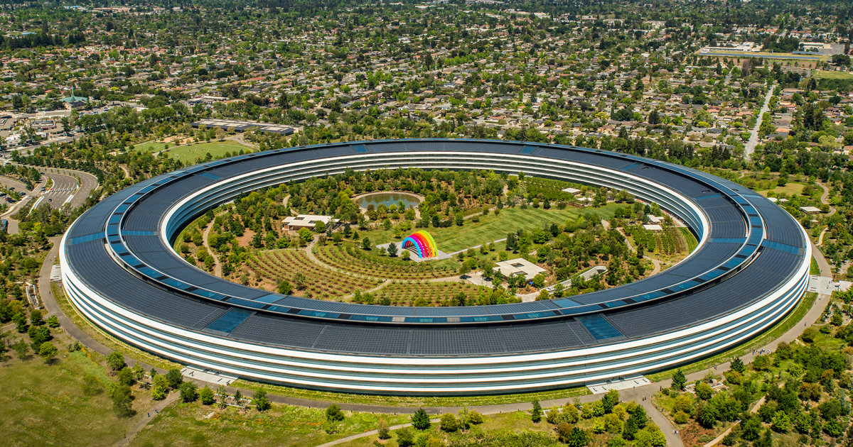
Preliminary sketches
Our initial sketch Apple park Cupertino
Unfortunately, this is only a sketch, merily an idea…

Slide 10
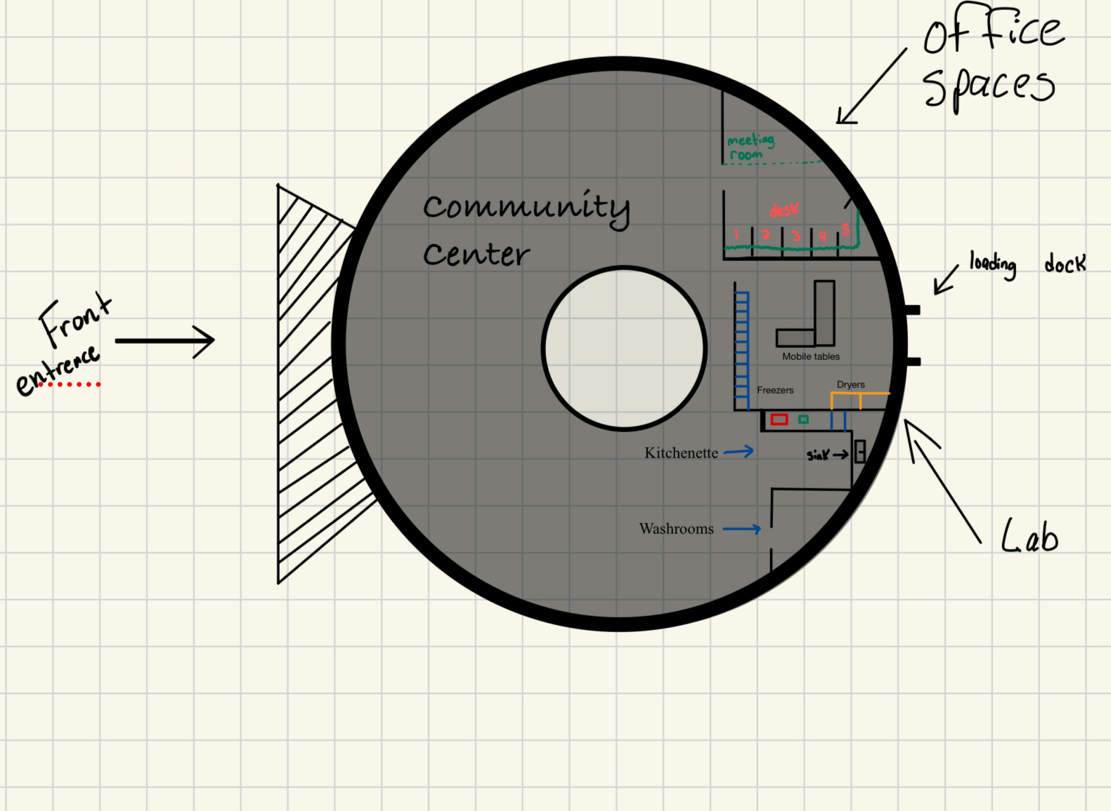
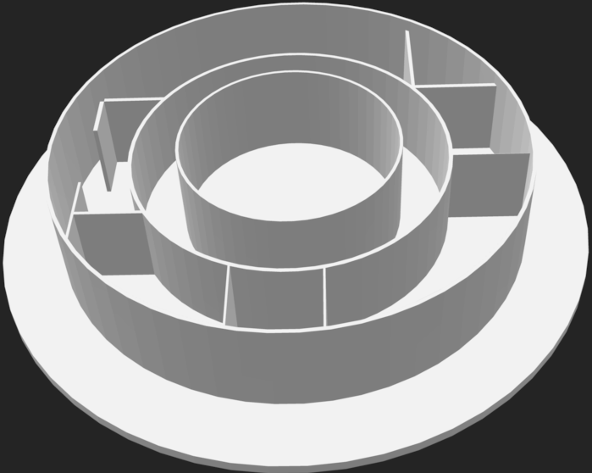
Prototype 1
First floor plan layout Preliminary Modeling
The client are not in need of such a large community area and have opted for modifications as seen in prototype 3

Slide 11
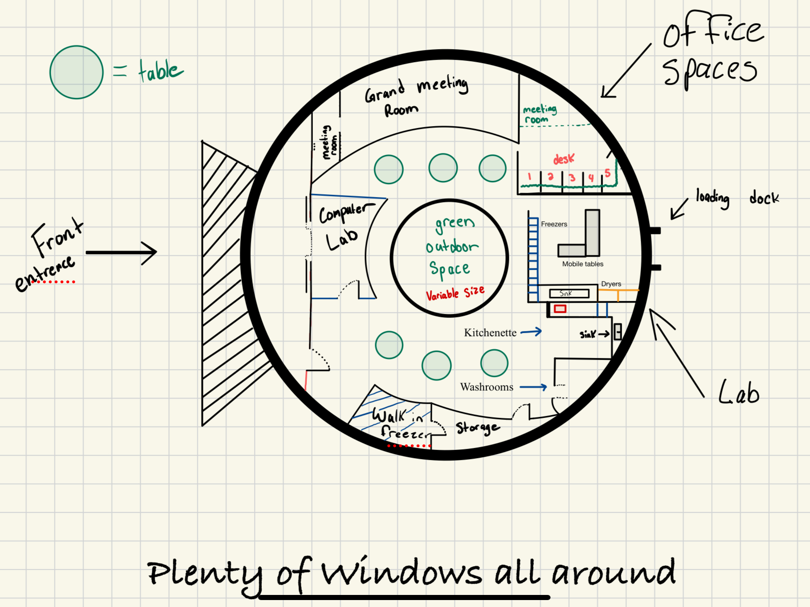
Prototype 2
First second plan layout Preliminary renderization
The clients were very happy with this design and layout, now onto the modeling

Slide 12
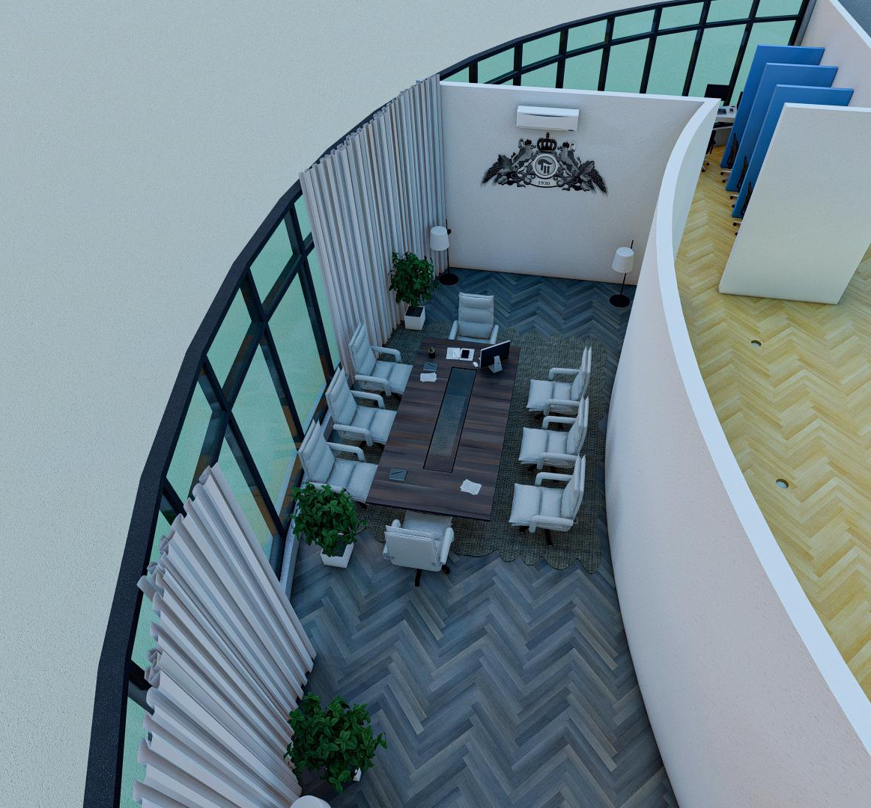
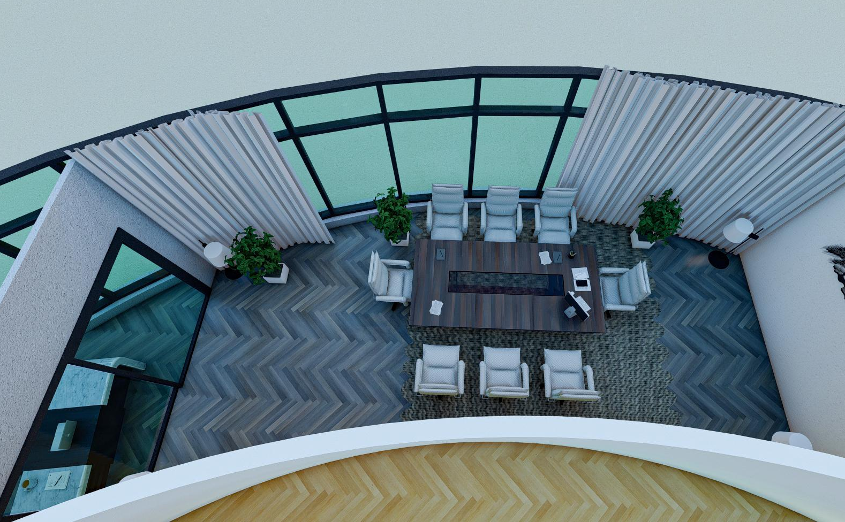
Prototype 3 - - Finalization
Modeling of meeting room Secondary view
From this point, modeling the remainder of the design as seen in the following slides

Slide 13
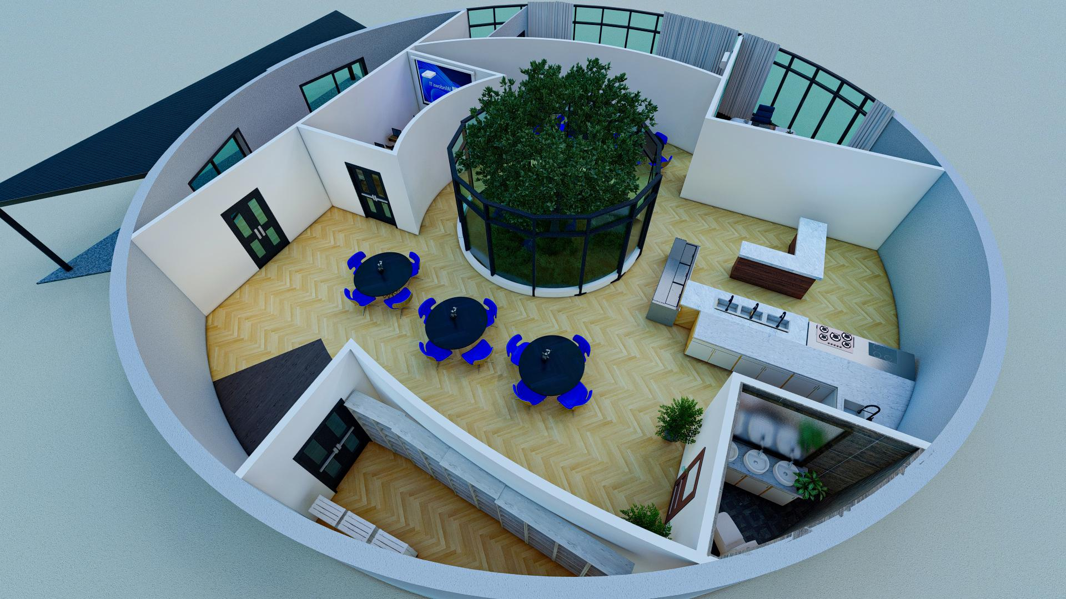
Final design

Slide 14
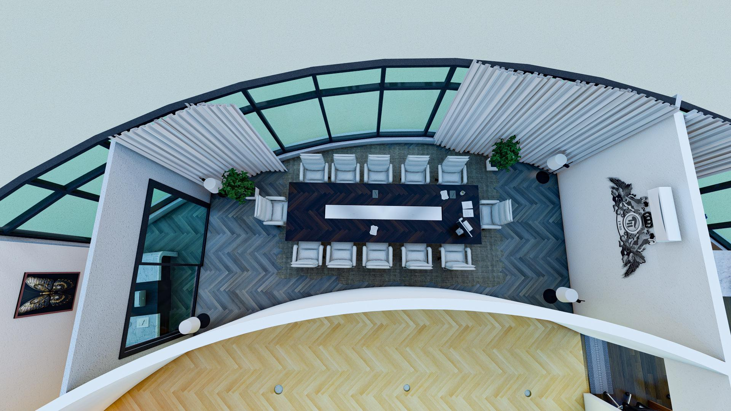
Board Meeting Room

Slide 15
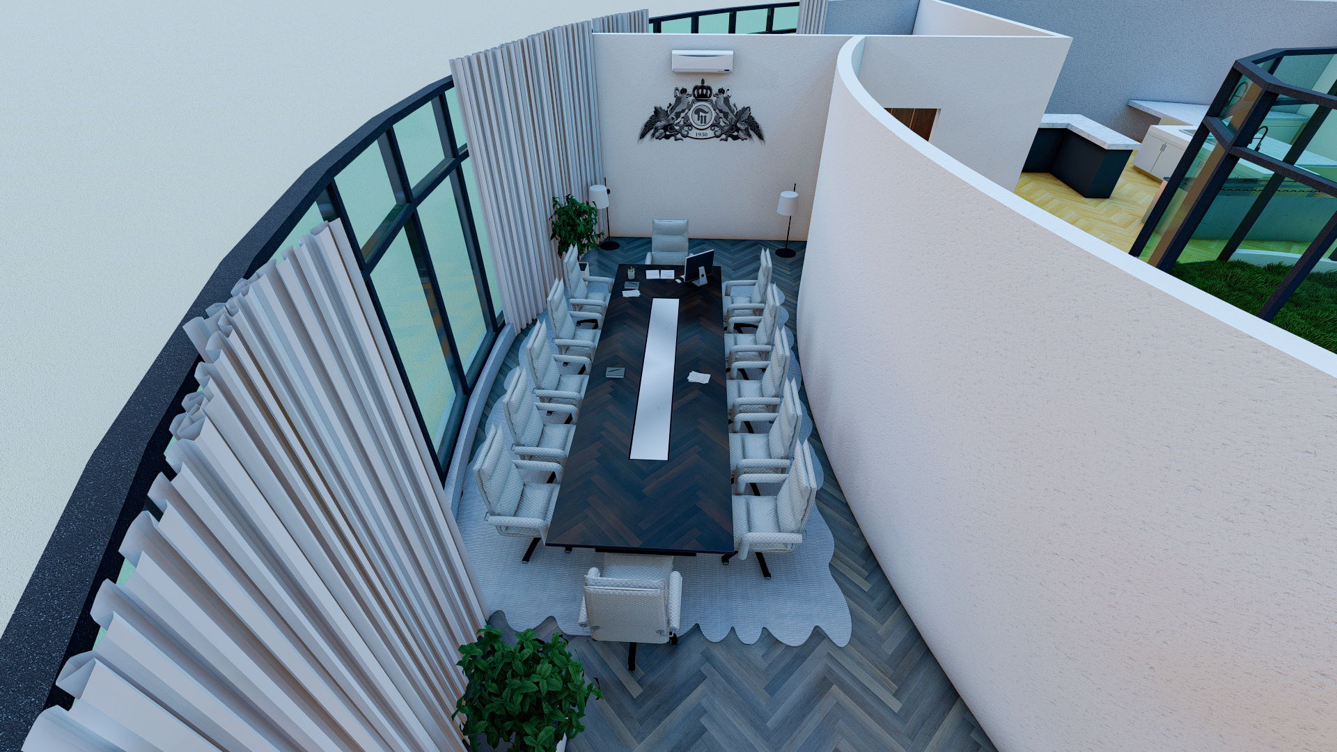
Aerial View of The Board Room

Slide 16
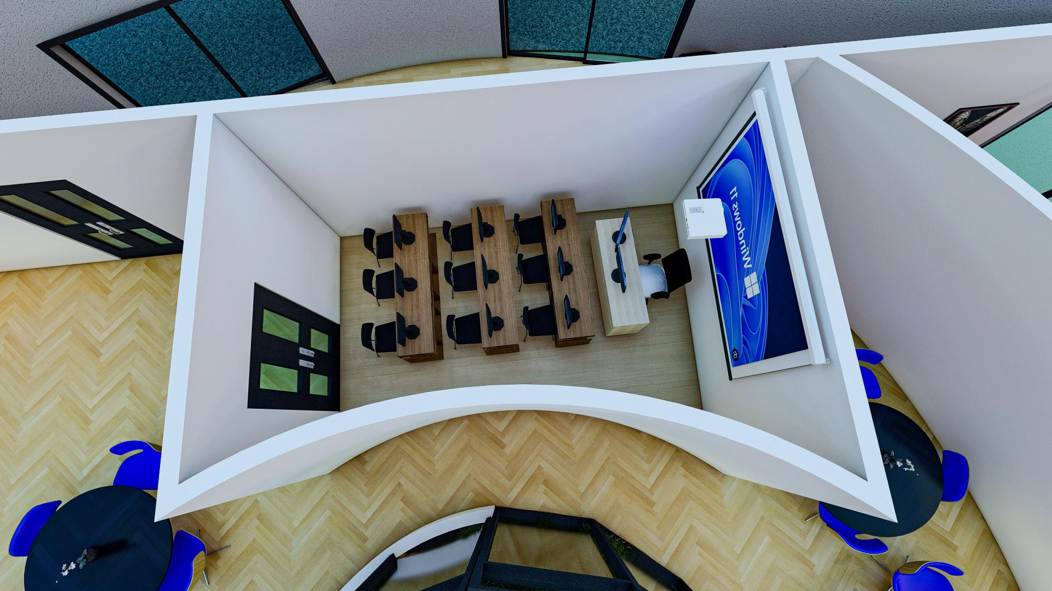
Meeting Room

Slide 17
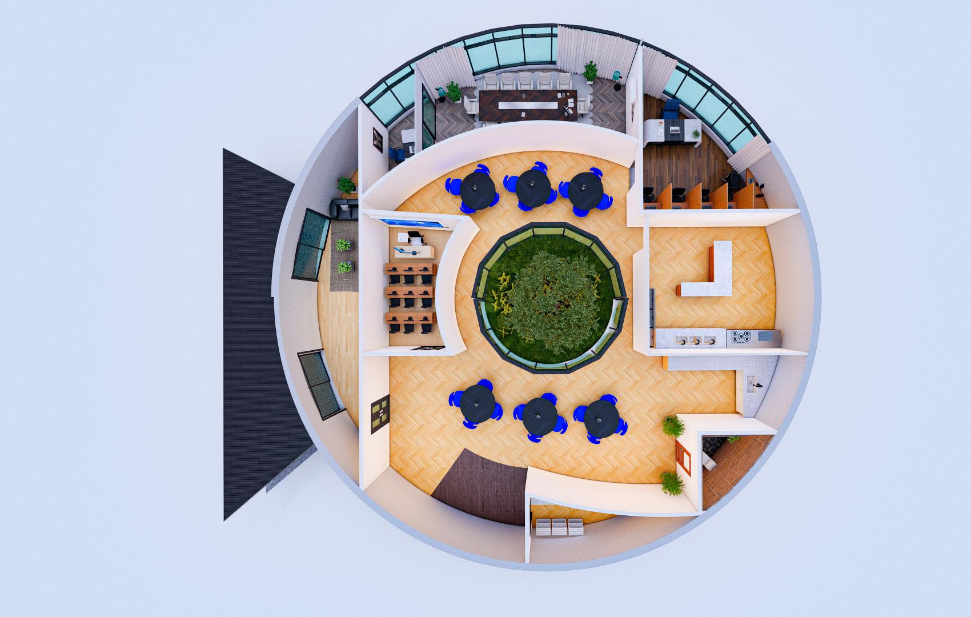
Top View

Slide 18
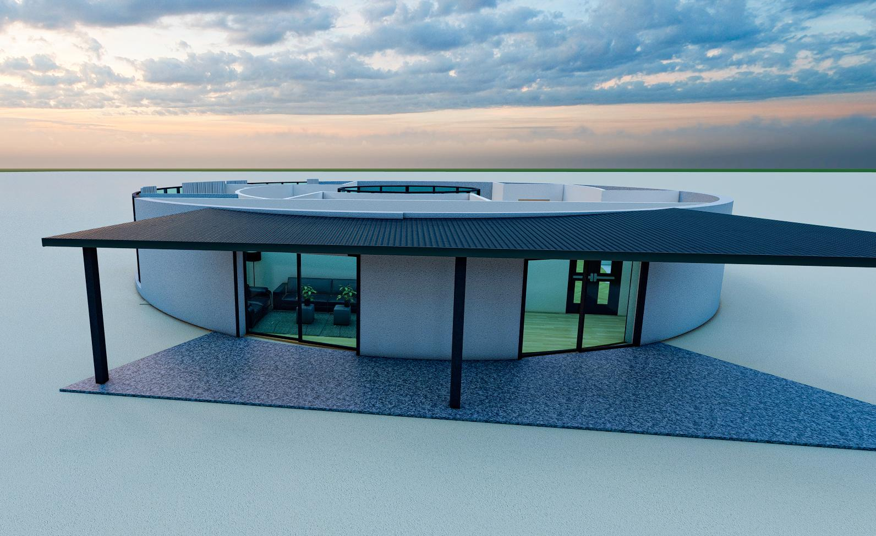
Outside View

Slide 19
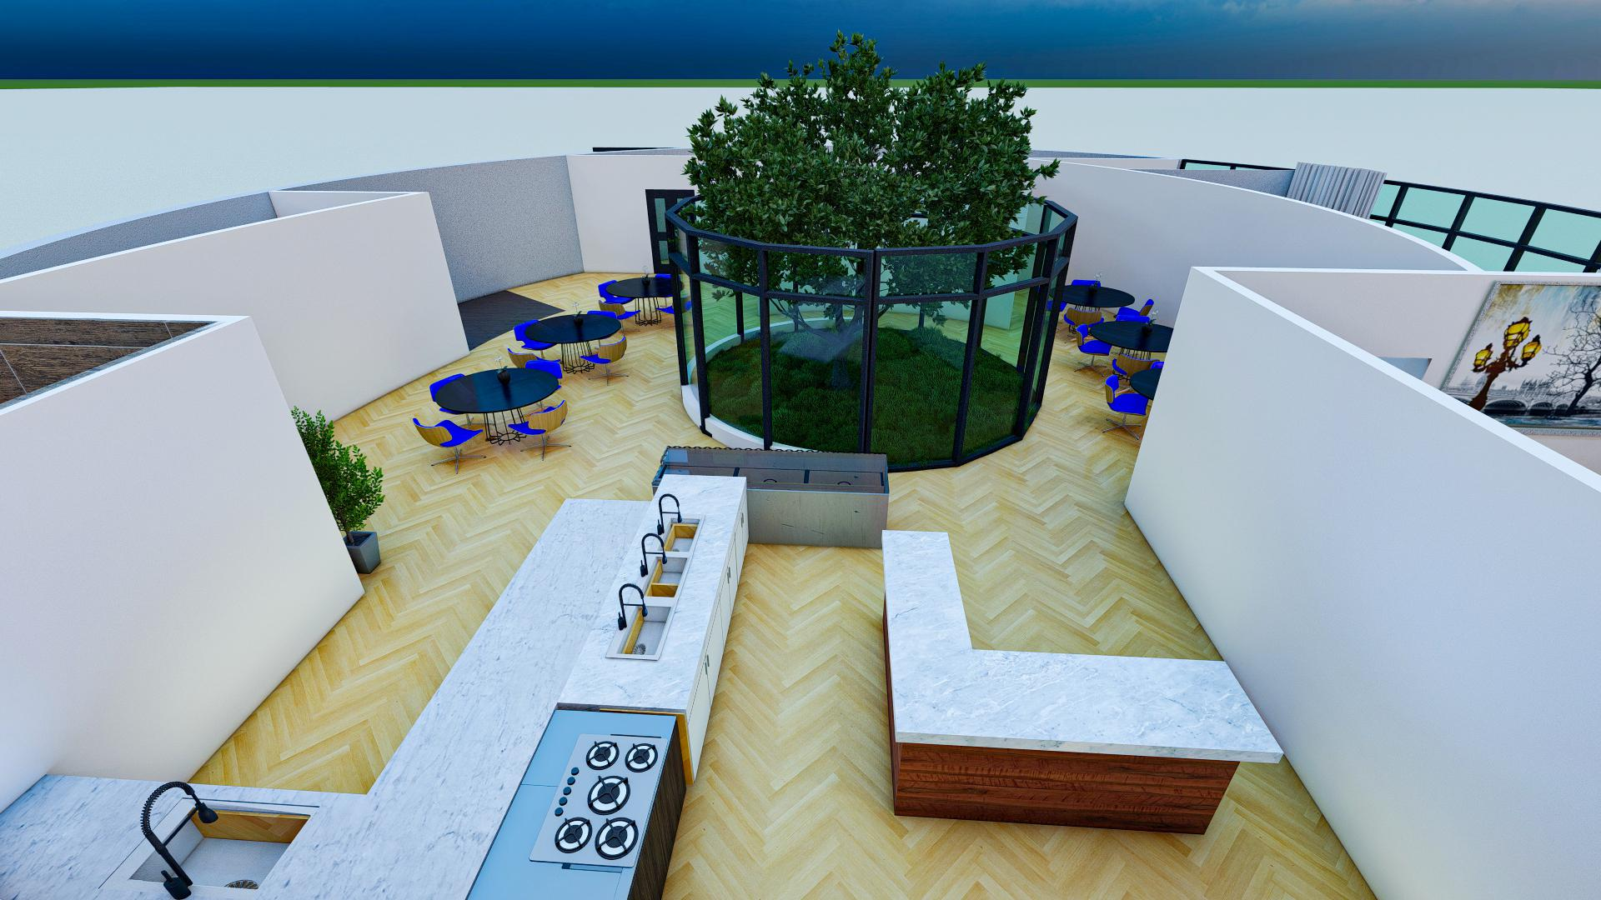
Kitchen & Garden Centre/Green Room

Slide 20
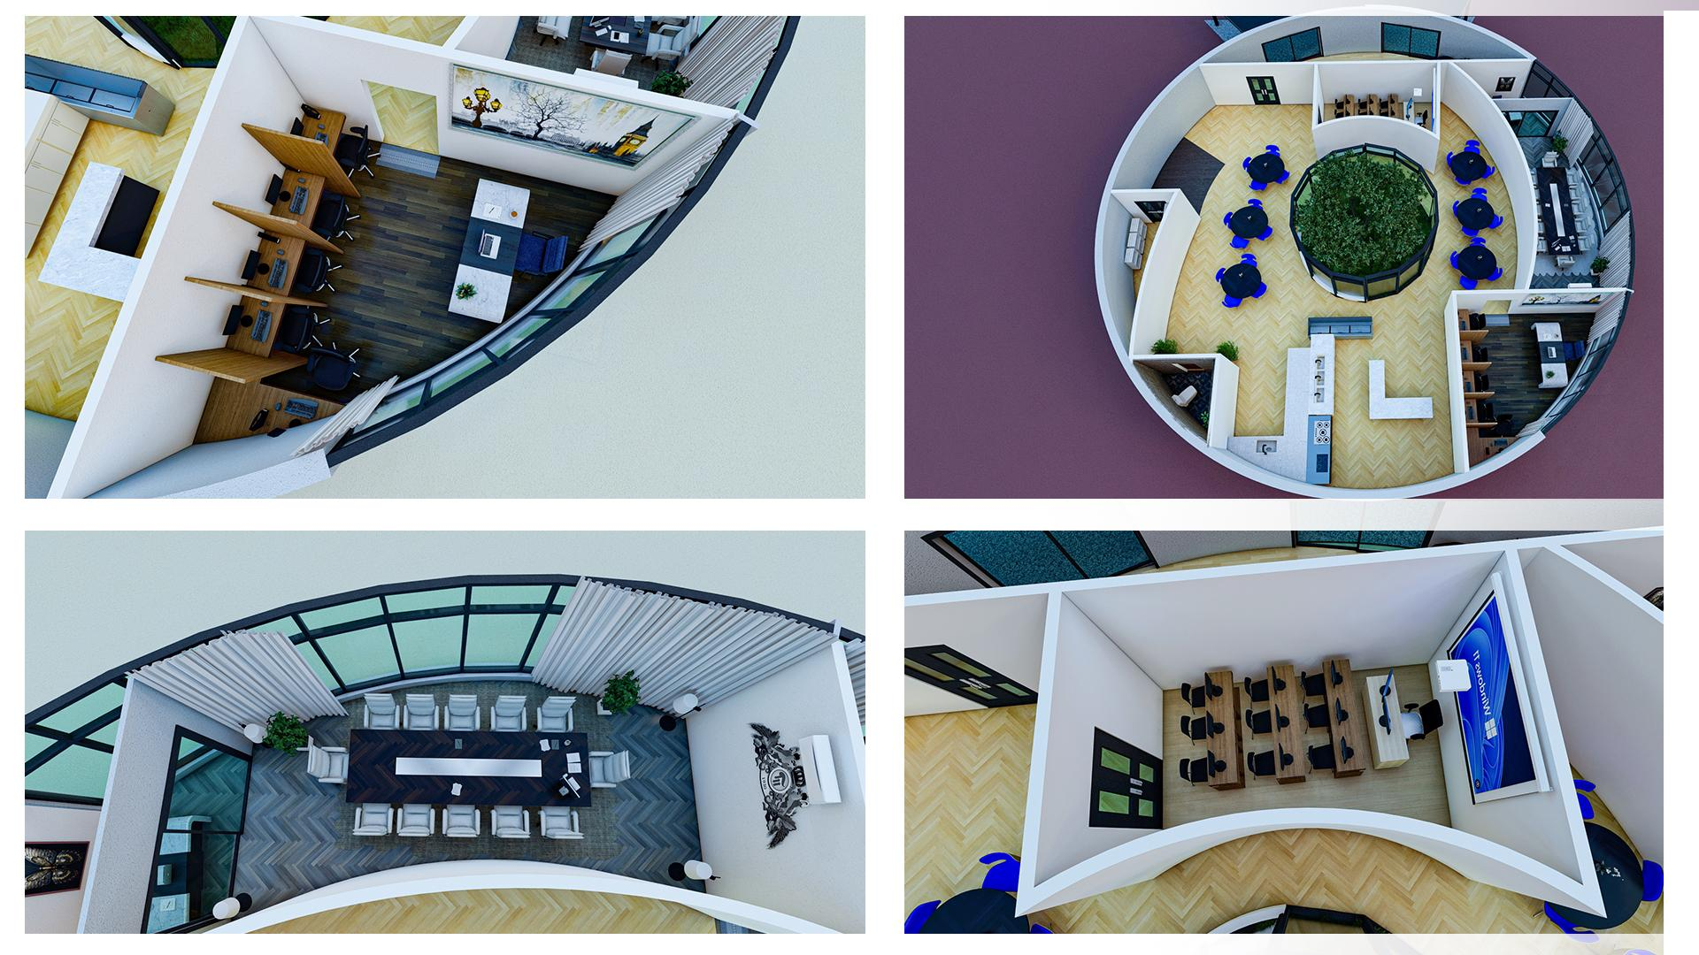
Overall Layout, Including Cubicles

Slide 21
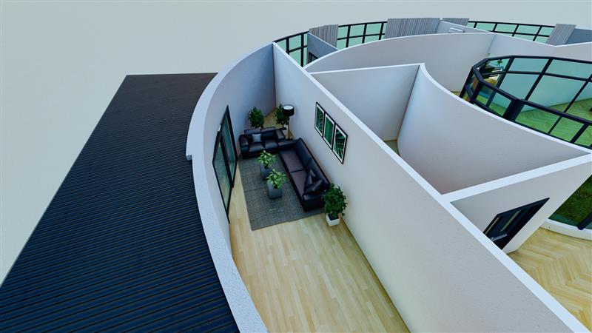
Lounge Area

Slide 22
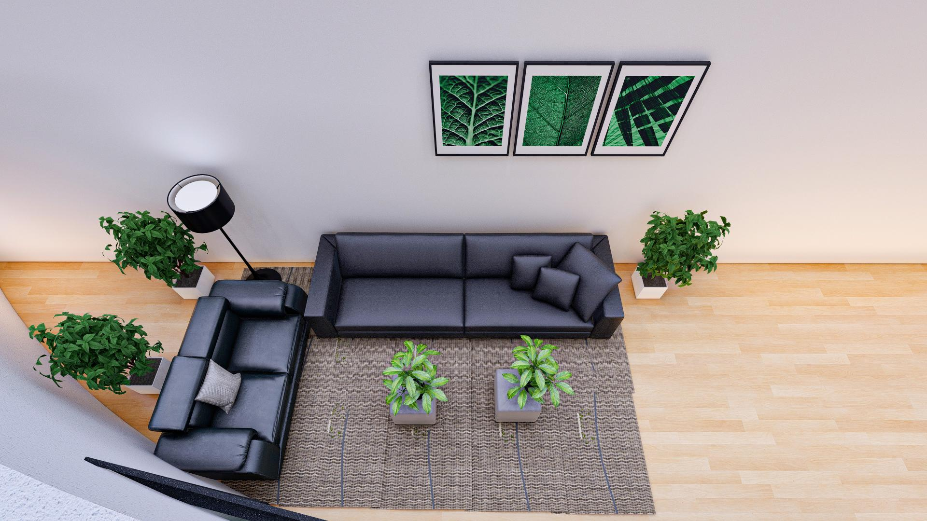
Top View of The Lobby/Lounge Area

Slide 23
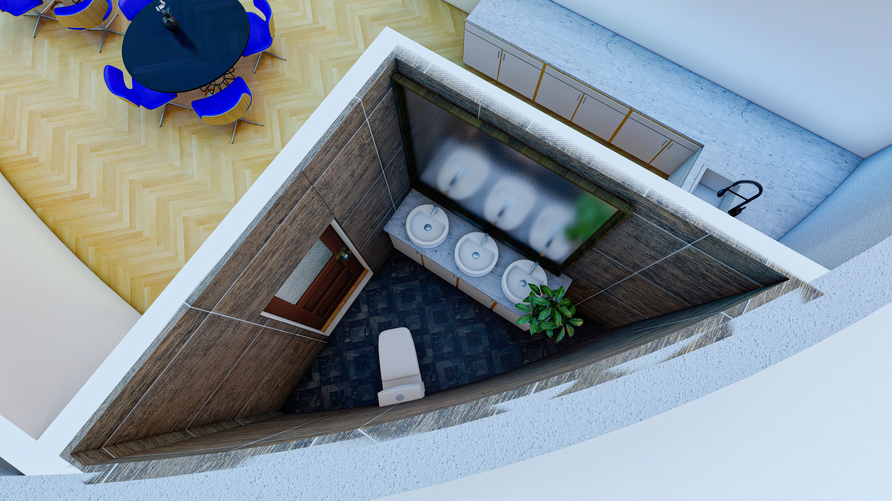
Washroom

Slide 24
Wrike Snapshot
Our Wrike Snapshot after completion of this Deliverable is available through this link:
https://www.wrike.com/frontend/ganttchart/index.html?snapshotId=HqVVRVBzCpPOTP7RjNWaZezwvde2LcLb%7CIE2DSNZVHA2DELSTGIYA

