Slide 1
Final concept
Automated Inventory Management System
Prototype I
By team 24BEES
BELMKADDEM Ziyad
BARROUG Elmehdi
BROU Deva
BOULAYAD Zakariae
SALIBA Elie

Slide 2
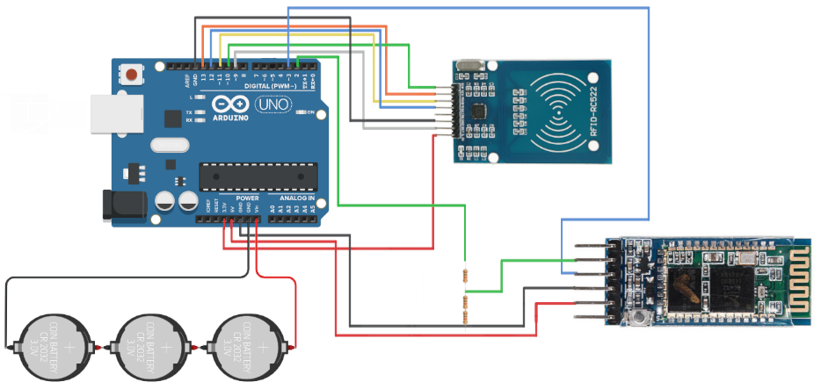
Final concept
Electrical system and layout
Prototype I
Arduino UNO for a microcontroller and main processing unit.
RFID RC522 reader for detecting RFID tags. (5cm range)
HC-05 Bluetooth module for transmitting data directly to the nearest relay. (30m range, allows for portability and more work flexibility)
3x Lithium coin cells (CR2032) as a power supply. Easily changeable.

Slide 3
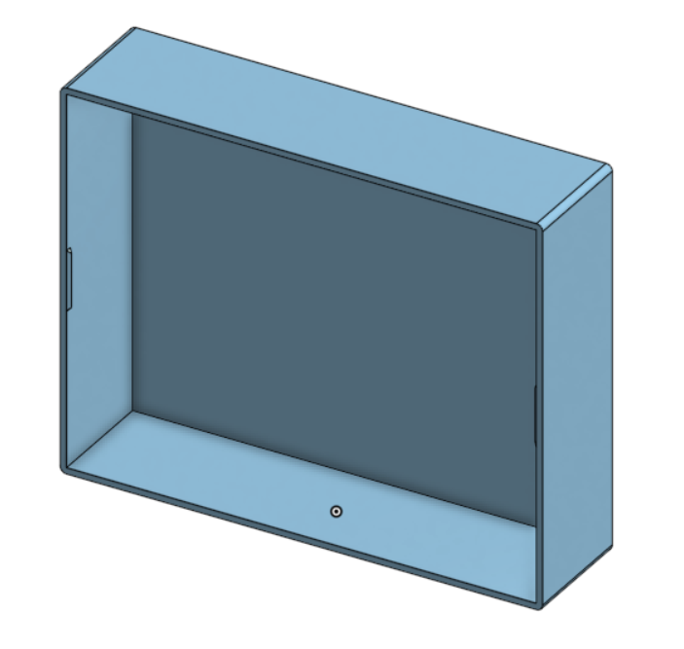
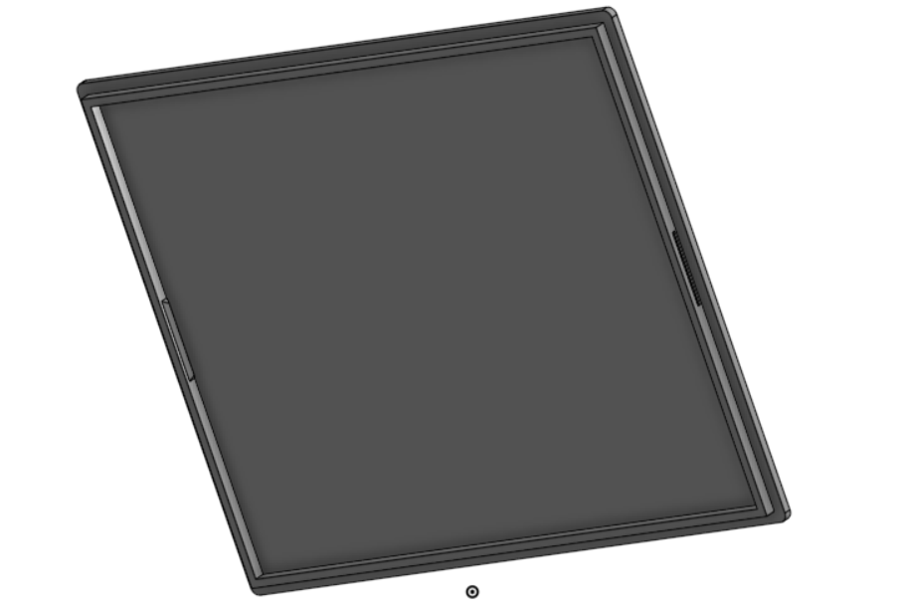
Final concept
Electronics container
Prototype I
3D printed box, serves as a container and fixture for all of the electrical components.
Easily but firmly closed using a simple lid design.
Small and easy to handle
(10 cm x 8 cm x 2.5 cm)
Made out of strong yet light PLA.
3D model of container lid
3D model of container compartment

Slide 4
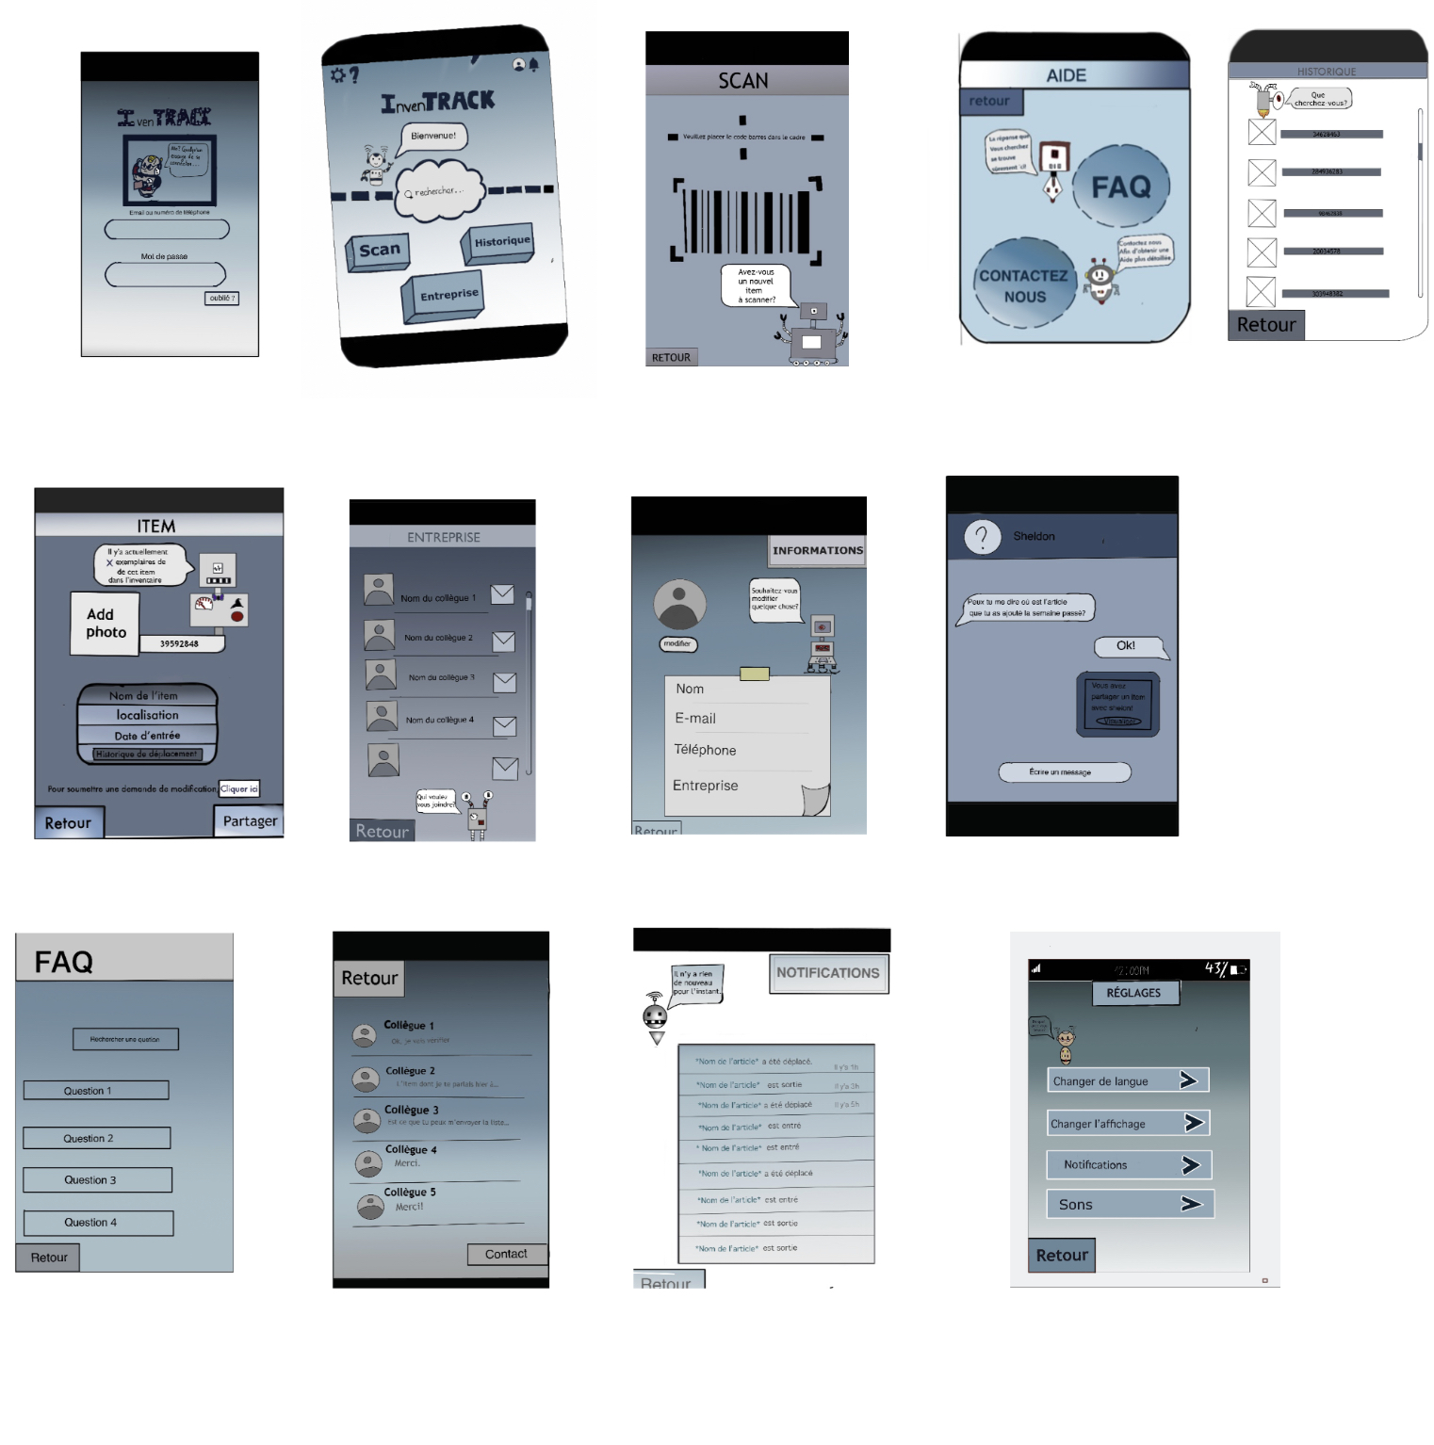
Final concept
Mobile app
Prototype I
Notifications system.
Secure account and profile-oriented design.
User-oriented approach, focused on providing as many learning resources as possible.
“Insta-Scan” capability.
Turns your mobile phone into a portable relay for the RFID data through Bluetooth connectivity.
(Acts as a Cloud-RFID reader intermedium)
Provides quick workplace communications as an additional feature, while prioritizing professionalism.
Allows instant access to inventory logs, inventory contents, statistics and entry/exit times and dates.
App wireframe

Slide 5
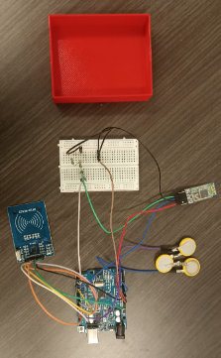
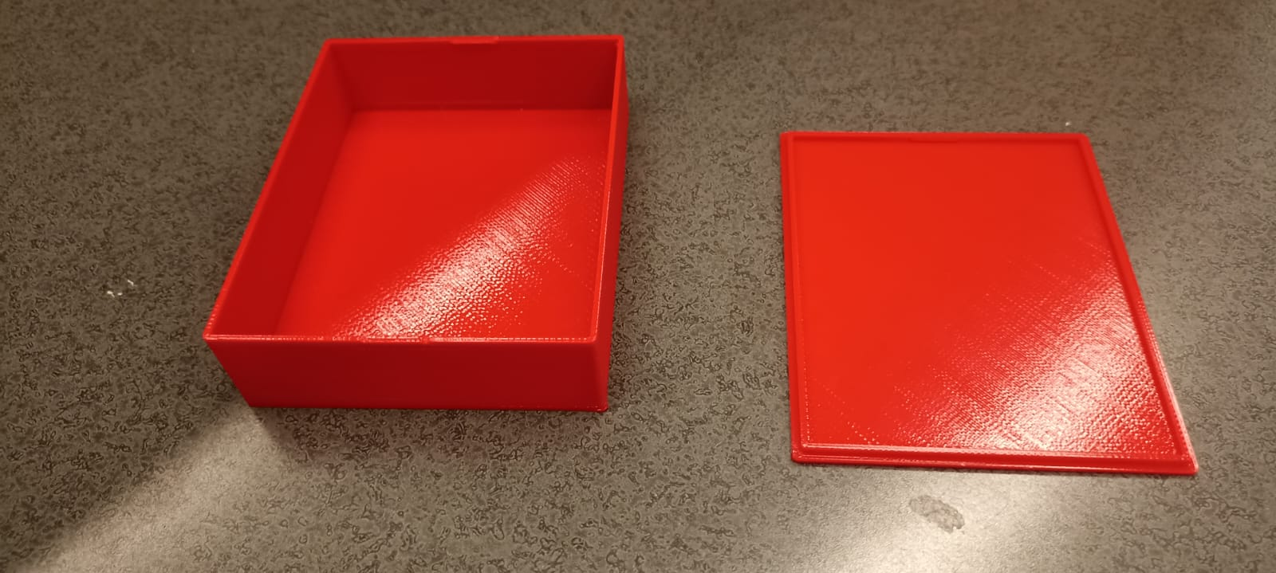
Final concept
Prototype overview
Prototype I
Physical / Partially comprehensive prototype
3D printed electronics box
Fully-functional semi-final circuit, next to its container for scale

Slide 6
Thank you for your attention!
QUESTIONS AND FEEDBACK

