Slide 1
Design Day Presentation
Group 6 - GreenAR World
Notes:
Alex (10 seconds)

Slide 2
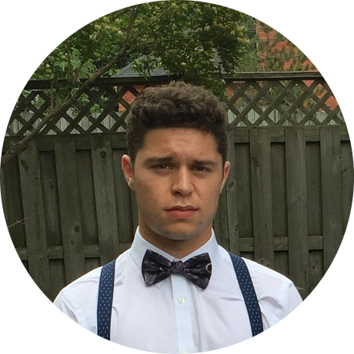
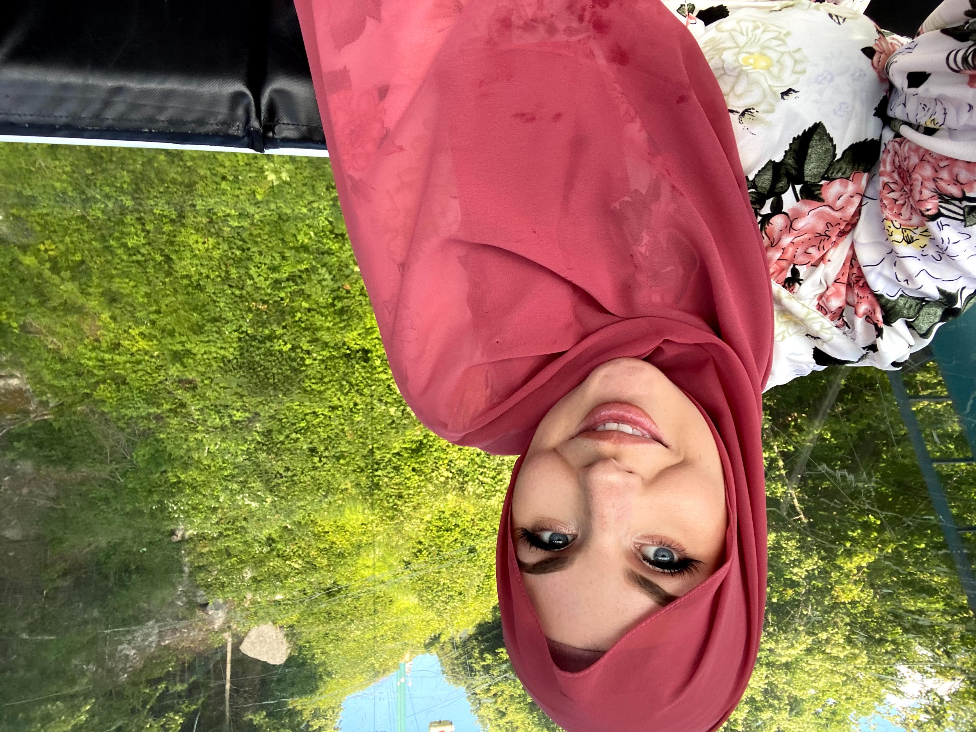
Our Team
Alexander Fournier BASc. Chemical Engineering
Monica Harada BASc. Electrical Engineering
Branden Leung BASc. Electrical Engineering
Keera Moretti BASc. Chemical Engineering
Ethan Leung BASc. Electrical Engineering
Notes:
Alex (5 seconds)

Slide 3
Problem Statement
A need exists for the general public to develop better recycling habits
Utilize a simple and intuitive way
Give proper recycling instructions about any disposable item
Must be cost effective and follow proper recycling regulations according to the City of Ottawa
Target market: catered towards users that possess a mobile device
Notes:
Alex (15 seconds)

Slide 4
Product of Improper Recycling
Canada alone produces approximately 5 million metric tonnes of plastic waste each year [1]
86%
Landfills
9%
Recycled Plastic
4%
Incinerators
1%
Litter that can contaminate lakes and oceans
Notes:
Branden (10 seconds)

Slide 5
Key Features
AR image recognition
Point collection system and leaderboard
Tutorial video and FAQ section
Accurate, up to date information section
Search button, flash toggle, and collection day calendar
Notes:
Branden (15 seconds)

Slide 6
Live Demo
Application Run Through (Final Product)
Notes:
Ethan (1 mins and 30 sec)

Slide 7
Thank You For Your Time
Any Feedback or Questions?
Notes:
Branden (5 seconds)

Slide 8
References
[1]
“Canada recycles just 9 per cent of its plastics,” Recycling Council of Ontario, 06-Dec-2019. [Online]. Available: https://rco.on.ca/canada-recycles-just-9-per-cent-of-its-plastics/. [Accessed: 31-Mar-2021].

Slide 9
Backup Demo
Notes:
Ethan

